Slide 1
Conceitos em criomicroscopia eletrônica para biologia estrutural
Gabriel G. Araujo
Departamento de Microbiologia
Instituto de Ciências Biomédicas
Universidade de São Paulo

Slide 2
Microscopia eletrônica de transmissão

Slide 3
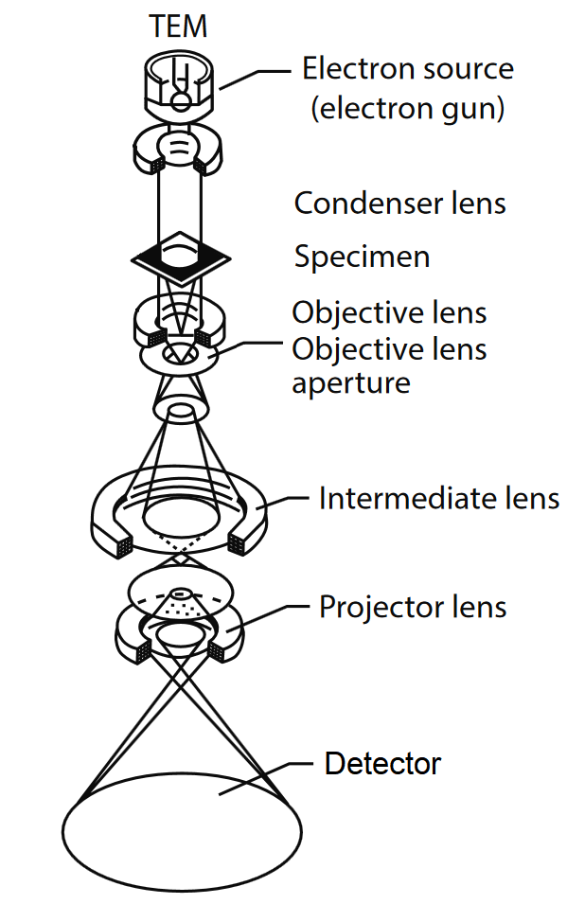
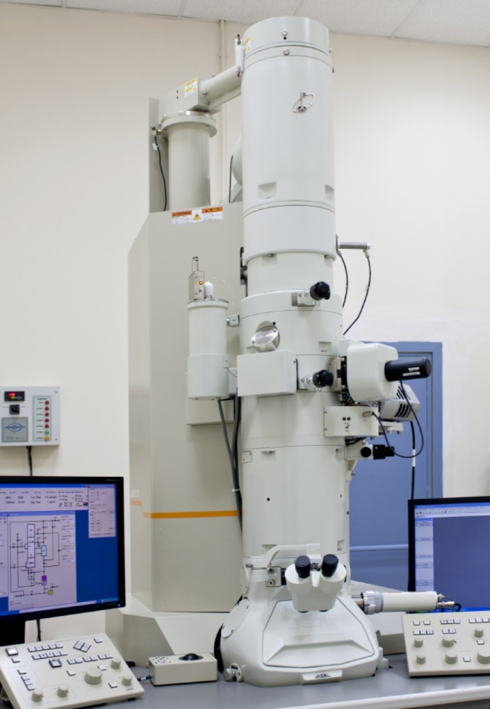
JEOL
Notes:
https://www.researchgate.net/publication/339950260_Synthesis_Characterization_and_Application_of_Modified_Textile_Nanomaterials
https://www.americanlaboratory.com/914-Application-Notes/167499-Microscopy-for-Materials-Characterization-Illuminating-Structures-With-Light-and-Electrons/
https://cnme.es/index.php/microscopios/tem/jeol-jem-2100

Slide 4
Patterson et al., 2019
Notes:
https://www.jove.com/t/59758/generation-alpha-synuclein-preformed-fibrils-from-monomers-use

Slide 5
Negative stain TEM
Notes:
https://www.gu.se/en/core-facilities/centre-for-cellular-imaging/electron-microscopy/negative-staining
https://www.creative-biostructure.com/negative-staining-transmission-electron-microscopy-service.htm

Slide 6
Notes:
X. citri PilQ-msfGFP-StrepTag

Slide 7
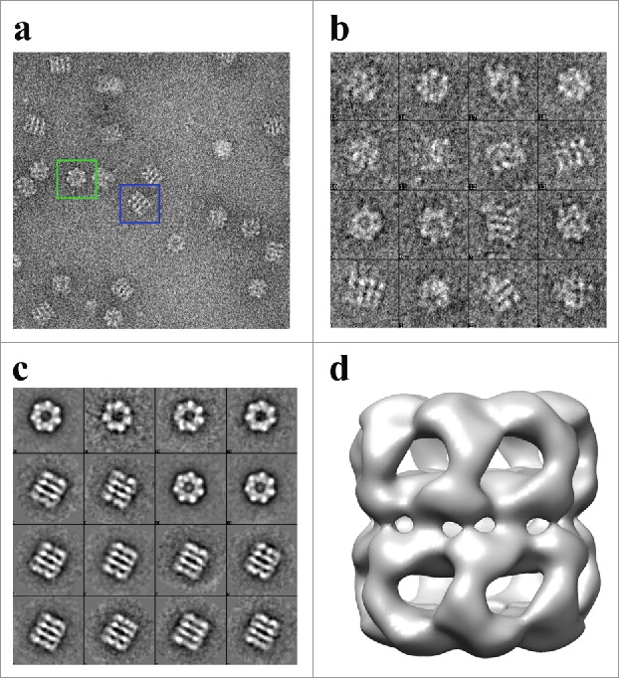
Human Mitochondrial APO-Hsp60 Reconstruction
Enriquez et al., 2017
Notes:
https://www.tandfonline.com/doi/full/10.1080/15384101.2017.1321180

Slide 8
Preparo de amostras para cryo-EM

Slide 9
Sgro & Costa, 2018
Notes:
https://www.frontiersin.org/articles/10.3389/fmolb.2018.00074/full

Slide 10
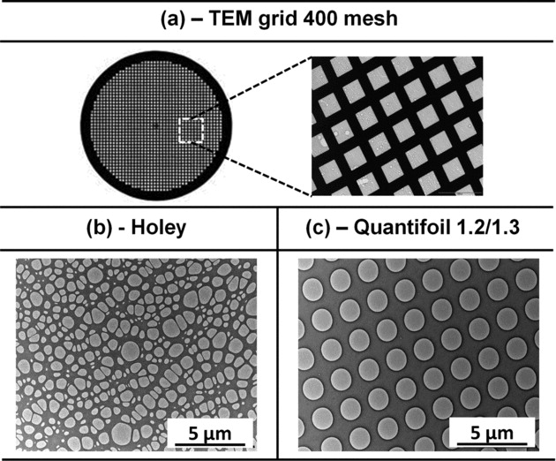
Sgro & Costa, 2018; R’mili et al., 2013
Notes:
https://www.frontiersin.org/articles/10.3389/fmolb.2018.00074/full

Slide 11
Costa et al., 2017
Notes:
https://www.researchgate.net/profile/Ev-Orlova/publication/318102798_Structural_Analysis_of_Protein_Complexes_by_Cryo_Electron_Microscopy/links/59d3874caca2721f436cd35b/Structural-Analysis-of-Protein-Complexes-by-Cryo-Electron-Microscopy.pdf?origin=publication_detail

Slide 12
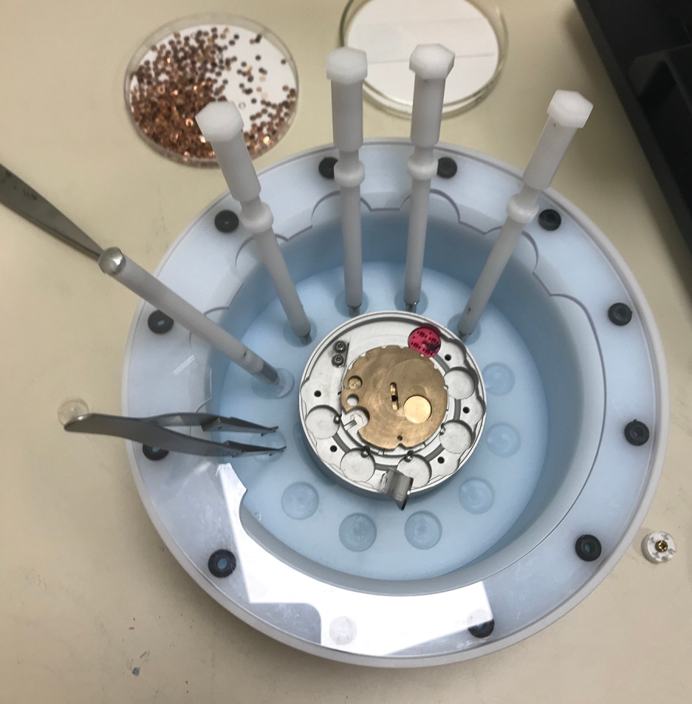
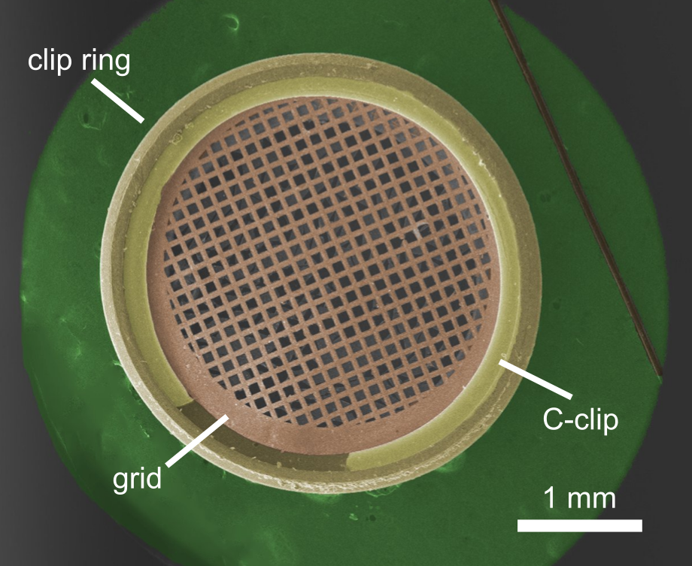
Notes:
https://www.jonipsaro.com/post/krios/
https://cryoem101.org/chapter-3/#part4

Slide 13
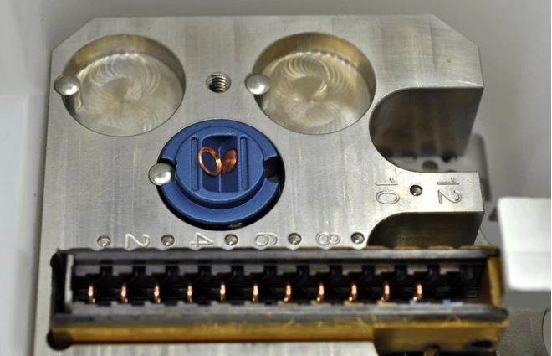
Notes:
https://www.mitegen.com/product/nanosoft-autogrid-inspection-tool/

Slide 14
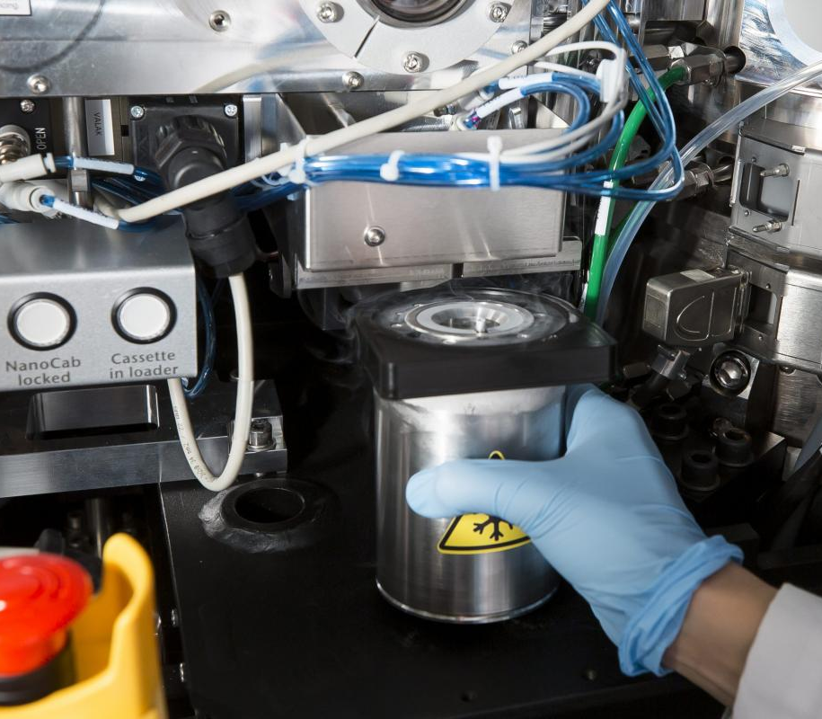
Notes:
https://cryo-em.hkust.edu.hk/gallery/

Slide 15
Triagem de grids e coleta de dados de cryo-em

Slide 16
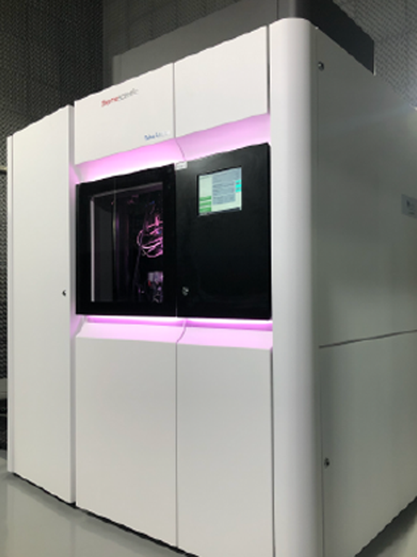
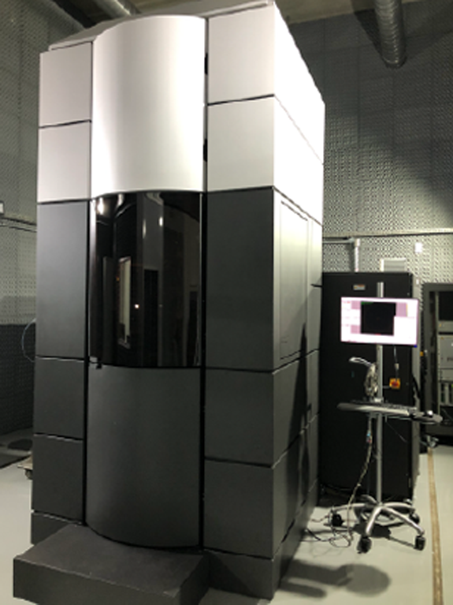

Slide 17
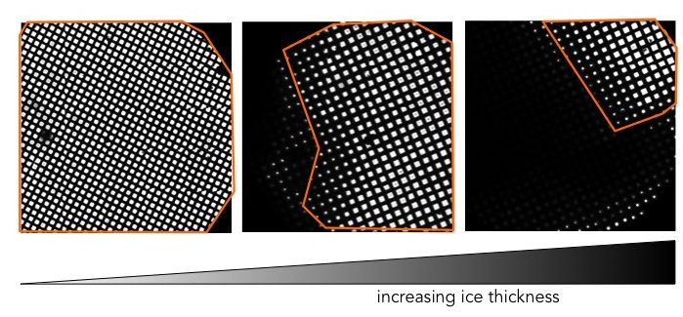
Notes:
https://cryoem.med.ubc.ca/get-started/workflow/grid-screening-and-optimisation/

Slide 18
Notes:
https://cryoem.med.ubc.ca/get-started/workflow/grid-screening-and-optimisation/

Slide 19
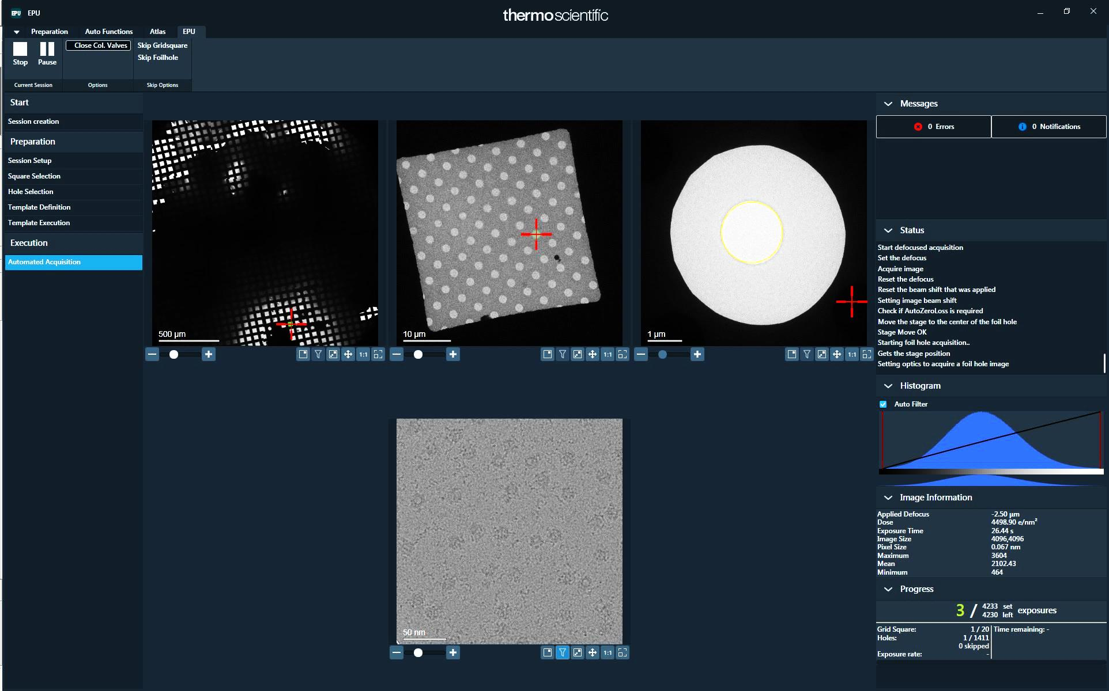

Slide 20
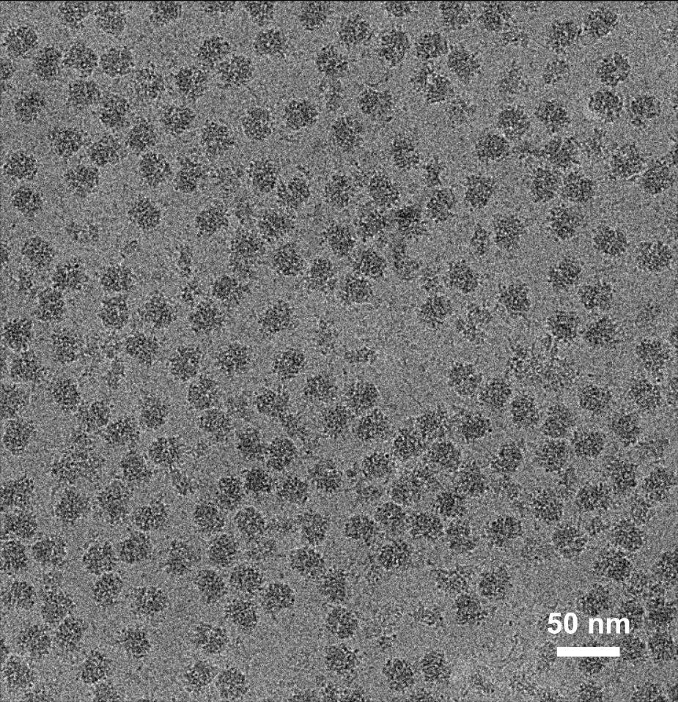
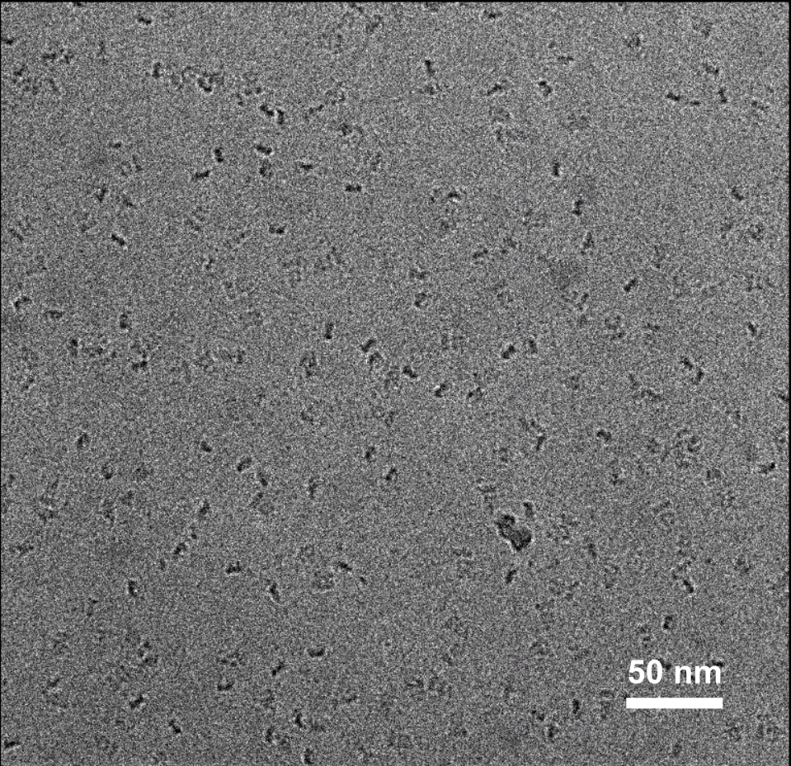
Ribosomes
PDE6 (EMPIAR-10228)
cryoem101.org
Notes:
https://cryoem101.org/chapter-3/#part4

Slide 21
Notes:
X. citri PilQ-msfGFP-StrepTag

Slide 22
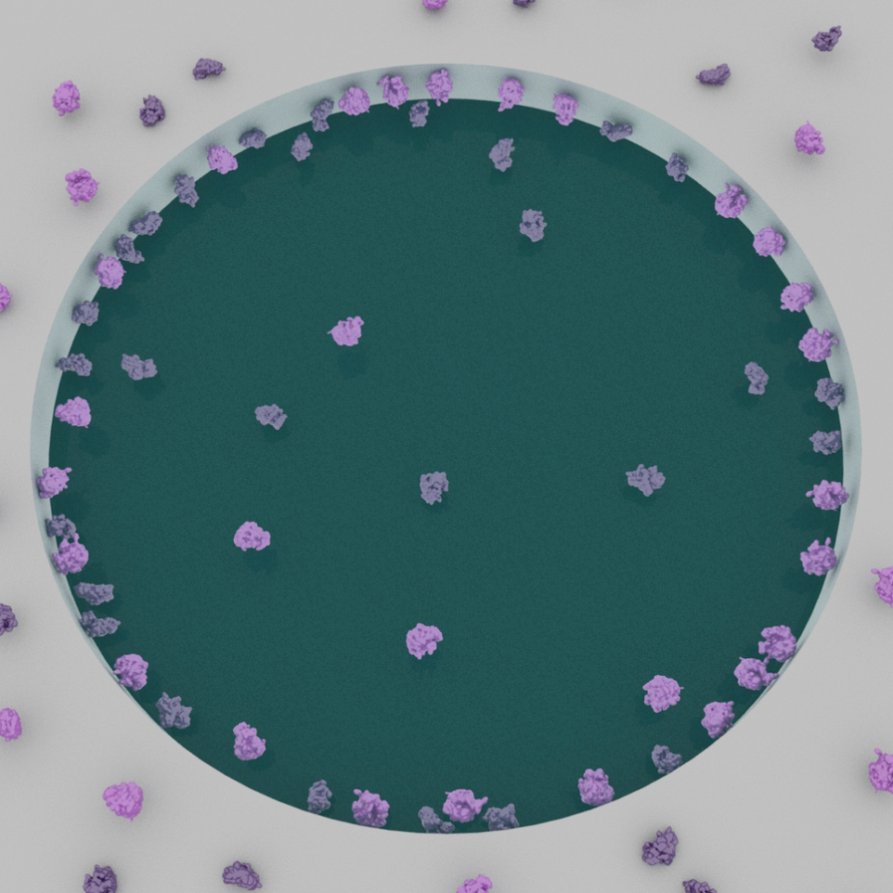
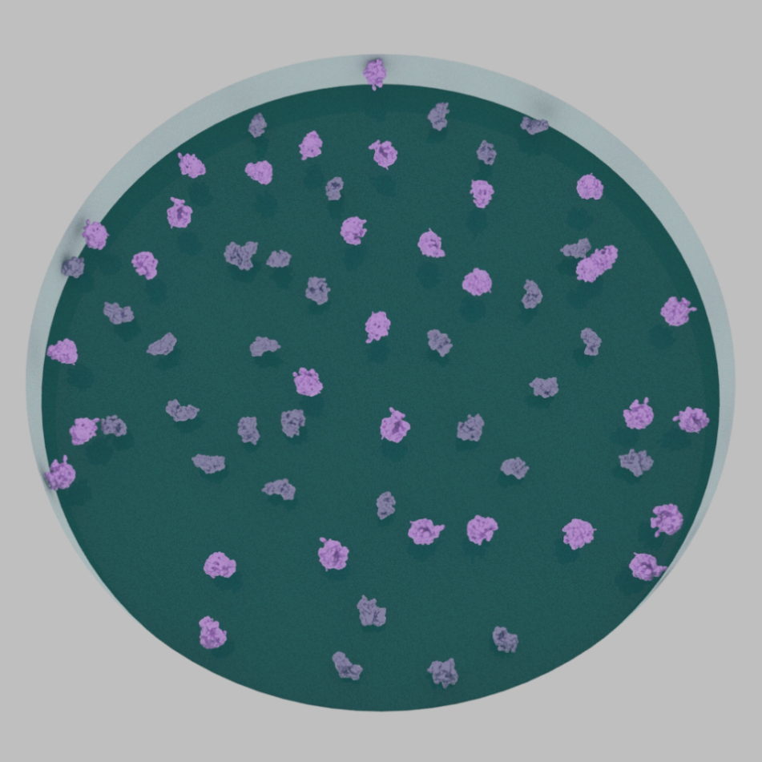
cryoem101.org
Notes:
https://cryoem101.org/chapter-2/#part2

Slide 23
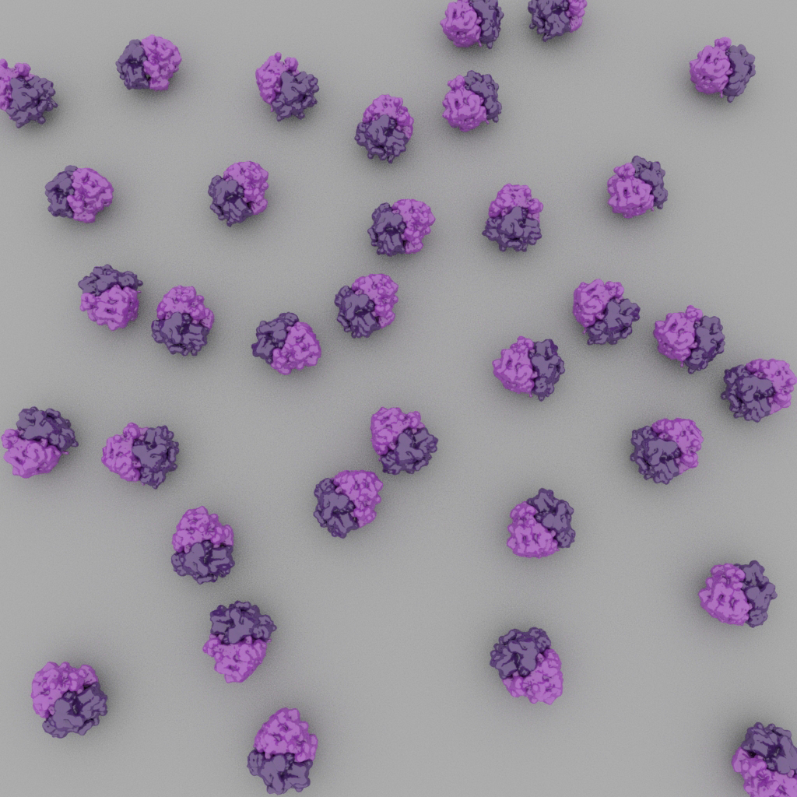
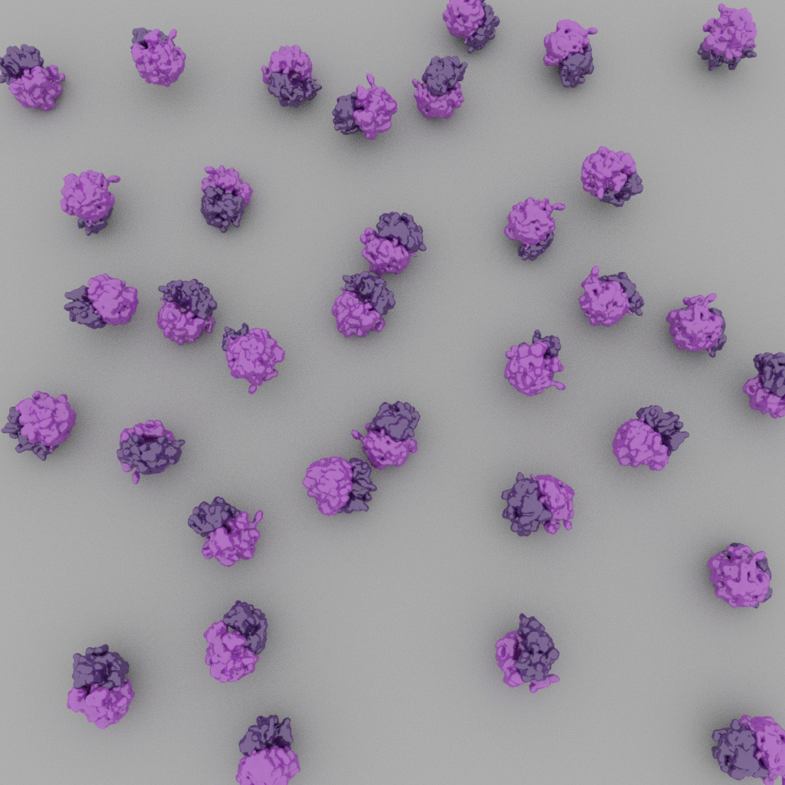
cryoem101.org
Notes:
https://cryoem101.org/chapter-2/#part2

Slide 24
Processamento de dados de cryo-em

Slide 25
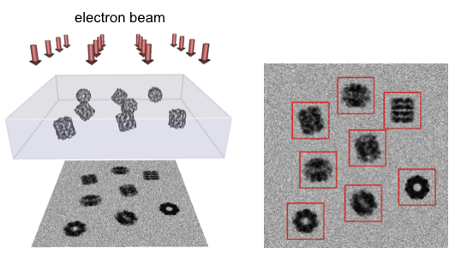
https://people.csail.mit.edu/gdp/cryoem.html

Slide 26
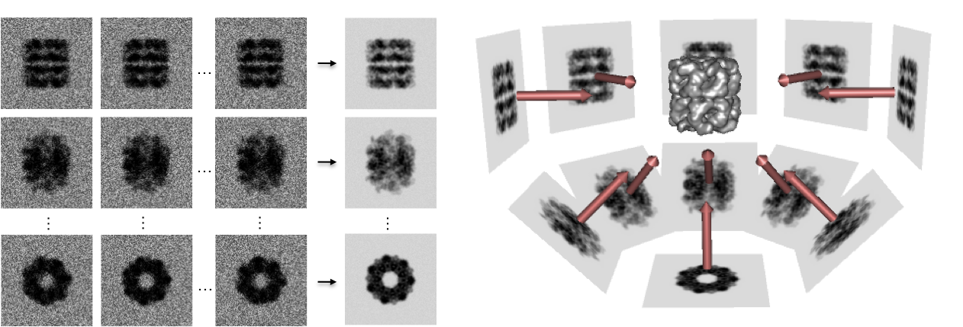
https://people.csail.mit.edu/gdp/cryoem.html

Slide 27
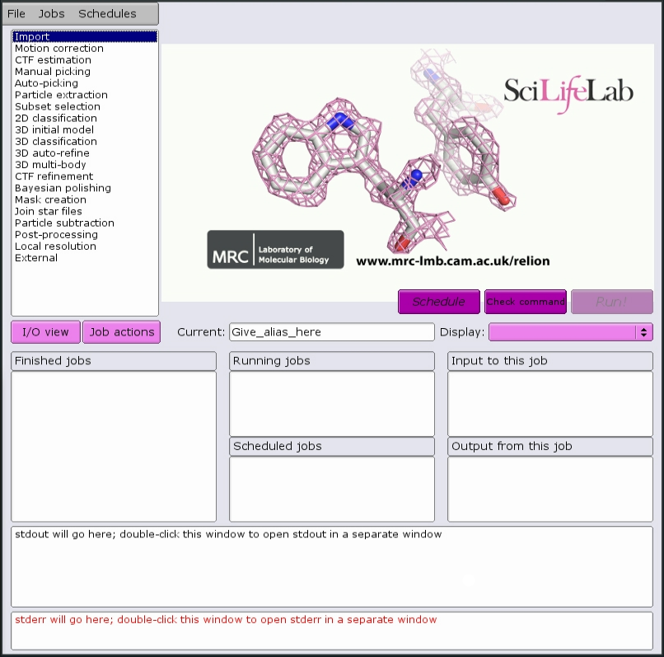
Single particle analysis
Relion
Scheres, 2012
Notes:
https://www.ncbi.nlm.nih.gov/pmc/articles/PMC3690530/

Slide 28
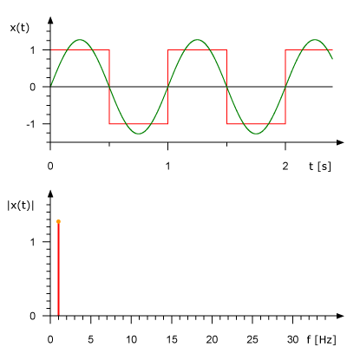
Notes:
https://pysdr.org/content/frequency_domain.html
https://commons.wikimedia.org/wiki/File:Fourier_synthesis_square_wave_animated.gif

Slide 29
Notes:
https://pysdr.org/content/frequency_domain.html
https://www.arxiv-vanity.com/papers/1801.01451/

Slide 30
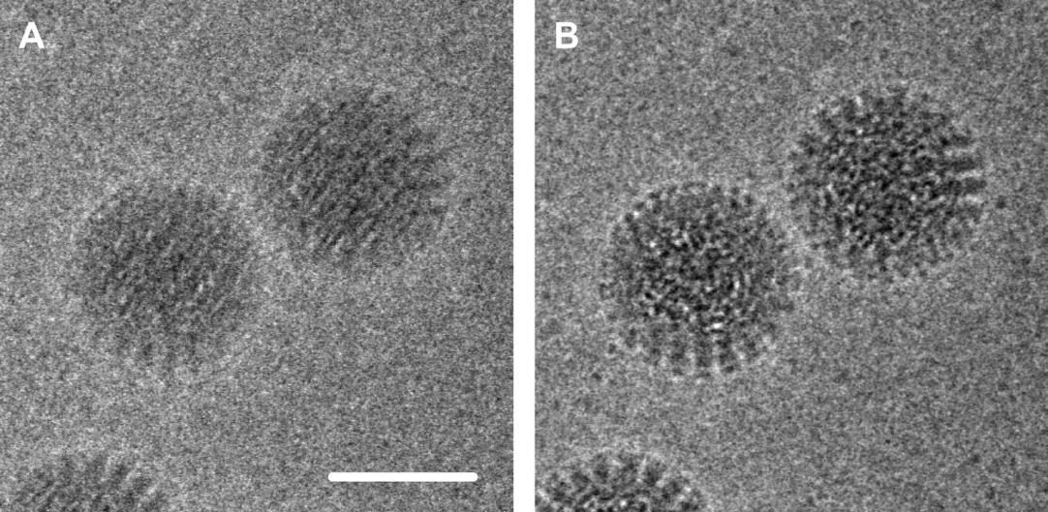
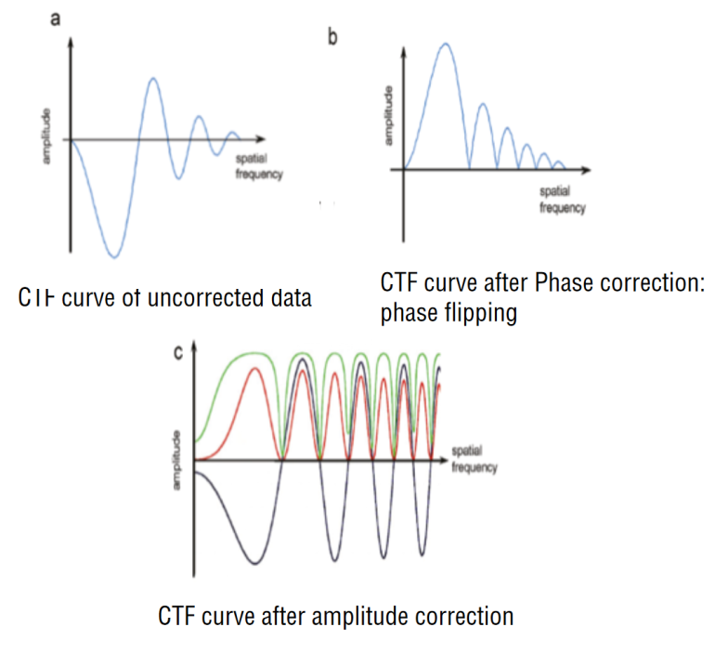
Motion correction
CTF correction
Grigorieff, 2013
Orlova and Saibil, 2011
Notes:
https://elifesciences.org/articles/00573
https://pubs.acs.org/doi/10.1021/cr100353t

Slide 31
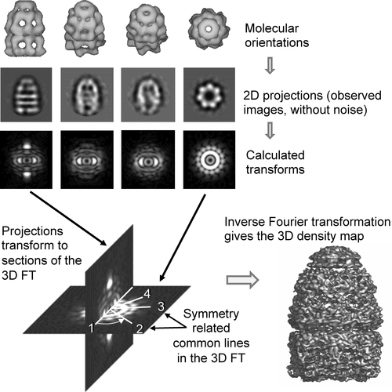
Orlova and Saibil, 2011
Notes:
https://pubs.acs.org/doi/10.1021/cr100353t

Slide 32
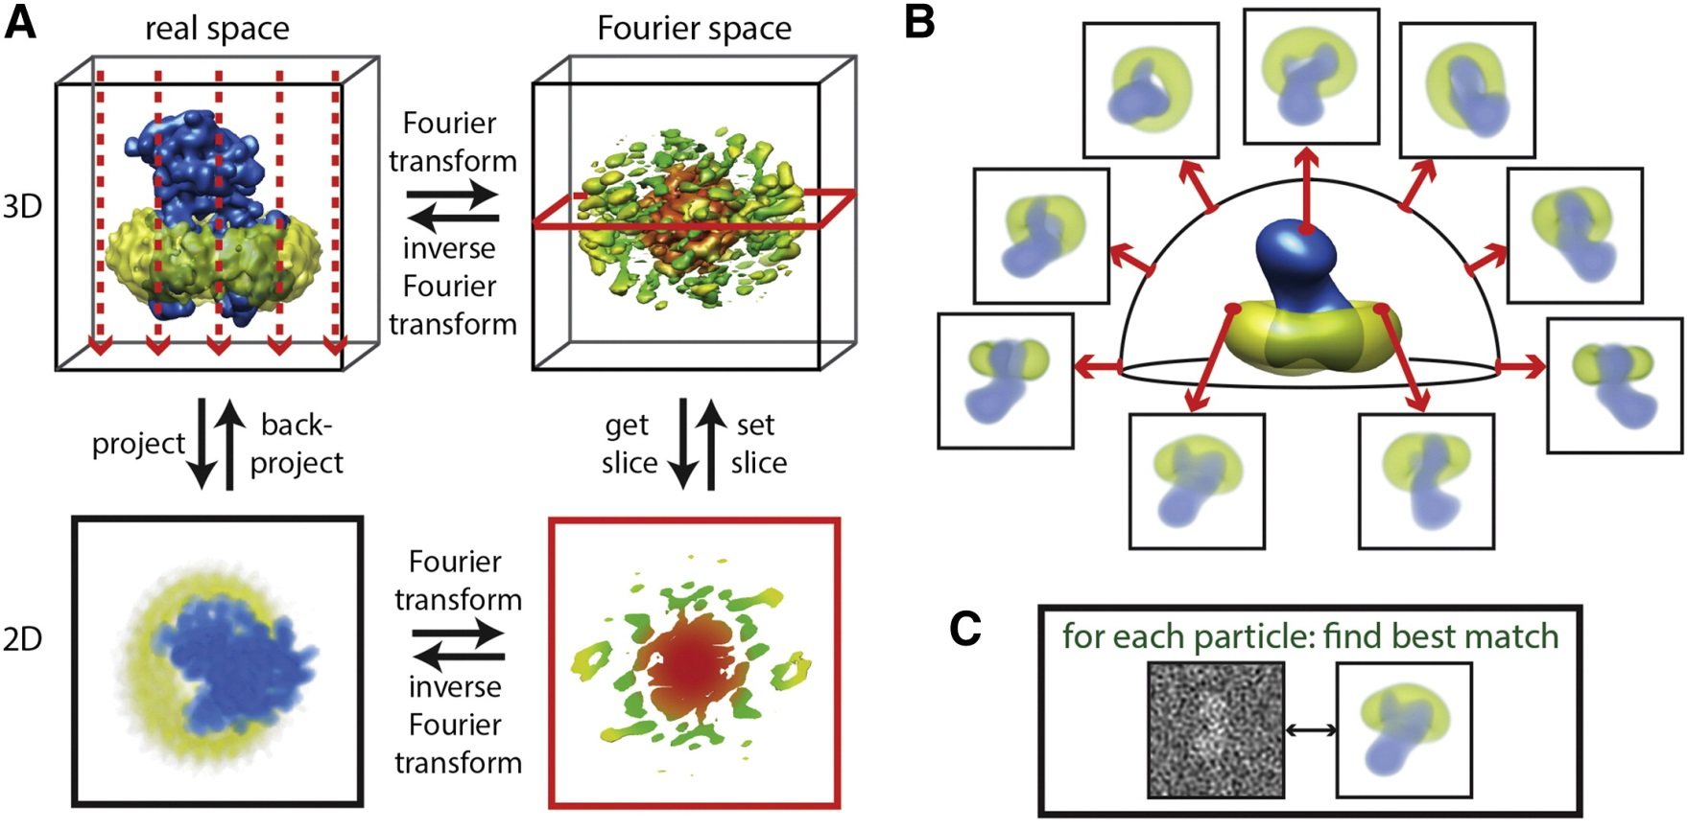
Nogales & Scheres, 2015
Notes:
https://www.sciencedirect.com/science/article/pii/S1097276515001331

Slide 33
Nogales & Scheres, 2015
Notes:
https://www.sciencedirect.com/science/article/pii/S1097276515001331

Slide 34
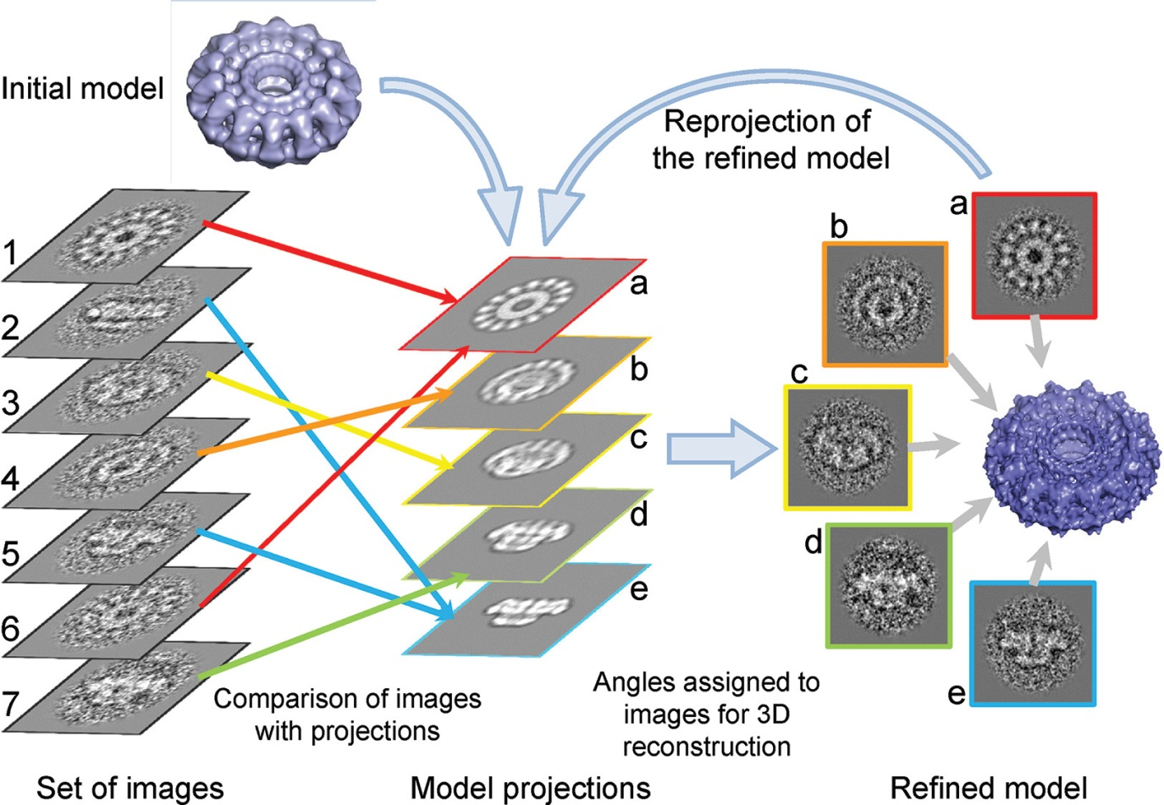
Orlova and Saibil, 2011
Notes:
https://pubs.acs.org/doi/10.1021/cr100353t

Slide 35
Beckers et al., 2021
Notes:
https://www.sciencedirect.com/science/article/pii/S0079610720300699

Slide 36
Beckers et al., 2021
Notes:
https://www.sciencedirect.com/science/article/pii/S0079610720300699

Slide 37
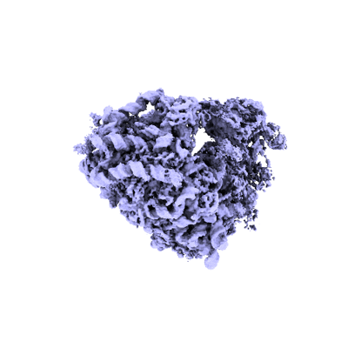
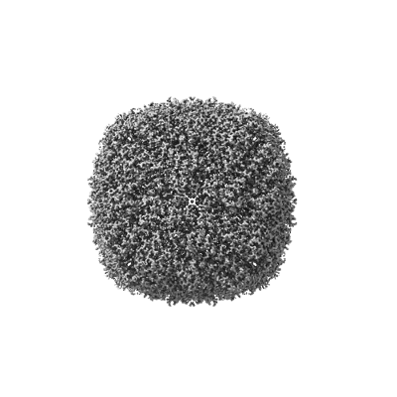
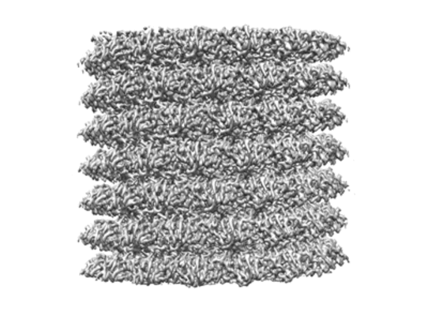
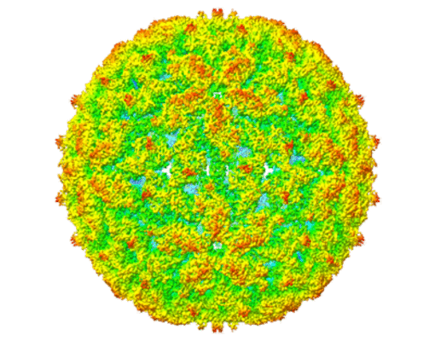
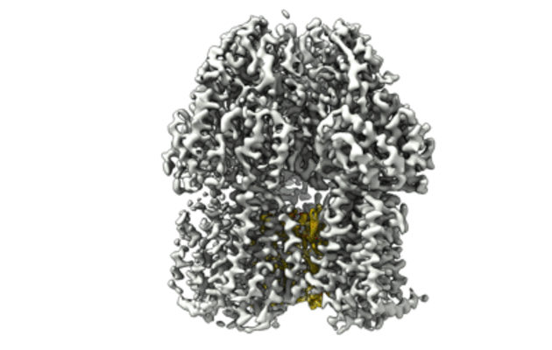
Recent entries:
TMV coat protein
Release: Nov. 23, 2022
Resolution: 2.3 Å
Leishmania RNA virus 1 virion
Release: Nov. 23, 2022
Resolution: 3.88 Å
Human 80S ribosome obtained from ssDNA coated grid
Release: Nov. 23, 2022
Resolution: 3.8 Å
Human Apoferritin obtained from ssDNA coated grid
Release: Nov. 23, 2022
Resolution: 1.77 Å
Multidrug efflux pump subunit AcrB
Release: Nov. 23, 2022
Resolution: 3.69 Å

Slide 38
Considerações finais

Slide 39
https://www.diamond.ac.uk/Instruments/Biological-Cryo-Imaging/eBIC/Training/Course-pages/Cryo-EM-course/2021.html

Slide 40
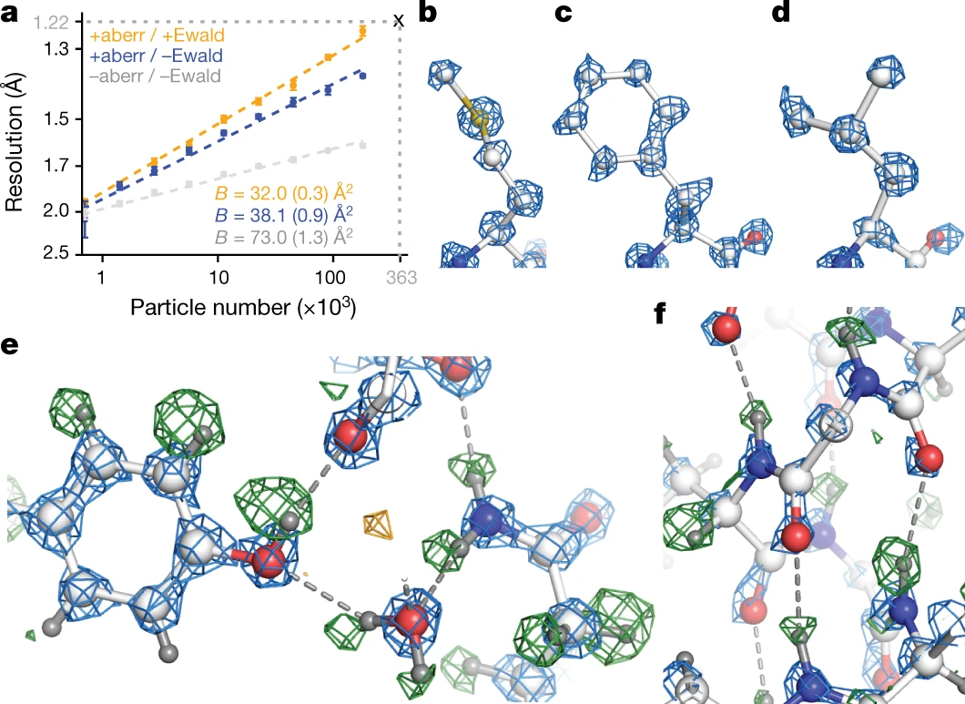
Nakane et al., 2020
Notes:
https://www.nature.com/articles/s41586-020-2829-0

Slide 41
Vantagens
Pequenas quantidades de amostra
Não requer cristalização
Conformação nativa
Múltiplas conformações – e até mesmo composições – observadas na mesma amostra

Slide 42
Limitações
Bioquímica
Preparo das amostras para cryoEM
Processamento
Tamanho do alvo

Slide 43
Wu & Lander, 2020
Notes:
https://www.sciencedirect.com/science/article/pii/S0959440X20300841
Figure 1. High-resolution sub-200 kDa structures determined by cryo-EM single-particle analysis. Top: Electron Microscopy Data Bank (EMDB) entries of complexes amassing below 200 kDa and resolved to better than 4 Å resolution, plotted by molecular weight and resolution. Data points are up to date to the point of this publication. Bottom: Cryo-EM density is shown for selected entries (outlined in black in the plot above) along with the corresponding EMDB identifier, molecule name, molecular mass, and reported resolution. Further details for each structure are listed in Table S1.

Slide 44
Wu & Lander, 2020
Notes:
https://www.sciencedirect.com/science/article/pii/S0959440X20300841
Figure 1. High-resolution sub-200 kDa structures determined by cryo-EM single-particle analysis. Top: Electron Microscopy Data Bank (EMDB) entries of complexes amassing below 200 kDa and resolved to better than 4 Å resolution, plotted by molecular weight and resolution. Data points are up to date to the point of this publication. Bottom: Cryo-EM density is shown for selected entries (outlined in black in the plot above) along with the corresponding EMDB identifier, molecule name, molecular mass, and reported resolution. Further details for each structure are listed in Table S1.

Slide 45
Outros métodos e aplicações de cryoEM:
https://www.ifsc.usp.br/mx2018/presentations/Colin/Cryo-EM.pdf

Slide 46
Recursos
A 3 minute introduction to CryoEM:
https://www.youtube.com/watch?v=BJKkC0W-6Qk
Cryo-EM 101:
https://cryoem101.org/
Caltech Getting Started in Cryo-EM:
https://cryo-em-course.caltech.edu/
MRC LMB Electron Cryo-microscopy Course:
https://www2.mrc-lmb.cam.ac.uk/research/scientific-training/electron-microscopy/
Yale University Cryo-EM Principles:
https://cryoemprinciples.yale.edu/

Slide 47
Grato pela atenção!
g.araujo@usp.br

