Slide 1
Leadership and Leadership Development
Alexandre Ardichvili, Professor
University of Minnesota

Slide 2
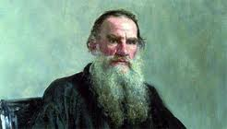
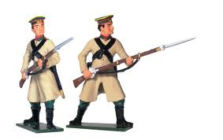
Leo Tolstoy’s story: “A soldier and a priest”
Stop!
Who are you?
Where do you come from?
Where are you going?

Slide 3
Today’s Topics
What is leadership?
A quick look at several influential and practical models of leadership
Personal implications: How to develop your leadership skills and attitudes?
Resources and next steps

Slide 4
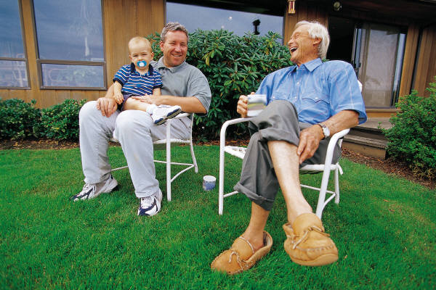
Leadership Development Challenge
17 million Gen Xers need to
replace 78 million boomers
90% of executives don’t believe their organizations develop leaders well
40% of new executive hires derail in first 18 months
(Research by MDA Consulting, Minneapolis)

Slide 5
What we know about leadership development:
Personality is correlated with leadership effectiveness
Most adults’ personality traits don’t change over time; But skills and attitudes can be developed over time
(Hogan, R., Curphy, G., & Hogan, J. (1994), What we know about leadership. American Psychologist, 49, No. 6, 493-504; Judge, T., Bono, J., Ilies, R., & Gerhardt, M. (2002), Personality and leadership: a qualitative and quantitative review. Journal of Applied Psychology, 87, No. 4, 765-780)
Notes:
Judge and Bono: Qualitative review of the trait perspective in leadership research, followed by a
meta-analysis. The authors used the five-factor model as an organizing framework and meta-analyzed
222 correlations from 73 samples. Overall, the correlations with leadership were Neuroticism .24,
Extraversion .31, Openness to Experience .24, Agreeableness .08, and Conscientiousness .28.
Results indicated that the relations of Neuroticism, Extraversion, Openness to Experience, and Conscientiousness
with leadership generalized in that more than 90% of the individual correlations were greater
than 0. Extraversion was the most consistent correlate of leadership across study settings and leadership
criteria (leader emergence and leadership effectiveness). Overall, the five-factor model had a multiple
correlation of .48 with leadership, indicating strong support for the leader trait perspective when traits are
organized according to the five-factor model.

Slide 6
Leadership Development
Four approaches:
Conceptual awareness (Reading; attending seminars and workshops)
Multi-rater feedback (360 instruments)
Skill building (experiential learning)
Self-awareness and personal growth

Slide 7
What is Leadership?
What is your definition of leadership?
Jot down your thoughts and share with others at your table

Slide 8
“Leadership is a process whereby an individual influences a group of individuals to achieve a common goal”
Northouse, P. G. (2010). Leadership: Theory and practice, Thousand Oaks, CA: Sage.
It is a process, not a trait or characteristic;
A two-way street: In this process, leader is influencing followers and is affected by followers
Occurs in groups of individuals who have common purpose
Focused on achieving certain goals (of the group, organization, larger community, etc.)

Slide 9
Leadership Theories Ardichvili, A., & Manderscheid, S. (2008). Emerging practices in leadership development, Advances in Developing Human Resources, 10(5), 619-631. Google Books search: more than 7,000,000 entries on leadership
Traits
Styles
Leader-member exchange theory
Situational Leadership
Transformational/
Transactional Leadership
Servant Leadership
Authentic Leadership
Complexity Theory
Strength-Based Approach
Appreciative Inquiry

Slide 10
Models of Leadership
Style
Situational Leadership
Transformational Leadership
Authentic Leadership

Slide 11
Style: The Blake and Mouton Grid
9 1, 9 9,9
8 Country Club Team
P 7
E 6
O 5 5, 5
P 4 Middle
L 3
E 2 Impoverished Authority-Compliance
1 1,1 9,1
1 2 3 4 5 6 7 8 9
R E S U L T S (TASK)

Slide 12
Style: Application
Leaders have a dominant style
Leaders should understand their behavioral style and modify it if needed
Trade-off between task and relationship is not the same for all situations
In stressful situations, people tend to fall back on their dominant style

Slide 13
Style Self-Assessment. For each question, write down a number indicating how often you engage in this behavior (1 – never; 2- seldom; 3 – occasionally, 4- often; 5 – always)
Tell groups of people what they are supposed to do
Act friendly with members of the group
Set standards of performance for groups
Help others feel comfortable in groups
Make suggestions about how to solve problems
Respond favorably to suggestions made by others
Make your perspective clear to others
Treat others fairly
Develop a plan of action for the group
Behave in a predictable manner toward group members

Slide 14
Self-assessment: Scoring
Sum all responses on the odd-numbered items (this is your task score)
Sum all responses on the even numbers (this is your relationship score)
Range: 20-25 – very high
15-18 – moderate range
less than 12 – low range

Slide 15
Discussion
Were you surprised by your scores?
What should you do if one score is high and the other is low?

Slide 16
Situational Leadership (Ken Blanchard)
There are four possible leadership styles: directing, coaching, supporting, and delegating.
Leaders must use different styles depending on the situation, to meet the changing needs of employees.
The choice of style depends on employees’ levels of competence and commitment.

Slide 17
Situational Leadership
High
Supporting S3 For people with: High Competence Variable Commitment | Coaching S2 For People with: Some Competence Some Commitment
Delegating S4 For people with: High Competence High Commitment | Directing S1 For people with: Low Competence High Commitment
Supportive Behavior
Low
Directive Behavior
High

Slide 18
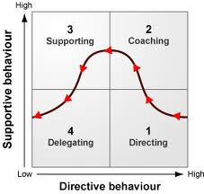

Slide 19
Application
Assess employees’ level of competence and commitment.
Use one of the four leadership styles to match the needs of that subordinate.
A leader must be flexible in his or her leadership behavior.

Slide 20
Discuss:
Do you currently have sufficient information about your employees’ levels of commitment and competence?
If not, what needs to be done/changed?

Slide 21
Transformational Leadership (Bass, B., & Avolio, B. (1994). Improving organizational effectiveness through transformational leadership. Thousand Oaks, CA: Sage.)
Idealized Influence: Leaders are ideal role models for followers
Inspirational Motivation: Followers are motivated to achieve inspiring goals and vision
Intellectual Stimulation: Followers are intellectually encouraged to be creative and innovative
Individualized Consideration: Leaders know the needs and feelings of individual people on their team

Slide 22
Transformational Leader
Has a clear vision of the future state of the organization or his/her group
Is able to get followers to accept a new vision
Can create trust
Emphasizes strengths, not weaknesses

Slide 23
IS and IC are even more important today:
Gen Y (or Millennials) require highly individualized approaches to motivation and more emphasis on intellectual stimulation (Spiro, 2010)

Slide 24
Transactional Leadership
Contingent reward: effort by subordinates is exchanged for specified rewards
Management by exception: corrective criticism, negative feedback and negative reinforcement are applied as needed
In many situations, successful leaders use both approaches: transactional behavior is needed to supplement transformational behavior (Avolio, 2005)

Slide 25
Research on Transformational/Transactional Leadership
Significant body of research documented validity of this framework (Bass, 1998)
Strong evidence of successful implementation in industry and the military (Avolio & Gardner, 2005)
Tested in cross-cultural settings (Ardichvili, 2001)

Slide 26
Models of Leadership
Style
Situational Leadership
Transformational Leadership
Authentic Leadership

Slide 27
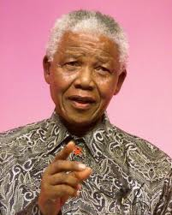
Authentic Leadership: What is deeper than style or competency?
Authenticity: alignment between the inner person and the “persona” we are at work
Being open; acknowledging our weaknesses, what we don’t know
Being open to our own gifts: “Our greatest fear is not our dark side, it is our light.” Nelson Mandela

Slide 28
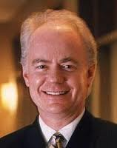
“Authenticity is well-developed self-awareness that openly faces strengths, vulnerabilities, and development challenges”
Kevin Cashman,
Founder, LeaderSource

Slide 29
“A soldier and a priest”
Stop!
Who are you?
Where do you come from?
Where are you going?

Slide 30
“As leaders, our real challenge is to curve out more time to think and more time to be. When we do it, we are more refreshed and more creative. Unfortunately, we get caught up in achieving and forget where our creativity comes from.”
Cashman, K. (2002), Leadership from inside out. Provo, UT: Executive Excellence Publishing.

Slide 31
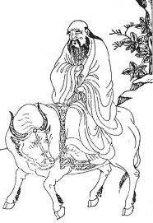
“In thinking, keep to the simple. In conflict, be fair and generous.
In leading, try not to control. In work, do what you enjoy. In family life, be completely present.”
Lao Tzu

Slide 32
Personal Development Plan
Individual goals (self-improvement)
Team goals (relationship improvement)
Organizational goals (your impact on organizational performance)
Solicit feedback on your plan from peers and direct reports
Source: Sandra Davis, President, MDA

Slide 33
Personal Development Plan, a sample:
Read a book on emotional intelligence by… (date)
Get 360-degree feedback from my manager, peers, customers, and subordinates in… (weeks)
Conduct a one-day situational leadership workshop
for my team in… (month)
NOTE: Specific timelines

Slide 34
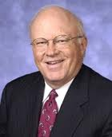
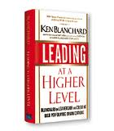
Further Reading
Ken Blanchard, Leading at a Higher Level (2006).
Provides a good overview of leadership issues, is sectioned in easy to follow chapters and covers many important areas: Developing vision, Managing Performance, Working with customers, Situational leadership, Self- leadership, Organization leadership, etc.

Slide 35
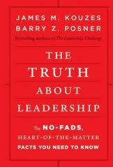
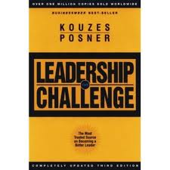
OR:
Kouzes and Posner (2010), The Truth about Leadership: The No-fads, Heart-of-the-Matter Facts You Need to Know. Jossey-Bass.

Slide 36
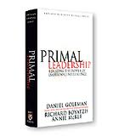
Leadership and Emotional Intelligence
Daniel Goleman (2004). Primal Leadership: Learning to Lead with Emotional Intelligence.
The importance of understanding the role of emotions (in self and in others), regulating one’s emotions, and empathizing with others.

Slide 37
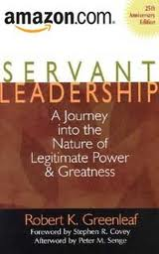
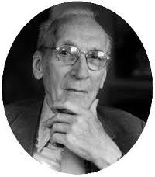
Greenleaf, R. (2002). Servant leadership: A journey into the nature of legitimate power and greatness. Mahwah, NJ: Paulist.
Leaders pursue service to others, rather than their own self-interest.
Leaders are motivated not by what they can get from their position, but what their role allows them to give others.

Slide 38
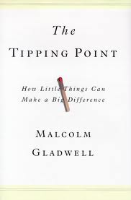
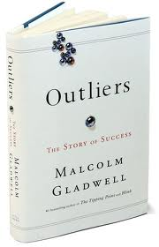
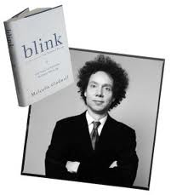
And….
Malcolm Gladwell’s Books

Slide 39
Academic References
Ardichvili, A. (2001). Leadership styles and work-related values of managers and employees of manufacturing enterprises in post- communist countries. Human Resource Development Quarterly, 12(4), 363-383.
Ardichvili, A., & Manderscheid, S. (2008). Emerging practices in leadership development. Advances in Developing Human Resources, 10(5), 619-631.
Avolio, B., & Gardner, W. L. (2005). Authentic leadership development: Getting to the root of positive forms of leadership. Leadership Quarterly, 16, 315-338.
Hazlett, S. (2008). Using multisource feedback to develop leaders, Advances in Developing Human Resources, 10, 703-720.
Northouse, P. G. (2010). Leadership: Theory and practice, Thousand Oaks, CA: Sage.
McCauley, C. D., & Van Velsor, E. (Eds.). (2005). The center for creative leadership handbook of leadership development. San Francisco: Jossey-Bass.
Schein, E. (2010). Organizational culture and leadership. SF: Jossey- Bass.

Slide 40
In Summary
While personality traits are hard to change, leadership skills and attitudes can be developed
Personal growth; Style and skills in leading your team and organization
Discussion:
Name one or two things you have learned today and one thing that you will change or explore further

