Slide 1
Last class: Is the “enemy” really inside???
That is, are minorities “responsible” for the crisis?
Or is there something going on elsewhere that is somewhat inevitable?

Slide 2
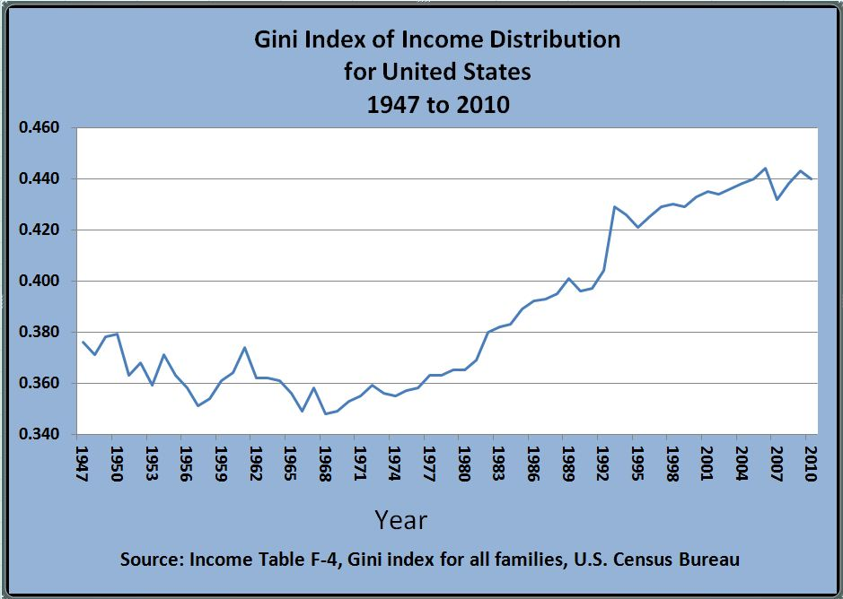

Slide 3
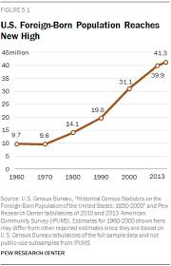

Slide 4
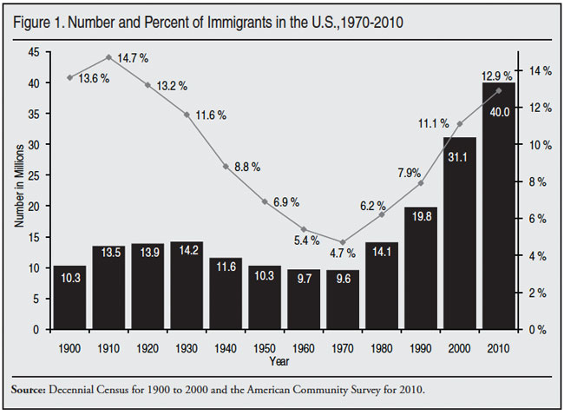

Slide 5
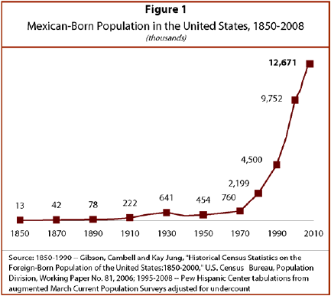

Slide 6
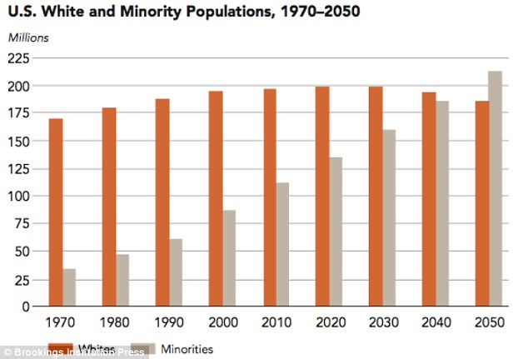

Slide 7
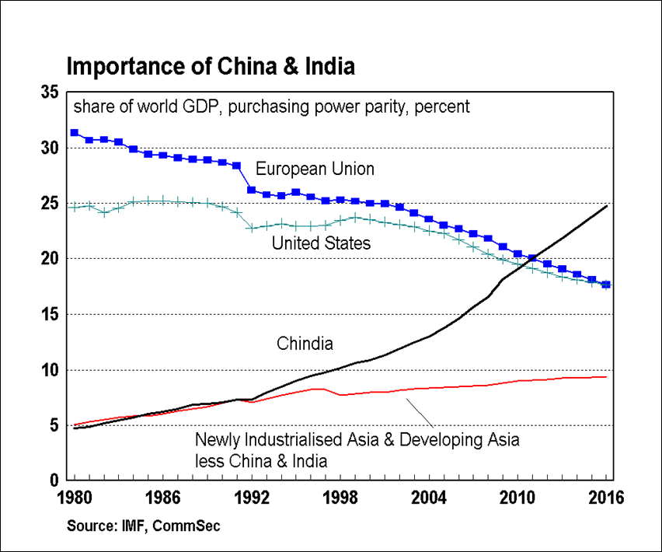
2 ) Which are the Emerging Powers?
b ) Definitions

Slide 8
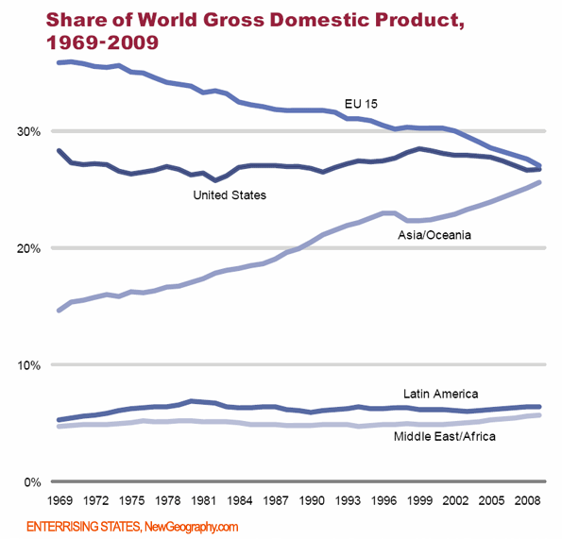
2 ) Which are the Emerging Powers?
b ) Definitions

Slide 9
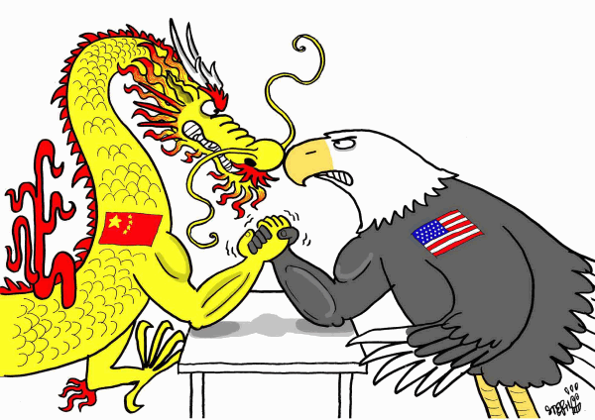
Or cycles are just “natural”?

Slide 10
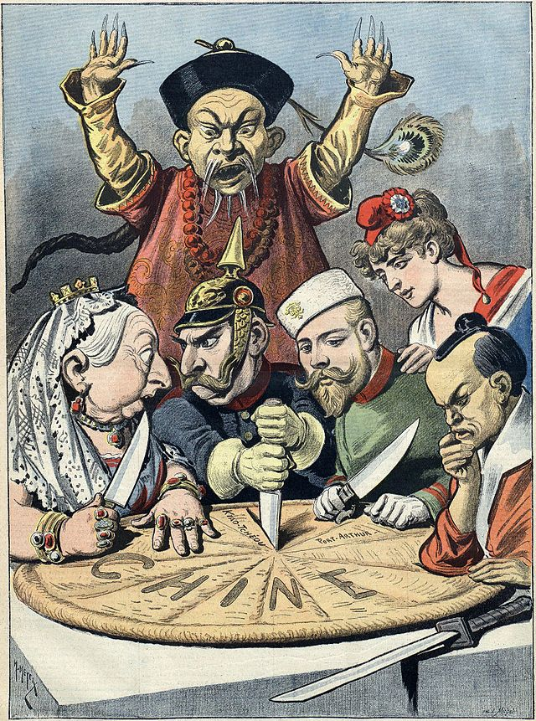
Or cycles are just “natural”?

Slide 11
The Politics of Economic Nationalism
Class 8
The Return of the Polanyian World? &
American US: Cohesion Crumbles, Hegemony Vanishes
Dr. Vinícius Rodrigues Vieira (IRI-USP)
10 October 2018

Slide 12
Remembering Polanyi
The meaning of free trade (or, to be more precise, growing exchange between distant lands): “The mobilization of the produce of the land was extended from the neighbouring countryside to tropical and subtropical regions—the industrial agricultural division of labour was applied to the planet. As a result, peoples of distant zones were drawn into the vortex of change the origins of which were obscure to them, while the European nations became dependent for their everyday activities upon a not yet ensured integration of the life of mankind. With free trade the new and tremendous hazards of planetary interdependence sprang into being (Polanyi [1944] 2001, p. 190).

Slide 13
A long-term trend towards autarchy...
“… since the 1870s an emotional change was noticeable though there was no corresponding break in the dominant ideas. The world continued to believe in internationalism and interdependence, while acting on the impulses of nationalism and self-sufficiency. Liberal nationalism was developing into national liberalism, with its marked leanings towards protectionism and imperialism abroad, monopolistic conservatism at home. Nowhere was the contradiction as sharp and yet as little conscious as in the monetary realm. For dogmatic belief in the international gold standard continued to enlist men's stintless loyalties, while at the same time token currencies were established, based on the sovereignty of the various central banking systems. Under the aegis of international principles, impregnable bastions of a new nationalism were being unconsciously erected in the shape of the central banks of issue” (Polanyi [1944] 2001, p. 207).

Slide 14
Economic
Nationalism
(i.e., protectionism)

Slide 15
Economic
Nationalism
(i.e., protectionism)
National
Identity
(i.e., who belongs)
Rising Inequality → Association with migrants
THE POLITICS OF ECONOMIC NATIONALISM

Slide 16
The Great Rebalancing (Pettis 2013, 178)
“A country’s savings level is not only or even primarily a function of domestic cultural and personal preferences. Savings rates, especially in countries with abnormally high or low levels of savings, are almost always determined by policies and institutional constraints that affect the relationship between consumption levels and GDP”;
“For relatively open economies, national savings rates are a function not just of domestic policies and institutional constraints but also, and very importantly, of foreign policies and institutional constraint”.

Slide 17
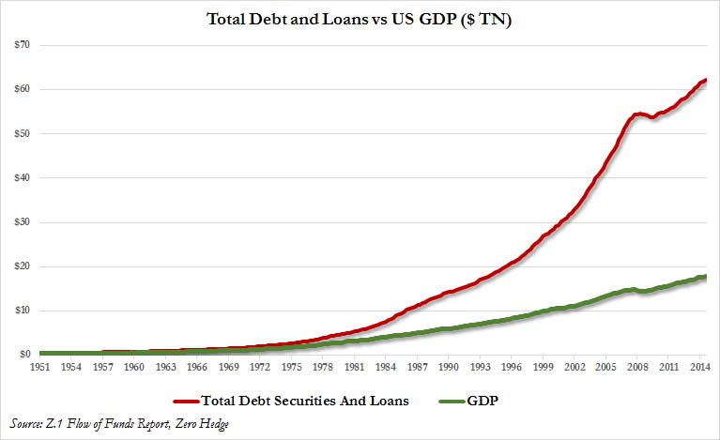

Slide 18
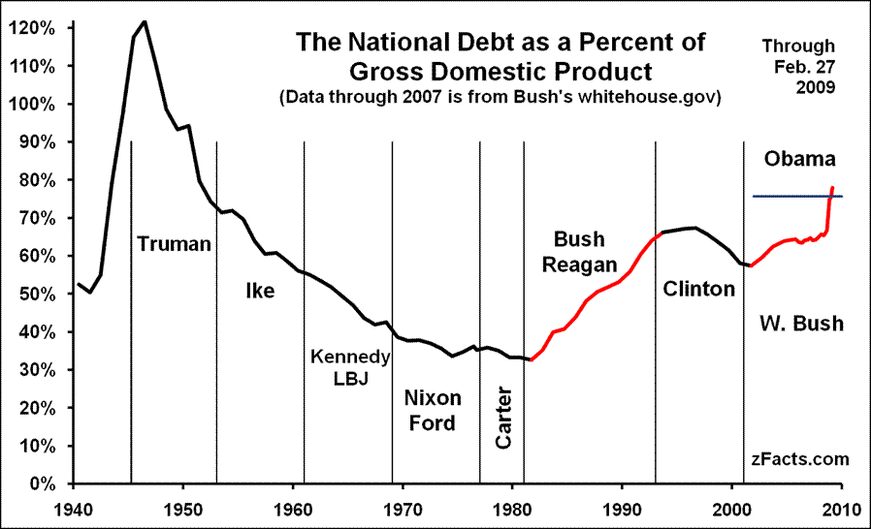

Slide 20
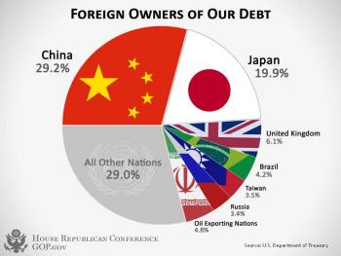

Slide 21
The Great Rebalancing (Pettis 2013, 179)
“[A]ttempts to adjust large savings, consumption, or investment imbalances levels in only one country, without equivalent and opposite adjustments abroad, can force undue stress on the global economy and can lead to very poor outcomes, especially at first for deficit countries but ultimately more so for surplus countries”.

Slide 22
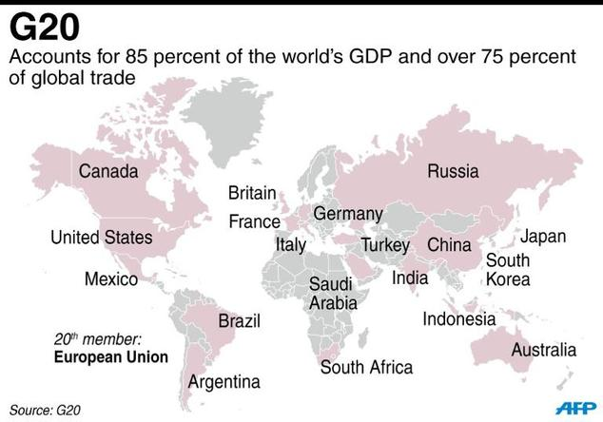
Is coordination possible? The case of the G20
http://www.reuters.co-idUSKCN11B0IT

Slide 23
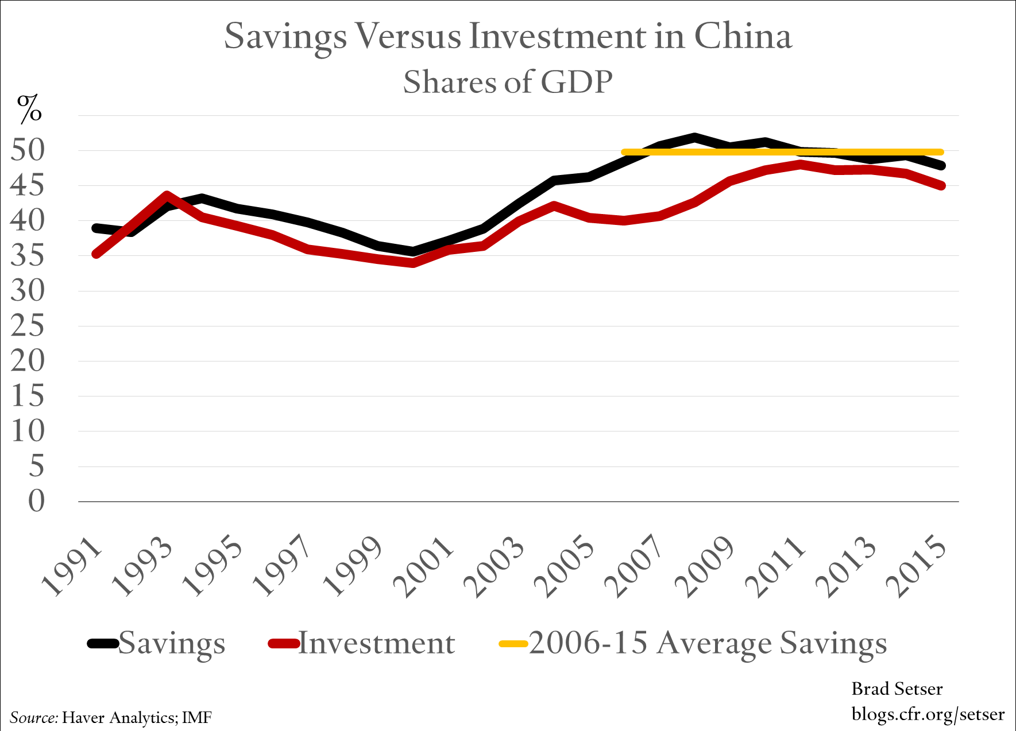

Slide 24
What can be done?
“If Chinese policy distortions played a role in creating the global imbalances, however—and clearly they have…—as the rest of the world adjusts it must force an equivalent and opposite adjustment within China itself. As the United States and Europe “dig themselves out from under their mountain of debt,” in other words, their deleveraging cannot take place without affecting the gap between Chinese savings and investment” (Pettis 2013, 192)
That is, China has to find a channel/outlet to invest its savings
Domestic consumption: if increases, threatens single-party regime
Exporting capital: establishes alliances with the developing world, weakening further US hegemony/leadership at the international level

Slide 25
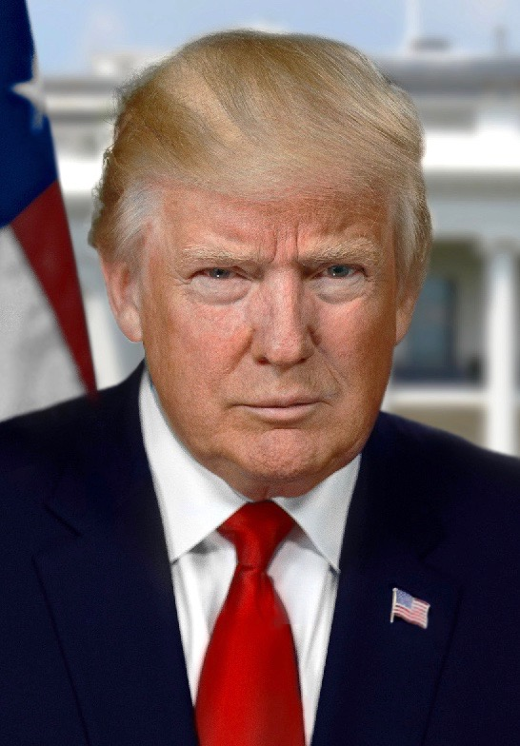
What can be done?
“[S]hould the United States take drastic steps to reduce disposable income relative to GDP, like imposing a consumption tax or much higher income taxes on the wealthy, the positive impact on U.S. unemployment and the U.S. savings rate will be dramatic, although it will also be extremely painful for countries, like China and Japan, that rely on American overconsumption to balance their own underconsumption (Pettis 2009, 186).

Slide 26
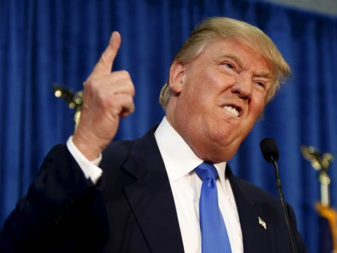
What is he going to do?
“Let them eat credit” (Rajan 2010) + Tax Breaks (as Trump is pushing for)
Long term effects include weakening U.S. position at the international level;
REMBEMBER: government borrows abroad, including from surplus countries such as China;
ALTERNATIVE: investment in infrastructure, but at the expense of reducing consumption.
→ In this case…

Slide 27
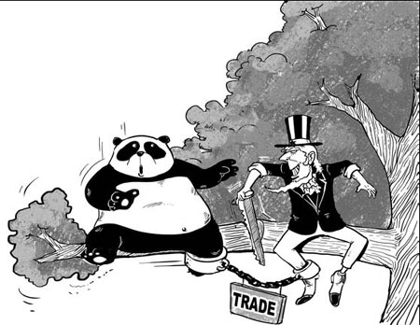
Back to Polanyi??? Let’s discuss in other classes
“Trade tensions will rise. In a world of deficient demand and excess savings, every country will try to acquire a greater share of global demand by exporting savings. This will be called trade protection, currency war, local content requirements, tariffs, and many other things, but these all amount to the same thing. It will be an attempt by each country to gain a greater share of global demand”(Pettis 2013, 192).

Slide 28
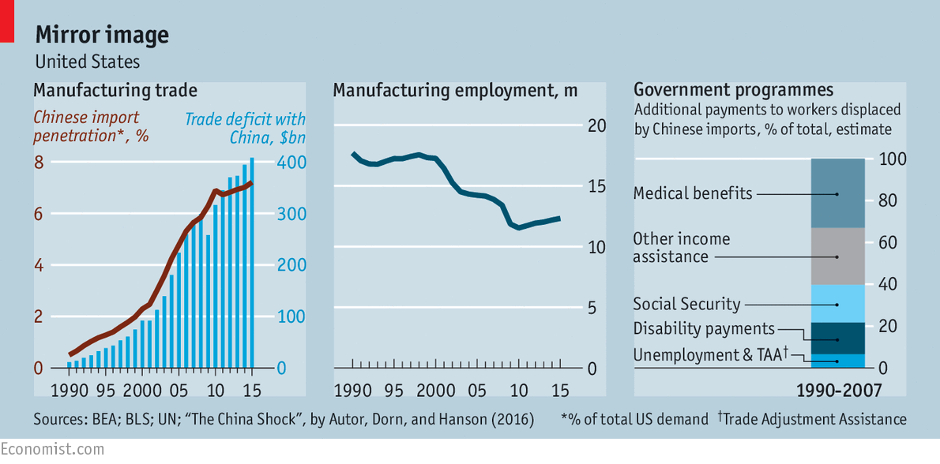
Back to Polanyi???

Slide 29
Final paper
Explore the Politics of Economic Nationalism in any case not covered by the course in current times (that is, exclude UK, US, India, and Turkey)
Size (1,500 words – about 4 to 5 pages excluding bibliography)
Due date: 5 December 2018 at 10 PM (just send by email to me and Elze)
Proposals (100 words) are due on 19 October 2018 at 10 PM (Friday). Must be sent to me and Elze too.

