Slide 1
Analysis Mat: UV, IR Vibrational Spectroscopy
Patricia TARGON CAMPANA
Lesson 04

Slide 2
Analysing a IR spectrum
What we are looking for?
An infrared spectrometer determines the positions and relative magnitudes of all absorptions in the infrared region and records them graphically peaks
In addition to the characteristic position of an absorption peak, the shape and intensity of this peak are also characteristic of the absorption.

Slide 3
From where do we start?
Focus your first efforts on:
Determine the presence (or absence) of some major functional groups
Do not attempt to make a detailed analysis of the absorptions of C—H (~3000 cm ⁻¹) almost all compounds have these absorptions
Don't worry about subtleties of the exact environment surrounding the functional groups
Absorption frequencies of functional groups
Correlation tables: provide as much information as is known about where the various functional groups absorb.

Slide 4
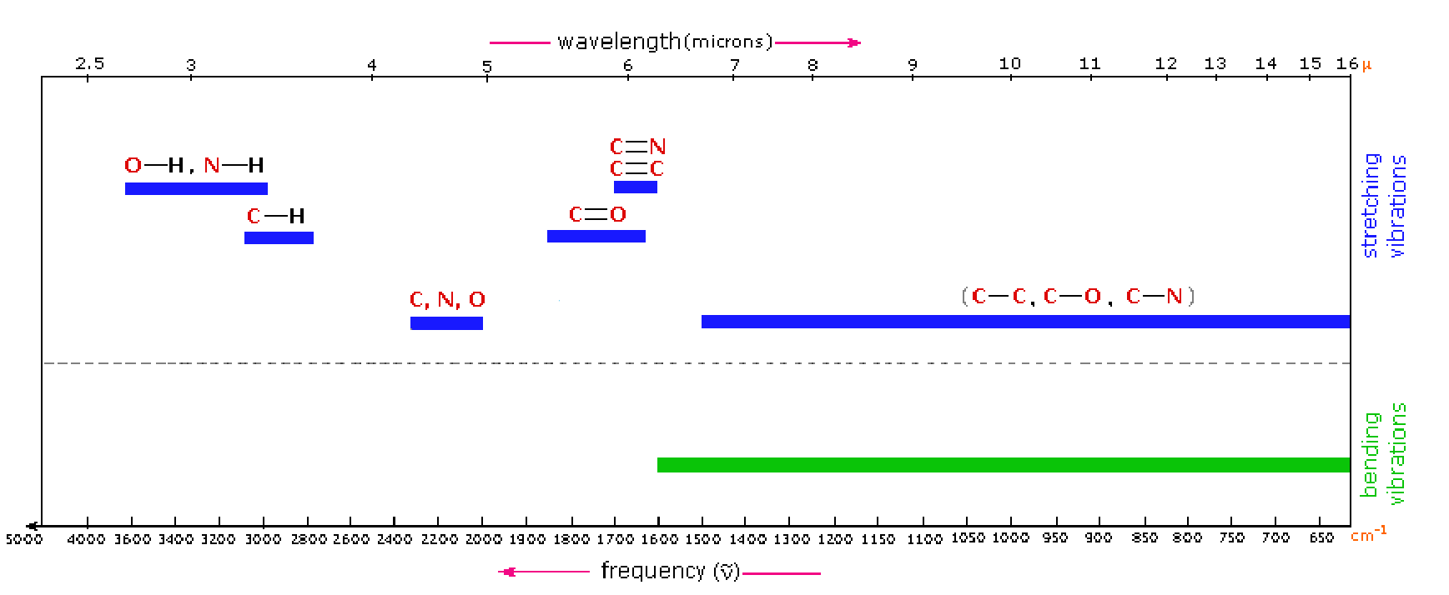
Absorption frequencies of functional groups

Slide 5
Alkanes
N-Alkanes: Simple spectrum, interpreted in terms of 4 vibrations:
stretch and bending of C–H and C–C bonds C–C bending: 500 cm^{–1}
stretch: 1200–800 cm^{–1}, weak bands ( not of value for interpretation, fingerprint)
C–H stretch: from 3000 - 2840 cm^{–1}
CH₃: 2962 cm^{–1}, asymmetrical stretch 2872 cm^{–1}, symmetrical stretch
CH₂: 2926 cm^{–1}, asymmetrical stretch 2853 cm^{–1}, symmetrical stretch
3000 cm^{–1} $≥$ sp³
3000 cm^{–1} $<$ sp² sp (vinylic, aromatic, acetylenic, cyclopropyl H)
bending: 1375 cm^{–1}
bending: 1465 cm^{–1} and rocking 4 $≥$CH₂: 720 cm^{–1}

Slide 8
Alkenes
Many more peaks than alkanes
C=C–H stretch > 3000 cm^{–1} and bending (oop) ~1000 - 650 cm^{–1}
For C=C vibrations
Cyclic alkenes
Cumulated alkenes
Linear unconjugated alkenes
Conjugated Alkenes

Slide 9
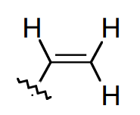
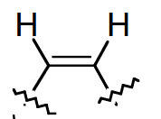
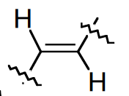
Linear unconjugated alkenes
C=C–H stretch > 3000 cm^{–1} and bending (oop) ~1000 - 650 cm^{–1}
- C=C stretch: moderate to weak absorption at 1670-1640 cm^{–1}
moderate
weak
very weak

Slide 10
Overtone (of 910 cm⁻¹ peak)
$−$C–H stretch (sp³)
C=C–H stretch (sp²)
C=C stretch
C=C–H bending (oop)

Slide 11
C=C stretch
C=C–H stretch (sp²)
$−$C–H stretch (sp³)
C=C–H bending (oop, cis)
very weak C=C stretch
C=C–H stretch (sp²)
$−$C–H stretch (sp³)
C=C–H bending (oop, trans)

Slide 12
Cyclic alkenes
C=C–H stretch > 3000 cm^{–1} and bending (oop) ~1000 - 650 cm^{–1}
$−$C=C stretch: sensitive to ring strain

Slide 13
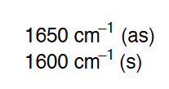
Cumulated alkenes
C=C–H stretch > 3000 cm^{–1} and bending (oop) ~1000 - 650 cm^{–1}
C=C=C stretch (asymmetric): 2000–1900 cm^{–1}
Conjugated alkenes
C=C–H stretch > 3000 cm^{–1} and bending (oop) ~1000 - 650 cm^{–1}
C=C stretch: resonance decreasing K, thus decreasing frequency

Slide 14
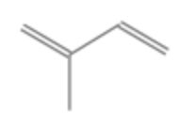
1,3-butadiene
C=C–H stretch (sp²)
C=C–H bending (oop)
C=C stretch (asymmetrical)
< 1600 cm⁻¹
2-Methyl-1,3-butadiene
C=C stretch (symmetrical) ~1640 cm⁻¹
C=C–H bending (oop)
C=C–H stretch (sp²)
C=C stretch (asymmetrical)
<1600 cm⁻¹

Slide 15
Alkynes
C$≡$C–H stretch (sp): 3333–3267cm^{–1} , strong, narrow (compared to OH or NH)
bend: 700-610 cm^{–1} (broad, strong) and 1400-1220 cm^{–1} (overtone)
C$≡$C stretch: weak absorption at 2260-2100 cm^{–1}
not observed for symmetrical alkynes
very weak for ‘pseudo’ symmetric alkynes
terminal alkynes: stronger absorptions

Slide 16
Terminal Alkynes
C$≡$C stretch
C$≡$C–H bend overtone
C$≡$C–H
stretch
$−$C–H stretch
C$≡$C–H bend

Slide 17
Remarks

Slide 18
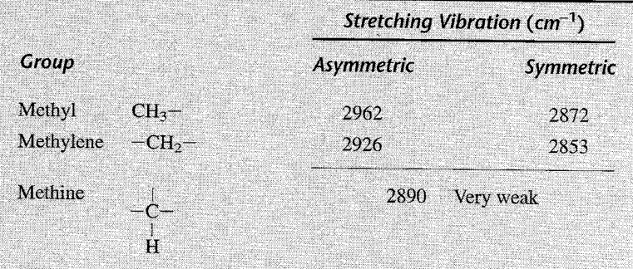
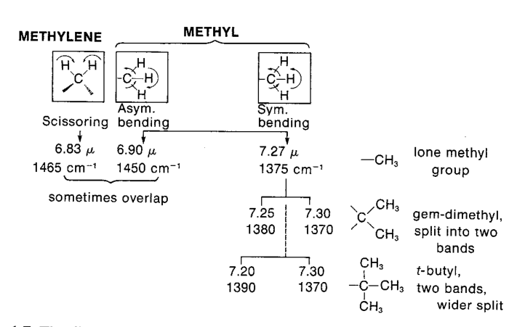
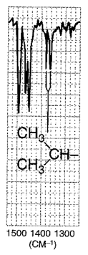

Slide 19
Aromatic rings
C=C–H stretch > 3000 cm^{–1} and bending (oop) ~900 - 650 cm^{–1}
intense bands, strongly coupled to adjacent hydrogens on the ring
C=C stretch (in pairs): 1600-1585 cm^{–1} and 1500-1400 cm^{–1}
oop ring bending: 600-420 cm^{–1}
(overtone and combination, weak, 2000-1667 cm^{–1}: used to assign ring substitution pattern)

Slide 20
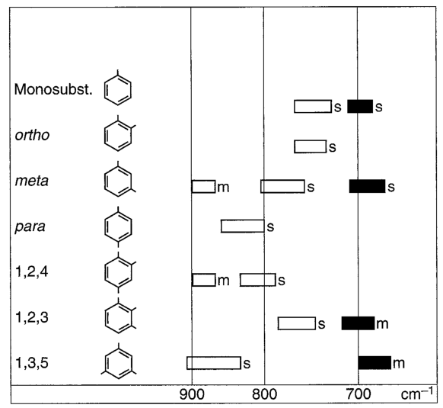

Slide 26
Alcohols and phenols
O$−$H stretch Strongly dependent on hydrogen-bonding
non-hydrogen bonded OH groups (free): 3700-3584 cm^{–1} range, sharp.
hydrogen bonded OH groups (intermolecular hydrogen bonding): 3550-3200 cm^{–1} range, broad.

Slide 27
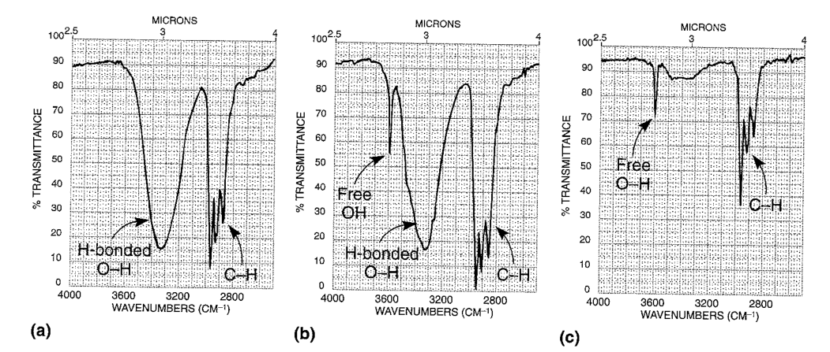

Slide 28
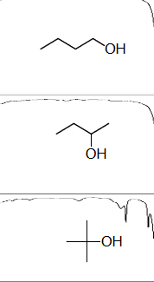
C$−$O stretching Vibrations • Alcohols (1260-1000 cm^{–1}) • Phenols (1800-1260 cm^{–1})
$$CH_{2}=CHCHCH_{3}$$
primary alcohol: 1050-1085 cm^{–1}
secondary alcohol: 1085-1125 cm^{–1}
tertiary alcohol: 1125-1200 cm^{–1}
$$−$$
$$OH$$
1100 1070 cm^{–1} 1100 1060 cm^{–1}
$$CH≡CCH_{2}OH$$
1050 1017 cm^{–1} 1050 1030 cm^{–1}

Slide 29
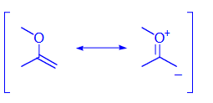
Ethers
absence of O-H stretch (3650 and 3600 cm⁻¹) and C=O stretch (1735 cm⁻¹), to eliminate alcohols and esters
C $−$O $−$C stretching bands are most characteristic
(strong!)
Aliphatic ethers: strong band due to asymmetrical stretching: 1150-1085 cm^{–1} (usually 1125 cm^{–1})
Alkyl aryl ethers: asymmetrical stretch at 1275-1200 cm^{–1} symmetrical stretch at 1075-1020 cm^{–1}
Vinyl alkyl ethers: asymmetrical stretch at 1225-1200 cm^{–1} symmetrical stretch at 1075-1020 cm^{–1}

Slide 30
Carbonyls
C$=$O stretch– easily recognized, intense band
Ketones, aldehydes, acids, esters, lactones, acid halides, anhydrides, amides and lactams:
in the region 1870-1540 cm^{–1}
Position will be determined by:
Electronic and mass of neighbouring groups
Presence of conjugation
Hydrogen bonding Ring strain

Slide 31
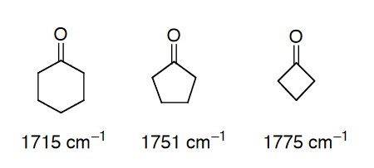
Ketones
Aliphatic: 1720 – 1708 cm^{–1}
conjugation: shifts position to lower frequency:
C$=$O stretch 1700-1675 cm^{–1}
C=C stretch 1644-1617 cm^{–1}
C$=$O stretch 1700-1680 cm^{–1}
ring stretch 1600-1450 cm^{–1}
C$=$O stretch 1670-1600 cm^{–1}
ring stretch 1600-1450 cm^{–1}
Cyclic Ketones The bond angle influences the absorption frequency of the C=O

Slide 32
Aldehydes
C–H stretch : 2830–2695 cm^{–1}
(two bands: C–H stretch + overtone of the C–H bend of the aldehyde)
C$=$O stretch
Aliphatic aldehydes: at 1740-1720 cm^{–1}
Electron withdrawing groups shift to higher frequency Conjugation shifts to lower frequency:
C$=$O stretch 1700-1680 cm^{–1}
C=C stretch 1640 cm^{–1}
C$=$O stretch 1700-1660 cm^{–1}
ring stretch 1600-1450 cm^{–1}
Long conjugated system:
C$=$O stretch 1680 cm^{–1}

Slide 33
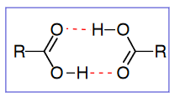
Carboxylic acids
O$−$H stretch ‘free’ OH (~ 3520 cm^{–1}), vapor phase or in very dilute (<0.01 M) solution in a non-polar solvent;
Very broad (strongly H-bonded) 3300–2500 cm^{–1} region (centred ~3000 cm^{–1})

Slide 34
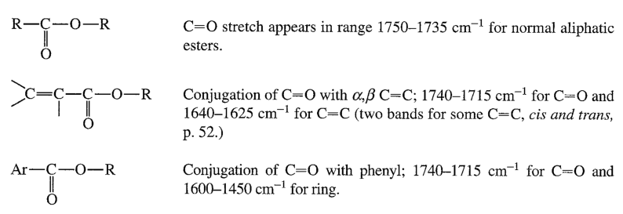
Esters

Slide 35
Amides

Slide 36
Acid chlorides

Slide 37
Anhydrides

Slide 38
Amines

Slide 39
References
Larkin, Peter. Infrared and Raman spectroscopy: principles and spectral interpretation. Elsevier, 2017.
Pavia, Donald L., et al. Introduction to spectroscopy. Cengage learning, 2014.
Banwell, C. N. Fundamentals of Molecular Spectroscopy: By CN Banwell. New York, McGraw-Hill, 1983.
Infrared Spectral Interpretation by Brian Smith, CRC Press, 1999
Infrared Spectroscopy: Fundamentals and Applications by Barbara Atuart, John Wiley&Sons,
Ltd., 2004
Interpretation of Infrared Spectra, A Practical Approach by John Coates in Encyclopedia of
Analytical Chemistry pp. 10815-10837, John Wiley&Sons Ltd, Chichester, 2000
The National Institute of Standards and Technology (NIST), NIST Standard Reference Database 69: NIST Chemistry WebBook, https://www.nist.gov/about-nist
https://www.chemicalbook.com/SpectrumEN_78-79-5_IR1.htm

