Slide 1
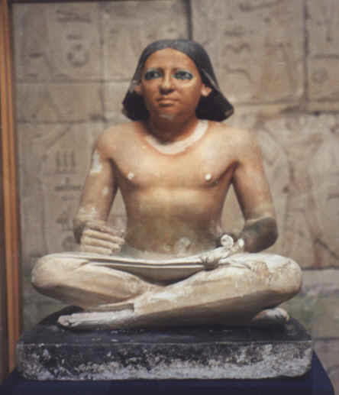
Strategy of Education in Egypt

Slide 2
Evolution of Education in Egypt

Slide 3
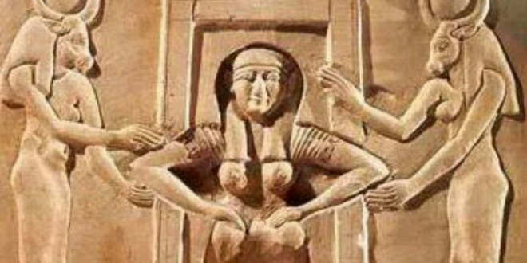
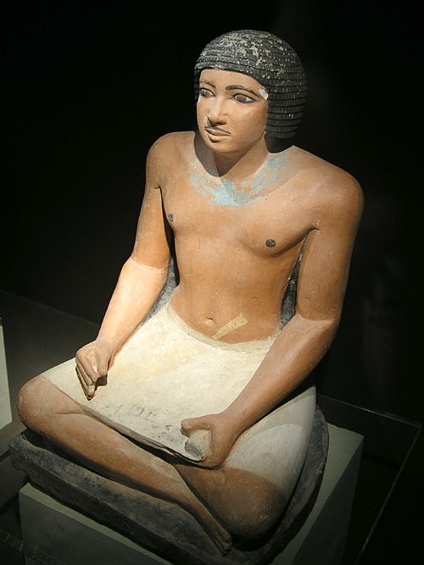
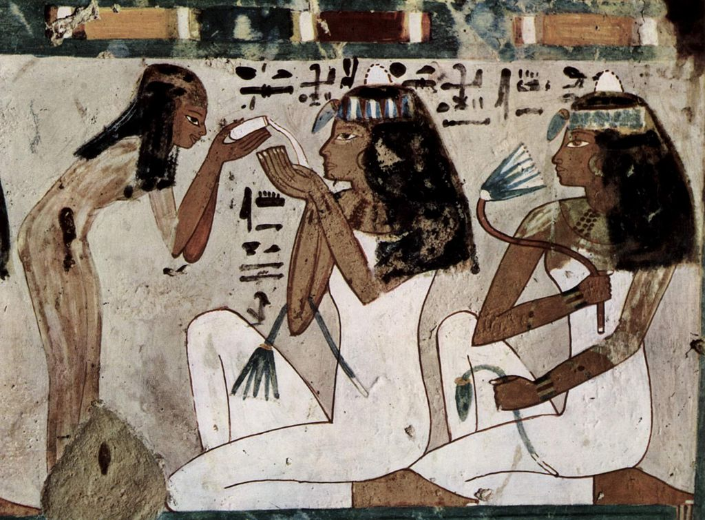
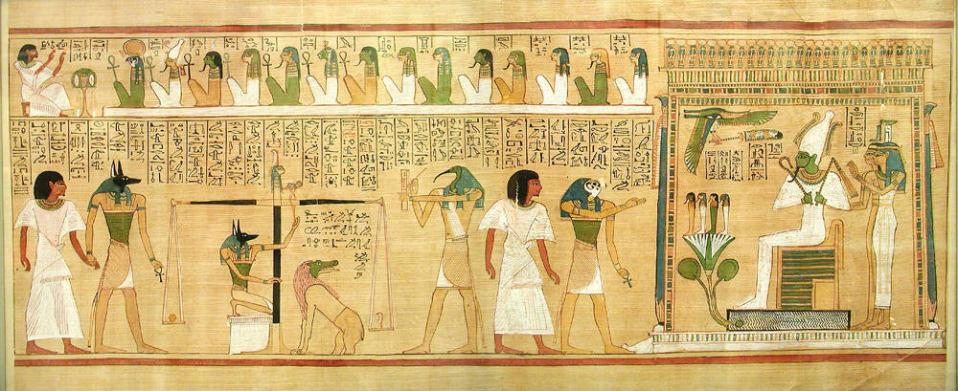
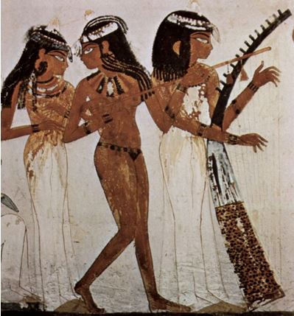
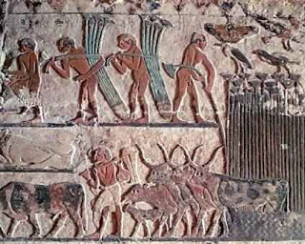
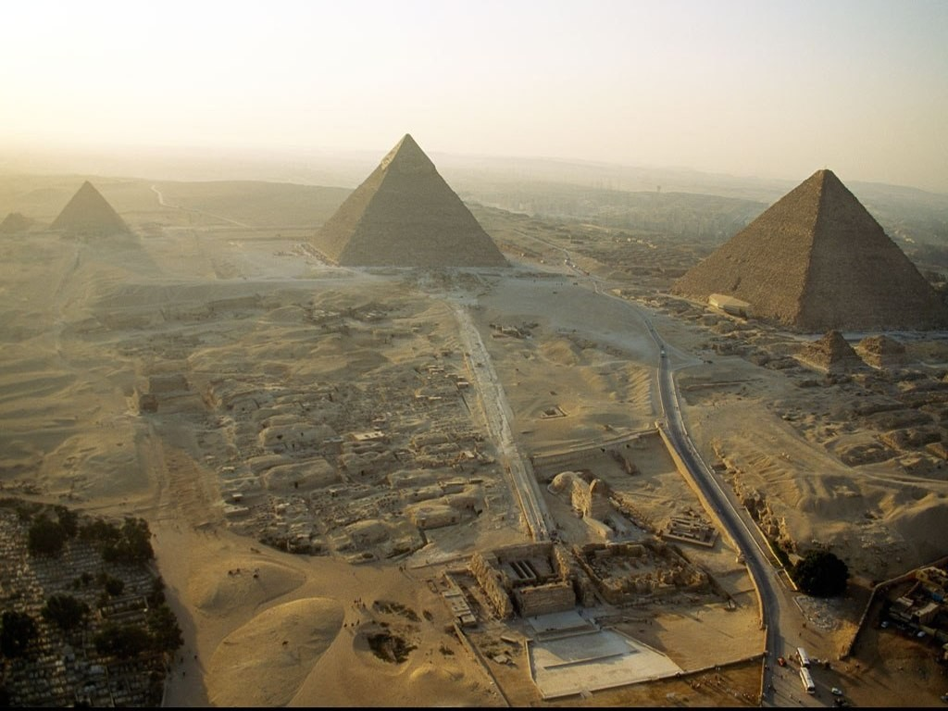
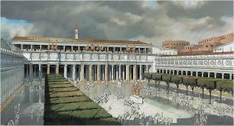
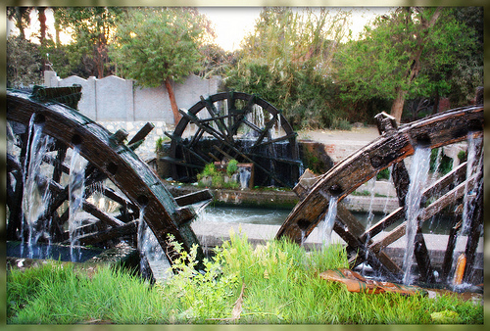
Evolution of Education in Egypt B.C.

Slide 4
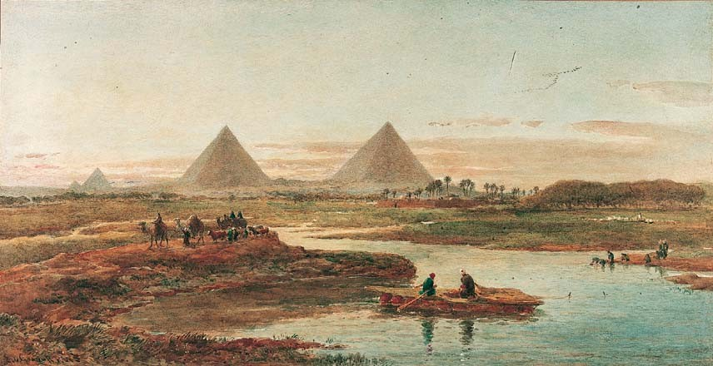
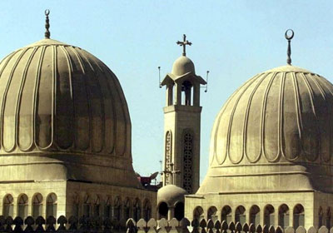
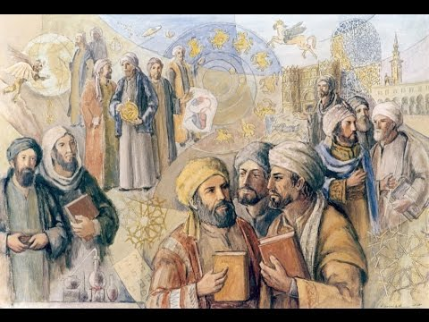
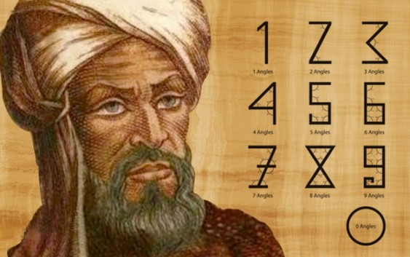
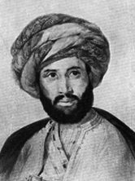
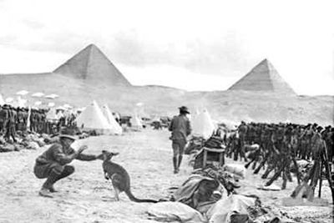
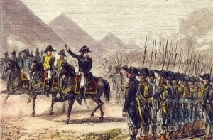
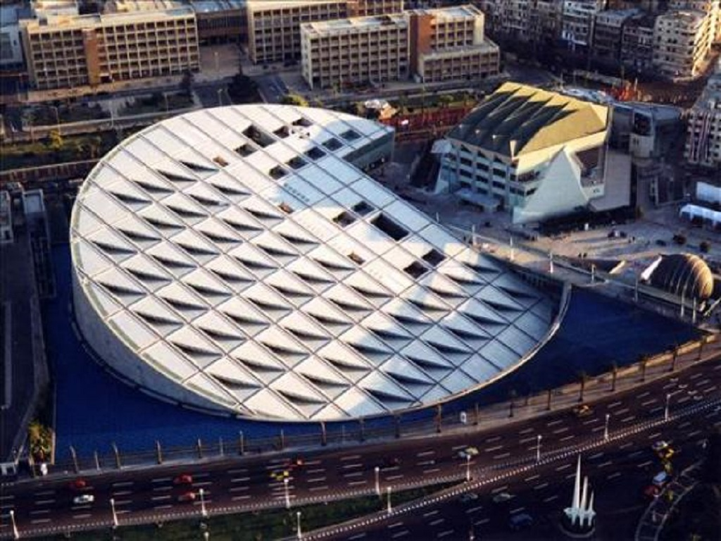
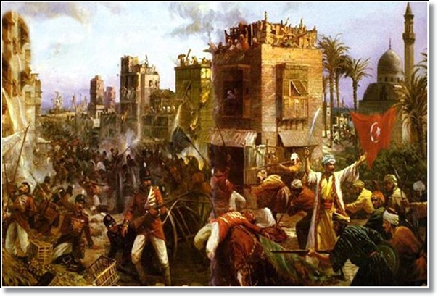
Evolution of Education in Egypt A.D.

Slide 5
The future vision for education in Egypt:
1 - Effective school provides quality education for each learner.
2 - Distinguished teacher at a high level of professionalism and expertise.
3 - Methods based on active learning and linked to the needs of the local reality.
4 - Advanced technology education integrated into the educational process.
5 - Community participation launches energy efficient civil society to support quality education and creating a culture of participation and building a democratic society in light of the trend towards decentralization, national
6 - Educational Administration distinct based on information and transparency, accountability and responsible leadership and informed consent to see the development in the context of decentralization.

Slide 6
The objectives of educational policy:
1 - Availability: To provide equal educational opportunities for all Egyptian and to increase educational opportunities for girls
2 - Quality: reform and continuous improvement of the educational process in accordance with national quality standards.
3 - Systems: the development of systems to increase their effectiveness and Institutionalization of decentralization and building information systems and monitoring and evaluation.

Slide 7
Areas of work
Distance Learning
An effective school
Teacher
Excellent management:
Community participation
Curriculum and learning outcomes
- Continues
- Planning
- Cooperation
- Training
- Preservation of cultural values and identity
- Looking Ahead for future

