Slide 1
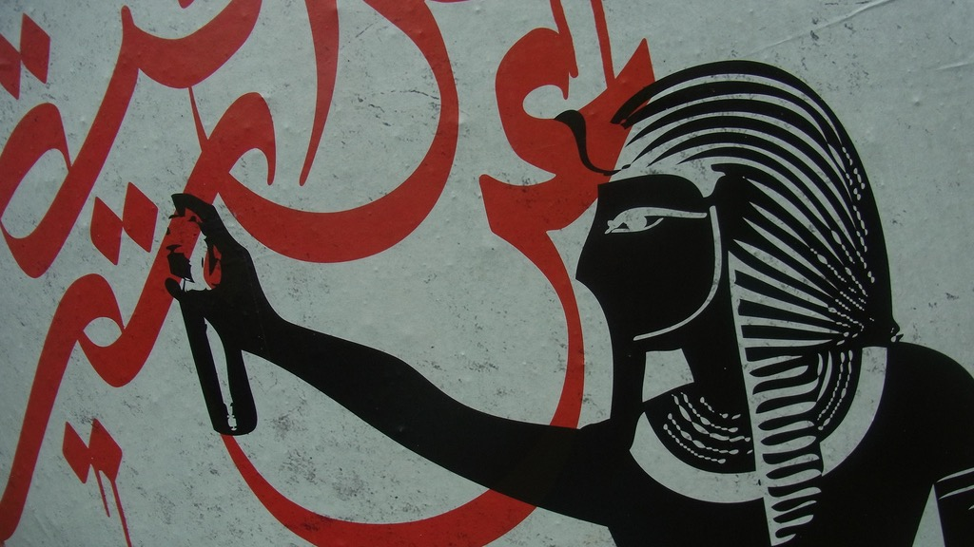
Major Themes in Contemporary Middle East
LECTURE 12.
FROM THE “ARAB SPRING” TO ARAB WINTER

Slide 2
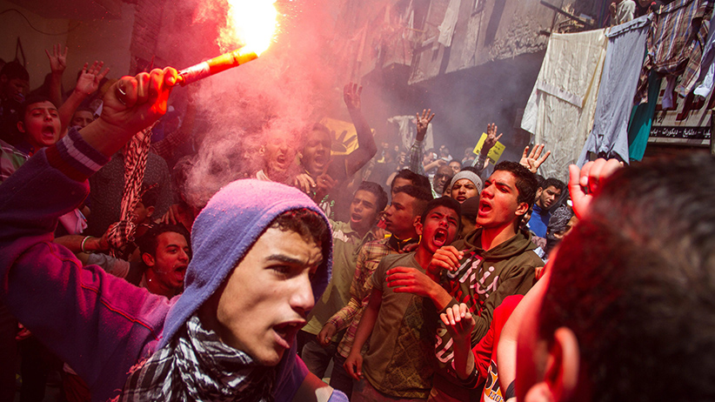
From the “Arab Spring” to the
Arab Winter

Slide 3
Washington Post, 2014

Slide 4
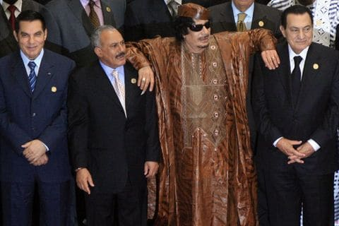
The Arab World before the “Spring”
Authoritarian secular republics or authoritarian conservative monarchies.
Governing elites of the Arab regimes specialised in keeping power than improving the lives of their people.
Security establishment & judiciary instruments of regime preservation rather than guarantors of citizens’ rights and security.
Piecemeal political reform initiatives fail to create meaningful change in the face of corruption, cronyism and abuse of power.
Individual or organised protests generally suppressed.

Slide 5
Explaining the persistence of autocratic regimes
The Essentialist (Orientalist) answers
Islam is inherently anti-democratic. “The idea of democracy is quite alien to the mindset of Islam.” – Elie Kedourie (1992)
Arabs don’t do revolution… (because they are too lazy, disunited, submissive, etc.)
Less openly articulated but still very powerful view in the West prior to the A.S.
Contextual answers
States dominate the economy. There is no (or little) room for independent bourgeoisie. “No bourgeoisie, no democracy” – Barrington Moore (1966)
“Ruling bargain” → settling for limited rights in exchange for security/prosperity
Preference of external (regional/global) powers for stability over democracy.

Slide 6
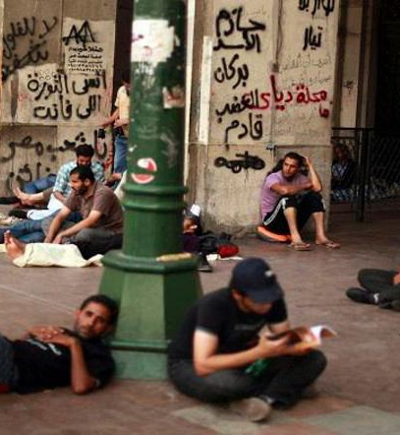
Trouble brewing…
In resource-poor states the “ruling bargain” becomes increasingly strained because of…
Fast growing, better informed young populations
Migration to the city and the creation of massive urban sprawls
Inability of the state to create enough jobs +
Neo-liberal disruption → Cuts in wages, subsidies, welfare state
A young, precarious population
Average youth unemployment in the Arab world before Arab Spring around 25%.
Potential triggers
Climate Change
2008 Financial Crisis
Still, many observers overestimated the durability of Arab autocracies before the Arab Spring

Slide 7
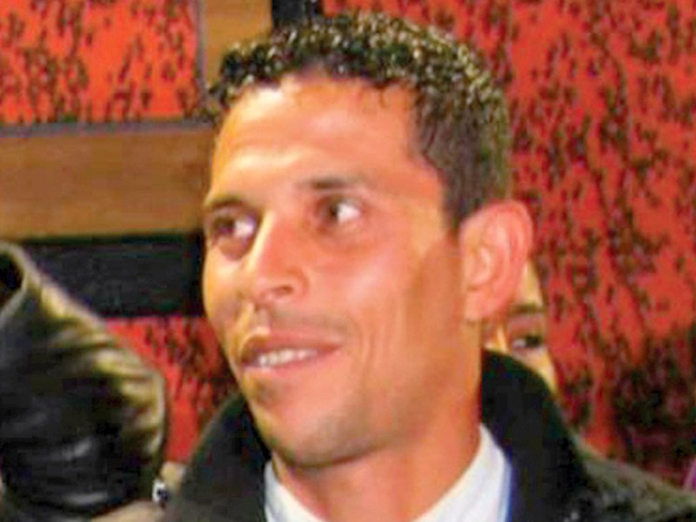
So what was the “Arab Spring” about?
A series of spontaneous mass revolts and revolutions driven by outrage at:
Injustice
Socio-political inequality
Lack of opportunities
Abuse of power by corrupt and disdainful regime elites
…and popular demands for:
Better governance
Dignity
Opportunity
Liberty
26-year Tunisian fruit vendor Mohammad Bouazizi
“Tipping Point”

Slide 8
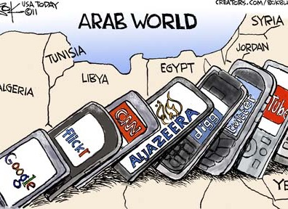
The (Digital) Ripple Effect?

Slide 9
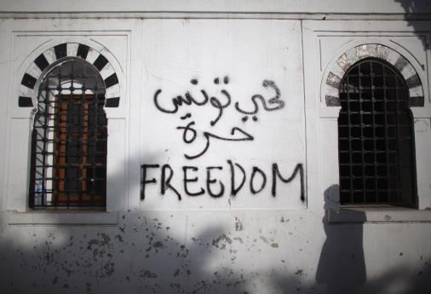
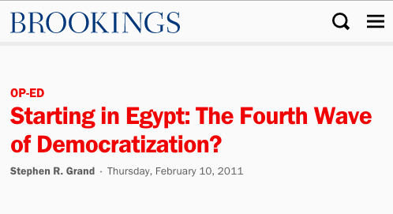
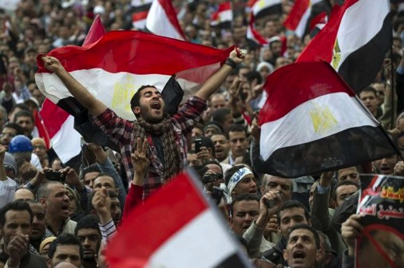
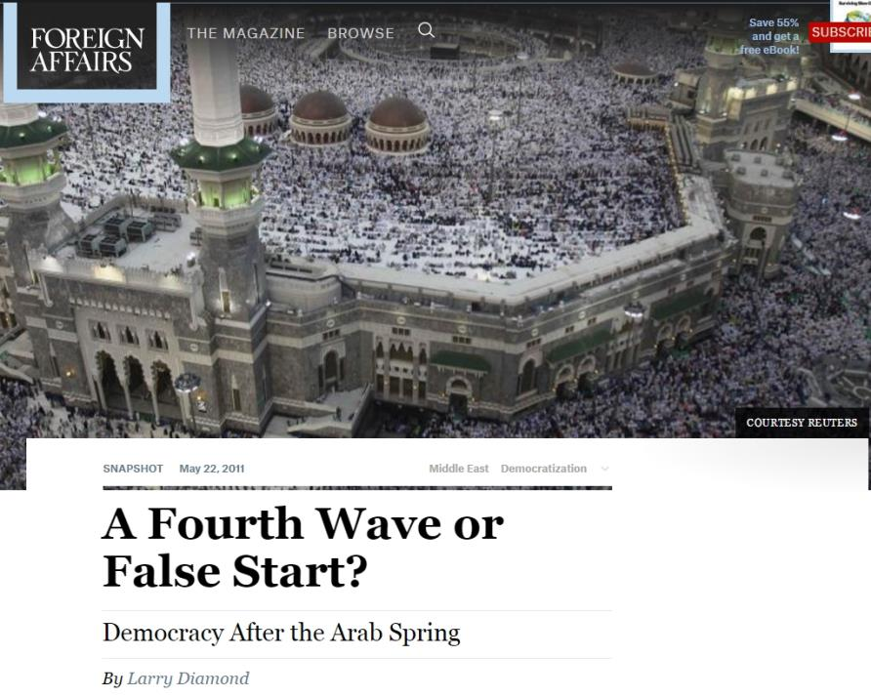
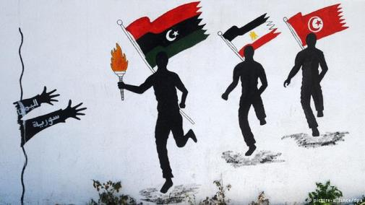
“Arab Spring”
as
the Fourth Wave?
1991

Slide 10
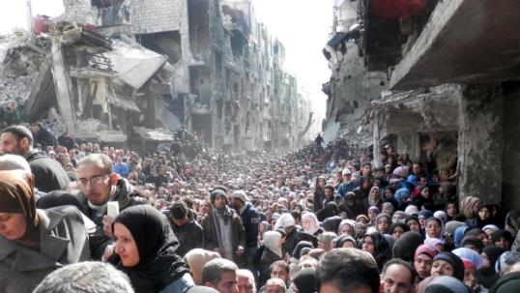
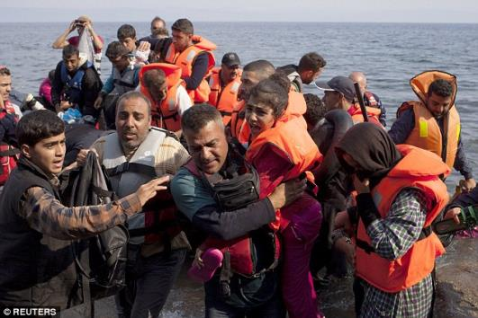
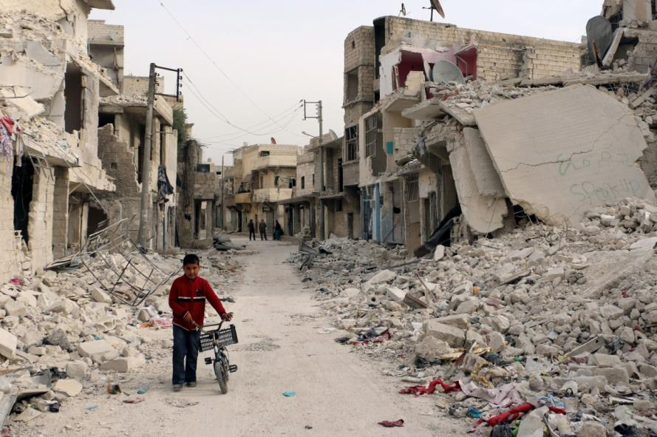
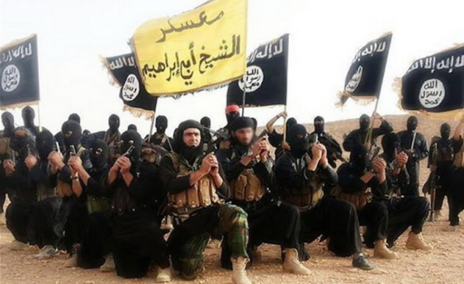
“Arab Spring” as the Fourth Wave?.... No
The Middle East on the brink: an urgent appeal for common sense
K. Akkoyunlu
Open Democracy, December 2011
“The Arab spring of pro-democracy protestors and authoritarian rulers is effectively over. That popular outcry for a better, fairer and more honourable human living is being stifled in a ruthless struggle for geopolitical hegemony and survival, played out along increasingly explosive sectarian lines. And as the elephants trample, once again the grass suffers.”

Slide 11
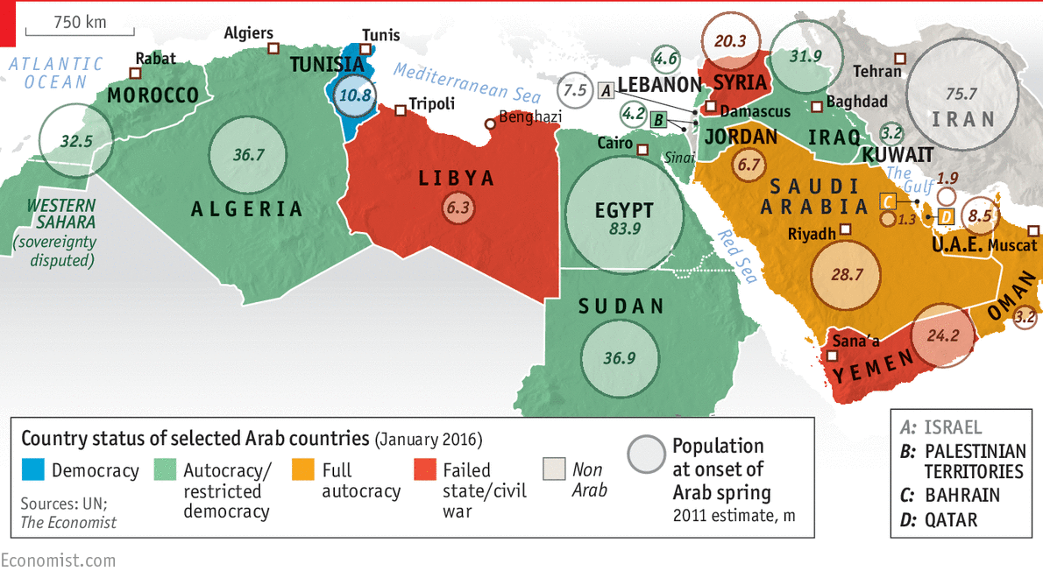
“Arab Spring” as the Fourth Wave?.... No

Slide 12
From “Arab Spring” to Arab Winter
Explaining the outcomes
Focus on country-specific outcomes
Focus on the general picture
Pre-A.S. background conditions
Civil War / State failure
Libya, Syria, Yemen
Tribal, sectarian, regional divisions
State willing to use lethal force
Outside military intervention
Fractured state apparatus with weak societal support (Libya → regime collapse)
United state apparatus w/ societal support (Syria → regime survival)
In contrast…
Tunisia, Egypt
More homogenous society -->
Central, urban, civil protests
State less willing to use force (initially)
No outside intervention (initially)

Slide 13
From “Arab Spring” to Arab Winter
Explaining the outcomes
Focus on country-specific outcomes
Focus on the general picture
Pre-A.S. background conditions
Sustained Democracy vs. Return to Autocracy
Tunisia
Smaller, better educated pop. (11m)
Larger middle class; high HDI
Women better integrated to society
Stronger labour unions & parties
Military out of politics & economy
Politics as compromise
Egypt
Larger, less educated population (95m)
Smaller middle class; medium HDI
Military involved in politics & economy
Weaker unions & independent parties (only capable opposition group M.B.)
Politics as zero-sum game
Outside intervention (pro-coup)

Slide 14
From “Arab Spring” to Arab Winter
Explaining the outcomes
Focus on country-specific outcomes
Focus on the general picture
Elites in survival mode → Return of massive, merciless state repression and violence after initial period of surprise.
Weakness of protest movements
Spontaneous, leaderless, colourful “people power” protests effective in toppling governments, but not steering post-revolutionary dynamics.
Without socially-rooted organisation and clear political agenda, protest movements can be hijacked, suppressed or diverted by more entrenched and powerful forces (MB, Sisi, ISIS, Saudi Arabia, Iran, etc.)
Lack of “critical mass” → “Tahrir Square isn’t Egypt”
Role of regional / international actors preferring stability over democracy

Slide 15
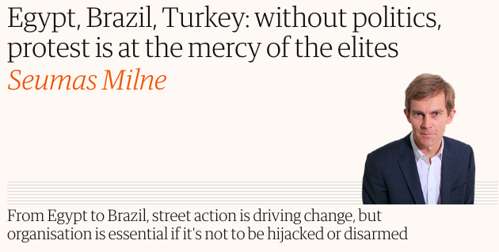
From “Arab Spring” to Arab Winter
Explaining the outcomes
Focus on country-specific outcomes
Focus on the general picture
The Guardian – 2 July 2013: https://www.theguardian.com/commentisfree/2013/jul/02/politics-protest-elites-brazil-egypt-organisation

Slide 16
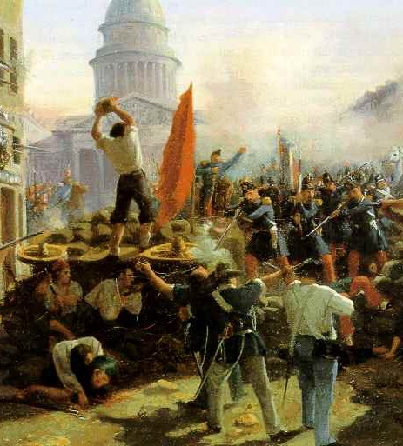
Arab Spring / Arab Winter – an exception?
European Revolutions of 1848
Middle-class led revolutions against aristocratic rule & inspired by liberalism, socialism, nationalism.
Spring 1848 → Spread across 50 countries (pre-Facebook!) “The Spring of 1848, Spring of Nations, Springtime of the Peoples”
Fall 1848 → caught off-guard at first, aristocracy plots its return to power
1849 → Revolutions suppressed/co-opted everywhere
Internal divisions + external intervention (Russia)
BUT → Some social reforms became permanent, and ideas of democracy, liberalism and nationalism never went away!
Barricade on Rue Soufflot, Horace Vernet, 1848

Slide 17
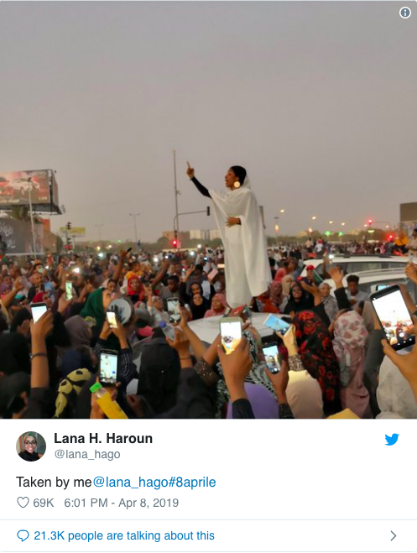
Reasons for hope…
Debunked the myths about Arab/Islamic exceptionalism
Introduced “the people” in regime-centric IR analyses
Proved that despotic systems are not unshakeable after all!
Some gains: Democracy (albeit flawed and fragile) in Tunisia, reforms in Morocco, Jordan.
A taste of revolution and continued source of inspiration → continuing in Algeria and Sudan!
Will they follow or avoid Egypt’s fate?
Lebanon & Iraq → Arab Spring vol. 2?

Slide 18
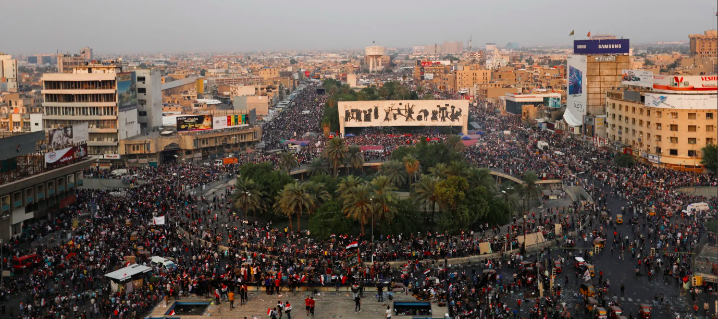

Slide 19
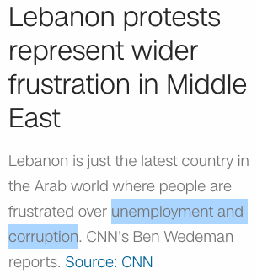

Slide 20
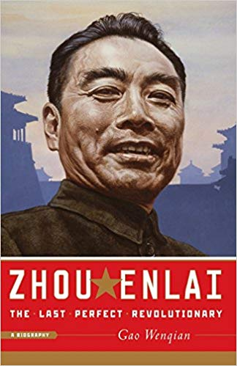
To Conclude…
Asked about the significance of the French Revolution, Zhou Enlai famously said:
“It’s too early to tell.”
(probably a misunderstanding/mistranslation, but too good not to quote!)

Slide 21
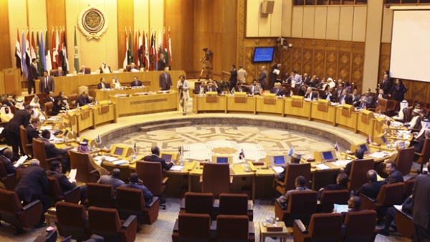
Regionalism & External Powers in the 21st century
Next Week

