Slide 1
Distinguishing causation and correlation: Causal learning from time-series graphs with trends
MAC6967 Seminar – Nicolas Vana and Liang Shen

Slide 2
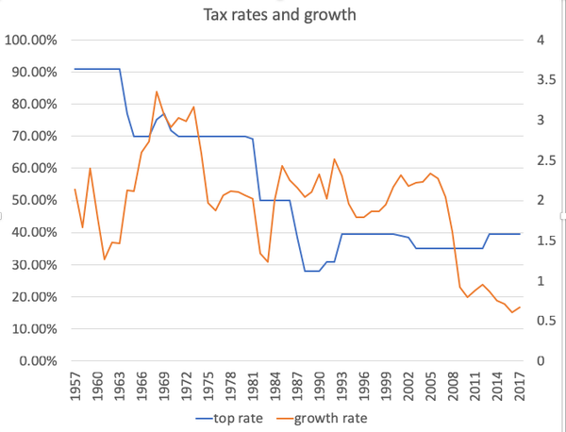
Time Series
Definition:
“A time series is a series of data points indexed (or listed or graphed) in a timely order. Most commonly, a time series is a sequence taken at successive equally spaced points in time. Thus it is a sequence of discrete-time data”
Much of the data presented to us in our daily life consists of time series

Slide 3
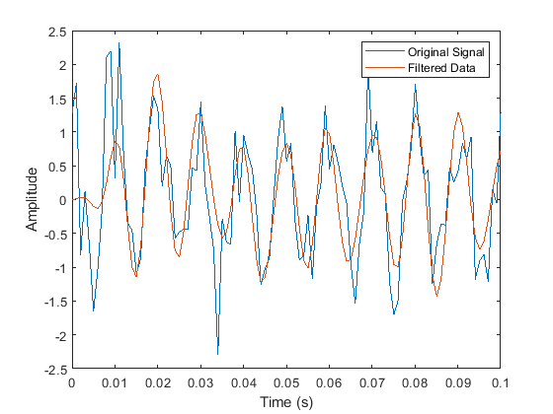
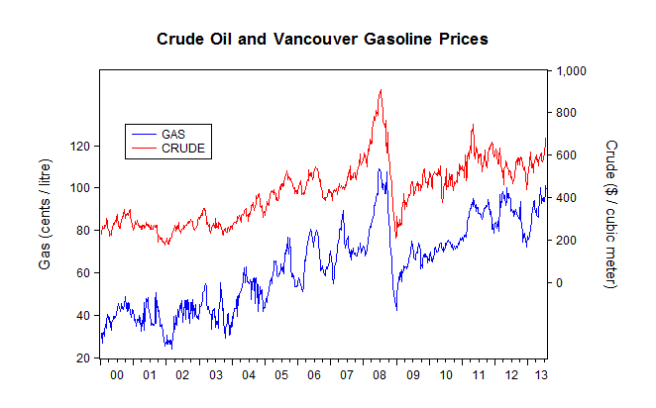
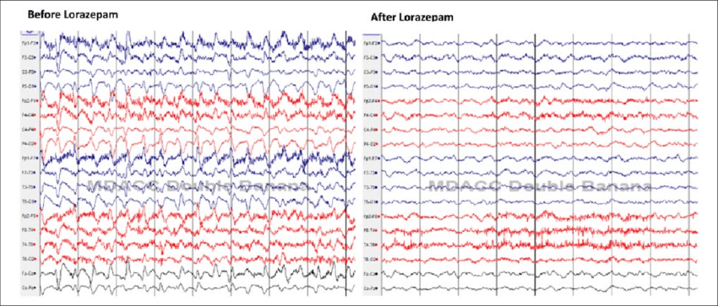
Time Series
Used in a variety of fields of work
Signal processing
Econometrics
Electroencephalography

Slide 4
Time Series
Static forms of presentation
There is also a variety types of time-series plot, and this is also of interest

Slide 5
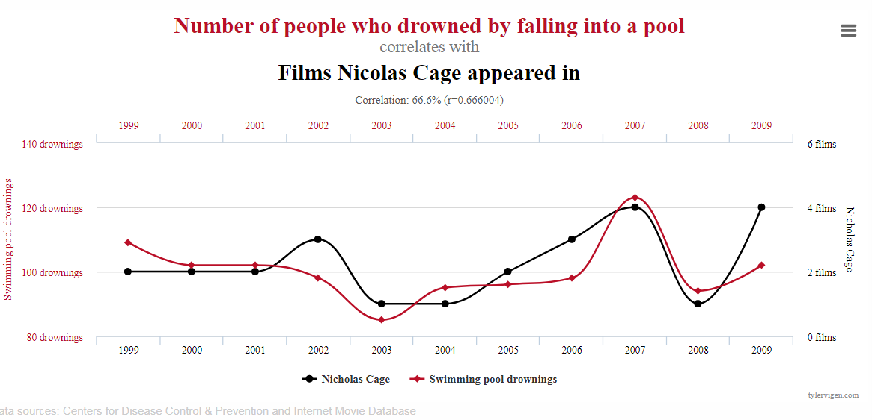
Correlation and causality
When analysing concurrent time series, it is generally of interest to understand the interactions between variables
Such interactions are often measured by correlation and causality as to give insights about the variables
But how are these defined?

Slide 6
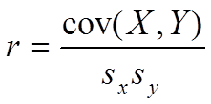
Correlation
Dictionary definition: “A mutual relationship or connection between two or more things”.
Correlation can be measured in many ways: Pearson’s coefficient, Kendall coefficient, mutual information and others
Pearson’s r

Slide 7
Correlation
Kendall’s Rank correlation
Mutual Information
If X_{i} < X_{j} and Y_{i} < Y_{j} → Concordant pair
If X_{i} < X_{j} and Y_{i} > Y_{j} → Discordant pair
Example:
Sample # | 1 | 2 | 3 | 4
X | 1 | 2 | 3 | 4
Y | 2 | 4 | 9 | 16

Slide 8
Causality
Diversity of definitions across fields of study, much broader concept
Causality usually implies a cause and effect, which means there is a specific “direction” on this relation
Humans have a good intuition of it even if it is generally hard to define

Slide 9
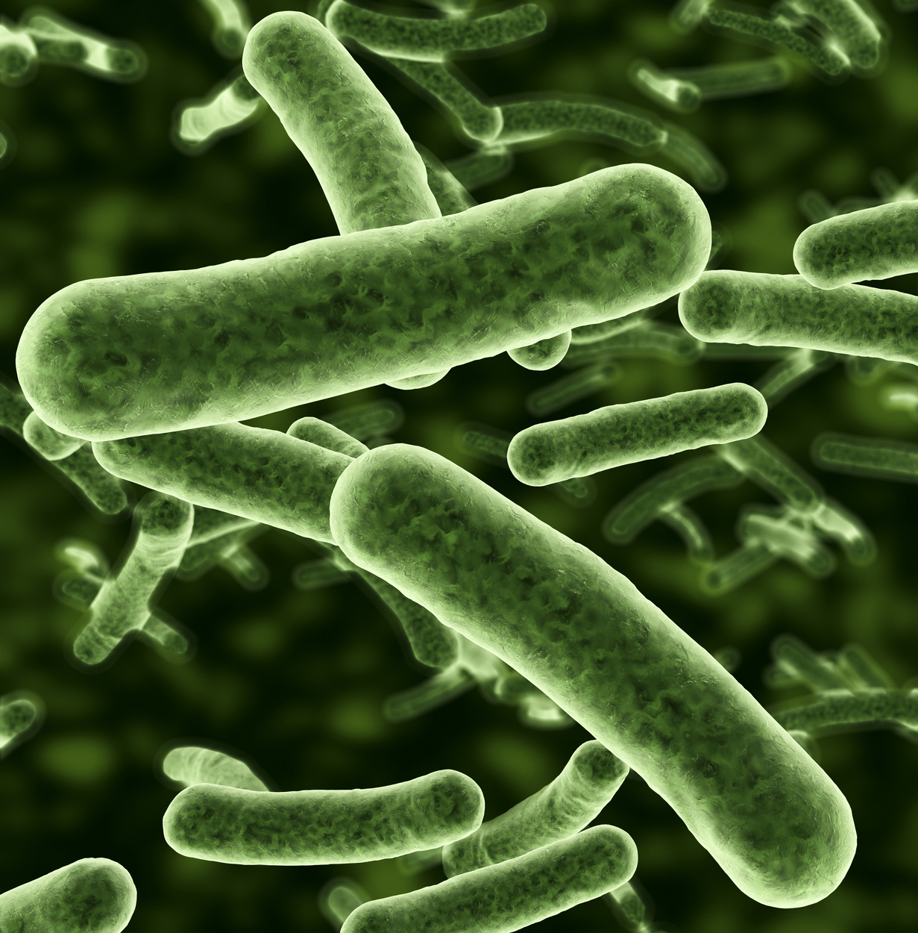
The experiment
-8 0 8
You will have to judge the efficacy of an antibiotic across 10 days.
Your task is to evaluate the causality between drug concentration (X) and microrganism size (Y), on a scale from 8 (high levels of drug cause the microrganism size to increase) and -8 (high levels of drug cause the microrganism size to decrease) and 0 equals to no causality between the two.

Slide 10
The experiment
Sample | x | y
1 | 15 | 16
2 | 12.5 | 20
3 | 27.5 | 7.5
4 | 23 | 48.3
5 | 54 | 27.6
6 | 17.5 | 58.8
7 | 84.5 | 40.3
8 | 40.5 | 83.7
9 | 93.8 | 71.4
10 | 72.5 | 116

Slide 11
The experiment

Slide 12
The Hypothesis
A static time-series is worse for the perception of causality as correlation becomes a confounding factor
A dynamic time-series, in opposition, makes it easier for people to perceive the causal relation between variables

Slide 13
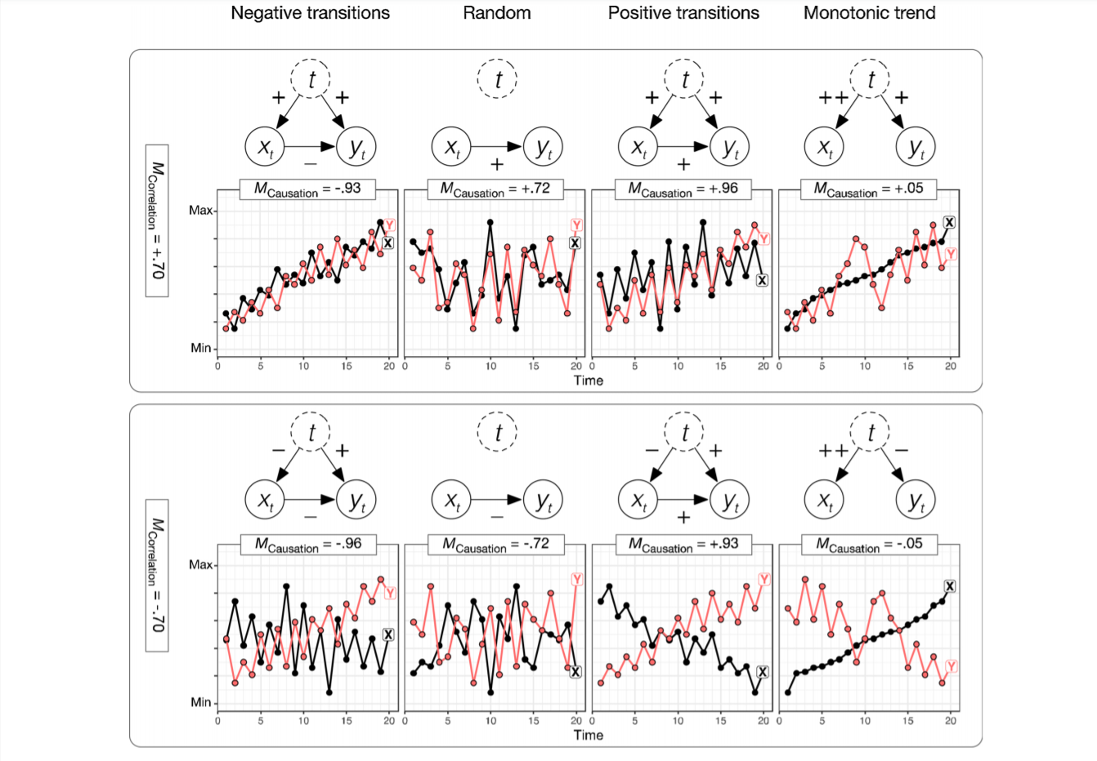
Correlation and Causality

Slide 14
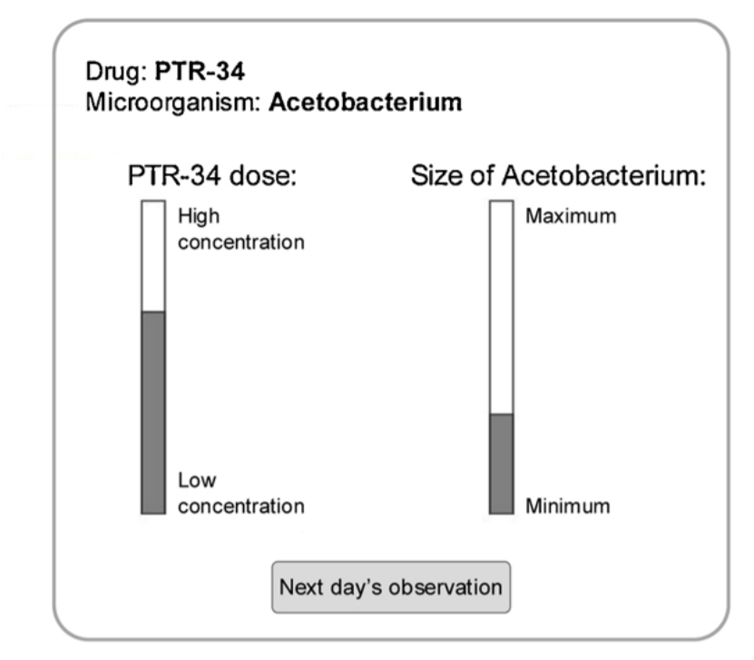
Previous Results
Soo and Rottman found out that on average people are often able to infer the correct causal relation despite the strong temporal trends in X and Y.
Method: trial-by-trial, changing size and opacity

Slide 15
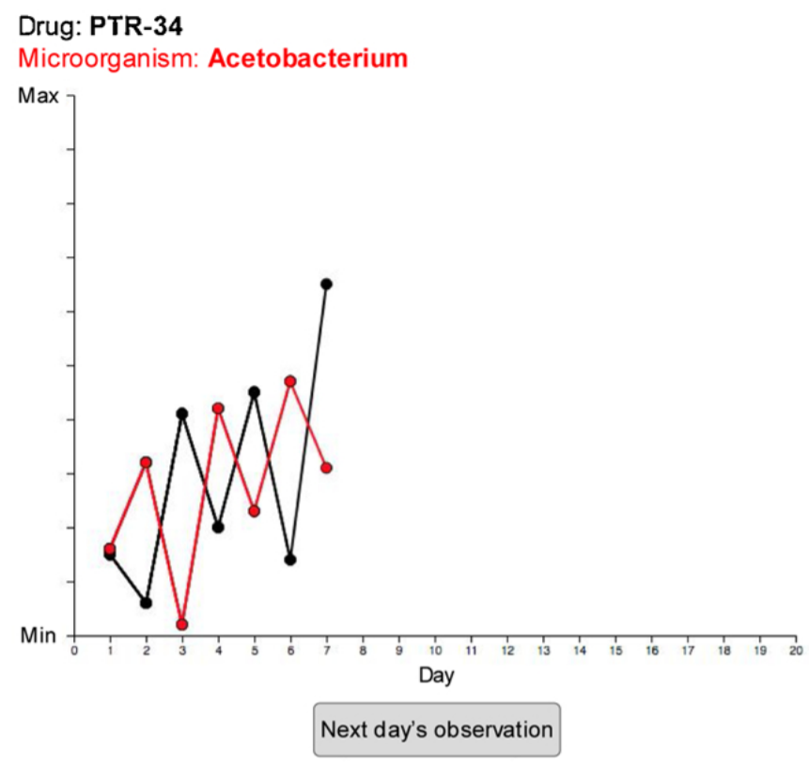
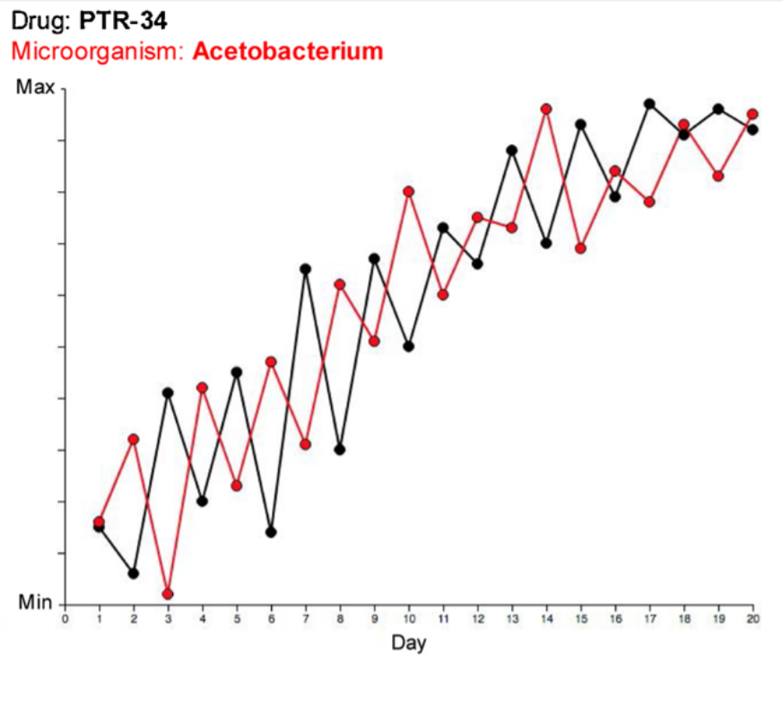
Methodology
2 groups of 151 and 152 each
-8 0 8
2 groups of 151 and 152 each
Dosage of a drug (X) -> size of a microorganism (Y)
20 observations for each dataset
Estimate the causal strength between 8 and -8
30 trials: 2 presentation format x 2 correlation x 5 causation

Slide 16
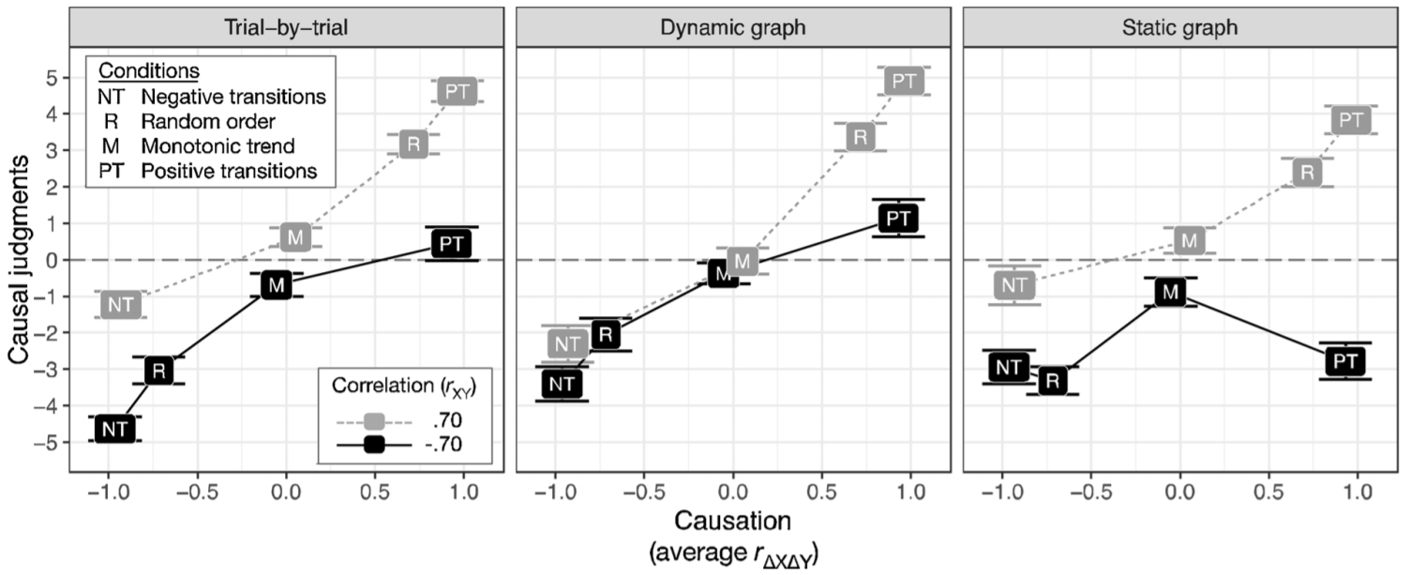
Results

Slide 17
Delayed effects time-series
Previous works on the field had shown that a delayed causality between the variables decreased subject's ability to recognize causality
More recent work has shown that this effect is diminished when the cover story presented to the subjects was one where delayed response would be expected
When subjects were asked to assess the delay between cause and consequence, the effects were further diminished

Slide 18
Beyond time-series

Slide 19
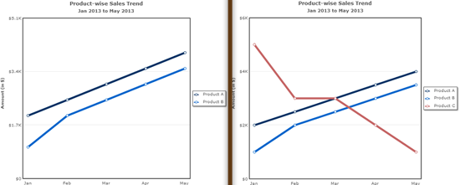
Beyond time-series: examples
Law of Common Fate

Slide 20
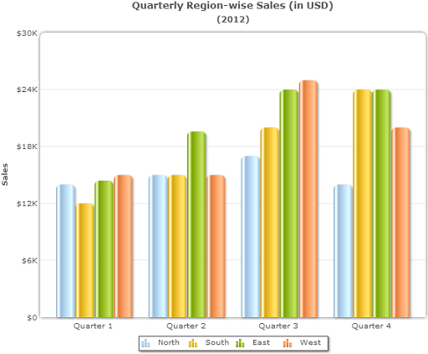
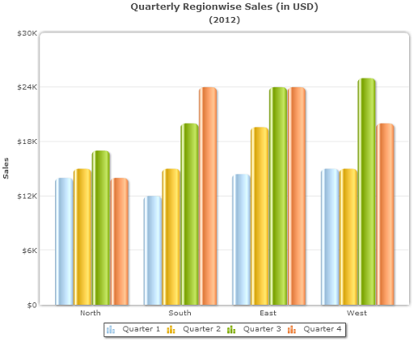
Beyond time-series: examples
Law of Proximity

Slide 21
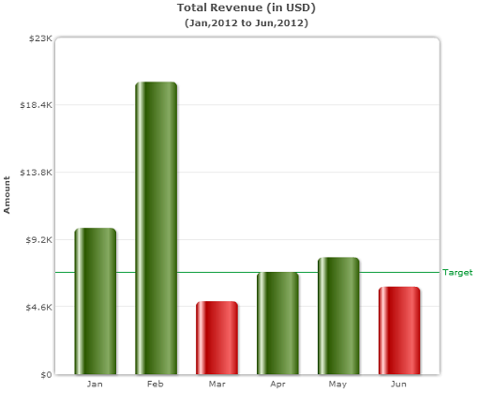
Beyond time-series: examples
Law of Isomorphic Correspondence

Slide 22
Beyond time-series: examples
Law of Pragnanz

Slide 23
Thank you!
nicolasvana@gmail.com
liang.shen@usp.br

