Slide 1
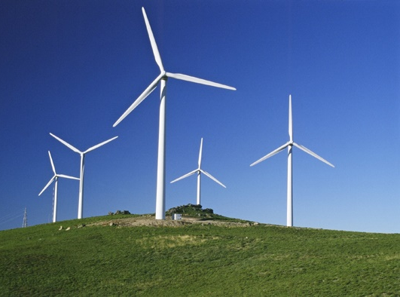
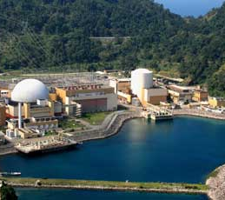
Energy Storage - Technologies and Applications
CHAPTER 1
COLETA E ARMAZENAMENTO
DE ENERGIA
Docente: André Luiz Veiga Gimenes
José Aquiles Baesso Grimoni

Slide 2
Techno-Economic Analysis of Different Energy Storage Technologies
Overall structure of electrical power system is in the process of changing. For incremental growth, it is moving away from fossil fuels - major source of energy in the world today – to renewable energy resources that are more environmentally friendly and sustainable [1]. Factors forcing these considerations are (a) the increasing demand for electric power by both developed and developing countries, (b) many developing countries lacking the resources to build power plants and distribution networks, (c) some industrialized countries facing insufficient power generation and (d) greenhouse gas emission and climate change concerns.

Slide 3
Nevertheless, exploitation of renewable energy sources (RESs), even when there is a good potential resource, may be problematic due to their variable and intermittent nature. In addition, wind fluctuations, lightning strikes, sudden change of a load, or the occurrence of a line fault can cause sudden momentary dips in system voltage [4]. Earlier studies have indicated that energy storage can compensate for the stochastic nature and sudden deficiencies of RESs for short periods without suffering loss of load events and without the need to start more generating plants.

Slide 4
Definition of electrical energy storage
Figure1 - Fundamental idea of the energy storage [55]

Slide 5
Role of energy storage systems
Figure 2 - New electricity value chain with energy storage as the sixth dimension [11]

Slide 6
Energy storage components
Every energy storage facility is comprised of three primary components [58]:
Storage Medium - The storage medium is the ‘energy reservoir’ that retains the potential energy within a storage device.
Power Conversion System (PCS) - It is necessary to convert from Alternating Current (AC) to Direct Current (DC) and vice versa, for all storage devices except mechanical storage devices e.g. PHES and CAES (Compressed Air Energy Storage) [59].
Balance of Plant (BOP) - These are all the devices that [58]: Are used to house the equipment, Control the environment of the storage facility e Provide the electrical connection between the PCS and the power grid.

Slide 7
Applications and technical benefits of energy storage systems
Figure 3 - Benefits of ESS along the electricity value chain [62]

Slide 8
Figure 4 - Energy storage applications into grid [32]

Slide 9
Generation
Commodity Storage
Contingency Service
Area Control
Grid Frequency Support
Black-Start
Transmission and distribution
System Stability
Grid Angular Stability
Grid Voltage Support
Asset Deferral

Slide 10
Energy service
Energy Management (Load Levelling / Peak Shaving)
Unbalanced Load Compensation
Power Quality improvement
Power Reliability

Slide 11
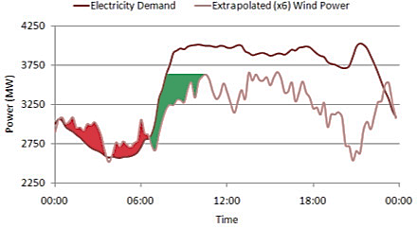
Supporting the integration of intermittent renewable energy sources
Figure 5 - Integration of extrapolated (x6) wind power using energy storage on the Irish electricity grid [58]

Slide 12
Decentralized electrical production from renewable energy sources yields a more assured supply for consumers with fewer environmental hazards. However, the unpredictable character of these sources requires that network provisioning and usage regulations be established for optimal system operation.
However, renewable energy resources have two problems. First, many of the potential power generation sites are located far from load centers.
The second problem is that the renewable resources fluctuate independently from demand.

Slide 13
Financial benefits of energy storage systems
Cost Reduction or Revenue Increase of Bulk Energy Arbitrage
Cost Avoid or Revenue Increase of Central Generation Capacity
Cost Avoid or Revenue Increase of Ancillary Services
Cost Avoid or Revenue Increase for Transmission Access/Congestion
Reduced Demand Charges
Reduced Reliability-related Financial Losses
Reduced Power Quality-related Financial Losses
Increased Revenue from Renewable Energy Sources

Slide 14
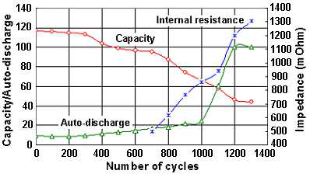
Techno-economic characteristics of energy storage systems
Storage capacity
Storage System Power
Storage ‘Emergency’ Power Capability
Figure 6 - Variation of energy capacity, self-discharge and internal resistance of a nickel-metal-hydride
battery with the number of cycles [71]

Slide 15
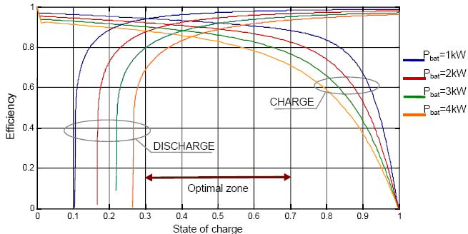
Autonomy
Energy and power density
Space requirements for energy storage
Efficiency
Figure 7 - Power efficiency of a 48V-310Ah (15 kWh/10 h discharge) lead accumulator [77]

Slide 16
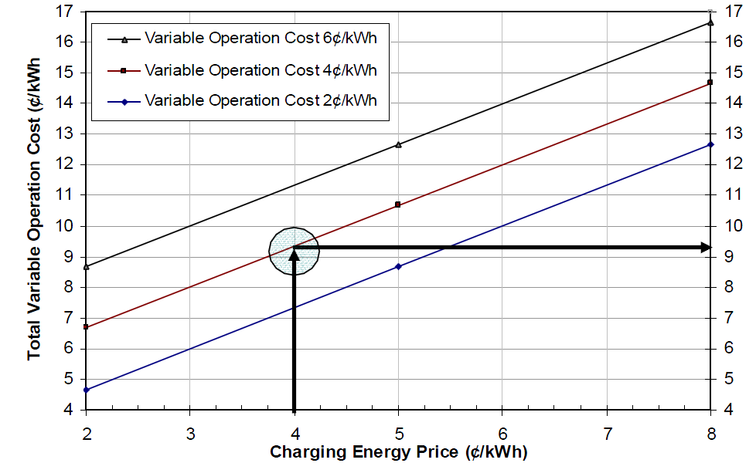
Storage operating cost
Figure 8 - Storage total variable operation cost for 75% storage efficiency [73]

Slide 17
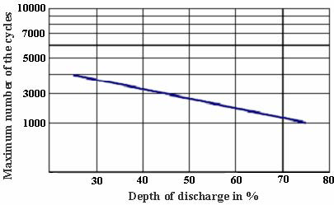
Durability
Reliability
Response time
Ramp rate
Figure 9 - Evolution of cycling capacity as a function of depth of discharge for a lead-acid battery [79]

Slide 18
Charge rate
Self-discharge and energy retention
Transportability
Power conditioning
Power quality
Modularity
Storage system reactive power capability
Monitoring, control and communications equipments
Interconnection
Operational constraints

Slide 19
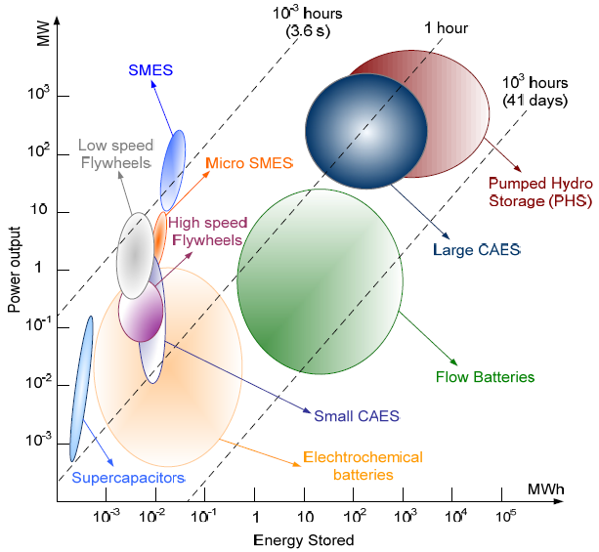
Feasibility and adaptation to the generating source
Figure 10 - Fields of application of the different storage techniques according to stored energy and
power output [80]

Slide 20
Environmental aspect
Decommissioning and disposal needs and cost
Other characteristics
The ease of maintenance, simple design, operational flexibility (this is an important characteristic for the utility), fast response time for the release of stored energy, etc.
Finally, it is important to note that these characteristics apply to the overall storage system: storage units and power converters alike [74].

Slide 21
Classification of energy storage systems
Figure 11 - Energy storage classification with respect to function [69].

Slide 22
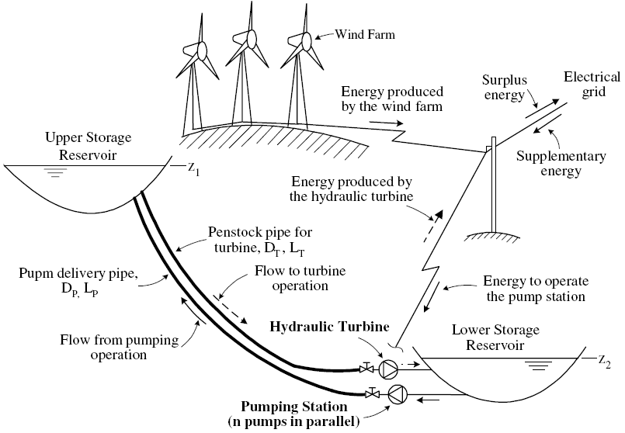
Description of energy storage technologies
Pumped hydro storage (PHS)
Figure 12 - Wind-Pumped hydro energy storage hybrid system [69].

Slide 23
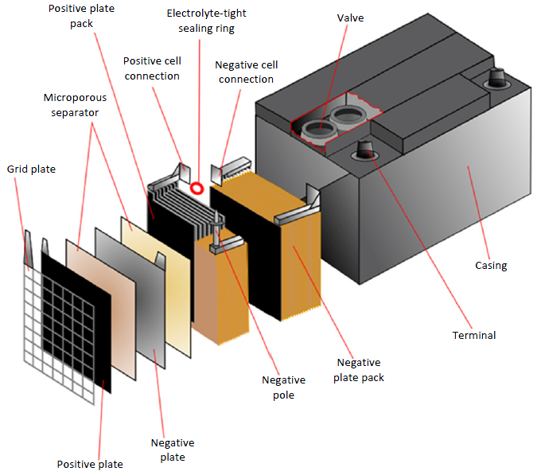
Batteries energy storage
Figure 13 - Structure of a lead‐acid battery [86]

Slide 24
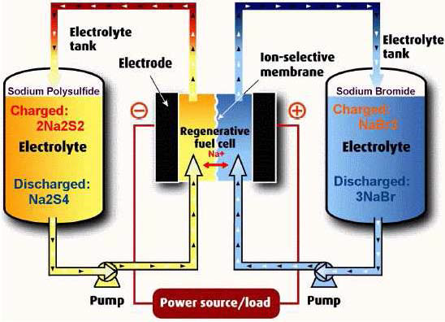
Flow batteries energy storage (FBES)
Figure 14 - Illustration of a flow-battery

Slide 25
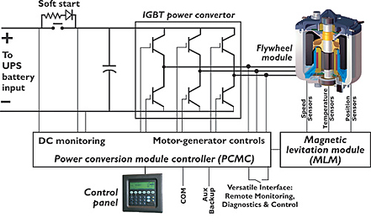
Flywheel energy storage (FES)
Figure 15 - Flywheel energy accumulators [89]

Slide 26
Supercapacitors energy storage (SES)
Supercapacitors are the latest innovational devices in the field of electrical energy storage. In comparison with a battery or a traditional capacitor, the supercapacitor allows a much powerful power and energy density [15].
Supercapacitors are electrochemical double layer capacitors that store energy as electric charge between two plates, metal or conductive, separated by a dielectric, when a voltage differential is applied across the plates. As like battery systems, capacitors work in direct current.

Slide 27
Superconducting magnetic energy storage (SMES)
An emerging technology, systems store energy in the magnetic field created by the flow of direct current in a coil of cryogenically cooled, superconducting material. Due to their construction, they have a high operating cost and are therefore best suited to provide constant, deep discharges and constant activity. The fast response time (under 100 ms) of these systems makes them ideal for regulating network stability (load levelling). Power is available almost instantaneously and very high power output can be provided for a brief period of time [20-21].

Slide 28
Fuel cells-Hydrogen energy storage (HES)
Fuel cells are a means of restoring spent energy to produce hydrogen through water electrolysis. The storage system proposed includes three key components: electrolysis which consumes off-peak electricity to produce hydrogen, the fuel cell which uses that hydrogen and oxygen from air to generate peak-hour electricity, and a hydrogen buffer tank to ensure adequate resources in periods of need.
Fuel cells can be used in decentralized production, spontaneous supply related or not to the network, mid-power cogeneration (a few hundred kW), and centralized electricity production without heat upgrading.

Slide 29
Thermal energy storage (TES)
Thermal energy storage (TES) already exists in a wide spectrum of applications. It uses materials that can be kept at high/low temperatures in insulated containments. Heat/cold recovered can then be applied for electricity generation using heat engine cycles.

Slide 30
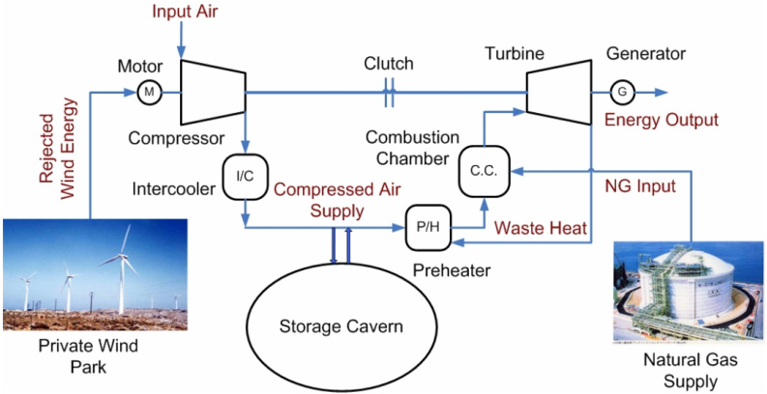
Compressed Air Energy Storage (CAES)
Figure 16 - Illustration of compressed-air energy storage

Slide 31
Assessment and comparison of the energy storage technologies
Technical maturity
Mature technologies: PHS and lead-acid battery are mature and have been used for over 100 years.
Developed technologies: CAES, NiCd, NaS, ZEBRA Li-ion, Flow Batteries, SMES, flywheel, capacitor, supercapacitor, Al-TES (Aquiferous low- temperature – Thermal energy storage) and HT-TES (High temperature – Thermal energy storage) are developed technologies.
Developing technologies: Fuel cell, Meta-Air battery, Solar Fuel and CES (Cryogenic Energy Storage) are still under development

Slide 32
Figure 17 - Technical maturity of EES systems [69]

Slide 33
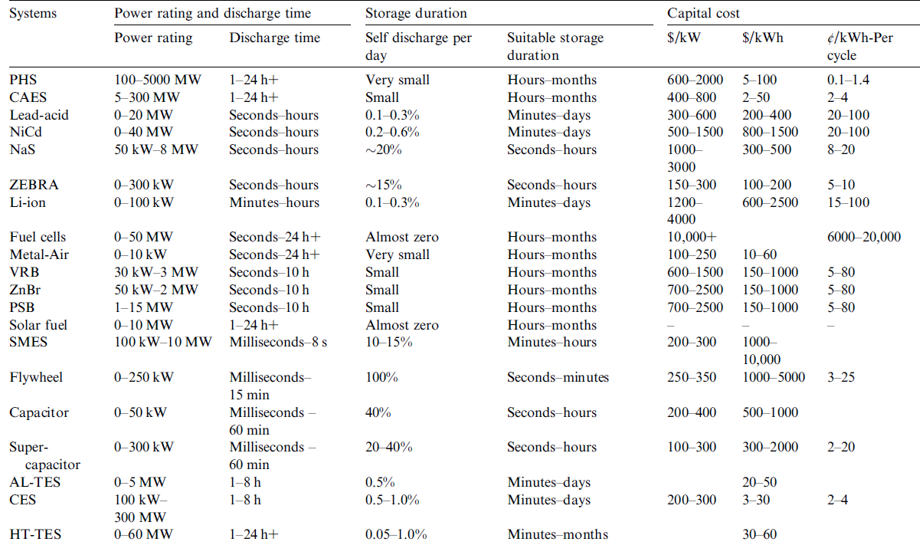
Power rating and discharge time
Table 1. Comparison of technical characteristics of EES systems [69]

Slide 34
Storage duration
Table 1 also illustrates the self-discharge (energy dissipation) per day for EES systems. One can see that PHS, CAES, Fuel Cells, Metal-Air Cells, solar fuels and flow batteries have a very small self-discharge ratio so are suitable for a long storage period. Lead-Acid, NiCd, Liion, TESs and CES have a medium self-discharge ratio and are suitable for a storage period not longer than tens of days [69].
NaS, ZEBRA, SMES, capacitor and supercapacitor have a very high self-charge ratio of 10–40% per day. They can only be implemented for short cyclic periods of a maximum of several hours.

Slide 35
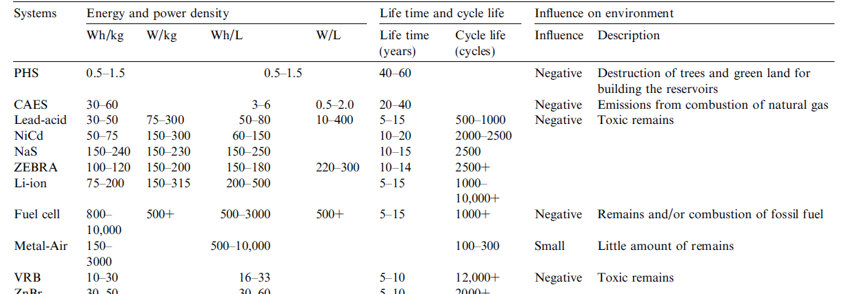
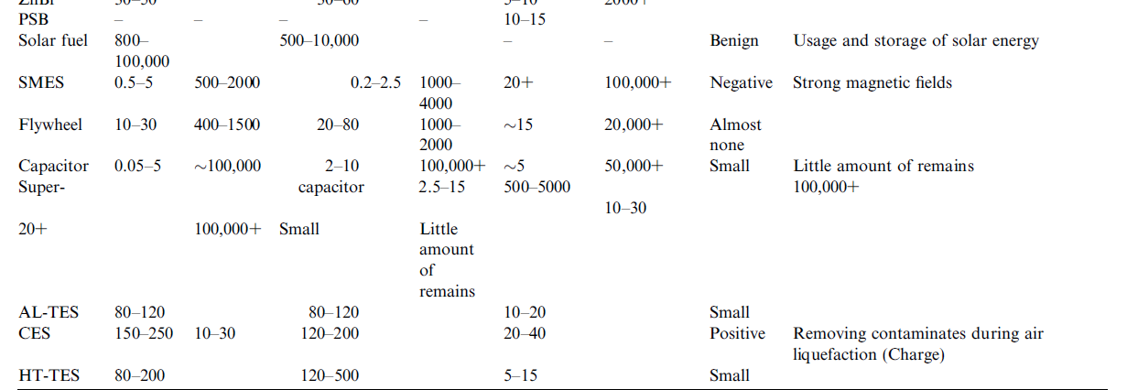
Capital cost
Table 2. Comparison of technical characteristics of EES systems [69]

Slide 36
Cycle efficiency
One can see that the EES systems can be broadly divided into three groups:
Very high efficiency: SMES, flywheel, supercapacity and Li-ion battery have a very high efficiency of > 90%.
High efficiency: PHS, CAES, batteries (except for Li-ion), flow batteries and conventional capacitor have a cycle efficiency of 60–90%.
Low efficiency: Hydrogen, DMFC, Metal-Air, solar fuel, TESs and CES have an efficiency lower than ~60% mainly due to large losses during the conversion from the commercial AC side to the storage system side.

Slide 37
Energy and power density
Figure 18 - Cycle efficiency of EES systems. [69]

Slide 38
Life time and cycle life
Also compared in Table 1 are life time and/or cycle life for various EESs. It can be seen that the cycle lives of EES systems whose principles are largely based on the electrical technologies are very long normally greater than 20,000. Examples include SMES, capacitor and supercapacitor. Mechanical and thermal energy storage systems, including PHS, CAES, flywheel, AL-TES, CES and HT-TES, also have long cycle lives.
These technologies are based on conventional mechanical engineering, and the life time is mainly determined by the life time of the mechanical components. The cycle abilities of batteries, flow batteries, and fuel cells are not as high as other systems due to chemical deterioration with the operating time

Slide 39
Conclusion
There is obviously a cost associated to storing energy, but we have seen that, in many cases, storage is already cost effective. More and more application possibilities will emerge as further research and development is made in the field [91].
Coupled with local renewable energy generation, decentralized storage could also improve power network sturdiness through a network of energy farms supplying a specific demand zone.
Each EES system has a suitable application range. PHS, CAES, large-scale batteries, flow batteries, fuel cells, solar fuels, TES and CES are suitable for energy management application; flywheels, batteries, capacitors and supercapacitors are more suitable for power quality and short duration UPS, whereas batteries, flow batteries, fuel cells and Metal-Air cells are promising for the bridging power.

Slide 40
Conclusion
PHS and Lead-Acid battery are technically mature; CAES, NiCd, NaS, ZEBRA Li-ion, flow battery, SMES, flywheel, capacitor, Supercapacitor, AL-TES and HT-TES are technically developed and commercially available; Fuel Cell, Meta-Air battery, Solar Fuel and CES are under development.
The cycle efficiencies of SMES, flywheel, capacitor/supercapacitor, PHS, CAES, batteries, flow batteries are high with the cycle efficiency above 60%. Fuel Cell, DMFC, Metal-Air, solar fuel, TES and CES have a low efficiency mainly due to large losses during the conversion from commercial AC to the storage energy form.

Slide 41
Conclusion
The cycle abilities of batteries, flow batteries, and fuel cells are not as high as other systems due to chemical deterioration with the operating time. Metal-Air battery has the lowest life time at least currently.
PHS, CAES, batteries, flow batteries, fuel cells and SMES are considered to have some negative effects on the environment due to one or more of the following: fossil combustion, strong magnetic field, landscape damage, and toxic remains. Solar fuels and CES are more environmentally friendly. However, a full life-cycle analysis should be done before a firm conclusion can be drawn.

Slide 42
Conclusion
The development of storage techniques requires the improvement and optimization of power electronics, often used in the transformation of electricity into storable energy, and vice versa.
The rate of penetration of renewable energy will require studies on the influence of the different storage options, especially those decentralized, on network sturdiness and overall infrastructure and energy production costs.
It is important to assess the national interest for compressed gas storage techniques.
Investment in research and development on the possibility of combining several storage methods with a renewable energy source will lead to the optimization of the overall efficiency of the system and the reduction of greenhouse gases created by conventional gas-burning power plants.

Slide 43
Conclusion
The development of supercapacitors will lead to their integration into the different types of usage.
The development of low-cost, long-life flywheel storage systems will lead to increased potential, particularly for decentralized applications.
To increase the rate of penetration and use of hydrogen-electrolysor fuel-cell storage systems, a concerted R&D effort will have to be made in this field.

Slide 44
References
[1] Smith, S.C.; Sen, P.K.; Kroposki, B., Advancement of Energy Storage Devices and Applications in Electrical Power System. Power and Energy Society General Meeting - Conversion and Delivery of Electrical Energy in the 21st Century, 22-24 2008
[2] P.C. Ghosh , B. Emonts, H. Janßen, J. Mergel, D. Stolten. “Ten years of operational experience with a hydrogen-based renewable energy supply system”, Solar Energy 75, 2003, pp. 469–478
[3] A. Bilodeau, K. Agbossou. Control analysis of renewable energy system with hydrogen storage for residential applications, Journal of Power Sources, 2005.
[4] N.Hamsic, A.Schmelter, A.Mohd, E.Ortjohann, E.Schultze, A.Tuckey, J.Zimmermann. “Stabilising the Grid Voltage and Frequency in Isolated Power Systems Using a Flywheel Energy Storage System,” The Great Wall World Renewable Energy Forum , Beijing, China, October 2006
[5] E.Ortjohann, N.Hamsic , A.Schmelter , A.Mohd, J.Zimmermann, A.Tuckey, E.Schultze. Increasing Renewable Energy Penetration in Isolated Grids Using a Flywheel Energy Storage System, the first International Conference on Power Engineering, Energy and Electrical Drives (POWERENG,IEEE),Portugal, April 2007.
[6] European Renewable Energy Council, “Renewable energy in Europe: building Markets and capacity,” James and James science publishers, August 2004.
[7] “FP7 Research Priorities for the Renewable Energy Sector”, Bruxelles, EUREC Agency, March 2005.
[8] Melissa M, “Flywheel Energy Storage System: The current status and future prospect,” Trinity Power Corporation, February 2004, pp.8-11.
[9] A.Ruddell, G.Schönnenbeck, R.Jones, “Flywheel Energy Storage Systems,” Rutherford Appleton Lab, UK.
[10] H.Bindner, “Power Control for Wind Turbines in Weak Grids,” Risø National Lab, March 1999.
[11] Alaa Mohd, Egon Ortjohann, Andreas Schmelter, Nedzad Hamsic, Danny Morton. Challenges in integrating distributed Energy storage systems into future smart grid. IEEE International Symposium on Industrial Electronics, June 30 - July 2, 2008.

Slide 45
References
[12] James A. McDowall, “Status and Outlook of the Energy Storage Market,” PES 2007, Tampa, July 2007.
[13] Baker JN, Collinson A. Electrical energy storage at the turn of the millennium. Power Eng J 1999;6:107–12.
[14] Dti Report. Status of electrical energy storage systems. DG/DTI/00050/00/00, URN NUMBER 04/1878, UK Department of Trade and Industry; 2004, p. 1–24.
[15] Australian Greenhouse Office. Advanced electricity storage technologies programme. ISBN: 1 921120 37 1, Australian Greenhouse Office; 2005, p. 1–35.
[16] Ahearne J. Storage of electric energy, Report on research and development of energy technologies. International Union of Pure and Applied Physics; 2004, p. 76–86. Available online http://www.iupap.org/wg/energy/report-a.pdf
[17] http://www.en.wikipeida.org/wiki/Hydroelectric_energy_storage
[18] Linden S. The commercial world of energy storage: a review of operating facilities (under construction or planned). In: Proceeding of 1st annual conference of the energy storage council, Houston, Texas, March 3, 2003.
[19] Walawalkar R, Apt J, Mancini R. Economics of electric energy storage for energy arbitrage and regulation. Energy Policy 2007;5:2558–68.
[20] Dti Report. Review of electrical energy storage technologies and systems and of their potential for the UK. DG/DTI/00055/00/00, URN NUMBER 04/1876, UK Department of Trade and Industry; 2004, p. 1–34.
[21] Bueno C, Carta JA. Wind powered pumped hydro storage systems, a means of increasing the penetration of renewable energy in the Canary Islands. Renew Sus Energy Rev 2006;10:312–40.
[22] Najjar Y, Zaamout MS. Performance analysis of compressed air energy storage (CAES) plant for dry regions. Energy Convers Manage 1998;39:1503–11.
[23] Sears JR. TEX: The next generation of energy storage technology. Telecommunications Energy Conference, INTELEC 2004. In: 26th annual international volume, Issue, Sept. 19–23 2004; p. 218–22.

Slide 46
References
[24] Najjar Y, Jubeh N. Comparison of performance of compressed-air energy-storage plant with compressed-air storage with humidification. In: Proceeding of IMechE, Part A: Journal of Power and Energy 2006; 220:581–8.
[25] Bullough C, Gatzen C, Jakiel C, et al. Advanced adiabatic compressed air energy storage for the integration of wind energy. In: Proceedings of the European wind energy conference. London, UK, 2004.
[26] Wang S, Chen G, Fang M, et al. A new compressed air energy storage refrigeration system. Energ Convers Manage 2006;47:3408–16.
[27] Cook GM, Spindler WC, Grefe G. Overview of battery power regulation and storage. IEEE T Energy Conver 1991;6:204–11.
[28] Chalk SG, Miller JF. Key challenges and recent progress in batteries, fuel cells and hydrogen storage for clean energy systems. J Power Sources 2006;159:73–80.
[29] Kashem MA, Ledwich G. Energy requirement for distributed energy resources with battery energy storage for voltage support in threephase distribution lines. Electr Pow Syst Res 2007;77:10–23.
[30] Kluiters EC, Schmal D, Ter Veen WR, et al. Testing of a sodium/ nickel chloride (ZEBRA) battery for electric propulsion of ships and vehicles. J Power Sources 1999;80:261–4.
[31] Karpinski AP, Makovetski B, Russell SJ, et al. Silver-zinc: status of technology and applications. J Power Sources 1999;80:53–60.
[32] Linden S. Bulk energy storage potential in the USA, current developments and future prospects. Energy 2006; 31:3446–57.
[33] Chalk SG, Miller JF. Key challenges and recent progress in batteries, fuel cells and hydrogen storage for clean energy systems. J Power Sources 2006;159:73–80.

Slide 47
References
[34] Weinmann O. Hydrogen-the flexible storage for electrical energy. Power Eng J-Special Feature: Electrical energy storage 1999:164–70.
[35] Steinfeld A, Meier A. Solar thermochemical process technology. In: Encycl Energy. Elsevier Inc; 2004, 5: 623-37.
[36] Kolkert WJ, Jamet F. Electric energy gun technology: status of the French–German–Netherlands programme. IEEE T Magn 1999; 35:25–30.
[37] Koshizuka N, Ishikawa F, Nasu H. Progress of superconducting bearing technologies for flywheel energy storage systems. Physica C 2003;386:444–50.
[38] Xue X, Cheng K, Sutanto D. A study of the status and future of superconducting magnetic energy storage in power systems. Supercond Sci Tech 2006;19:39.
[39] Kondoh J, Ishii I, Yamaguchi H, et al. Electrical energy storage systems for energy networks. Energ Convers Manage 2000;41:1863–74
[40] Suzuki Y, Koyanagi A, Kobayashi M. Novel applications of the flywheel energy storage system. Energy 2005; 30:2128–43.
[41] http://www.beaconpower.com/products/EnergyStorageSystems/flywheels.htm
[42] Rosen MA. Second-law analysis of aquifer thermal energy storage systems. Energy 1999; 24:167–82.
[43] Ameri M, Hejazi SH, Montaser K. Performance and economics of the thermal energy storage systems to enhance the peaking capacity of the gas turbines. Appl Therm Eng2005; 25:241–51.
[44] Akbari H, Sezgen O. Performance evaluation of thermal energy storage systems. Energ Buildings 1995; 22:15–24.

Slide 48
References
[45] Ordonez CA, Plummer MC. Cold thermal storage and cryogenic heat engines for energy storage applications. Energy Sources 1997; 19(4):389–96.
[46] Kessling W, Laevemann E, Peltzer M. Energy storage in open cycle liquid desiccant cooling systems. Int J Refrig 1998; 21(2):150–6.
[47] Kishimoto K, Hasegawa K, Asano T. Development of generator of liquid air storage energy system. Mitsubishi Heavy Industries, Ltd. Technical Review, 1998; 35(3):117–20.
[48] Chen HS, Ding YL. A cryogenic energy system using liquid/slush air as the energy carrier and waste heat and waste cold to maximise efficiency, specifically it does not use combustion in the expansion process. UK Patent G042226PT, 2006-02-27.
[49] Wen DS, Chen HS, Ding YL, et al. Liquid nitrogen injection into water: pressure buildup and heat transfer. Cryogenics 2006; 46: 740–8.
[50] Chen HS, Ding YL, Toby P, et al. A method of storing energy and a cryogenic energy storage system. International Patent WO/2007/ 096656, 2007-08-30.
[51] Mclarnon FR, Cairns EJ. Energy storage. Ann Rev Energy 1989;14:241–71.
[52] Dobie WC. Electrical energy storage. Power Eng J 1998; 12:177–81.
[53] Koot M, Kessels J, Jager B, et al. Energy management strategies for vehicular electric power systems. IEEE T Veh Technol 2005; 54:771–82.
[54] Weinstock IB. Recent advances in the US Department of Energy’s energy storage technology research and development programs for hybrid electric and electric vehicles. J Power Sources 2002; 110:471–4.
[55] Energy Storage Association, www.electricitystorage.org

Slide 49
References
[56] Ibrahim H., A. Ilinca, R. Younès, J. Perron, T. Basbous, "Study of a Hybrid Wind-Diesel System with Compressed Air Energy Storage", IEEE Canada, EPC2007, Montreal, Canada, October 25-26, 2007.
[57] H. Ibrahim, A. Ilinca, J. Perron, "Solutions actuelles pour une meilleure gestion et intégration de la ressource éolienne". CSME/SCGM Forum 2008 at Ottawa. The Canadian Society for Mechanical Engineering, 5-8 Juin 2008
[58] David Connolly. A Review of Energy Storage Technologies For the integration of fluctuating renewable energy. Ph.D. project, University of Limerick, October 2010.
[59] Baxter, R., Energy Storage ‐ A Nontechnical Guide, PennWell Corporation, Oklahoma, 2006.
[60] Energy Storage Systems, Sandia National Laboratories, 14th October 2007,
[61] Gonzalez, A., Ó'Gallachóir, B., McKeogh, E. & Lynch, K. Study of Electricity Storage Technologies and Their Potential to Address Wind Energy Intermittency in Ireland. Sustainable Energy Ireland, 2004.
[62] Makansi J, Abboud J. Energy storage: the missing link in the electricity value chain-An ESC White Paper. Energy storage Council 2002; p. 1-23.
[63] Moore T, Douglas J. Energy storage, big opportunities on a smaller scale. EPRI J 2006; Spring Issue, p. 16–23.
[64] Mears D. EPRI-DOE storage handbook-storage for wind resources. In: Annual peer review meeting of DOE energy storage systems research. Washington DC, USA, Nov.10–11, 2004, p. 1–18.
[65] Ribeiro PF, Johson BK, Crow ML, et al. Energy storage systems for advanced power applications. In: Proceedings of the IEEE 2001;89:1744–56.
[66] Ratering-Schnitzler B, Harke R, Schroeder M, et al. Voltage quality and reliability from electrical energy-storage systems. J Power Sources 1997;67:173–7.

Slide 50
References
[56] Ibrahim H., A. Ilinca, R. Younès, J. Perron, T. Basbous, "Study of a Hybrid Wind-Diesel System with
[67] Y. Rebours, D. Kirschen. ”What is spinning reserve?”, The University of Manchester , Sept 2005.
[68] Market Analysis of Emerging Electric Energy Storage Systems. National Energy Technology Laboratory. DOE/NETL-2008/1330. July 31, 2008
[69] Haisheng Chen, Thang Ngoc Cong, Wei Yang, Chunqing Tan, Yongliang Li, Yulong Ding. Progress in electrical energy storage system: A critical review. Progress in Natural Science. July 2008.
[70] James M. Eyer, Joseph J. Iannucci, Garth P. Corey. “Energy Storage Benefits and Market Analysis Handbook, “Sandia National Laboratories REPORT, SAND2004-6177, December 2004.
[71] http://www.buchmann.ca
[72] Mears, D. Gotschall, H. EPRI-DOE Handbook of Energy Storage for Transmission and Distribution Applications. Electric Power Research Institute Report #1001834. December 2003.
[73] Jim Eyer, Garth Corey. Energy Storage for the Electricity Grid: Benefits and Market Potential Assessment Guide. SANDIA REPORT SAND2010-0815, February 2010.
[74] H. Ibrahim, A. Ilinca, J. Perron, Energy storage systems—Characteristics and comparisons, Renewable and Sustainable Energy Reviews, Volume 12, Issue 5, June 2008, Pages 1221–1250.
[75] Robin G, Rullan M, Multon B, Ben Ahmaed H, Glorennec PY. Solutions de stockage de l’énergie pour les systèmes de production intermittente d’électricité renouvelable. 2004.
[76] Shoenung, Dr. Susan M. Hassenzahl, William M. Long - versus Short-Term Energy Storage Technologies Analysis, A Lifecycle Cost Study. Sandia National Laboratories, Energy Storage Program, Office of Electric Transmission and Distribution, U.S. Department of Energy. Sandia National Laboratories Report #SAND2003-2783. August 2003

Slide 51
References
[77] Gergaud O. Modélisation énergétique et optimisation économique d’un système de production éolien et photovoltaïque couplé au réseau et associé à un accumulateur. Thèse de l’ENS de Cachan;décembre 2002.
[78] Mémoire concernant la contribution possible de la production éolienne en réponse à l’accroissement de la demande québecoise d’électricité d’ici 2010. Régie de l’énergie, Québec, Canada. Dossier R-3526;Avril 2004.
[79] R. Messenger R, Ventre J. Photovoltaic systems engineering. CRC Press, 1999.
[80] Emerging Energy Storage Technologies in Europe. Rapport Frost & Sullivan; 2003.
[81] Bonneville JM. Stockage cinétique. Institut de Recherche de l’Hydro-Québec, Varennes, Québec, Canada. Rapport interne; février 1975.
[82] IEEE 1547 Standard for Interconnecting Distributed Resources with Electric Power Systems. Approved by the IEEE Standards Board in June 2003. Approved as an American National Standard in October 2003.
[83] Faure F. Suspension magnétique pour volant d’inertie. Thèse de doctorat. Institut National Polytechnique de Grenoble,France;Juin 2003.
[84] Alaa Mohd, Egon Ortjohann, Andreas Schmelter, Nedzad Hamsic, Danny Morton. Challenges in integrating distributed Energy storage systems into future smart grid. IEEE International Symposium on Industrial Electronics, June 30 - July 2, 2008.
[85] Rudell A. Storage and Fuel Cells. EPSRC SuperGen Workshop : Future Technologies for a Sustainable Electricity System. Univ. of Cambridge, 7 november2003.
[86] Lead/acid batteries, University of Cambridge, 15th October 2007, http://www.doitpoms.ac.uk/tlplib/batteries/batteries_lead_acid.php

Slide 52
References
[87] Sergio Vazquez, Srdjan M. Lukic, Eduardo Galvan, Leopoldo G. Franquelo, Juan M. Carrasco, Energy Storage Systems for Transport and Grid Applications, IEEE TRANSACTIONS ON INDUSTRIAL ELECTRONICS, VOL. 57, NO. 12, DECEMBER 2010, Pages. 3881-3895.
[88] www.cea.fr
[89] http://www.power-thru.com/flywheel_detail.html
[90] Anzano JP, Jaud P, Madet D. Stockage de l'électricité dans le système de production électrique. Techniques de l'ingénieur, traité de Génie Électrique D4030; 1989.
[91] Multon B, Ruer J. Stocker l’électricité : Oui, c’est indispensable, et c’est possible! pourquoi, où, comment?. Publication ECRIN en contribution au débat national sur l’énergie; Avril 2003.
[92] Robyns B. Contribution du stockage de l’énergie électrique à la participation au services système des éoliennes. Séminaire SRBE – SEE – L2EP « Éolien et réseaux : enjeux », 22 mars 2005.
[93] Multon B. L’énergie électrique : analyse des ressources et de la production. Journées section électrotechnique du club EEA. Paris, France, 28-29 janvier 1999, p. 8.

