Slide 1
Tutorial on Semantic Web
Ivan Herman, W3C
Last update: 2012-04-09
Notes:
This is just a generic slide set. Should be adapted, reviewed, possibly with slides removed, for a specific event. Rule of thumb: on the average, a slide is a minute…

Slide 2
One level higher up: RDFS, Datatypes
Nexus Simulation Credit Erich Bremmer

Slide 3
Need for RDF schemas
First step towards the “extra knowledge”:
define the terms we can use
what restrictions apply
what extra relationships are there?
Officially: “RDF Vocabulary Description Language”
the term “Schema” is retained for historical reasons…

Slide 4
Classes, resources, …
Think of well known traditional vocabularies:
use the term “novel”
“every novel is a fiction”
“«The Glass Palace» is a novel”
etc.
RDFS defines resources and classes:
everything in RDF is a “resource”
“classes” are also resources, but…
…they are also a collection of possible resources (i.e., “individuals”)
“fiction”, “novel”, …

Slide 5
Classes, resources, … (cont.)
Relationships are defined among resources:
“typing”: an individual belongs to a specific class
“«The Glass Palace» is a novel”
to be more precise: “«http://.../000651409X» is a novel”
“subclassing”: all instances of one are also the instances of the other (“every novel is a fiction”)
RDFS formalizes these notions in RDF

Slide 6
Classes, resources in RDF(S)
rdfs:Class
rdf:type
http://…isbn/000651409X
rdf:type
#Novel
RDFS defines the meaning of these terms
(these are all special URI-s, we just use the namespace abbreviation)

Slide 7
Schema example in RDF/XML
The schema part:
<rdf:Description rdf:ID="Novel">
<rdf:type rdf:resource="http://www.w3.org/…/rdf-schema#Class"/>
</rdf:Description>
The RDF data on a specific novel:
<rdf:Description rdf:about="http://…/isbn/000651409X">
<rdf:type rdf:resource="http://…/bookSchema.rdf#Novel"/>
</rdf:Description>

Slide 8
An aside: typed nodes in RDF/XML
A frequent simplification rule: instead of
<rdf:Description rdf:about="http://...">
<rdf:type rdf:resource="http://..../something#ClassName">
...
</rdf:Description>
use:
<yourNameSpace:ClassName rdf:about="http://...">
...
</yourNameSpace:ClassName>
ie:
<a:Novel rdf:about="http://…/isbn/000651409X">
...
</a:Novel>

Slide 9
Further remarks on types
A resource may belong to several classes
rdf:type is just a property…
“«The Glass Palace» is a novel, but «The Glass Palace» is also an «inventory item»…”
i.e., it is not like a datatype!
The type information may be very important for applications
e.g., it may be used for a categorization of possible nodes
probably the most frequently used RDF property…
(remember the “Person” in our example?)

Slide 10
Inferred properties
#Fiction
rdf:type
rdf:subClassOf
http://…isbn/000651409X
rdf:type
#Novel
(<http://…/isbn/000651409X> rdf:type #Fiction)
is not in the original RDF data…
…but can be inferred from the RDFS rules
RDFS environments return that triple, too

Slide 11
Inference: let us be formal…
The RDF Semantics document has a list of (33) entailment rules:
“if such and such triples are in the graph, add this and this”
do that recursively until the graph does not change
The relevant rule for our example:
If:
uuu rdfs:subClassOf xxx .
vvv rdf:type uuu .
Then add:
vvv rdf:type xxx .

Slide 12
Properties
Property is a special class (rdf:Property)
properties are also resources identified by URI-s
There is also a possibility for a “sub-property”
all resources bound by the “sub” are also bound by the other
Range and domain of properties can be specified
i.e., what type of resources serve as object and subject

Slide 13
Properties (cont.)
Properties are also resources (named via URI–s)…
So properties of properties can be expressed as… RDF properties
this twists your mind a bit, but you can get used to it
For example, (P rdfs:domain C) means:
P is a property
C is a class
when using P, I can infer that the “subject” is of type C

Slide 14
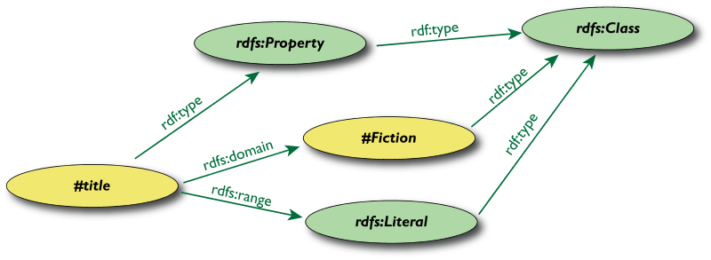
Property specification example

Slide 15
Property specification serialized
In RDF/XML:
<rdf:Property rdf:ID="title">
<rdfs:domain rdf:resource="#Fiction"/>
<rdfs:range rdf:resource="http://...#Literal"/>
</rdf:Property>
In Turtle:
:title
rdf:type rdf:Property;
rdfs:domain :Fiction;
rdfs:range rdfs:Literal.

Slide 16
What does this mean?
Again, new relations can be deduced. Indeed, if
:title
rdf:type rdf:Property;
rdfs:domain :Fiction;
rdfs:range rdfs:Literal.
<http://…/isbn/000651409X> :title "The Glass Palace" .
then the system can infer that:
<http://…/isbn/000651409X> rdf:type :Fiction .

Slide 17
Literals
Literals may have a data type
floats, integers, booleans, etc., defined in XML Schemas
full XML fragments
(Natural) language can also be specified

Slide 18
Examples for datatypes
<rdf:Description rdf:about="http://…/isbn/000651409X">
<page_number rdf:datatype="http://...#integer">543</page_number>
<publ_date rdf:datatype="http://...#gYear">2000</publ_date>
<price rdf:datatype="http://...#float">6.99</price>
</rdf:Description>
<http://…/isbn/000651409X>
:page_number "543"^^xsd:integer ;
:publ_date "2000"^^xsd:gYear ;
:price "6.99"^^xsd:float .

Slide 19
Examples for language tags
<rdf:Description rdf:about="http://…/isbn/000651409X">
<title xml:lang="en">The Glass Palace</title>
<fr:titre xml:lang="fr">Le palais des mirroirs</fr:titre>
</rdf:Description>
<http://…/isbn/000651409X>
:title "The Glass Palace"@en ;
fr:titre "Le palais des mirroirs"@fr .

Slide 20
XML literals in RDF/XML
XML Literals
makes it possible to “include” XML vocabularies into RDF:
<rdf:Description rdf:about="#Path">
<axsvg:algorithmUsed rdf:parseType="Literal">
<math xmlns="...">
<apply>
<laplacian/>
<ci>f</ci>
</apply>
</math>
</axsvg:algorithmUsed>
</rdf:Description/>

Slide 21
A bit of RDFS can take you far…
Remember the power of merge?
We could have used, in our example:
f:auteur is a subproperty of a:author and vice versa (although we will see other ways to do that…)
Of course, in some cases, more complex knowledge is necessary (see later…)

Slide 22
Vocabularies
RDFS makes it possible to define vocabularies:
collection of properties and classes
relationships among those and to terms in other vocabularies
Some examples:
Dublin Core terms: creator, date, …
FOAF terms: characterization of persons
Good Relations: eCommerce terms
Creative Commons: copyright classes, license relations, …
schema.org terms: events, organizations, places, reviews, …
…

