Slide 1
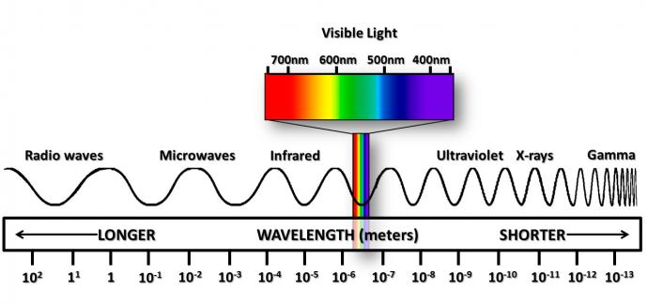
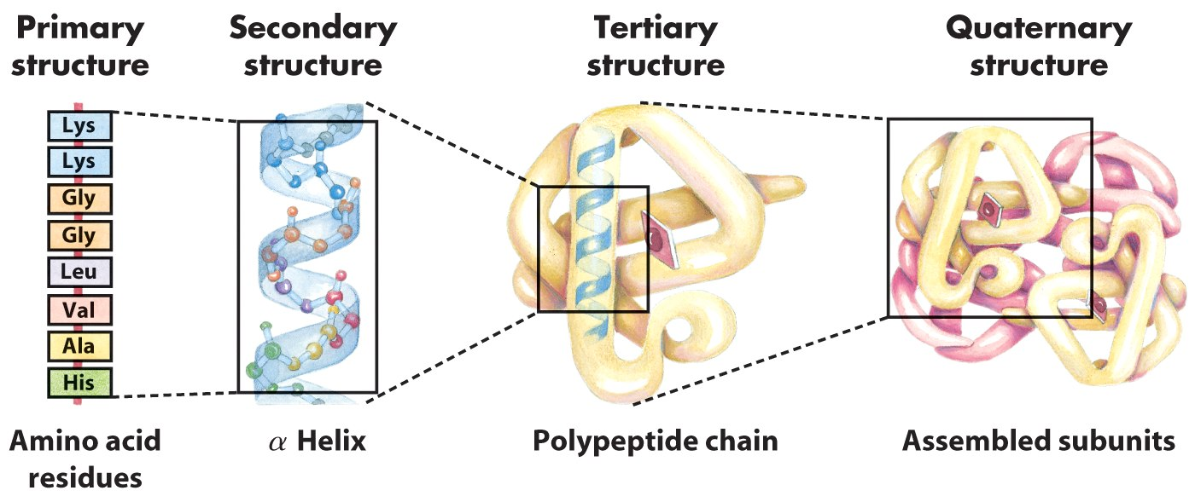
Atomic and molecular spectroscopy (electromagnetic)
Study of the interaction between EM radiation with matter
Analysis of the EM radiation that is absorbed, emitted or scattered by biological (macro)molecules
Composition: C, N, O, S and H
Chemical analysis: composition fingerprint
Structural analysis: distances, bond length, bond angle, strength, energy level, etc
4. Possible interations
2. Probing tool
1. Size scale
3. Chemistry
Objeto de estudo
Ferramentas de medida
$$E_{\text{total}}=E_{\text{nuc}}+E_{\text{elect}}+E_{\text{v}\text{ibr}}+E_{\text{rot}}+E_{\text{trans}}$$
Types of molecular energy can probe: translational, rotational, vibrational and electronic

Slide 2
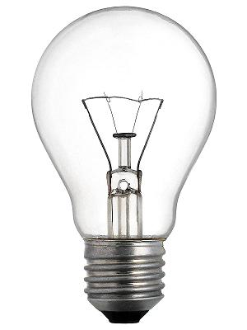
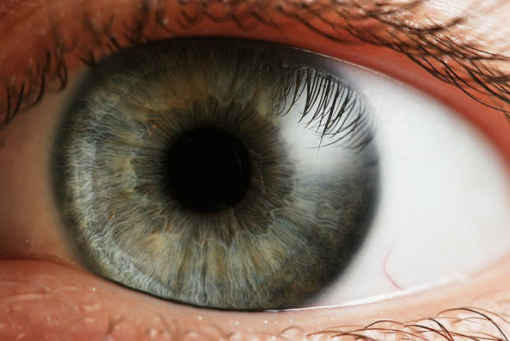
An everyday spectroscopic experiment we take for granted: vision
For an object to be seen, we need to (1) light it up and (2) look at it and (3) process the information
?
Object
Detector
Data processing
Light source
Light can be absorbed, emitted or scattered by matter.

Slide 3
Matter and the four observed fundamental forces in physics
Single or Multibody system
Gravity
Matter: An entity that occupies space and possesses a non-zero rest mass
Interactions between Molecules define
Interactions between Atoms define
Interactions between Protons, neutrons, electrons define
Interactions between Quarks, gluons, mesons, etc. define
Electromagnetism
Weak forces
Strong forces

Slide 4
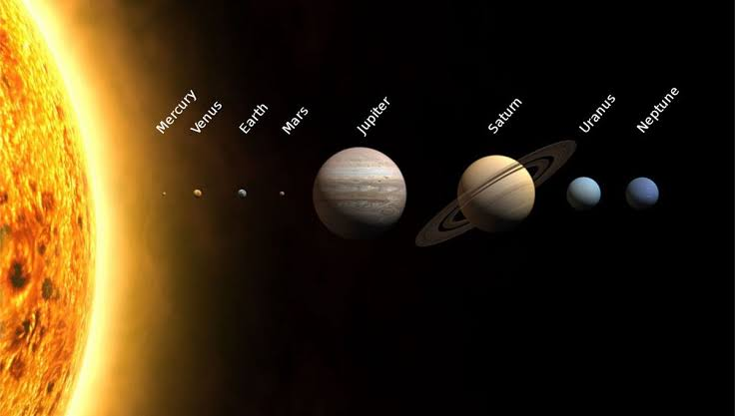
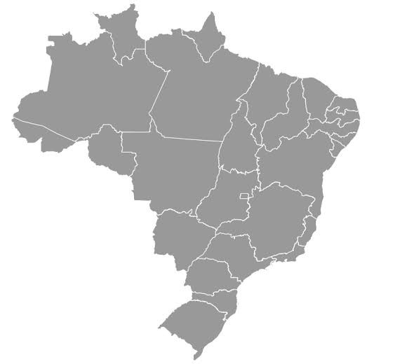
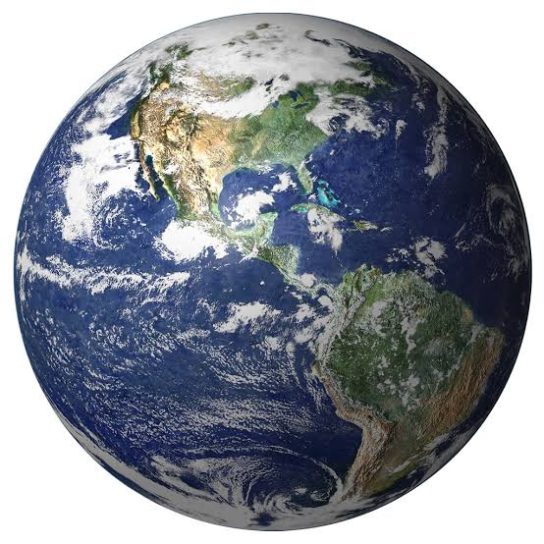
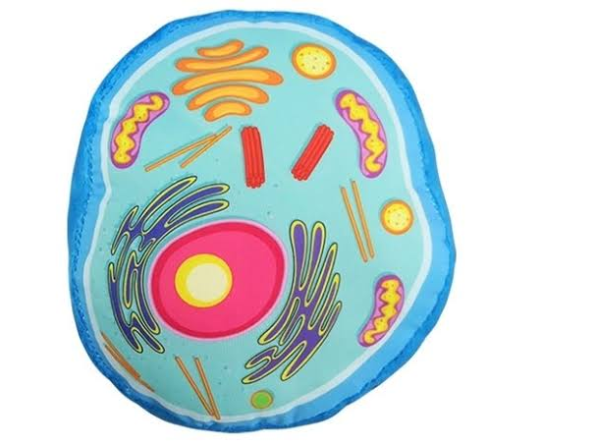
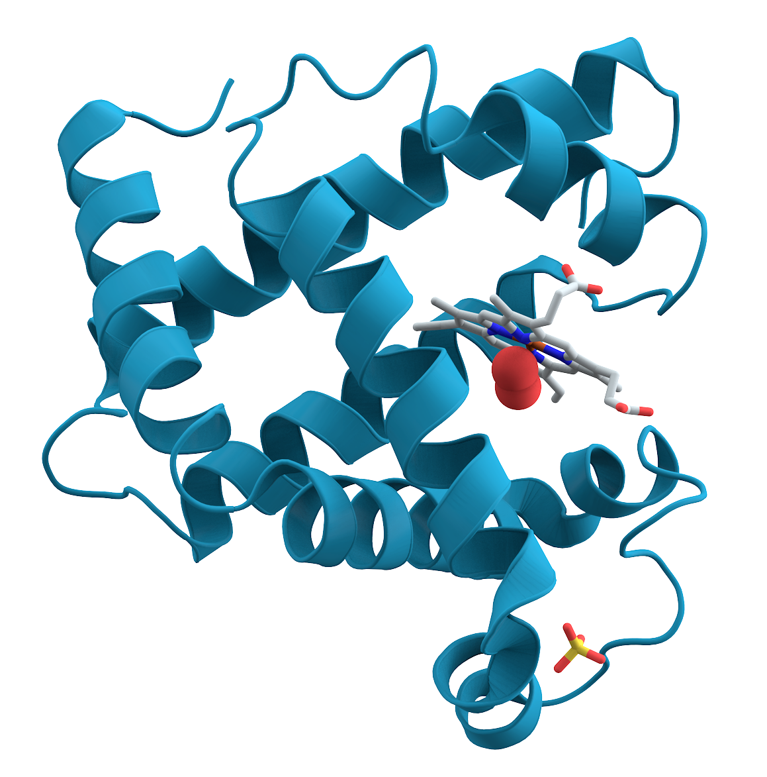
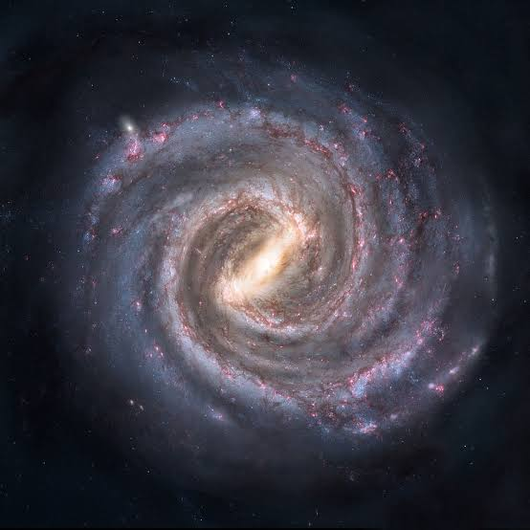
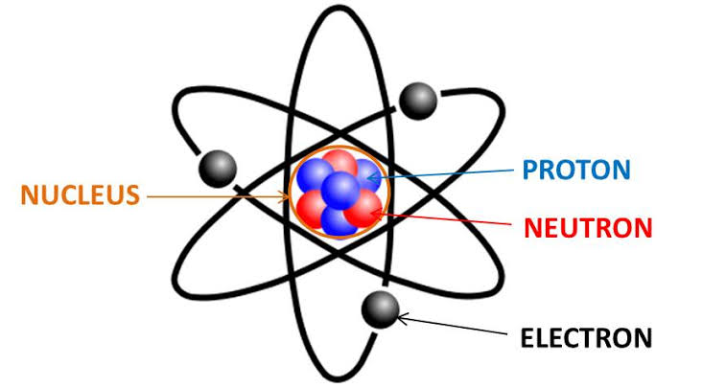
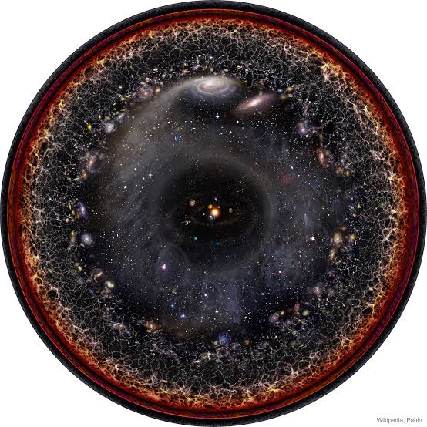
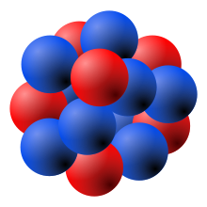
The Universe, in orders of magnitude
Human
Cell
Planet
Country
Protein
10⁻⁵ m
Solar system
10¹³ m
10⁴ m
10⁰ m
10⁷ m
Milky way
10⁻⁸ m
Atom
10²¹ m
10⁻¹⁰ m
Visible universe
Small
Big
10²⁶ m
Nucleus
10⁻¹⁵ m
How much DNA do we have in our body, in length?

Slide 5
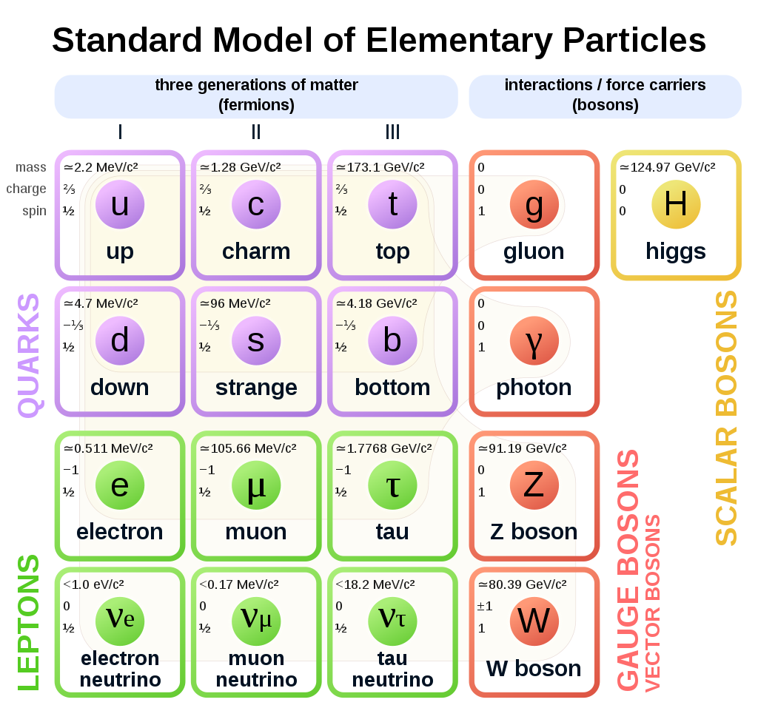
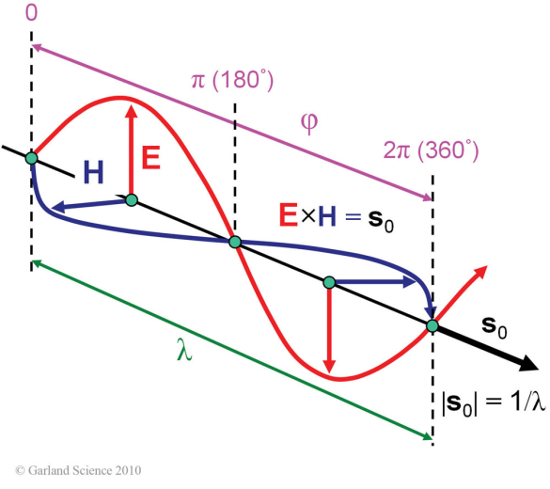
Electromagnetic radiation
EM radiation is basically oscilating disturbances (periodic in space and time) in $\vec{E}$ and $\vec{B}, as harmonic waves$
A photon is the quantum of and the force carrier of EM radiation
The electric field vector $\vec{E}$ is perpendicular to the magnetic field vector $\vec{H}$ and both oscillate perpendicularly to the propagation vector s_{o}, with a wavelength $λ$, and phase $φ$.
Radio
Microwave
Infrared
Ultraviolet
X-rays
Gamma
10³
10²
10¹
10⁰
10⁻¹
10⁻²
10⁻³
10⁻⁴
10⁻⁵
10⁻⁶
10⁻⁷
10⁻⁸
10⁻⁹
10⁻¹⁰
10⁻¹¹
10⁻¹²
10⁻¹³
Wavelength, m
10⁵
10⁶
10⁷
10⁸
10⁹
10¹⁰
10¹¹
10¹²
10¹³
10¹⁴
10¹⁵
10¹⁶
10¹⁷
10¹⁸
10¹⁹
10²⁰
10²¹
Frequency, Hz

Slide 6
$E= hf=h\frac{v}{λ}$, [J, eV, cal]
where $v=\frac{1}{\sqrt{με}}$ and $h$ = 6.626$×$10⁻³⁴ J·s (Planck´s constant)
Electromagnetic wave
In vacum, $v=\frac{1}{\sqrt{μ_{o}ε_{o}}}=c$ $=$ 3$×$10⁸ m.s⁻¹
Permeability: measure of magnetization that a material obtains in response to an applied magnetic field
Permittivity: is a measure of the electric polarizability of a dielectric (insulator)
permittivity >>>> permeability in biological samples (> 10⁶)

Slide 7
Lorentz Force law and Maxwell's equations: Classical electromagnetism
Describe how charged particles generate or are affected by EM fields
Region in which each point is affected by a force (according to Newton’s 2nd law: $\vec{F}=m\vec{a}$)
Lorentz Force
$\vec{F}=q\left(\vec{E}+\vec{v}×\vec{B}\right):$combination of electric and magnetic force on a point charge due to EM field
Maxwell's equations
$∇∙\vec{E}=\frac{ρ}{ε_{o}}:$(Gauss´) relationship between a static electric field and the electric charges that cause it
$∇∙\vec{B}=0:$(Gauss´ for magnetism) magnetic field has divergence equal to zero
$∇×\vec{E}=−\frac{∂\vec{B}}{∂t}:$(Faraday´s) time varying magnetic field creates an electric field
$∇×\vec{B}=μ_{o}\vec{J}+μ_{o}ε_{o}\frac{∂\vec{E}}{∂t}:$(Ampère-Maxwell´s) magnetic fields can be generated by electric current and…
Fluxo
pontual
Circulação no
espaço

Slide 8
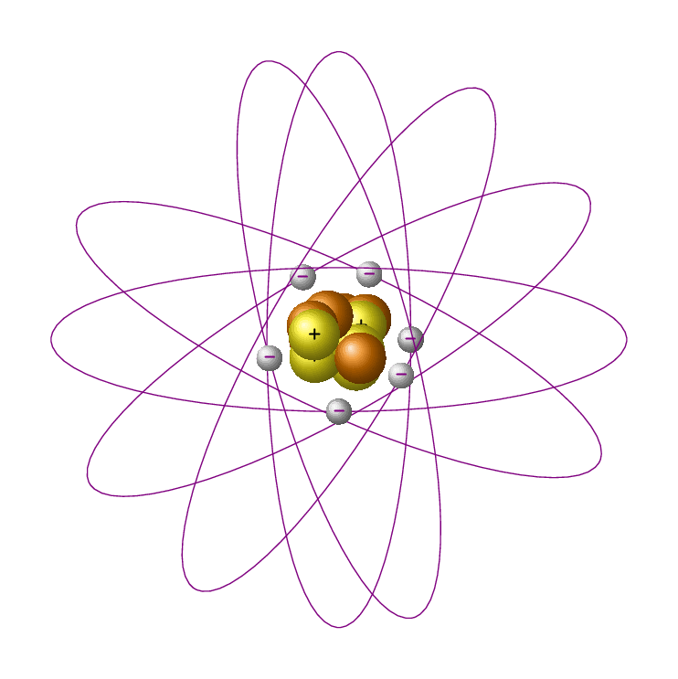
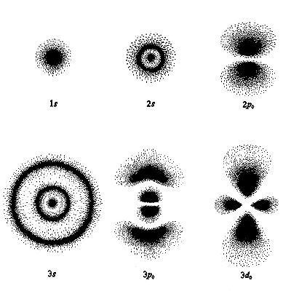
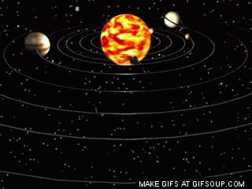
Models of the atom
Classical model of the atom
Quantum mechanical model of the atom
Solar system
Orbit: mathematically defined pathway
Orbital: where an electron is likely to be found in an atom 90% of the time, with fixed amount of energy (boundary surface):
Energy + shape = orbital
We know nothing about how the electron moves around the nucleus

Slide 9
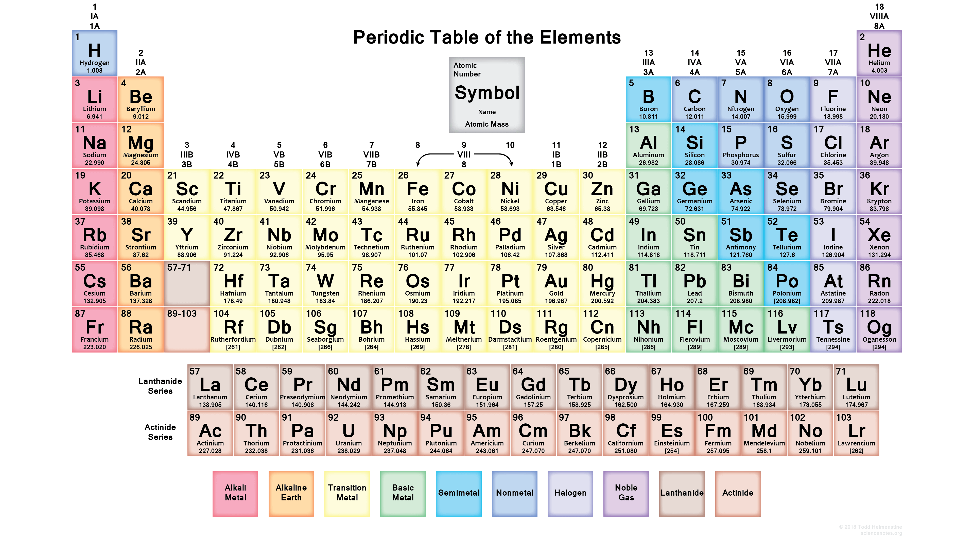
Electron configuration: finding a home (orbital) for each electron
1s²
2s² 2p⁶
3s² 3p⁶ 3d¹⁰
4s² 4p⁶ 4d¹⁰ 4f¹⁴
5s² 5p⁶ 5d¹⁰ 5f¹⁴
6s² 6p⁶ 6d¹⁰ 6f¹⁴
7s² 7p⁶ 7d¹⁰ 7f¹⁴
${1s}_{2}^{2} {2s}_{4}^{2}{ 2p}_{10}^{6} {3s}_{12}^{2}$ ${3p}_{18}^{6} {4s}_{20}^{2}$ ${3d}_{30}^{10} {4p}_{36}^{6}$ ${5s}_{38}^{2} {4d}_{48}^{10}$ ${5p}_{54}^{6} {6s}_{56}^{2}$ ${4f}_{70}^{14} {5d}_{80}^{10}$ ${6p}_{86}^{6} {7s}_{88}^{2}$ ${5f}_{102}^{14} {6d}_{112}^{10}$

Slide 10
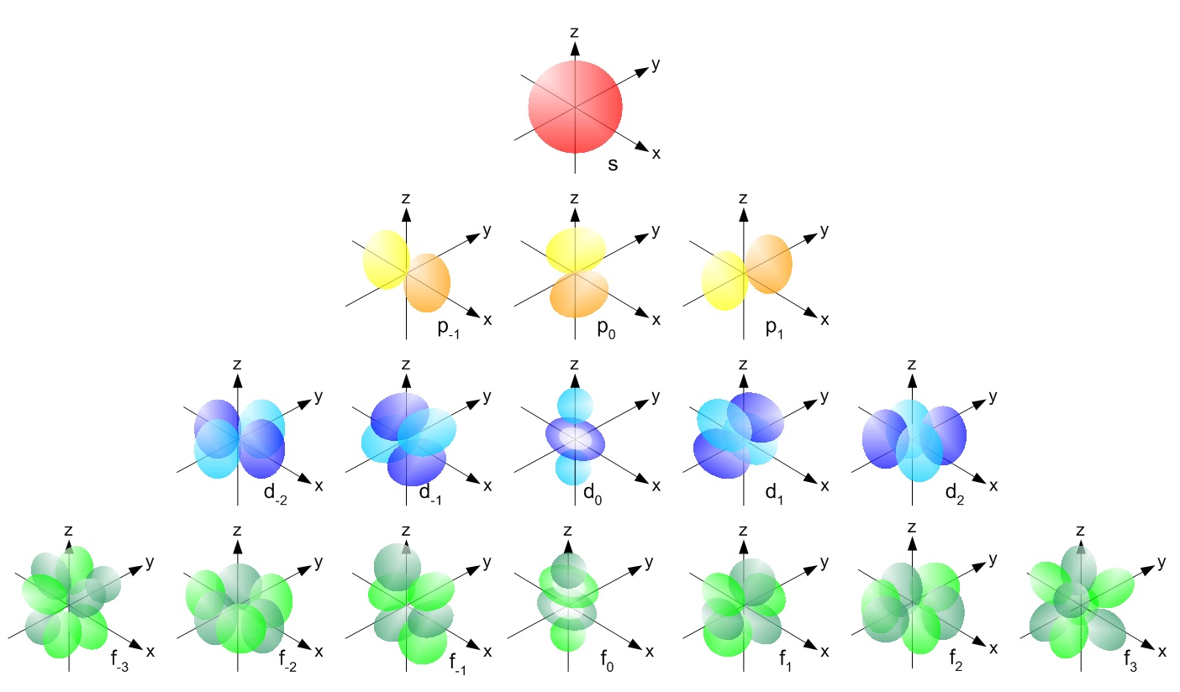
Electron configuration: finding a home for each electron
Principal quantum number (n): energy level (shell) occupied by electron; n = 1, 2, 3, 4, 5, 6, 7...
Angular momentum quantum number ($ℓ$): shape of the orbital(s) within the shell; (ℓ = 0, 1, 2,..., n − 1) of n
Magnetic quantum number (m_{ℓ}): orientation of an orbital around the nucleus; (from −ℓ to ℓ, in intergers);
Spin quantum number (s): projection of intrinsic angular momentum of electron (±½)
1s²
2s² 2p⁶
3s² 3p⁶ 3d¹⁰
4s² 4p⁶ 4d¹⁰ 4f¹⁴
5s² 5p⁶ 5d¹⁰ 5f¹⁴
6s² 6p⁶ 6d¹⁰ 6f¹⁴
7s² 7p⁶ 7d¹⁰ 7f¹⁴
ℓ = 0 (spherical), ℓ = 1 (principal), ℓ = 2 (diffuse), ℓ = 3 (fundamental)...
ℓ = 0
First p orbital(ℓ = 1) appear in the second shell (n = 2), the first d orbital (ℓ = 2) appear in the third shell (n = 3), and so on
ℓ = 1
ℓ = 2
ℓ = 3

Slide 11
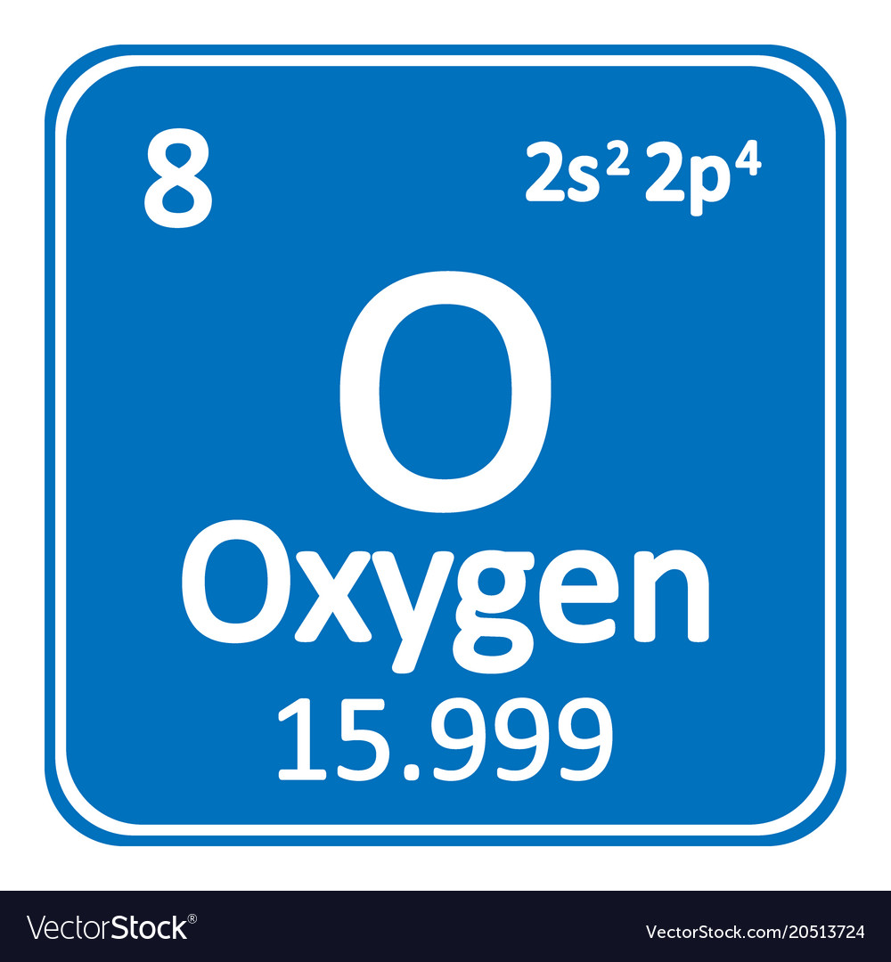
Electron configuration: finding a home for each electron (4 QN combined)
6p
5d
4f
6s
5p
4d
5s
4p
3d
4s
3p
3s
2p
2s
1s
f (-3) f (-2) f (-1) f (0) f (1) f (2) f (3)
d_{xy} (-2) d_{xz} (-1) d_{yz} (0) d_{x2-y2} (1) d_{z2} (2)
How to add electrons to orbitals
3 rules: Aufbau + Pauli + Hund
p_{x} (-1) p_{y} (0) p_{y} (1)
Two electrons in s
Six electrons in p
Ten electrons in d
Fourteen electrons in f
s (0)
Each line represents an orbital (abstractly)

Slide 12
Periodic table of elements and quantum numbers
3d
2p
4d
3p
1s
1s
2s
5d
4f
4p
3s
6d
5f
5p
4s
6p
5s
7p
6s
7s
${1s}_{2}^{2} {2s}_{4}^{2}{ 2p}_{10}^{6} {3s}_{12}^{2}$ ${3p}_{18}^{6} {4s}_{20}^{2}$ ${3d}_{30}^{10} {4p}_{36}^{6}$ ${5s}_{38}^{2} {4d}_{48}^{10}$ ${5p}_{54}^{6} {6s}_{56}^{2}$ ${4f}_{70}^{14} {5d}_{80}^{10}$ ${6p}_{86}^{6} {7s}_{88}^{2}$ ${5f}_{102}^{14} {6d}_{112}^{10}{ 7p}_{118}^{6}$

Slide 13
quantum mechanical model of the atom

Slide 14
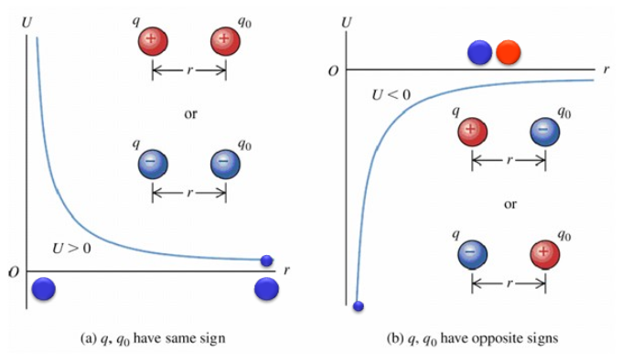
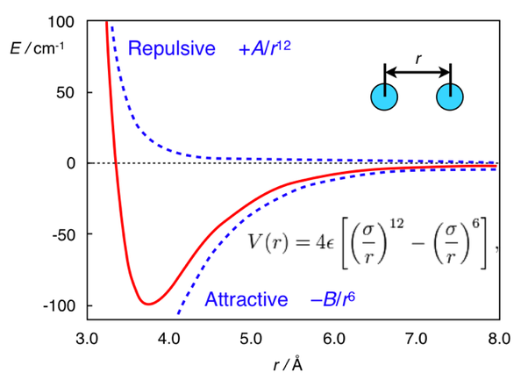
Potencial de interação entre duas cargas pontuais
Potencial de Lenard-Jones

Slide 15
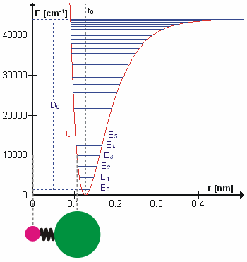
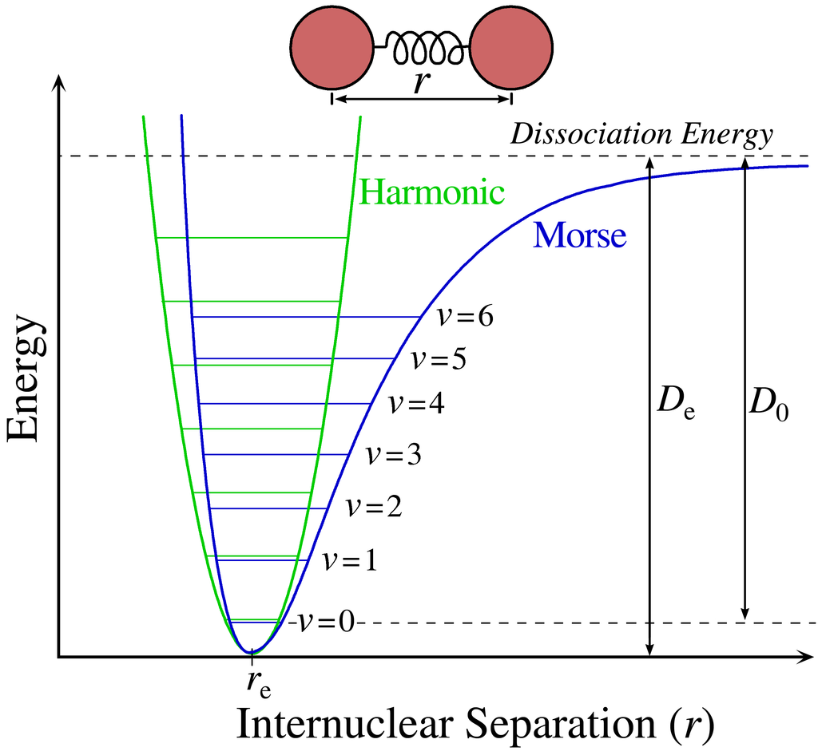
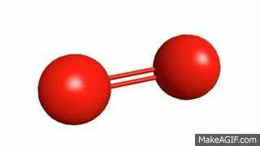
Potencial de uma molécula diatômica
Eletrônica
Vibracional
Energia vibracional da molécula

Slide 16
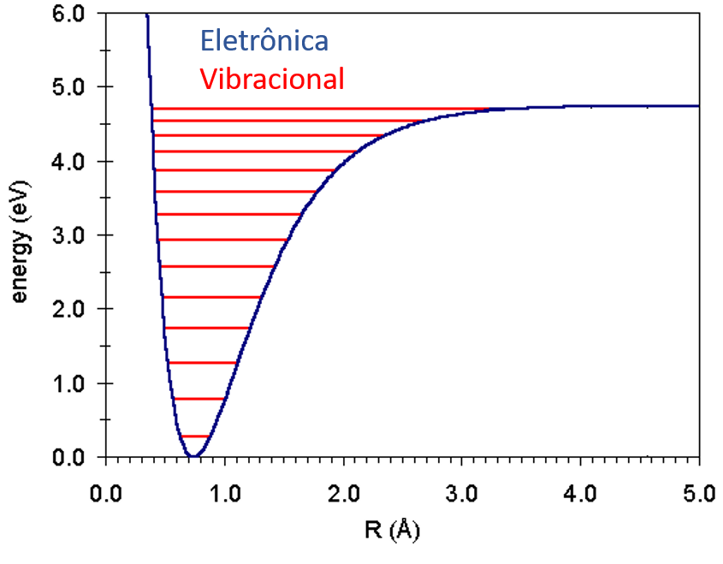
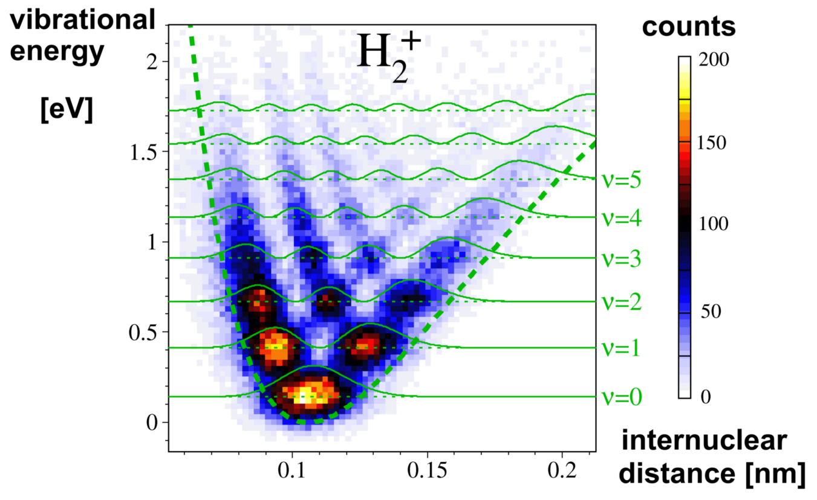
Energia vibracional da molécula
Vibrational wave function

Slide 17
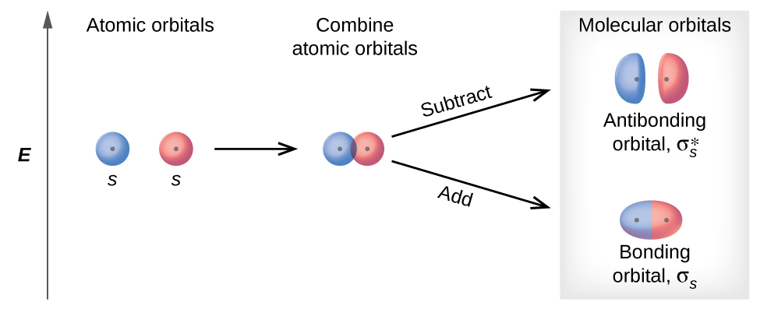
We are working with molecules, not isolated atoms = molecular orbitals
Bonding occur when two atoms are brought close enough to permit overlap of valence orbitals: single orbital encompassing both nuclei
Energy is released during overlap and covalente bond is formed.
Atoms overlap in-phase: wave functions reinforce one another: Bonding orbital
(b) Atoms overlap out-of-phase: wave functions have opposite signs: Anti-bonding orbital

Slide 18
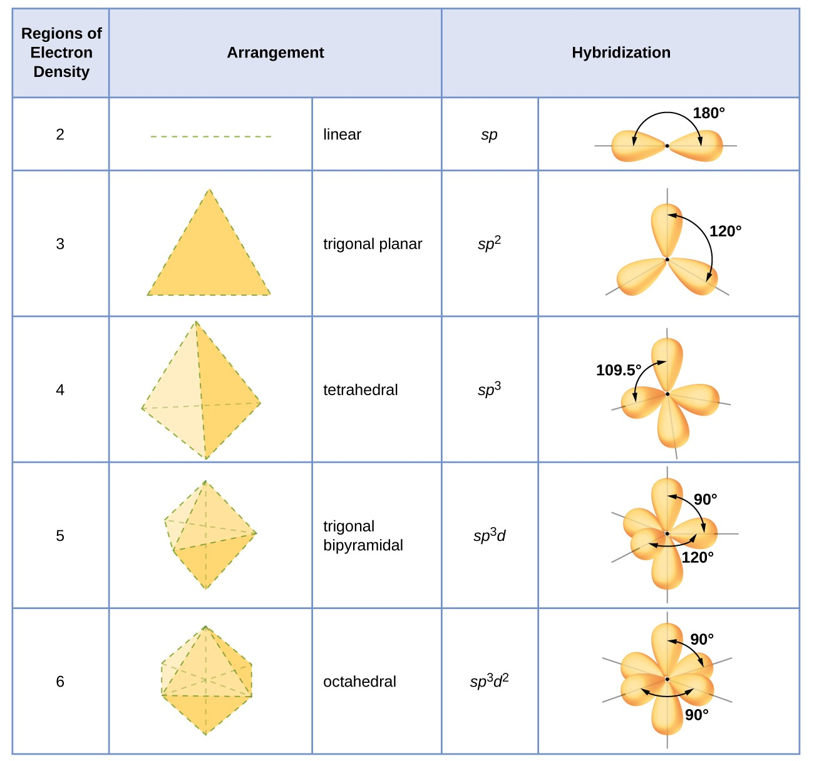

Slide 19
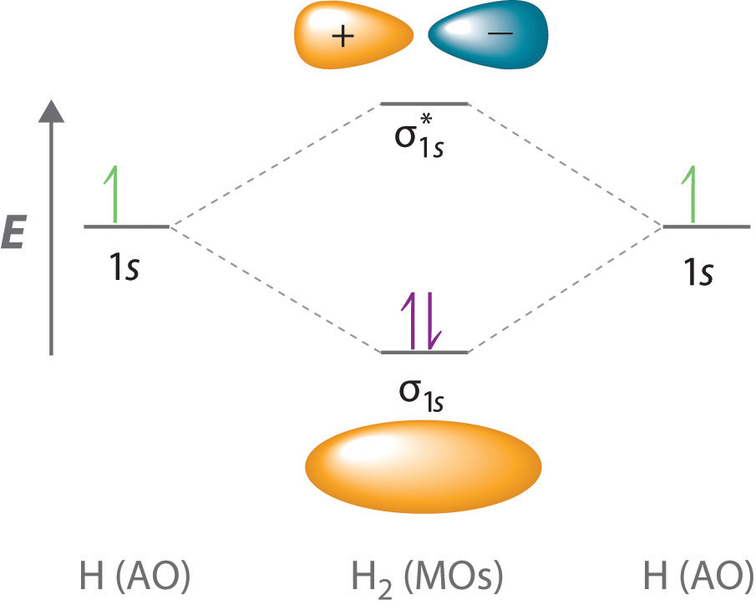
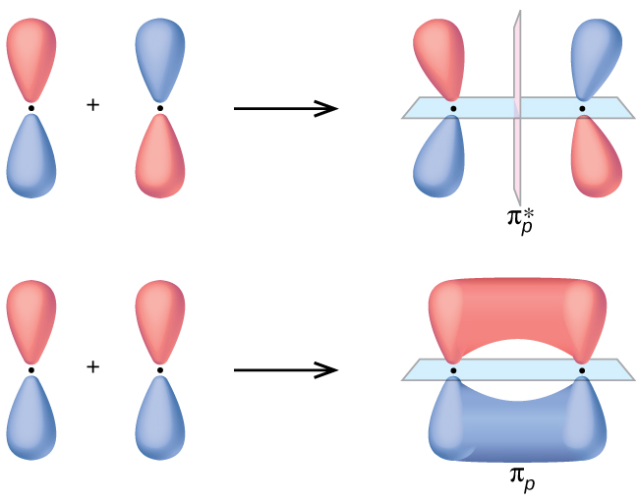
Molecular orbital. Ex: H₂
Anti-bonding: node develops between two atoms
Bonding: ED is high between two atoms
Side-by-side overlap of two p orbitals
π* antibonding molecular orbital
End-to-end overlap of two s or p orbitals
σ_{px} bonding molecular orbital
σ_{px} antibonding molecular orbital
pi (π) bonding molecular orbital

Slide 20
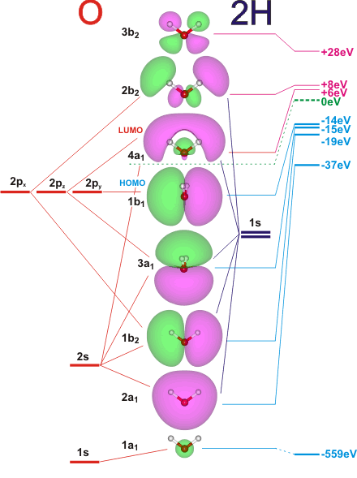
Organic molecules
Atomic and non-bonding orbitals
Molecular bonding orbitals

Slide 21
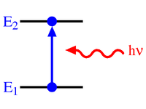
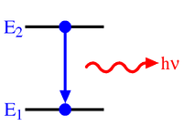
When an EM photon hits an atom, nothing happens at 99% of the times.
Atoms and molecules are mostly empty space!
The remaining 1% consists of:
Absorption
Emission
Scattering
Energy state transition;
Ionization;
Photoelectric effect;
Heat;
Depends on the existance or not, and lifetime, of an excited state as well as enegy conservation
Elastic
Inelastic
Thomson;
Rayleigh;
Mie;
Geometric.
Compton;
Raman.

Slide 22
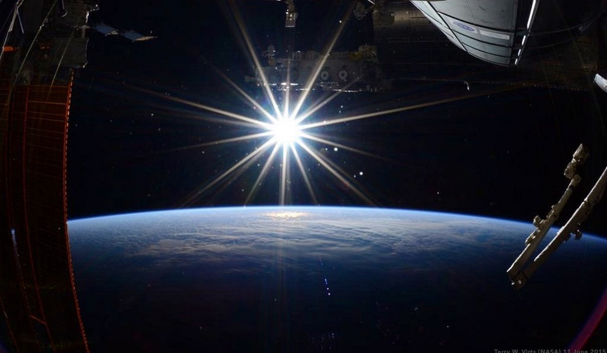
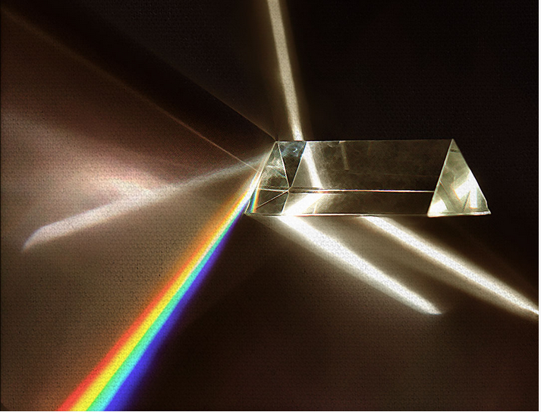
Models of light scattering by matter: just look at the sky!
Three domains, based on a dimensionless size parameter $α=\frac{πD_{p}}{λ}$
Detector
Sun, as seen from space
Newton´s prism

Slide 23
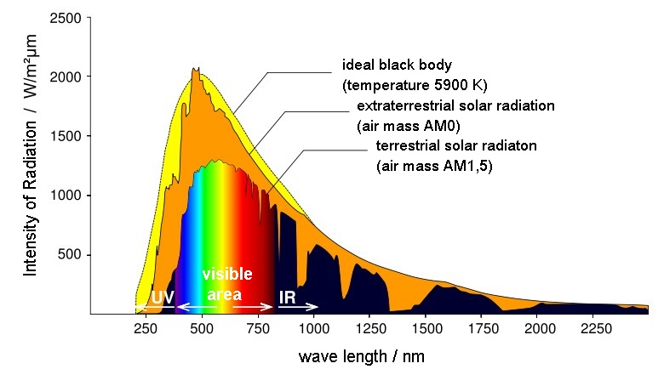
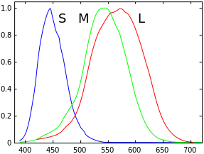
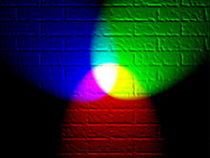
400 Comprimento de onda, nm 700
3000 Frequência, THz 300
12.4 Energia, eV 1.24
Porque as nuvems são brancas?
Porque o céu não é violeta? Ou verde?

Slide 24
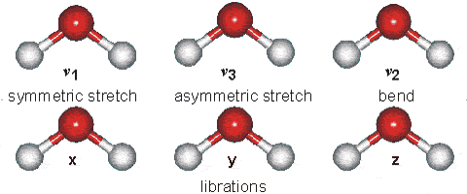
Energy levels in proteins are limitless
$$E_{\text{total}}=E_{\text{eletronic}}+E_{\text{nuclear}}+E_{\text{rota}\text{t}\text{ional}}+E_{\text{vibra}\text{t}\text{ional}}+E_{\text{transla}\text{t}\text{ional}}$$
For a 3-atom molecule

Slide 25
Electromagnetic radiation versus biological energy levels
$$E_{\text{total}}=E_{\text{eletronic}}+E_{\text{nuclear}}+E_{\text{rota}\text{t}\text{ional}}+E_{\text{vibra}\text{t}\text{ional}}+E_{\text{transla}\text{t}\text{ional}}$$
Magnetic coupling
Nuclear Electronic
Vibronic
transitions
Electronic
transitions
Vibrational
Radio
Microwave
Infrared
Visible
Ultraviolet
X-rays
Gamma
10³
10²
10¹
10⁰
10⁻¹
10⁻²
10⁻³
10⁻⁴
10⁻⁵
10⁻⁶
10⁻⁷
10⁻⁸
10⁻⁹
10⁻¹⁰
10⁻¹¹
10⁻¹²
10⁻¹³
Wavelength, m
10⁵
10⁶
10⁷
10⁸
10⁹
10¹⁰
10¹¹
10¹²
10¹³
10¹⁴
10¹⁵
10¹⁶
10¹⁷
10¹⁸
10¹⁹
10²⁰
10²¹
Frequency, Hz

