Slide 1
Social protection implies in autarchy???
“Free trade which, in 1846, had been fought and won on the Corn Laws, was eighty years later fought over again and this time lost on the same issue. The problem of autarchy haunted market economy from the start. Accordingly, economic liberals exorcised the spectre of war and naively based their case on the assumption of an indestructible market economy. It went unnoticed that their arguments merely showed how great was the peril of a people which relied for its safety on an institution as frail as the self-regulating market. The autarchy movement of the 1920s was essentially prophetic: it pointed to the need for adjustment to the fact of a vanishing order” (Polanyi [1944] 2001, pp. 198-199).

Slide 2
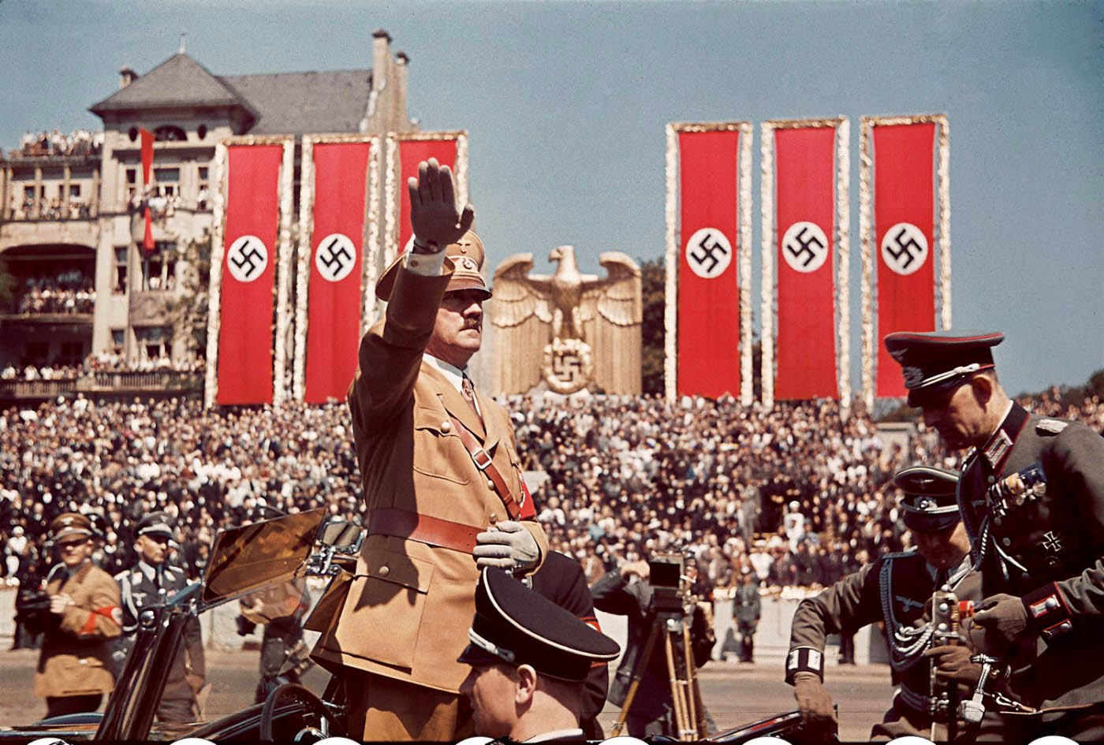

Slide 3
For this class…
“In the 1940s economic liberalism suffered an even worse defeat. Although Great Britain and the United States departed from monetary orthodoxy, they retained the principles and methods of liberalism in industry and commerce, the general organization of their economic life. This was to prove a factor in precipitating the war and a handicap in fighting it, since economic liberalism had created and fostered the illusion that dictatorships were bound for economic catastrophe. By virtue of this creed, democratic governments were the last to understand the implications of managed currencies and directed trade…; also, the legacy of economic liberalism barred the way to timely rearmament in the name of balanced budgets and stable exchanges, which were supposed to provide the only secure foundations of economic strength in war” (Polanyi [1944] 2001, p. 149).

Slide 4
The Politics of Economic Nationalism
Class 4
Re-Embedding Markets
Dr. Vinícius Rodrigues Vieira (IRI-USP)
August 22, 2018

Slide 5
The Double Movement
“For a century, the dynamics of modern society was governed by a double movement: the market expanded continuously but this movement was met by a countermovement checking the expansion in definite directions. Vital though such a countermovement was for the protection of society, in the last analysis it was incompatible with the self-regulation of the market, and thus with the market system itself” (Polanyi [1944] 2001, p. 136).

Slide 6
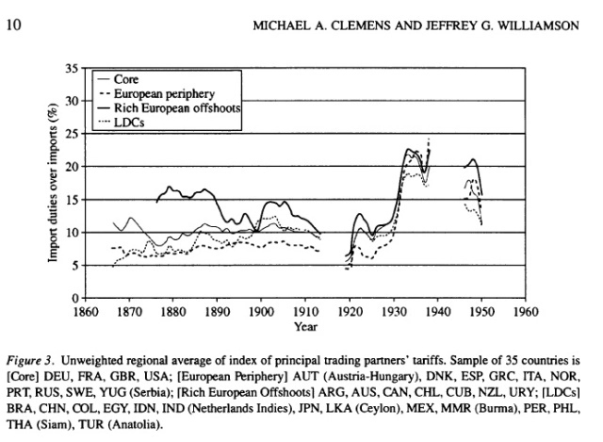

Slide 8
A long-term trend towards autarchy...
“… since the 1870s an emotional change was noticeable though there was no corresponding break in the dominant ideas. The world continued to believe in internationalism and interdependence, while acting on the impulses of nationalism and self-sufficiency. Liberal nationalism was developing into national liberalism, with its marked leanings towards protectionism and imperialism abroad, monopolistic conservatism at home. Nowhere was the contradiction as sharp and yet as little conscious as in the monetary realm. For dogmatic belief in the international gold standard continued to enlist men's stintless loyalties, while at the same time token currencies were established, based on the sovereignty of the various central banking systems. Under the aegis of international principles, impregnable bastions of a new nationalism were being unconsciously erected in the shape of the central banks of issue” (Polanyi [1944] 2001, p. 207).

Slide 9
That is, more and more....
Factors of production became a matter of national sovereignty
Labor → with growing social rights
Trade → with rising tariffs
Capital/money → with central banks (amid the gold standard)
What has Polanyi missed???

Slide 10
That is, more and more....
Factors of production became a matter of national sovereignty
Labor → with growing social rights
Trade → with rising tariffs
Capital/money → with central banks (amid the gold standard)
What has Polanyi missed???
Immigration/minorities → who is a citizen de facto? → This explains...

Slide 11
Economic
Nationalism
(i.e., protectionism)

Slide 12
Economic
Nationalism
(i.e., protectionism)
National
Identity
(i.e., who belongs)
THE POLITICS OF ECONOMIC NATIONALISM

Slide 13
However, let’s first study the 1920s in depth
Banking rises after World War I just to collapse again
“There is indeed nothing surprising either in the dominating influence of international bankers in the 1920s, nor in their eclipse in the 1930s. In the 1920s, the gold standard was still regarded as the precondition of a return to stability and prosperity, and consequently no demand raised by its professional guardians, the bankers, was deemed too burdensome, if only it promised to secure stable exchange rates; when, after 1929, this proved impossible, the imperative need was for a stable internal currency and nobody was as little qualified to provide it as the banker” (Polanyi [1944] 2001, p. 208).

Slide 14
However, let’s first study the 1920s in depth
That is the case as governments controls labor and tariffs
“With the international gold standard the most ambitious market scheme of all was put into effect, implying absolute independence of markets from national authorities. World trade now meant the organizing of life on the planet under a self-regulating market, comprising labor, land, and money, with the gold standard as the guardian of this gargantuan automaton. Nations and peoples were mere puppets in a show utterly beyond their control. They shielded themselves from unemployment and instability with the help of central banks and customs tariffs, supplemented by migration laws. These devices were designed to counteract the destructive effects of free trade plus fixed currencies, and to the degree in which they achieved this purpose they interfered with the play of those mechanisms.” (Polanyi [1944] 2001, p. 208).

Slide 15
However, let’s first study the 1920s in depth
Therefore, banking has collapsed due to the lack of regulation
“In contrast to men and goods, money was free from all hampering measures and continued to develop its capacity of transacting business at any distance at any time. The more difficult it became to shift actual objects, the easier it became to transmit claims to them... Payments, debts, and claims remained unaffected by the mounting barriers erected against the exchange of goods; the rapidly growing elasticity and catholicity of the international monetary mechanism was compensating, in a way, for the ever-contracting channels of world trade. When, by the early 1930s, world trade was down to a trickle, international short-term lending attained an unheard-of degree of mobility” (Polanyi [1944] 2001, p. 215).

Slide 16
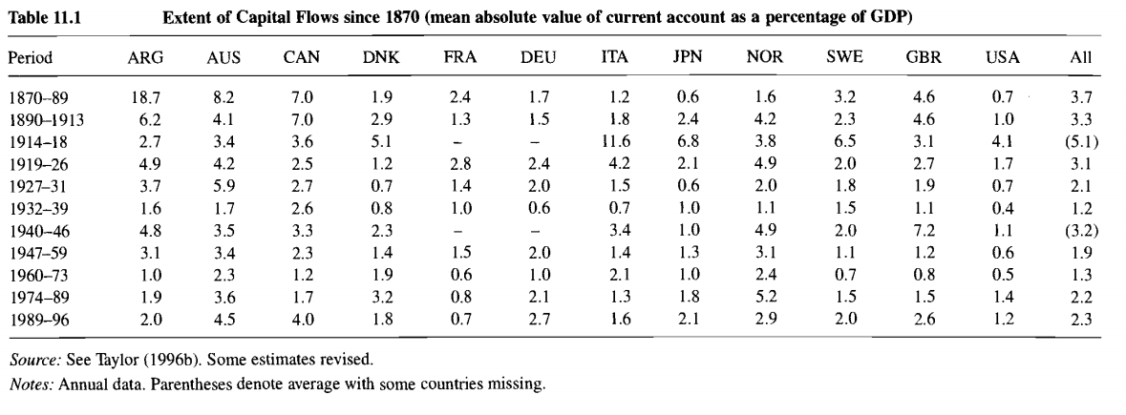
Source: Obstfeld and Taylor, p. 339

Slide 18
Consequences of impaired regulation
According to Polanyi ([1944] 2001, p. 218)
Tension of classes → unemployment
Pressure on exchange rates → lack of foreign currency/financial stability
Imperialist rivalries → countries are less eager to cooperate with each other

Slide 19
Great Depression

Slide 20
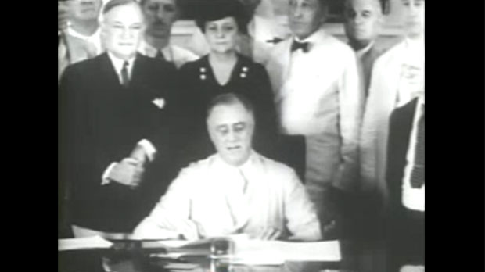
Great Depression: The Reaction
US as a latecomer in providing comprehensive social security through the Social Security Act (SSA) in 1935: American exceptional Welfare State

Slide 21
Great Depression: The Reaction

Slide 22
Great Depression: The Reaction

Slide 23
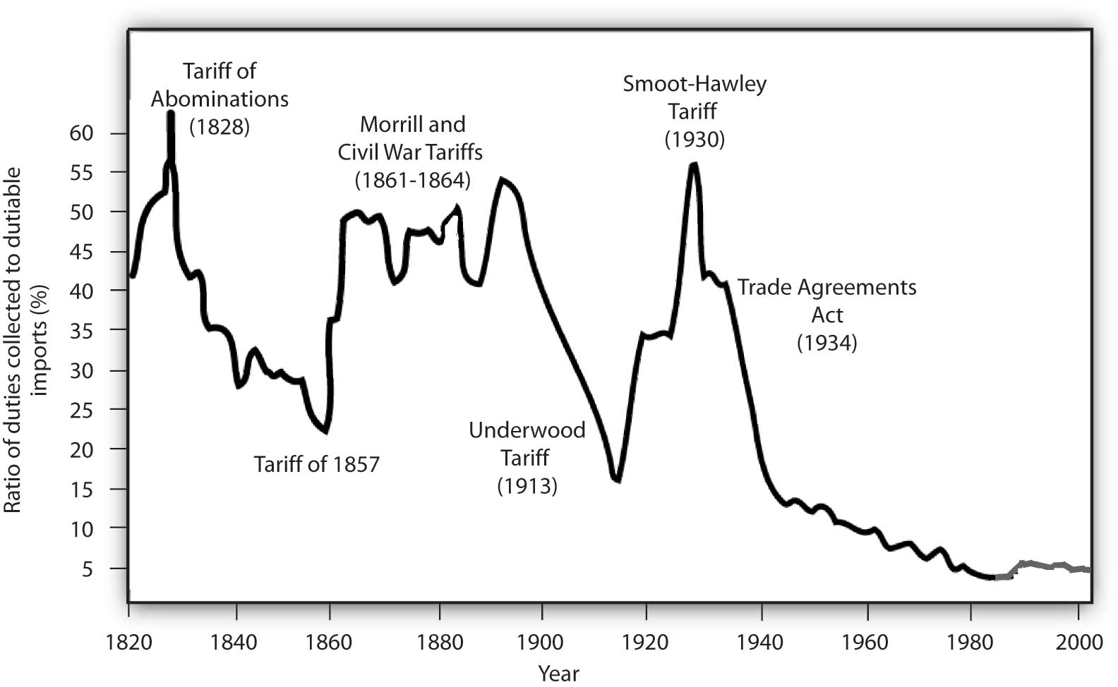

Slide 25
Was the New Deal “socialist”?
“Socialism is, essentially, the tendency inherent in an industrial civilization to transcend the self-regulating market by consciously subordinating it to a democratic society. It is the solution natural to industrial workers who see no reason why production should not be regulated directly and why markets should be more than a useful but subordinate trait in a free society…”

Slide 26
Was the New Deal “socialist”?
“…From the point of view of the community as a whole, socialism is merely the continuation of that endeavor to make society a distinctively human relationship of persons which in Western Europe was always associated with Christian traditions. From the point of view of the economic system, it is, on the contrary, a radical departure from the immediate past, insofar as it breaks with the attempt to make private money gains the general incentive to productive activities, and does not acknowledge the right of private individuals to dispose of the main instruments of production…”

Slide 27
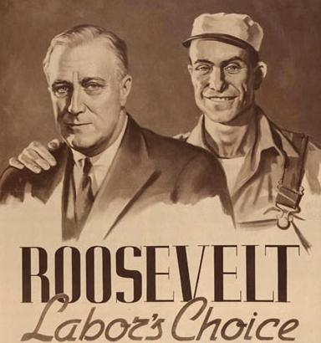
The New Deal was not “socialist”
“…This is, ultimately, why the reform of capitalist economy by socialist parties is difficult even when they are determined not to interfere with the property system” (Polanyi [1944] 2001, p. 242)
→ Post-Depression and Post-War: capital(productive)-labor alliance
→ What is missing though???

Slide 28
Quick Task
Imagine that you and your closest colleague are part of Roosevelt’s team in assembling the New Deal measures in the 1935s. At that time, the Democratic Party—to which the president belongs—relied heavily on the support of whites from Southern states, which do not grant the right of voting to blacks and other racial minorities. Which concessions would you advise the president to make in order to grant the support necessary for approving social protection? Discuss in pairs in the next two minutes
Clue: most manufacturing workers are White and live in Northern states (including the current Rust Belt).

Slide 29
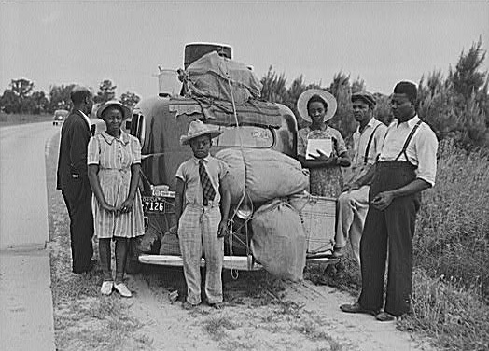
The Great Migration → Blacks leave the South
For an alternative view on the exclusion of agricultural and domestic workers from the SSA in 1935,
https://www.ssa.gov/policy/docs/ssb/v70n4/v70n4p49.html

Slide 32
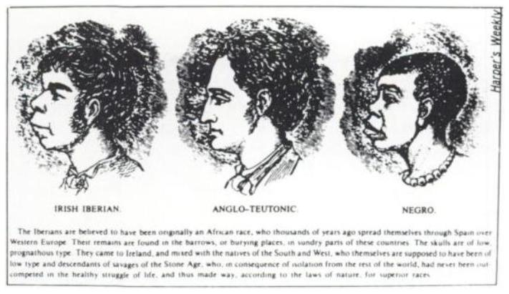
Beyond contentions with Blacks
Not all whites were equal....

Slide 33
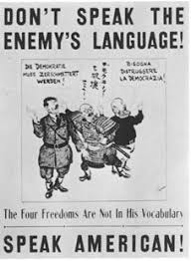
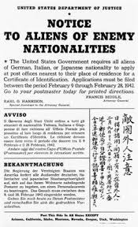

Slide 35
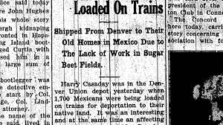

Slide 36
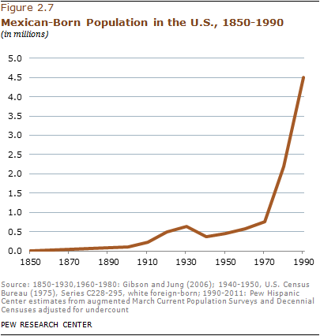

Slide 38
Was the “social-liberal” reaction efficient?

