Slide 1
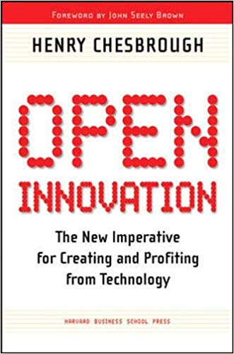
Introduction
Notes:
This book is talk about the process of innovation, about how companies utilize and advance technologies to create new productis an services, and also how the company managing innovation.

Slide 2
Research and technology Intensive based on company innovation
Scan start-up companies, invest them, partnered with them or acquire them
Notes:
Lucent Technologies, Inc., was an American multinational telecommunications equipment company,created in the breakup of AT&T(American Telephone and Telegraph Company),it also get a large share of Bell Laboratories which make the company become research and technology intensive in telecommunications equipment market.
Cisco, an American multinational technology conglomerate,manufactures and sells networking hardware, telecommunications equipment and other high-technology services and products
Lucent and Cisco were not innovating in the same way.
And because of world idea abound and company like CISCO is growing up, internal industrial research is less effective, and of courese the leading enterprises will face strong competiton from many newer companies.
So ,the author think this is a shift in innovation paradigms.

Slide 3
A shift in innovation paradigms
“The way we innovate new ideas and bring them to market is undergoing a fundamental change.”
Old paradigm ”Closed innovation” to New paradigm ”Open innovation”
Notes:
The author said:…

Slide 4
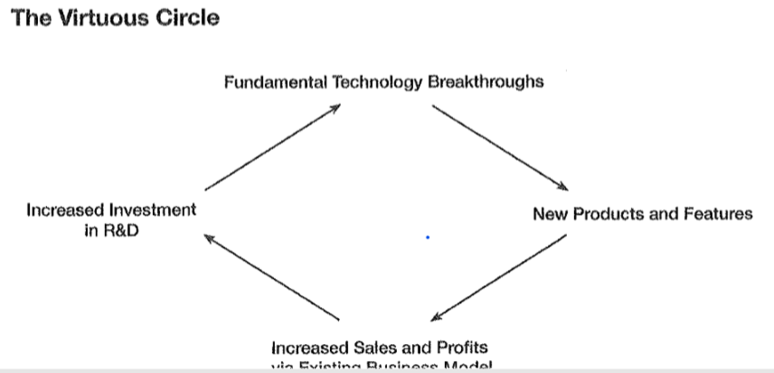
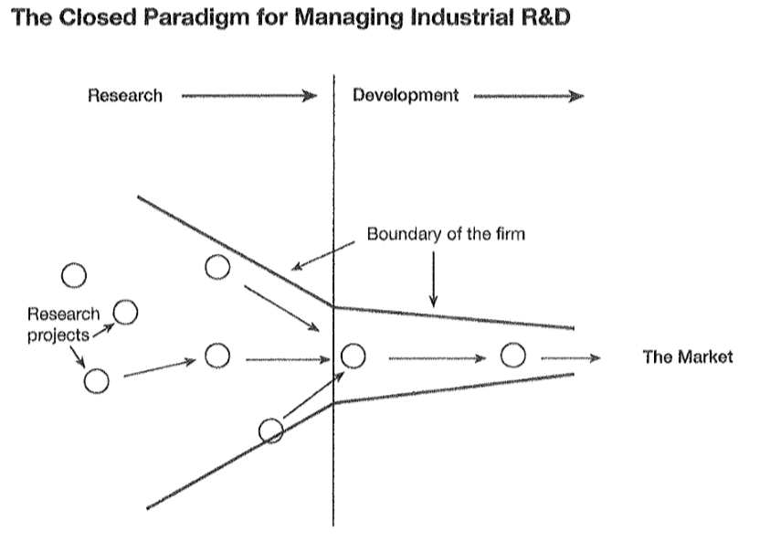
Closed innovation thinking was an internally focused logic, successful innovation requires control
E.G : GE, Dupont, Merck, AT&T
Closed Innovation
Notes:
So, the companies work as closed innovation, they generate their own idea and develop them by their own, they think successful innovation requires control. And Closed innovation thinking was an internally focused logic.
For most of the twentieth century, this paradigm worked and worked well. Like GE, Dupont, Merck, AT&T .
The heavy solid linese show the boundary of the firm, Idea flow into the firm on the left and they screened it ,then the surviving ideas are transferred into development and then flow out to the market to the right.

Slide 5
Erosion factors undermined the Closed Innovation
1. the growing mobility of highly experienced and skilled people
2. the growing presence of private venture capital(VC)
(1&2 making the shelf life of a particular technology shorter)
3. Increasingly knowledgeable customers and suppliers
(3 challenged the firm’s ability to profit from their knowledge silos)
Notes:
When people left a company, they took a good hard – won knowledge with them to their new employer.
Focus on creat new firms that commercialized external research and support them growing that become strong competitors for large company.

Slide 6
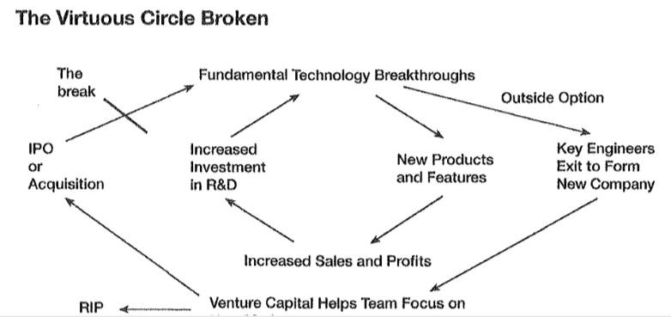
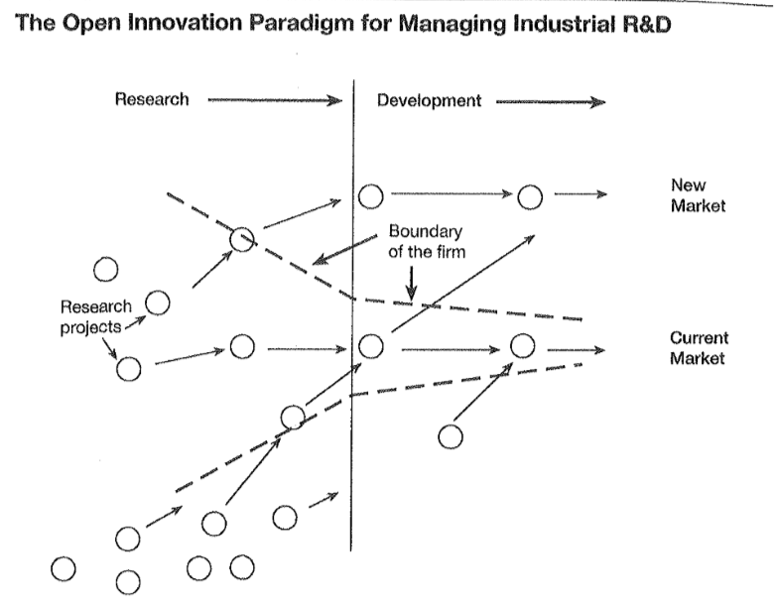
1 The business model of firm stylizes both external and internal ideas to create value
2 Internal idea can also be taken to market through external channels, outside the current businesses of the firm, to get additional value.
Open Innovation
Notes:
So ,because of these factors, open innovation show up.
The logic of open innovation based on a landscape of abundant knowledge. The know that internal idea can also be taken to market through external channels, outside the current businesses of the firm, to get additional value.

Slide 7
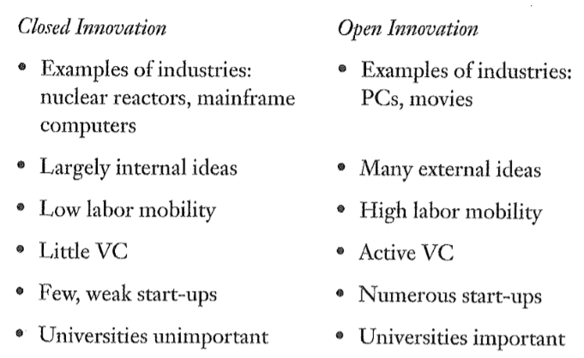
Assessing the prevalence of Open Innovation
1 Open innovation are not specific to the high-tech portion of the overall economy, but also suitable for non-high-tech industry. (Procter & Gamble)
2 Some industries still operate in an Closed innovation regime, and they work well. (Nuclear reactors, aircraft enfines)
3 Some industries have been in an Open innovation mode for a while. ( Hollywood film industry)
Notes:
Procter&Gamble,decided to extended its internal R&D to the outside world.
Contribution: Nowadays，many industries are transition between the two paradigms , if your business face this kind of shift, this book will be a valuable book for you.
Also, this book talk about so many example, the experience of other industries, maybe you will get some insights to deal with things that may happen to you in the future.

Slide 8
Insight
Chapter1: Xerox Corporation, Transition from CI to OI
Chapter4: The value of an idea or a technology depends on its business model.
Chapter5: How IBM manages innovation.
Chapter6: Intel’s approach, bringing external technology inside
Chapter7: Lucent’s approach, taking internal technology outside
Chapter8: Examines the management of intellectual property(IP) in the innovation process. That in a world of abundant knowledge, companies should be active buyers and active sellers of IP
Chapter9: How companies can make the transition to a more Open Innovation System.
Chapter2: Closed Innovation & Chapter3: Open Innovation

