Slide 1
Missing concepts
Critical Cybernetics, Sustainability , Artificial Intelligence

Slide 2
Klaus Krippendorff: Critical Cybernetics (I), Feb.21, 2021 > https://youtu.be/VnF8_enkWKM , 45min
Organizado pela American Society of Cybernetics

Slide 7
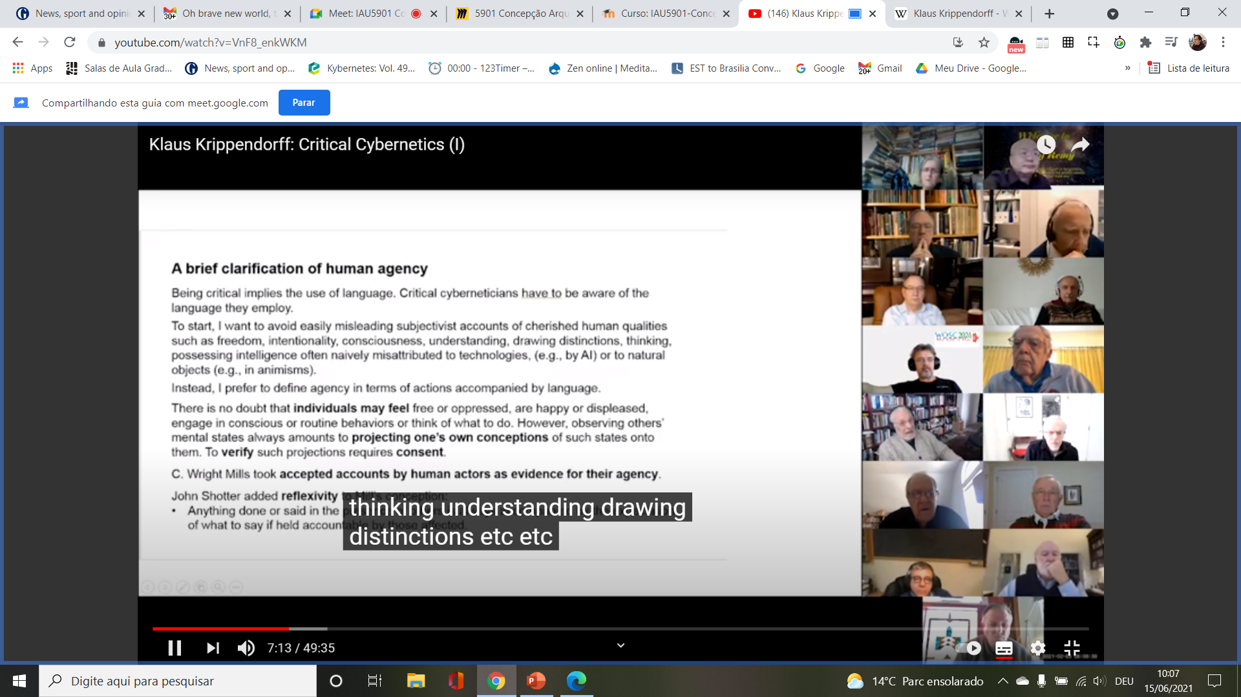

Slide 8
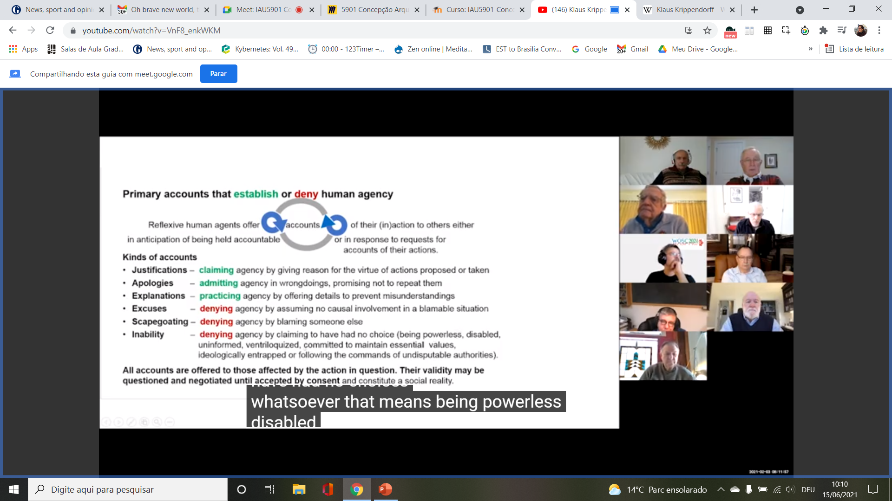

Slide 9
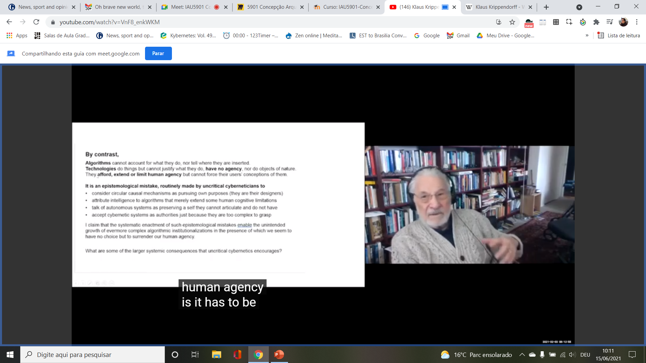

Slide 10
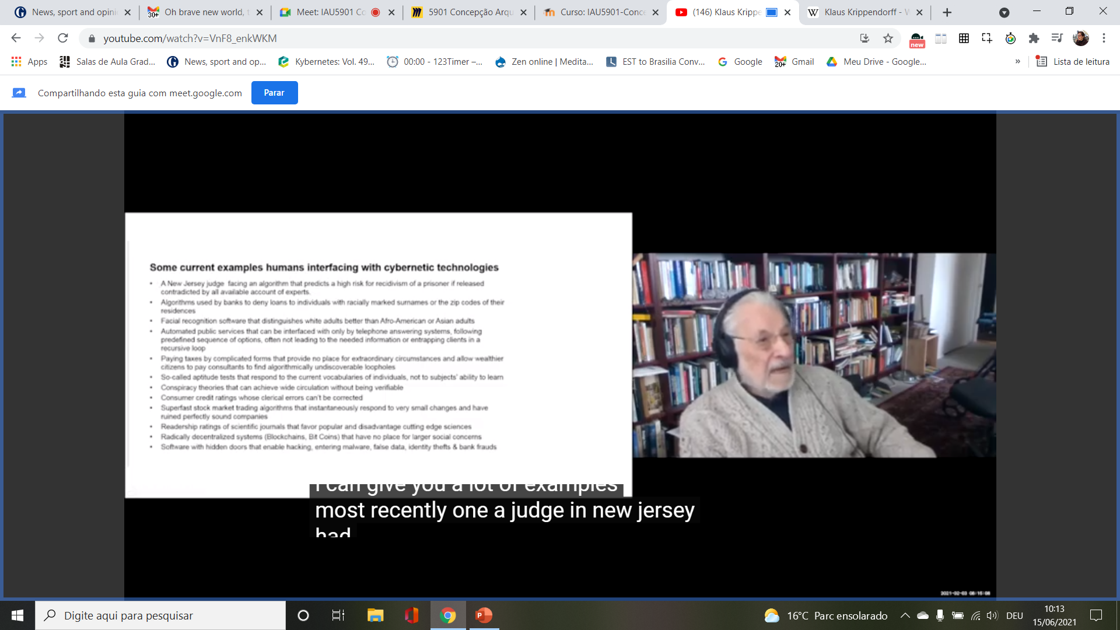

Slide 11
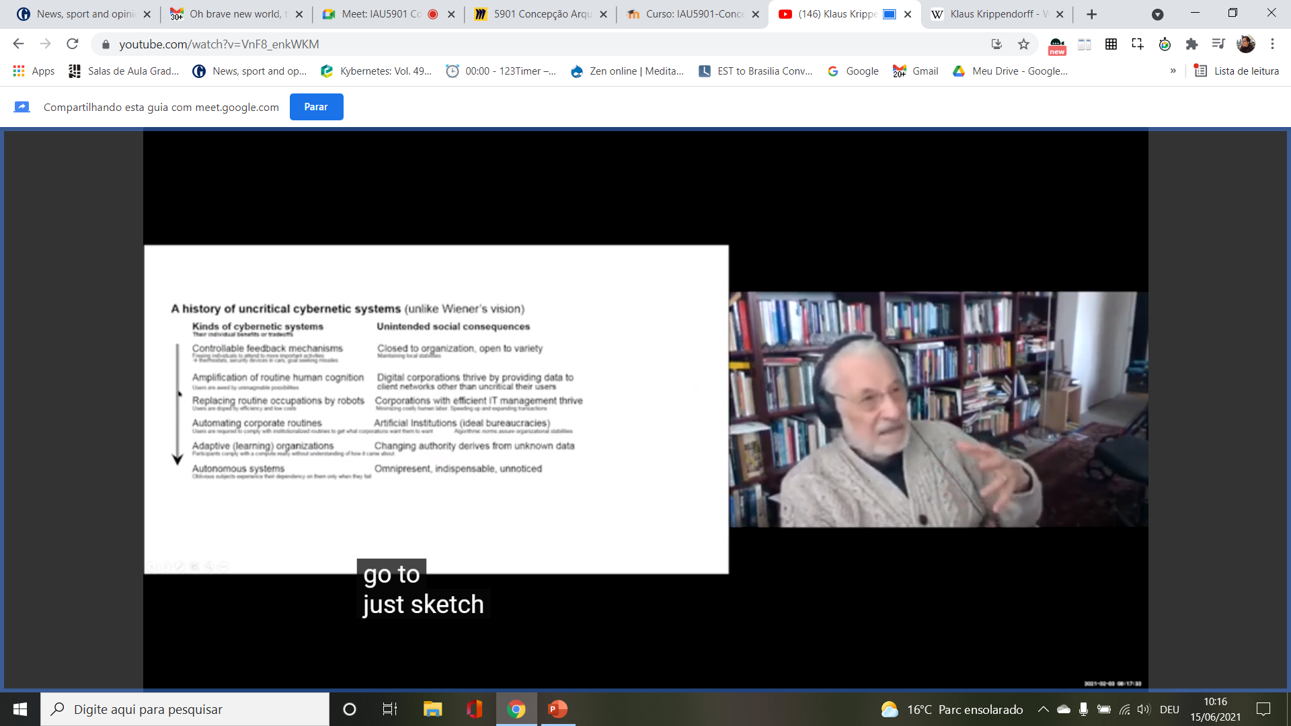

Slide 13
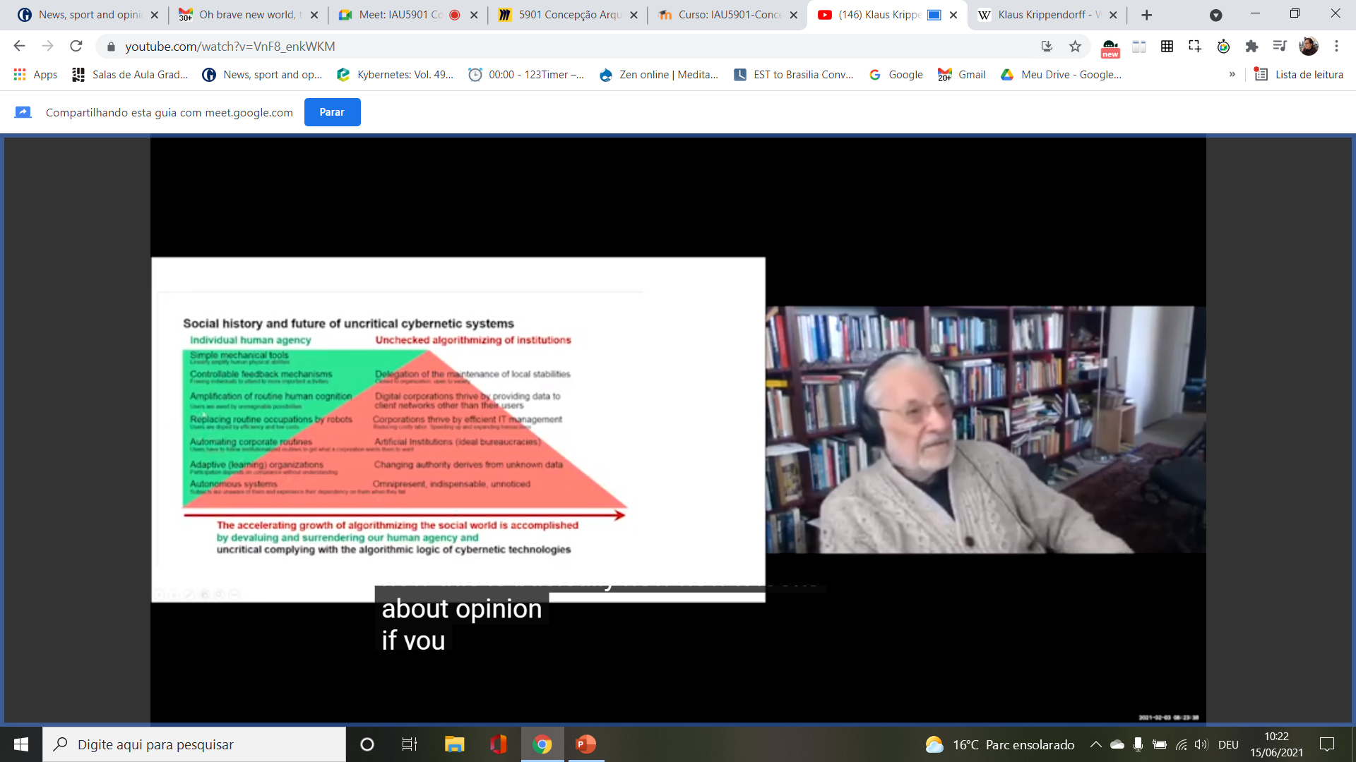

Slide 14
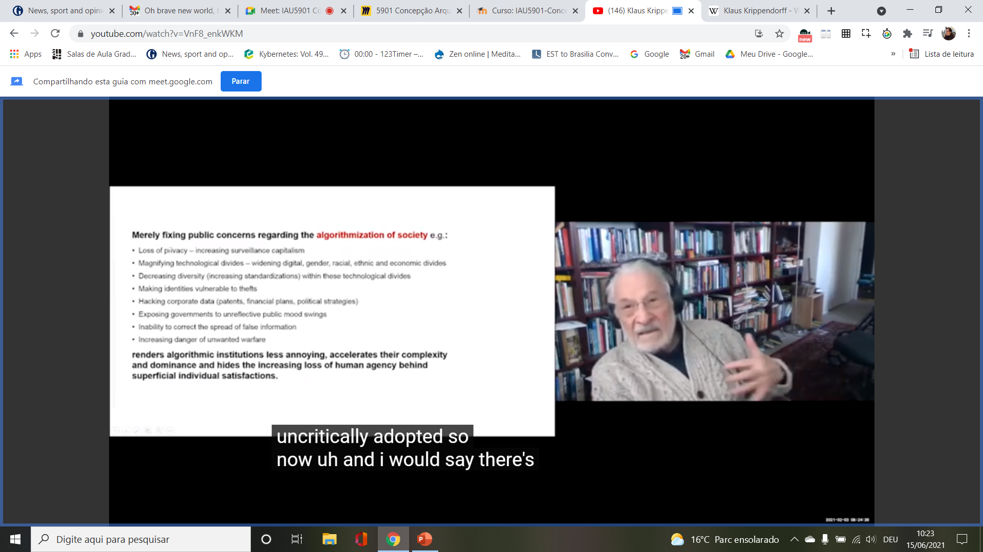

Slide 18
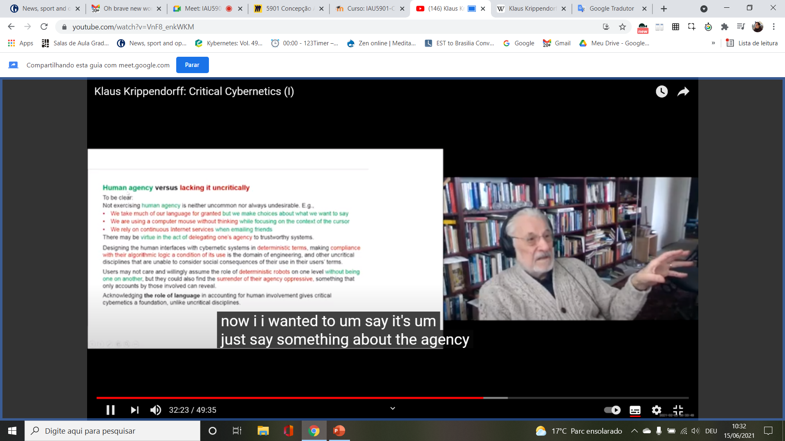

Slide 19
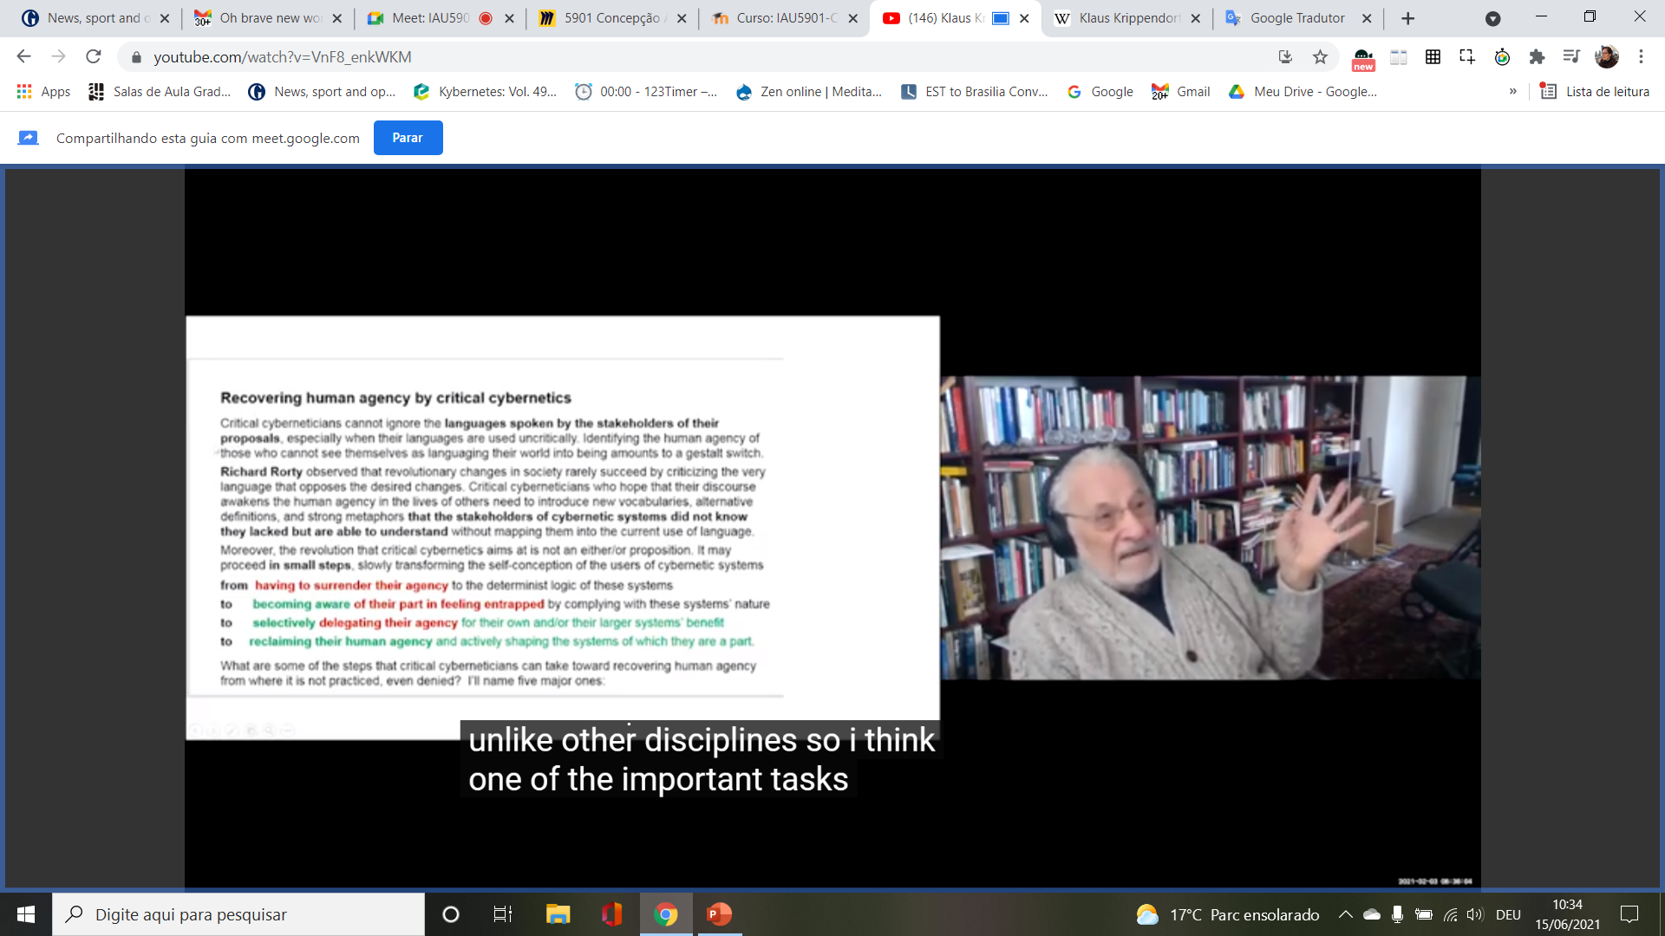

Slide 20
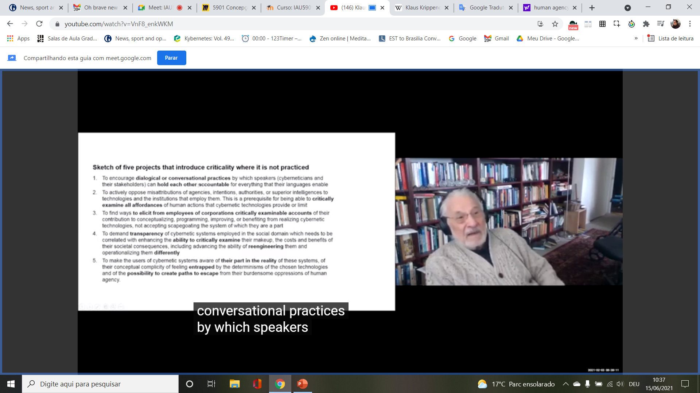

Slide 21
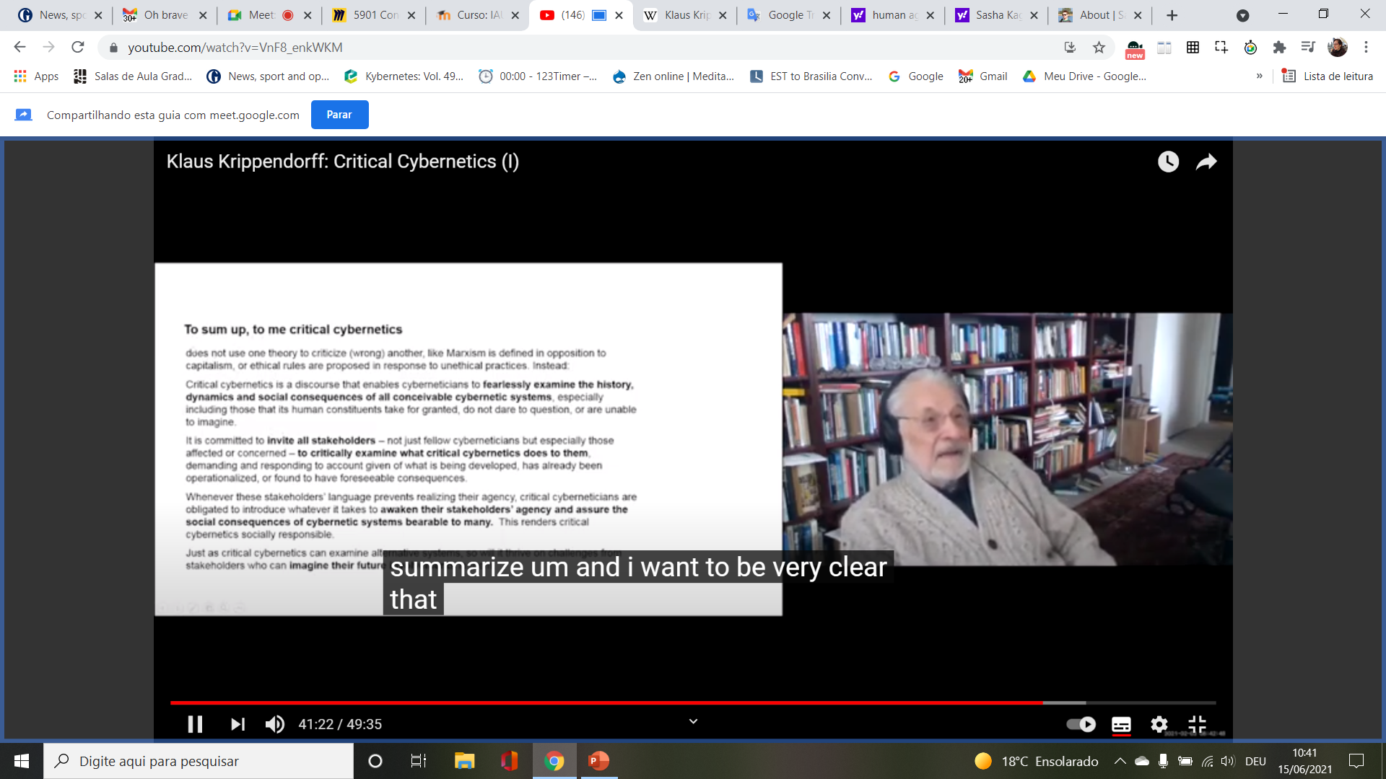
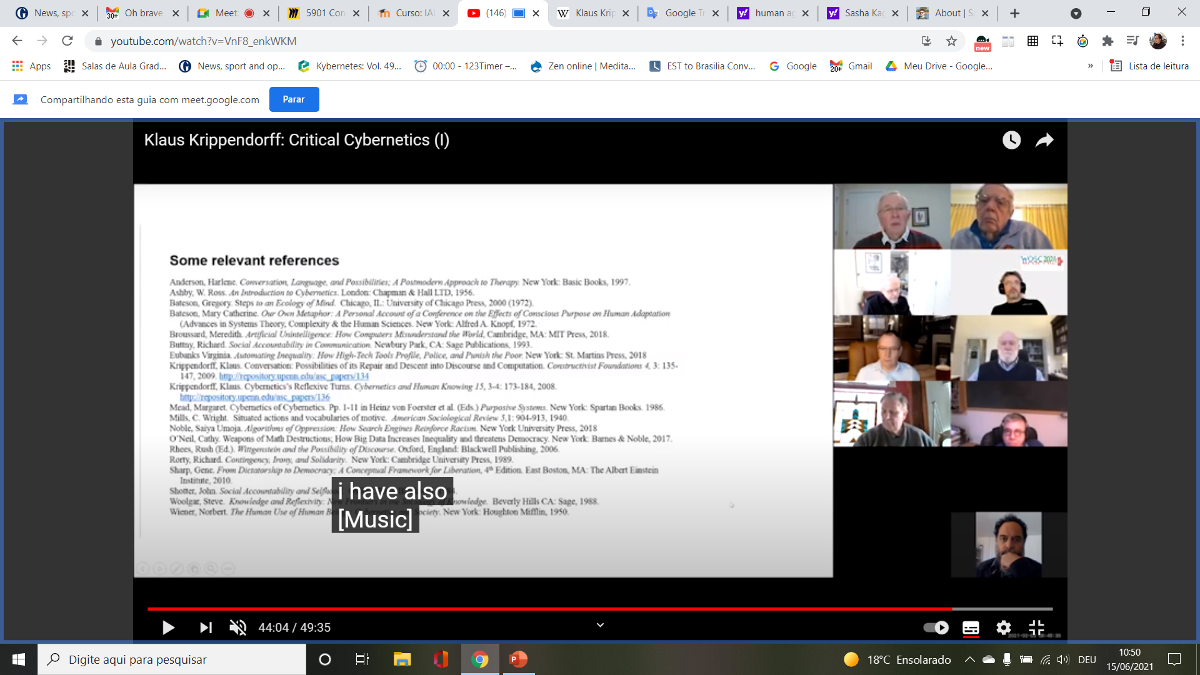

Slide 22
Sacha Kagan, Introduction to Sustainability and Culture, https://youtu.be/aM4LoypTVZ4 , set. 10,2020, 24min54

Slide 25
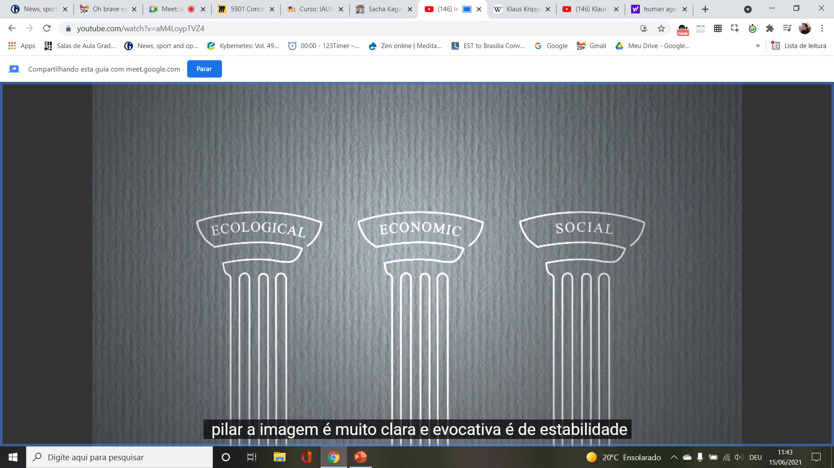

Slide 26
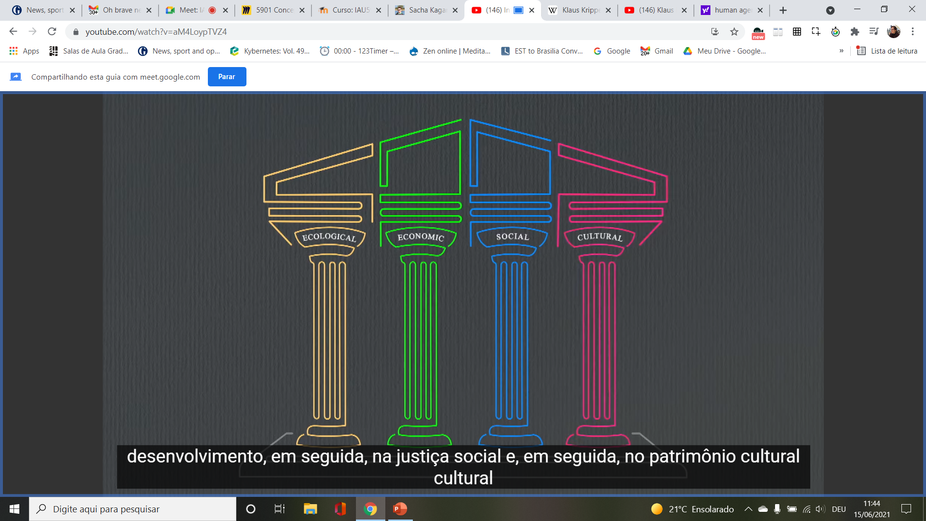

Slide 27
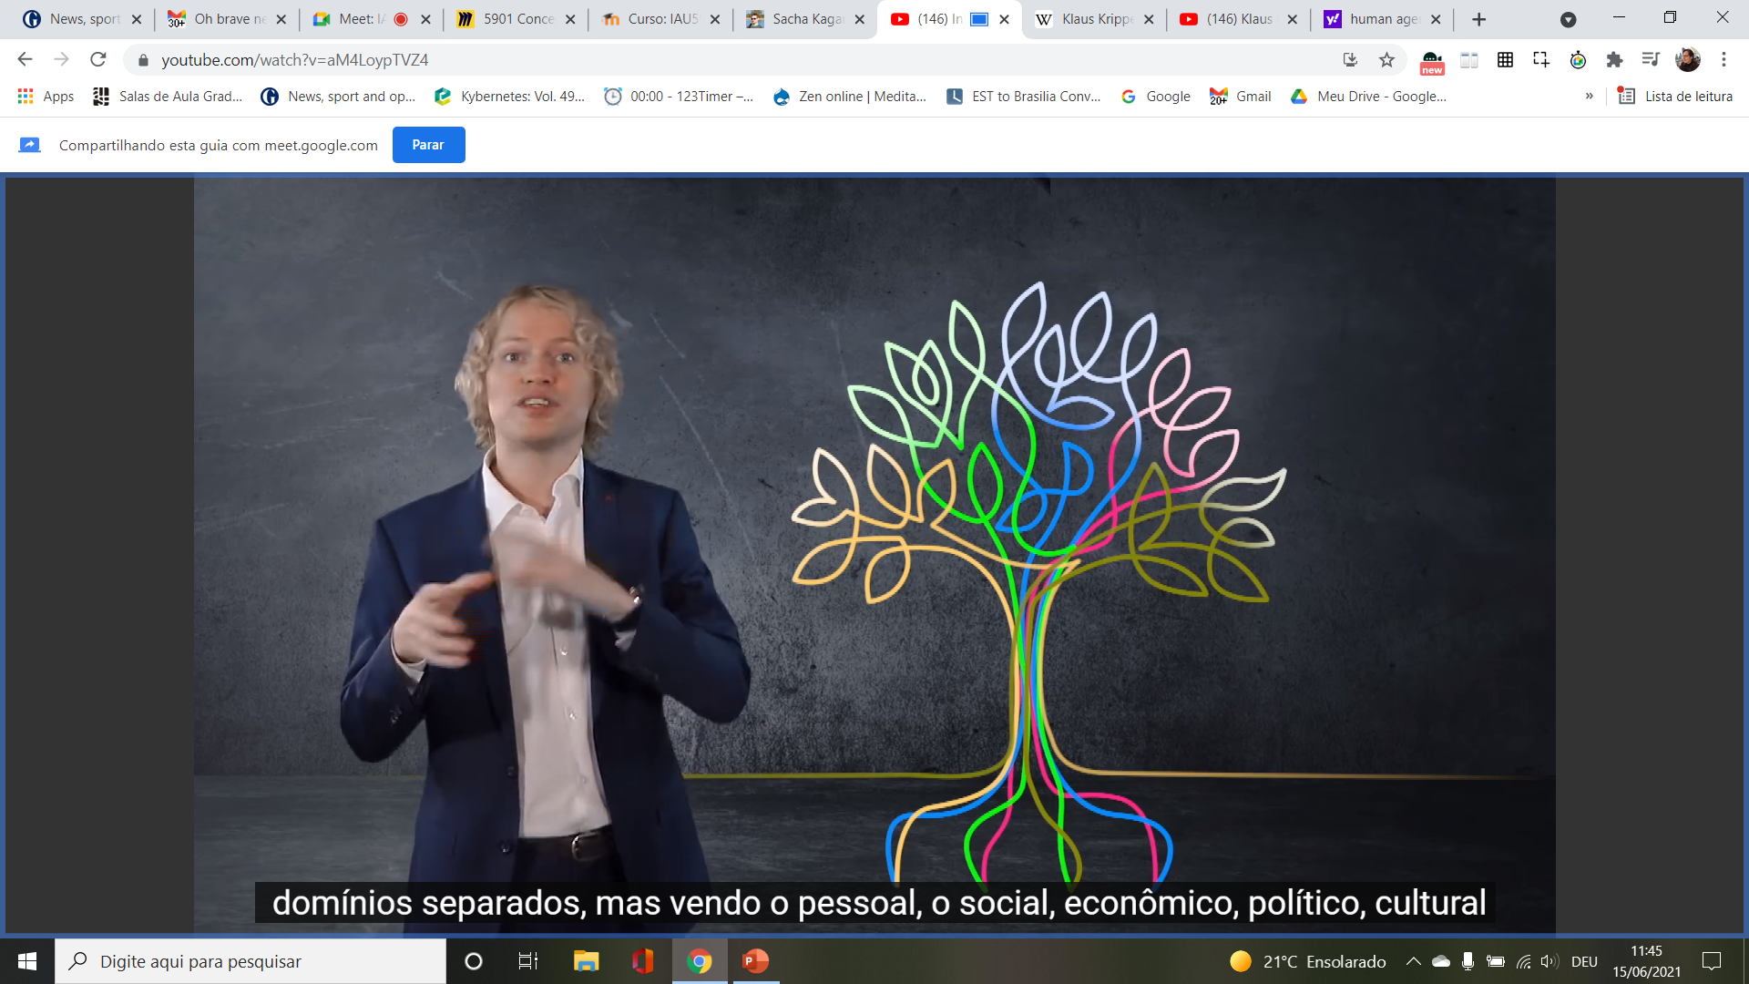

Slide 28
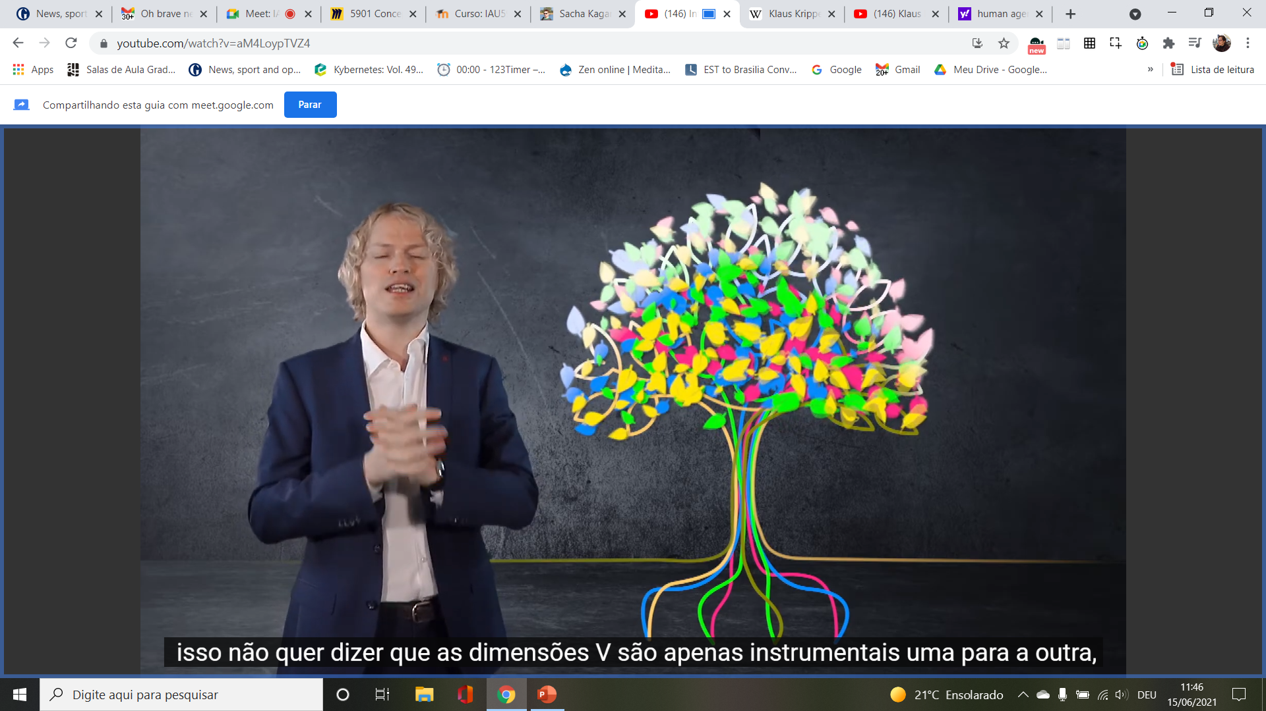

Slide 36
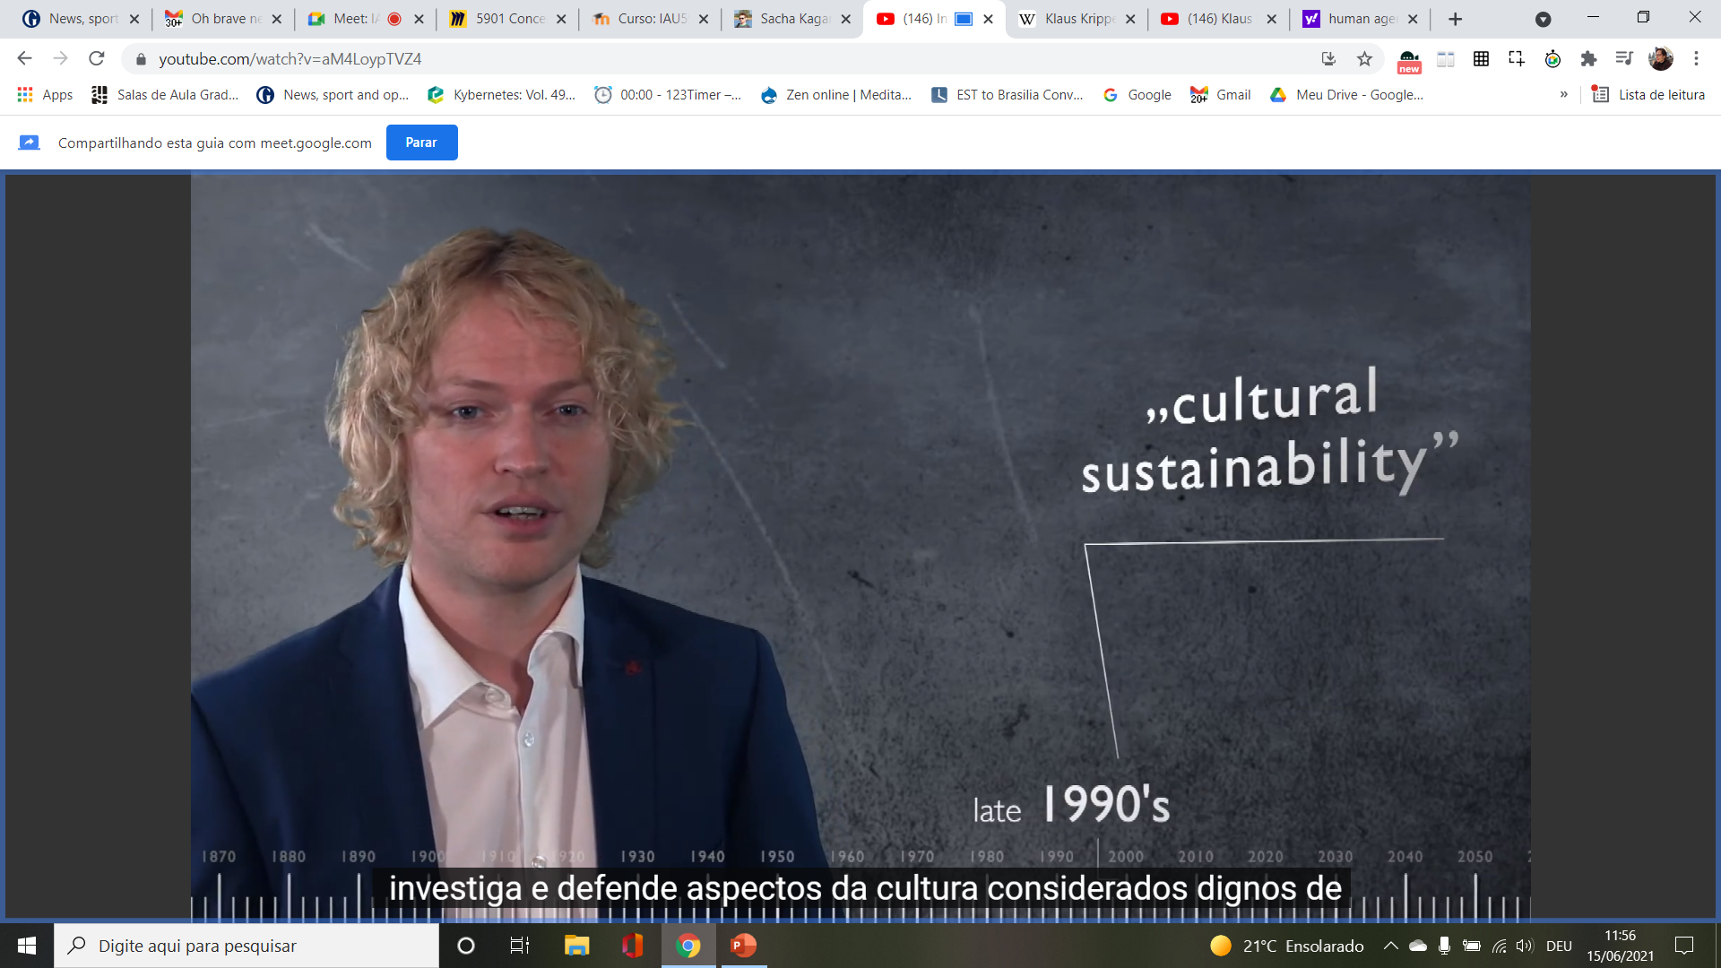

Slide 39
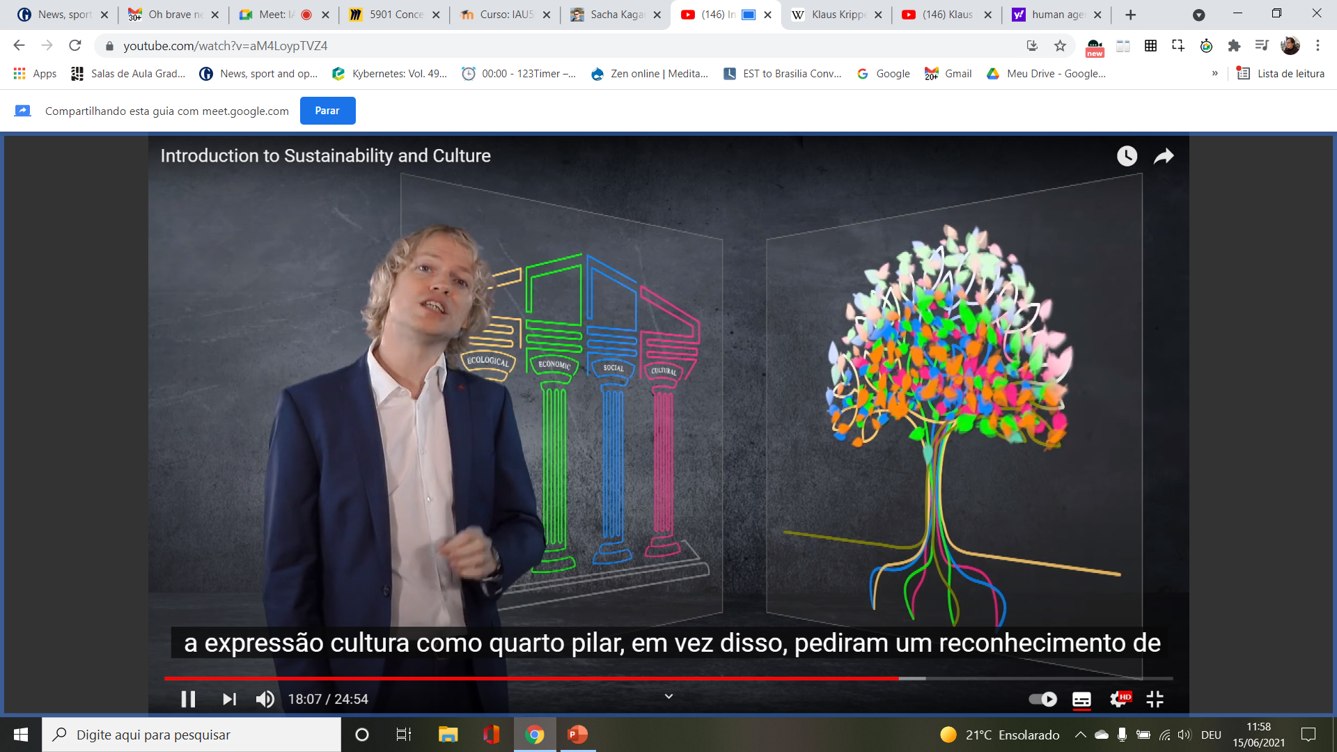

Slide 40
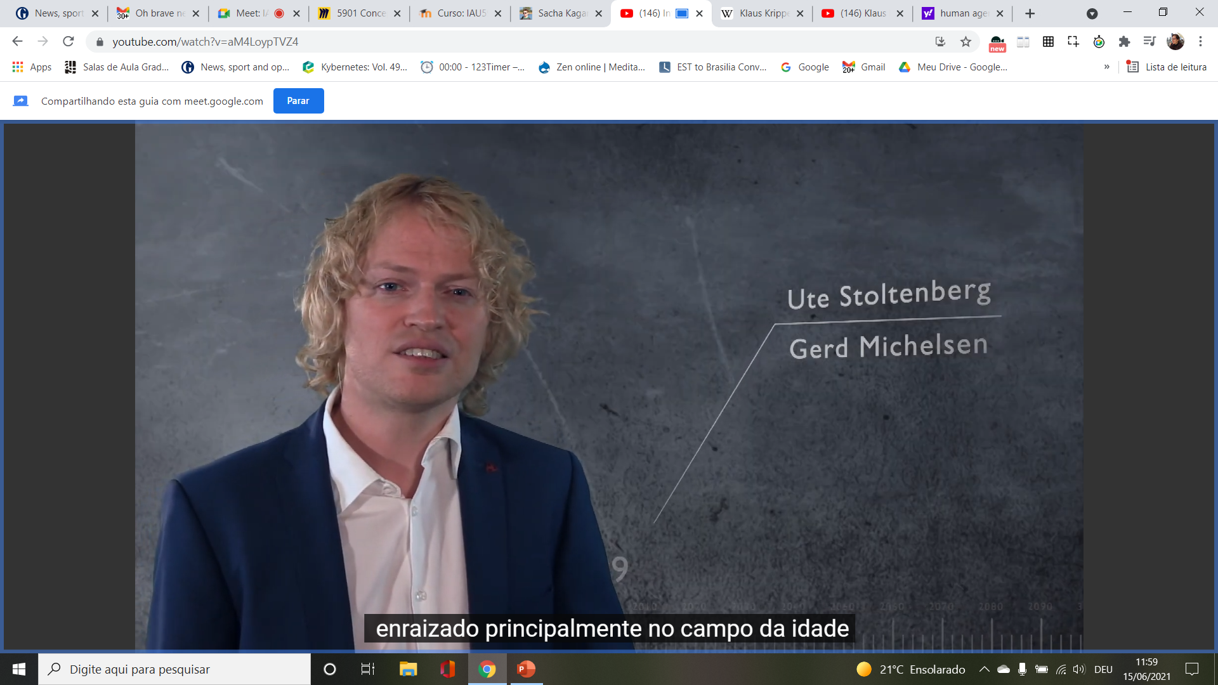

Slide 41
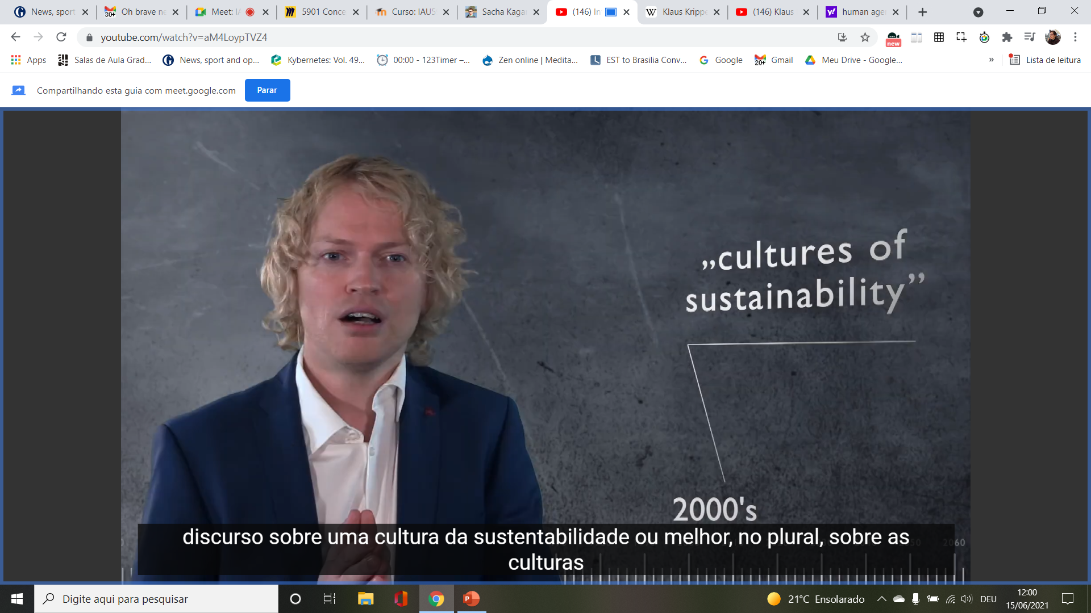

Slide 43
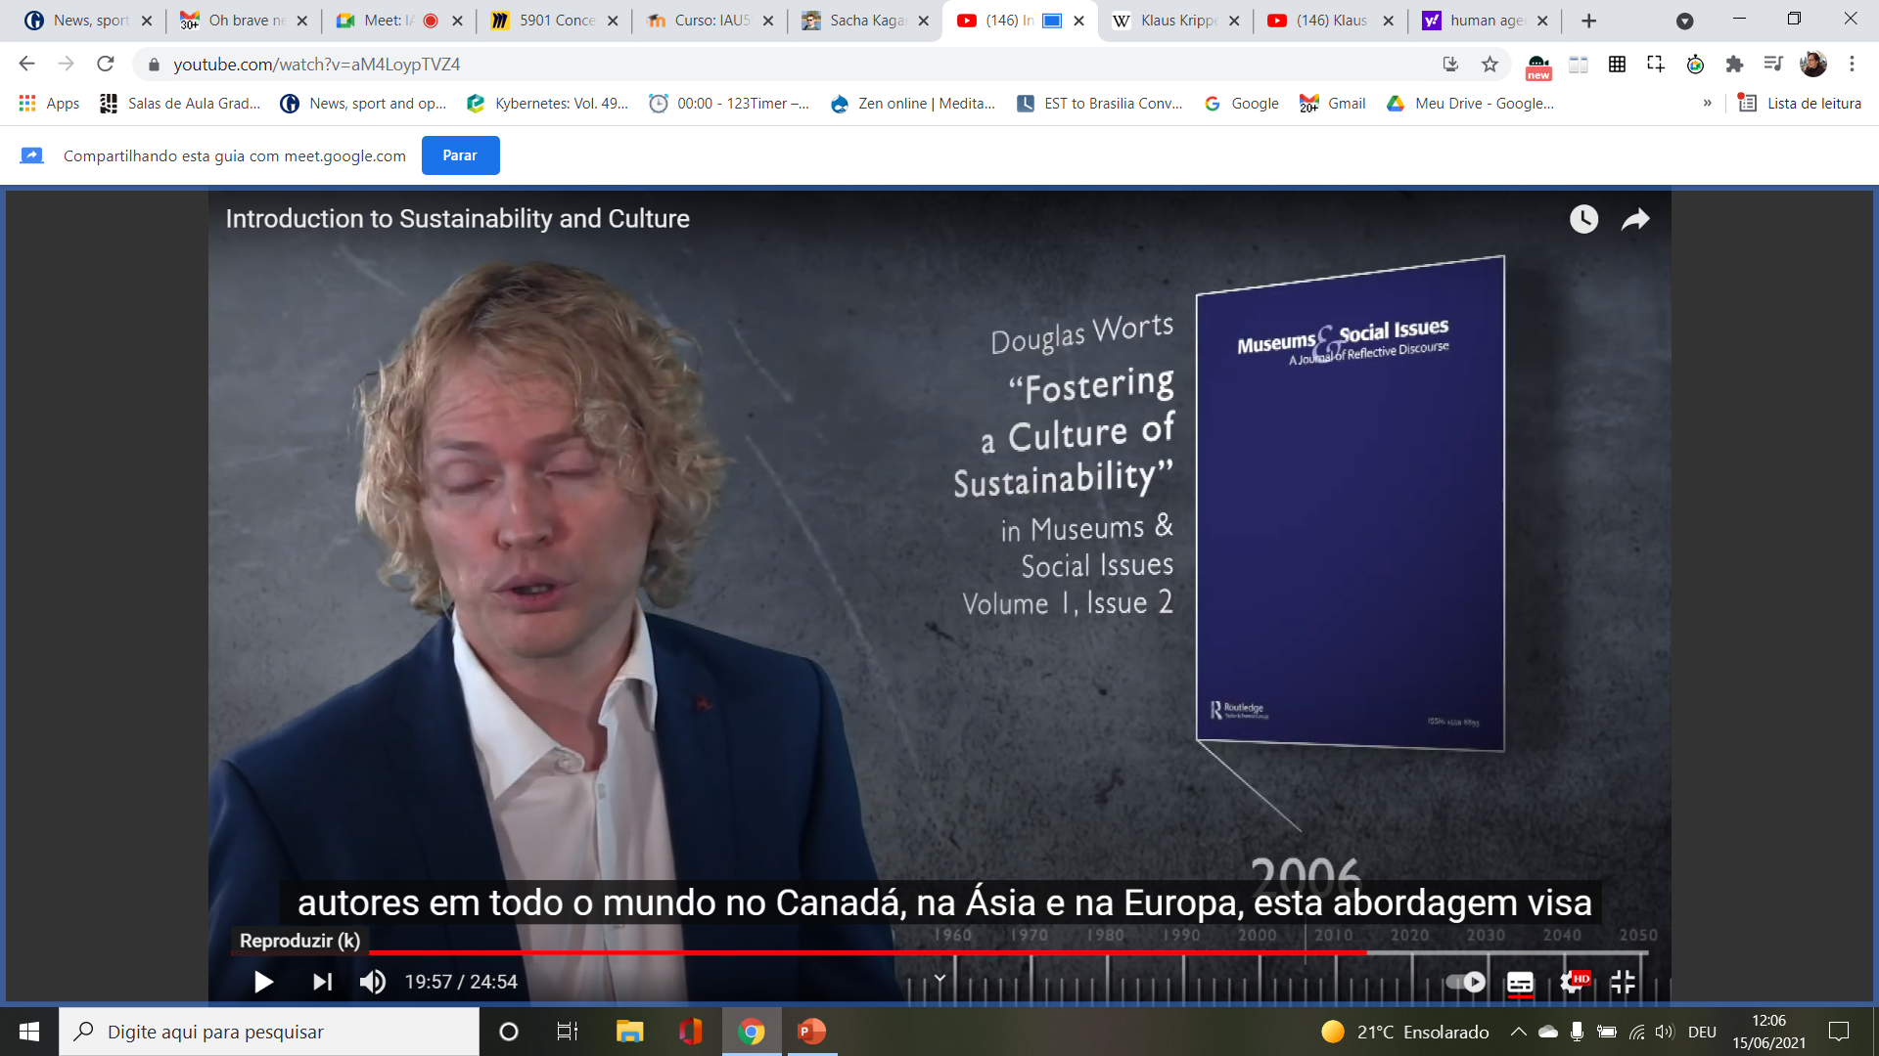

Slide 44
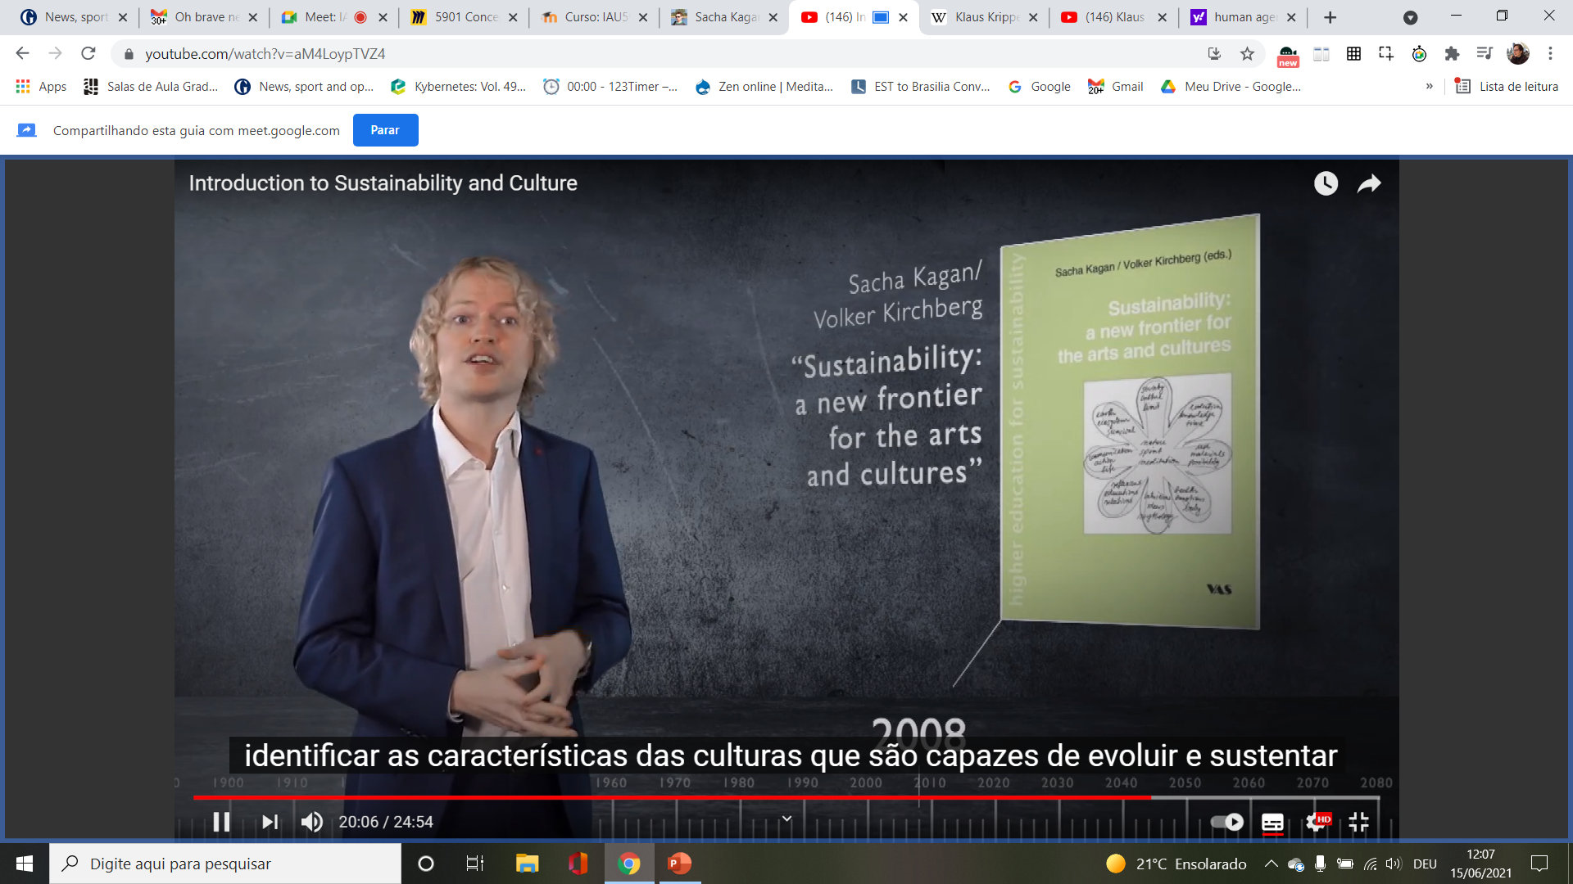

Slide 45
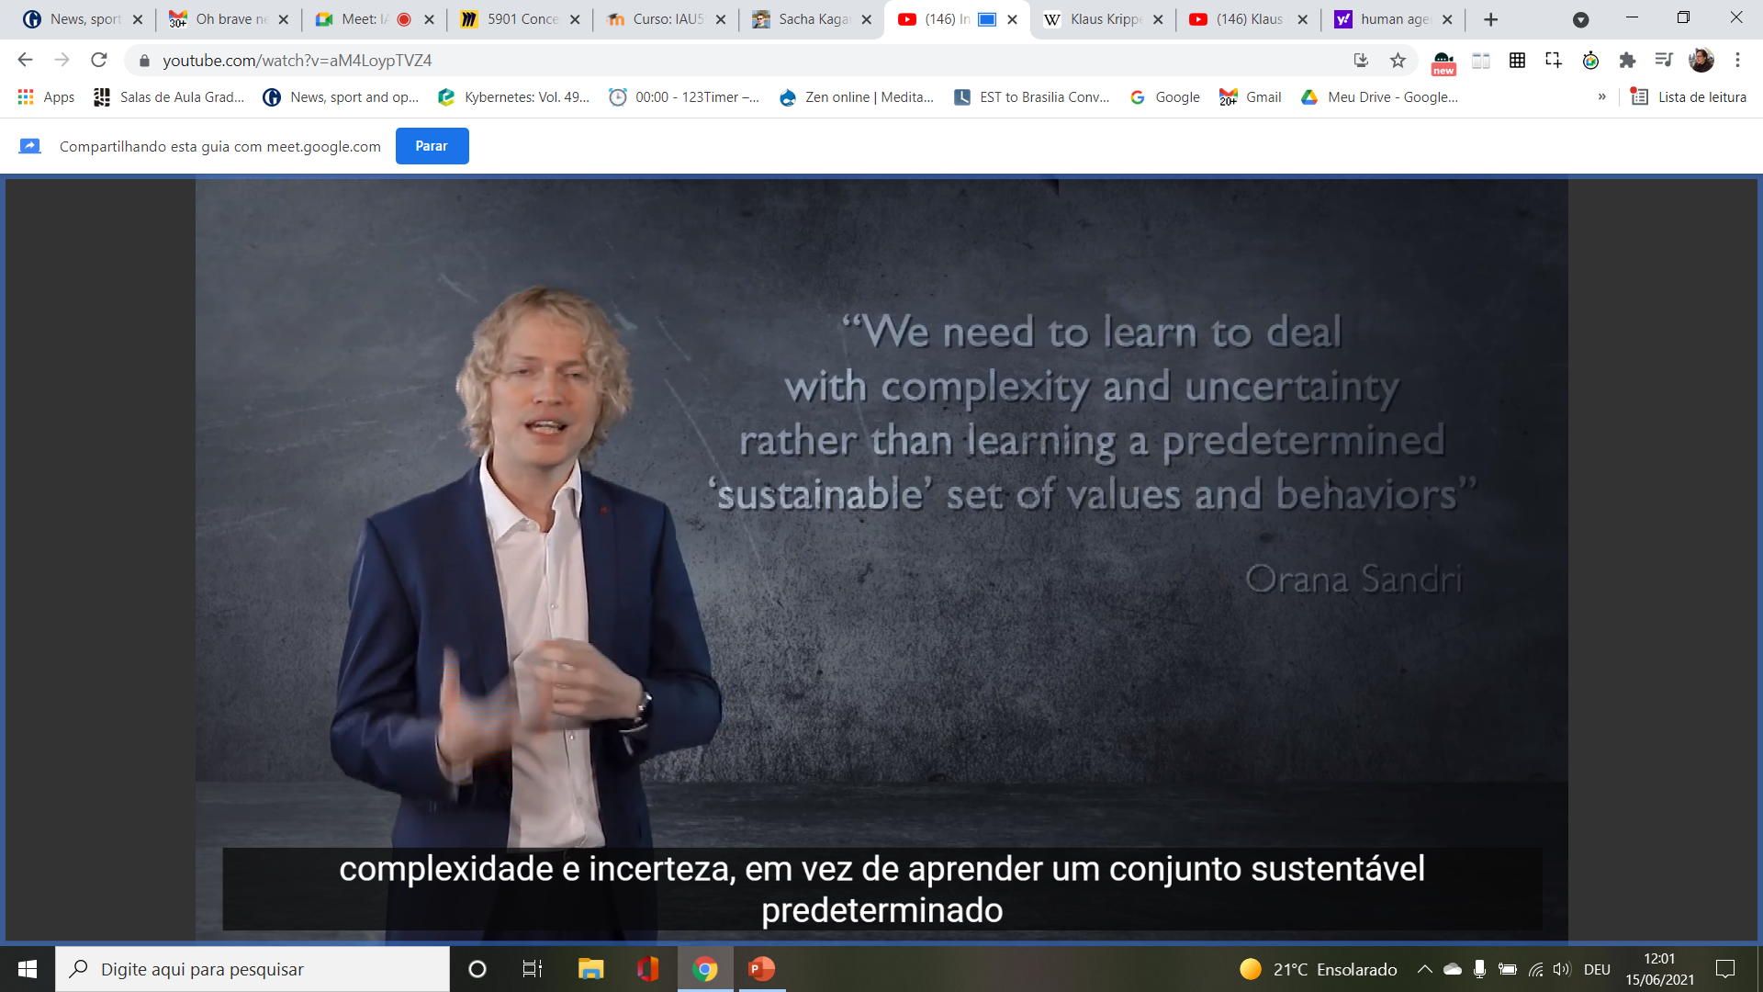

Slide 49
Simposio Vertigo: impasse et devenir de la cibernetique, Palestra Andrew Pickering https://youtu.be/Vg_HgvDMMLo, fev, 27. 2020, min 11-20, IRCAM,

Slide 50
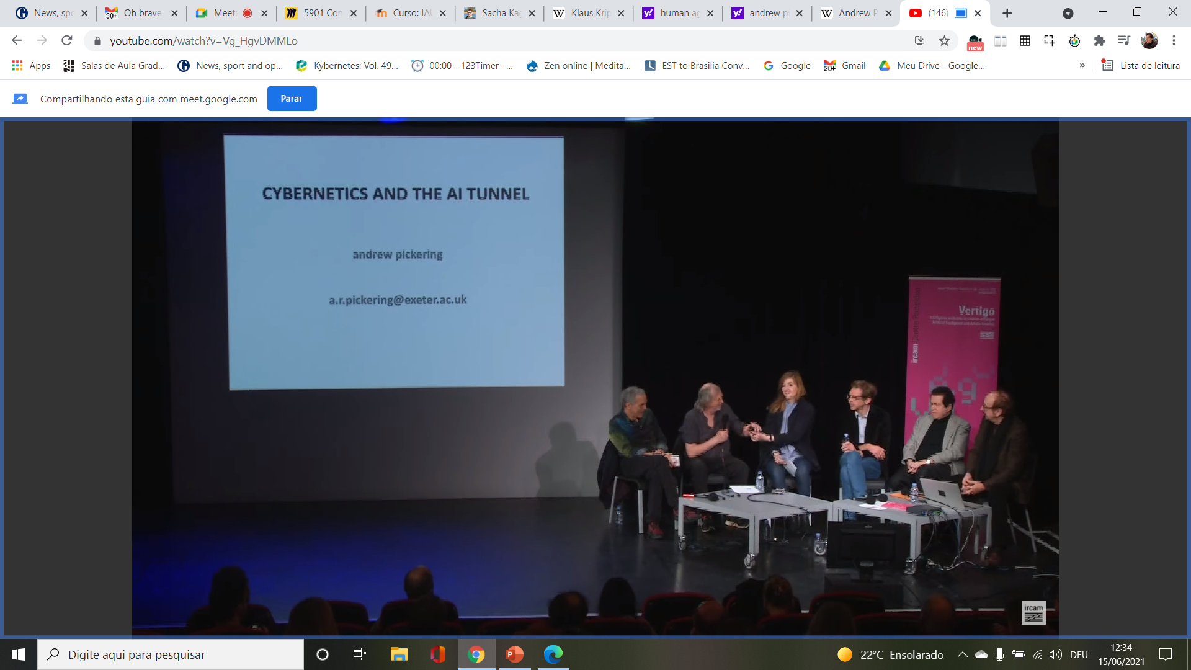

Slide 53
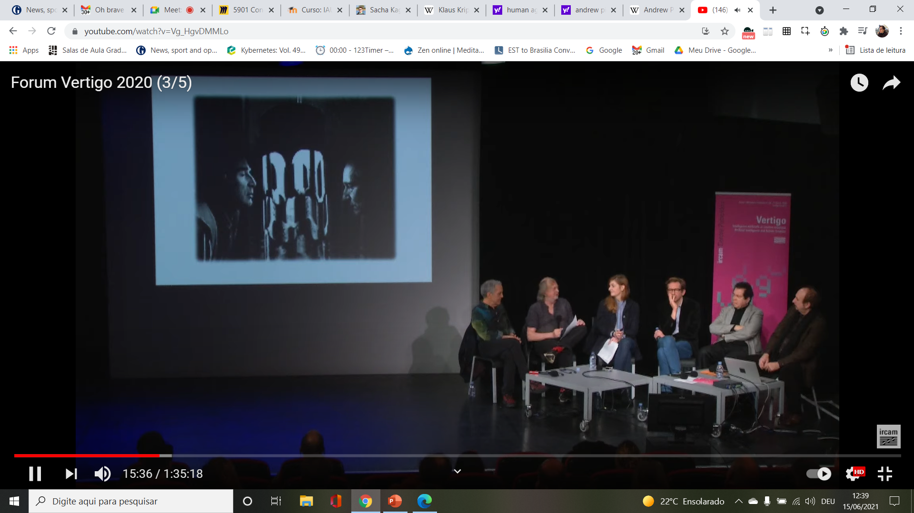

Slide 57
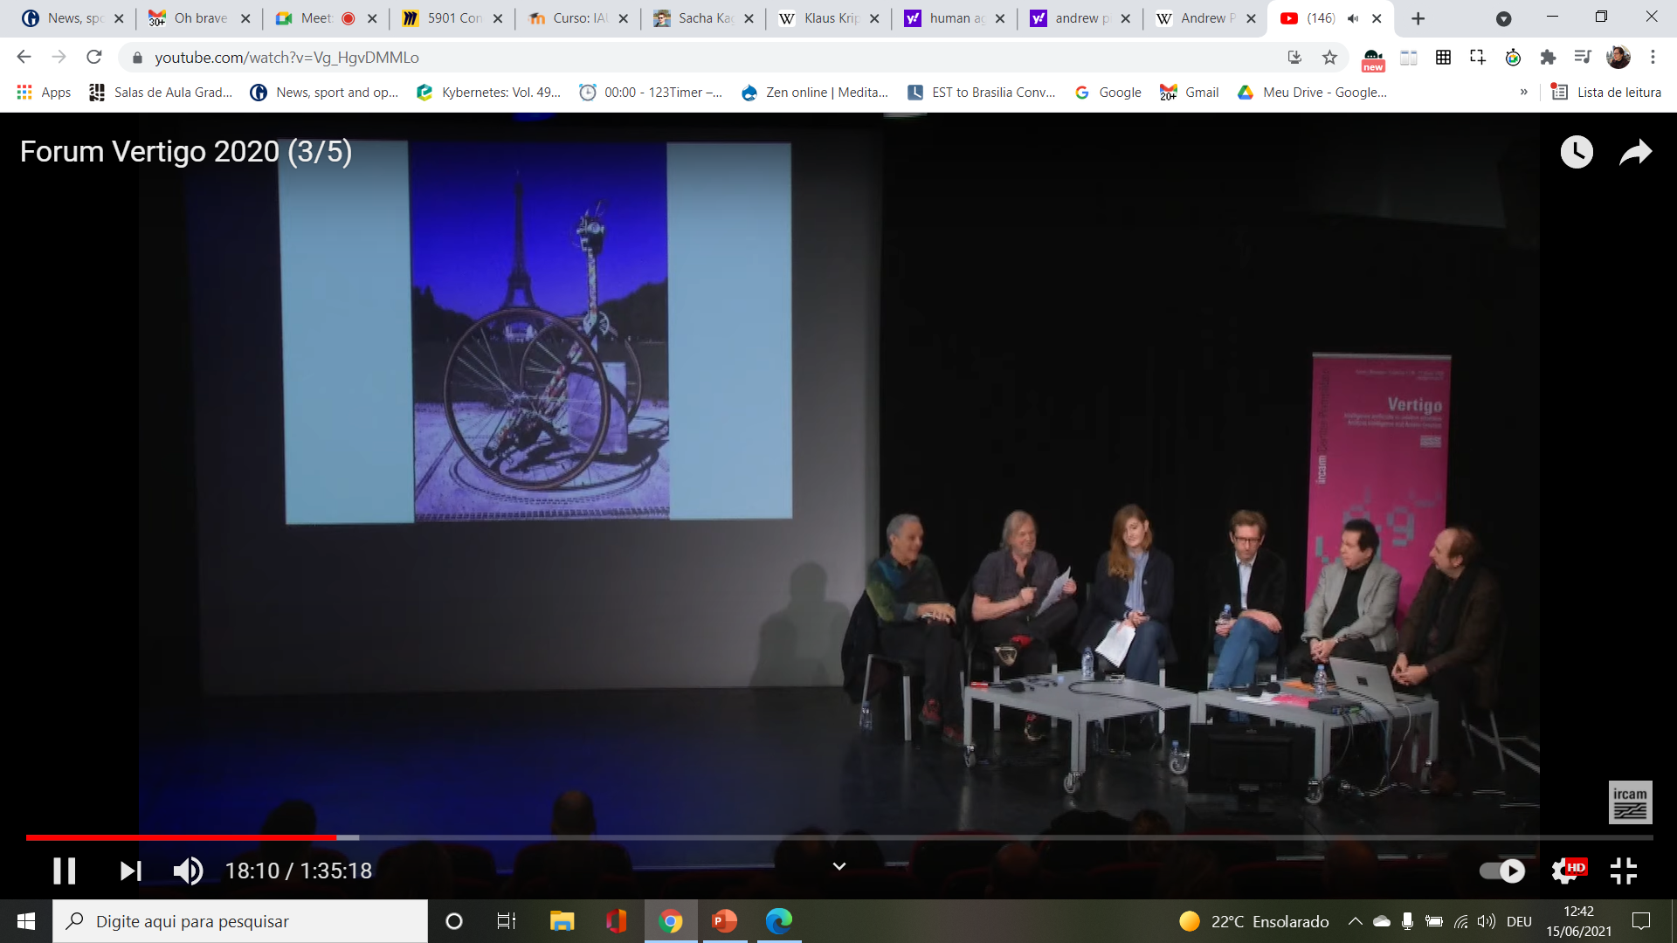

Slide 60
Organizaçoes > https://en.wikipedia.org/wiki/Cybernetics
American Society of Cybernetics, https://asc-cybernetics.org/
16. Congresso Brasileiro de Sistemas, http://eventos.unifacef.com.br/cbs/2021/eventos
Congresso da World Organisation of Systems and Cybernetics CBS, WOSC: https://www.wosc2020.org/

