Slide 1
The economist: Will we ever invent anything this useful again
-The great innovation debate
-has the ideas machine broken down?
By THEERAPORN MANEERATANAPORN

Slide 2
Positive
some of the people think that our age is the most innovative ever
smartphones, supercomputers, big data , nanotechnologies, transplants, gene therapy, stem-cell and so on.
Governments, universities and firms together spend around $1.4 trillion a year on R&D, more than ever before.

Slide 3
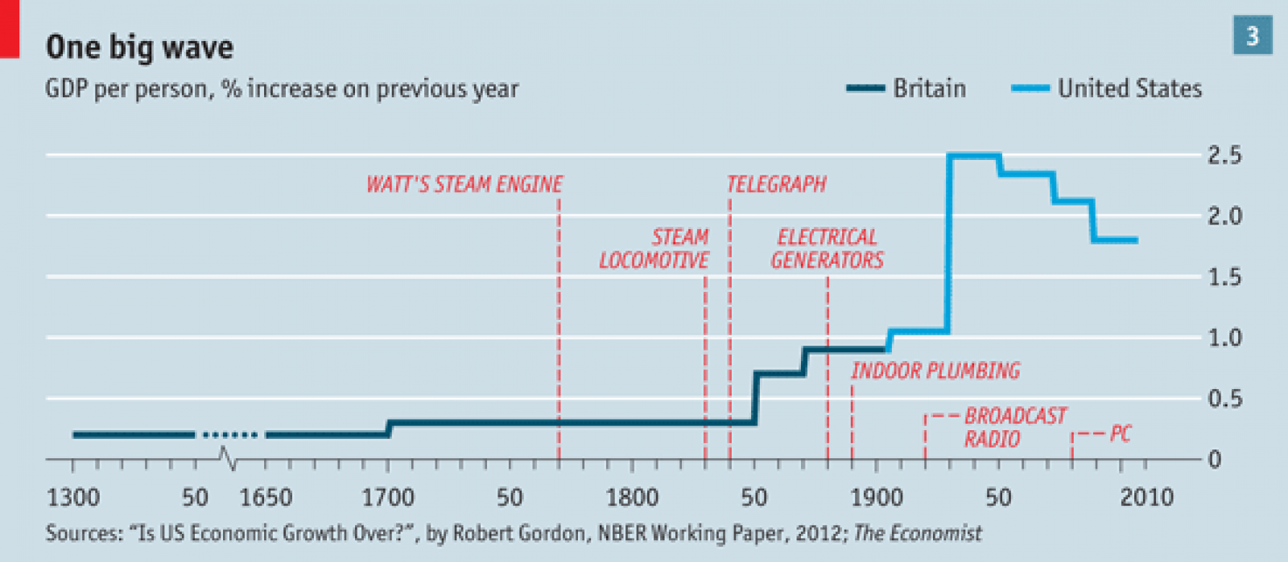
Negative
some other gloomsters (including Robert Gordon and Peter Thiel) claim that the pace of innovation has slowed because Nobody recently has come up with an invention half as useful as car, planes, telephone, radio and antibiotics which can transformed the lives of billions of people.

Slide 4
The argument about the world is on a technological plateau runs along three lines
Growth statistics
Extensive growth: labour, capital and resources
Intensive growth: technology
How much invention is going on
In 1950 an average R&D worker in America contributed almost seven times more to “total factor productivity” that an R&D worker in 2000 did
“Burden of knowledge”
Evidence of your senses
Evolution of kitchen
Life expectancy at birth in America
Notes:
1. 1If economic groth depend on one of the factor, the space for developing an extensive economy will become smaller and smaller.
1.2allows continuous improvement in incomes and welfare, and enables an economy to grow even as its population decreases. In this accounting, “technology” is the bit left over after calculating the effect on GDP of things like labour, capital and education. And at the moment, in the rich world, it looks like there is less of it about. Emerging markets still manage fast growth, and should be able to do so for some time, because they are catching up with technologies already used elsewhere. The rich world has no such engine to pull it along, and it shows.
2.1 The growth in the number of people working in research and development might seem to contradict this picture of a less inventive economy。
2.2One factor in this may be the “burden of knowledge”: as ideas accumulate it takes ever longer for new thinkers to catch up with the frontier of their scientific or technical speciality. Mr Jones says that, from 1985 to 1997 alone, the typical “age at first innovation” rose by about one year.
3.1 In 1900 kitchens in even the poshest of households were primitive things. Most households lacked electric lighting and running water. 1970 and middle-class kitchens in America and Europe feature gas and electric hobs and ovens, fridges, food processors, microwaves and dishwashers. Move forward another 40 years, though, and things scarcely change. The gizmos are more numerous and digital displays ubiquitous, but cooking is done much as it was by grandma.
3.2 Life expectancy at birth in America soared from 49 years at the turn of the 20th century to 74 years in 1980. Enormous technical advances have occurred since that time. Yet as of 2011，Despite hundreds of billions of dollars spent on research, life expectancy rested at just 78.7 years.

Slide 5
Innovation is slowing are exaggerated
1.Some example
Life expectancy in America has risen more slowly----but still improving
Across the economy as a whole productivity did slow in 2005 and 2006—but productivity growth in manufacturing fared better.
because of the globalization, a sharing that information technology makes ever easier. The rise of the emerging world is among the biggest reasons for optimism. The larger the size of the global market, the more the world benefits from a given new idea,

Slide 6
Innovation is slowing are exaggerated
2.Innovation takes time to spread and learn
Susanto Basu and John Fernald suggests that the lag between investments in information-and-communication technologies and improvements in productivity is between 5 and 15 years.
Innovation is what people newly know how to do. Technology is what they are actually doing; and that is what matters to the economy.
Roughly a century lapsed between the first commercial deployments of James Watt’s steam engine and steam’s peak contribution to British growth.
Driverless cars produced by Google, could be common on streets within a decade. The performance of human Prosthetics is rapidly catching up with that of natural limbs.
So, it is too soon to judge how big a deal these inventions will turn out to be.
Notes:
1-2:Full exploitation of a technology can take far longer than that.

Slide 7
Innovation is slowing are exaggerated
3.“the second half of the chess board”--Ray Kurzweil
not only has the cumulative effect of innovations become large, but each new iteration of innovation delivers a technological jolt as powerful as all previous rounds combined.
Notes:
a pioneer of computer science and a devotee of exponential technological extrapolation,
1.This person describes modern technology as

Slide 8
Government Role
The biggest danger --Government
When government was smaller, innovation was easier. Industrialists could introduce new processes or change a product’s design without a man from the ministry claiming some regulation had been broken.

Slide 9
Government Role
The biggest danger --Government
When government intervenes excessively, it will reduce the efficiency of innovation.
poorly crafted regulations may unduly raise the cost of new research, discouraging further innovation.
Process becomes complicated.
The state has also notably failed to open itself up to innovation（for example, Productivity is mostly stagnant in the public sector）
(Some good: Environmental protection)
Notes:
1 Far more rule which unnecessary for the public good,

Slide 10
Government Role
Technological unemployment.
new technologies and the globalisation have already contributed to stagnant incomes and a decline in jobs that require moderate levels of skill. Further progress could threaten jobs higher up and lower down the skill spectrum that had.
Government preference
Eg. Apollo program which provided an ongoing demand for talent and invention. But Private investors rationally prefer modest business models with a reasonably short time to profit and cash out.
If the government responds properly, the benefits of technological advancement can be widely benefited to the whole society; if they are screwed up, it will lead to two attacks – angry and unemployed workers, and resentful taxpayers.
Notes:
1.1 We know that when technology develops to a certain extent, many machines will replace human work.
1.2 Government investment trends are inconsistent with private entrepreneurs,like Apollo programme which provided an ongoing demand for talent and invention. But Private investors rationally prefer modest business models with a reasonably short time to profit and cash out

