Slide 1
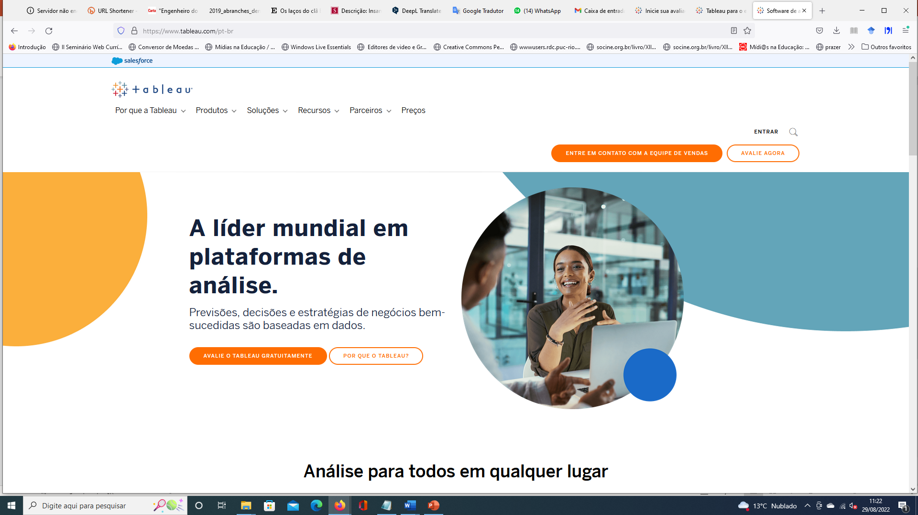
https://www.tableau.com/pt-br

Slide 2
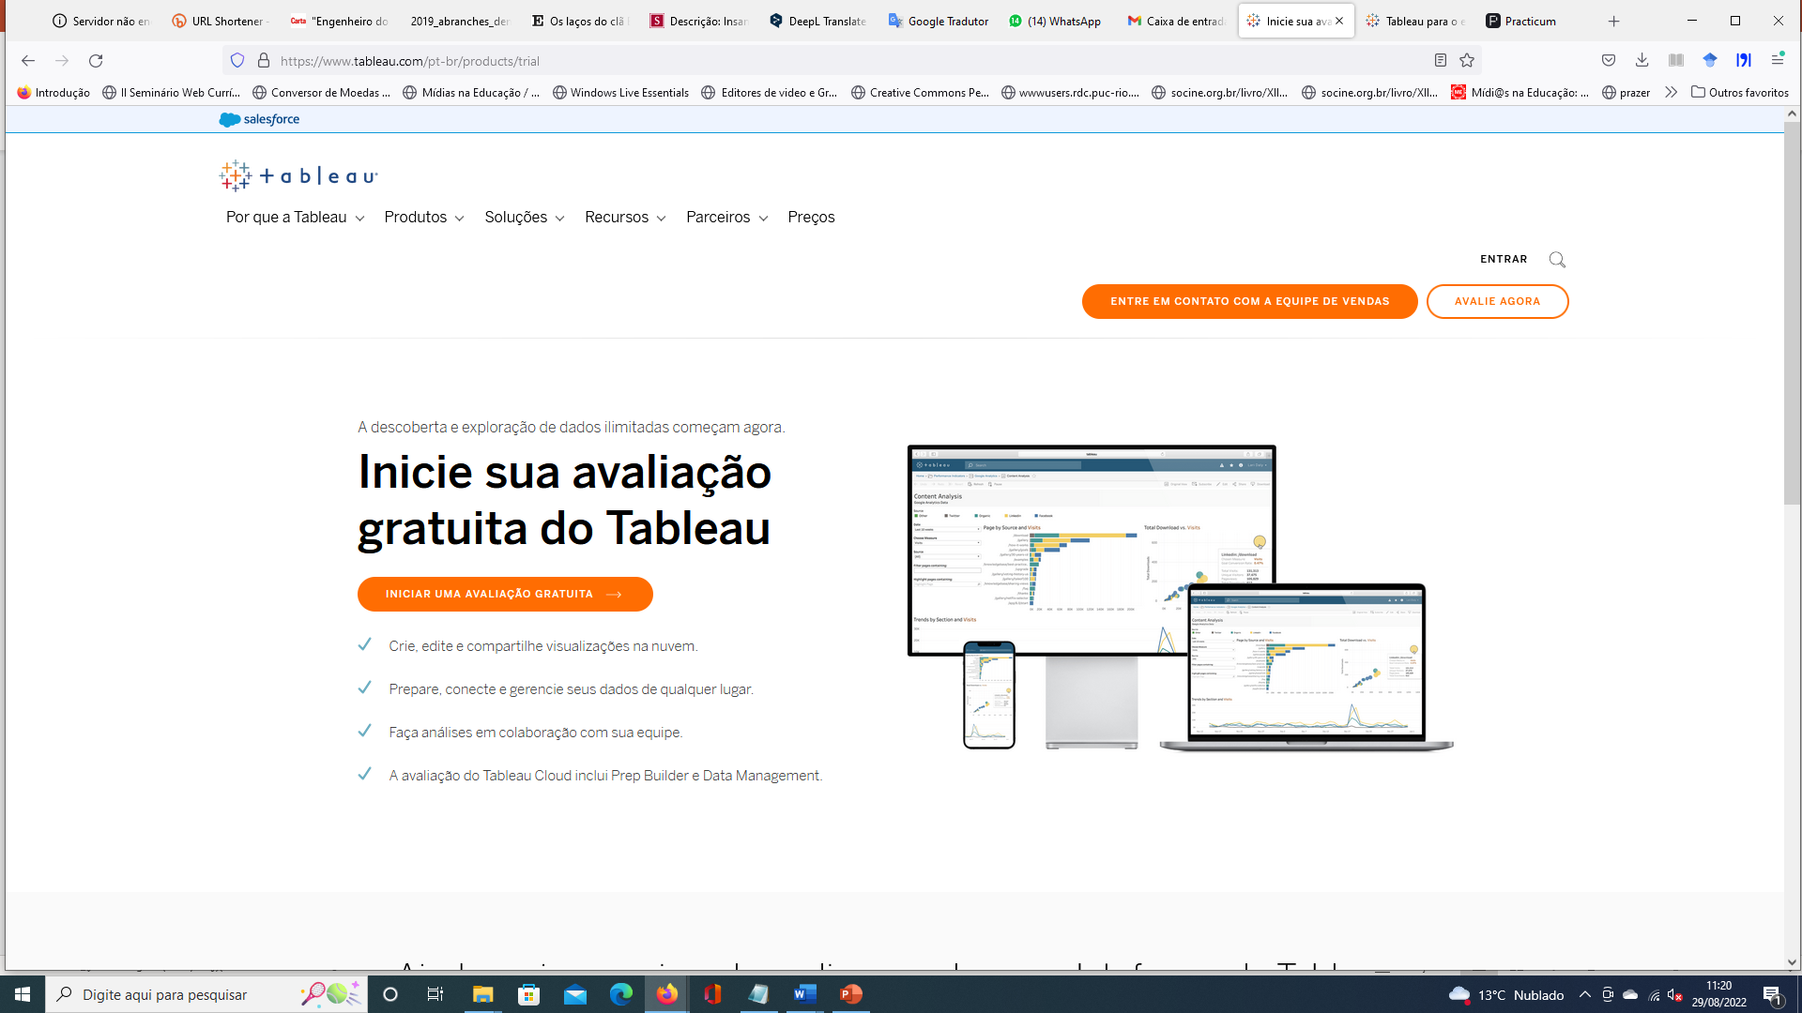
https://www.tableau.com/pt-br/products/trial

Slide 3
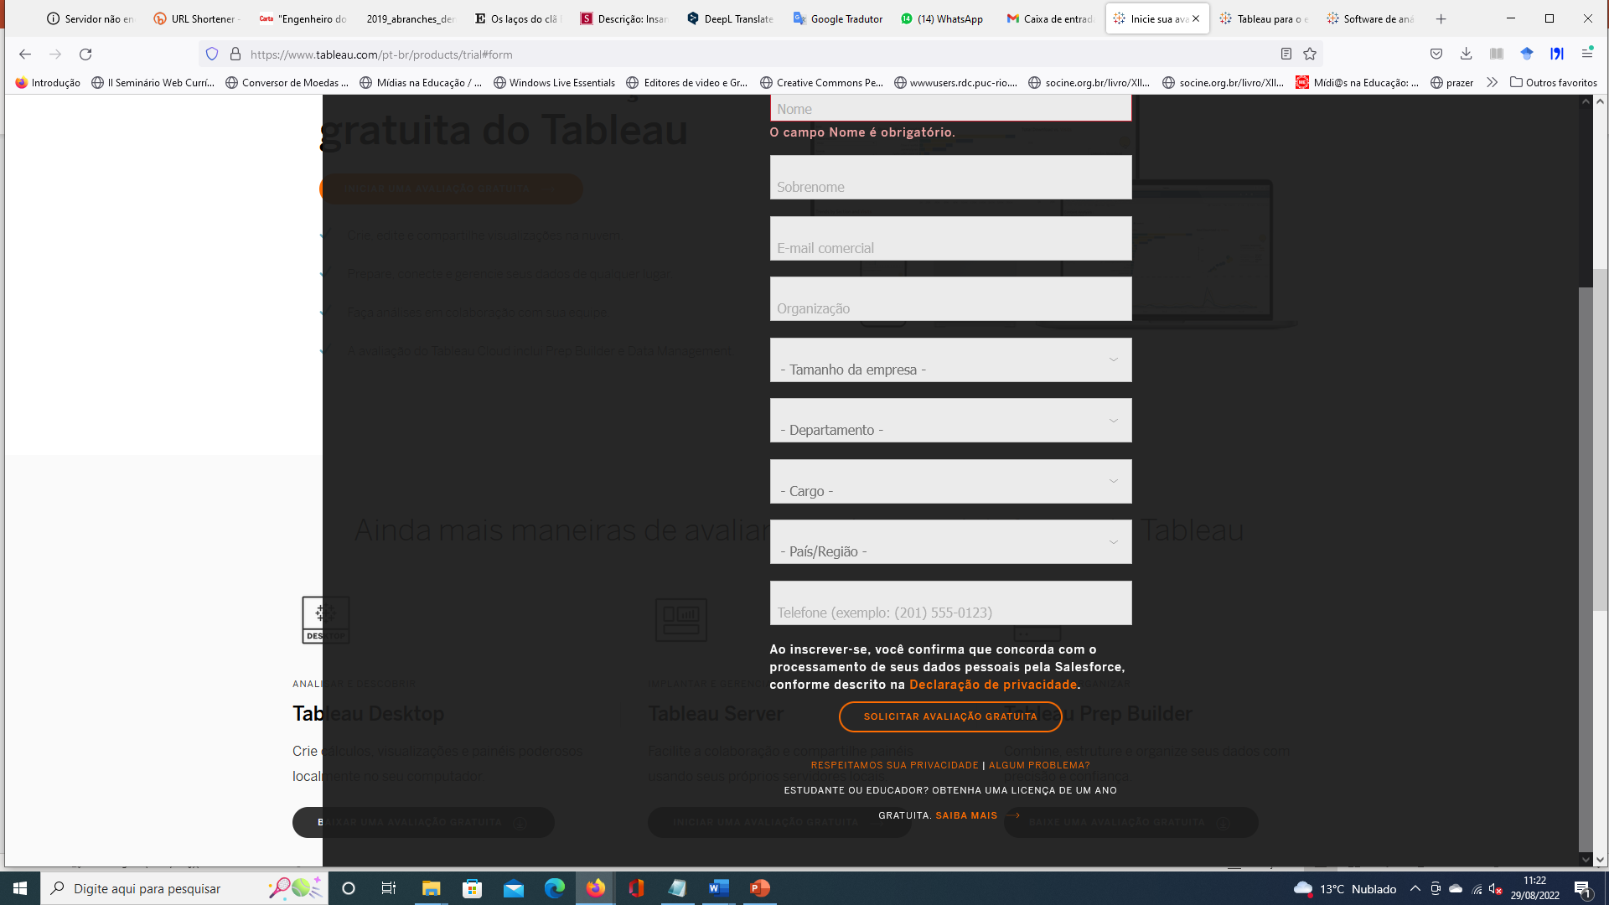

Slide 4
