Slide 1
Arquitetura de Redes Ópticas

Slide 2
Evolução das Redes Ópticas
In less than a decade, the state of the art in fiber-optic transport systems has evolved from simple point-to-point chains of optically amplified fiber spans to massive networks with hundreds of optically amplified spans connecting transparent add/drop nodes spread over transcontinental distances.
The primary driver for this transformation has been a remarkable improvement in cost, while its primary enabler has been the emergence of the reconfigurable optical add/drop multiplexer (ROADM) as a network element (NE).

Slide 3
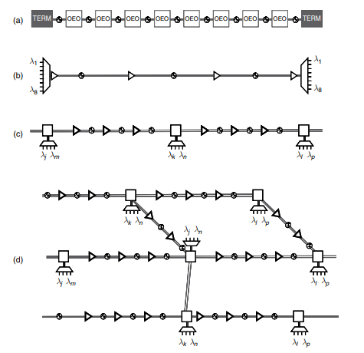
Tipos de Redes Ópticas
Fonte: M. Feuer et al. Optical Fiber Telecommunications: Systems and Networks (2008)

Slide 4
ADD & DROP
The ability to optically add/drop a fraction of a system’s wavelengths at a node was first achieved using fixed OADMs. These were constructed from optical filters, and by enabling wavelengths to optically bypass nodes and eliminate unnecessary regeneration, they provided significant cost savings.
However, because traffic growth is inherently unpredictable, it is advantageous for the add/drop capability to be reconfigurable. Therefore, although fixed OADMs are usually lower in cost, ROADMs are supplanting them in all but the most cost-sensitive applications.
ROADMs can be reconfigured remotely, they enable new wavelength channels to be installed by simply placing transponders at the end points, without needing to visit multiple intermediate sites.

Slide 5
Terminologia
A ROADM is defined as an NE that permits the active selection of add and drop wavelengths within a WDM signal, while allowing the remaining wavelengths to be passed through transparently to other network nodes.
Thus, the simplest ROADM will have two line ports (East and West) that connect to other nodes and one local port (add/drop) that connects to local transceivers.
In today’s networks, optical links are typically bidirectional, so each line port represents a pair of fibers. When using conventional local transceivers that can process only a single wavelength at a time, the number of fibers in the add/drop port sets the maximum number of wavelengths that can be added or dropped at a given node

Slide 6
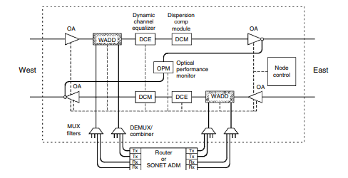
ROADM 2 graus
WADD: wavelenght add-drop device
WSS: wavelenght selective switch

Slide 7
ROADM Concepts
Degree of a ROADM is equal to the number of line fiber pairs it supports.
A full ROADM is one that provides add/drop (de)multiplexing of any arbitrary combination of wavelengths supported by the system with no maximum, minimum, or grouping constraints.
If a ROADM has access to only a subset of the wavelengths, or the choice of the first wavelength introduces constraints on other wavelengths to be dropped, it is called partial ROADM.
The drop fraction of a ROADM is the maximum number of wavelengths that can be simultaneously dropped, divided by the total number of wavelengths in the WDM signal. (Typically, the analogously defined add fraction is equal to the drop fraction.)
If a given add or drop fiber can be set to address any of the line ports (e.g., East or West for a two-degree ROADM), it is said to be steerable.

Slide 8
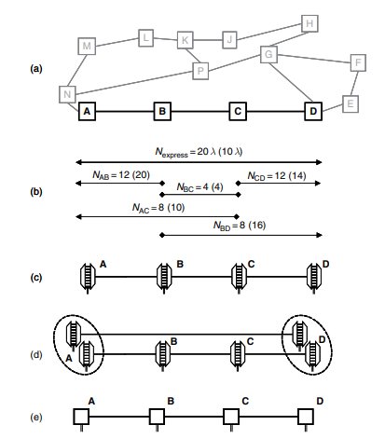
Avaliação Simples de Arquiteturas

Slide 9
Avaliação de Arquiteturas

Slide 10
Routing Properties
As a rule, the most desirable ROADMs are the ones with the greatest flexibility: i.e., full ROADMs with 100% add/drop fraction, and colorless, steerable add/drop fibers. However, these are also the most costly solutions, so less ideal options, such as partial ROADMs, have also been extensively investigated.

Slide 11
Routing Power
Feuer and Al-Salameh [9] introduced a figure of merit called routing power that provides a framework for comparisons of WADDs. The routing power describes the WADD’s ability to establish network connectivity by counting how many distinct connection states it supports.
[9]. M. D. Feuer and D. Al-Salameh, “Routing Power: A Metric for Reconfigurable Wavelength Add/ Drops,” in “Proc. OFC, 2002, pp. 156–158.

Slide 12
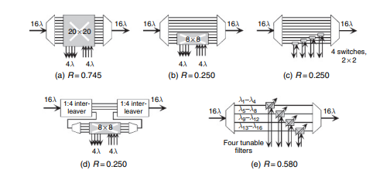
Exemplos de ROADM

Slide 13
Restrições da Modelagem
O ROADM tem duas entradas lógicas (IN e ADD) e duas saídas lógicas (OUT e DROP)
O ROADM tem a capacidade de rotear um sinal de uma das entradas para uma das saídas (mas somente para uma).
Cada uma das portas lógicas pode ter mais do que uma fibra, ou pode combinar sinais na mesma fibra.
O número N representa a quantidade de comprimentos de onda nas portas IN e OUT.
O número k representa o número de canais simultâneos nas portas ADD e DROP.
O roteamento mais flexível é obtido quando k = N, mas em geral isso é desnecessário e caro.

Slide 14
Caso 1
Situação 1: Todos os 16 canais passam -> 1 configuração
Situação 2: 1 canal vai para o drop, 15 passam -> 16 configurações
Situação 3: 2 canais vão para o drop, 14 passam -> 120 configurações
Situaçao 4: 3 canais vão para o drop, 13 passam -> 560 configurações
Situação 5: 4 camais vão para o drop, 12 passam -> 1820 configurações
Total: 2517 estados de conexão
$$R=\frac{log⁡(2517)}{log2^{16}}=0,706$$

Slide 15
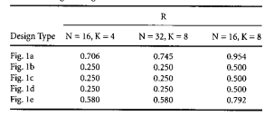
Caso 2
12 canais passam direto, não há opções
4 canais vão para o ADD -> 16 conexões
$$R=\frac{log16}{16log2}=0,25$$
Outros Resultados

Slide 16
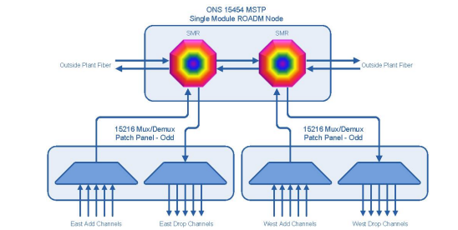
40 channel dual side scheme

Slide 17
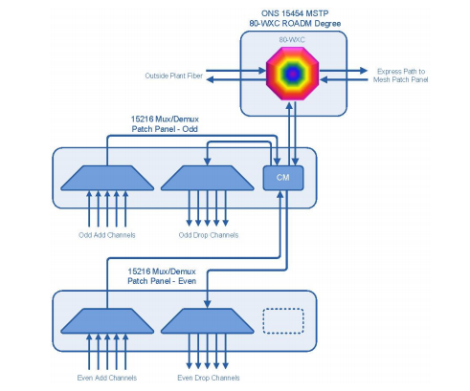
80-channel multidegree

Slide 18
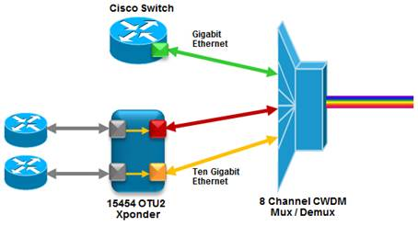
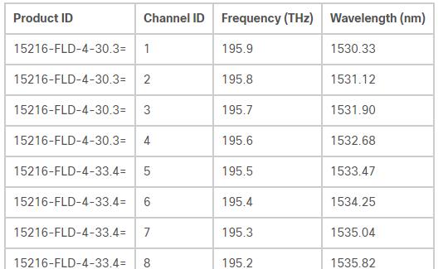
4 channel and 8 channel mux/demux
channel plan

Slide 19
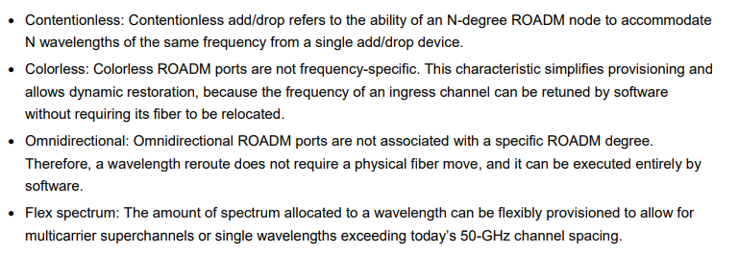
DWDM Innovations

Slide 20
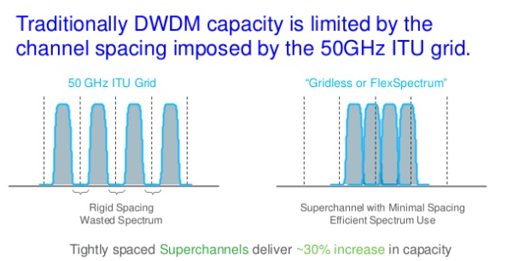
Flex Spectrum

Slide 21
Colorless and Omnidirectional ROADM

Slide 22
Contentionless Interfaces

Slide 23
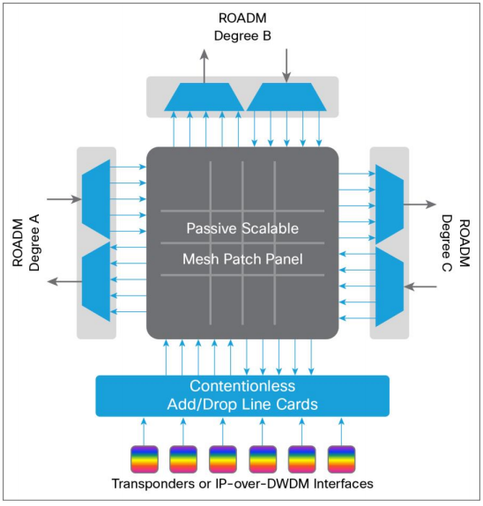
nLight ROADM Architecture

Slide 24
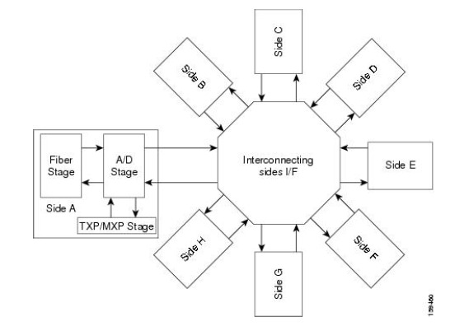
Site Model

Slide 25
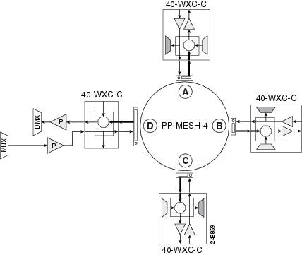
4 - Degree Site 40 channels

Slide 26
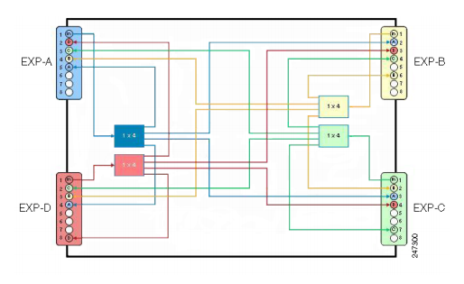
PP-MESH-4

Slide 27
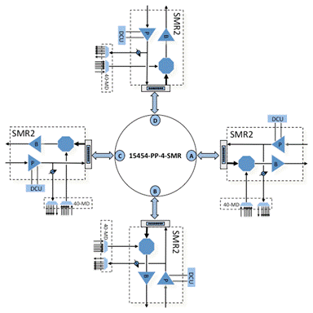
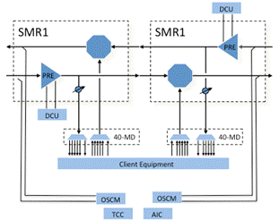
Logical Diagrams for SMR

Slide 28
Colorless Ports
Original ROADM technology dedicated a separate port for each wavelength. Usually ROADMs allocated the optical C-Band into 96 distinct channels, each carrying a different wavelength. We refer to these wavelengths as “colors”.

Slide 29
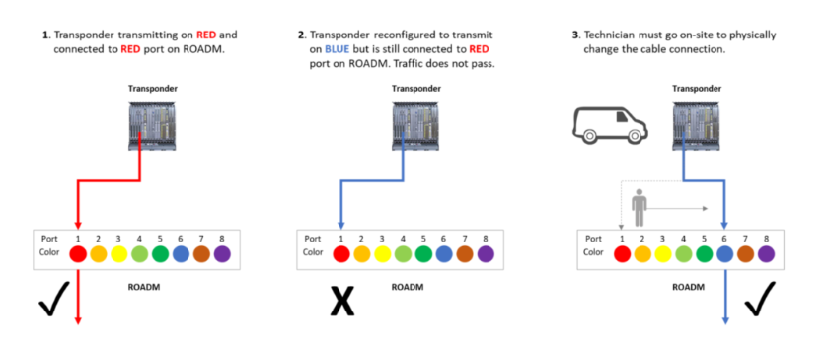
Changing Wavelenghts

Slide 30
Colorless Ports
Colorless ROADMs eliminate the 1:1 mapping between the physical port and the wavelength color. Any port can now accommodate any color:

Slide 31
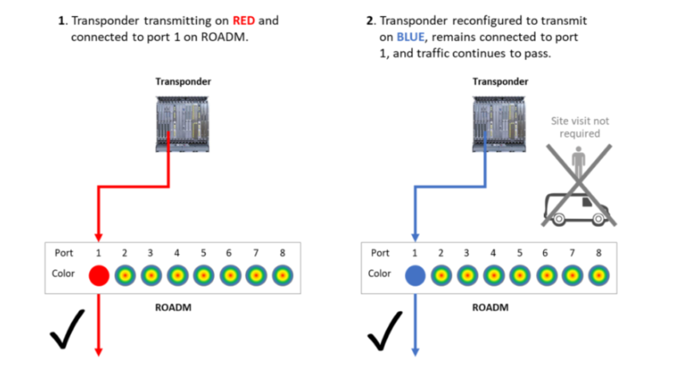
Changing Transponder with Colorless ROADM

Slide 32
Directionless ROADM
Original ROADM technology dedicated an add/drop complex for each ROADM degree. Remember that one degree is equivalent to one fiber link direction (i.e. one direction = one degree). This means that a transponder had to be physically connected to the add/drop complex dedicated to the direction the wavelength is assigned to. This is illustrated below for a four degree ROADM using North, South, East, and West as the four directions.

Slide 33
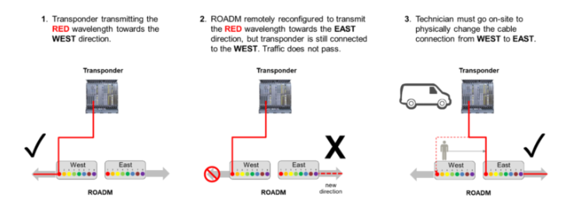
Change Directions -> Manual operation

Slide 34
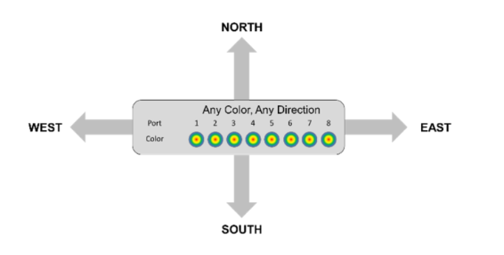
Directionless Ports

Slide 35
Changing Directions By Command

Slide 36
Contentionless – Old ROADM
A ROADM is contentionless if it is possible to simultaneously add/drop the same wavelength (or color) in different directions. This might come as a bit of a surprise, but fixed mux/demux legacy ROADMs were contentionless.

Slide 37
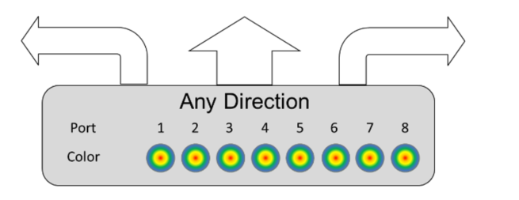
New ROADM are prone to contention

Slide 38
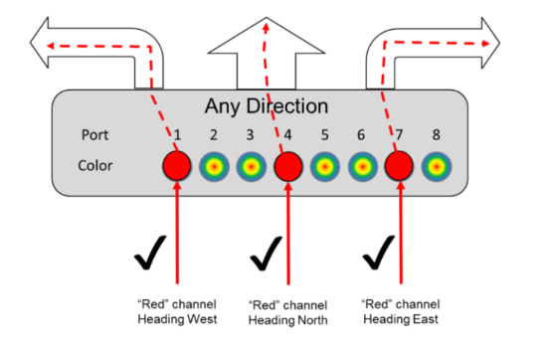
Contentionless ROADM

Slide 39
OmniDirectional Property
The omnidirectional functionality on a side enables you to connect the side to a local multiplexer and demultiplexer that can add or drop traffic to or from any of the node directions.
Omnidirectional traffic can be added or dropped only on the omnidirectional side.
Omnidirectional sides are different from standard add/drop sides in the following ways:
• Omnidirectional sides are internal sides that cannot be connected through fibers or ducts.
• Amplifiers on omnidirectional sides are placed between the 80-WXC-C card (bidirectional mode) and the Add/Drop (Mux/Demux) units.
• Raman amplification is excluded on omnidirectional sides, as the amplification depends on the Raman Amplified option on a duct.
Multi-degree sites that use the OXC functionality and are equipped with the following equipment can support omnidirectional sides:
• 40-WXC-C/MESH-PP-4
• 40-WXC-C/MESH-PP-8
• 80-WXC-C/MESH-PP-4
• 80-WXC-C/MESH-PP-8
• Flexible (nodes equipped with 20-SMR or 9-SMR equipment)
• 40-SMR2-C

Slide 40
Colorless Functionality
The colorless property enables tuning of channel wavelengths without changing the optical interface of the port.
A colorless side is connected to two 80-WXC-C cards configured as a multiplexer and demultiplexer.
A colorless stage is available at the local add/drop stage on line, terminal, or multi-degree sites. In line and terminal sites, you can implement colorless sides using the following configurations:
• Line or terminal ROADM site with 80-WXC-C cards
• Line or terminal sites equipped with 40-SMR1-C
• Line or terminal sites equipped with 40-SMR2-C
• Line or terminal sites equipped with 20-SMRFS
• Line or terminal sites equipped with 9-SMRFS

Slide 41
Colorless Omnidirectional Functionality
A colorless and omnidirectional side is connected to a multiplexer (80-WXC-C, 20-SMR, or 9-SMR card) and demultiplexer (80-WXC-C, 20-SMR, or 9-SMR card) that can add or drop traffic to or from any of the node directions.
You can define an omnidirectional colorless side by adding one or more colorless ports to an omnidirectional side.
In all service demands (except ROADM), you can configure colorless termination points as omnidirectional, to achieve full routing capability for all possible wavelengths.

