Slide 1
Use of winter cultures for forage conservation
Prof. Dr. Valter Harry Bumbieris Junior
Parana State University in Londrina
Department of Animal Science
UEL

Slide 2
Introduction
• Seasonality of forage production
• Fostering in forage production in south Brazil
• Use of irrigation for the production of summer crops (Europe)

Slide 3
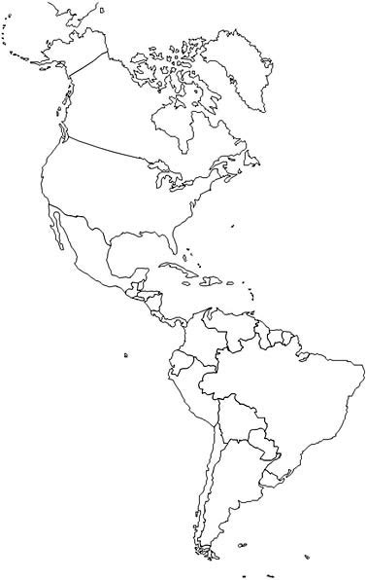
BRASIL

Slide 5
Introduction
• Current status of winter cereals in Europe for silage production
• In Brazil may be more a technological tool to improve the livestock activity

Slide 6
Our purposes in the presentation
Approach strategic and qualitative aspects of silages production in winter crops for better use of these in livestock production systems

Slide 7
Topics approached
1) Nutritional potential of winter cereal silages
2) Wilted winter cereals silages
3) Maturity stage x Quality of winter cereals silages
4) Winter cereals silages x Corn Silages
5) Additives for winter cereals silages production
6) Strategy use of winter cereal silage in cattle feed
7) Considerations

Slide 8
Nutritional potential of winter cereal silages
• Temperate grasses higher nutritional value
• Important characteristic of ensilability = % DM

Slide 9
Table 1 - Chemical composition and fermentation characteristics of winter cereals silages
Parameters (%) | Berto & Mühlbach (1997) | Emile et al, (2007) | Wallsten et al, (2010) | Oliveira et al, (2010)
 | Oat | Wheat | Barley | Triticale
DM | 15,30 | 33,50 | 41,60 | 29,20
CP | 17,70 | 8,10 | 10,00 | 11,40
NDF | 46,70 | 53,20 | 41,10 | 61,30
ADF | 34,80 | --- | 26,30 | 37,80
pH | 4,60 | 3,91 | 4,50 | 4,30
N-NH3 (% N total) | 11,80 | 9,90 | 6,70 | 13,80
Acetic acid | 3,60 | 2,98 | 0,80 | 1,93
Propionic acid | --- | --- | 0,10 | 0,20
Butyric acid | 0,18 | 0,09 | 0,00 | 0,13
Lactic acid | 8,4 | 3,83 | 2,90 | 6,90
IVDMD | --- | 60,80 | 67,50 | ---

Slide 10
Nutritional potential of winter cereal silages
• The aim of improving the nutritional value of
Silages winter cereals + legumes
Agronomic
Advantages = Sustainable
Zootechnical

Slide 11
Table 2 - Chemical composition and fermentation characteristics of winter cereals silages with legumes
Parameters (%) | Dias, (2007) |  | Bumbieris Jr, (2009) |  | Huuskonen et al. (2010)
 | TFPS | TOFPS | TFPS | TOFPS | BFPS | WVS
DM | 25,28 | 24,46 | 23,44 | 22,57 | 26,80 | 31,50
CP | 10,27 | 9,50 | 11,63 | 13,06 | 10,60 | 13,30
NDF | 56,85 | 56,90 | 58,52 | 56,39 | 54,00 | 54,70
ADF | 36,35 | 36,02 | 37,48 | 36,11 | --- | ---
pH | 3,44 | 3,80 | 3,83 | 4,20 | 3,98 | 3,85
N-NH3 (% N total) | 12,80 | 13,70 | 11,40 | 14,80 | 7,10 | 8,30
Acetic acid | 1,90 | 2,95 | 2,79 | 4,70 | --- | ---
Propionic acid | 0,03 | 0,03 | 0,13 | 0,13 | --- | ---
Butyric acid | 0,06 | 0,06 | 0,08 | < 0,05 | --- | ---
Lactic acid | 10,55 | 2,86 | 8,24 | 7,28 | 4,50 | 6,30
IVOMD | 60,94 | 61,03 | 59,70 | 60,28 | 68,5 | 57,80

Slide 12
Nutritional potential of winter cereal silages
• In Brazil, these results are timid for winter cereals + legumes silages
• Tomm et al. (2003) – Triticale + Forage pea
• Fontaneli et al. (2009) – Oat + Vetch

Slide 13
We can advance more !!!

Slide 14
Wilted winter cereals silages
• The wilting of winter cereals before ensiling is a technique widely adopted in order to raise the dry matter content of forage.
•The wilting is also a management strategy to reduce environmental pollution (Lorenz et al. 2010; Schimdt et al. 2011).

Slide 18
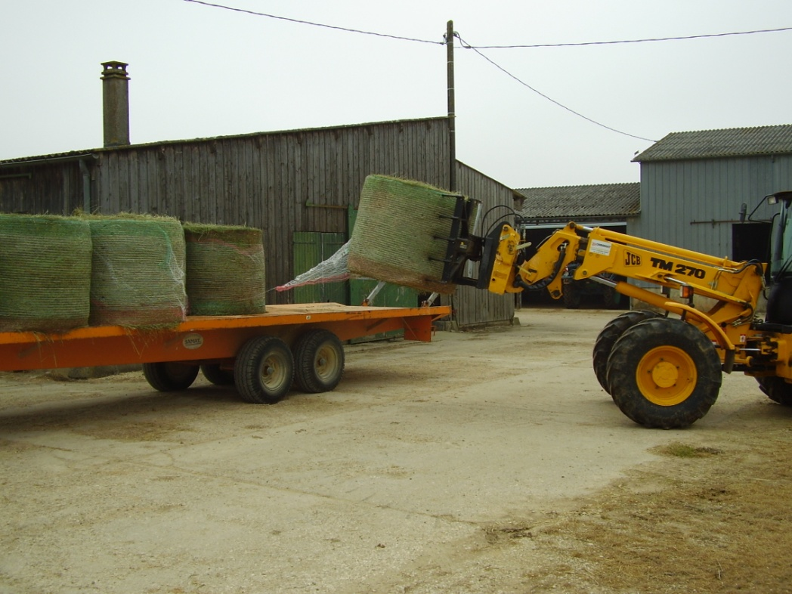
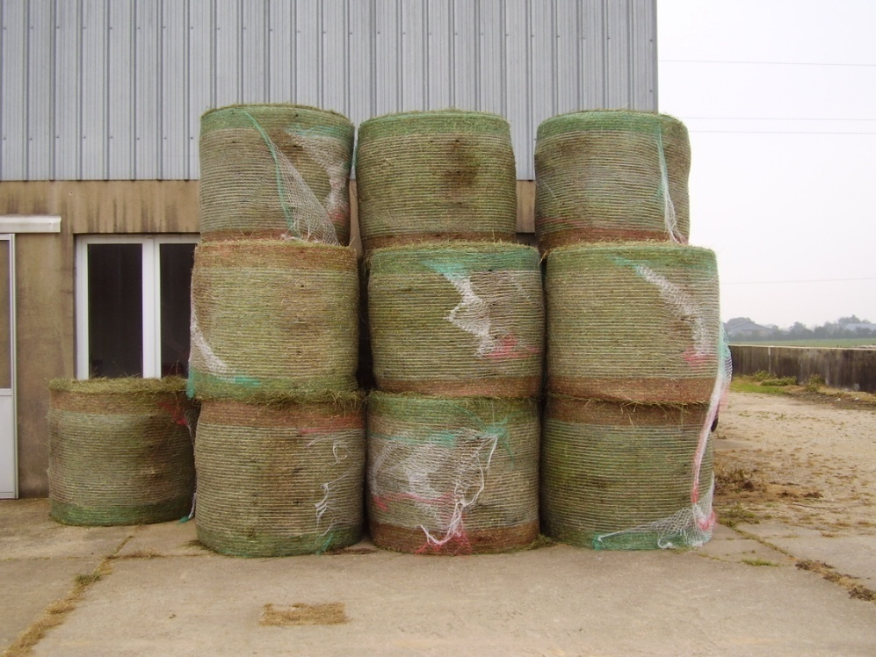

Slide 19
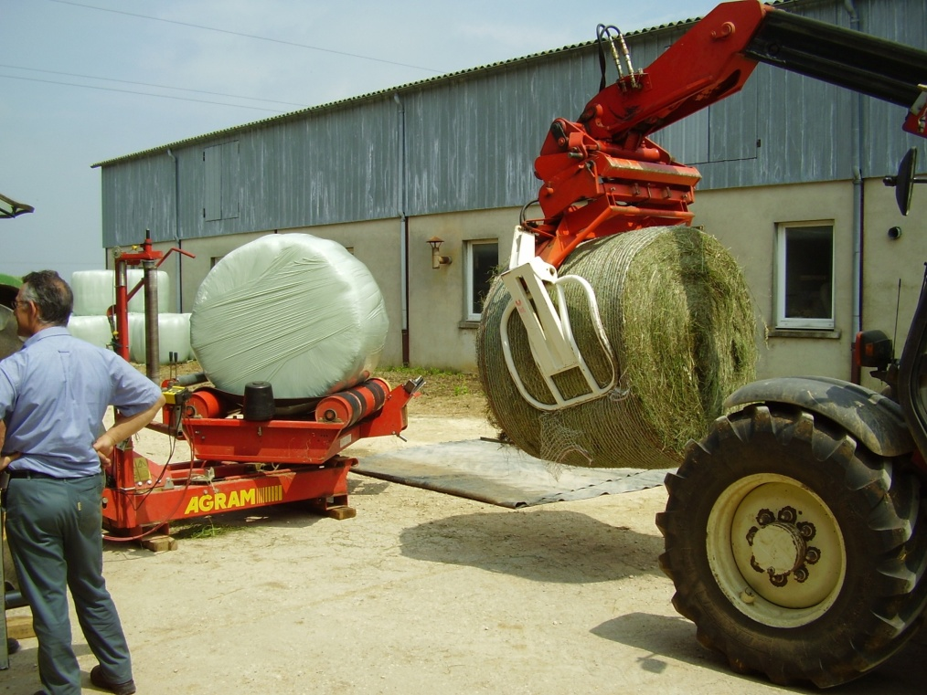
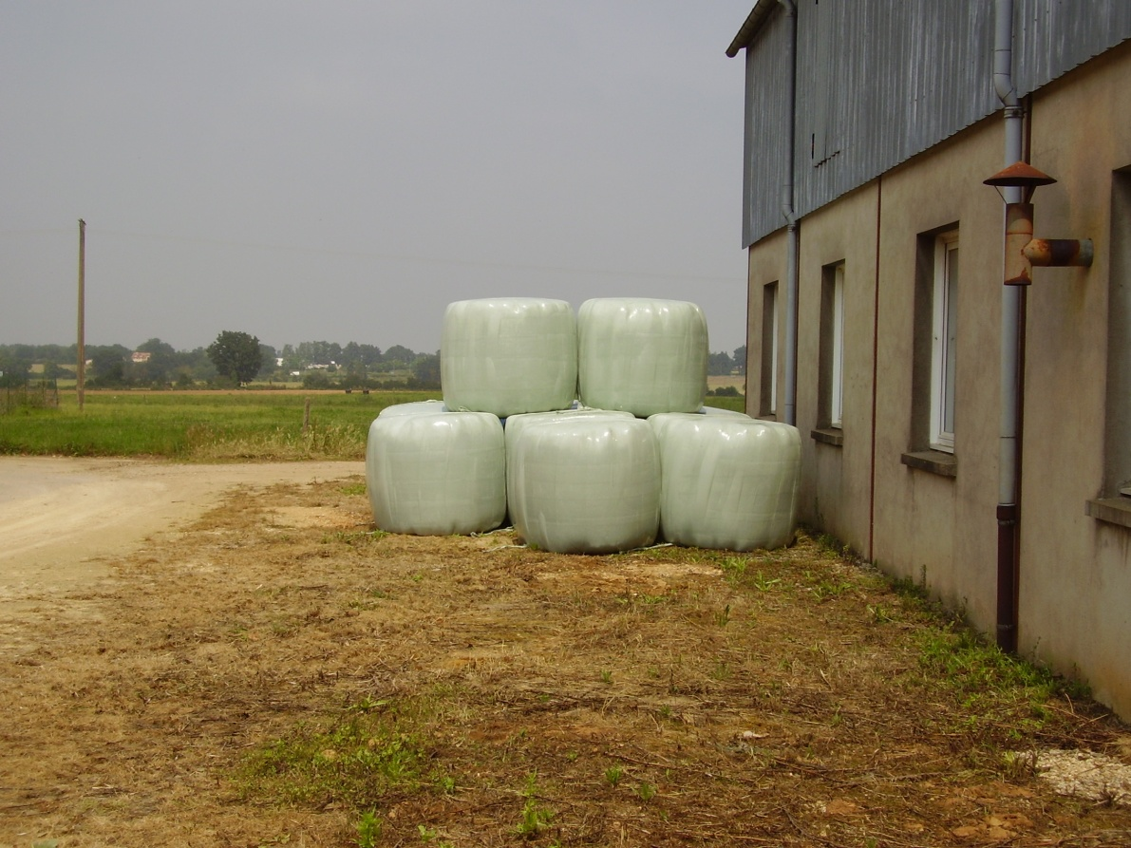

Slide 21
Figure1. Effects of duration of wilting and ensiling on (a) pH, (b) lactic acid, (c) acetic acid, (d) ethanol, of silage fermentation along the 0-h (- ● -), 24 (- ○ -), and 48h (- ▼ -) wilting. Source: McEniry et al. (2008).

Slide 22
Figure1. Effects of duration of wilting and ensiling on (e) butyric acid, (f) proportion of lactic acid (L): products total fermentation (AF), (g) concentration of ammonia-N and (h) buffering capacity (BC) of silage fermentation along the 0-h (- ● -), 24 (- ○ -), and 48h (- ▼ -) wilting. Source: McEniry et al. (2008).

Slide 23
Wilted winter cereals silages
The benefits of reduced moisture content to give the best when they reach at least 30% of DM (Woolford, 1984)

Slide 24
Maturity stage x Quality of winter cereals silages
• It is recognized that changes in chemical composition of forages are due to the developmental stage of plants
• Beck et al. (2009) reported that DM production increased because of the advance in the maturity stage of wheat

Slide 25
Maturity stage x Quality of winter cereals silages
Beck et al. (2009) - Wheat 2781 kg DM/ha - flowering (21,5% DM)
6261 kg DM/ha - flours grains (46,7% DM)
David et al. (2010) - Oat 3547 kg DM/ha - flowering
9170 kg DM/ha - dough grains

Slide 26
Maturity stage x Quality of winter cereals silages
• There is a reduction in crude protein (CP) as it advances the maturity stage of winter cereals (Fontaneli & Fontaneli, 2009; Coblentz & Walgenbach, 2010).
• Fontaneli & Fontaneli, (2009) evaluating the nutritional composition, based on the CP of wheat, oats and rye silages into three maturity stages, had average levels of CP around 17.7, 13.0 and 10.2% , respectively, in the flowering, dough grains and flours grains stages.

Slide 27
Maturity stage x Quality of winter cereals silages
• Coblentz & Walgenbach (2010) found that reductions in digestible crude protein content with the advance of maturity, were offset by increases in levels of digestible non-fiber carbohydrates.
• Wallsten & Martinsson (2009) observed that the advance of the maturity of barley, provides a reduction in NDF and DM digestibility, while an starch accumulation.

Slide 28
Maturity stage x Quality of winter cereals silages
• Beck et al. (2009) found no effect of the maturity of the wheat silages on the performance of steers
• Coblentz & Walgenbach (2010) suggested a large window cut, according to the almost constant energy density at different times in court.

Slide 29
Maturity stage x Quality of winter cereals silages
• Ashbell & Weinberg (2000), recommended the use of late cultivars for silage production, seeking to extend the cropping window, and in warm climates is a fast drying rate, which hinders the correct control of the stadium ensiling.
• The effects reported in the literature as to the maturity stage of winter cereals are inconsistent.

Slide 30
Maturity stage x Quality of winter cereals silages
Such responses can be justified due to differences in;
participation of the plant constituents
nutrients translocation
soil types
water availability
growing season
fertilization program
drying rates between different regions of warm and temperate climates.

Slide 31
Winter cereals silages x Corn Silages
• According to Jobim et al. (2007) the quality of forage is a reference to the nutritive value of forage mass in interaction with the consumption made ​​by the animal and the animal's performance potential.
• An important factor to consider when it comes to winter cereal silage is its lower productivity compared to tropical grass silages

Slide 32
Table 3. Cutting height, dry matter content and production (kg DM / ha) of winter cereals
Winter cereals | Cutting height(cm) | DM (%) | DM production kg/ha
White Oat UPF 18 | 111b | 29,5ef | 6.159bc
Black Oat IPFA 99009 | 117b | 28,5fg | 6.455bc
Black Oat Agro Zebu | 112b | 25,7g | 5.419bcde
Rye BR 1 | 136a | 37,8ab | 7.027b
Rye BRS Serrano | 142a | 39,1a | 9.721a
Barley BRS 195 | 57f | 31,7def | 3.641e
Barley BRS 224 | 73de | 30,2def | 4.696cde
Barley BRS 225 | 66ef | 32,5cde | 3.962de
Triticale BRS 148 | 99c | 33,0cd | 5.375bcde
Triticale BRS 203 | 96c | 32,8cd | 4.738cde
Triticale Embrapa 53 | 93c | 35,2bc | 5.590bcd
Wheat BRS Figueira | 68ef | 36,9ab | 5.022cde
Wheat BRS Umbu | 77de | 38,1ab | 5.091cde
Wheat BRS 277 | 80d | 38,4ab | 5.175cde
Mean | 94,7 | 33,5 | 5.577

Slide 33
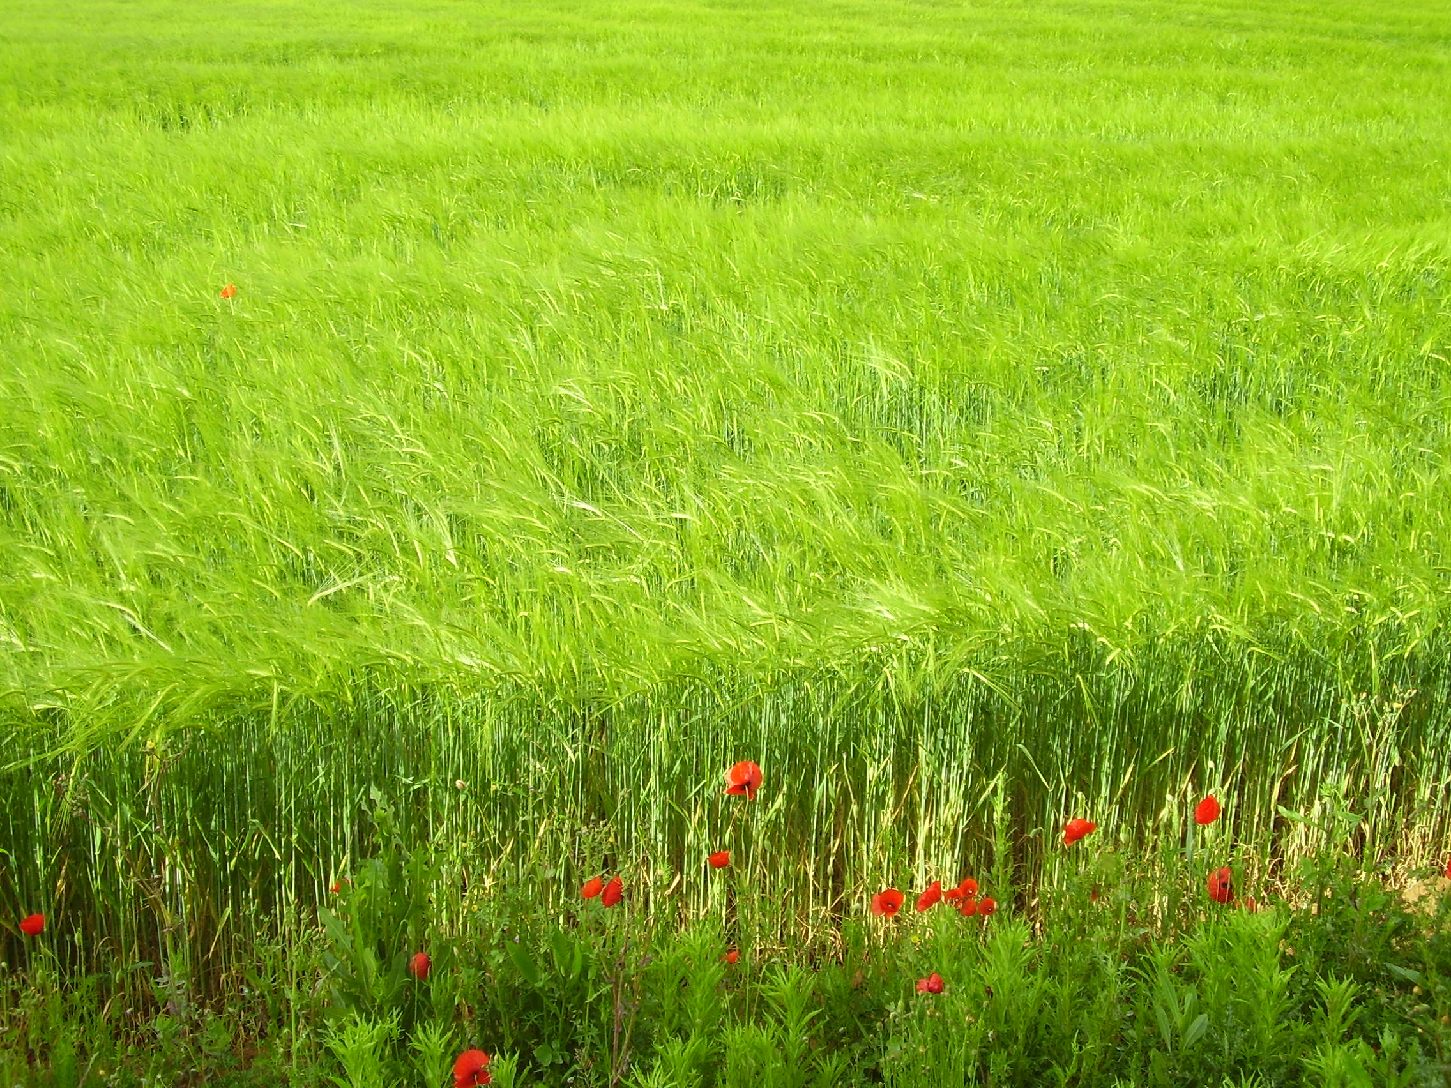
Barley

Slide 34
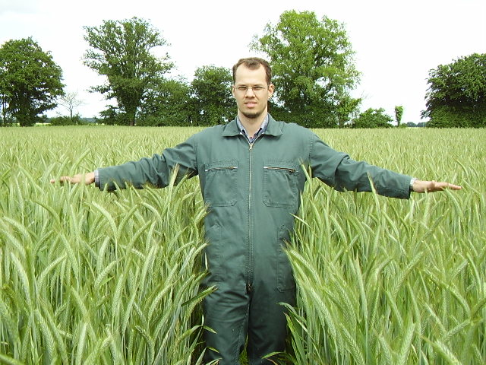
Triticale

Slide 35
Winter cereals silages x Corn Silages
• Keady et al. (2007) reported that the replacement of perennial ryegrass silage + corn silage did not differ in dry matter intake (DMI), digestible energy intake and ADG in the blend with ryegrass silage + wheat silage.
• Walsh et al. (2008b) evaluated the nutrient intake, digestibility and performance of steers fed wheat silage and barley silage at two cutting heights (0.12 and 0.29 m) compared to corn silage, did not detect influence of diet on the DMI, in vivo digestibility, and ADG.

Slide 36
Winter cereals silages x Corn Silages
• Oltjen & Bolsen (1980) corn silage vs oat silage and Coombs et al. (1997) corn silage vs wheat silage there gains different from those found by previous authors, with values ​​from 1.15 to 0.5 and 1.07 to 0.77 kg /animal/day respectively
• In the literature variable effects on animal performance

Slide 37
Winter cereals silages x Corn Silages
Answers found in the literature can be attributed to differences in;
nature of the diet intake effect
roughage : concentrate ratio ruminal fermentation
genetic potential of animals

Slide 38
Additives for winter cereals silages production
Microbial
Nutritional Moisture absorbent
Chemical NPN
Enzymes and Organics Acids
Improve the nutritional value
• keys functions
Improve the quality of fermentation

Slide 39
Additives for winter cereals silages production
•
• Positive results - Coan et al. (2000 and 2001); Evangelista et al. (2002) and Lima et al. (2002)
In winter cereals moisture absorbent additives could help in the preservation of silage

Slide 40
Additives for winter cereals silages production
• Corn grains, sorghum and other cereals can be used for this purpose.
• Dehydrated byproducts such as citrus pulp, soybean hulls, wheat bran, can also be used.

Slide 41
Additives for winter cereals silages production
• Microbial inoculants potentiate the fermentation process
• Addah et al. (2011) evaluating the inoculation with a mixture of L. plantarum, E. faecium and P. acidilactici did not observe reductions in DM losses in corn and barley silages.
• The same authors also found no differences in performance of animals fed silage with or without the use of inoculants

Slide 42
Additives for winter cereals silages production
• Hristov & McAllister (2002) found no influence of additives on the microbial degradation rates of DM in barley silage
• In deciding to use of an additive should be taken into consideration;
- Forage species
- DM content of forage
- Animal category and the productive potential of animals to be fed.
• Any additives can replace good ensiling techniques, but can improve the fermentation and nutritive value

Slide 43
Strategy use of winter cereal silage in cattle feed
•In the feeding of dairy cattle winter cereals silages has been notoriously a resource that has shown the greatest potential.
•Crop-livestock integration
• Dias (2007) noted that after grazing of triticale, grain production was up 78% compared to non-grazed area (5300 kg of grain), thus recommending the use for grazing and harvest after grazing

Slide 44
Strategy use of winter cereal silage in cattle feed
• Meinerz et al. (2011) handled areas of winter cereals (oats, triticale, rye, wheat and barley) by cutting prior to harvesting for silage
-Triticale cv. BRS 148
Most precocious for silage production
- Rye cv. BR 1

Slide 45
Strategy use of winter cereal silage in cattle feed
• Meinerz et al. (2011) handled areas of winter cereals (oats, triticale, rye, wheat and barley) by cutting prior to harvesting for silage
- Oat cv. UPF 18
Best yield of forage mass at the pre-ensiling - Rye cv. BR 1

Slide 46
Strategy use of winter cereal silage in cattle feed
• Meinerz et al. (2011) handled areas of winter cereals (oats, triticale, rye, wheat and barley) by cutting prior to harvesting for silage
Wheat cv. Umbu - greatest participation of grain in the silage mass, providing greater nutritional quality of silage

Slide 47
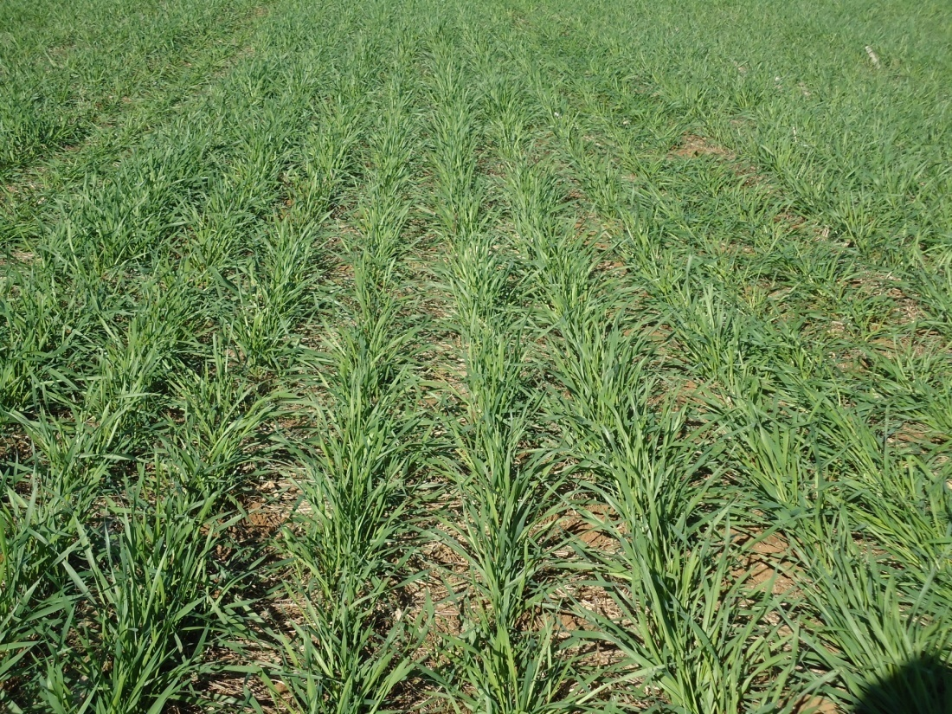
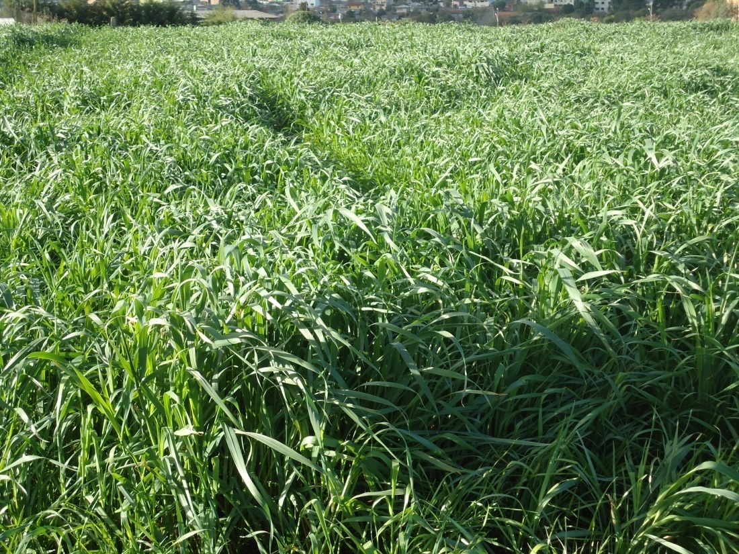
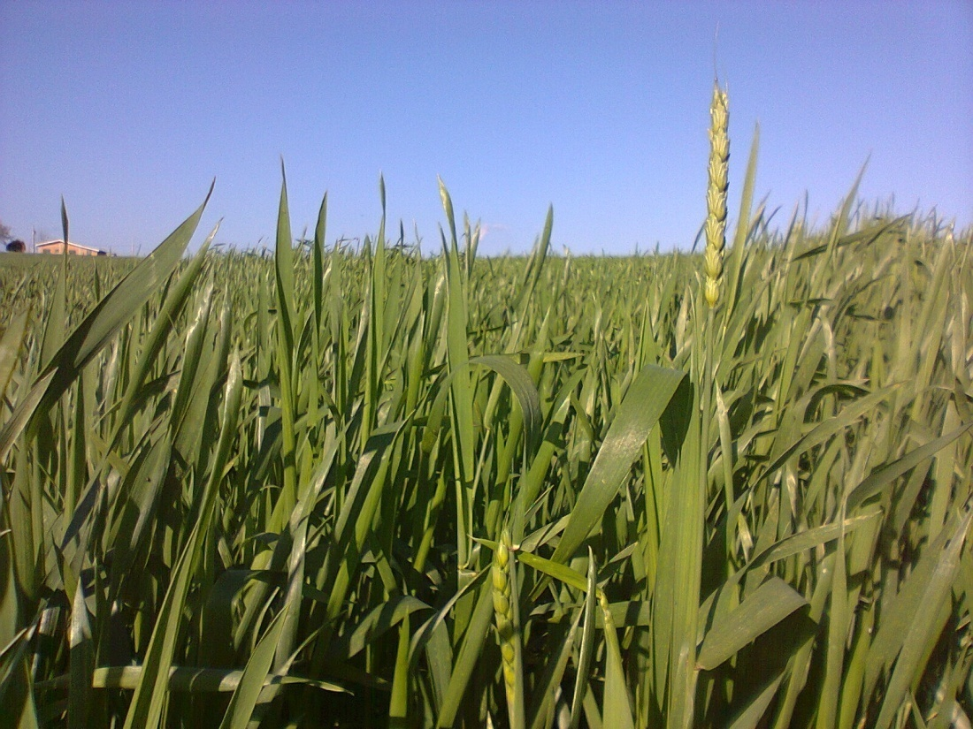
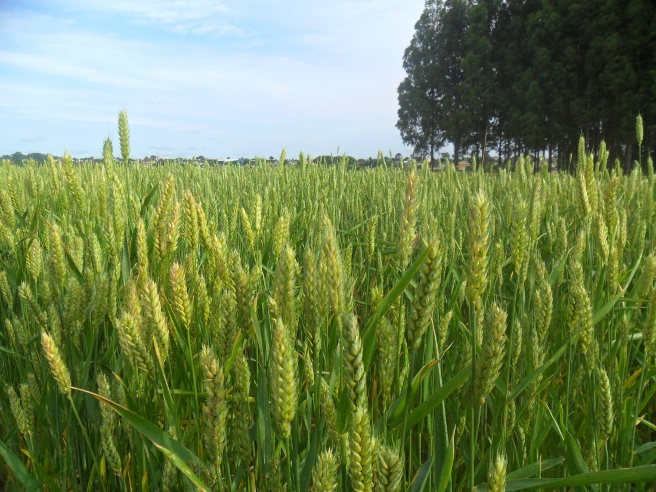

Slide 48
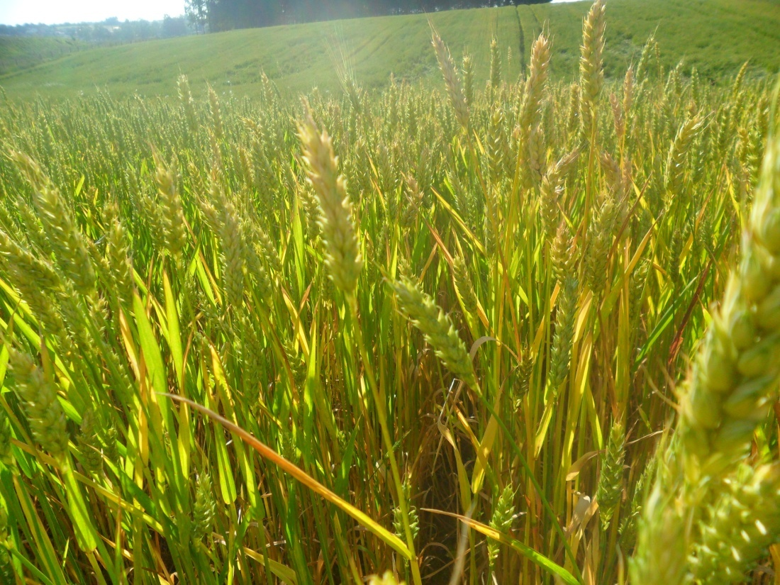
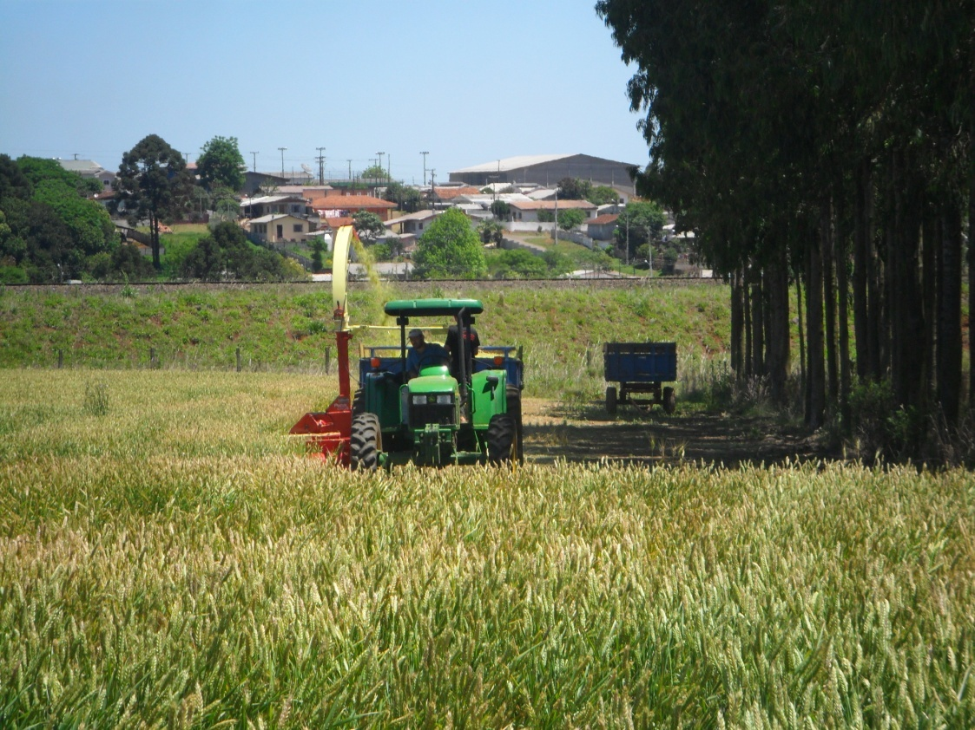
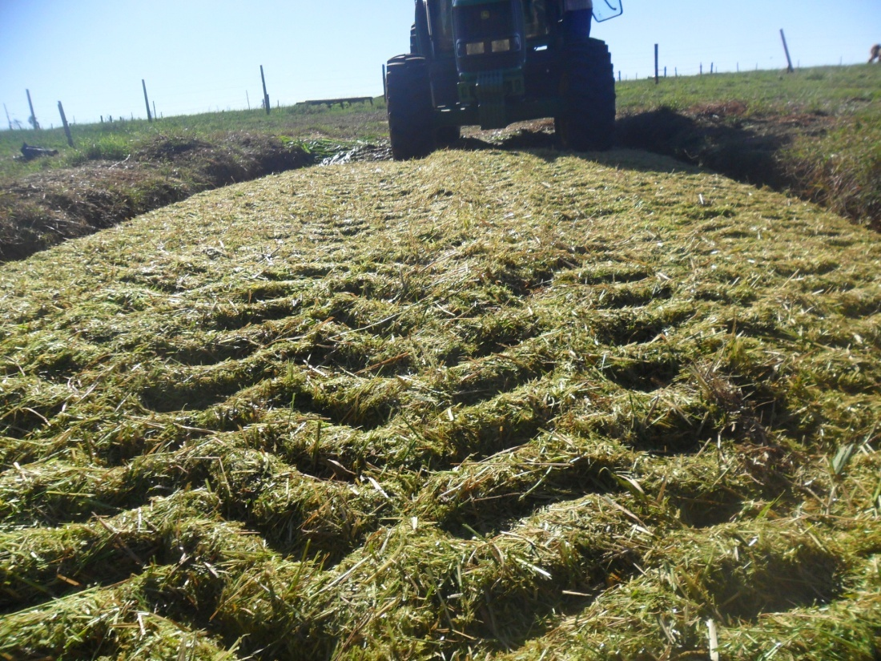
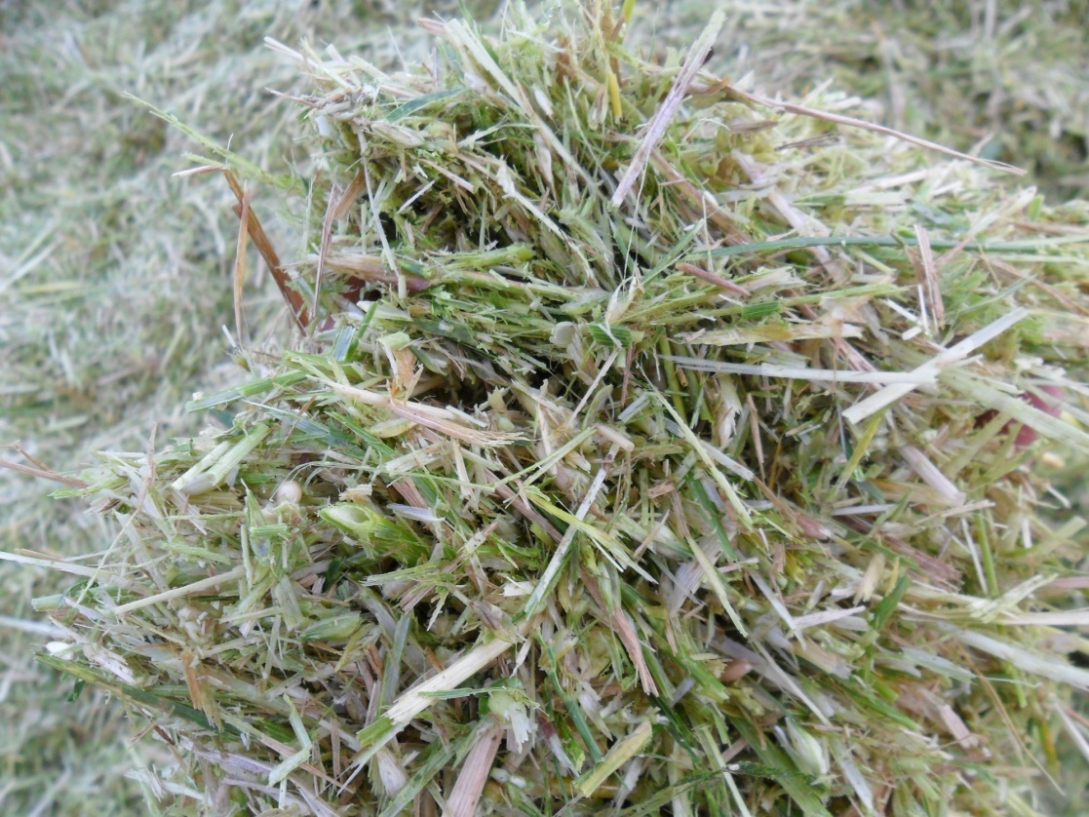

Slide 49
Strategy use of winter cereal silage in cattle feed
• According to Novak et al. (2011), winter cereals silages intercropped with legumes, can be used to feed cows in late lactation, dry cows and heifers without any damage
• The authors found that lactating cows fed triticale silage and triticale silage + legumes, produced between 19 to 21 L/animal/day respectively

Slide 50
Strategy use of winter cereal silage in cattle feed
• Eifert et al. (2004), used triticale silage as a strategic source of roughage associated with 35, 45, 55 and 65% concentrate in diet of Braford calves weaned early
ADG = 0,270; 0,536; 0,728 and 0,784 kg/animal/day
respectively

Slide 51
Strategy use of winter cereal silage in cattle feed
• The development of cultivars with dual-purpose (grazing and grain and/or silage) has been crucial to advancing the use of winter cereals silages in the context of animal production systems
• More research with the aim of validate the use of winter cereals in the silage form as a strategy for ruminants feed are necessary

Slide 52
Considerations
• In Brazil, the use and research on winter cereal silages are still quite incipient.
• The use of intercropping of winter cereals and legumes for silage as well as wilting and additives, can be constituted in strategies to improve the quality fermentation and nutritional value in silages
• Validation of research in Brazil with these silages in animal feed can effectively motivate the strategic use of forage in planning, promoting greater use by farmers.

Slide 53
Thank you for your attention !!!

