Slide 1
INTERNATIONAL LAW
Notions of Private International Law
Introduction
Sources
LICC Decree-Law 4.657/42
ProfªLuciana Romano Morilas

Slide 2
1 Introduction
CONCEPT: A set of rules that shows the legal system applicable to a particular fact in the rule.
They are standards of indirect laws, in other words, PIL (Private International Law) indicates the legal system that will be applied to some given situation.
In the most modern PIL, law incurs directly on the fact. Example: international adoption law. It is the tendency of international law, with harmonization of rights. The objective is to achieve a uniform law.

Slide 3
2 Sources
2.1 Internal Sources:
Primary:
Law of Introduction to Brazilian Regulations (Law number 4657/42)
Costums
Secundary:
Jurisprudence
Doctrine

Slide 4
2.2.1 Lex mercatoria
International custom – set of regulations that rules the right of traders, the international trade.
Set of rules and customs adopted by traders with the application and interpretation required.
E.g.: Incoterms - acronyms are not part of an international treaty, although it is part of a custom, and even then, it is obligatory. FOB: free on board - the debtor is released with the shipment of goods. Once inserted the clause, it is not possible to discuss its meaning.

Slide 5
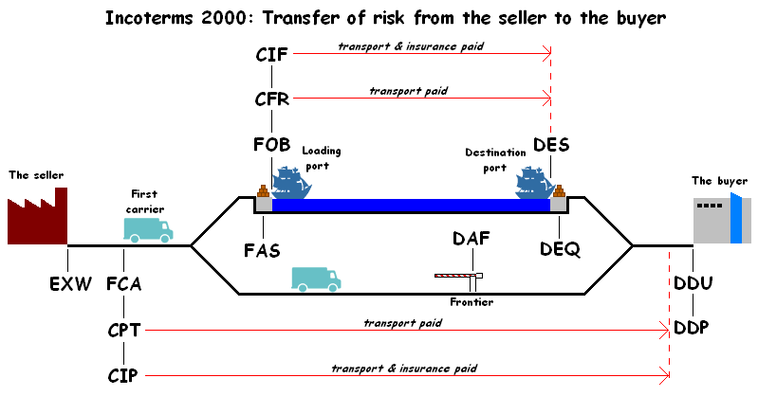

Slide 6
3 Conflicts of law in space
PIL aims to avoid the conflict of laws in space because if there is no PIL, 2 or more legal systems would be applicable to the same fact
The DIP does not regulate the conflict of laws in time.
The rules of conflict of laws in the area start in the art. 7 of the Law of Introduction to Brazilian Regulations.
The conflict of laws in space is always potential, because there is always a standard PIL pre-existing, so there is never a doubt about which law is applicable.

Slide 7
4 Extraneous element
The PIL is applicable when there is an extraneous element (foreigner) in fact. It is this element that causes the application of standards of PIL.
In the same fact, there can be many foreign elements. E.g.: domicile in the U.S., payment in Chile and guarantees in Argentina. Depending on the foreign element, there will be a different standard applicable.

Slide 8
5 Internal jusprivatist fact
This fact is the object of DIP rules.
Jusprivatista = fact of private law – only matters of private law are governed by private international law, that is, matters of civil and business law. Ex.: marriage, contracts, civil liability, succession.
Ex.: an Argentine who wants to get a driver's license in Brazil has no relationship with private law, but public law. Thus, the domicile rule does not apply.

Slide 9
5 Internal jusprivatist fact
It is a fact of private law that has an international connection → it is necessary to have the element of foreignness.
The norms of private international law are norms of public law, that is, the parties cannot dispose.
In fact, the name Private International Law can cause problems, as they are rules of domestic law (LINDB) and it is public. Its name refers to the fact that it governs private relationships with an element of foreignness.

Slide 10
6 Typical and atypical relationship (normal and abnormal)
TYPICAL RELATIONSHIP: one that does not involve conflict of laws in space. Ex.: marriage between a woman from Rio Grande do Sul and a man from Santa Catarina.
ATYPICAL RELATIONSHIP: one that has the potential to apply more than one legal order. E.g.: marriage between a Brazilian woman and an Australian man.

Slide 11
Classification Structure Articles of LINDB
Study of LICC
Decree-Law 4.657/42
INTERNATIONAL LAW

Slide 12
Classification
Indirect laws: a classical private international law – one that does not solve the conflict itself, does not regulate it, but only indicates the applicable law.
Direct laws: they rule the fact directly. They do not indicate the applicable law, but directly governe the situation.
Ex: Article 11, § 1º It’s not allowed, however, to posses affiliates in Brazil, agencies or establishments before the constitutive acts be approved by the Brazilian Government, being under subject to the Brazilian Law.
Qualifying law: they are standards of civil law that support the application of private international law.
Ex: standards about domicile according to the Civil Code.

Slide 13
Structure of an indirect law
‘CONCEPT BOX’ = object of the law, part of the law of private international law which is a legal institution of private law.
‘ELEMENT OF CONNECTION’ = applicable law. It's part of the LAW that connects the legal system with the fact. It follows the doctrine of Savigny.

Slide 14
Article | Concept Frame | Connecting Factors
7°,caput | Personality, name, capacity and rights of family | Law of Domicile
7º,§1º | Formality of the wedding celebration and diriment impediments | Law of the local of the marriage
7°,§3° | Invalidities of the marriage | Matrimonial domicile
7º,§4º | Property regime | Domicile of the parties or 1st matrimonial domicile
8°,caput | Property - real statute – Principle of territoriality | Local of the property situation
8º,§1° | Personal property | Domicile of the owner
8º,§2º | Pledge | Domicile of who has the ownership
9º,caput | Contractual obligations | Local where the contract was signed
 | Tort obligations | Local where the tort has occurred
9º,§1º | Special Formalities for the execution of obligations | Local of the execution of obligation
9º,§2º | Contracts between absents | Local where lives the proponent
10,caput | Succession | Law of Domicile of deceased (de cujus)
10,§1° | Brazilian Children and spouses | The most benefic law
10,§2° | Capacity to succeed | Domicile of successor
11,caput | Legal entity | Local law of the formation’s place of legal entity

Slide 15
Article 7
Article 7º The law of the contry where the person is resident determine the rules about the begining and ending of the personality, the name, the capacity and the rights of the family.
§1º By performing the marriage in Brazil, Brazilian law will be applied as the diriment impediments and formalities of the celebration.
PRINCIPLE LOCUS REGIT ACTUM
The formalities of the Act are those according to law of the place where the act was committed, not the law of the place where the document will be used.
Consular Marriage: it is possible if both spouses are nationals of the consulate.

Slide 16
Article 9th
Article 9º To qualify and govern the obligations, the law of the country where they were established will apply.
In Mercosul, there are special rules about traffic accidents. If people who were involved in the accident are from the same state, the jurisdiction and applicable law are from that state. The rule came about because of traffic accidents occurring between Argentines in Florianopolis. If two Brazilians hit in Punta Del Leste, the case is solved in Brazil!

Slide 17
ATTENTION: in Brazil, the choice of law is not accepted, only the choice of forum.
Contractual obligations: if the contract is signed in Germany, but the forum is in Brazil, the parties must bring foreign law to the file.

Slide 18
Article 10th
Art. 10. The succession on death or absence obeys the law of the country where was domiciled the deceased or disappeared, whatever the nature and location of property.
§1º The succession of foreigners' property, located in Country, shall be governed by Brazilian law for the benefit of the Brazilian spouse or children, or those who represent them, whenever it is not more favorable to them the personal law of the deceased.
§2º The law of the domicile of the heir or legatee regulates the ability to succeed.

Slide 19
Article 10th
The most beneficial law is found between the law of the domicile of the deceased to Brazilian.
Ex: An Italian had an illegitimate daughter in Brazil. According to Italian law, she has no right to inheritance, but it applies to Brazilian law and she inherited her share in the proportion of property in Brazil. The Brazilian judge only divides the properties that are in Brazil.
When it comes to succession, there will be several judgments - each country applying the local law where the property is located.

Slide 20
Article 11
Art. 11. Organizations aimed at purposes of collective interest, as societies and foundations, obey the law of the State where they were established.
Refers to corporate law.
The NCC, in art. 1126, says a company which has a record and headquartered in Brazil is Brazilian.

Slide 21
Public Order (Article 17, LICC) Evasion of law (art. 6, Cidip/79)
Limitations to the application of foreign law in Brazil
INTERNATIONAL LAW

Slide 22
Public Order (Article 17, LICC)
Art. 17th Laws, acts and judgments of other country, as well as any will statements, will not be effective in Brazil when offending national sovereignty, public order and morality.
Public order corresponds to the constitutional principles, according to some authors. For others goes beyond the basics. It is the feeling of what is fair, what is appropriate. It may therefore be even more abstract.
Ex: the capacity is governed by the individual’s domicile.

Slide 23
Evasion of law
Article 6, INTER-AMERICAN CONVENTION ON GENERAL RULES OF PRIVATE INTERNATIONAL LAW (1979)
The law of a State Party shall not be applied as foreign law when the basic principles of the law of another State Party have been fraudulently evaded.
The competent authorities of the receiving State shall determine the fraudulent intent of the interested parties.
Ex: Sophia Loren

Slide 24
Law of immediate application
Ex: Code of Consumer Protection
Whenever there is a consumerist relationship, the location on which the obligation is will not be checked.
Issues of antitrust and competition also enter here.
Famous example: case-Panasonic.

Slide 25
Theory of vested rights
Concept of Pillet (Franch counselor): a right that has been regularly acquired in one country, according to the laws there in force, may be invoked and take effect in another country.
Ex: bigamous marriage - it is not recognized in Brazil itself, but the effects are recognized. Thus, if a wife comes to live in Brazil and here requires food, she has that right.
Ex: gambling debt - in itself could not be established in Brazil, but the charging of a debt legally established in another state that allows it can be performed in Brazil.
Ex: purchase and sale of slaves-not paid - the debt of the person may be charged if he is in Brazil.

