Slide 1
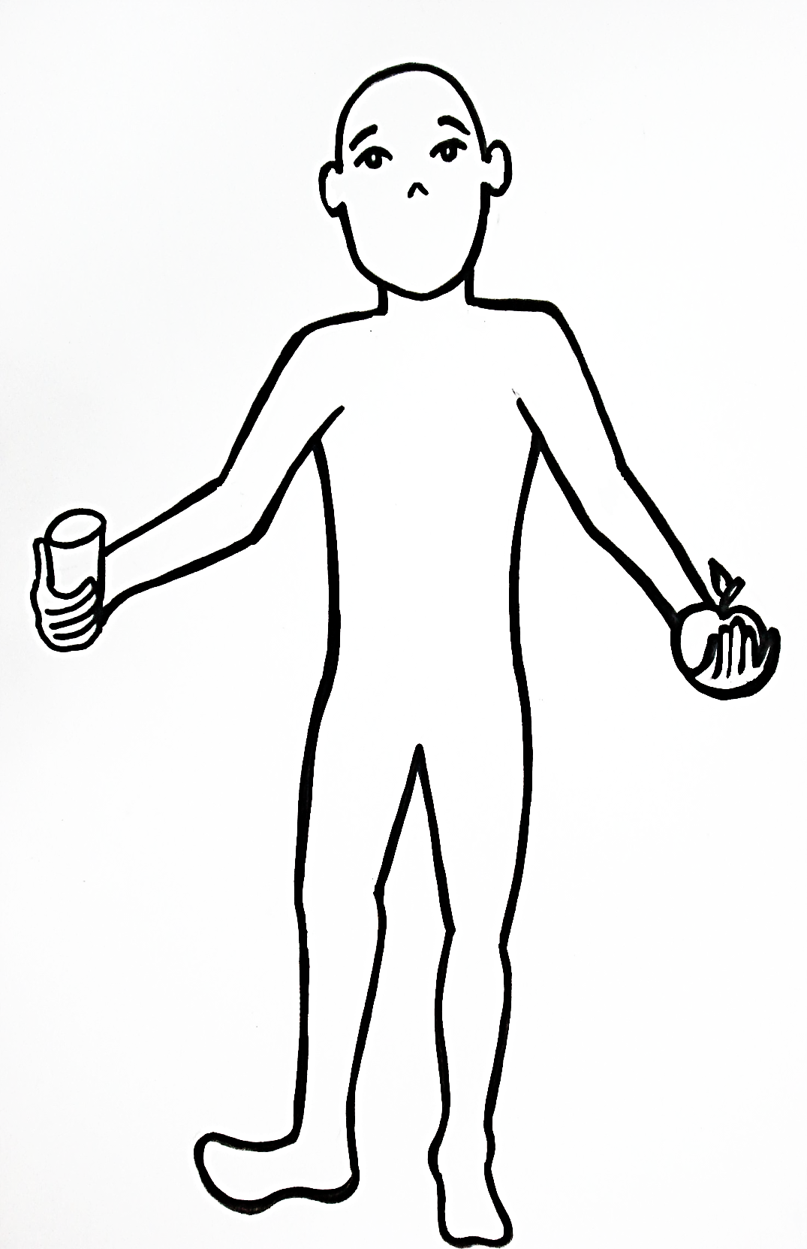
Série:
Idade:
O que acontece com o alimento que comemos e bebemos?
__________________________________________________________________________________________________________________________________________________________________________________________________________________________________________________________________________________________________________________________________________________________________________________________________________________________________________________

