Slide 1
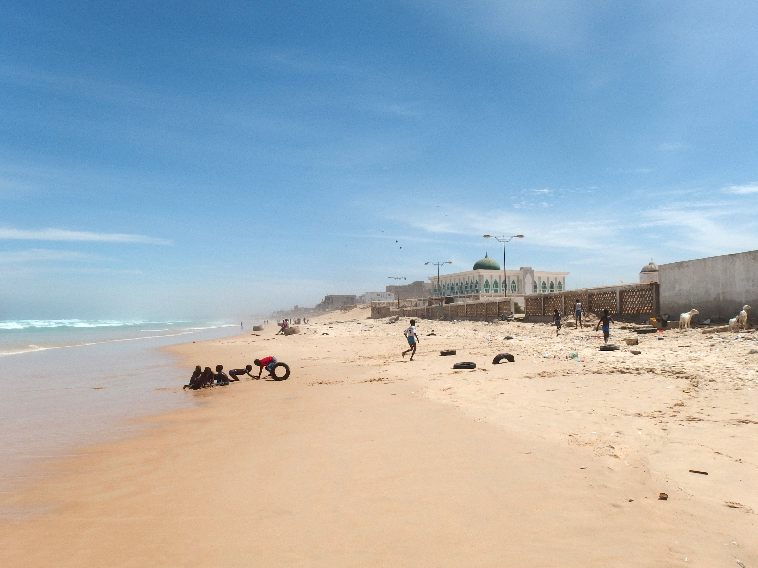
Classificação nominal em línguas africanas
LNIE II Aula 8
05/11/2020
Prof. Alexander Yao Cobbinah
USP/FFLCH/Linguistica

Slide 2
numeral classifier
gender/NC
budou | o | hyaku-fusa | tabe-ta
grape | Obj | hundred-Num.Cl | eat-Past
‘I ate 100 (bunches of) grapes.’
Japanese, Inoue 2000:225[glosses by AC]
ño-kër ñoño
Cl.ño-chicken Agr.ño:Dem.prox
‘these small chickens‘ Baínounk Gub́eeher
noun classifier
xil | naj | xuwan | no7 | lab’a
Saw | CL(man) | John | CL(animal) | snake
‘(man) John saw the (animal) snake.’
Jacaltec, Craig 1986:264
Criterion | Noun class systems | Classifiers systems
Realisation | prefix, suffix, article | separate morpheme
Size | small set | large set
Scope | agreement outside the noun phrase | no agreement outside the NP
Other | obligatory and closed morphological system, no stylistic variation | potentially open systems, context dependent use of classifiers
Summary of Dixon's (1986:106f) criteria

Slide 3
Sistemas de classificação nominal
gender / noun class: ‘as a morphosyntactic notion [that] is defined as a particular type of nominal classification in which a partition of the set of nominal lexemes into subsets manifests itself in agreement mechanisms in which nouns act as controllers’ (Creissels to appear).
frase nominal
frase verbal
CL- nome
AGR- modificadores
AGR- verbo
O-mú-límí ó-mú-néné ó-mú-kâddé ó-mû a-gênda.
PPF1-CL1-farmer PPF1-CL1-fat PPF1-CL1-old PPF1-CL1.one SC1-go
‘One fat, old farmer is going.’
Ganda; Bantu/NC (Katamba, 2003: 108 apud Zerbian & Krifka)
marcação:
sufixado
prefixado
suprasegmental
zero
concordância:
não tem
só dentro da frase nominal,
na frase nominal e verbal
função:
só marca gênero
marca gênero e número
semântica/derivação
tamanho: 2-30

Slide 4
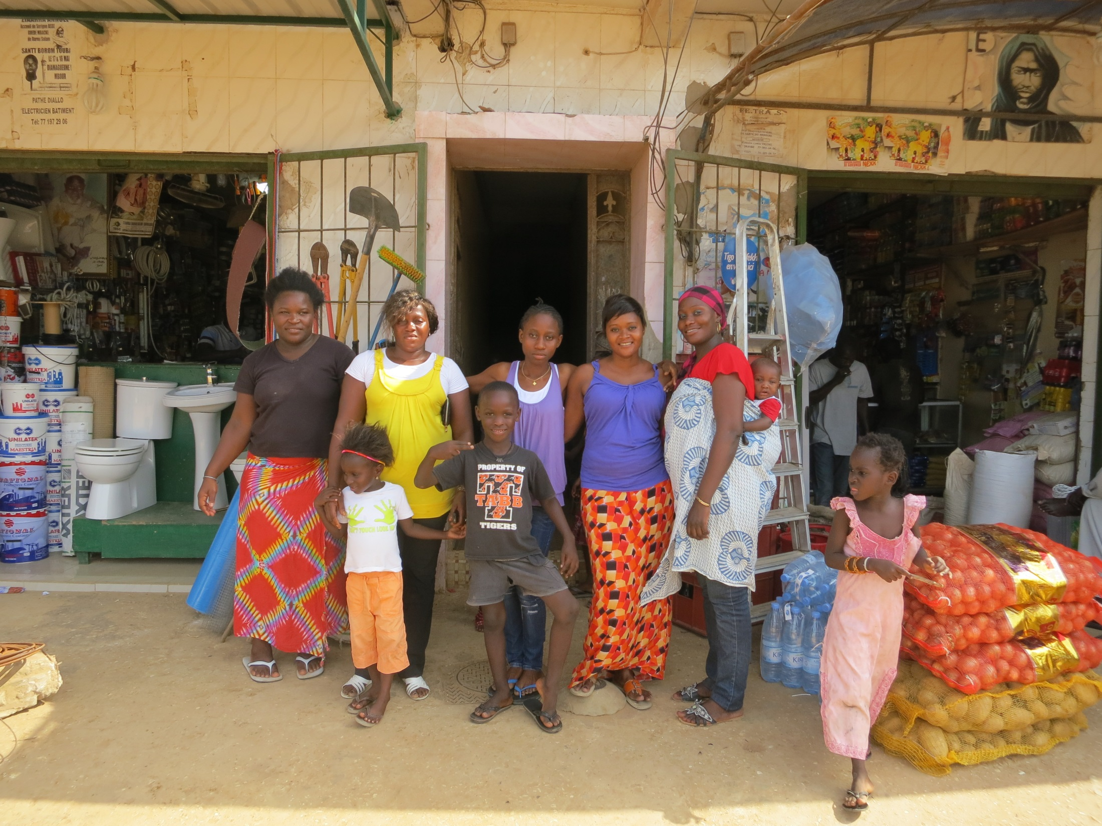
Exemplos de sistemas de classe nominal

Slide 5
Classes nominais em línguas africanas
tronco | familia
Nigero-congolês | Bantu, Atlântico Gur, Adamawa, Kwa
 | Zande (Ubangi), Ijoid
Nilo-saariano | algumas
Coissã | Khoe (central)
 | Coissã sul e norte
Afro-asiático | cuxita, chadico, semita
sex-based: contrasto básico entre referentes femininos e másculinos,
Kambaata; Cuxita/AA (Treiss 2008: 127)
zatim-á boor-á
magro-M.ACC bói-M.ACC
‘bói magro’
zatim-áta sulum-úta
magro-F.ACC vaca-F.ACC
‘vaca magra’
non-sex-based: contrasto entre seres humanos e objetos inanimados, mais outros contrastos semánticos. em muitas linguas a classe nominal exprime número também:
Baïnounk Gubëeher; Atlântico/NC
u-dikaam u-mooŋ
Cl.u-mulher Agr.u-Dem
‘aquela mulher’
in-dikaam im-meeŋ
Cl.in-mulher Agr.in-Dem
‘aquelas mulheres’
ñan-leekon im-meeŋ
Cl.ñan-escola Agr.in-Dem
‘aqueles estudantes’

Slide 6
Funções de classes nominais
concordância sintatica
ń sí nǀā-è nǂàhrè !xā-ē ǂ’ū-ē
1S IPF see-3 sheep.S.3 big.S-3 one-3
‘I see one big sheep’
West-!Xoon; Coissã do sul (Kiessling 2008)
concordância com o objeto
b-sǎay m-ndâŋ b-ɪ́
Cl.b-silk.cotton.tree Cl.b-big Cl.b-ID
‘This is a big silk cotton tree.’
Balanta; Atlântico/NC (Creissels to appear)
concordância com o subjeto
classificação semántica
Konyagi; Atlântico/NC (Santos 1996: 180)
NC paradigm | Semantics | Example with root gwə́d ‘mango’
æ III-/væ III | arvore | æ̀-nkwə́d ‘mango tree’ væ̀-nkwə́d ‘mango trees’
i II-/wae I | fruta | ì-gwə́d ‘mango fruit’ wæ̀-wə́d ‘mango fruits’
yæ I | folhas | yæ̀-wə́d ‘mango leaves’
Outras funções: referent tracking , aumentação do léxico, indicação de número, individuação; affective values (Contini-Morava & Kilarski 2013)

Slide 7
Classe nominal em banto
preprefixos, Sistema de numeros, reconstrução, agreement, animacy
u-jenzi w-a ki-wanda ch-a Ø-taifa ch-a ma-dawa y-a mi-mea ch-a Moshi
NCP11-construct CP11-of NCP7-factory CP7-of NCP5-nation CP7-of NCP6-medicine CP6-of NCP3-plant CP7-of [place]
‘the construction of the national factory of medicinal plants of/in Moshi’ [lit., construction of factory of nation of medicines of plants of Moshi]
Contini-Morava & Kilarski 2014: 36
O-mu-ti mu-nene.
AUG-3-árvore 3-grande
'A árvore é grande.'
mu-ti mu-nene
3-árvore 3-grande
'grande árvore'
o-mu-ti o-mu-nene
AUG-3-árvore AUG-3-grande
'grande árvore'
Luganda; Banto/NC (Thanassoula, p.c.)

Slide 8
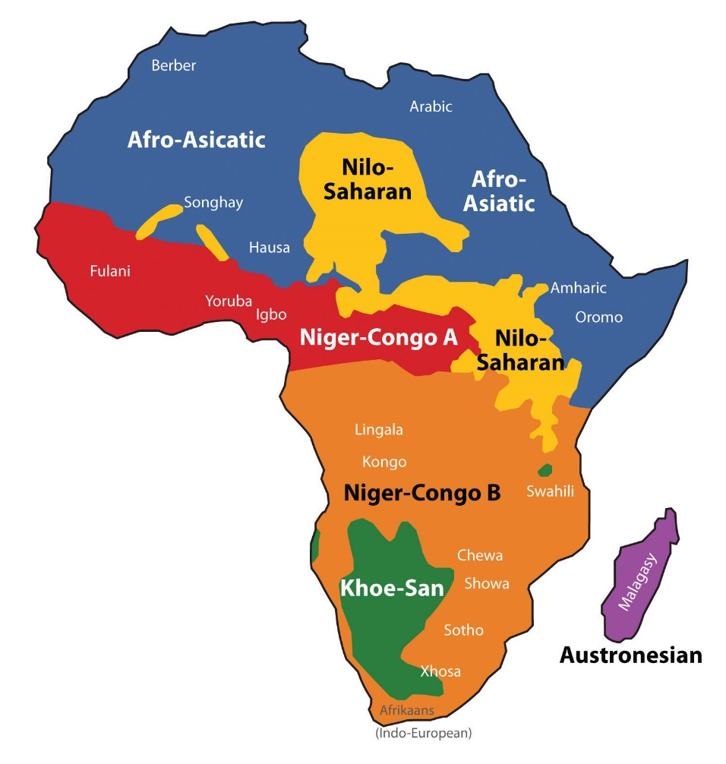
Classe nominal em Coissã do norte
N!āū má (ȍhā) mí yȁ
House TOP COP 1Sg N1
‘The house is mine.’
 | NC | POSS | semantics | examples
N1 | hȁ | -yȁ | human singular; plants, inanimates | dàbà ‘girl’ n!āū ‘house’
N2 | (*sì) | / | / | /
N3 | hīí, yīí | -yīí | human plural; inanimates | dèbē ‘girls’ g|à’à ‘eye
N4 | kā | -gā | body parts, abstracts, inanimates | tc’ū ‘traditional house’ dcŋ̏
dèbē má (ȍhā) mí yīí
girls TOP COP 1Sg N3
‘The girls are mine.’
Tc’ū má (ȍhā) mí gā
Trad:house TOP COP 1Sg N4
‘The (traditional) house is mine.’
No marking on the noun, only on dependent (pronominal, possessive). Only animates mark number using NC, (Sg: N1/Pl: N3). All other classes use optional plural enclitics (regular: hŋ̏ kinship: hŋ̀.)
Dȁhmà hȁ ŋ̄ŋ̀ this woman’
Dȅhmē yīí ŋ̄ŋ̀ ‘these women’
N!āū hȁ ŋ̄ŋ̀ ‘this house’
N!āū (hŋ̀) hȁ n̄ŋ̀ ‘these houses’
Ju/’hoan; coissã do norte
(Heine 2006:74)

Slide 9
Classe nominal e número em cuxita
plural = forma básica
singulativo (marcado)
masculino: kin-ú ‘pedras’
femenino: kor-ú-ta ‘polgas’
kin-ch-ú ‘pedra’
kor-ch-ú-ta ‘polga’
Kambaata; Cuchita/AA, (Treiss 2008: 135f)
singular = forma basica
plurativo (marcado)
masculino: min-í ‘casa’
feminino: gon-ú-ta ‘asa’
masculino: kaashsh-á ‘bala’
feminino: shal-á-ta ‘canção’
min-n-á-ta ‘casas’
gon-n-á-ta ‘asas’
kaashsh-aakk-á-ta ‘balas’
shal-aakk-á-ta ‘canções’
Plurativos em kambaata são marcados como femininos (-ta) e tomam correspondência feminina. Esse fenómeno (polaridade de gênero) é tipico pelas línguas cuchitas, comparem no Somali (Lecarme 2002:112):
aqál (-ka) (M) ‘hut’
aqalló (-á-da) (F) ‘huts’
sheekó (-á-da) (F) ‘tale’
sheekoóyin (-ka) (M) ‘tales’

Slide 10
Classe nominal em Nilo-Saariano.
m/f system
ɛnk-apʊtánì
'wife's female parent'
câmbio de gênero
ol-apʊtánì
'wife's male parent'
Sistema m/f com semantica afectiva: diminutiva/augmentativa ou pejorativa
ɛnk-anáshɛ̀
'sister'
<m> = augmentativo
olk-anáshɛ̀
'very large sister'
<f> = pejorativo
ɛnk-ámʊ̀yɛ̀
'wimpy male donkey'
ol-ámʊ̀yɛ̀
'male donkey'
Maasai; Eastern Nilotic/NS (Payne 1998: 166)
Classe nominal em Laal (isolado)
nīīnī → já yùr-ù ‘I know her.’
‘woman’ I know-3F.SG
nāārā → já yìr-ár ‘I know him.’
‘man’ I know-3M.SG
ɓiāāg/nyàw → já yìr-àr ‘I know it.’
‘dog/house’ I know-3N.SG
Sistema m/f/n system
estrictamente semântico, só marcação em pronomes e demonstrativos
Laal; isolado (Chad) Lionnet 2015.

Slide 11
Mutação consonántica
Atlântico (Tenda, Seereer, Fula)
Mande (sul-occidental)
. Consonant mutation grades in Konyagi (Santos 1996: 79)
I | f | v | w | w̃ | r | r | l | l̃ | s | y | y | ỹ | x | y/w | ỹ/w̃
II | p | ɓ | b | m | t | ɗ | d | n | c | ƴ | j | ñ | k | g | ŋ
III | p | mb | mp | m | t | nd | nt | n | c | nj | nc | ñ | k | nk | ŋ
Konyagi, Atlântico/NC (Santos 1996: 80)
classe
nominal
grau | exemplo
I | wæ̀-vu | ‘frutas de baobab’
II | ì- ɓú | ‘fruta de baobab’
III | æ̀- mbu | ‘baobab (árvore)’
βə̀-yə́lé βə́-sân ì-ŋə́lé í-ɓə̂n
CL I -quel CL I –homme CL III -quel CL III -cendre
‘quais homens’ ‘qual cinza’
concordância
Konyagi, Atlântico/NC (Storch 1995:90-92 in McLaughlin, to appear)
flexão
foco
tók-ə́nì
‘comeram’
ǽmí ròkə̀-kə́
‘sou eu quem come’
p.92 regularisation
Konyagi, Atlântico/NC (Santos 1996: 217)

Slide 12
Bibliografia
Contini-Morava, Ellen, and Marcin Kilarski. 2013. Functions of nominal classification. In Language Sciences 40: 263–299.
Creissels, Denis. This volume a. Noun class systems in Atlantic languages. In The Oxford guide to the Atlantic languages of West Africa, edited by Friederike Lüpke. Oxford University Press: Oxford.
Greenberg, Joseph H. 1963. The languages of Africa. Research Center in Anthropology, Folklore, and Linguistics Publications 25. Bloomington: Indiana University.
Güldemann, Tom. 2010. Sprachraum and geography: linguistic macro-areas in Africa. In Lameli, Alfred, Roland Kehrein and Stefan Rabanus (eds.), “Language and space: an international handbook of linguistic variation, volume 2: language mapping.” Handbooks of Linguistics and Communication Science 30,2. Berlin: Mouton de Gruyter, 561-585, Maps 2901-2914.
Bernd Heine, 2006 .Strukturkurs Nord-Khoisan. materiais didacticos. University of Cologne
Hyman, Larry 2007. Selected Proceedings of the 37th Annual Conference on African Linguistics, ed. Doris L. Payne and Jaime Peña, 149-163. Somerville, MA: Cascadilla Proceedings Project.
Katamba, F. (2003). Bantu nominal morphology. In: The Bantu Languages (D. Nurse and G. Philippson, eds.), pp. 103-120. Routledge, London and New York.
Kihm, Alain. 2000. Noun class, gender, and the lexicon-syntax-morphology interfaces. A comparative study of Niger-Congo and Romance languages (ms.).
Kiessling, Roland 2008. Noun classification in !Xoon. In: Ermisch, Sonja (ed.), Proceedings of the 2nd International Symposium January 8-12, 2006, Riezlern/Kleinwalsertal. Köln: Rüdiger Köppe, 225-248.
Lecarme, Jacqueline 2002. Gender “polarity”: Theoretical aspects of Somali morphology. In: Many Morphologies, ed. Paul Boucher and Marc Plénat, 109–141. Somerville, MA: Cascadilla Press.
Lionnet, Florian 2015. Nominal classification in Laal: an African exception. Linguistisches Kolloquium, 19 May 2015. Humboldt Uni berlin. https://www.iaaw.hu-berlin.de/de/afrika/linguistik-und-sprachen/veranstaltungen/afrikalinguistischeskolloquium/paper-sommersemester-2015/handout_lionnet_19_05_2015.pdf
Payne, Doris L. 2008. Maasai gender in typological perspective. In: Studies in African Linguistics, Volume 27, Number 2.
Santos, Rosine. 1996. Le mey. Langue Ouest-Atlantique de Guinée. PhD thesis. Université Paris III.
Treiss, Yvonne. 2008. A grammar of Kambaata. Part 1. Cologne: Rüdiger Köppe.

