Slide 1
Chapter 15 External Growth Strategies: Mergers, Acquisitions & Alliance
Prof. Luciano Thomé e Castro

Slide 2
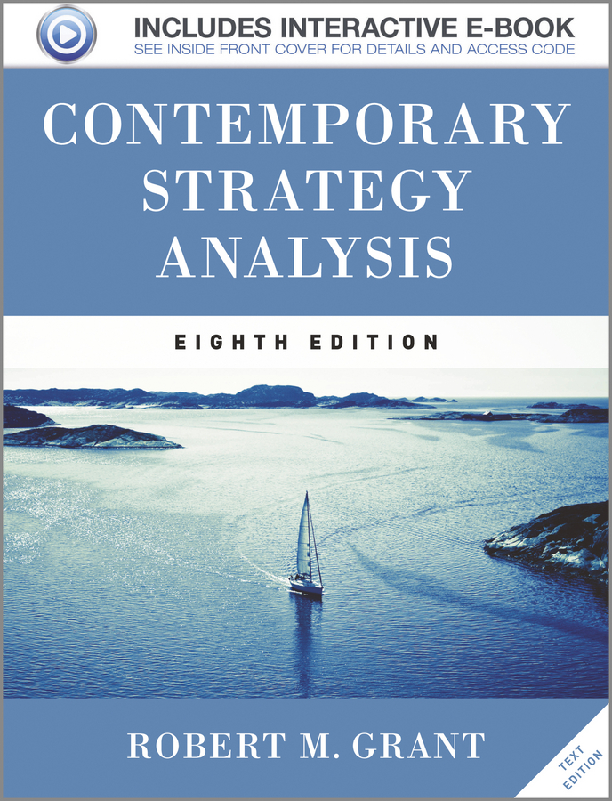
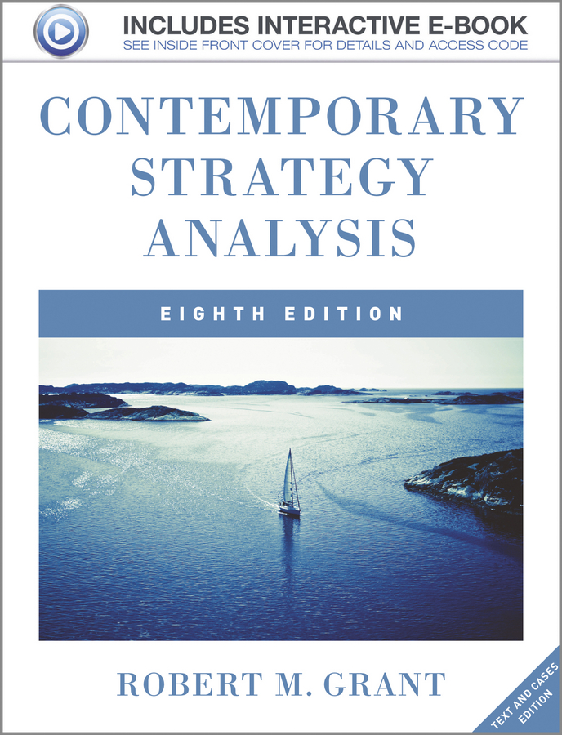
© 2013 Robert M. Grant
www.contemporarystrategyanalysis.com

Slide 3
External Growth Strategies: Mergers, Acquisitions & Alliances
OUTLINE
Mergers and Acquisitions: Causes and Consequences
Strategic Alliances— Motives
© 2013 Robert M. Grant
www.contemporarystrategyanalysis.com

Slide 4
The Motives for Mergers & Acquisitions
Acquiring Resources or Capabilities
Some resources and capabilities not transferable or replicable: to obtain them may require acquiring the entire company (e.g. Disney and Pixar)
Acquisitions are especially important for established companies seeking to acquire emerging technologies (during 2005-11, Google acquired 95 firms and Microsoft 71)
Cost Economies and Market Power
Horizontal mergers (especially between competitors) offer clearest benefits from mergers in terms of scale economies and market power (e.g. United and Continental airlines; Exxon and Mobil)
Geographical Extension
Acquisition is the most popular means of entry into foreign markets by companies. Allows acquiring firm to gain critical mass and overcome “liabilities of foreignness”
Diversification
Acquisition is the predominant mode of diversification by firms
© 2013 Robert M. Grant
www.contemporarystrategyanalysis.com

Slide 5
Consequences of Mergers & Acquisitions
Financial Outcomes
Many studies, inconsistent results
In terms of returns to shareholders, main finding is that shareholders of acquiring firms lose; shareholders of acquired firms gain; combined impact a v. small gain
If acquisitions destroy value for the acquirer, why do they happen?
Motivated by managerial goals (e.g. growth)
Imitation (e.g. internationalization by banks, merger wave among petroleum firms)
Acquiring firms overestimate the benefits, underestimate the costs
Learning effects
Some firms more successful acquirers than others. Acquisition capability the result of (a) learning through experience (b) systematizing the approach to acquisition management
© 2013 Robert M. Grant
www.contemporarystrategyanalysis.com

Slide 6
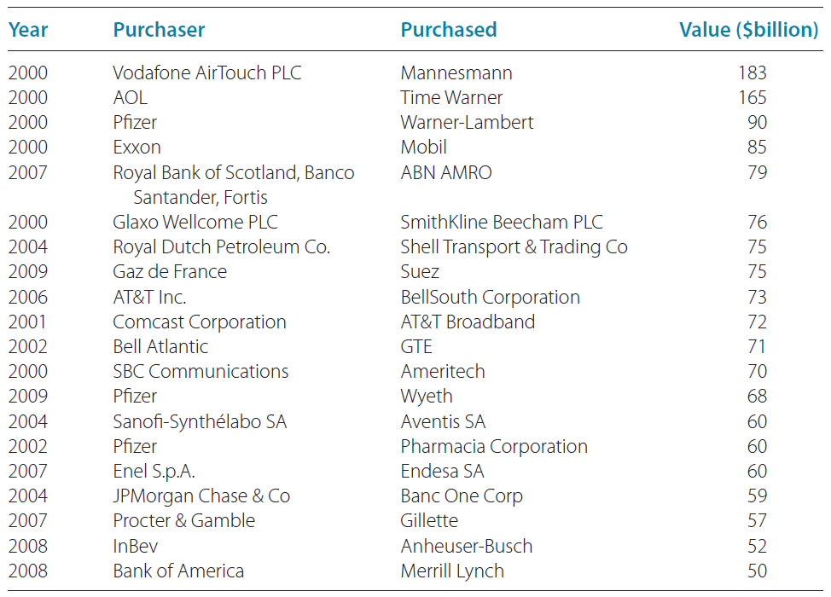
Top-20 Mergers and Acquisitions of the 21st Century
© 2013 Robert M. Grant
www.contemporarystrategyanalysis.com

Slide 7
Alliances & Joint Ventures: Management Issues
Benefits
Combining resources and capabilities of different companies
Learning from one another
Reducing time-to-market for innovations
Risk sharing
Problems
Management differences between the two partners. Conflict most likely where the partners are also competitors
Benefits are seldom shared equally. Distribution of benefits determined by:
Strategic intent of the partners- which partner has the clearer vision of the purpose of the alliance?
Appropriability of the contribution-- which partner’s resources and capabilities can more easily be captured by the other?
Absorptive capacity of the company-- which partner is the more receptive learner?
© 2013 Robert M. Grant
www.contemporarystrategyanalysis.com

