Slide 1
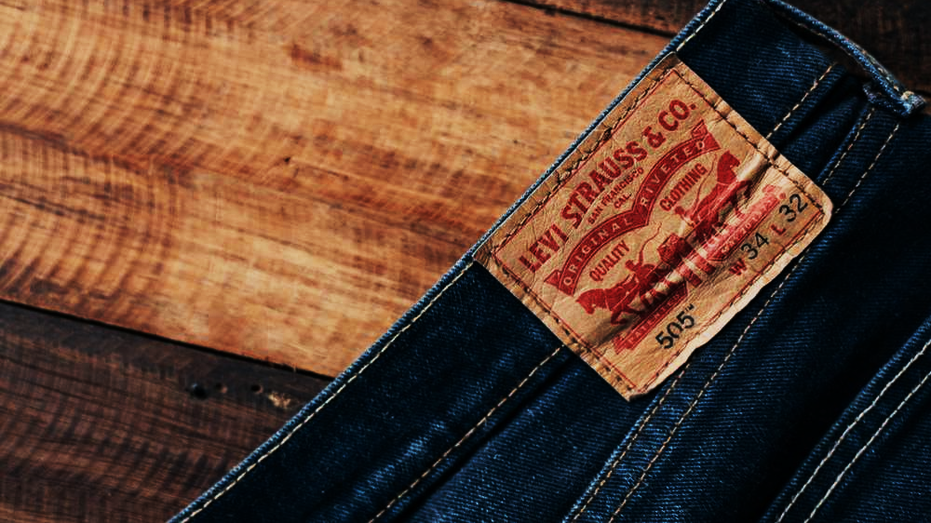
Levi Strauss & Co.
Carlos Paro, Guilherme Pestilho e Pedro Paro

Slide 3
Agenda
History;
Diagnosis;
Core Strategy;
Future Scenarios;
Recommendations.

Slide 4
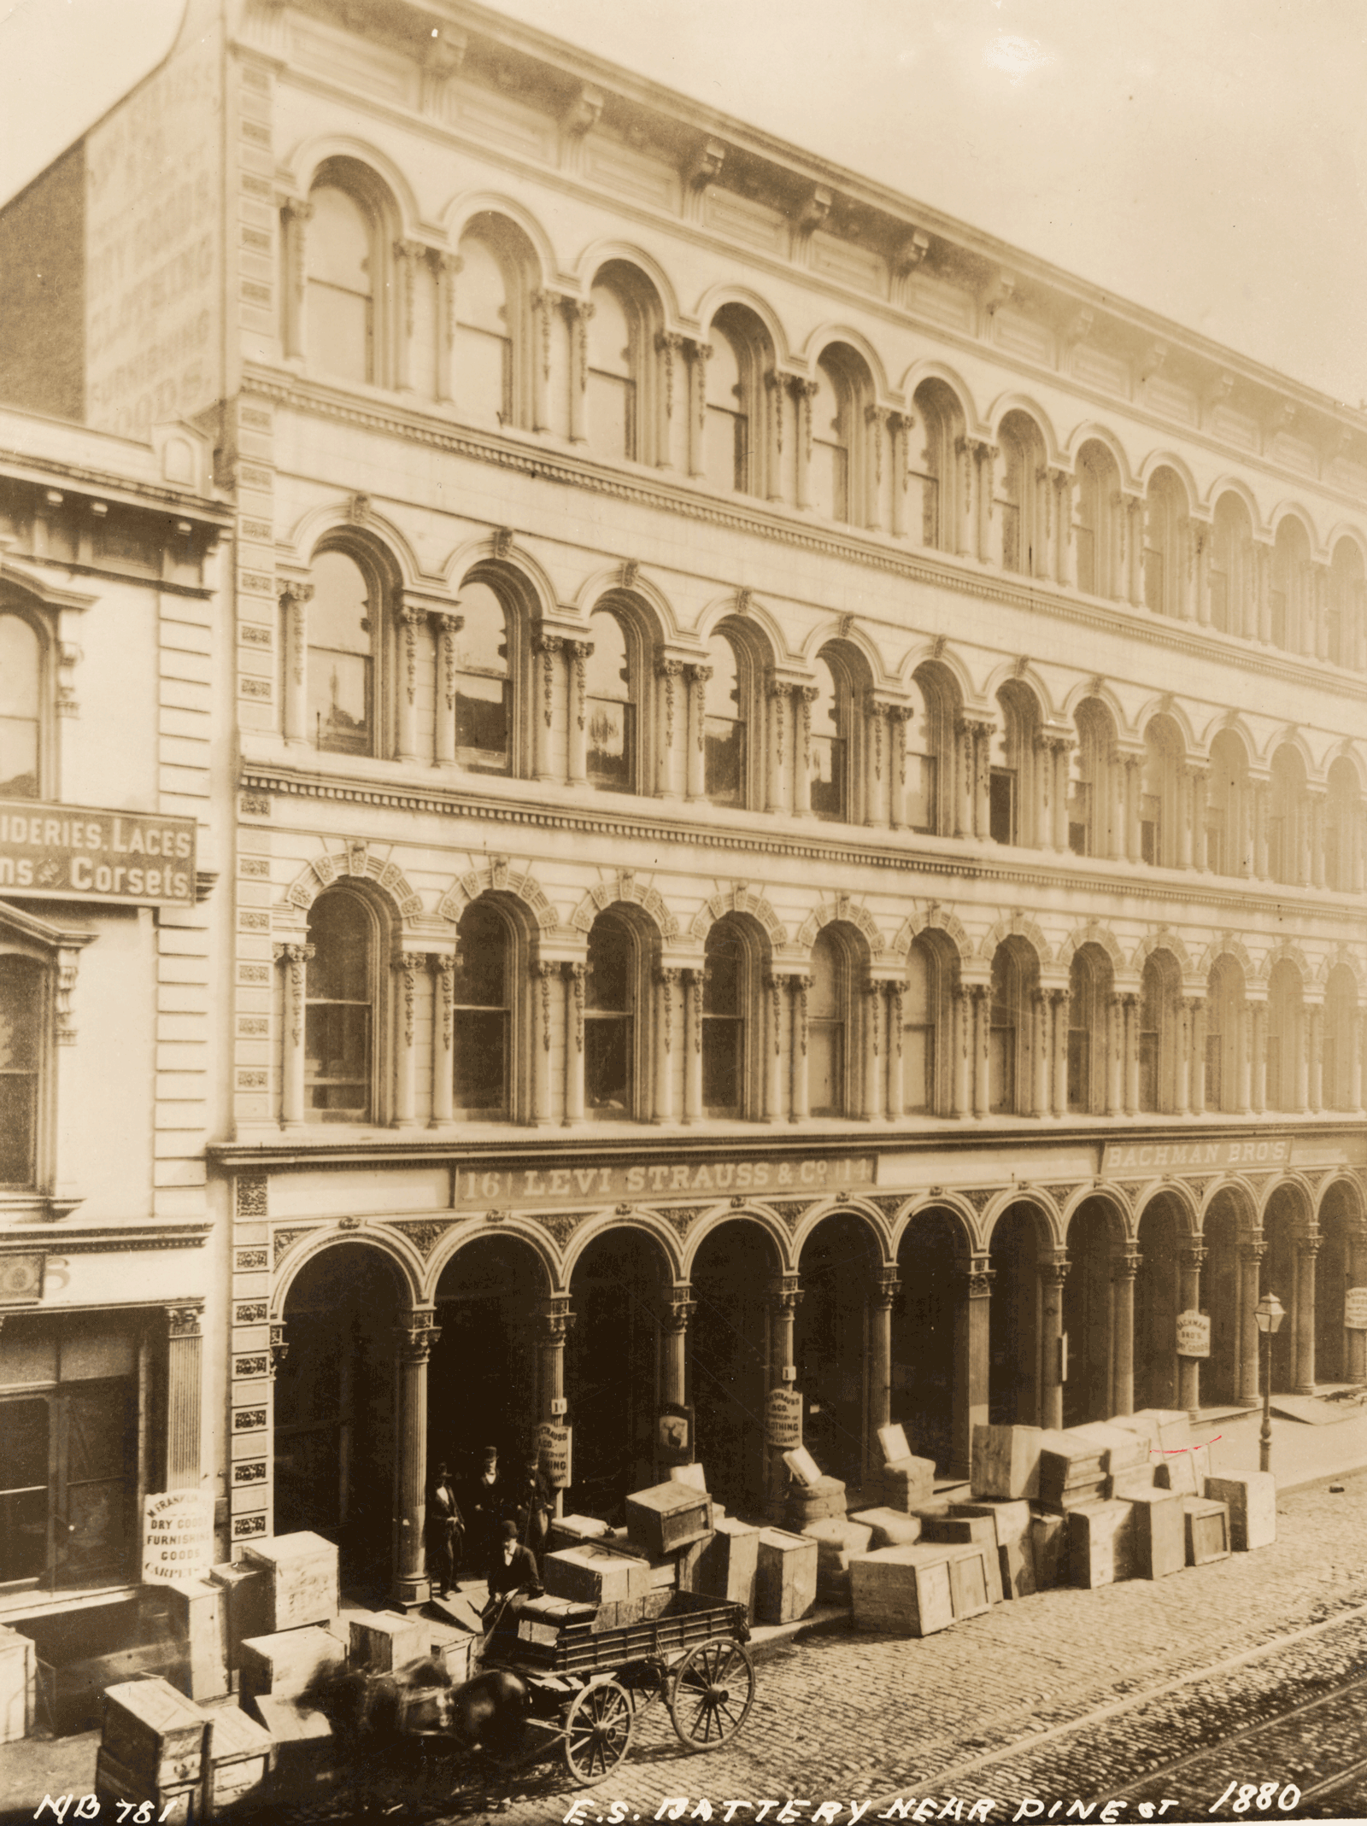
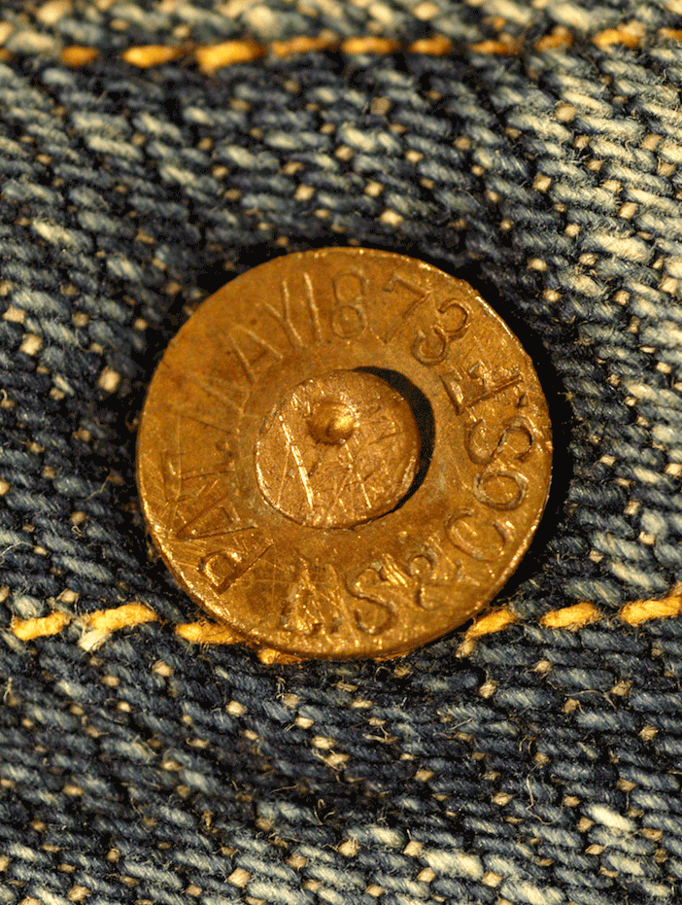
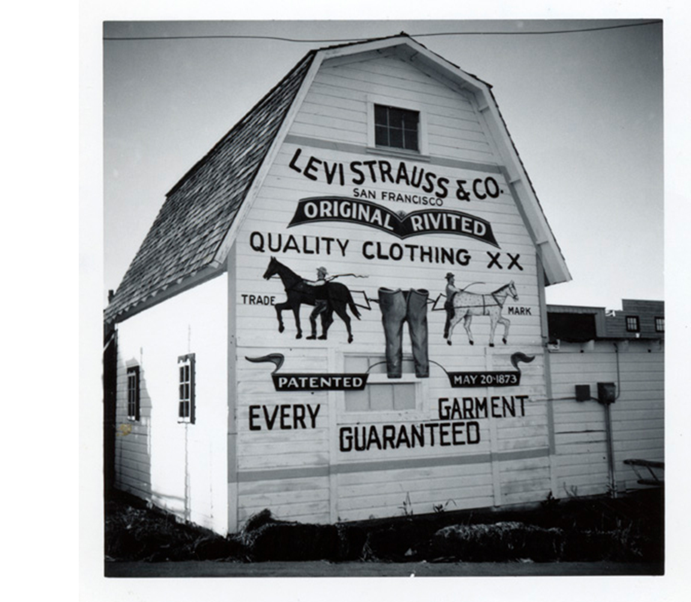
History
1829 – The Birth of Levi Strauss
1853 – Levi Strauss & Co is founded
1873 – Blue Jeans are born
1886 – The Two Hourses Brand
Levi Strauss was born in Bavaria, Germany, and moved to the United States after his father died of tuberculosis.
Leve Straus was working with the brothers at a shop that imports clothes, and then he opens his own business.
Jacob Davis & Levi Strauss receive a patent for the improvement in the opening of handbags. And by adding rivets to their pants, they created the jeans.
The Two Horses Brand symbolizes a pair of Levi's waist overalls, illustrating the brand's strength against the competition.

Slide 5
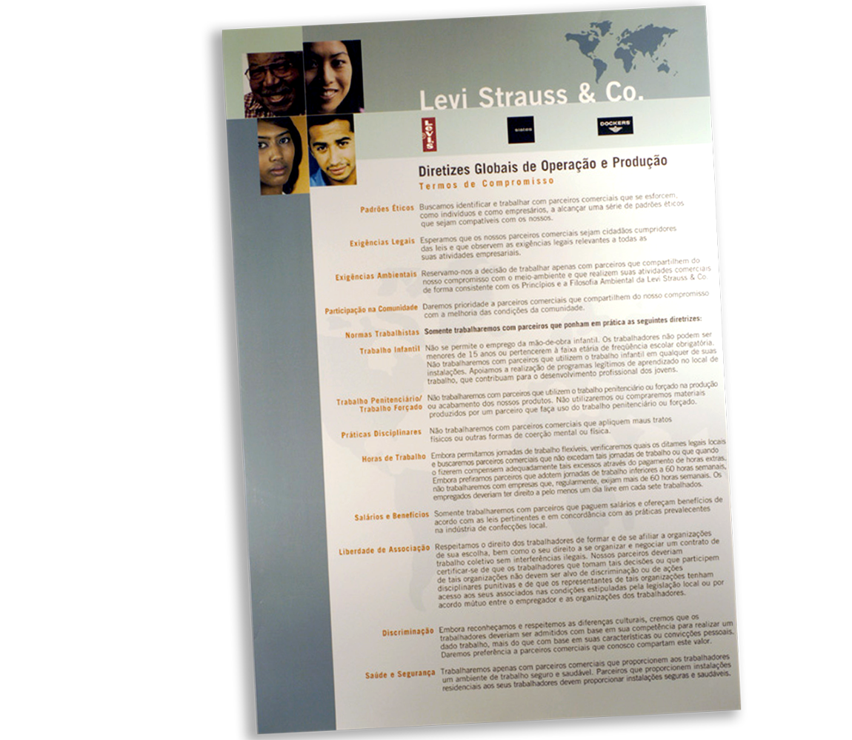
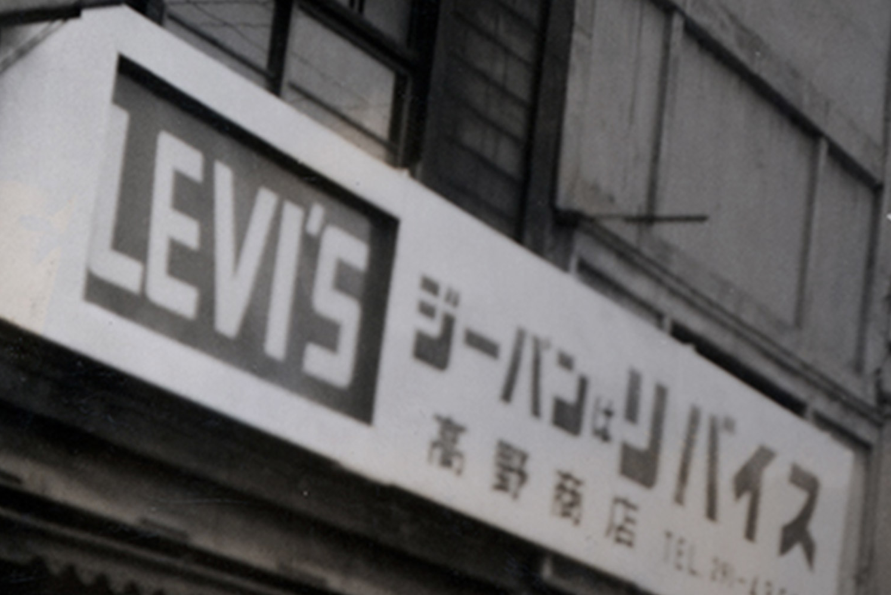
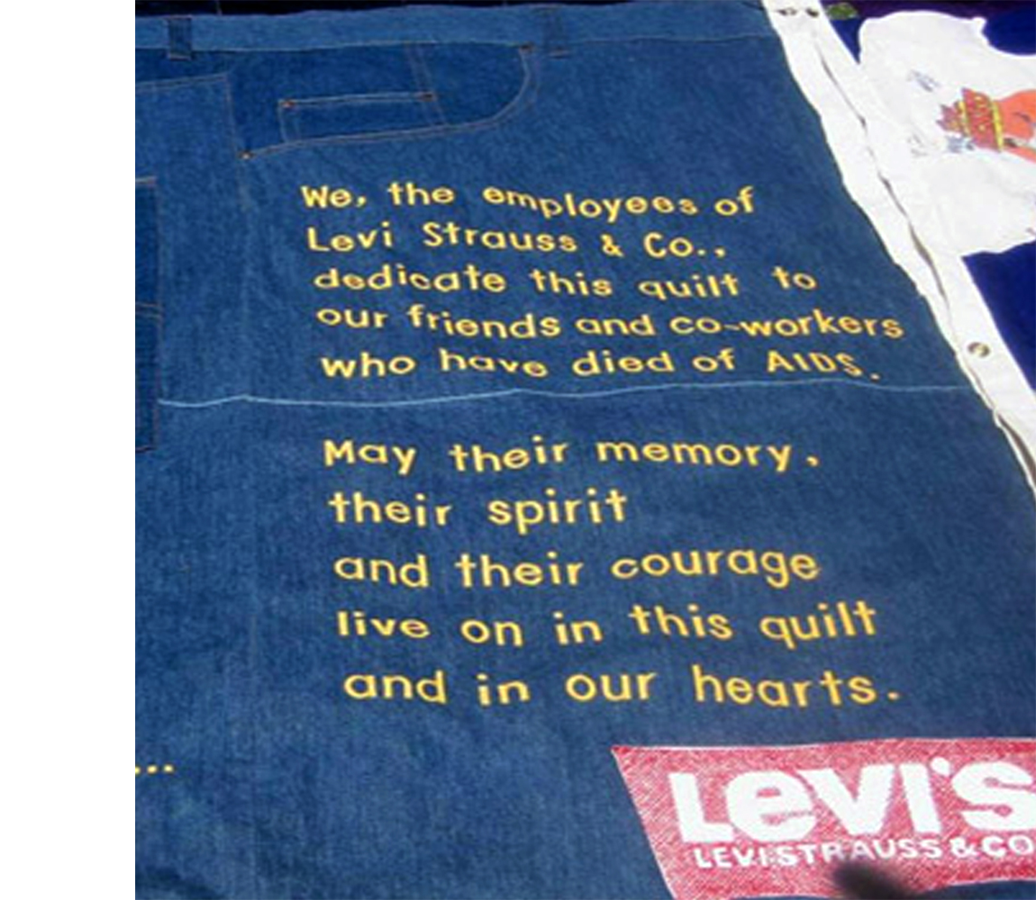
History
1934 – Lady Levi’s
1965 – The beginning of internationalization
1982 – The AIDS crises
1991 – Term of commitment
The brand features the first blue jeans made exclusively for women.
In the 60's the brand was famous in the US, and then began to expand to Europe and Asia.
The Levi Strauss Foundation helps with donations to employees with AIDS, and soon after forming a support group.
It is the world's first apparel brand to launch a code of conduct, with ethical, environmental, community-based standards.
Notes:
Talvez seja legal introduzir o desenvolvimento das khaki (https://www.wisegeek.com/what-are-khakis.htm) da marca Dockers (https://www.levistrauss.com/who-we-are/brands/dockers/)

Slide 6
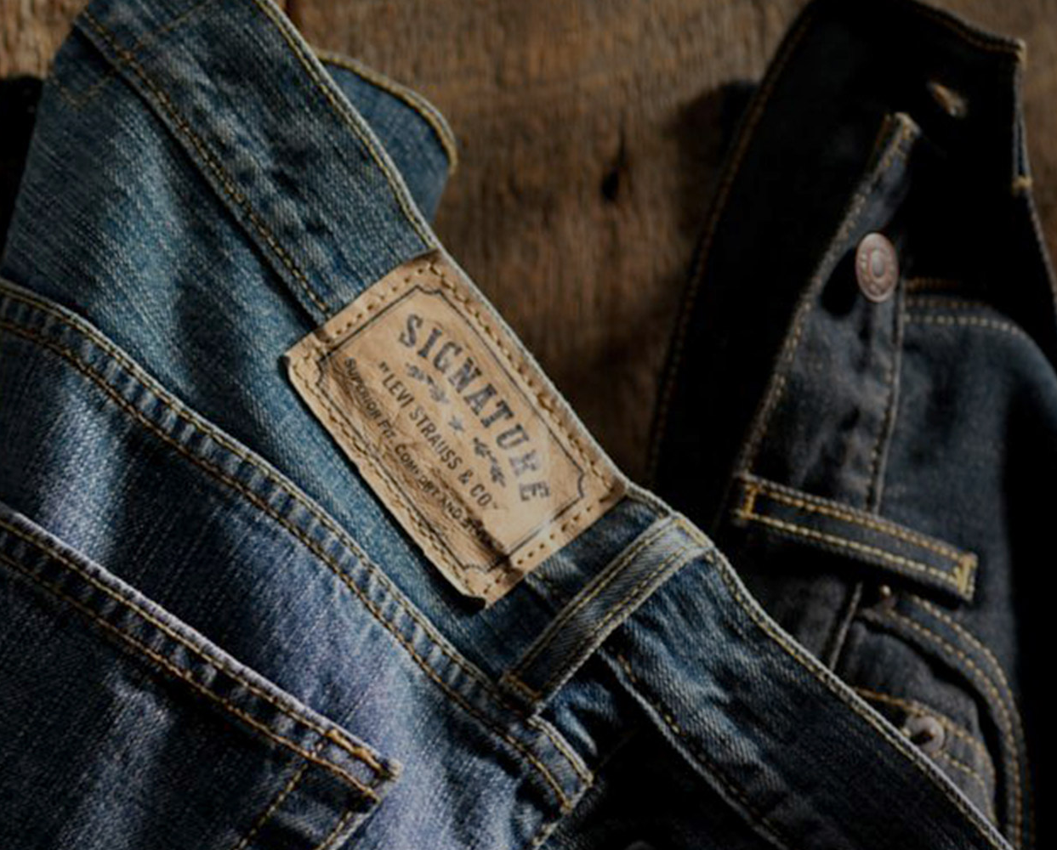
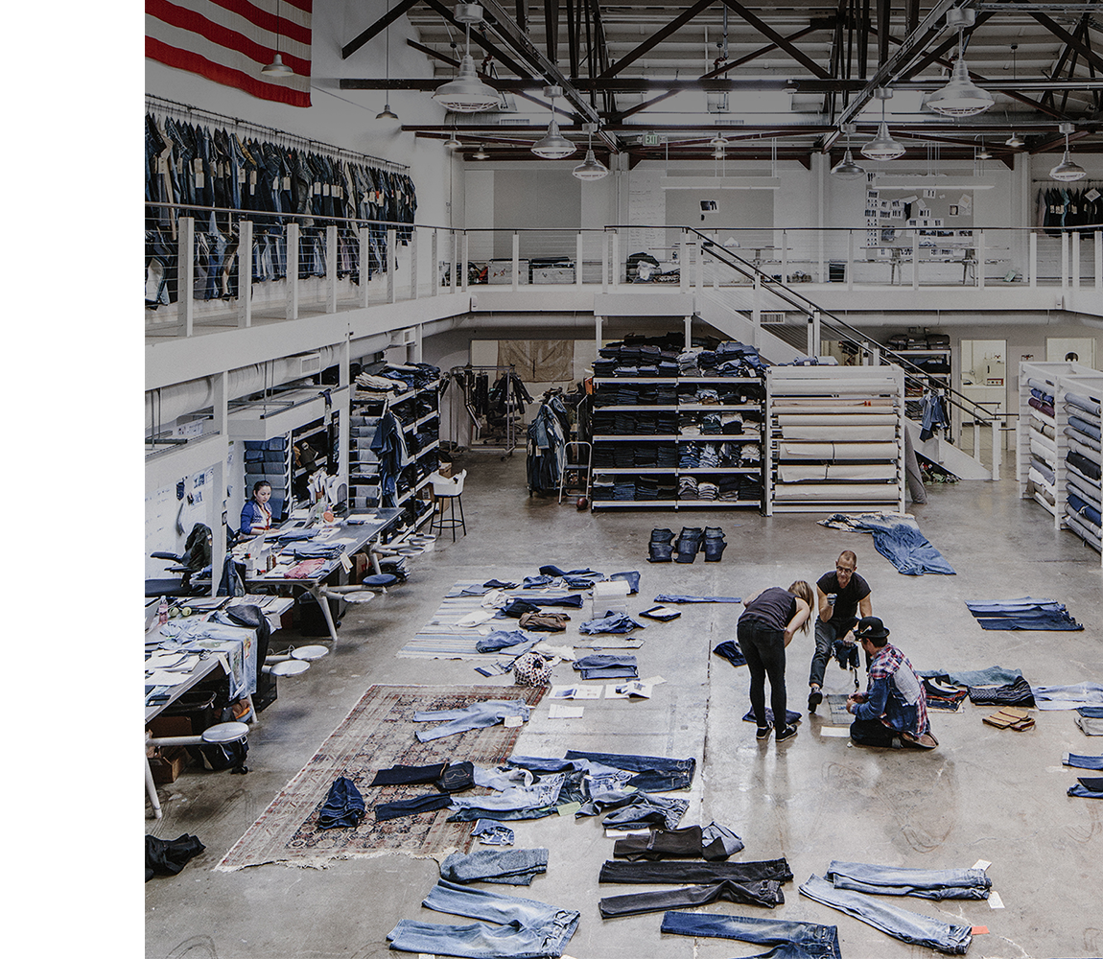
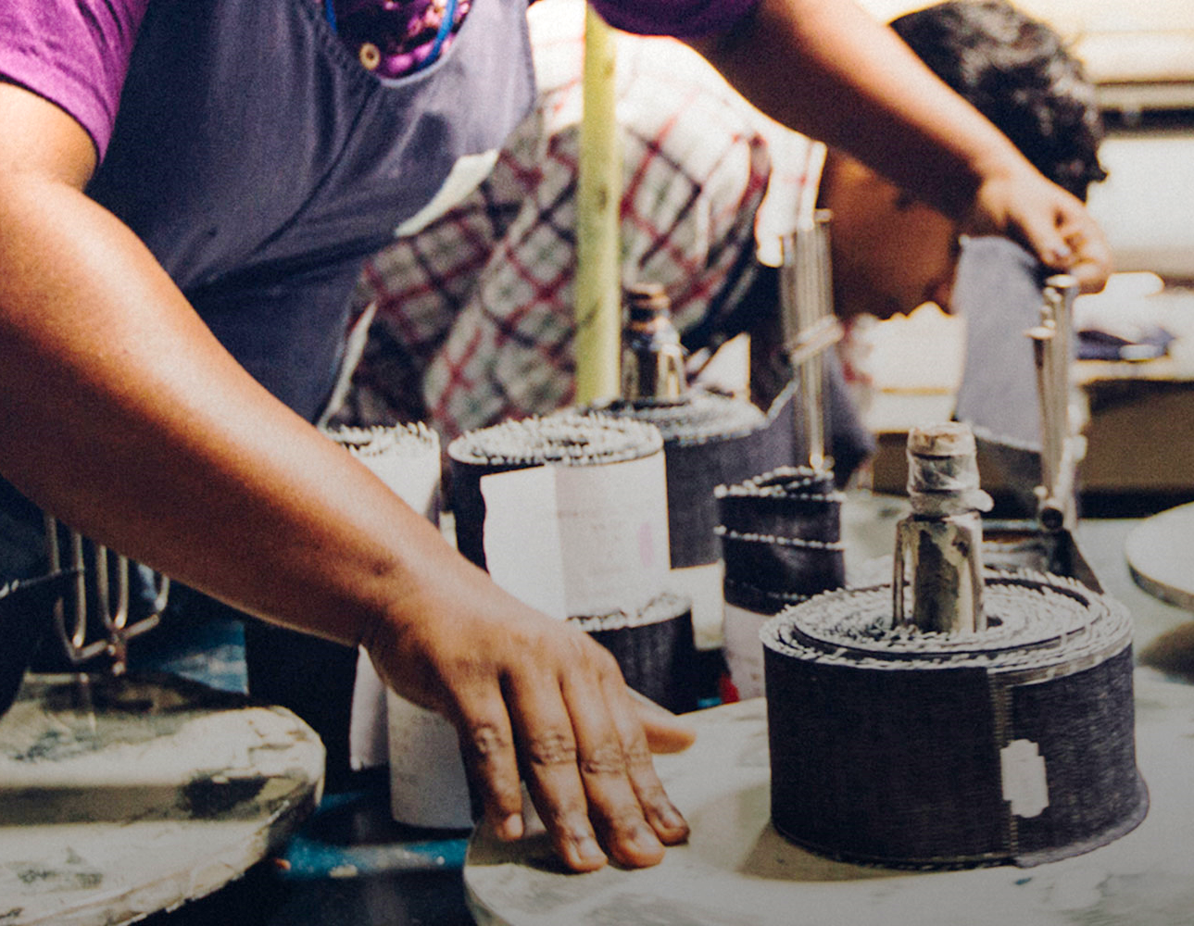
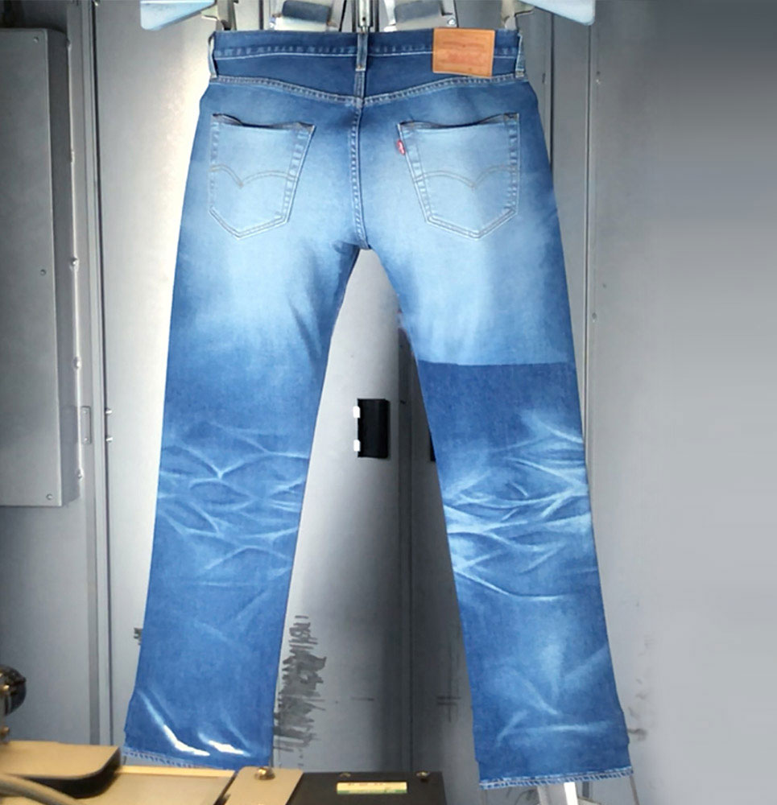
History
2003 – Signature by Levi Strauss
2013 – Eureka Lab is created
2015/16 – Featured Chemistry Program and Wellness
2018 – Product Development
Created the Signature brand to meet bulk buyers in retail stores, always maintaining the quality of Jeans.
An installation focused on prototyping and product development.
The programs analyze the impacts of chemicals on health and the environment to identify solutions, as well as work on the well-being of employees.
The brand starts to develop products in line with consumers (pocket for cell phones) and with more sustainable technologies.

Slide 7
Diagnosis
Internal and External Analysis

Slide 8
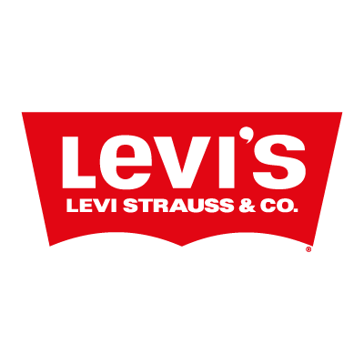

Slide 9
+
86%
8%
6%
Notes:
Contribuição nas vendas.
The Denizen® brand was introduced in the United States starting in 2011, and includes a variety of jeans to complement active lifestyles and to empower consumers to express their aspirations, individuality and attitudes at a value price point.
Signature was launched in 2003, cheap, quality, style.

Slide 10
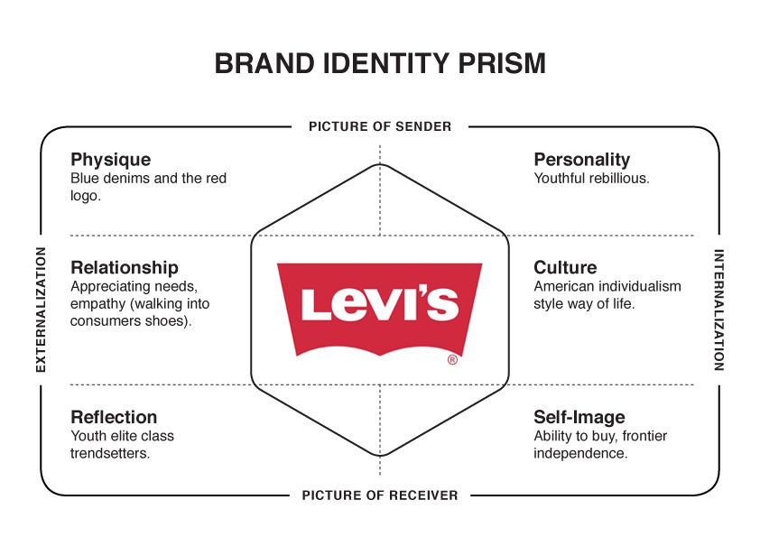

Slide 12
Distribution Channels
Levi's makes its offerings available to the customers through a variety of channels;
Independent product manufacturers;
Levi's network is responsible to the availability of their products in over 110 countries.

Slide 13
Contract Risks (Transaction Costs)
"The cost associated with exchange of goods or services and in overcoming market imperfections"
Levi's is heavily dependent on its 10 major wholesalers who account for over 31% of its net revenues;
Approximately 97% of Levi's products are from independent product manufacturers. Dependence on contract manufacturers.

Slide 14
SWOT Analysis
Strenghts:
Strong brand portfolio;
Expertise in jeans industry;
Multiple distribution channels;
Strong free cash flow;
Strong global presence;
Patents.
Notes:
http://fernfortuniversity.com/term-papers/swot/1433/547-levi-strauss.php
https://www.marketing91.com/swot-analysis-of-levi-strauss/

Slide 15
SWOT Analysis
Weakness:
Over dependence on few wholesale customers;
Dependence on contract manufacturers;
Customer loyalty declining;
Market share loss in niche markets;
Nine plants have been shut since 1982.
Notes:
Not very good at product demand forecasting leading to higher rate of missed opportunities compare to its competitors.

Slide 16
SWOT Analysis
Opportunities:
Growing casual wear market;
Low manufacturing and production costs in various international markets;
Increasing acceptability of western wear across the world;
The customers becoming more leisure-oriented and wearing jeans more often.

Slide 17
SWOT Analysis
Threats:
Fast changing consumer tastes;
Lack of protection of property rights in some countries like China;
Increasing competition and product substitution.

Slide 18
Financial Position (First Quarter 2019)
Net Income of $147M Compared to Net Income of $86M in 2007;
First Quarter Reported Revenues up 7% on Growth Across All Regions;
Growth and expansion of the company's direct-to consumer business;
Lower margins in comparison to its competitors.

Slide 19
Pricing Position
Diesel
Tommy Hilfiger
Calvin Klein
Levi's
LEE

Slide 20
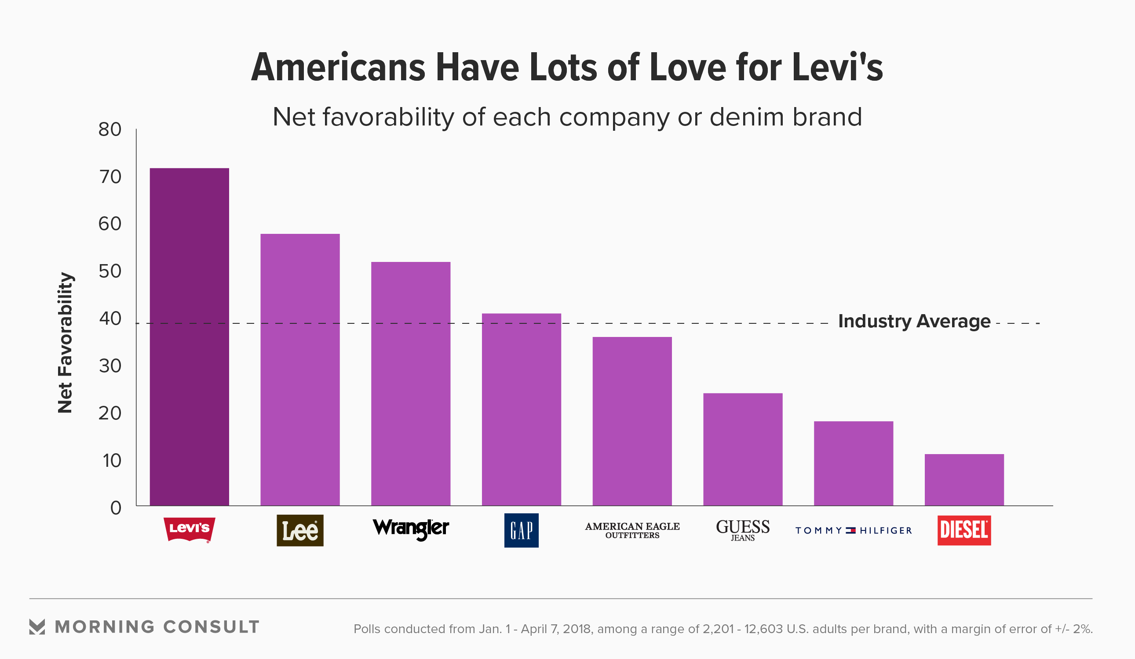

Slide 21
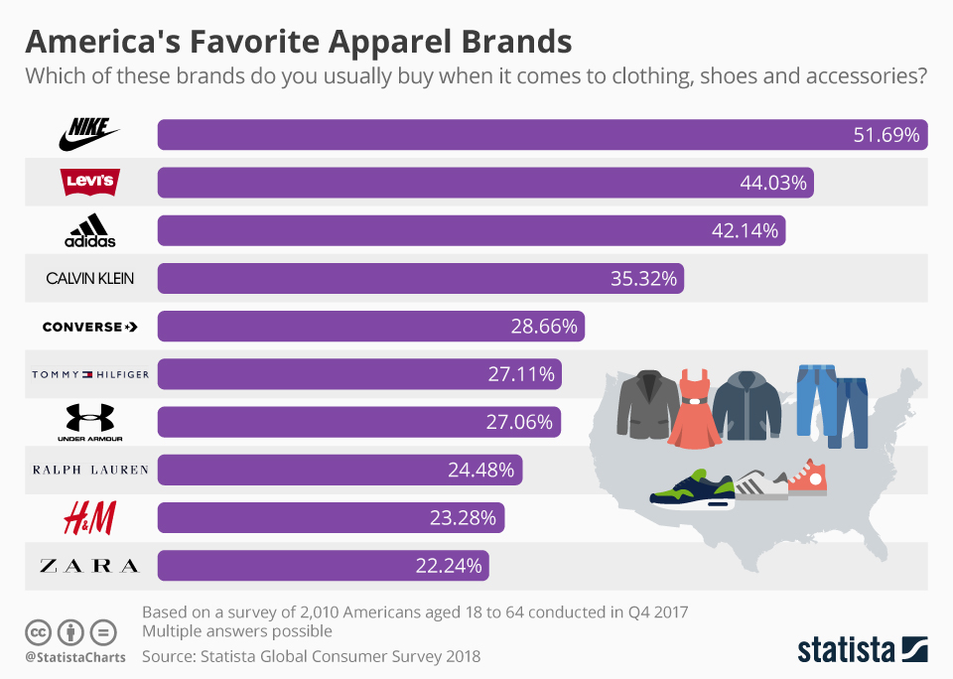

Slide 23
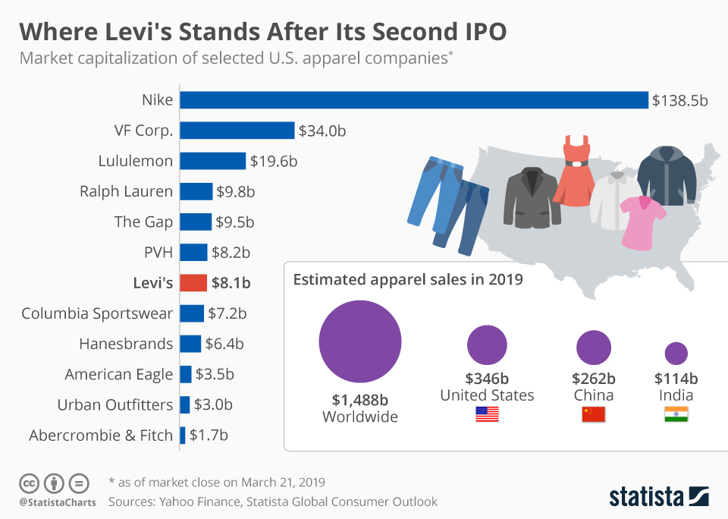

Slide 24
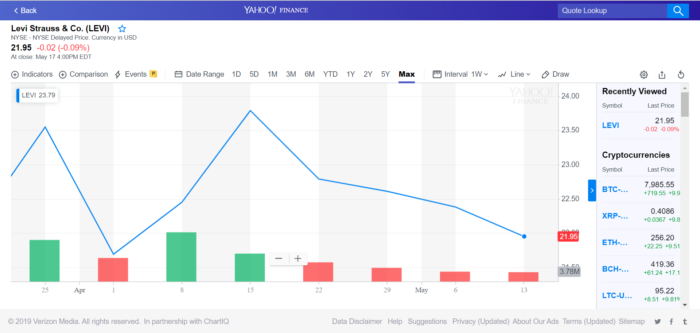
Levi Strauss was valued by $8.1bn when the denim-maker rejoined the stock market after 34 years away.

Slide 25
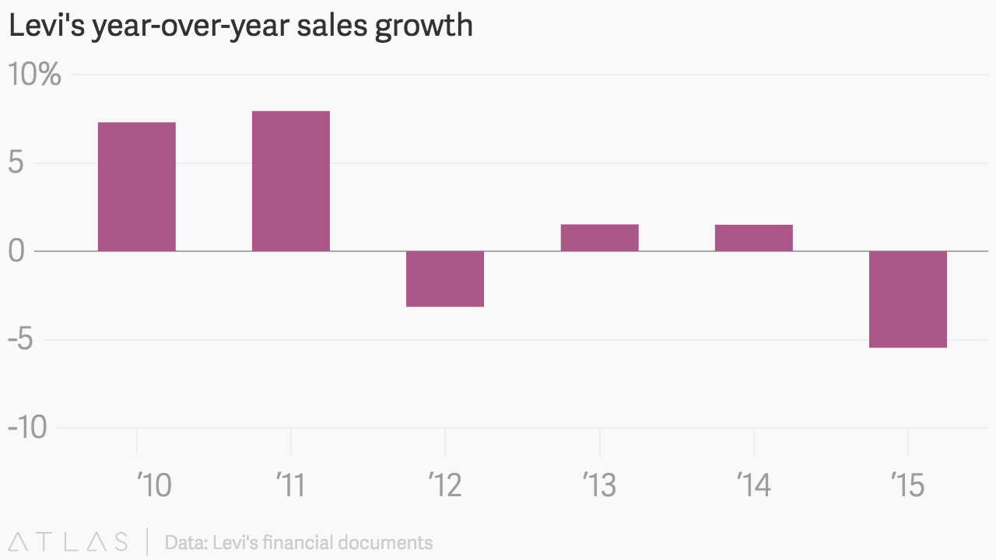

Slide 26
Critical Success Factors
Trending Value Proposition: Antecipate and respond to consumer behavior.
Brand Portfolio: Highly recognized, associated with comfort, reliability and style and deriving the sales to different segments.
Multichannel Approach: To penetrate the market it uses multi-channel approach; supermarkets/multi-brand outlets, online retail.

Slide 27
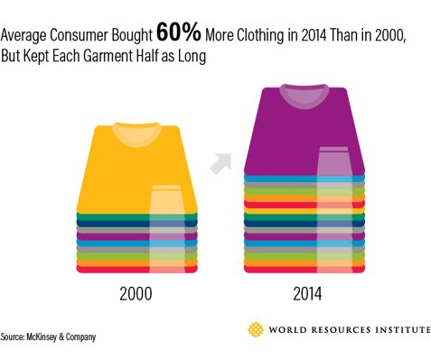
Global Apparel Industry
Highly competitive;
Low barriers to entry;
Brands targeted at specific segments;
Many regional and local competitors;
Increasingly number of global competitors;
Negative environmental impact.
Notes:
It takes 2700l of waters to make one cotton shirt

Slide 28
Industry trends
Factors that impact consumer discretionary spending, which remains mixed globally;
More competitors are seeking growth globally;
Wholesaler/retailer dynamics and wholesale channels remain challenged by slowed growth prospects due to increased competition from e-commerce shopping;
Competitors also open exclusive stores;

Slide 29
Risk Factors
Economic conditions that impact consumer spending;
Intense competition on prices;
Ability to offer on trend and updated apparel;
Supply costs;
Exchange rates and overseas regulation;
Consumer power;
Retailers as main distributor;

Slide 30
Core Strategy

Slide 31
Key Strategies
Drive the profitable core business;
Improve our cost structure to achieve operational excellence;
Expand the reach of our brands and build a more balanced portfolio;
Become a world-class omni-channel retailer.

Slide 32
Notes:
"From our products to our practices, innovation is integral and sustainability is as essential as fabric and thread."

Slide 33
Future Scenarios

Slide 34
Future Scenarios
"What is the future of the apparel market in 2030?"
Commom sense:
Competitors seek growth globally and establish direct selling channels;
Wholesalers and retailers are weakened by e-commerce shopping;
Consumers are more socioenvironmentally conscious.

Slide 35
Critical Uncertainties
Classic's appealing;
External market:
Regulation;
Exchange rate;
Cotton yield.

Slide 36
Future Scenarios
Classic gets
obsolete
Classic's Appealing
Classic never
fades

Slide 37
Future Scenarios
Favorable
Externa l Market
Classic gets
obsolete
Classic's Appealing
Classic never
fades
Unfavorable

Slide 38
Future Scenarios
Favorable
Externa l Market
Classic gets
obsolete
Classic's Appealing
Classic never
fades
Parking
brake
Unfavorable

Slide 39
Future Scenarios
Favorable
Externa l Market
Struggle to reinvent
Classic gets
obsolete
Classic's Appealing
Classic never
fades
Parking
brake
Unfavorable

Slide 40
Future Scenarios
Favorable
Externa l Market
Struggle to reinvent
Classic gets
obsolete
Classic's Appealing
Classic never
fades
Parking
brake
Margin
corrosion
Unfavorable

Slide 41
Future Scenarios
Favorable
Externa l Market
Struggle to reinvent
Global
penetration
Classic gets
obsolete
Classic's Appealing
Classic never
fades
Parking
brake
Margin
corrosion
Unfavorable

Slide 42
Future Scenarios
Material inovation;
Design inovation;
Supply chain redistribution;
Favorable
Externa l Market
Struggle to reinvent
Global
penetration
Classic gets
obsolete
Classic's Appealing
Classic never
fades
Parking
brake
Margin
corrosion
Unfavorable

Slide 43
Recomendations

Slide 44
Recommendations
Brand | Possible actions
Levi's | Make an in-depth study on changing the behavior of the new generation to ensure the maintenance of the position as Customer Intimacy. Focus on the global growth of the brand's own stores. Eureka Lab: seek to develop the patent for new products, rescuing the essence of Levis. Digital Strategy: investing in new technologies to improve the consumer buying experience (Virtual Reality and tailor-made clothing development at a high value).
Acquisitions | Purchase a brand specializing in Product Development (a brand like Diesel). Invest on an innovative apparel's material engineering company. Ensuring greater diversity in the portfolio. Product development competence can be useful to push disruptive innovation..

Slide 45
Recommendations
Brand | Possible actions
Dockers | Conduct a risk analysis of Chinese market growth. Develop actions to achieve the minimum standard of customer intimacy - complete rebranding, review processes, people profile and competency model in strategic positions.
Denizem | Conduct a risk analysis of Chinese market growth. Expand the portfolio of partners for the sale of products. Growth in other countries (for example: developing countries).
Signature | Conduct a risk analysis of Chinese market growth. Expand the portfolio of partners for the sale of products. Growth in other countries (for example: developing countries).

Slide 46
References
Essays, UK. A market analysis for Levi Strauss and Co Vision. Retrieved from: https://www.ukessays.com/essays/marketing/a-market-analysis-for-levi-strauss-and-co-marketing-essay.php?vref=1. 2018.
BHOJANI, X. et al. Marketing Report On Levis Inc. Retrieved from: https://www.academia.edu/23711812/MARKETING_REPORT_ON_LEVIS_INC. 2015.
Levi Strauss & Co. Reports First Quarter 2019 Earnings
Levi Strauss & Co. Reports Annual Report 2017 & 2007
Statista Global Consumer Survey 2018. Based on a survey of 2,010 people.
Morning Consult 2018. Based on a survey of 2,201 US adults.
BHASIN, Hitesh. Marketing mix of Levi’s Marketing91 Retrieved from: https://www.marketing91.com/marketing-mix-of-levis/
Essays, Term Papers & Research Papers; Levi Strauss SWOT Analysis / Matrix. Fern Fort University. Retrieved from: http://fernfortuniversity.com/term-papers/swot/1433/547-levi-strauss.php
DREW, Deborah; YEHOUNME, Genevieve The Apparel Industry’s Environmental Impact in 6 Graphics. World Resources Institute. Retrieved from: https://www.wri.org/blog/2017/07/apparel-industrys-environmental-impact-6-graphics

