Slide 1
INTERNATIONAL LAW Human Rights
Historical
Dimensions / Human Rights Generations
Human Rights X Fundamental Rights
Profª Luciana Romano Morilas

Slide 2
1 Definition
Definition: rights inherent to all human beings, whatever our nationality, place of residence, sex, national or ethnic origin, color, religion, language, or any other status.
Objective: to establish a minimum ethical level of protection to human dignity.
Finality: to allow the development of everyone’s personal qualities and safe physical and mental integrity, both in the relation with the State and in the relation with other private.

Slide 3
2 Characteristics
Universal and inalienable: It is the duty of States to promote and protect all human rights and fundamental freedoms, regardless of their political, economic and cultural systems.
Interdependent and indivisible: The improvement of one right facilitates advancement of the others. Likewise, the deprivation of one right adversely affects the others.
Equal and non-discriminatory: “All human beings are born free and equal in dignity and rights.”
Both Rights and Obligations: States assume obligations and duties under international law to respect, to protect and to fulfil human rights.

Slide 4
3 Historical
Magna Carta Libertatum, England, 1215: a initial mark of the HR.
Agreed to by King John of England
At Runnymede, near Windsor
On 15 June 1215.
First drafted by the Archbishop of Canterbury to make peace between the unpopular King and a group of rebel barons
It promises:
the protection of church rights
protection for the barons from illegal imprisonment
access to swift justice
limitations on feudal payments to the Crown
to be implemented through a council of 25 barons.

Slide 5
3 Historical
Bill of Rights, England, 1689:
limits the powers of the monarch
sets out the rights of Parliament, including
the requirement for regular parliaments,
free elections,
freedom of speech in Parliament.
sets out certain rights of individuals, including
the prohibition of cruel and unusual punishment
and reestablished Protestants to have arms for their defense within the rule of law.

Slide 6
3 Historical
Virginia Declaration of Rights, USA, 1776: origin of religious freedom and democracy warranty.
16 articles
Affirms the inherent nature of rights to life, liberty, property, and pursuing and obtaining happiness and safety
Describes a view of Government as the servant of the people
Enumerates its separation of powers into the administration, legislature, and judiciary.
Not only prescribes legal rights, but it also describes moral principles upon which a government should be run.

Slide 7
3 Historical
Declaration of the Rights of Man and of the Citizen: passed by France’s National Constituent Assembly in August 1789. It is still current.
First step toward writing a constitution for France
Qualifies the rights as “natural, unalienable and sacred”
“Simple and incontestable principles” on which citizens could base their demands.
“The natural and imprescriptible rights of man” are defined as “liberty, property, security and resistance to oppression”.

Slide 8
3 Historical
Called for the destruction of aristocratic privileges by proclaiming an end
to feudalism
to exemptions from taxation
freedom and equal rights for all “Men”
access to public office based on talent.

Slide 9
3 Historical
The monarchy was restricted, and all citizens were to have the right to take part in the legislative process.
Freedom of speech and press were declared, and arbitrary arrests outlawed.
Principles of popular sovereignty, in contrast to the divine right of kings that characterized the French monarchy, and social equality among citizens.

Slide 10
3 Historical
Mexican Constitution, 1917: still current.
The first such document in the world to set out social rights, serving as a model for the Weimar Constitution of 1919 and the Russian Constitution of 1918.
Aimed at restricting the Roman Catholic Church in Mexico:
free, mandatory, and secular education;
foundation for land reforms;
empower the labor sector.

Slide 11
3 Historical
The International Labor Organization (1919)
Part of the Treaty of Versailles: ended World War I, to reflect the belief that universal and lasting peace can be accomplished only if it is based on social justice.
Belgium, Cuba, Czechoslovakia, France, Italy, Japan, Poland, the United Kingdom and the United States.

Slide 12
3 Historical
Universal Declaration of Human Rights, Paris, UN General Assembly 1948, article first:
“All human beings are born free and equal in dignity and rights. They are endowed with reason and conscience and should act towards one another in a spirit of brotherhood.”
Basic Principles
Person’s Integrity
Person’s Autonomy
Person’s Dignity

Slide 13
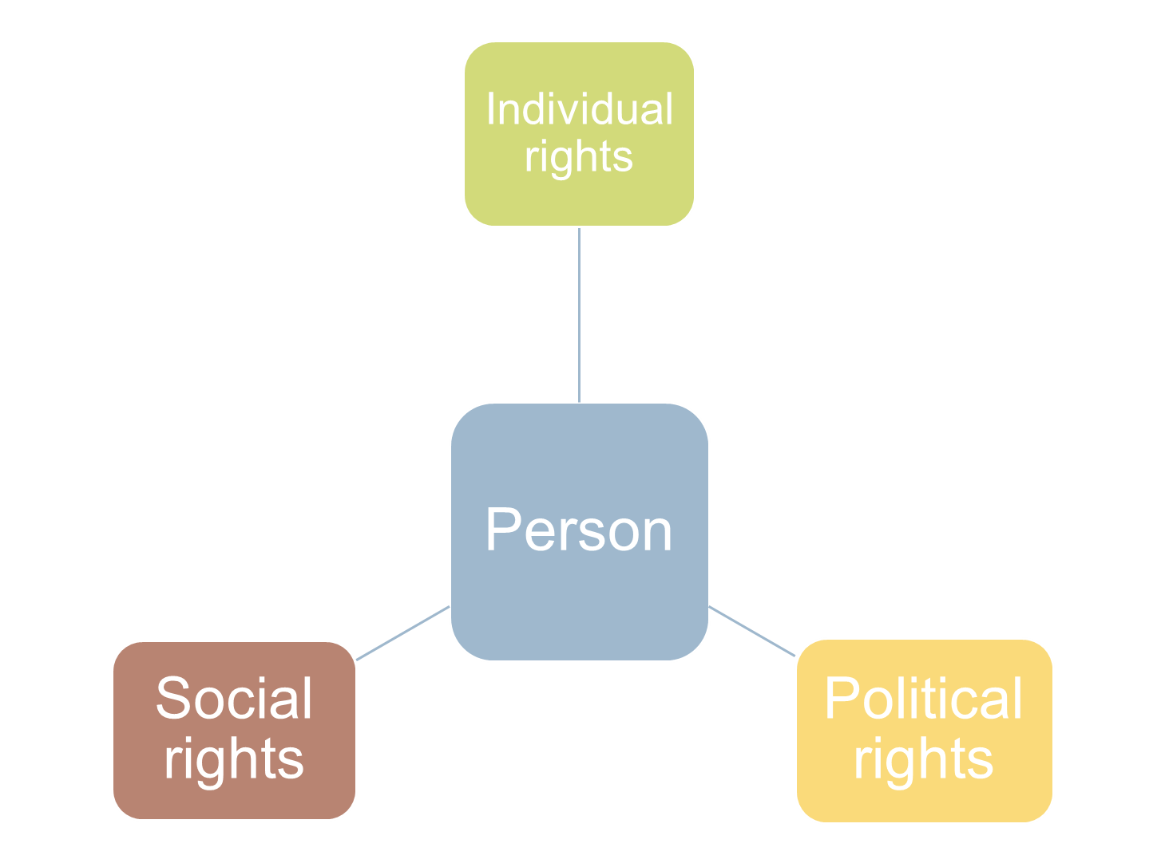

Slide 14
4 Human Rights Generations
Generations x Dimensions: Karel Vasák
1st Generation (freedom): Civil and political rights. Negative Rights.
right to life and political participation
2nd Generation (equality): Economic, social and cultural rights. Positive Rights.
right to subsistence, right to work, freedom of association, right to education
3rd Generation (brotherhood): solidarity rights.
right to peace, right to clean environment
consumer, self-determination of persons

Slide 15
4 Human Rights Generations
4th Generation: Freedom of Information and Communication
Technological rights – genetic inclusion
the right to sustainable development of the future generation
5th Generation: right of having feelings and recognizing other persons’ feelings – emotional intelligence.
Sexual minorities
Right to peace
6th Generation: Globalization
Right to democracy
Right to correct information
Right to pluralism

Slide 16
5 Principle of Equality
Formal Equality X Material Equality
Binomial : discriminator element x reason or finality of utilization of discrimen in that specific case.
Discrimen and public exams
Vacancy in public exams, universities and Parking Lots.
Positive or Reverse Discrimination: affirmative actions
Maria da Penha Law
Vacancy for women in elections
Seats for obese
Racial Shares System

Slide 17
Modern Protection of International Human Rights
In 1948, the UN General Assembly adopted the Universal Declaration of Human Rights.* The Declaration enumerates civil, political, economic, social, and cultural rights, but the Declaration contains no provisions for monitoring or enforcement.
* 48-0 with 8 abstentions (Eastern bloc, Saudi Arabia and South Africa)

Slide 18
Modern Protection of International Human Rights
In 1966, the General Assembly adopted:
The Covenant on Civil and Political Rights (and its First Optional Protocol)
The Covenant on Economic, Social and Cultural Rights
which, together with the UDHR, are now known as the International Bill of Human Rights

Slide 19
Covenant on Civil and Political Rights
Prohibits discrimination on the basis of “race, color, sex, language, religion, political or other opinion, national or social origin, property, birth or other status” without regard to citizenship
Prohibits torture and cruel, inhuman or degrading treatment or punishment (personal integrity)
Prohibits slavery
Limits the death penalty (in countries that still allow it) to the most serious crimes committed by persons over 18.

Slide 20
Covenant on Civil and Political Rights
Prohibits arbitrary arrest or detention
Protects freedom of movement and residence
Protects the right to trial, presumption of innocence, right to a lawyer, right to an appeal, freedom from self-incrimination, and freedom from double jeopardy
Protects freedom of opinion and expression
Protects freedom of association and assembly
Public emergency exception (but no torture, executions, or slavery is ever permissible)
Ratified by the United States in 1992

Slide 21
Covenant on Economic, Social and Cultural Rights
Right to work and make a “decent living for themselves and their families”
Safe and healthy working conditions
Right to form trade unions with the right to strike
Right of everyone to Social Security, including social insurance “widest possible protection and assistance should be accorded to the family, which is the natural and fundamental group unit of society”.

Slide 22
Covenant on Economic, Social and Cultural Rights
Right to adequate food, clothing and housing and to the continuous improvement of living conditions
Right to education
Right to health care
Economic rights are subject to each county’s ability to provide such rights progressively as its resources permit
Signed but not ratified by the United States.

