Slide 1
Analysis Mat: UV, IR Vibrational Spectroscopy
Patricia TARGON CAMPANA
Lesson 03

Slide 2
Summary
Vibrational spectra of polyatomic molecules (rotational, transitional, and vibrational energies)
Fundamental vibrations and their symmetry
Overtone and combination frequencies

Slide 4
Normal modes
Considering a molecule with N atoms, each of them with coordinates at x,y,z:
When the positions are fixed in the space, the angles and distances of the bonds are also fixed
3N degrees of freedom

Slide 5
Now, consider the molecules moving into space without changing form:
Translation: 3N degrees of freedom
Rotation: 3N degrees of freedom
For a non-linear molecule: 3N-6 fundamental vibrations

Slide 6
For linear molecules:
Translation: 3N degrees of freedom
Rotation: 2N degrees of freedom
For a linear molecule: 3N-5 fundamental vibrations

Slide 7
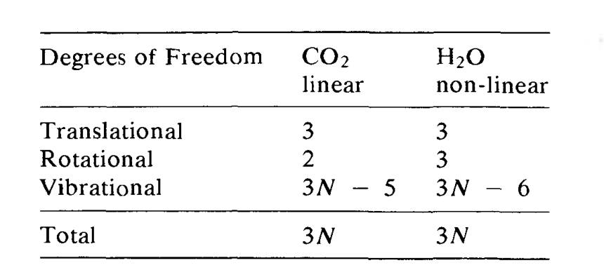

Slide 8
For acyclic molecules, the number of stretching vibrations is N-1, thus:
Non-linear molecules:
3N – 6 – (N-1) = 3N-6-N+1= 2N – 5 bending vibrations
Linear molecules:
3N – 5 – (N-1) = 3N – 5 – N +1 = 2N – 4 bending vibrations

Slide 9
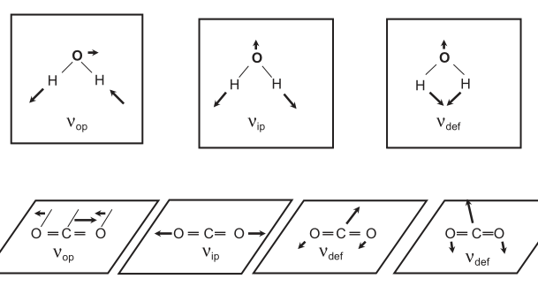
asymmetric (out-of-phase) and symmetric (in-phase) stretch
bending (deformation)

Slide 10
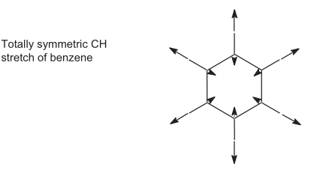
What is normal mode??
In normal mode vibrations: Cartesian displacements of each atom in molecule change:
periodically
with the same frequency
go through equilibrium positions simultaneously
The centre of the mass:
does not move
the molecule does not rotate
For harmonic oscillator: displacements of each atom plotted as a function of time results in a sinusoidal wave.

Slide 11
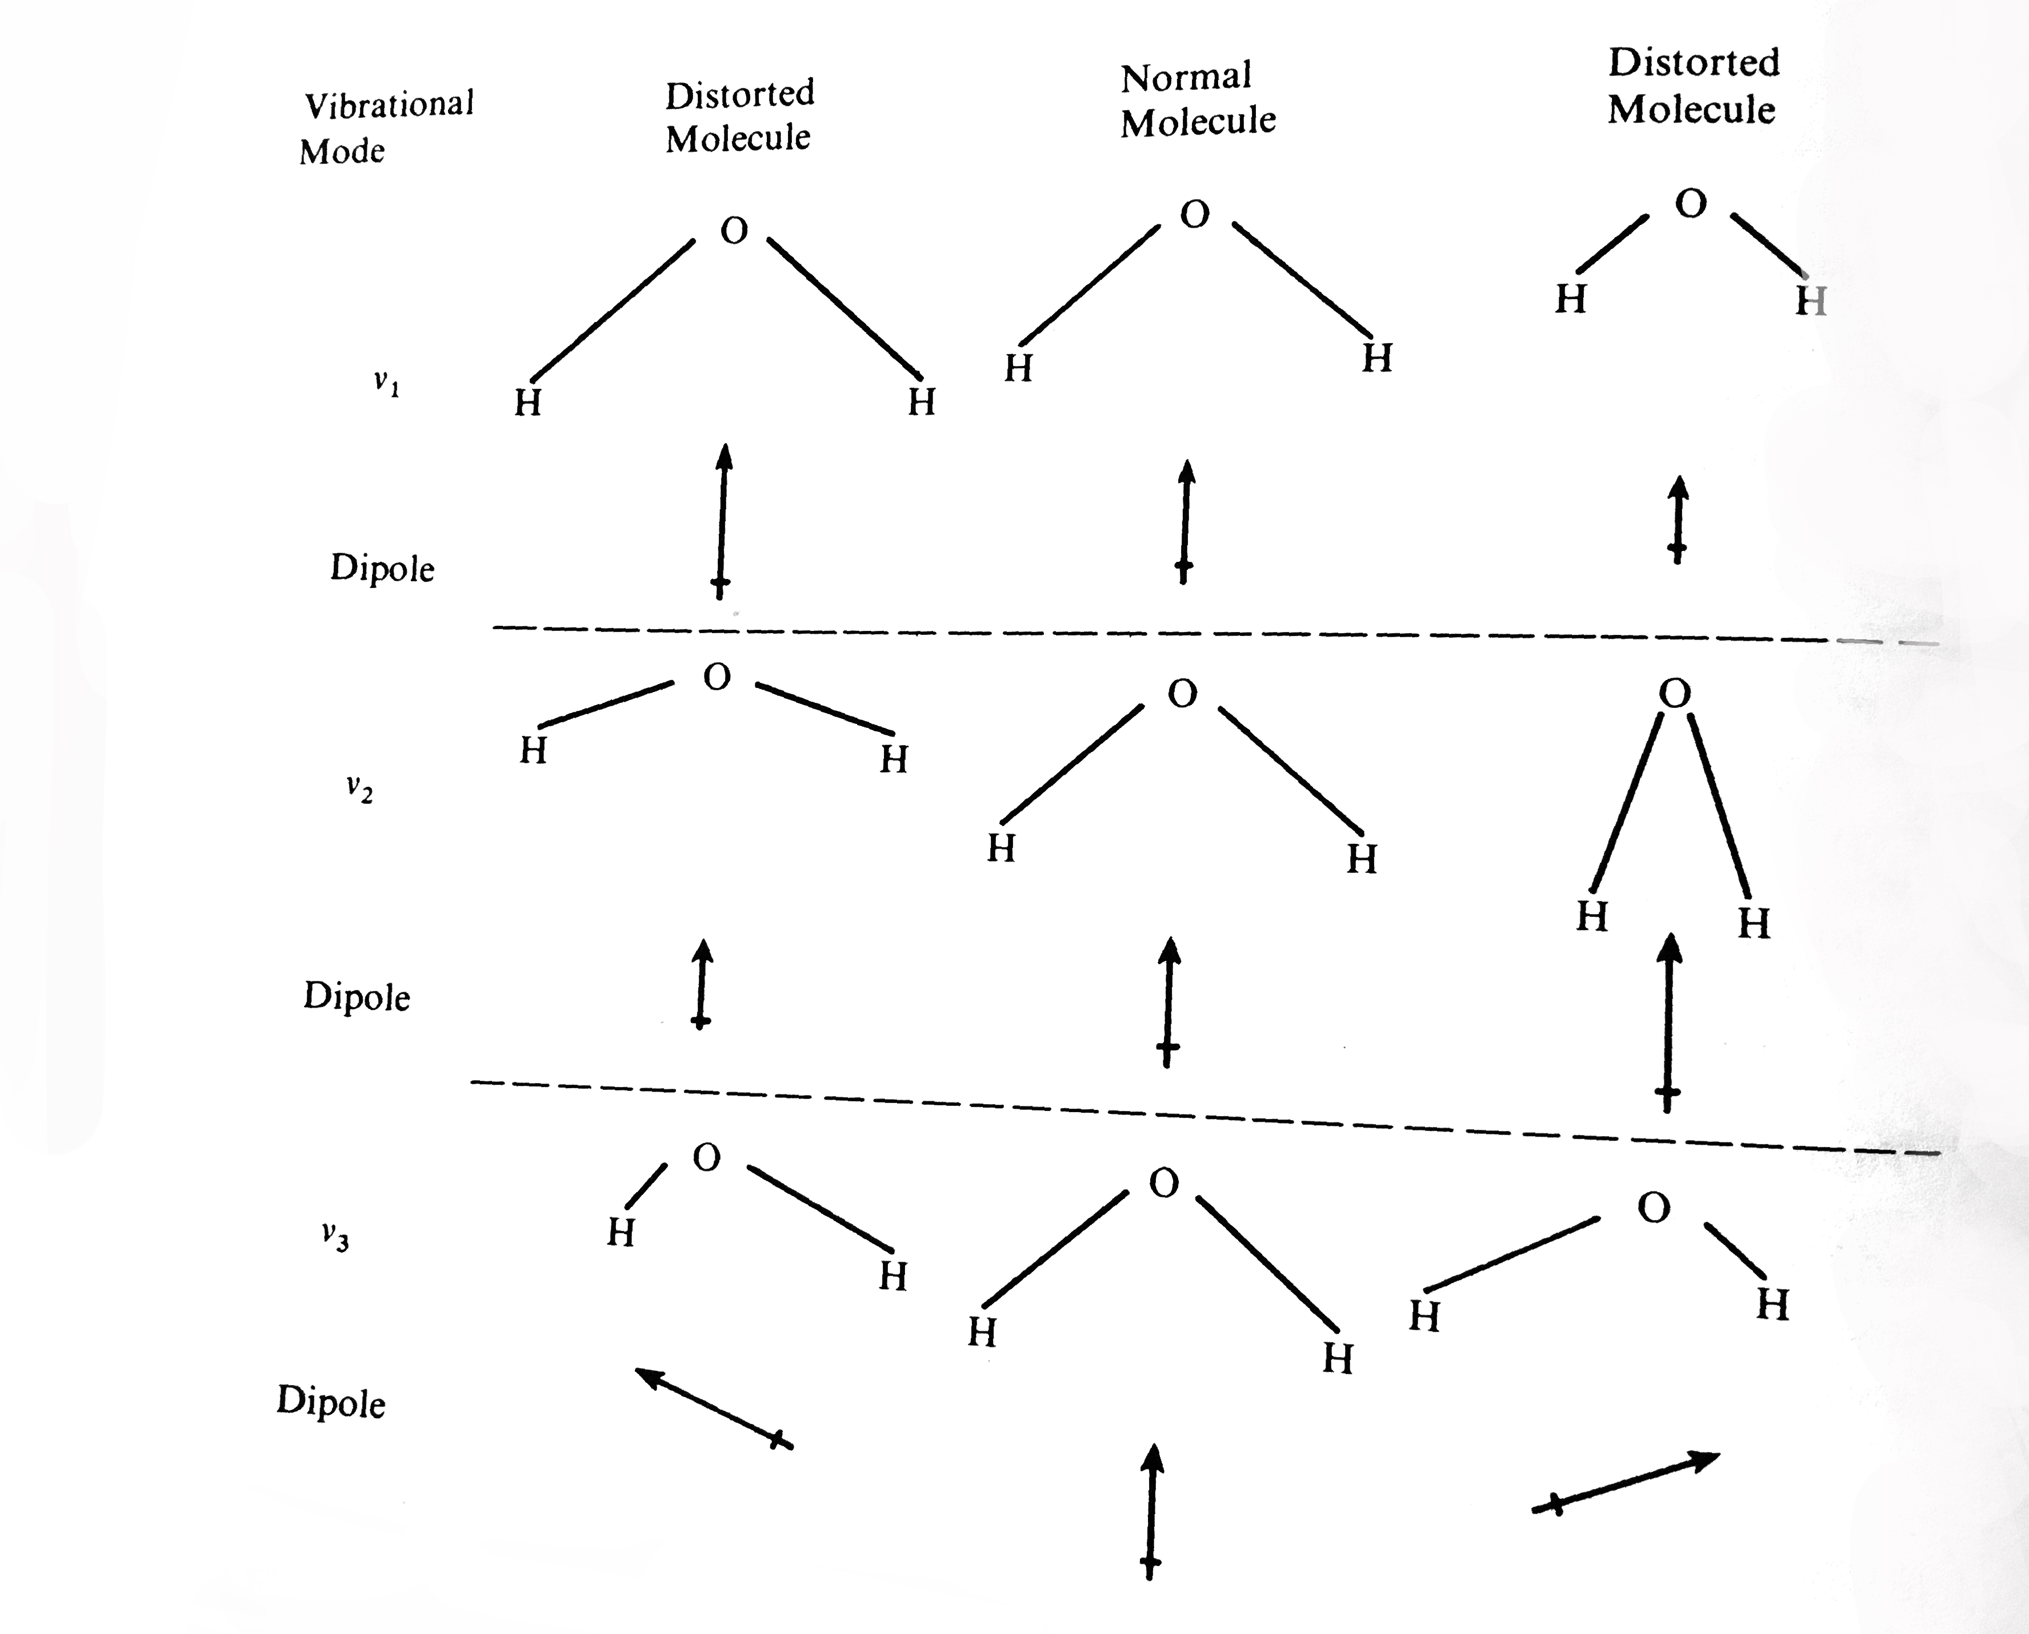
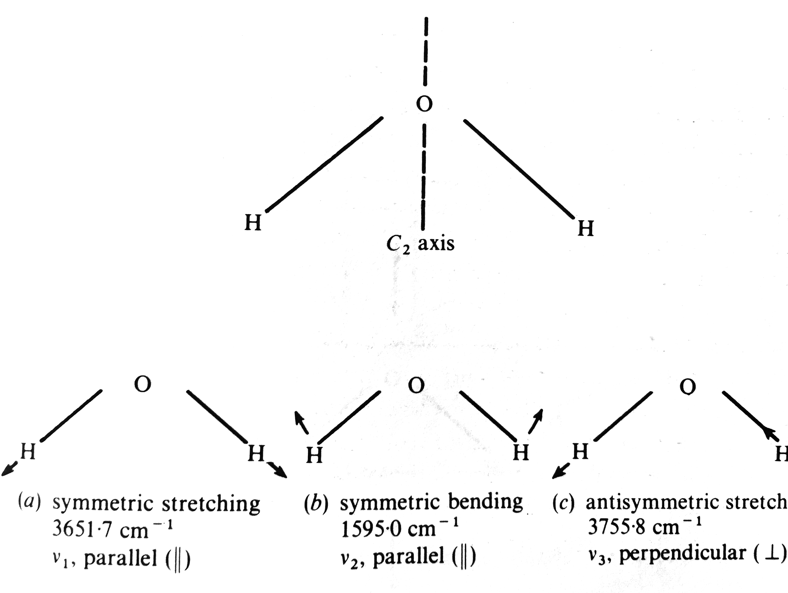
For IR activity

Slide 12
References
The Harmonic Oscillator Approximates Molecular Vibrations. (2022, February 25). https://chem.libretexts.org/@go/page/13415
Sode, Olaseni, et al. "Fermi resonance in solid CO2 under pressure." The Journal of Chemical Physics 138.7 (2013): 074501.
Larkin, Peter. Infrared and Raman spectroscopy: principles and spectral interpretation. Elsevier, 2017.
Pavia, Donald L., et al. Introduction to spectroscopy. Cengage learning, 2014.
Morse, Philip M. "Diatomic molecules according to the wave mechanics. II. Vibrational levels." Physical review 34.1 (1929): 57.
Banwell, C. N. Fundamentals of Molecular Spectroscopy: By CN Banwell. New York, McGraw-Hill, 1983.

