Slide 1
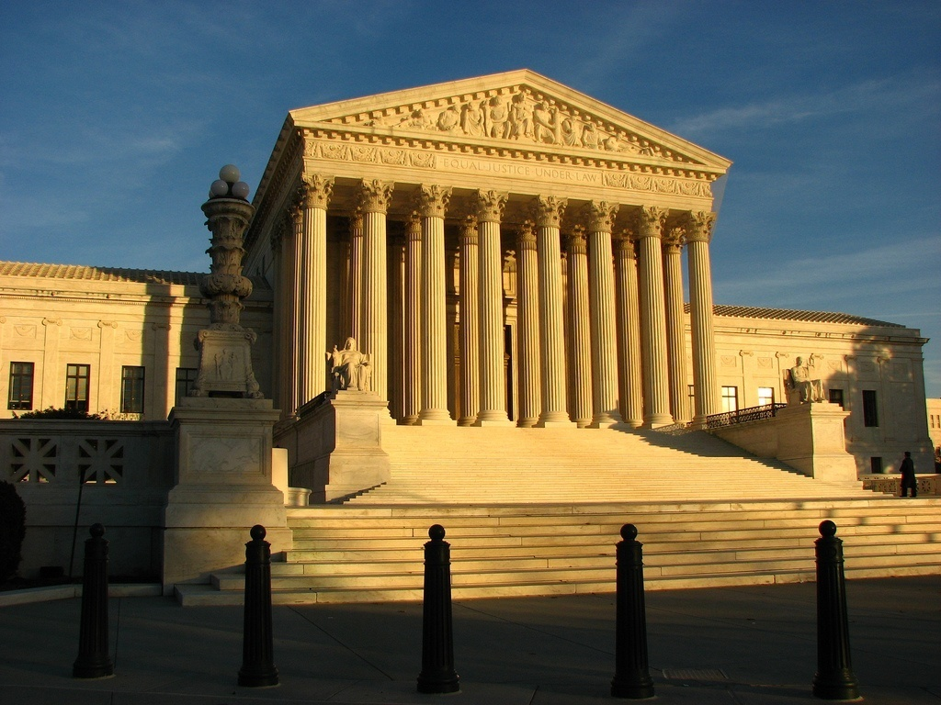
Educational as Fundamental Human
Right: Update, Reflections, and
Recommendations
The American Educational Research Association
Special Interest Group on Law and Education
Monday April 11, 2011
New Orleans, Louisiana
Charles J. Russo, J.D., Ed.D.
Panzer Chair in Education
University of Dayton
937-229-3722
charles.russo@notes.udayton.edu
Direito a educação 2017
Constitutional Aspects of the
Right to Education
Universadade de São Paulo
Faculdade de direito
Education as a Fundamental Human Right
27 March 2017
Charles J. Russo, J.D., Ed.D.
Panzer Chair in Education
University of Dayton
937-229-3722
crusso1@udayton.edu

Slide 2
Knowledge is Power
Francis Bacon

Slide 4
Outline
1. Introduction
2. Education as a Fundamental Right:
a) Brief History of Compulsory Attendance
b) Best Interest of the Child?
3. Education as a Fundamental Right: International
Documents
4. The Role of Parents
5. Recommendations

Slide 6
1. Introduction
Brown v. Board of Education 347 U.S. 483, 493 (1954)
“…education is perhaps the most important
function of state and local governments.”

Slide 7
1. Introduction
But
Cf. San Antonio Independent School District
v. Rodriguez, 411 U.S. 1, 35 (1973)
“Education, of course, is not among the rights afforded explicit protection under our Federal Constitution. Nor do we find any basis for saying it is implicitly so protected (p. 35).”

Slide 8
1. Introduction
Of course, under the Tenth Amendment, education is
a responsibility of states, making the United States
unique . . .

Slide 10
2. Education as a Fundamental Right
a) Brief History of Compulsory Attendance
b) Best Interest of the Child?

Slide 11
2a) Compulsory Attendance-History
France enacted a law granting state control of secondary
education in 1802 before placing primary schools under
the auspices of communal committees in 1816.
Prussia pioneered the development of national
education in the eighteenth century, but this national
system was not consolidated until 1840.

Slide 12
2a) Compulsory Attendance-History
Shortly after the Jesuits arrived in Brazil in1549, they founded the first elementary school in Salvador (Bahia).
1759 Jesuits were expelled from Portugal and its colonies.
Brazilian education and culture started to move forward in 1808, under the direction of the Portuguese royal family.
Brazil’s educational policy was deeply affected by the country's independence in 1822.

Slide 13
2a) Compulsory Attendance-History
The Constitution of 1824 guaranteed free elementary education to all citizens, and the state created basic-level public schools in cities, towns, and villages.
Brazil decentralized the basic education system in the Additional Act in 1834, giving provinces the power to enact legislation for elementary education, casting off the government's duty to grant free education for all.

Slide 14
2a) Compulsory Attendance-History
In the first years of the newly formed Republic (1889), the decentralized educational policy was maintained, preventing the state from taking over the formulation and coordination of the elementary educational system. This lack of action by the government resulted in a greater social and educational gap between the popular classes and the elite.

Slide 15
2a) Compulsory Attendance-History
20th Century was a time of transformation; influenced by European positivism, Brazilian educators adopted a series of reforms and laws transferring responsibility of administrating elementary back to the government.
During the 1920s and 1930s, the first universities were created in Rio de Janeiro (1920), Minas Gerais (1927), Porto Alegre (1934), and São Paulo (1934).

Slide 16
2a) Compulsory Attendance-History
University of São Paulo was created with the support and import of French and German scholars, following the French model for its structure.
The constitution of 1934 incorporated major advances into the educational system. Both the government and the family were considered responsible for the elementary education of all citizens.

Slide 17
2a) Compulsory Attendance-History
In 1852 Massachusetts became the first jurisdiction in the
United States to enact a compulsory education law.
Louisiana enacted such a law in 1910.
Georgia, in 1916, became the last American state in the
Union to that time to enact a compulsory attendance law.

Slide 18
2b) Best Interest of the Child? – Who Decides?

Slide 19
2b) Best Interest of the Child?
As the children’s rights movement developed, rights were categorized as
welfare and liberty interests or, as more commonly stated in relation to children, protection rights
participation rights

Slide 20
2b) Best Interest of the Child?
1. Welfare and liberty rights are most frequently accorded children who are raised in safe and caring family environments with access to appropriate educational systems, health benefits, and sustenance.
2. Participation rights address the full enjoyment of rights granted adults, beginning with education as the key that opens the door to full citizenship.

Slide 21
2b) Best Interest of the Child?
Amid on-going discussions over the status of children,
many advocates of participation rights argue that
students should be granted the opportunity to take part
in all matters intimately involving them on such issues
as their families, health, or education.

Slide 22
2b) Best Interest of the Child?
Advocates argue that, at certain stages in their lives,
children are equally as competent as adults to participate
fully in rights that adults take for granted.
BUT Cf. Tinker: Students do not check their rights at the school house gate . . . But are not coextensive with those of adults.
AND LATER REFLECTIONS

Slide 23
2b) Best Interest of the Child?
Advocates suggest that these rights include fundamental
concerns such as political and free speech rights as well
as to associate freely with whomever they wish,
regardless of adult pressures.
In brief, these advocates claim that children should be
given the same rights as adults, with critics essentially
equating “the best interests of the child” as synonymous
with “the wishes of the child.”

Slide 24
3. International Documents
Universal Declaration on
Human Rights (UDHR, 1948)
(1) Everyone has the right to education. Education shall be free, at least in the elementary and fundamental stages. Elementary education shall be compulsory. Technical and professional education shall be made generally available and higher education shall be equally accessible to all on the basis of merit.

Slide 25
3. UDHR
(2) Education shall be directed to the full development of the human personality and to the strengthening of respect for human rights and fundamental freedoms. It shall promote understanding, tolerance and friendship among all nations, racial or religious groups, and shall further the activities of the United Nations for the maintenance of peace.
(3) Parents have a prior right to choose the kind of education that shall be given to their children.

Slide 26
3. Principle 7 of the Declaration on the Rights of the Child (1959)
The child is entitled to receive education, which shall be free
and compulsory, at least in the elementary stages.
He shall be given an education which will promote his general
culture and enable him, on a basis of equal opportunity, to
develop his abilities, his individual judgment, and his sense of
moral and social responsibility, and to become a useful member
of society.

Slide 27
3. Principle 7 of the Declaration on the Rights of the Child (1959)
The best interests of the child shall be the guiding principle
of those responsible for his education and guidance; that
responsibility lies in the first place with his parents.

Slide 28
3. Principle 5 of the Declaration on the Rights of the Child (1959)
“[t]he child who is physically, mentally, or socially handicapped shall be given the special treatment, education and care required by his particular condition.”

Slide 29
3. Convention on the Rights of the Child (CRC) 1989
Article 3: in “all actions concerning children . . . the best interests of the child shall be a primary consideration.”
Article 12 claims just such a right in stating that a “child who is capable of forming his or her own views” has a right “to express these views freely in all matters affecting them.”

Slide 30
3.CRC
Article 28 of the Convention directs signatories to:
(a) Make primary education compulsory and available free to all;
(b) Encourage the development of different forms of secondary education, including general and vocational education, make them available and accessible to every child and take appropriate measures such as the introduction of free education and offering financial assistance in case of need; . . .

Slide 31
3.CRC
Article 28 of the Convention directs signatories to …
(d) Make educational and vocational information and guidance available and accessible to all children;
(e) Take measures to encourage regular attendance at schools and the reduction of drop-out rates.

Slide 32
3. CRC
Justice Kennedy: “…every country in the world has ratified save for the United States and Somalia, [and that it] contains an express prohibition on capital punishment for crimes committed by juveniles under 18.”
Roper v. Simmons, 543 U.S. 551, 576 (2005).

Slide 33
3. CRC
President Clinton signed the Convention in 1995, but
the Senate refused to ratify it based on the fears that it
“would become the supreme law of the land, taking
precedence over State and Federal laws regarding
family life.” Selected Senators were concerned as to
whether educators could use corporal punishment, used
in about 20 US states.

Slide 34
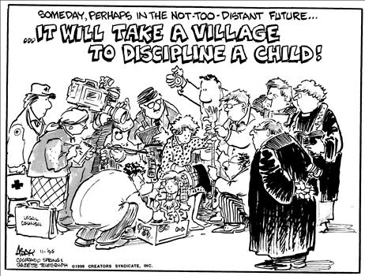

Slide 35
3. CRC
Debates over the Senate’s attitudes aside, few could
argue that American educators fail to afford students
significant protections that meet or exceed virtually all
international standards, particularly since a number of
Signatories, and vocal critics of the US, fail to meet
even the Convention’s minimal expectations.

Slide 37
4. Reflections
Returning to the status of children, two positions conflict:
Parents serve as protectors for their children
Students have self-determination

Slide 38
4. Reflections
Bellotti v. Baird, 443 U.S. 622 (1979)
Three reasons why the rights of children are not equal to
those of adults
The vulnerability of children
Inability of children to make critical decisions
Importance of parental role in child-rearing

Slide 39
4. Reflections
International organizations, often joined by judicial
bodies, have adopted a similar perspective in deciding
that the right of children to an education is limited
primarily to attending school and not selecting where
they will take their classes or what subjects they will
study, thereby deferring to parents.

Slide 40
4. Reflections
As to participation rights, while the Supreme Court ruled
in In re Gault 387 U.S. 1 (1987) that the right to equal
protection applies to children, but it accorded greater
authority to school officials as they regulate student actions
under in loco parentis.
This is similar to the position taken by legal systems in
countries where protection, rather than participation, rights
are most usually recognized and upheld.

Slide 41
4. Reflections
As noted, pro-student rights advocates argue that, at
some point, students are equally as competent as adults
to participate fully in exercising their rights, including
directing the content of their education. As noted, they
essentially argue that the Convention’s policy of the
“best interests of the child” should essentially become
one of “the wishes of the child.”

Slide 42
4. Reflections
Even though the perspective of pro-child advocates
gathered some momentum during the 1980s, this utopian
vision of treating children and adults as equals has been
tempered by reality.

Slide 43
4. Reflections
The reality is that leaders must meet the basic educational
needs of students in many parts of the developing world
where schools operate irregularly at best, the educational
rights of females are often overlooked completely, and
children are exploited in a myriad of ways.

Slide 44
4. Reflections
An applied example of the tension between the two
positions with regard to rights of parents to direct the
education of children and the rights of the young
surfaced in Wisconsin v. Yoder, 406 U.S. 205 (1972).

Slide 45
4. Reflections
In partial dissent, Douglas wrote:
“If he is harnessed to the Amish way of life by those in
authority over him and if his education is truncated, his
entire life may be stunted and deformed. The child,
therefore, should be given an opportunity to be heard
before the State gives the exemption which we honor
today.” Id. at 245-246.

Slide 46
4. Reflections
But . . . ???

Slide 47
4. Reflections
A kind of mid-way position emerged in developed
Nations . . . recognizing that while older students should
have some say in the content of their education, starting
with secondary schools, parents have the duty to interact
with school officials in ensuring the rights of their
younger children, in particular.

Slide 48
4. Reflections
U.S. Supreme Court in Pierce v. Society of Sisters, 268 U.S.
510, 525 (1925) are instructive. According to the Court,
“[t]he child is not the mere creature of the state; those who
nurture him and direct his destiny have the right, coupled
with the high duty, to recognize and prepare him for
additional obligations.”

Slide 49
4. Reflections
The challenge, then, is to get signatories, especially in
developing Nations to ensure the educational rights of
all children regardless of such demographic
characteristics as their ethnicity, genders, races, and/ or
religions.

Slide 50
5. Recommendations

Slide 51
Recommendations
1. Consistent with internationally accepted norms, all must recognize that education is a fundamental human right.
In other words, all Nations must develop laws and policies designed to protect and enhance this right.

Slide 52
Recommendations
2a. National leaders must provide adequate funding designed to create schools that will provide children with a world-class education.

Slide 53
Recommendations
2b. Funding must cover not only construction of facilities and purchasing instructional materials but also paying salaries designed to enhance “the best and brightest” to enter the field of education.

Slide 54
Recommendations
3. Treat education as an integrative factor, one that can help prepare all children to become productive members of their societies rather than set them apart from one another.

Slide 55
Recommendations
4. Create a re-conceptualized educational school system that is open to all children (and staff), which emphasizes pluralistic, multi-cultural principles.
In other words, the system must be inclusive, not exclusive.

Slide 56
Recommendations
5. Create policies to meet the needs of special populations of students including, but not limited to, those who are disabled, of ethnic, religious, and linguistic minorities, and/ or are refugees to the extent that it is reasonable to do so.

Slide 57
Recommendations
6. Universities must enhance teacher (and administrator) preparation programs.
These programs must be at the cutting edge of school reform.

Slide 58
Recommendations
7a. Adopt pro-active roles helping to create shared values among all groups in developing educational curricular/ standards.

Slide 59
Recommendations
7b. It is essential that officials in central governmental ministries maintain leadership role in education to ensure that policies and practices are adopted uniformly in all schools and areas.

Slide 60
Recommendations
8a. Develop curricula, and accompanying texts, that are drafted primarily by appropriate professionals who can call on outside experts for assistance.

Slide 61
Recommendations
8b. Leadership on this important project should be provided by individuals from the respective governmental and educational ministries as well as from the university sector.

Slide 62
Recommendations
9. Implement curricula (or sets of standards) that all can accept.
At the same time, educational leaders should provide some consideration for ways of permitting groups to preserve their independent heritages in schools.

Slide 63
Recommendations
10. Select members of committees who are assigned the task of developing curricular materials from among a broad representation of stakeholders, including, but not limited to parents, students, teachers, civil leaders, interested in helping to ensure equal educational opportunities for all children.

Slide 64
Recommendations
11. Schedule conferences/ meetings on education to obtain input from all parties, again including, but not limited to parents, students, teachers, civil leaders, interested in helping to ensure equal educational opportunities for all children.

Slide 65
Recommendations
12. In light of the pace at which change occurs, leaders should regularly re-evaluate and update educational goals to keep them current.

