Slide 1
The Ricardian model – part ii
Econ 490
International Economics
UIUC, Fall 2019
Mauro Rodrigues

Slide 2
Welfare Effect on wages
There is only one factor: labor
To assess the welfare effects of trade, one needs only to look at wages
Not much to say about distributive effects
Real wage – purchasing power of wages
We have not made specific assumptions about the demand
Therefore, we look at two extreme cases
Consumers only care about good 1 - $w/P_{1}$
Consumers only care about good 2 - $w/P_{2}$
Impact on real wages is somewhere in between

Slide 3
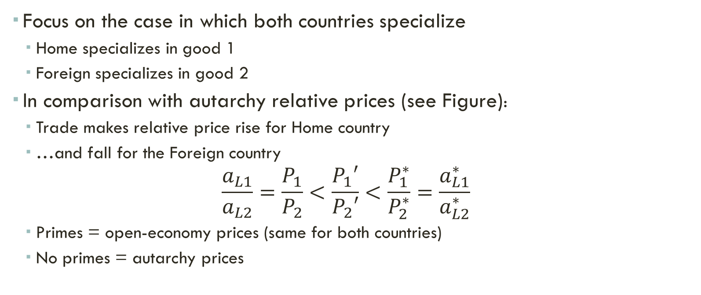
Welfare Effect on wages
Focus on the case in which both countries specialize
Home specializes in good 1
Foreign specializes in good 2
In comparison with autarchy relative prices (see Figure):
Trade makes relative price rise for Home country
…and fall for the Foreign country
$$\frac{a_{L1}}{a_{L2}}=\frac{P_{1}}{P_{2}}<\frac{P_{1}′}{P_{2}′}<\frac{P_{1}^{∗}}{P_{2}^{∗}}=\frac{a_{L1}^{∗}}{a_{L2}^{∗}}$$
Primes = open-economy prices (same for both countries)
No primes = autarchy prices

Slide 4
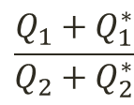
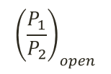
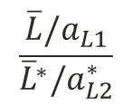
Figure 1
Open-economy equilibrium
$$\frac{P_{1}}{P_{2}}$$
$${\left(\frac{P_{1}^{∗}}{P_{2}^{∗}}\right)}_{aut}=\frac{a_{L1}^{∗}}{a_{L2}^{∗}}$$
Relative Supply
$${\left(\frac{P_{1}}{P_{2}}\right)}_{open}$$
$${\left(\frac{P_{1}}{P_{2}}\right)}_{aut}=\frac{a_{L1}}{a_{L2}}$$
Relative Demand
$$\frac{Q_{1}+Q_{1}^{∗}}{Q_{2}+Q_{2}^{∗}}$$
$$\frac{\overline{L}/a_{L1}}{{\overline{L}}^{∗}/a_{L2}^{∗}}$$

Slide 5

Welfare Effect on wages
Remember that in autarchy countries have to produce both goods. Then:
$$w=\frac{P_{1}}{a_{L1}}=\frac{P_{2}}{a_{L2}}$$
$$w^{∗}=\frac{P_{1}^{∗}}{a_{L1}^{∗}}=\frac{P_{2}^{∗}}{a_{L2}^{∗}}$$
Autarchy wages in terms of goods 1 and 2 are then:
Home:
$$\frac{w}{P_{1}}=\frac{1}{a_{L1}}; \frac{w}{P_{2}}=\frac{1}{a_{L2}}$$
Foreign:
$$\frac{w^{∗}}{P_{1}^{∗}}=\frac{1}{a_{L1}^{∗}}; \frac{w^{∗}}{P_{2}^{∗}}=\frac{1}{a_{L2}^{∗}}$$

Slide 6
Welfare Effect on wages
In an open economy, given that both countries specialize (primes denote open economy prices and wages):
$$w^{′}=\frac{P_{1}′}{a_{L1}}>\frac{P_{2}′}{a_{L2}}$$
$$w^{∗}′=\frac{P_{2}′}{a_{L2}^{∗}}>\frac{P_{1}′}{a_{L1}^{∗}}$$
In real terms:
$$\frac{w^{′}}{P_{1}′}=\frac{1}{a_{L1}}=\frac{w}{P_{1}}$$
$$\frac{{w^{∗}}^{′}}{P_{2}′}=\frac{1}{a_{L2}^{∗}}=\frac{w^{∗}}{P_{2}^{∗}}$$

Slide 7
Welfare Effect on wages
Therefore, in terms of the exported good, wages do not change
But they increase in terms of the imported good
Home:
$$\frac{w^{′}}{P_{2}′}=\frac{P_{1}′}{P_{2}′}\frac{1}{a_{L1}}>\frac{a_{L1}}{a_{L2}}\frac{1}{a_{L1}}$$
$$\frac{w^{′}}{P_{2}′}>\frac{1}{a_{L2}}=\frac{w}{P_{2}}$$
In the Home country, wages:
Constant in units of good 1 (exportable)
Rises in terms of good 2 (importable)
Real wages then increase

Slide 8
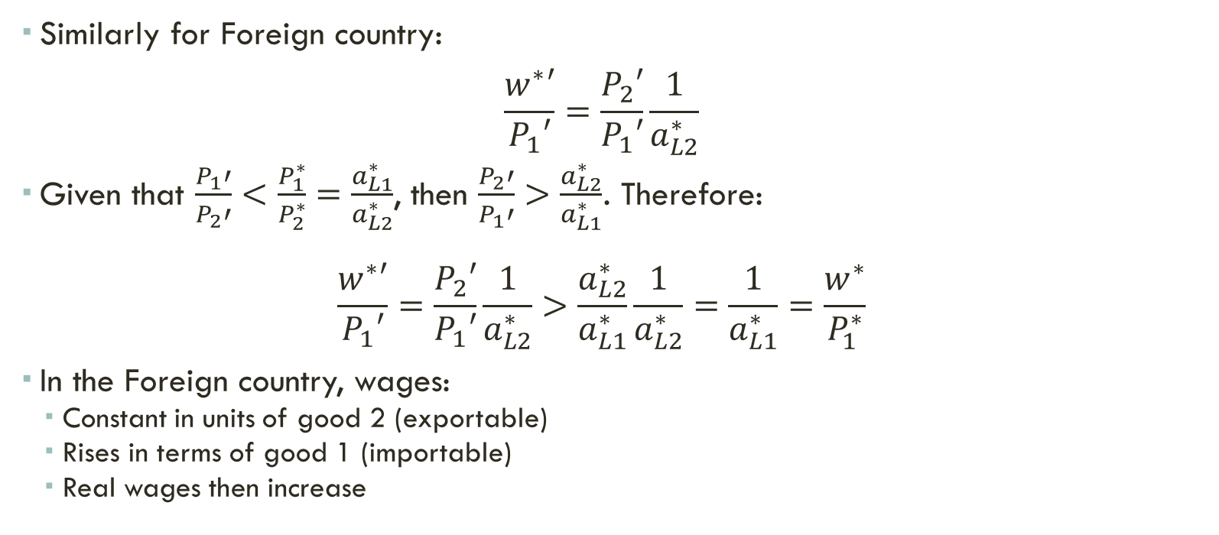
Welfare Effect on wages
Similarly for Foreign country:
$$\frac{w^{∗}′}{P_{1}′}=\frac{P_{2}′}{P_{1}′}\frac{1}{a_{L2}^{∗}}$$
Given that $\frac{P_{1}′}{P_{2}′}<\frac{P_{1}^{∗}}{P_{2}^{∗}}=\frac{a_{L1}^{∗}}{a_{L2}^{∗}}$, then $\frac{P_{2}′}{P_{1}′}>\frac{a_{L2}^{∗}}{a_{L1}^{∗}}$. Therefore:
$$\frac{w^{∗}′}{P_{1}′}=\frac{P_{2}′}{P_{1}′}\frac{1}{a_{L2}^{∗}}>\frac{a_{L2}^{∗}}{a_{L1}^{∗}}\frac{1}{a_{L2}^{∗}}=\frac{1}{a_{L1}^{∗}}=\frac{w^{∗}}{P_{1}^{∗}}$$
In the Foreign country, wages:
Constant in units of good 2 (exportable)
Rises in terms of good 1 (importable)
Real wages then increase

Slide 9
Welfare Effect on wages
Real wages increase in both countries
Both countries gain from trade
Gains are evenly distributed – there is only labor
There are no losers
You may check the case of large/small country
If a country is sufficiently large, it gains nothing from trade
Next we revisit these results
More structure on the demand side
Micro review first

Slide 10
A detour Community Indifference Curves
Reference: Markusen et al, chapter 3.
Demand side: consumers/workers get income from labor; use that buy good 1 and good 2
There are $j=1,2,…,N$ consumers in a country (say, Home)
Consumer $j$ likes both goods; her preferences are summarized by a utility function:
$$U_{j}(c_{1j},c_{2j})$$
Utility function:
Increasing in both arguments
Indifference curves are convex toward the origin and never touch axes

Slide 11
Figure 2
Individual indifference curves
$$U_{j}(c_{1j},c_{2j})=\overline{U}$$
$$c_{2j}$$
$$\overline{U^{′}}>\overline{U}$$
$$\overline{U}$$
$$c_{1j}$$

Slide 12
A detour Community Indifference Curves
Consumer $j$ has income $I_{j}$ and faces prices $P_{1}$ and $P_{2}$
She has therefore the following budget constraint
$${P_{1}c}_{1j}+P_{2}c_{2j}=I_{j}$$
Rewriting:
$$c_{2j}=\frac{I_{j}}{P_{2}}−\frac{P_{1}}{P_{2}}c_{1j}$$
Slope of budget constraint (in absolute value):
$$−\frac{dc_{2j}}{dc_{1j}}=\frac{P_{1}}{P_{2}}$$

Slide 13
Figure 3
Individual budget constraint
$$c_{2j}$$
$P_{1}c_{1j}+$ $P_{2}c_{2j}=I_{j}$
$$I_{j}/P_{2}$$
slope = $P_{1}/P_{2}$
$$c_{1j}$$
$$I_{j}/P_{1}$$

Slide 14
A detour Community Indifference Curves
Consumer chooses $c_{1j}$ and $c_{2j}$ that maximize her utility, taking as given income and prices
$$\max{U_{j}(c_{1j},c_{2j})}$$
subject to:
$${P_{1}c}_{1j}+P_{2}c_{2j}=I_{j}$$
The solution is given by the usual tangency condition (next slide)
Individual demands functions:
$$c_{1j}=c_{1j}(P_{1},P_{2},I_{j})$$
$$c_{2j}=c_{2j}(P_{1},P_{2},I_{j})$$

Slide 15
Figure 4
Individual maximization problem
$$c_{2j}$$
$$I_{j}/P_{2}$$
$$c_{2j}(P_{1},P_{2},I_{j})$$
$$c_{1j}$$
$$c_{1j}(P_{1},P_{2},I_{j})$$
$$I_{j}/P_{1}$$

Slide 16
A detour Community Indifference Curves
Total demands are then:
$$C_{1}=\sum_{j=1}^{N}{c_{1j}(P_{1},P_{2},I_{j})}$$
$$C_{2}=\sum_{j=1}^{N}{c_{2j}(P_{1},P_{2},I_{j})}$$
In principle, total demands may the depend on the whole distribution of income:
$$C_{1}=C_{1}\left(P_{1},P_{2},I_{1},I_{2},…,I_{N}\right)$$
$$C_{2}=C_{2}(P_{1},P_{2},I_{1},I_{2},…,I_{N})$$

Slide 17
A detour Community Indifference Curves
Special case: if all consumers have the same preferences and they are homothetic, total demands depend only on prices and total income
Homothetic preferences: ratio $C_{1}/C_{2}$ depend only on prices, not income
$$C_{1}=C_{1}\left(P_{1},P_{2},I\right)$$
$$C_{2}=C_{2}(P_{1},P_{2},I)$$
Where $I=\sum_{j=1}^{N}{I_{j}}$ is the economy’s total income
In the aggregate, the economy is just like a problem of a single person, that has income $I$
Total welfare is given by the height of the indifference curve of this person
Community indifference curves

Slide 18
Figure 5
Community indifference curves
$$C_{2}$$
$$I/P_{2}$$
$$C_{2}(P_{1},P_{2},I)$$
$$C_{1}$$
$$C_{1}(P_{1},P_{2},I)$$
$$I/P_{1}$$

Slide 19
welfare Back to the Ricardian Model
Initially, we focus on the case in which both countries specialize
Homogeneous and homothetic preferences (use community indifference curves)
Total income (Home) = $I=w\overline{L}$
Aggregate budget constraint (Home):
$${P_{1}C}_{1}+P_{2}C_{2}=I$$
$$slope=−\frac{dC_{2}}{dC_{1}}=\frac{P_{1}}{P_{2}}$$

Slide 20
$\frac{a_{L1}}{a_{L2}}<$ $\frac{a_{L1}^{∗}}{a_{L2}^{∗}}$
Figure 4
Production Possibilities Frontiers – Home and Foreign
HOME
FOREIGN
$$Q_{2}$$
$a_{L1}Q_{1}+$ $a_{L2}Q_{2}=\overline{L}$
$$Q_{2}^{∗}$$
$a_{L1}^{∗}Q_{1}^{∗}+$ $a_{L2}^{∗}Q_{2}^{∗} ={\overline{L}}^{∗}$
$${\overline{L}}^{∗}/a_{L2}^{∗}$$
$$\overline{L}/a_{L2}$$
slope = $a_{L1}/a_{L2}$
slope = $a_{L1}^{∗}/a_{L2}^{∗}$
$$Q_{1}$$
$$Q_{1}^{∗}$$
$$\overline{L}/a_{L1}$$
$${\overline{L}}^{∗}/a_{L1}^{∗}$$

Slide 21
Figure 1
Open-economy equilibrium
$$\frac{P_{1}}{P_{2}}$$
$${\left(\frac{P_{1}^{∗}}{P_{2}^{∗}}\right)}_{aut}=\frac{a_{L1}^{∗}}{a_{L2}^{∗}}$$
Relative Supply
$${\left(\frac{P_{1}}{P_{2}}\right)}_{open}$$
$${\left(\frac{P_{1}}{P_{2}}\right)}_{aut}=\frac{a_{L1}}{a_{L2}}$$
Relative Demand
$$\frac{Q_{1}+Q_{1}^{∗}}{Q_{2}+Q_{2}^{∗}}$$
$$\frac{\overline{L}/a_{L1}}{{\overline{L}}^{∗}/a_{L2}^{∗}}$$

Slide 22
welfare Back to the Ricardian Model
In autarchy, the slope of Home’s budget constraint is
$$−\frac{dC_{2}}{dC_{1}}={\left(\frac{P_{1}}{P_{2}}\right)}_{aut}=\frac{a_{L1}}{a_{L2}}$$
Which is the same slope as Home’s PPF
Therefore, in autarchy, the PPF and the aggregate budget constraint coincide
Welfare is given by the height of the community indifference curve that is tangent to both lines

Slide 23
Figure 6
Autarchy equilibrium – Home
$$C_{2}$$
$$\overline{L}/a_{L2}$$
A
$$C_{2}^{A}$$
Aggregate BC, slope = ${\left(P_{1}/P_{2}\right)}_{aut}=a_{L1}/a_{L2}$
PPF, slope = $a_{L1}/a_{L2}$
$$C_{1}$$
$$C_{1}^{A}$$
$$\overline{L}/a_{L1}$$

Slide 24
welfare Open economy
When the Home country opens to trade, relative price of good 1 increases:
$${\left(\frac{P_{1}}{P_{2}}\right)}_{open}>{\left(\frac{P_{1}}{P_{2}}\right)}_{aut}=\frac{a_{L1}}{a_{L2}}$$
Budget constraint becomes steeper for the Home country:
It has to cross the production point (value of production = value of income)
Trade allows consumption to happen away from the PPF
Production and consumption points are not the same anymore

Slide 25
Figure 7
Open-economy equilibrium – Home
A – autarchy (production = consumption)
B – open-economy production
C – open-economy consumption
$$C_{2}$$
Open-economy BC, slope = ${\left(P_{1}/P_{2}\right)}_{open}>a_{L1}/a_{L2}$
$$\overline{L}/a_{L2}$$
C
$$C_{2}^{C}$$
$$C_{2}^{A}$$
A
PPF = autarchy BC, slope = $a_{L1}/a_{L2}$
Imports
B
$$C_{1}$$
$$C_{1}^{C}$$
$$\overline{L}/a_{L1}$$
$$C_{1}^{A}$$
Exports

Slide 26
welfare Open economy
For the Foreign, relative price of good 1 decreases:
$${\left(\frac{P_{1}}{P_{2}}\right)}_{open}<{\left(\frac{P_{1}^{∗}}{P_{2}^{∗}}\right)}_{aut}=\frac{a_{L1}^{∗}}{a_{L2}^{∗}}$$
Budget constraint becomes flatter.

Slide 27
Figure 8
Open-economy equilibrium – Foreign
A* – autarchy (production = consumption)
B* – open-economy production
C* – open-economy consumption
$$Q_{2}^{∗}$$
B*
$${\overline{L}}^{∗}/a_{L2}^{∗}$$
Open-economy BC, slope = ${\left(P_{1}/P_{2}\right)}_{open}>a_{L1}/a_{L2}$
Exports
$$C_{2}^{∗A}$$
A*
C*
$$C_{2}^{∗C}$$
PPF = autarchy BC, slope = $a_{L1}^{∗}/a_{L2}^{∗}$
$$Q_{1}^{∗}$$
$$C_{1}^{∗A}$$
$$C_{1}^{∗C}$$
$${\overline{L}}^{∗}/a_{L1}^{∗}$$
Imports

Slide 28
Figure 9
Open-economy equilibrium – Home and Foreign
HOME
FOREIGN
$$Q_{2}$$
slope = ${\left(P_{1}/P_{2}\right)}_{open}$
$$Q_{2}^{∗}$$
slope = ${\left(P_{1}/P_{2}\right)}_{open}$
B*
$${\overline{L}}^{∗}/a_{L2}^{∗}$$
$$\overline{L}/a_{L2}$$
Exports
A*
slope = $a_{L1}/a_{L2}$
C
A
C*
Imports
slope = $a_{L1}^{∗}/a_{L2}^{∗}$
B
$$Q_{1}$$
$$Q_{1}^{∗}$$
$$\overline{L}/a_{L1}$$
$${\overline{L}}^{∗}/a_{L1}^{∗}$$
Exports
Imports

Slide 29
welfare Open economy
Gains from trade depend on how much prices change relative to autarchy
See example for Home in the next slide (you can check for Foreign)
Larger technological differences across countries lead to larger gains from trade
Two situations:
Countries are similar: $a_{L1}/a_{L2}$ close to $a_{L1}^{∗}/a_{L2}^{∗}$
Countries are quite different: $a_{L1}/a_{L2}$ much smaller than $a_{L1}^{∗}/a_{L2}^{∗}$

Slide 30
Figure 10
Open-economy equilibrium – Home
(larger variation in relative prices)
$$C_{2}$$
Open-economy BC, slope = ${\left(P_{1}/P_{2}\right)}_{open}>a_{L1}/a_{L2}$
$$\overline{L}/a_{L2}$$
C’
C
Larger variation in relative prices
A
PPF, slope = $a_{L1}/a_{L2}$
B
$$C_{1}$$
$$\overline{L}/a_{L1}$$

Slide 31
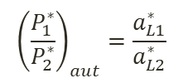
Figure 11
Larger technological differences between countries
$$\frac{P_{1}}{P_{2}}$$
$${\left(\frac{P_{1}^{∗}}{P_{2}^{∗}}\right)}_{aut}=\frac{a_{L1}^{∗}}{a_{L2}^{∗}}$$
$${\left(\frac{P_{1}^{∗}}{P_{2}^{∗}}\right)}_{aut}=\frac{a_{L1}^{∗}}{a_{L2}^{∗}}$$
Relative Supply
$${\left(\frac{P_{1}}{P_{2}}\right)}_{open}$$
$${\left(\frac{P_{1}}{P_{2}}\right)}_{aut}=\frac{a_{L1}}{a_{L2}}$$
$${\left(\frac{P_{1}}{P_{2}}\right)}_{aut}=\frac{a_{L1}}{a_{L2}}$$
Relative Demand
$$\frac{Q_{1}+Q_{1}^{∗}}{Q_{2}+Q_{2}^{∗}}$$
$$\frac{\overline{L}/a_{L1}}{{\overline{L}}^{∗}/a_{L2}^{∗}}$$

Slide 32
welfare Open economy
Size of countries can also affect how relative prices change
Smaller countries have larger variation in relative prices compared to their autarchy level; tend to benefit more from trade
Larger countries have smaller variation in relative prices compared to their autarchy level
If a country is sufficiently large, its relative price will not change with trade
Has to produce both goods
No welfare gain for the large country

Slide 33

Figure 12
Changing the size of Home country
$$\frac{P_{1}}{P_{2}}$$
$${\left(\frac{P_{1}^{∗}}{P_{2}^{∗}}\right)}_{aut}=\frac{a_{L1}^{∗}}{a_{L2}^{∗}}$$
Relative Supply
$${\left(\frac{P_{1}}{P_{2}}\right)}_{open}$$
$${\left(\frac{P_{1}}{P_{2}}\right)}_{aut}=\frac{a_{L1}}{a_{L2}}$$
Relative Demand
$$\frac{Q_{1}+Q_{1}^{∗}}{Q_{2}+Q_{2}^{∗}}$$
$$\frac{\overline{L}/a_{L1}}{{\overline{L}}^{∗}/a_{L2}^{∗}}$$

Slide 34
Figure 13
Changing the size of Home country
$$\frac{P_{1}}{P_{2}}$$
$${\left(\frac{P_{1}^{∗}}{P_{2}^{∗}}\right)}_{aut}=\frac{a_{L1}^{∗}}{a_{L2}^{∗}}$$
Relative Supply
$${\left(\frac{P_{1}}{P_{2}}\right)}_{open}$$
$${\left(\frac{P_{1}}{P_{2}}\right)}_{aut}=\frac{a_{L1}}{a_{L2}}$$
Relative Demand
$$\frac{Q_{1}+Q_{1}^{∗}}{Q_{2}+Q_{2}^{∗}}$$
$$\frac{\overline{L}/a_{L1}}{{\overline{L}}^{∗}/a_{L2}^{∗}}$$

Slide 35
Figure 14
Open-economy equilibrium – Home and Foreign (if Home is sufficiently large)
HOME
FOREIGN
$$Q_{2}$$
$$Q_{2}^{∗}$$
slope = ${\left(P_{1}/P_{2}\right)}_{open}$
slope = ${\left(P_{1}/P_{2}\right)}_{open}$
B*
$${\overline{L}}^{∗}/a_{L2}^{∗}$$
$$\overline{L}/a_{L2}$$
Exports
A*
slope = $a_{L1}/a_{L2}$
C
A
C*
Imports
B
slope = $a_{L1}^{∗}/a_{L2}^{∗}$
$$Q_{1}$$
$$Q_{1}^{∗}$$
$$\overline{L}/a_{L1}$$
$${\overline{L}}^{∗}/a_{L1}^{∗}$$
Exports
Imports

