Slide 1
Ipsos.
Innovation

Slide 2
THE IPSOS INNOVATION PRACTICE IS A SPECIALIZED GROUP DEDICATED TO HELPING CLIENTS DEVELOP PRODUCTS AND SERVICES SET UP FOR SUCCESS
ACCELERATE INNOVATION
A true end-to-end innovation partner with unparalleled expertise. Rooted in consumer-centricity and getting 'closer to real'. With agile platforms geared toward simplicity and speed.
87+
Markets
40+
Years Innovation Experience
WIDE ARRAY OF SECTORS
~1500
Certified Ipsos Employees
Ranked 1st most innovative company according to 2019 GRIT report
Winner 2014 Edison Award for Archetypes Methodology
Featured innovation speaker at
ESOMAR Congress, ESOMAR Asia Pacific, ESOMAR Latin America
Notes:
READ SLIDE.

Slide 3
Typical questions clients bring
Do consumers like my innovation?
How can I optimize the communication?
What is the potential of my innovation?
Is my product delivering what I promised in my concept?
Is my product adjusted?
How much are consumers willing to pay for my product?
How much can I increase my price and not lose consumers significantly?
Is my brand vulnerable to price change from competition?
What should I do in case a competitor changes its price?
From whom I win and to whom I lose volume when I change my price?
Concept Test Product Test CPT
Conjoint
PSM
Gabor Granger
Conjoint
3 ‒

Slide 4
OUR INNOVATION PHILOSOPHY.
4 ‒

Slide 5
Behavioral Science has shown consumer decisions are driven by many factors
GAINS:
Advantages gained by trying/using the innovation
ATTRACTION OF NEW
BARRIERS
EXISTING PRODUCT
PRODUCT CHOICE
NEW PRODUCT
LOSSES:
Any perceived loss from switching to innovation
BENEFITS
STATUS QUO BIAS
Notes:
OUR ADOPTION FRAMEWORK SEEKS TO CREATE CONCEPTS THAT BALANCE BENEFITS FOR SWITCHING WITH OVERCOMING BARRIERS TO SWITCHING

Slide 6
IPSOS TESTING IS GROUNDED IN B-SCI PRINCIPLES TO BETTER MIMIC REAL CONSUMER BEHAVIOR
Prospect Theory
Consumers evaluate innovations relative to their current products. Perceived LOSS switching to new products have much larger impact on perceived GAIN.
Status Quo Bias
Habit is strong. Any changes from the status quo are often viewed as LOSS. Consumers have strong tendency to not want to change.
6

Slide 7
A CONSISTENT PHILOSOPHY UNDERPINS THE SERVICES IPSOS PROVIDES AT ALL STAGES OF INNOVATION DEVELOPMENT
OUR PHILOSOPHY
Innovation Must Be Evaluated Through Two Lenses
Consumer Lens
How We Do It:
RED Measures
Competitive Lens
How We Do It:
Consumer-defined competition
Notes:
Therefore, we evaluate your Innovations through a Behavioral Science lens

Slide 8
Innovation potential is assessed using validated Ipsos metrics predictive of REAL in-market success
CONCEPTS WITH
R
RELEVANCE
Extent to which an innovation meets consumer needs
High Relevance and High Differentiation
54%
more likely to achieve higher than expected trial
E
EXPENSIVENESS
Extent to which an innovation is perceived to be higher-priced than competitors
High Purchase Intent
34%
more likely to achieve higher than expected trial
OUR R&D ALSO SHOWS PURCHASE INTENT…
D
DIFFERENTIATION
Extent to which the innovation provides unique benefits vs. competitors
Does not provide performance diagnostics
Favors low differentiated products
Disadvantages premium-priced innovation
Does not reflect competitive context

Slide 9
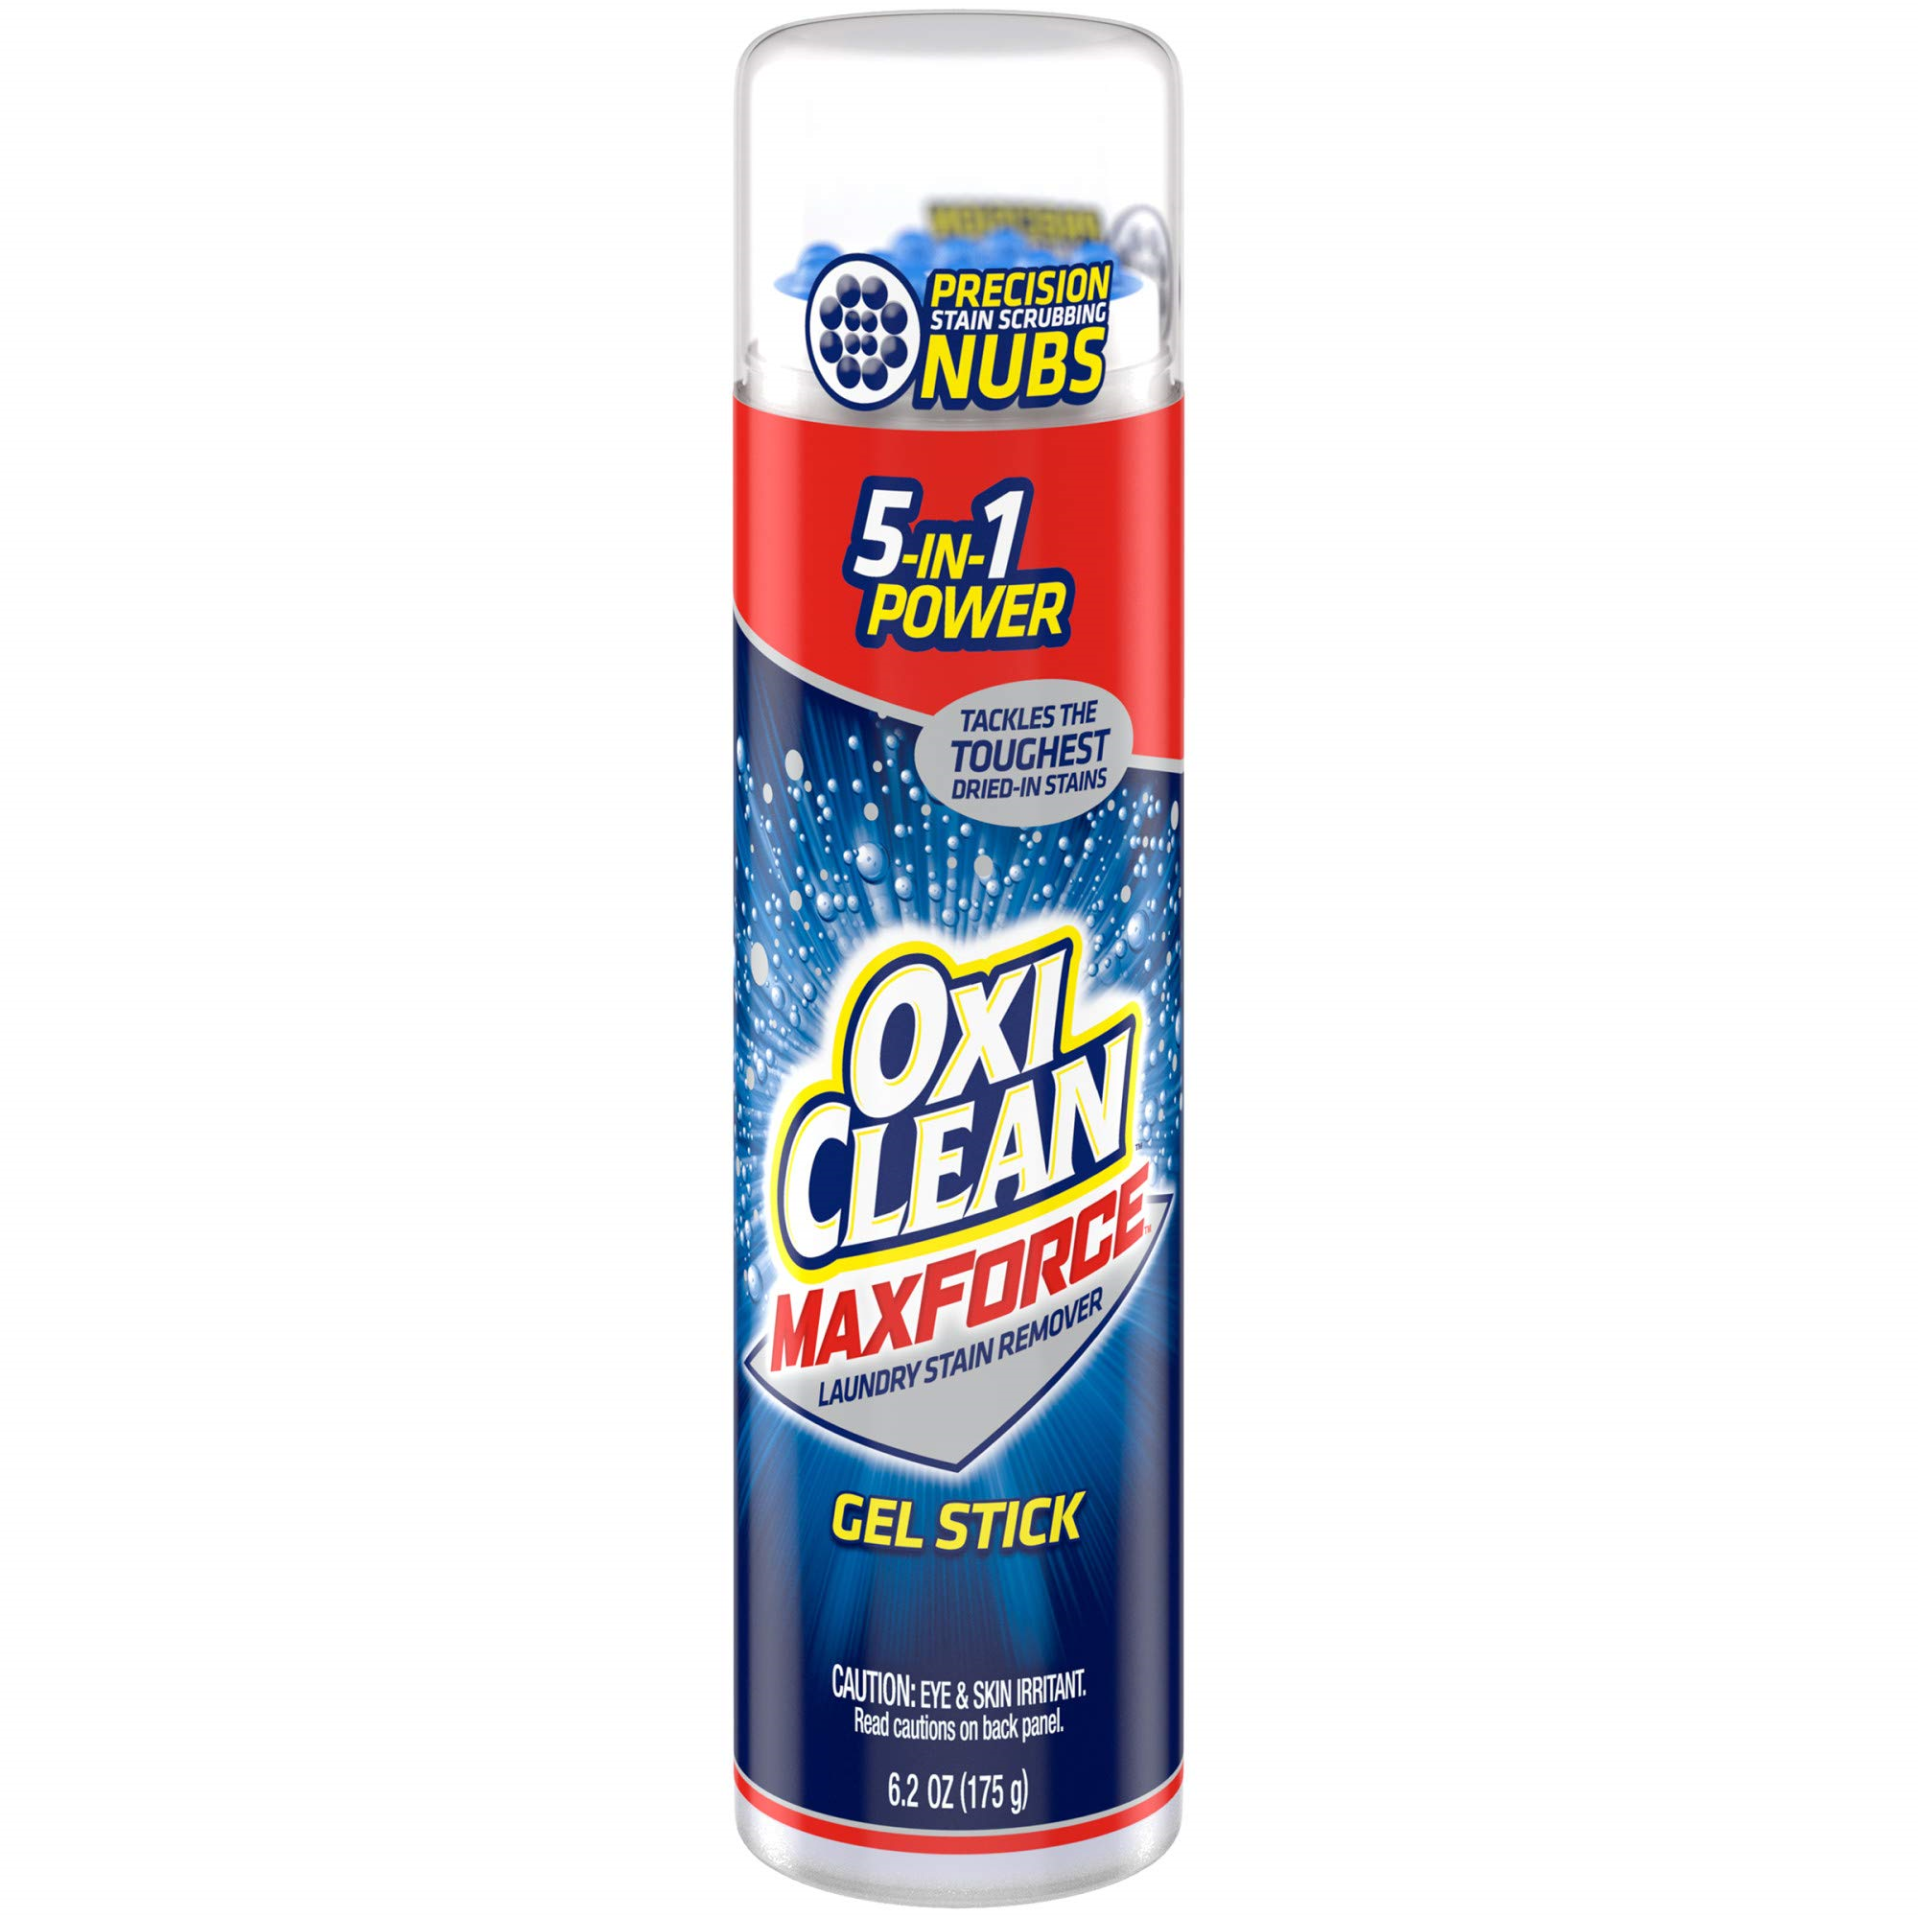
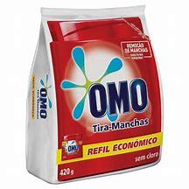
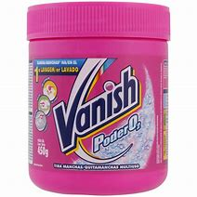
To truly succeed, innovations have to be strong enough to perform against REAL life competition
The competitive set Is individually defined by each respondent in-survey (Likely Substituted Product - Most Often Purchased Product)
HOW CONSUMER-
DEFINED
COMPETITION
WORKS
The Innovation is compared to real in-market products, defined by the respondent, including private label and new disruptive brands — NOT OLD IDEAS THAT NEVER LAUNCHED!
By comparing the new innovation to each respondent’s competitive product (on the RD measures), we benchmark the innovation’s performance

Slide 10
CONSUMER CENTRIC =
REPLICATING INNOVATION ADOPTION PROCESS IN RESEARCH
LOSS: MOPP Wins In Choice Tasks
What was chosen: Choice Wins
RELEVANCE vs. MOPP
DIFFERENTIATION vs. MOPP
GAINS:
Innovation Wins
In Choice Tasks
EXPENSIVENESS vs. MOPP
Wins with faster response time indicates conviction
Wins with longer response time indicates hesitation
Loss with longer response time indicates higher opportunity to convert
Loss with faster response time indicates lower opportunity to convert
Conviction of Choice: Response Time
“ What comes to mind about…”
(free text by consumer )
Artificial Intelligence Driven Automatic Sentiment Detection From Text
Sentiment of Choice: AI Based Text Analysis
64%
36%
Positive Sentiment Detected
Negative Sentiment Detected

Slide 11
The Ipsos approach to databases is unique and provides competitive advantages and greater flexibility
C
D
A
DIRECTION
The Traditional Approach
Stores absolute scores for all tests and benchmarks against average scores in a given category or country if there are sufficient records
The Ipsos Approach
We have a database containing many thousands of records developed over 40 years using the stable relationship between innovations and in-market competition.
REALISTIC
HOLISTIC
MODERN
Compares innovations to products that exist and are successful
Works for any type of innovation in all categories and countries.
Always up-to-date because it is based on products bought today, not ideas tested 20 years ago
Even incorporates emerging brands, private label brands and homemade solutions
Our stable benchmark means the database works for ALL countries, categories, trade channels and consumer targets
Perfect for the blurring lines of today’s complex markets

Slide 12
R&D has shown relationship between test product and Most Often Purchased Product is stable, quite different from the impact of the traditional approach.
Traditional approach
Ipsos approach
Historical Database Relevance
130
Competitive Benchmark Relevance
130
120
120
110
110
100
100
90
90
80
80
70
70
1
2
3
4
5
6
7
8
9
10
11
12
13
14
15
16
17
18
1
2
3
4
5
6
7
8
9
10
11
12
13
14
15
16
17
18
Country
Country
Absolute scores vary significantly by market, being impacted by outside variables like economy.
The relationship between test product and Most Often Purchased Product is stable. Any outside variable will impact both test product and competition evaluation.
Face-to-Face
Both
Online
12 ‒
Notes:
We conducted extensive R&D comparing the historical database approach to the Most Often Purchased Product.
Historical Database Comparison
To emulate historical databases, we computed the average concept score for each country and the average concept score across countries (global average). We indexed each country’s average to the global average (set equal to 100). We looked at Relevance, Expensiveness and Differentiation – for today’s purposes, we are showing just the Relevance scores. What we found was that the indices for each country varied considerably around the global average, because concept scores varied widely by country and category.
Most Often Purchased Product Comparison
To emulate how the test concept would compare to real competition, we computed a ratio of the test concept score to the MOPP-based benchmark score for each concept. We computed the average ratio for each country and the average ratio across countries (global average). We indexed each country’s ratio to the global average
(set equal to 100). Again, we analyzed Relevance, Expensiveness and Differentiation, but are just showing Relevance here. What we found was that for the M.O.P.P. approach, the indices for each country were very close to the global average because the comparison of a concept to the M.O.P.P. among the same consumers would
remove the high and low response patterns across countries.
We repeated this procedure for different categories, and got the same results: great variability for historical databases and stability for the M.O.P.P. approach.

Slide 13
The Ipsos database is a truly universal database rooted in relationships, not absolute scores
Our database contains scores for the test product and for existing products purchased most often by consumers.
Our benchmarks show how strong the test product is relative to the competitor.
 | Test Concept (mean score) | Competitor e. g., MOPP (mean score) | Index of Test Concept to Competition | How strong is that relationship?
Relevance | 4.9 | 5.2 | 94 | M
Expensiveness | 3.3 | 3.0 | 91 | ML
Differentiation | 5.5 | 5.0 | 107 | MH
13 ‒
Notes:
We then leverage a database of relationships, not absolute scores.
Our database contains scores for the test product and for existing products purchased most often by consumers.
Specifically, we ask the consumer to define the competition during the concept screening survey by asking the Most Often Purchased Product – what we call the M.O.P.P. Then, we ask the consumer to rate the M.O.P.P. on the same measures we are using the evaluate the test concept, namely the RED measures. We then compare the test concept scores to a benchmark we develop based on the M.O.P.P. This M.O.P.P.-based benchmark shows how strong the test product is relative to the competition the innovation will face in the real world.
IF CLIENT ASKS HOW M.O.P.P. BENCHMARK WAS DEVELOPED:
We found that for any given key measure (for example, Relevance), the relationship between a test concept a M.O.P.P. is very similar regardless of country, category, data collection methodology or sample. Therefore, the relationships between the test concept and the M.O.P.P. from concept screening studies from around the world can be combined into one global relational database that reflects reality better than historical databases.

Slide 14
Incorporating behavioral science and consumer psychology
Purchase Drivers
Competitive Context
Realistic Consumer Task
Measure proven drivers of purchase behavior, instead of just stated intent.
Relevance, Expensiveness, and Differentiation measures have been demonstrated via a forecasting model to be strong predictors of consumer interest.
Focusing on drivers instead of stated interest allows for diagnosis and for optimization.
Provide realistic likelihood of adoption by assessing within competitive context.
MOPP comparisons are against other items within the test, allowing for a more direct comparison of the best performing items.
Normative comparisons are done within the context of competitors/currently used products, to better understand the potential for actual change in consumer behavior.
Better replicate real purchase decisions by forcing choices instead of focusing only on scaled measures.
Consumers don’t make decisions in a vacuum. By incorporating direct choice vs. current habit, you can accurately predict whether innovation can change current behavior.
In additional to choice based consumer tasks, passive metrics such as response time and AI based sentiment detection maximize the discrimination between the innovations tested.
14 ‒

Slide 15
Not all innovations are equal, you need to manage a portfolio of innovations aligned to your strategy …
Innovation Activity:
Innovation Returns:
10% Core
70% Core
20% Adjacent
20% Adjacent
Do you have the right balance?
70% Transformational
10%
Transformational
Source: Harvard Business Review, Managing Your Innovation Portfolio,, May 2013.
15 ‒
Notes:
Innovation success is not just about pursuing innovations with the highest scores. You also need to consider where they will fit in your innovation portfolio. That’s why Strategic Alignment is part of our Innovation Success Framework.
Before you make a decision about which innovation to pursue, you need to step back, look at your innovation pipeline and ask yourself: Are you in the best position for balancing your risk and maximizing your return?
In many cases, the answer is “no.”
According to a recent article in the Harvard Business Review, today’s innovation pipelines typically look like this:
70% are Core Innovations: focused on product maintenance – incremental improvement, new news, close-in line extensions.
20% are Adjacent Innovations: aren’t necessarily new categories, but they may be new for the manufacturer in question. By expanding into an adjacent category, there tends to be more revenue, and it tends to be more incremental.
10% transformational innovation: tends to result in category creation, which leads to market leadership. It also tends to result in entering categories that are starting their growth phase rather than those that have plateaued.
The problem is that the proportion of time spent against core, adjacent and transformation innovation do not align with their potential returns.
CLICK TO REVEAL INNOVATION RETURNS AND SAY:
As a result, it’s not enough to have “good” (in air quotes) innovations in your pipeline. You also need to have a variety of opportunities that span these different types of innovations – and by definition different time horizons.
You need to manage your innovation portfolio to get the right balance.

Slide 16
Our archetypes identify the types of innovations to help you focus on the right portfolio mix
Leverage Ipsos’ Archetypes
Each of your innovations will be identified as a unique Archetype, based on our algorithm that identifies product personality profiles.
Does the mix align with your strategy?
Do you have enough breakthroughs?
How can you maximize potential while managing risk?
Overpriced
Winner
Unconvincing
Depends on Strategy
Underpriced
Handle with Care
Promising
Restart
Breakthrough
Archetypes
Niche
Good Start
11
Innovation types, developed using our Database and 4 key measure: Relevance, Differentiation, Expensiveness and Believability
Me-Too
Premium
Value
Ipsos’ Archetypes were awarded the 2014 Bronze Medal for Research and Business Optimization in the Edison Awards global competition.
16 ‒
Notes:
So how do you successfully manage your portfolio? A great first step is to identify the types of innovations in your pipeline. Our unique Archetype system enables you to do just that, via an algorithm that essentially identifies your innovation’s ‘personality profile’.
With this information, you can then answer 3 key questions:
CLICK: Does your portfolio mix align with your strategy?
CLICK: Do you have enough breakthroughs?
CLICK: How can you maximize potential while managing risk?
Archetype profiling can be conducted as a early as the idea stage.
It’s worth mentioning that our Archetypes system is so well-regarded that it was awarded the 2014 Bronze Medal for Research and Business Optimization in the Edison Awards global competition.

Slide 17
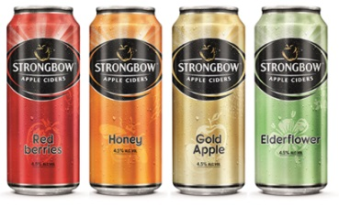
Big mass market innovations are not the only route to success, other archetypes may fit with your strategy
Premium/Value Archetypes
Is the price point right for your brand?
Me-Too Archetype
Do you need it to meet short-term goals?
Is following a successful trend the right option for the brand?
Niche/Targeted Archetype
Is there a loyal group who really love it?
Archetypes help to pull apart concepts operating in a narrow innovation space
Incorporating them into global action standards will ensure the right innovations are progressed for each brand in each market
NOTE: Purchase Intent based approaches disadvantages Premium and Niche Innovations
17 ‒
Notes:
Archetypes will force you to consider your brand strategy as well: You might find your innovation profiles as a certain type when you intended otherwise.
To illustrate how you can use Archetypes to ensure your innovation fits with your strategy let’s consider the issue of price.
Two of the archetypes focus on pricing:
A premium innovation is a fairly strong performer at a premium price.
A value innovation is an average performer at a favorable price.
The decision to progress an innovation or not if it falls into one of these two areas relies entirely on your considering the strategy you have for your brand. For instance if a new idea tested for an upscale brand such as Godiva was identified as premium that would be fine. If on the other hand it fell into the value archetype this would be a poor fit with the brand and run the risk of undermining the brand’s equity. (INSERT YOUR OWN LOCAL EXAMPLE.)
Me-Too:
Another area where strategy is an important consideration is in the area of me-too ideas. We have already talked about the fact that line extensions can play an important role in growing your business but that there tends to be too much focus in this area for too little return on investment.
That is why it is important to be able to clearly identify when your idea falls into the me-too category – it is relevant to consumers because it meets a need but it lacks differentiation.
There are situations where it might be right to progress an idea here. If your objectives are short term or it is important that you develop a presence in a category then it could be ok. However it is important to consider that without a clear point of difference your long term potential may be limited and success will be reliant on a strong brand and big marketing budgets to constantly remind consumers of your presence and keep your product in their consideration set.
And, it is important to know if your innovation is more of a niche product, such as the product on the far right. The question then is will there be a loyal group who really love it?

Slide 18
BUSINESS APPLICATIONS FOR OPPORTUNITY SIZING
Core applications
Additional applications
Benchmarks for new product launches,
in a given category & market
Opportunity forecasts by country, region, and category
Top country/category combinations for global expansion of new products
White space opportunities for future innovation
Portfolio optimization opportunities, in a given category & market
18 ‒

Slide 19
Concept Test
Product Test
CPT.
19 ‒

Slide 20
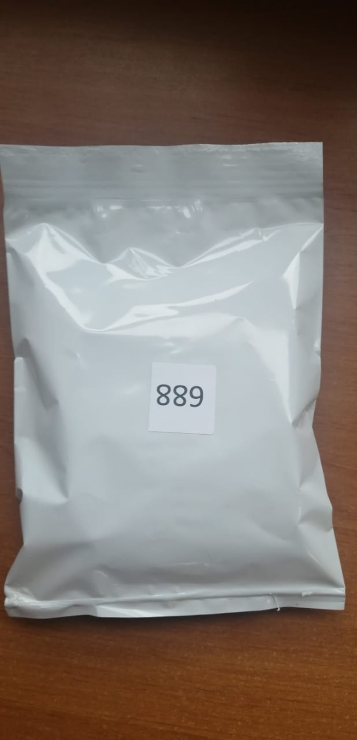
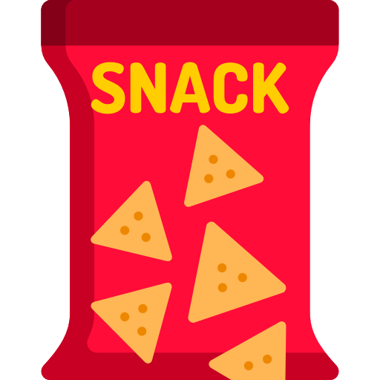
WHAT DO WE RECEIVE FROM CLIENTS?
Innovation Concept
Product
Category Data
Insight
What is the demographic profile of the consumers of that category?
How is the market share distribution?
Which are the competitors brands?
What is the category penetration?
What atributes are important for the category?
Benefits
Reason to believe
Price
Description of the Innovation:
What is it?
Why do I need it?
What does it do for me?
How does it work?
How much does it cost?
Blind or branded
Used to screen consumers and represent market
20 ‒

Slide 21
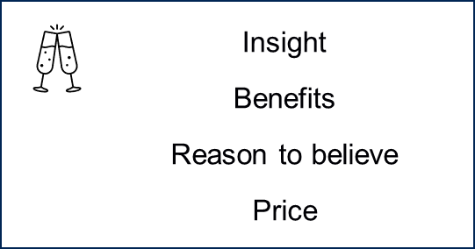
CONCEPT TEST: WHAT DO WE ASK RESPONDENTS?
Screeners
Concept Evaluation vs. Most Often Product
Concept Exhibition
Which categories do you consume?
Which brands?
Which one is your most often?
How often?
Are you responsible for the purchase?
Insight
Benefits
Most Often
Reason to believe
Innovation
Price
Which is more relevant?
Which is more expensive?
Which is more unique?
Concept Evaluator
Additional Questions
Click the words you consider: More Relevant, Least Relevant, Difficult do Believe, Unique
How much do you agree each sentence matches with the product description you saw?
How much do you like it?
How willing are you to purchase it?
How believable is it?
What does it come to your mind when you think of it?
21 ‒

Slide 22
PRODUCT TEST: WHAT DO WE ASK RESPONDENTS?
Screeners
Product Trial
Product Evaluation
Which categories do you consume?
Which brands?
Which one is your most often?
How often?
Are you responsible for the purchase?
How relevant is it?
How unique is it?
How liked is it?
How liked are its main features? E.g. Fragrance, Taste, Consistency, etc.
How adjusted are its main features? E.g. Just about right for smell, saltiness, consistency, flavor intensity, etc.
Additional Questions
How much do you agree each sentence matches with the product you tried?
How willing are you to purchase it?
What does it come to your mind when you think of it?
22 ‒

Slide 23
CONCEPT TEST: WHAT DO WE DELIVER?
Archetypes
Consumer Demand Summary
Overpriced
Winner
Unconvincing
Depends on Strategy
Underpriced
Handle with Care
Promising
Restart
Breakthrough
Archetypes
A summary of concept performance vs benchmarks with guidance on where strengths and weaknesses lie
Niche
Good Start
Me-Too
Premium
Value
Archetypes help you understand how a concept could fit into your portfolio

Slide 24
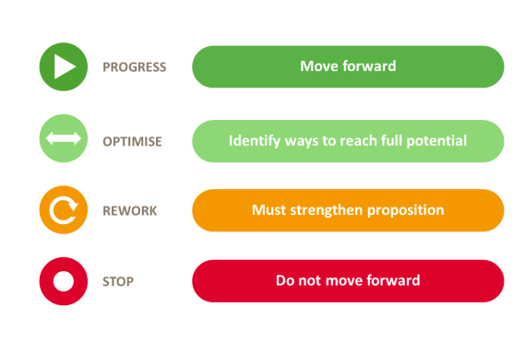
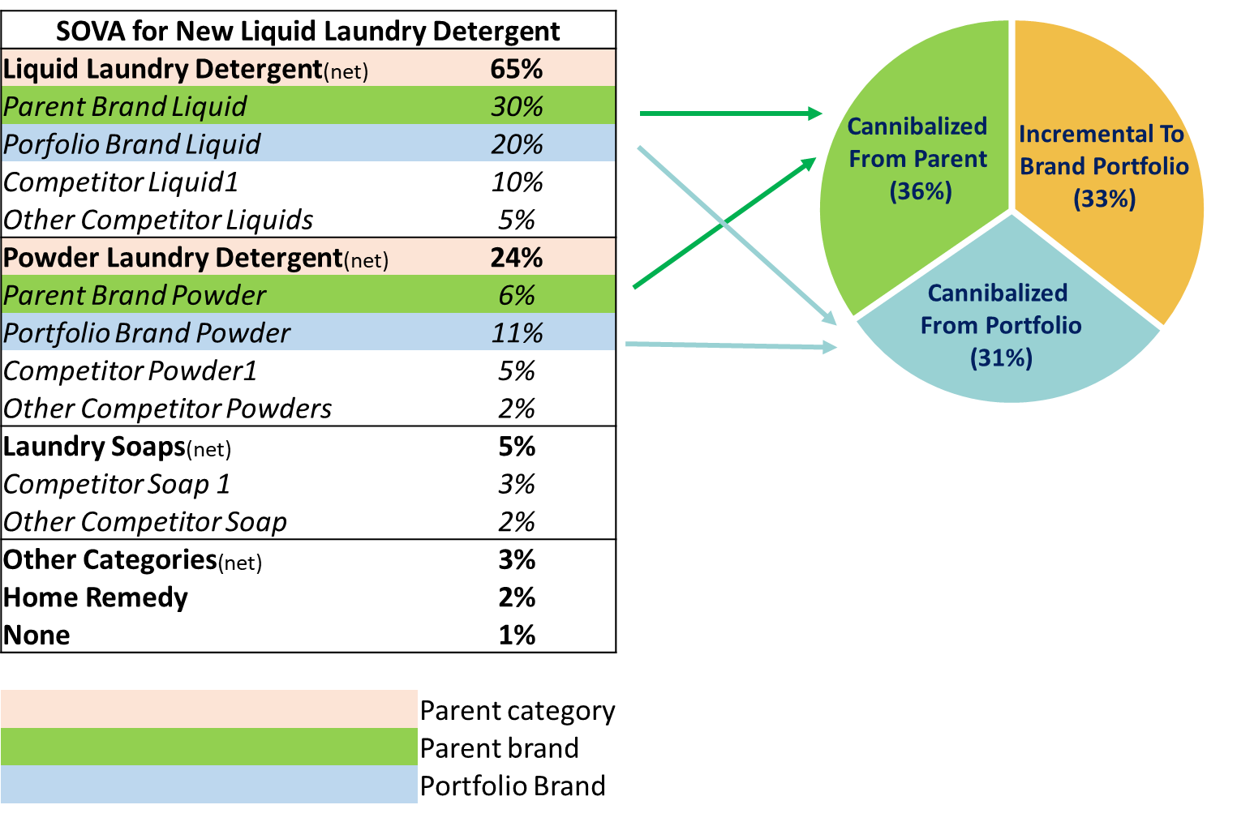
CONCEPT TEST: WHAT DO WE DELIVER?
Action Standard
Incrementality
Action Standards are designed to be actionable and clear for all stakeholders
Obtain the incremental growth and understand if it is above or below expectations according to the market reality

Slide 25
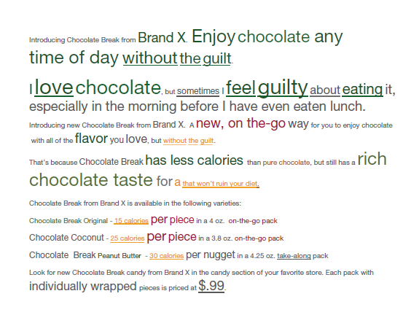
CONCEPT TEST: WHAT DO WE DELIVER?
Message Optimization: What you need to say different?

Slide 26
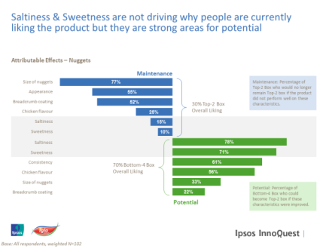
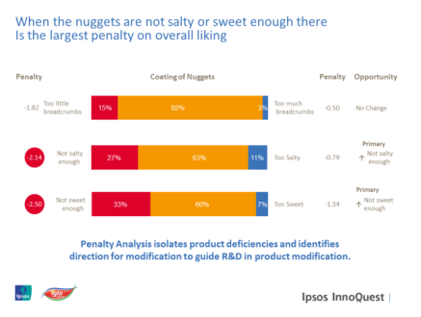
PRODUCT TEST: WHAT DO WE DELIVER?
What do I need to change?
Which attributes would strengthen liking and which must be maintained?
In what way?
What is the direction for change needed on those attributes and what should be prioritised?
How do I change it?
Which aspects of the product could drive this change?

Slide 27
PRODUCT TEST: WHAT DO WE DELIVER?
Overall Product Perceptions
Overall Liking
Fragrance
Overall Liking (%)
JAR- Fragrance Intensity (%)
6pt scale %
PRODUCT
M. SAMPLE
(a) N=250
TB
59
T2B
88
Too Strong
Just about Right
Too smooth
T3B
97
T2B
83
T3B
91
B2B
3
B3B
9
Mean
5,3

Slide 28
CPT: WHAT DO WE DELIVER?
+ Consumer Demand Summary
A summary of concept & product performance vs benchmarks with guidance on where strengths and weaknesses lie

Slide 29
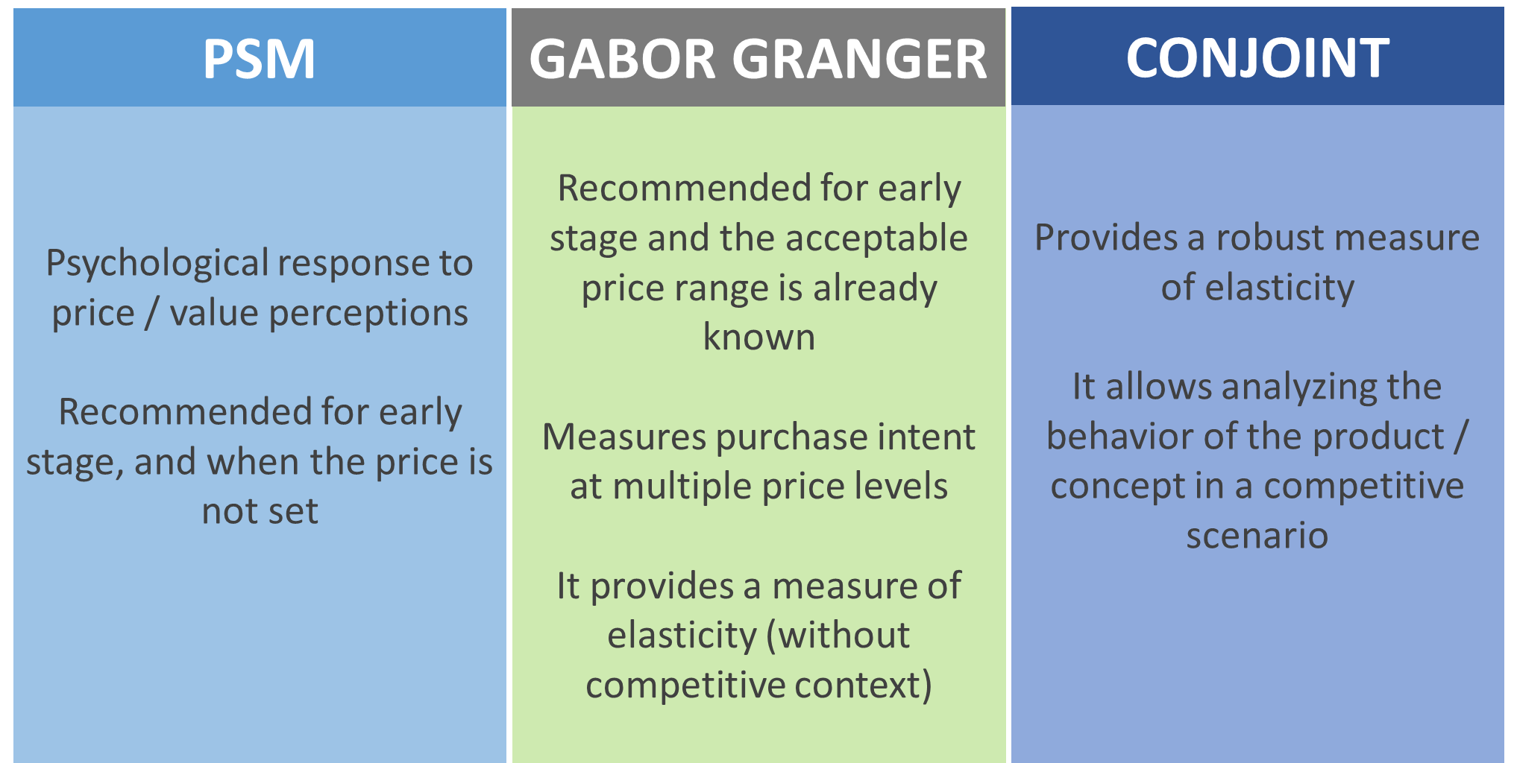
Price Evaluation Methods
29 ‒

Slide 30
Price Evaluation Methods
PSM (Van Westendorp)
Gabor Granger
Conjoint
30 ‒

Slide 31
PSM: Price Sensitivity Measurement
Evaluate ideal price positioning range for concept/product. Determine ideal value, to minimize number of “non buyers” and “indicise consumers”, maximizing the number of “potential buyers” at the same time.
What do we receive from clients?
The stimuli we want to assess price:
Innovation Concept
Product
Insight
Benefits
Reason to believe
Price
Blind or branded

Slide 32
PSM: Price Sensitivity Measurement
What do we ask?
After consumer was exposed to concept/ product, we ask:
What price would you consider this product cheap, thinking it will be available in a 100g pack?
What price would you consider this product expensive, thinking it will be available in a 100g pack?
What price would you consider this product so cheap you would question its quality and would not purchase it, thinking it will be available in a 100g pack?
What price would you consider this product so expensive you would not purchase it, thinking it will be available in a 100g pack?

Slide 33
PSM: Price Sensitivity Measurement
Expensive
Too expensive
Cheap
Too Cheap
Cheap
Expensive
Too
Expensive
Too Cheap
Normal Price (Indifference)
Point of Marginal Expensiveness
Point of Marginal Cheapness
Acceptable Price Range
Minimum Rejection Price/Point of Lease Resistance (Optimal)

Slide 34
PSM: Price Sensitivity Measurement

Slide 35
PSM: Price Sensitivity Measurement
Example of Deliverable

Slide 36
Price Evaluation Methods
PSM (Van Westendorp)
Gabor Granger
Conjoint
36 ‒

Slide 37
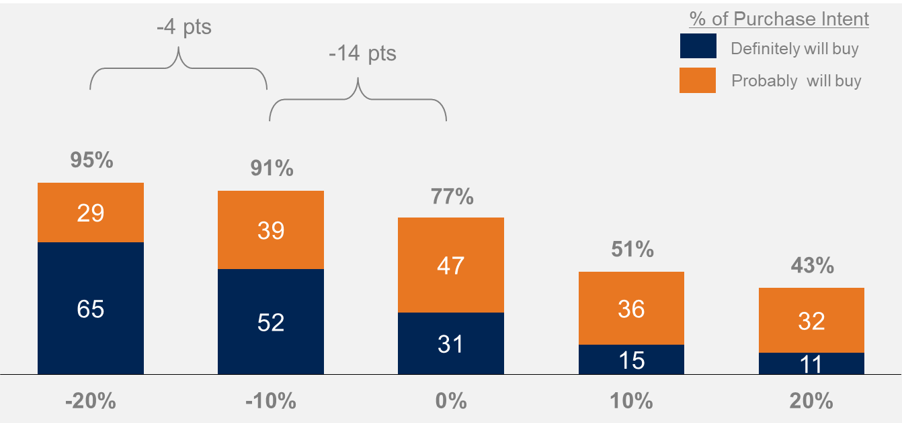
Gabor Granger
Example:
The Gabor Granger Pricing Method, is a simple technique used to evaluate interest in a concept/product.
Gabor Granger is a form of pricing analysis based upon respondent ratings of purchase intention of a concept at a number of pre-defined price levels.
Respondents are asked their likelihood to purchase the concept being evaluated at each price level.
The level of purchase intention at each price level is summarized using a top or top two box purchase interest percentage plotted against price to create a purchase intent curve, which can be examined for an inflection point or a trend flattening, offering an indicator of what price might be suggested at retail.
This graph provides an illustration of top 2 box purchase intent levels at each price point.

Slide 38
Gabor Granger
What do we receive from clients?
The stimuli we want to assess price:
The price points we are asking purchase intention.
The range covered should be wide enought to cover the cheapest to the most expensive price possibilities in real life.
R$ XX,00
R$ XX,00 +
R$ XX,00 ++
R$ XX,00 +++
R$ XX,00 ++++
R$ XX,00 ++++++
Innovation Concept
Product
Insight
Benefits
Reason to believe
Price
Blind or branded

Slide 39
Gabor Granger
Example of deliverable
The range of R$ 59,99 – R$69,99 is the most acceptable for consumers.
The intended price R$ 79,99, seems to be quite high for 51% of consumers.
-18 pts
-14 pts
% of Purchase Intent
-06 pts
Definitely will buy
-07 pts
Probably will buy
T2B
-04 pts
-04 pts
B2B 51%
-02 pts

Slide 40
Price Evaluation Methods
PSM (Van Westendorp)
Gabor Granger
Conjoint
40 ‒

Slide 41
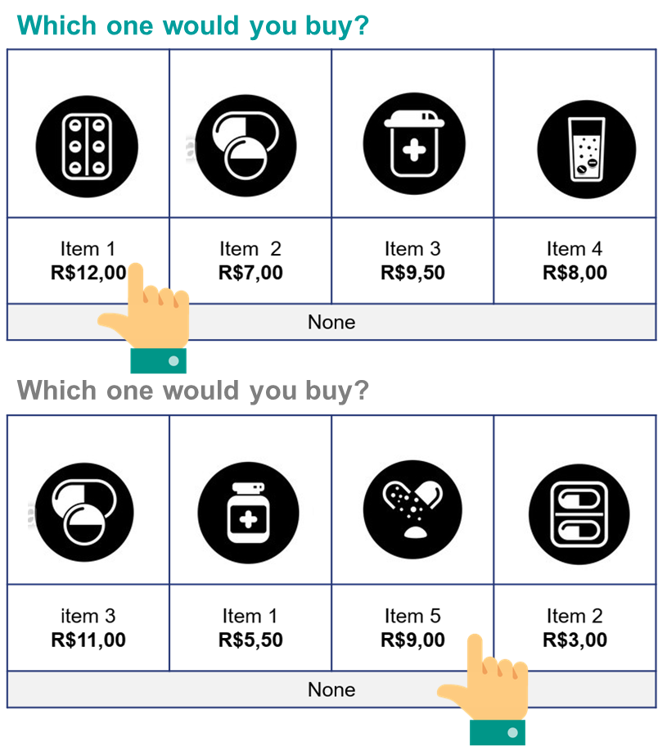
Conjoint
How does it work?
Consumers express their preference “choosing” a product among different options (“purchase scenarios”).
The purchase simulation (“choice task”) simulates the real purchase situation, including the possibility to choose “none”.
In this method, the respondent evaluates several elements (price, brand, size, packaging, etc.) “conjointly”.
After each choice task, the system shows a different products set combining different levels of each attribute.
We include our test product + competitive universe
We do not show the same products in all the choice tasks
The price of each SKU can increase or decrease along the tasks
The exercise is repeated many times (the amount of tasks will depend on the amount of attributes and levels to be tested).
The purchase scenarios change among the tasks.
Consumer attention is divided among the attributes, so price is not emphasized or super estimated.

Slide 42
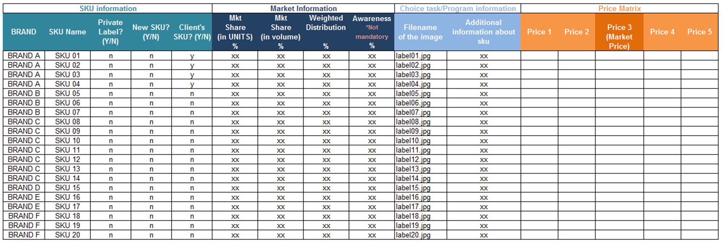
Gabor Granger
What do we receive from clients?
Images, descriptions, prices and market information for the main SKUs which compose the market. These SKUs are used to compose the purchase scenarios

Slide 43
Conjoint
What do we deliver

Slide 44
Conjoint
What do we deliver

Slide 45
Conjoint
What do we deliver

Slide 46
Conjoint
What do we deliver

Slide 47
Conjoint
What do we deliver

Slide 48
Conjoint
What do we deliver

Slide 49
Conjoint
What do we deliver

Slide 50
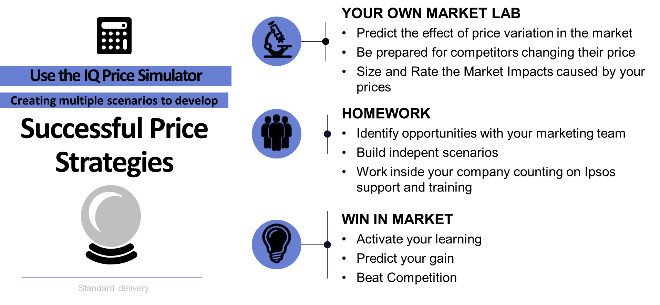
Conjoint
What do we deliver

Slide 51
Conjoint
What do we deliver

Slide 52
Conjoint
What do we deliver

