Slide 1
Chapter 4 Further Topics in Industry and Competitive Analysis
Prof. Luciano Thomé e Castro

Slide 2
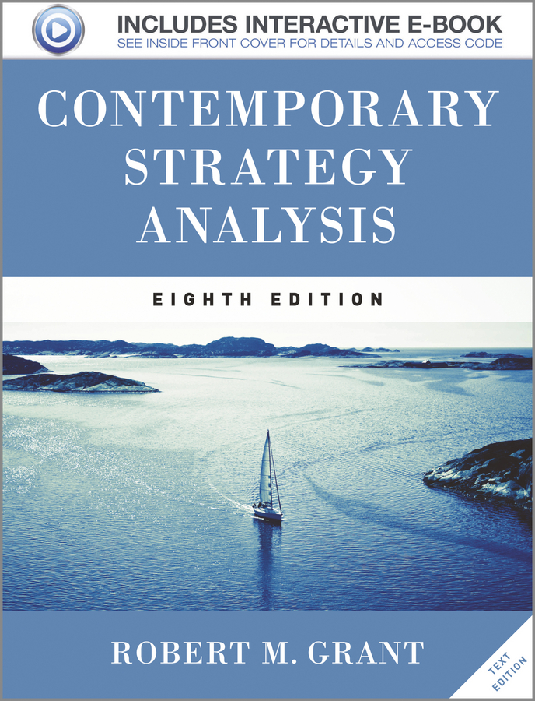
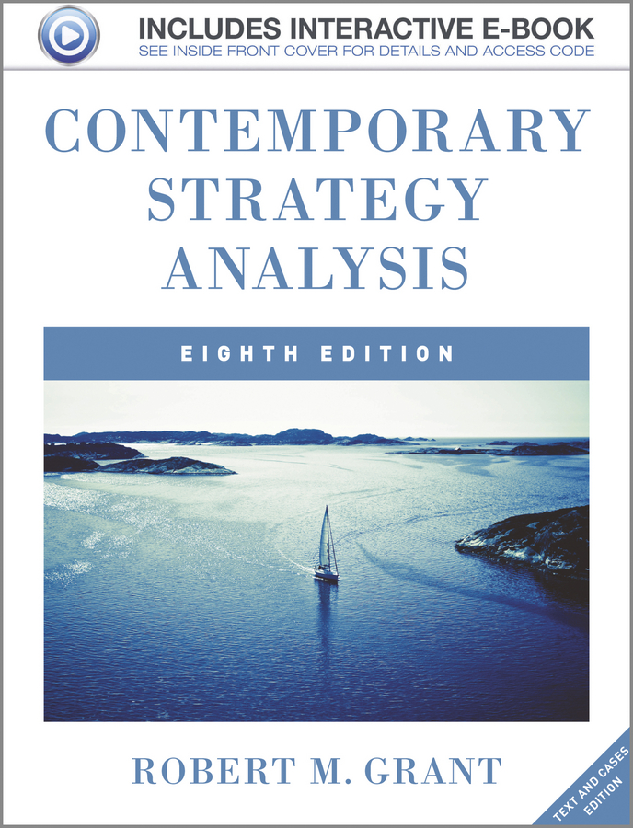
© 2013 Robert M. Grant
www.contemporarystrategyanalysis.com

Slide 3
Further Topics in Industry and
Competitive Analysis
OUTLINE
Extending 5-forces analysis
Does industry matter?
Complements
Dynamic competition
Dynamic competition
“Schumpeterian” and “Hyper” competition
Game Theory
Competitor Analysis
Segmentation and strategic groups
© 2013 Robert M. Grant
www.contemporarystrategyanalysis.com

Slide 4
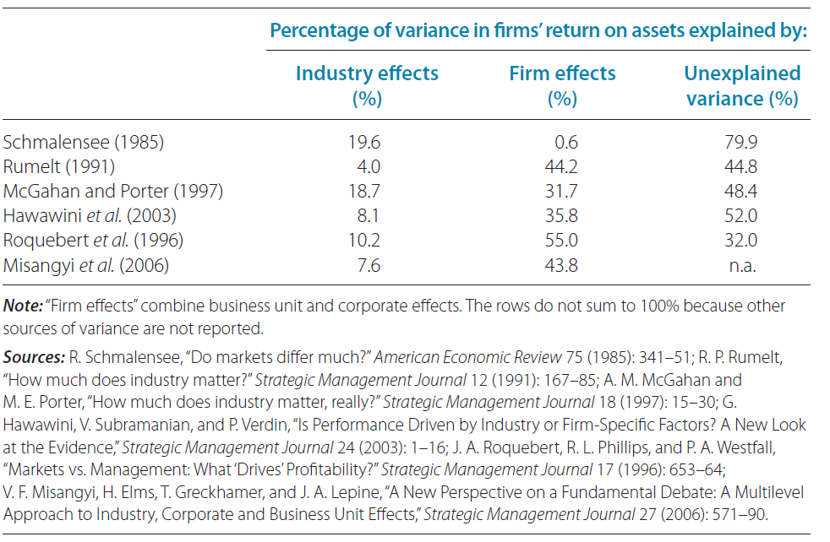
How Much Does Industry Matter?
© 2013 Robert M. Grant
www.contemporarystrategyanalysis.com

Slide 5
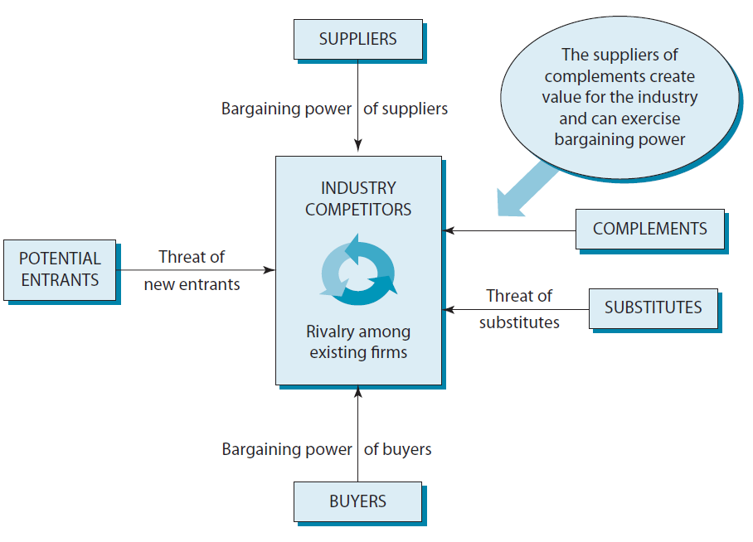
Five Forces or Six?
Introducing Complements
© 2013 Robert M. Grant
www.contemporarystrategyanalysis.com

Slide 6
The Objectives of Industry Analysis
Porter framework assumes:
Industry structure drives competitive behaviour
Industry structure is (fairly) stable
But, competition also changes industry structure
Schumpeterian Competition – A “perennial gale of creative destruction” – market leaders over thrown by innovation
Hypercompetition – “Intense and rapid competition moves… continuously creating new competitive advantages and destroying existing competitive advantages
Implication:
Within 5 forces framework
INDUSTRY STRUCTURE COMPETITIVE STRATEGY
Under dynamic competition
COMPETITIVE STRATEGY INDUSTRY STRUCTURE
© 2013 Robert M. Grant
www.contemporarystrategyanalysis.com

Slide 7
The Contribution of Game Theory to Competitive Analysis
Main value:
Framing strategic decisions as interactions between competitors
Predicting outcomes of competitive situations involving a few, evenly-matched players
Some key concepts:
Competition and Cooperation – Game theory can show conditions where cooperation is more advantageous than competition
Deterrence – Changing the payoffs in the game in order to deter a competitor from certain actions
Commitment – Irrevocable deployments of resources that give credibility to threats
Signalling – Communication to influence a competitor’s decision
© 2013 Robert M. Grant
www.contemporarystrategyanalysis.com

Slide 8
The Contribution of Game Theory to Competitive Analysis
Problems of Game Theory:
Useful in explaining past competitive behaviour – Weak in predicting future behaviour
Lack of an integrated general theory – Many different models; outcomes highly sensitive to small changes in assumptions
© 2013 Robert M. Grant
www.contemporarystrategyanalysis.com

Slide 9
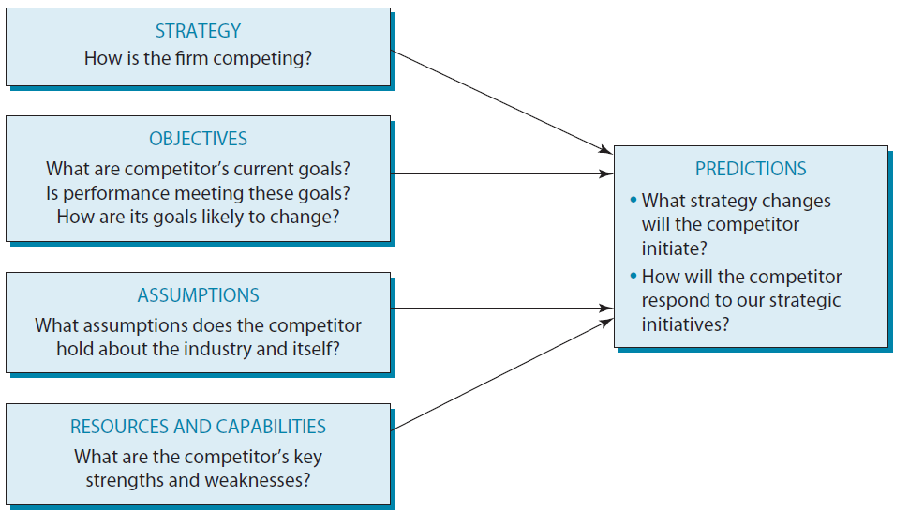
A Framework for Competitive Analysis
© 2013 Robert M. Grant
www.contemporarystrategyanalysis.com

Slide 10
Segmentation Analysis:
The Principal Stages
Identify key variables and categories
Identify segmentation variables
Reduce to 2 or 3 variables
Identify discrete categories for each variable
Construct a segmentation matrix
Analyze segment attractiveness
Identify KSFs in each segment
Analyze benefits of broad vs. narrow scope
Potential for economics of scope across segments
Similarity of KSFs
Product differentiation benefits of segment focus
© 2013 Robert M. Grant
www.contemporarystrategyanalysis.com

Slide 11
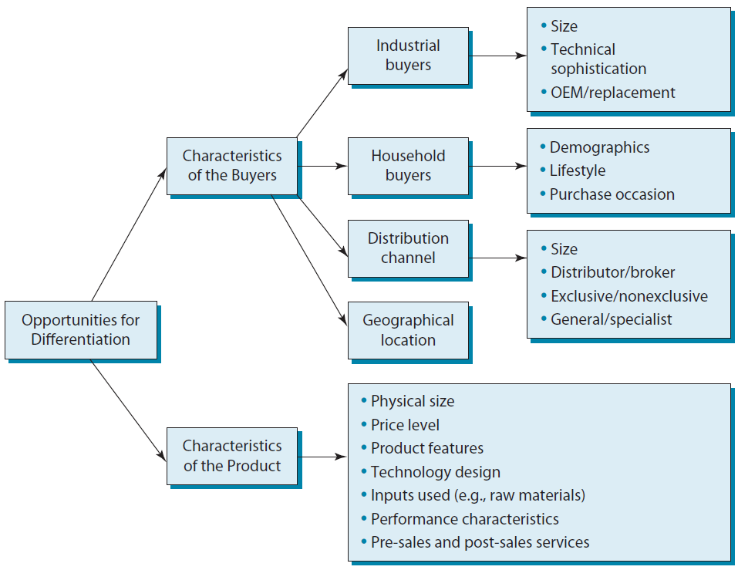
The Basis for Segmentation: Customer and Product Characteristics as Segmentation Variables
© 2013 Robert M. Grant
www.contemporarystrategyanalysis.com

Slide 12
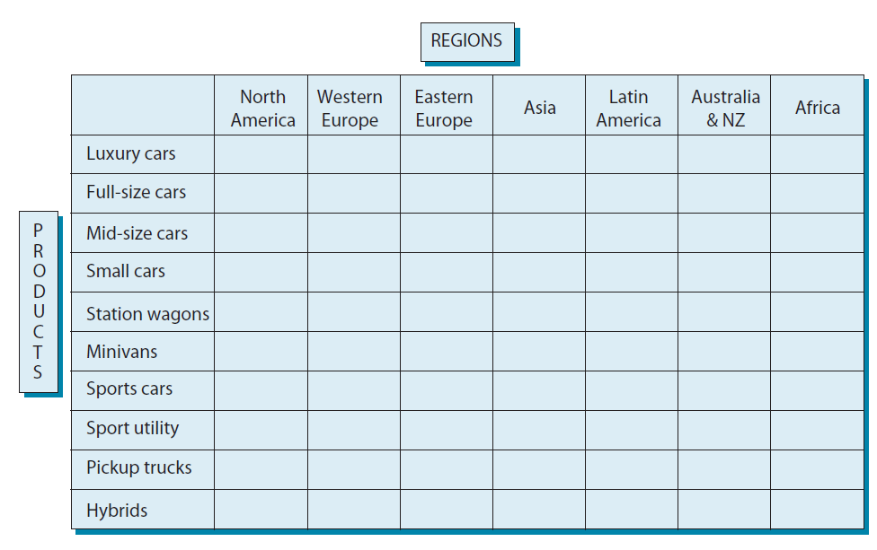
Segmenting the World Automobile Market
© 2013 Robert M. Grant
www.contemporarystrategyanalysis.com

Slide 13
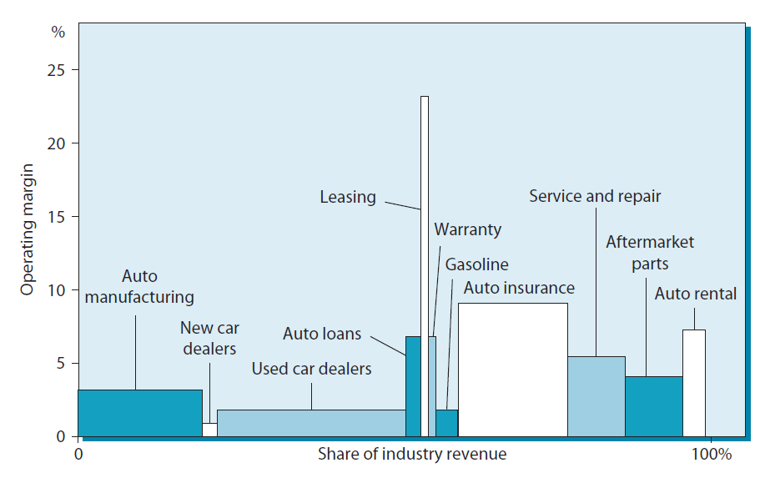
Vertical Segmentation & Industry Profit Pools: The US Auto Industry
© 2013 Robert M. Grant
www.contemporarystrategyanalysis.com

Slide 14
Segmentation & Key Success Factors: The US Bicycle Market
Segment | Key Success Factors
Low price bicycles sold primarily through department and discount stores, mainly under the retailer’s own brand | Low cost through global sourcing of components and low wage assembly Supply contract with major retailer Leading competitors: Assemblers in Taiwan & China and a few US manufacturers
Medium-priced bicycles sold mainly under manufacturer’s brand; distributed through specialist cycle stores | Cost efficiency through scale and low wage costs Reputation for quality Good dealer reputation International marketing and & distribution Leading competitors: Raleigh, Peugeot, Fuji
High-priced bicycles for enthusiasts | Quality components and assembly Design innovation – e.g. less weight/wind resistance Reputation (e.g. success in racing) Strong dealer relations
Children’s bicycles/tricycles sold through discount stores and toy stores | Similar to low price bicycle segment
© 2013 Robert M. Grant
www.contemporarystrategyanalysis.com

Slide 15
Strategic Group Analysis
A strategic group is a group of firms in an industry that follow the same or similar strategies
Identifying strategic groups:
Identifying principal strategic variables which distinguish firms
Position each firm in relation to these variables
Identify clusters
© 2013 Robert M. Grant
www.contemporarystrategyanalysis.com

Slide 16
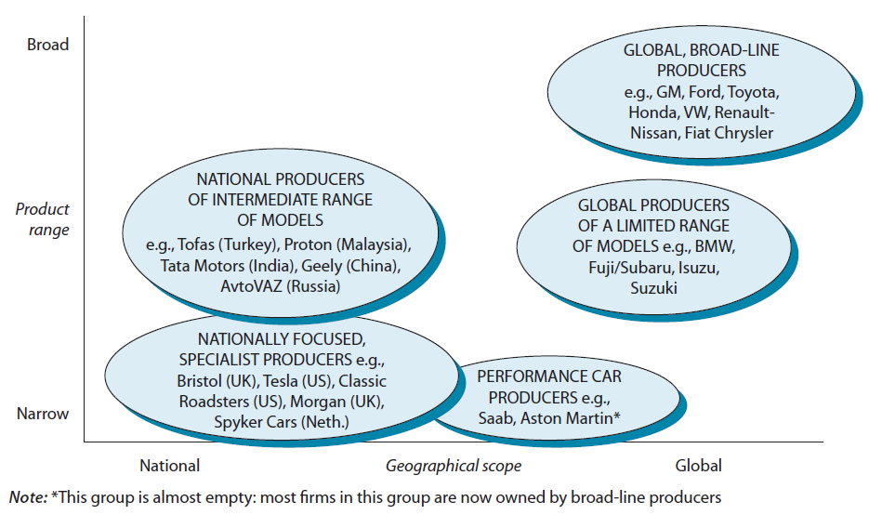
Strategic Group Within the World Automobile Industry
© 2013 Robert M. Grant
www.contemporarystrategyanalysis.com

Slide 17
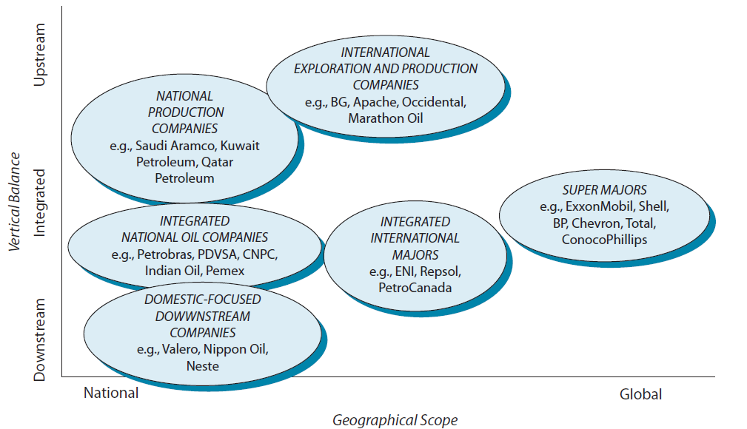
Strategic Groups Within the World Petroleum Industry
© 2013 Robert M. Grant
www.contemporarystrategyanalysis.com

