Slide 1
Chapter 3 Industry Analysis: The Fundamentals
Prof. Luciano Thomé e Castro

Slide 2
© 2013 Robert M. Grant
www.contemporarystrategyanalysis.com

Slide 3
Industry Analysis: The Fundamentals
OUTLINE
The objectives of industry analysis
From environmental analysis to industry analysis
Porter’s Five Forces Framework
Applying industry analysis
Industry and market boundaries
Identifying Key Success Factors
© 2013 Robert M. Grant
www.contemporarystrategyanalysis.com

Slide 4
The Objectives of Industry Analysis
To understand how industry structure drives competition, which determines the level of industry profitability
To assess industry attractiveness
To use evidence on changes in industry structure to forecast future profitability
To formulate strategies to change industry structure to improve industry profitability
To identify Key Success Factors
© 2013 Robert M. Grant
www.contemporarystrategyanalysis.com

Slide 5
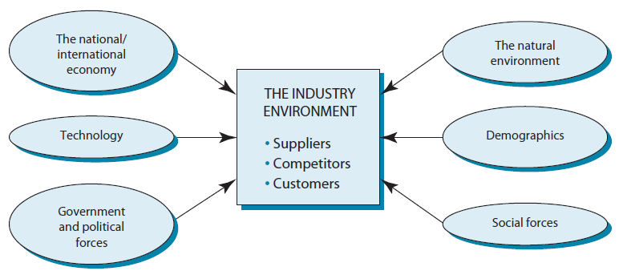
From Industry Analysis to
Environmental Analysis
The Industry Environment lies at the core of the Macro environment
The Macro Environment impacts the firm through its effect on the Industry Environment
© 2013 Robert M. Grant
www.contemporarystrategyanalysis.com

Slide 6
Profitability of US Industries
(selected industries only)
Median return on equality (%), 2000-2010
High profitability |  | Low Profitability
Tobacco | 33.5 | Packaging and containers | 10.2
Household and personal products | 27.8 | Automotive retailing and services | 9.8
Pharmaceuticals | 20.5 | Food and drugs stores | 9.6
Food consumer products | 20.0 | Insurance | 9.1
Food services | 19.9 | Hotels, casinos, resorts | 8.5
Medical products and equipment | 18.5 | Metals | 8.2
Mining, crude oil production | 16.3 | Semiconductors and electronic components | 7.7
Securities | 15.9 | Forest and paper products | 7.3
Chemicals | 15.7 | Food production | 5.2
Aerospace and defence | 15.7 | Telecommunications | 5.8
Construction and farm equipment | 14.5 | Motor vehicles and parts | 4.4
IT services | 14.1 | Airlines | -11.3
© 2013 Robert M. Grant
www.contemporarystrategyanalysis.com

Slide 7
The Determinants of Industry Profitability
Three key influences:
The value of the product to customers
The intensity of competition
Relative bargaining power at different stages of the value chain
© 2013 Robert M. Grant
www.contemporarystrategyanalysis.com

Slide 8
The Spectrum of Industry Structures
 | Perfect Competition | Oligopoly | Duopoly | Monopoly
Concentration | Many firms | A few firms | Two firms | One firm
Entry and Exit Barriers | No barriers | Significant barriers |  | High barriers
Product Differentiation | Homogeneous product | Potential for product differentiation
Information | Perfect information flow | Imperfect availability of information
© 2013 Robert M. Grant
www.contemporarystrategyanalysis.com

Slide 9
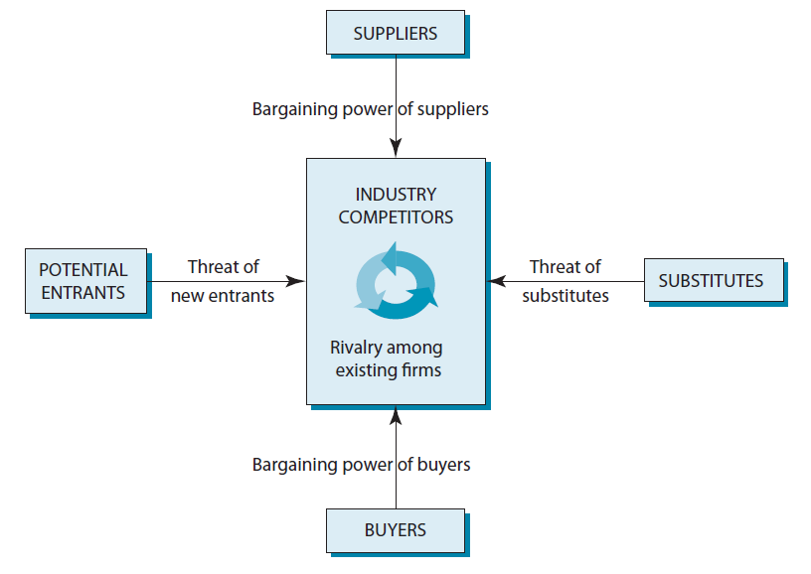
Porter’s Five Forces
Competition Framework
© 2013 Robert M. Grant
www.contemporarystrategyanalysis.com

Slide 10
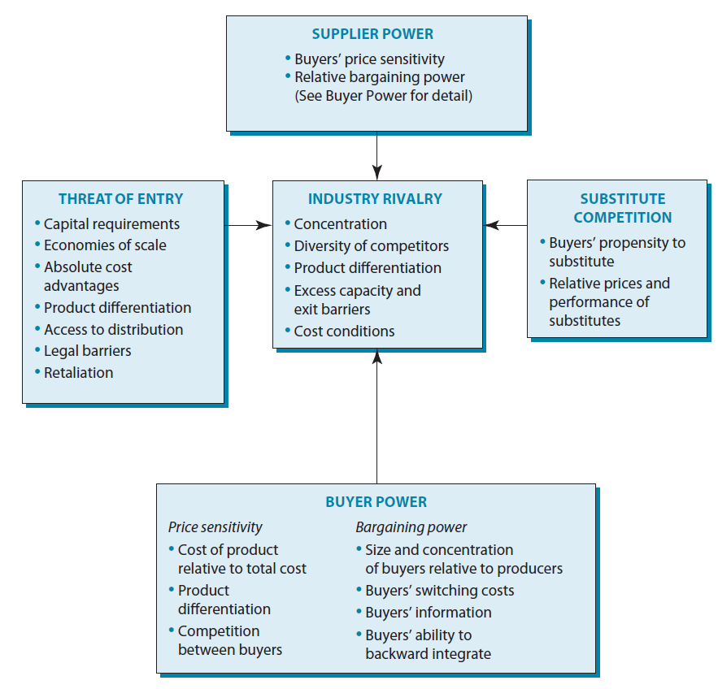
The Structural Determinants of Competition
© 2013 Robert M. Grant
www.contemporarystrategyanalysis.com

Slide 11
Threat of Substitutes
Extent of competitive pressure from producers of substitutes depends on:
Buyer’s propensity to substitute
The price-performance characteristics of substitutes
© 2013 Robert M. Grant
www.contemporarystrategyanalysis.com

Slide 12
Threat of New Entrants
Entrants’ threat to industry profitability depends upon the height of barriers to entry
The principle sources of barriers to entry is:
Capital requirements
Economies of scale
Absolute cost advantage
Product differentiation
Access to channels of distribution
Legal and regulatory barriers
retaliation
© 2013 Robert M. Grant
www.contemporarystrategyanalysis.com

Slide 13
Bargaining Power of Buyers
The extent to which buyers are able to depress profitability depends on:
Buyer’s price sensitivity
Does the item comprise a big percentage of the buyer’s total costs?
Whether purchased item is a commodity or differentiated?
How intense is competition between buyers?
Is the item critical to the quality of the buyer’s own output
Relative bargaining power
Size and concentration of buyers relative to sellers
Buyer’s information
Ability to backward integrate
Note: Analysis of supplier power is symmetric
© 2013 Robert M. Grant
www.contemporarystrategyanalysis.com

Slide 14
Rivalry Between Established Competitors
The extent to which industry profitability is depressed by aggressive price competition depends upon:
Concentration (number and size distribution of firms)
Diversity of competitors (difference in goal, cost strategies, etc.)
Product differentiation
Excess capacity and exit barriers
Cost conditions
Extent of sale economies
Ratio of fixed to variable costs
© 2013 Robert M. Grant
www.contemporarystrategyanalysis.com

Slide 15
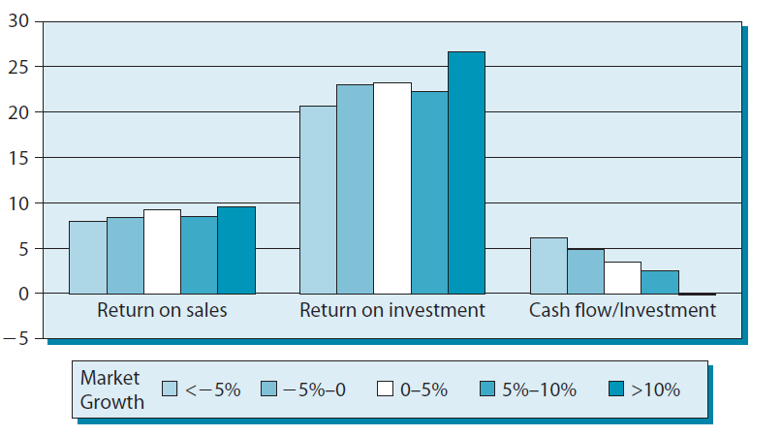
Profitability and Market Growth
© 2013 Robert M. Grant
www.contemporarystrategyanalysis.com

Slide 16
Supplier Power: The Impact of Unionization on Profitability
PROFITABILITY (%)
PERCENTAGE OF EMPLOYEES UNIONIZED
© 2013 Robert M. Grant
www.contemporarystrategyanalysis.com

Slide 17
Applying Five-Forces Analysis
Forecasting Industry Profitability
If we can forecast changes in industry structure we can predict likely impact on competition and profitability
Strategic Planning
Once we know which structural features of the industry support profitability and which depress profitability, we can choose a favorable positioning within the industry
Strategies to Improve Industry Profitability
Which of the structural variables that are depressing profitability can we change by individual or collective strategies?
© 2013 Robert M. Grant
www.contemporarystrategyanalysis.com

Slide 18
Drawing Industry Boundaries
What is the Relevant Market?
What industry is Jaguar in:
The motor vehicle industry (SIC 371)
The automobile industry (SIC 3712)
The luxury car industry?
Is its industry global, regional (Europe) or national (UK)?
Key criterion: SUBSTITUTABILITY
On the demand side: Are buyers willing to substitute between types of cars and across countries
On the supply side: Are manufacturers able to switch production between types of cars and across countries
We may need to draw industry boundaries differently for different types of decision
© 2013 Robert M. Grant
www.contemporarystrategyanalysis.com

Slide 19
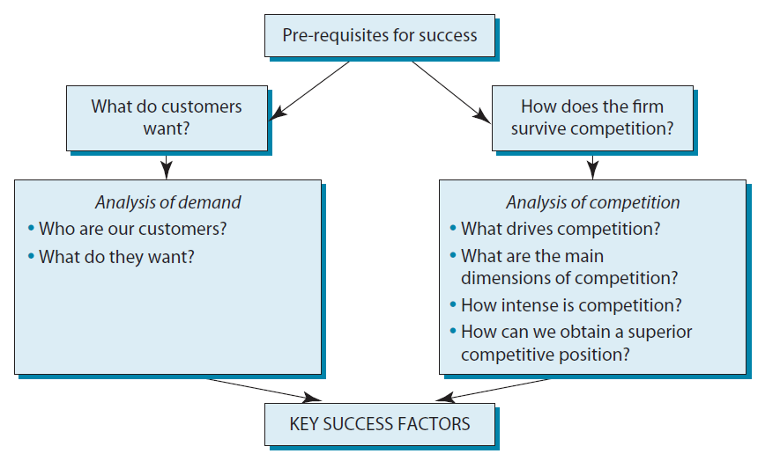
Identifying Key Success Factors
© 2013 Robert M. Grant
www.contemporarystrategyanalysis.com

Slide 20
Identifying Key Success Factors:
Steel, Fashion Clothing & Supermarkets
 | What do customers want? | How do firms survive competition? | Key success factors
Steel | Low price Product consistency Reliability of supply Specific technical specifications for special steels | Strong price competition and cyclical profitability necessitates cost efficiency and strong financial resources | Cost efficiency through: large-scale plants, low-cost location, speedy capacity adjustment Or hi-tech mini-mills can achieve low costs through flexibility and high productivity Quality and service differentiation
Fashion clothing | Demand segmented by garment type, style, quality, color Customers pay price premium for brand, style, exclusivity and quality | Intensely competitive due to low entry barriers, low seller concentration and strong retail buying power Differentiation can yield substantial price premium but imitation rapid | Combining differentiation with low-costs Key differentiation variables: design, speedy to fashion trends, brand reputation, quality Cost efficiency requires manufacture in low wage countries
Super-markets | Low prices Convenient location Wide range of products adapted to local preferences Freshness of produce, good service, pleasant ambience, easy parking | Market localized Intensity of price competition depends on number and proximity of competitors Bargaining power a critical determinant of cost of bought-in-goods | Low-cost operation requires operational efficiency, scale-efficient stores, strong buying power, low wage costs Differentiation requires wide product range (hence, large stores), convenient location, easy parking
© 2013 Robert M. Grant
www.contemporarystrategyanalysis.com

Slide 21
Identifying Key Success Factors Through Modelling Profitability: The Airline Industry
Profitability = Yield x Load factor – Unit cost
Income = Revenue x RSPMs - Expenses
ASMs RPMs ASMs ASMs
Strength of competition on routes
Responsiveness to challenging market conditions
% business travellers
Achieving differentiation advantage
Price competitiveness
Efficiency of route planning
Flexibility and responsiveness
Customer loyalty
Meeting customer requirements
Wage rates
Fuel efficiency of planes
Employee productivity
Load factors
Administrative overhead
ASM = Available Seat Miles RPM = Revenue Passenger Miles
© 2013 Robert M. Grant
www.contemporarystrategyanalysis.com

Slide 22
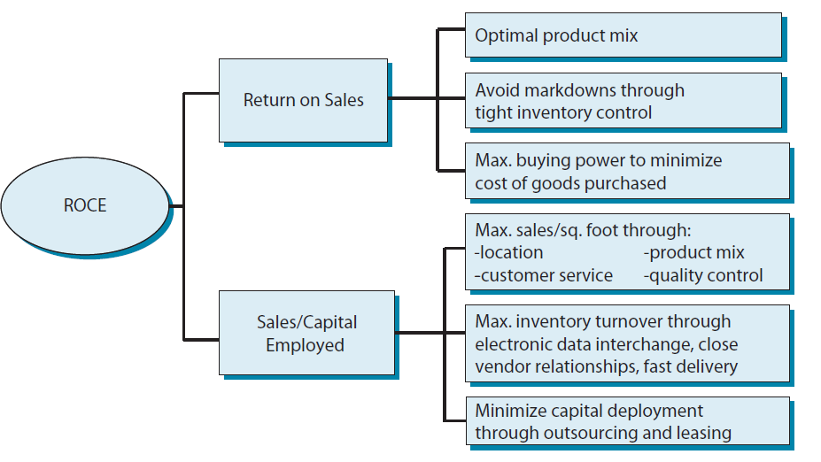
Identifying Key Success Factors by Analysing Profit Drivers: Retailing
© 2013 Robert M. Grant
www.contemporarystrategyanalysis.com

Slide 23
Summary
What Have We Learnt?
Forecasting Industry Profitability
Past profitability a poor indicator of future profitability
If we can forecast changes in industry structure we can predict likely impact on competition and profitability
Strategies to Improve Industry Profitability
What structural variables are depressing profitability?
Which can be changed by individual or collective strategies?
Defining Industry Boundaries
Key criterion: substitution
The need to analyze market competition at different levels of aggregation (depending on the issues being considered)
Key Success Factors
Starting point for the analysis of competitive advantage
© 2013 Robert M. Grant
www.contemporarystrategyanalysis.com

