Slide 1
Ergonomic Work Analysis (EWA) in the Nutrition and Dietetics Service (SND) of the University of São Paulo Hospital (HU-USP)
Andréa Geiger Neiva, Cláudio Marcelo Brunoro,
Profa Dra Uiara Bandineli Montedo, Prof. Dr Laerte Idal Sznelwar
Beijing, IEA 2009

Slide 2
Introduction
Demand analysis
Focus of the EWA: the Nutrition and Dietetics Service (SND), more specifically on the work developed by the team of kitchen helpers of this service.
2 processes: the assembly and distribution of meals to the patients housed in the University of São Paulo Hospital (HU-USP).
A reform was planned for the purpose of:
Modernizing the equipment used;
Improving the current processes;
Improving the use of the area available.
EWA’s objective: allow the HU-USP to take possession of its results and to carry out the design of the future equipment taking into account its recommendations.
Notes:
The Ergonomic Work Analysis (EWA) presented hereafter, conducted in the Nutrition and Dietetics Service (SND) of the University of São Paulo Hospital (HU-USP), was part of a broader technical cooperation project, carried-out between 2007 and 2008 by a team of researchers attached to the Industrial Engineering Department of the University of São Paulo Polytechnic School (EP), with the support of the Carlos Alberto Vanzolini Foundation (FCAV).
The EWA was focused on the Nutrition and Dietetics Service (SND), more specifically on the work developed by the team of kitchen helpers of this service. In general, the SND kitchen helpers work in two processes: the assembly and distribution of meals to the patients housed in the HU-USP.
The reason for choosing this focus was based on the fact that a reform was planned for the purpose of modernizing the equipment used, of improving the current processes and the use of the area available. The work analysis associated with this process, taken as ergonomic demand, will allow the HU-USP to take possession of its results and to carry out the design of the future equipment taking into account its recommendations.
Another reason for this focus was the high rate of absenteeism in this sector.

Slide 3
Population datas
Sex (%)
Masculine
(17%)
Age
71% of the population has 40 years old or more.
public institution, stability on the job
Feminine
(83%)
Graph 1: Population distribution by age group (%) in SND in 2006 (N=110).
Graph 2: Population distribution by sex group (%) in SND in 2006 (N=110).
Long employment duration
51% of the population has more than 20 years of experience.
- team stability collective knowledge and strategies
Absenteeism
Gravity of the situation in the Nutrition sector SND in comparison with HU-USP’s other sectors. SND’s employees take longer medical leaves than those of other sectors.
Notes:
Age
As we can see on graph 1, in 2006, 53% of the population was between 40 and 50 years old.
The 40 years and older group represents 71% of the population. One of the reasons for this is the fact that the HU-USP is a public institution, which means that there exists a certain stability on the job. For this reason, persons of higher age represent the largest part of the hospital’s workforce.
The younger part of the population, below 30 years of age, is small and represents only 4% of the total.
Sex
Out of the 110 employees of SND, 91 are women and only 19 are men. The women represent 83% of the workforce, which is almost 5 times the number of male employees.
Employment duration
Another important characteristic of this population is their long employment duration. The distribution of the employees in groups according to their employment duration is reasonably homogeneous, with the exception of those with more than 25 years in the service. However, only 14 employees, that is 13% of the total of employees, has been employed for less than 5 years. The group with more than 20 years of experience represents approximately 51% of the total.
This fact has a direct effect on the service work activity knowledge, giving stability to the team, which allows for the development of collective knowledges and strategies.
Based on the datas referring to age and employment duration, one can conclude that a large part of SND’s current workforce started working in the service when they were young and continued working until today. The part of new employees in the service is still relatively small. This can cause complications in the future once the older employees (and with longer employment durations) retire and take with them the knowledge accumulated along their years of experience without passing this knowledge to the new employees and without having had sufficient time to transmit this practical knowledge to the newcomers.
Absenteeism
The datas gathered during the project showed the gravity of the situation in the Nutrition sector. A large part of SND’s employees take longer medical leaves than those of other HU-USP’ sectors. Inadequate working conditions prevailing in the sector cause frequent and prolonged absences for health reasons which results in the sector undergoing productivity losses. Besides the loss of productivity, operating with a reduced team – due to the medical leaves and return to work – adds workload to the healthy employees, increasing the probability of additional medical leaves.

Slide 4
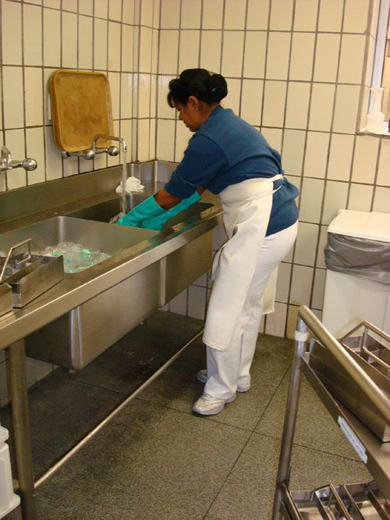
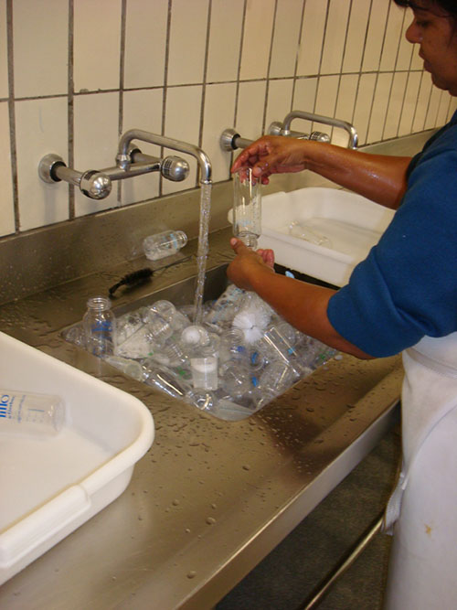
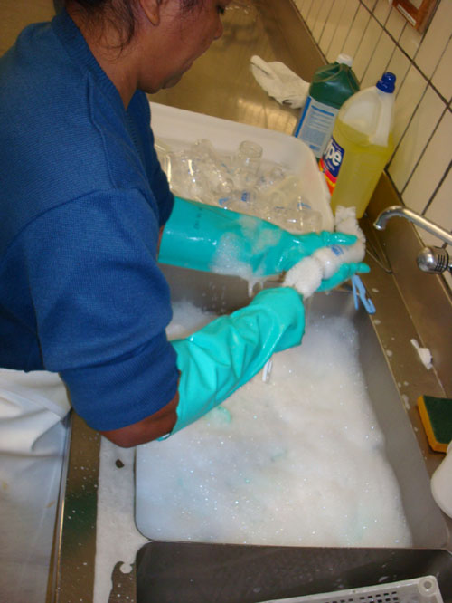
SND’s lactation center - hygienization
This process consists of 3 subsequent steps and repeats itself throughout the kitchen helper’s working day:
washing
soaking
rinsing
Notes:
For the 2009 International Ergonomics Association Congress, we decided to focus our presentation on the systematic observations carried-out in the process of baby-bottle washing of the SND’s lactation center.
This process consists of 3 subsequent steps and repeats itself throughout the kitchen helper’s working day.
On the first picture you can see the first step of the process, which we called the “soaking”. During this step, the kitchen helper takes out the baby bottles and their lids from their support one by one. Then, she detaches the nipples from the baby bottles and empties the bottles. She then rinses each item (on the sink on the right part of the picture) and leaves it soaking in a deep sink (on the left prat of the picture) which contains water mixed with a cleansing liquid.
On the second picture, we can see the second step of the process, which we called the “washing”. During this step, the kitchen helper takes each bottle out of the sink, scrubs it with a brush by making repetitive rotating wrist movements. At the end, the bottle is placed on a basin (on the left of the employee on the picture).
On the third picture, we can see the “rinsing”, which corresponds to the last step of the baby bottle washing process. In this step, the kitchen helper takes the basin (on the left of the picture) containing the washed bottles to a shallower sink. Then she places all the bottles in the sink and rinses them one by one, scrubbing further, if necessary. Afterwards she places the rinsed bottles in another basin (on the right of the picture).
The three steps of the baby bottle washing process take place in the same room.

Slide 5
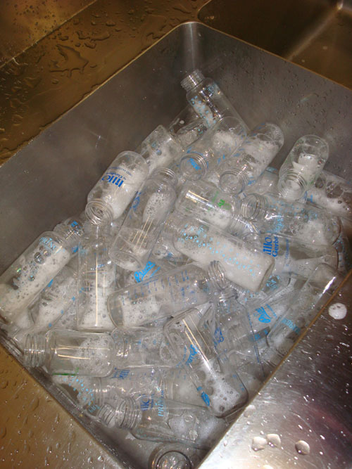
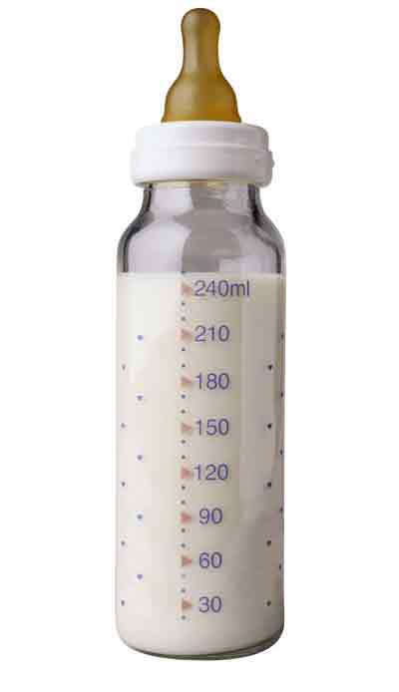
SND’s lactation center - production
3 shifts:
Morning 07:00 - 13:00
Afternoon 13:00 - 19:00
Night 19:00 - 07:00
In the SND’s lactation center hygienization process:
1 kitchen helper X 1 shift
In 2008, around 800 per day:
Morning shift: 200 - 300
Afternoon shift: 200 - 300
Night shift: 200 - 400
Notes:
The work organization in SND is characterized by a continuous work process: the sector operates 24 hours a day, 365 days a year. To ensure this service the employees work in three fixed shifts:
In the morning: from 7am to 1pm, 6 hour shift
In the afternoon: from 1pm to 7pm, 6 hour shift
At night: from 7pm to 7am, 12 hour shift with 36 hour breaks.
Only one employee work in the lactation center hygienization process per shift.
And around 800 baby bottles needs to be washed per day.
This means that during the morning and the afternoon shifts, one employee can wash from 200 to 300 baby bottles.
And during the night shift from 200 to 400 baby bottles.
These numbers may vary depending on the number of children present in the HU-USP at a given time and their feeding habits, which can differ between night and day.

Slide 6
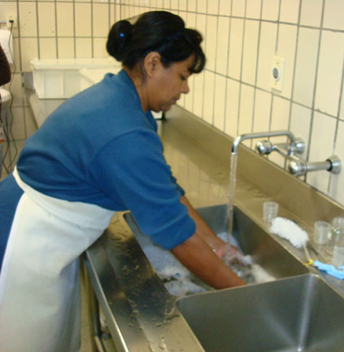
Method
The kitchen helpers’ work in the lactation center was filmed during the process of baby bottle soaking, washing and rising for 28 baby bottles.
Step 1 (soaking): 04:55 minutes
Step 2 (washing): 05:05 minutes
Step 3 (rising): 03:06 minutes
These sequences were analysed with Kronos 2.4 ® software developed by Alain Kerguelen with the support from ANACT.
Elements analyzed in the film sequences:
slightly inclined
Inclination of the spinal column
Handling / manual activity
Standing still / in displacement
very inclined
Notes:
For the systematic observation carried-out in the process of baby-bottle washing, the kitchen helpers’ work was filmed during the process of baby bottle soaking, washing and rising for 28 baby bottles.
The duration of the three sequences observed were 04:55, 05:05 and 03:06 minutes, corresponding to steps 1, 2 and 3.
These sequences were analysed with Kronos 2.4 software developed by Alain Kerguelen with the support from ANACT.
This software performs statistical analyses and graph plotting, allowing for a deeper understanding of the work activity under observation.
The kitchen helper’s work elements analyzed in the film sequences (called classes in the Kronos ® software) are the following:
The first element was the inclination of the spinal column: which correponded to the observation of the spinal column inclination during the work (upright, slightly inclined and very inclined).
As an example, here we have two pictures that show what we considered to be a slightly inclined position of the spinal column and a very inclined position. As we will se in the results, the employee stood in the first position most of the time of the whole process. The second position (the very inclined position) was not maintained for very long periods of time and occured mostly when the employee leaned to grab the baby bottles in the bottom of the sink.
The second element was the handling or manual activity: which correponded to the observation of the manual actions performed during the steps.
And the last element was the observation of the kitchen helper’s displacement, as well as the time during which she stood still.

Slide 7
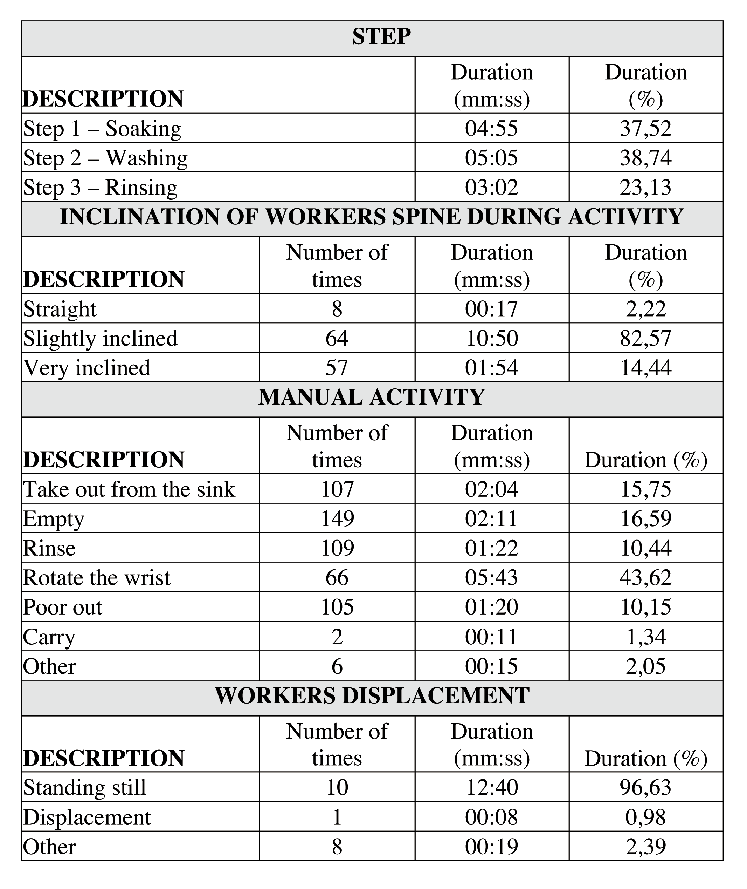
Results
The worker stays in the slightly inclined position for longer periods of time than in the very inclined position.
Indeed, the very inclined position occurs when the worker leans to grab the bottles lying at the bottom of the sink and, after this movement, returns to the slightly inclined position to perform the rest of the work (rinsing, scrubbing, etc.)
The person working in day shift and washing 200 bottles will perform the wrist rotating movement approximately 471 times during the 6 hours of her shift. Following the same reasoning, if she was to wash 300 bottles, she would perform 707 times the wrist rotating movement during her shift.
Notes:
This table presents the three steps combined, in a total of 13 minutes and 10 seconds of filmed sequence.
It allows to observe the time spent on each activity for each class: the inclination of the workers spine during activity, the manual activity and the workers displacement.
In this table we can see in more detail the diferent manual activities highlighted during the observations, corresponding to diferent movements:
Take the baby bottles out from the sink
Empty the baby bottles
Rinse
Rotate the wrist (corresponding to the moment when the employee uses the brush to wash the baby bottles)
Poor out
Carry (corresponding to carrying heavier objects than baby bottles, for example a basin full of baby bottles, or a detergent bottle)
Concerning the position of the spinal column, the slightly inclined position was observed during most of the time: 82.57% of the total time. The upright position was observed during only 2.22% of the total time. The time spent with the spinal column in the very inclined position is relatively short in comparison with the slightly inclined position (14.44% of the total time). However, if we consider the number of times that the kitchen helper finds herself in the very inclined position, we will notice that it is close to that of the slightly inclined position (57 times in the very inclined position versus 64 times in the slightly inclined position). This means that she stays in the slightly inclined position for longer periods of time than in the very inclined position. In reality, during practically the entire duration of the observations. Indeed, as said before, the very inclined position occurs when the helper leans to grab the bottles lying at the bottom of the sink and, after this movement, returns to the slightly inclined position to perform the rest of the work (rinsing, scrubbing, etc.)
Concerning the handling of the baby bottles, the major part of the time is taken by rotation movements, with 43.62% of the total time. This means that during all this time the helper performs rotation movements to open the bottles and scrub them. If we consider the three steps needed to wash the 28 bottles, the helper perfoms the wrist rotation movement 66 times. As 800 baby bottles are handled daily, the helper working in the lactation center in the morning shift and the one working in the afternoon shift may wash approximately up to 200 and 300 each per shift. The helper working in the night shift may wash approximately between 200 and 400 bottles per shift. We can therefore extrapolate that a helper working in day shift and washing 200 bottles will perform the wrist rotating movement approximately 471 times during the 6 hours of her shift. Following the same reasoning, if she was to wash 300 bottles, she would perform 707 times the wrist rotating movement during her shift.

Slide 8
Results
Step 2
Inclination of worker’s spine during activity: Slightly inclined
The percentage of time dedicated to wrist rotation movements increases, reaching 73.89% of the total time of this step (5.5 minutes). (43.62% of the total time for steps 1,2 and 3 together)
This increase is understandable as the scrubbing is an indispensable action of the bottle washing process, especially considering the shape of the bottle and the thread on which the nipple and lid are fastened on which dried milk may accumulate.
Manual activity:
wrist rotation
Worker’s
displacement:
Standing still
Notes:
This figure represents another way of showing results extracted from the software Kronos 2.4.
As the table shown earlier, this figure allows to observe the time spent on each activity for each class (represented by this dark line):
first the step (here we only consider step 2)
the inclination of the workers spine during activity (here we can see clearly that the slightly inclined position is maintained over longer periods of time than the very inclined position),
the manual activity (here we can see that more time is dedicated to wrist rotation movements during this step. In comparison to the table that considered the three steps together, here the percentage of time dedicated to wrist rotation movements increases, reaching 73.89% of the total time of this step (5.5 minutes) (43.62% of the total tima for steps 1,2 and 3 together). This increase is understandable as the scrubbing is an indispensable action of the bottle washing process, especially considering the shape of the bottle and the thread on which the nipple and lid are fastened on which dried milk may accumulate.
This way of showing the results is also interesting because it allows to see clearly the sequences of the diferent movements realized during this step. Concerning the manual activity, we can see clearly all of the movements realized for the washing of each baby bottle:
First take the baby bottle out from the sink, then wash it with the brush rotating the wrist andfinally put the baby bottle in the basin. This sequence repeats itself for the 28 baby bottles in only 5.5 minutes!
Finally on the bottom of this figure, we can see that during almost all of the time of this second step of the baby bottle washing process, the employee works standing up. Indeed, the majority of the washing work, including the three steps described above, is performed in front of the sink and requires this position.

Slide 9
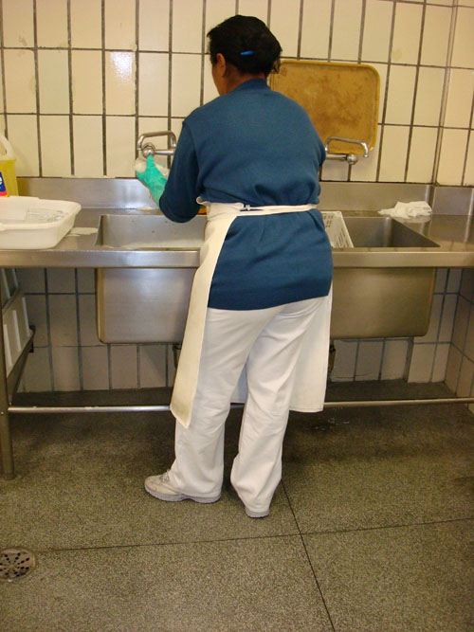
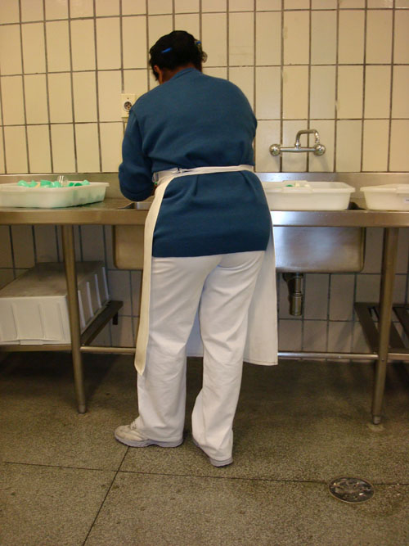
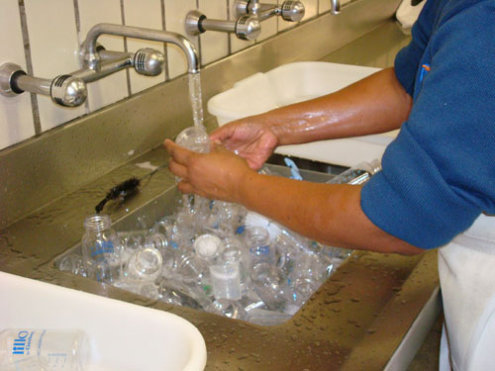
Discussion and recommendations for work change
30 cm
25 cm
35 cm
15 cm
1. washing sink (step 2)
2. rising sink (step 3)
3. Position of the rinsing sink and the faucet
4. Two brushes attached together to scrub the baby bottles
Notes:
Concerning the lactation center, considerations can be made based on the systematic observations. The first one is that the washing process could be performed in the seating position, provided the workplace had been conceived accordingly: as we can see on pictures 1, 2 and 3, in the present configuration there is no space under the sink to accommodate the worker’s legs and the depth of the sink combined with the position of the faucet require a constraining posture to perform the activity, with the torso leaning forward.
The sinks are too deep, which obliges the helpers to work constantly with their torso inclined or very inclined, each time they reach for the next bottle to be washed.
As we can see on picture 3, the position of the faucet is another problem to be solved as it contributes to the forward leaning position that the helpers must adopt while performing this activity.
The need for designing new utensils was also observed in the lactation center, for the purpose of minimizing the need for repeatedly rotating the wrist during the scrubbing of the bottles (example picture 4). A modification of the design of the bottles was suggested but discarded during validation, remaining the alternative of automating this operation, with the helpers performing a final check as they remove the bottles from the washing machine (in order to guarantee the quality of the process and prevent any problems that may result from a poorly washed bottle).
Another important question related to the lactation center concerns its location in relation to the other work spaces that are occupied in different ways depending on the shift (day or night) which causes the isolation of the worker working in the lactation center during the night shift. In the refurbishment project this question should be considered, in order to allow by means of a physical re-arrangement, for a visual contact between the helper occupied in the lactation center and the other helpers working in the same shift. The solutions must take into account the norms and rules specific to such areas within hospitals.

Slide 10
Conclusion
Illnesses, medical leaves and absenteeism
Related to the overload of the worker’s upper limbs.
The sector currently undergoes a loss of productivity
This situation imposes an overload on the workers that are still in good health.
Up-coming refurbishment of the SND facilities
An opportunity to re-think the work patterns.
A re-organization of the work activities.
Notes:
The results of the Ergonomic Work Analysis (EWA) carried out in the SND bring forward some questions that should be taken into account in the cooperation project as a whole. They are: illnesses and medical leaves, absenteeism, the place of work conditions in the projects of new facilities or in the refurbishment of existing facilities.
Concerning illnesses and medical leaves, it is clear that they are related to the overload of the worker’s upper limbs, caused mainly by the present working conditions, resulting in cases of WMSDs. Our understanding as ergonomists recognizes the need to treat illnesses but more importantly the need to change the conditions under which work is performed in order to prevent (or at least minimize) the risk of new cases of WMSDs.
Thanks to the analysis of the data gathered, it became clear that a large number of SND workers need to take medical leaves of greater duration than those of other sectors. This means that the sector currently undergoes a loss of productivity and that the present working conditions are causing workers to be withdrawn from their workplace for health related reasons. In addition, this situation imposes an overload on the workers that are still in good health, increasing the probability that additional medical leaves occur.
Besides the impact on the teams, this situation impacts the managers as well, who, due to the fact that their team is reduced and is impacted by the return of workers with function restrictions, must face difficulties in the establishment of work schedules.
Another important question is the up-coming refurbishment of the SND facilities which represents an opportunity to re-think the work patterns and to conceive the project taking into consideration the future work conditions. This project will allow for a re-organization of the work activities, resulting in a new physical arrangement and in the adoption of new equipments. This practice – integrating in both new-built and refurbishment projects the knowledge of the future work patterns – represents an excellent opportunity to put Conception Ergonomy in practice, which should provide us with better chances of improving the work conditions than with Correction Ergonomy.
To finalize, it is important to highlight that the SND EWA resulted in a clear indication of new opportunities for the pursuit of the cooperation between the HU-USP and the PRO/FCAV, as for example the research on utensils and equipment (especially the trolleys used in distribution) and, more broadly, the participation in the SND refurbishment project.

