Slide 1
Process Tracing I
KKV understand process tracing as the search for intervening variables that link an independent variable with a dependent variable.
They view uncovering these intervening steps as part of the more fundamental goal of estimating the causal effect (if any) of an independent variable of interest.
On the other hand, they suggest that process tracing is “unlikely to yield strong causal inference” and can only “promote descriptive generalizations and prepare the way for causal inference”.
Given these problems, their final conclusion is that process tracing is mainly a descriptive tool and an early step in causal analysis.
At the core of KKV’s advice is the admonition to expand the N of qualitative studies in order to achieve a determinate research design.
For KKV process tracing would be helpful if it expanded the number of observations.

Slide 2
Process Tracing II
Collier, Brady and Seawright (2006) use the label “data-set observation” (DSO) to refer to an “observation” in the normal statistical and KKV sense.
A DSO is equivalent to a row in a rectangular data set - that is, the scores for a given case on all measured variables. In mainstream statistical research, adding DSOs is a standard method for increasing degrees of freedom (or the potential inability to discriminate between competing explanations on the basis of the evidence).
By contrast, a “causal-process observation” (CPO) is “an insight or piece of data that provides information about context, process, or mechanism, and that contributes distinctive leverage in causal inference”.

Slide 3
Process Tracing III
The leverage gained for causal inference from CPOs is correspondingly distinct from though not incompatible with DSOs.
The information contained within a CPO reflects in-depth knowledge of one or more particular cases rather than data collected as part of a systematized array of variables.
Process tracing often generates non-comparable observations that cannot be assembled into a standardized rectangular data set but that are nonetheless extremely useful for causal inference.

Slide 4
Process Tracing IV
Process tracing involves the examination of ‘‘diagnostic’’ pieces of evidence within a case that contribute to supporting or overturning alternative explanatory hypotheses.
Process tracing is an analytic tool for drawing descriptive and causal inferences from diagnostic pieces of evidence - often understood as part of a temporal sequence of events or phenomena.
A central concern is with sequences and mechanisms in the unfolding of hypothesized causal processes.
The researcher looks for the observable implications of hypothesized explanations, often examining evidence at a finer level of detail or a lower level of analysis than that initially posited in the relevant theory.

Slide 5
Process Tracing V
Given the close engagement with cases and the centrality of fine-grained case knowledge, process tracing can make decisive contributions to diverse research objectives, including:
identifying novel political and social phenomena and systematically describing them;
evaluating prior explanatory hypotheses, discovering new hypotheses, and assessing these new causal claims;
gaining insight into causal mechanisms;
providing an alternative means - compared with conventional regression analysis and inference based on statistical models - of addressing challenging problems such as reciprocal causation, spuriousness, and selection bias.

Slide 6
Process Tracing VI
Description and sequence are important traits of process-tracing:
Description. Careful description is a foundation of process tracing. Process tracing inherently analyzes trajectories of change and causation, but the analysis fails if the phenomena observed at each step in this trajectory are not adequately described. Hence, what in a sense is “static” description is a crucial building block in analyzing the processes being studied.
Sequence. Process tracing gives close attention to sequences of independent, dependent, and intervening variables.

Slide 7
Process Tracing VII
Descriptive inference: as a tool of causal inference, process tracing focuses on the unfolding of events or situations over time.
Yet grasping this unfolding is impossible if one cannot adequately describe an event or situation at one point in time.
The descriptive component of process tracing begins not with observing change or sequence, but rather with taking good snapshots at a series of specific moments.
To characterize a process, one must be able to characterize key steps in the process, which in turn permits good analysis of change and sequence.

Slide 8
Process Tracing VIII
Equifinality: tracing the processes that may have led to an outcome helps narrow the list of potential causes. Yet even with close observation, it may be difficult to eliminate all potential rival explanations.
Process-tracing forces the investigator to take equifinality into account, that is, to consider the alternative paths through which the outcome could have occurred, and it offers the possibility of mapping out one or more potential outcomes.

Slide 9
Process Tracing IX
Detailed Narrative: The simplest variety of process-tracing takes the form of a detailed narrative or story presented in the form of a chronicle that purports to throw light on how an event came about.
Such a narrative is highly specific and makes no explicit use of theory or theory-related variables.
It may be supportable to some extent by explanatory hypotheses, but these remain tacit.
Historical chronicles are a familiar example of what is at best an implicit, atheoretical type of process-tracing.

Slide 10
Process Tracing X
The process-tracing technique must be adapted to the nature of the causal process thought to characterize the phenomenon being investigated.
Varieties of Process-Tracing:
The simplest form is linear causality, a straightforward, direct chain of events that characterizes simple phenomena.
In a more complex form of causality the outcome flows from the convergence of several conditions, independent variables, or causal chains.

Slide 11
Process Tracing XI
Bayesianism is the most developed logic in the context of process tracing. It uses evidence to affirm some explanations and cast doubt upon others.
It puts importance on the probative value of evidence relative to competing explanations, and on diverse or independent evidentiary tests, rather than on the number of pieces of evidence.
It also allows for the possibility that a few pieces or even one piece of evidence with high probative value can help observers, who approach a case with different theoretical priors, to converge in their views on the proper explanation of the case.
It warns against becoming 100% confident in any theory or explanation due to the limits on observational evidence and the possibility that undiscovered theories may yet prove superior to existing ones.
https://www.youtube.com/watch?v=BrK7X_XlGB8

Slide 12
Process Tracing XII
Process tracing usually proceeds through a combination of induction and deduction.
For phenomena on which there is little prior knowledge and for cases that are not well explained by extant theories, process tracing proceeds primarily through inductive study.
If theories that appear to offer potential explanations of a case already exist, or after such theories have been developed inductively, process tracing can proceed more deductively.

Slide 13
Process Tracing XIII
Stephen Van Evera (1997) tests:
Straw-in-the-wind tests provide weak or circumstantial evidence that is neither unique nor certain. Any one such test is not very decisive.
Hoop tests involve evidence that is certain, but not unique; failing a hoop test disqualifies an explanation, but passing it does not greatly increase confidence in that explanation. Hoop tests are thus most useful in excluding alternative hypotheses.
Van Evera’s example of a hoop test is: “Was the accused in the state on the day of the murder?” Failing this hoop test falsifies the hypothesis that the accused was the murderer. Whether passing a hoop test constitutes strong evidence in favor of a hypothesis depends on how frequently the condition occurs naturally. The higher the number of suspects that were in the state at the time of the murder, the less this hoop test increases the likelihood that any particular one of them is the murderer.

Slide 14
Process Tracing XIV
Smoking-gun tests are unique, but not certain. Passing a smoking-gun test strongly affirms an explanation, but passing such a test is not necessary to build confidence in an explanation.
In Van Evera’s example, a smoking gun in a suspect’s hands right after a murder strongly implicates that suspect, but the absence of such a smoking gun does not exonerate this suspect because murderers have incentives to hide smoking-gun evidence. Again, the strength of a smoking-gun test depends on how often the condition in question occurs on its own.
Doubly decisive tests use evidence that is both unique and certain, or that is necessary and sufficient to provide great confidence in an explanation.
Van Evera uses the example of a bank camera that catches the faces of bank robbers, thereby strongly implicating the guilty and exonerating the innocent.

Slide 15
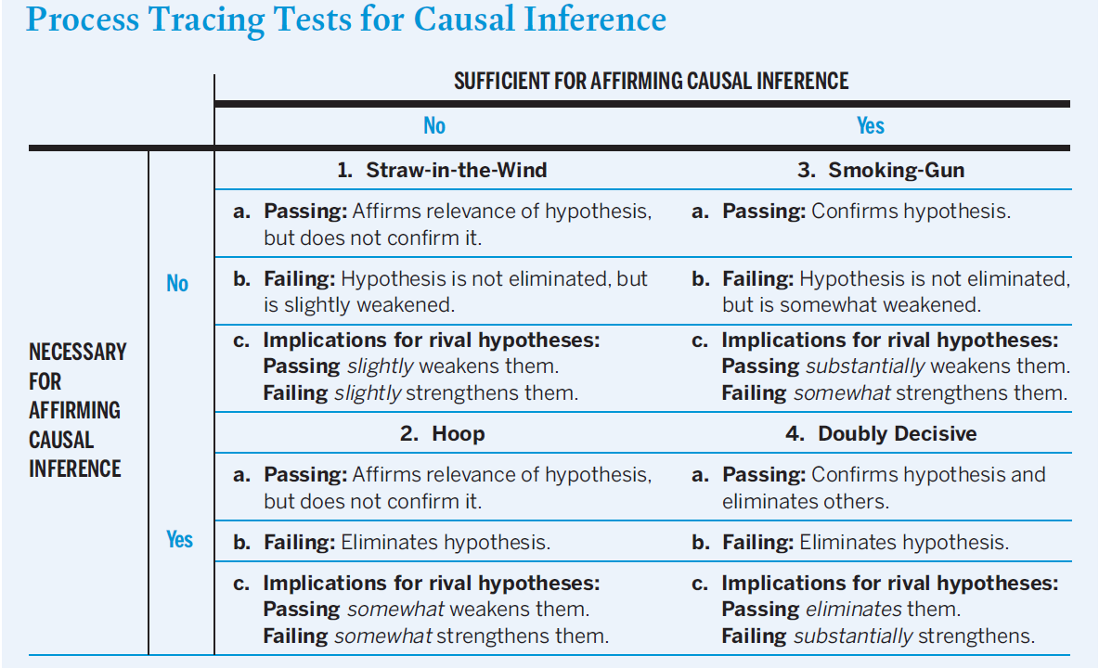
Process Tracing XVI

Slide 16
Process Tracing XV
Critics have raised two critiques of process tracing: the ‘‘infinite regress’’ problem and the ‘‘degrees of freedom’’ problem.

