Slide 1
HARMONIA II
Prof. Dr. Paulo de Tarso Camargo Cambraia Salles
2018

Slide 2
1. Modo________________
https://www.youtube.com/watch?v=g6DKf0WN3kA

Slide 3
2. Modo________________
https://www.youtube.com/watch?v=wiZJP_XLmrQ

Slide 4
3. Modo ________________
https://www.youtube.com/watch?v=Mpl86S5z9ic

Slide 5
4. Modo ________________
https://www.youtube.com/watch?v=ybrxCqbfVvQ

Slide 6
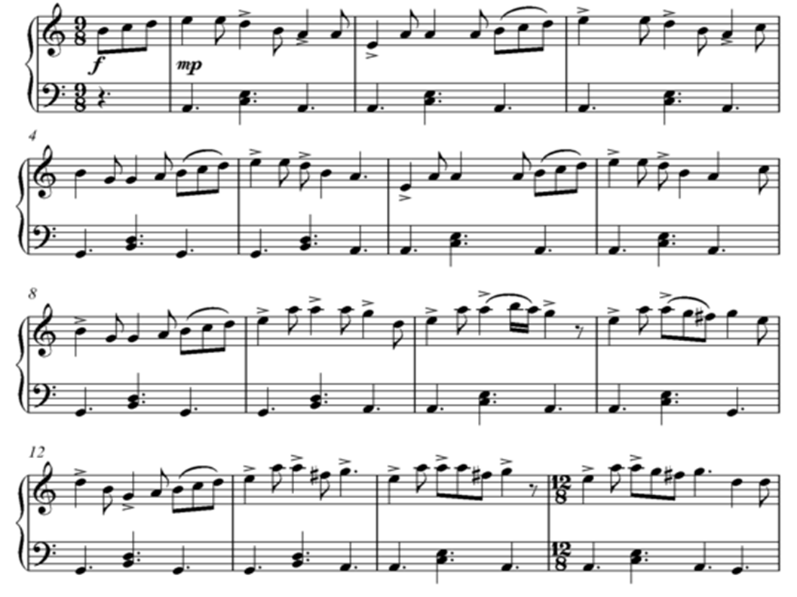
5. Modo ________________
https://www.youtube.com/watch?v=jxBKgOyMzSc

Slide 7
6. Modo ________________

Slide 8
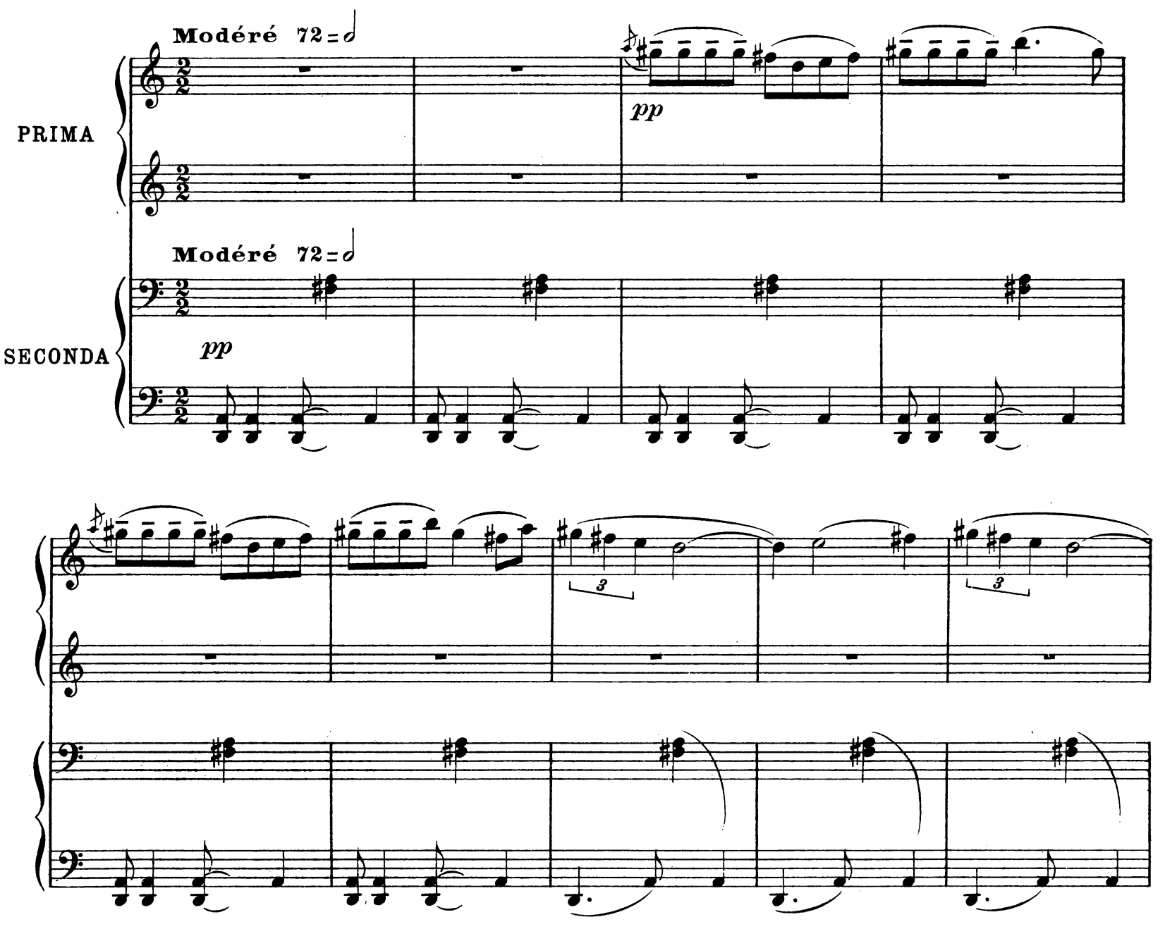
7. Modo ________________
https://www.youtube.com/watch?v=mtNqkYg0ZRo

