Slide 1
Scale and Innovation in Today’s Economy by Michael Mandel

Slide 2
Introduction (1)
Idea of the fact that scale is an advantage for innovation come from than more 60 years ago.
Shumpeter suggested that large-scale firms were « the most powerful engine of progress».
Bigger firms have more of an incentive to spend on innovation than a smaller one.
Campanie with more market power might also be more willing to invest in innovation.
After lot paper business and economist come with this conclusion : IT DEPEND!
Notes:
Campanie with 10M vs 10k is more willing to put big buck to develop its process and so on
Campanie who innove tend to becopied and not capitalize on it, but campanie with more power is more willing to hold his gain by continuing to improve it.
A small innovative campany will turn in a big scale campany who can dominate his market.

Slide 3
Introduction (2)
Link between scale and innovation depend of the economic environment.
Condition that can make scale a positive influence on innovation :
Today economic and growth are drive by large scale innovation ecosystems (Iphone, Android)
Globalization, a big domestic campany can be small in the world scale
U.S faces lot challenge in large scales integrated systems
Notes:
Drive by large scale campany who can make an ecosystem
For capitalize on innovation campanies have to have ressource to stand against foreign one

Slide 4
Scale and U.S. post-war technological dominance
The entrepreneurial model of innovation was a big source of new idea during the past 20 years.
But during post-war the biggest part of innovation come from big campanie.
Historically IBM and AT&T, in 1980 combined 3% of U.S. GDP.
AT&T produced 7 Nobel Prizes (transistor , Unix by Bell labs)
IBM was pioneered the the personal computer, relatoin data base
Without those firms it is very possible that the U.S. wouldn’t be the same. Because those firms invest a lot and was devoted t oresearch
In contrast there is only one Prize Nobel for a start up in 1909
Notes:
They were so powerfull that they had the ressource to hire all the best researchers scientists and engineers
One of the scientist that was at AT&T created the lazer and Unix
Development of wareless telegraph

Slide 5
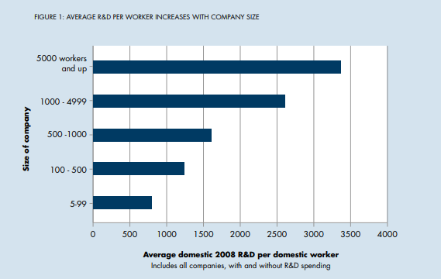
DATA
« Scale may be a plus in innovation in today’s economy, not a minus »
Is the fact to spend more in R&D make you more innovative?

Slide 6
Economic theoriy and research
Why bigger campanies devote more ressource to Innovation?
Innovation is an expensive time consumming process.
Innovation has invreasing returns to scale.
Shumpeterian hypothesis are contested:
« the incentive to invent is less under monopolistic than under competitive condition »Kenneth Arrow
They advance that large succesful firms were at disavantage in implement disruptive technologie
Notes:
For creating new product or to improve the quality of a product
For exemple telecom campanies : improving their quality
One with a large scale network will have more incentive to spend the money on developping and testing, because profit will be bigger

Slide 7
Scale, Innovation and Jobs
Small firm generate most of the jobs, which suggest that innovation at small firm is disproportionately important.
A study by Kauffman show that job growth is driven by the small pourcentage of fast growing class of small companies
Top 1% performing of firm generates roughtly 40% of all new jobs
Dane Strangler advance that :
this 1% high growth firms will become scale firm
They will add lot of jobs by purchasing youger campanies
Notes:
At the beginning the authors advance that innovation is the major source of new job

Slide 8
Scale, Innovation Ecosystems & Globalisation
Rise of Innovation Ecosystem
Area where a large core campany firm invest in key technologies which create a stable platform that imrove the innovation
Environment around apple
Environment around AT&T
The advantage of this environment is to be more able to handle risk and scale
In the global technologie economie
Talent, technologie, laws, dependance
Notes:
Less risky for star up, core campany can absorb new technologi that can they can scan them self
China tryed to impose a standard for data encription that favorize them

Slide 9
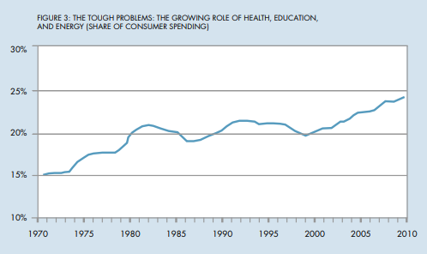
Fixing Large-scale Integrated Systems
The big issue in U.S. are delivered by large scale integrated system in some area.
Provider and implementer
Healthcare optimisation of process
Education
Energy
Notes:
In healthcare, education and energy

Slide 10
Government Policy and Scale
Succesful innovation ecosystems anchored by big campanies don’t look like conventional competitive market
“Antitrust cases that do not recognize this level of organization run the risk of ignoring and possibly damaging important collaborative, innovation-furthering public goods…. making the courts unwitting tools of narrow competitive interests and inadvertently impairing collective advances that might benefit the whole society.“ James moore
Regulator are used to think about US market but those campanies are global. And what is important is the scale relative to the global economie,n ot U.S. market

Slide 11
Conclusion
Small companies are important for jobs growth.
The scale of the « core » firm has the potential of maling the entire ecosystem
Investment still one key point for innovation.

