Slide 1
Chapter 9 Technology-Based Industries & the Management of Innovation
Prof. Luciano Thomé e Castro

Slide 2
© 2013 Robert M. Grant
www.contemporarystrategyanalysis.com

Slide 3
Technology-Based Industries & the Management of Innovation
OUTLINE
Competitive advantage in technology-intensive industries
Strategies to exploit innovation
Competing for standards
Implementing technology strategy
© 2013 Robert M. Grant
www.contemporarystrategyanalysis.com

Slide 4
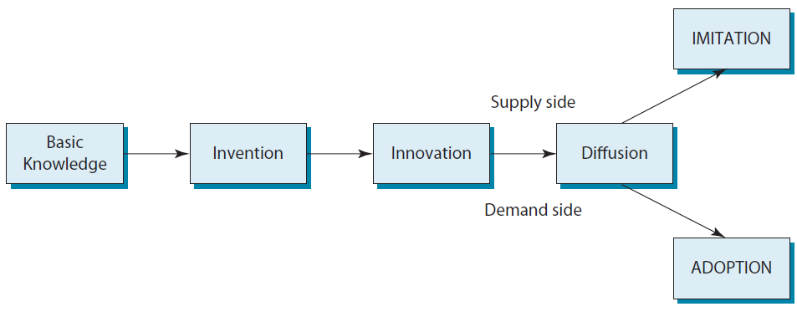
The Development of Technology: Knowledge Generation to Diffusion
© 2013 Robert M. Grant
www.contemporarystrategyanalysis.com

Slide 5
Compressing the Technology Cycle: Shorter Lags Between Knowledge Generation and Commercialization
 | Basic Knowledge | First Patents | Product Launch | Imitation
Jet Engines | 17th century Newtonian physics | 1930 | 1957 | 1959
Xerography | Late 19th, early 20th centuries | 1940 | 1958 | 1974
Fuzzy Logic Controllers | 1960s | 1981 | 1987 | 1988
Automobile Satellite Navigation | Late 1950s | Early 1960s | 1998 | 2002
MP3 Players | Early 1990s | 1994 | 1997 | 1999
© 2013 Robert M. Grant
www.contemporarystrategyanalysis.com

Slide 6
Appropriation of Value: How are the Benefits from Innovation Distributed?
Customers
Suppliers
Innovator
Imitators and other “followers”
© 2013 Robert M. Grant
www.contemporarystrategyanalysis.com

Slide 7
The Development of Technology: Knowledge Generation to Diffusion
Legal protection
Complementary Resources
Value of the Innovation
Profits from Innovation
Innovator’s ability to appropriate the value of the innovation
Imitability of the technology
Lead time
© 2013 Robert M. Grant
www.contemporarystrategyanalysis.com

Slide 8
Legal Protection of Intellectual Property
Patents – Exclusive rights to a new product process, substance or design
Copyrights – Exclusive rights to artistic, dramatic and musical works
Trademarks – Exclusive rights to words, symbols or other marks to distinguish goods and services; trademarks are registered with the Patent Office
Trade Secrets – Protection of chemical formulae, recipes and industrial processes
Also, private contracts between firms and between a firm and its employees can restrict the transfer of technology and know how
© 2013 Robert M. Grant
www.contemporarystrategyanalysis.com

Slide 9
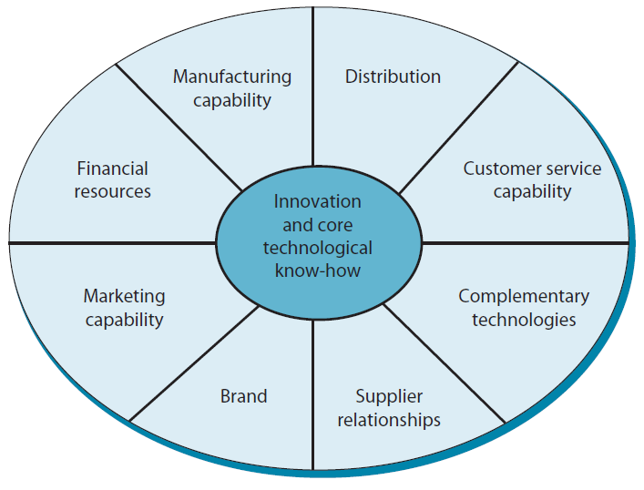
Complementary Resources
Bargaining power of owners of complementary resources depends upon whether complementary resources are generic or specialized.
© 2013 Robert M. Grant
www.contemporarystrategyanalysis.com

Slide 10
Lead-Time
If rivals can imitate – Time lag is the major advantage of the innovator
But maintaining lead-time advantage requires continuous innovation
Lead time is reinforced by learning effects
© 2013 Robert M. Grant
www.contemporarystrategyanalysis.com

Slide 11
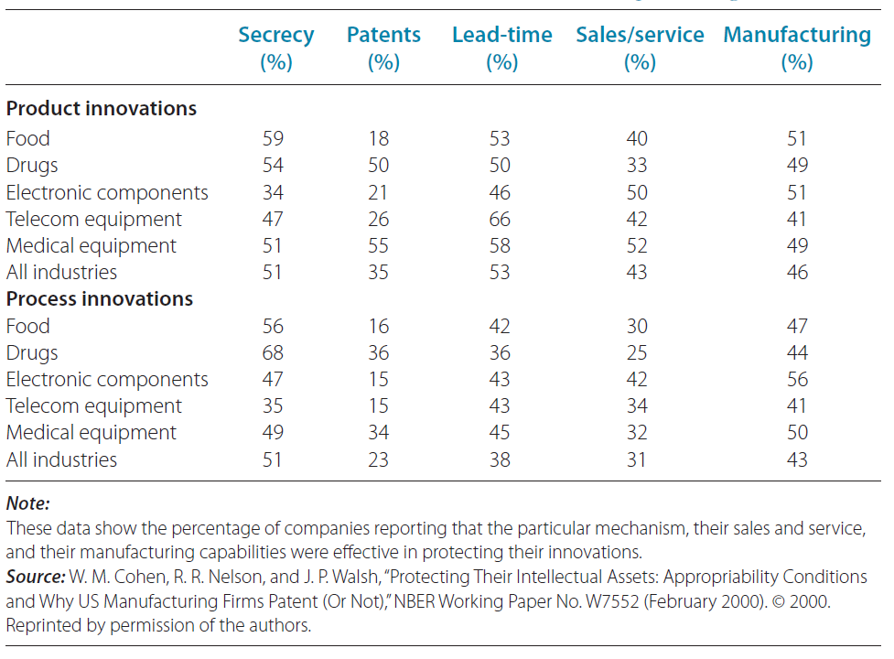
The Effectiveness of Different Mechanisms for Protecting Innovation
© 2013 Robert M. Grant
www.contemporarystrategyanalysis.com

Slide 12
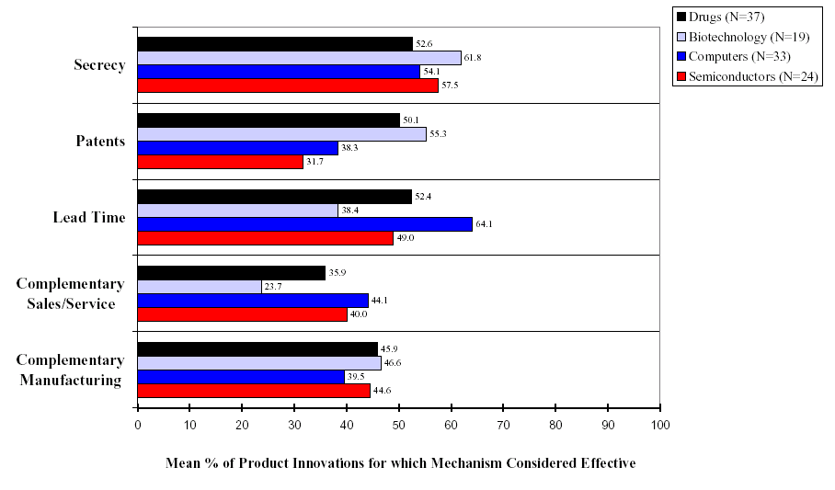
The Effectiveness of Different Mechanisms to Protect Innovation in Four Industries

Slide 13
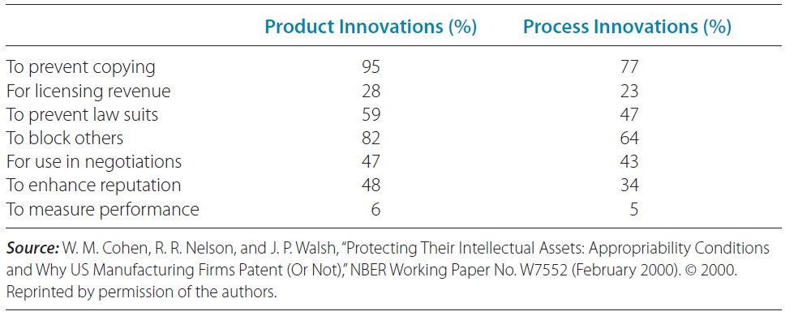
Why Do Firms Patent?
(Responses by 674 US Manufacturers)
© 2013 Robert M. Grant
www.contemporarystrategyanalysis.com

Slide 14
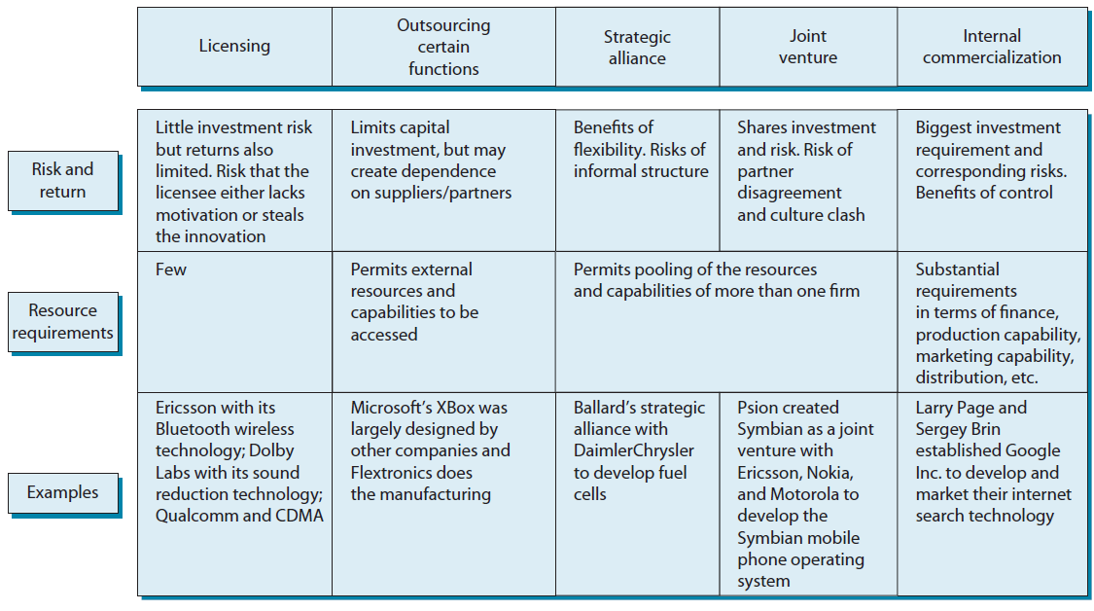
Alternative Strategies for Exploiting Innovation
© 2013 Robert M. Grant
www.contemporarystrategyanalysis.com

Slide 15
To Lead or to Follow?
Some Key Considerations
Can the innovation be protected by intellectual property rights or lead-times advantages
If so, advantages in leadership?
Followers can avoid investing in complementary resources by using better-established industry infrastructure
Firms possessing complementary resources have the luxury of waiting
How important are complementary resources
How important are complementary resources
If so, advantages in leadership?
© 2013 Robert M. Grant
www.contemporarystrategyanalysis.com

Slide 16
Uncertainty and Risk Management in Tech-Based Industries
Technological
uncertainty
Selection process for standards and
dominant designs emerge is complex
and difficult to predict, e.g. future of 3G
Sources of
uncertainty
Market
uncertainty
Customer acceptance and adoption rates
of innovations notoriously difficult to
predict, e.g. PC, Xerox copier, Walkman
Cooperating with lead users
early identification of customer requirements
assistance in new product development
SStrategies for
managing risk
Limiting risk exposure
Avoid major capital commitments
(e.g. lease don’t buy)
Outsource
Alliances to access other firms’
resources & capabilities
Keep debt low
Flexibility
Keep options open
Use speed of response to
adapt quickly to new
information
Learn from mistakes
© 2013 Robert M. Grant
www.contemporarystrategyanalysis.com

Slide 17
The Emergence of Standards
Emergence of a dominant design paradigm
Model T in autos
IBM 360 in mainframes
Douglas DC3 in passenger aircraft
Emergence of technical standards
Emerge in industries where they are network extremities
Entrenchment of the dominant designs and technical standards
Learning effects: Incremental improvement of the dominant design
Switching costs
Need for coordinated action by multiple players
© 2013 Robert M. Grant
www.contemporarystrategyanalysis.com

Slide 18
Sources of Network Externalities
User linkages, e.g.:
Telephone systems – Only value of telephone is connection to other users
Online auction – Value of auction depends on number of buyers and sellers participating
Smartphones – Same platform with the biggest user base (currently Android) attracts the most applications
Also social identification – The desire to conform encourages us to listen to the same music, watch the same TV shows and wear the same clothes as those with whom we identify
Availability of complementary products, e.g.:
Most PC applications software Written for Windows, not Mac
In economy autos, easier to get parts and repair for a Ford Focus or Honda Accord than a Kia, Proton or Lamborghini
Economizing on switching costs, e.g.
Office software (Microsoft Office vs. Lotus SmartSuite)

Slide 19
Companies that Own Technical Standards
Company | Product Category | Standard
Microsoft | PC operating systems | Windows
Intel | PC microprocessors | X86 series
Sony/Philips | Compact disks | CD-ROM format
ARM (Holdings) | Microprocessors for mobile devices | ARM architecture
Oracle Corporation | Programming language for web apps | Java
Rockwell & 3Com | 56K modems | V90
Qualcomm | Digital cellular wireless communication | CDMA
Adobe Systems | Common file formats for creating and viewing documents | Acrobat Portable Document Format
Adobe Systems | Web page animation | Adobe Flash
Adobe Systems | Page description language for document printing | PostScript
Bosch | Antilock braking system | ABS & TCS (Traction Control System)
IMAX Corporation | Motion picture filming/projection system | IMAX
Apple | Music downloading system | iTunes/iPod
Sony | High definition DVD | Blu-ray
NTT DoCoMo | Mobile phone payment system in Japan | Osaifu-Keitai
© 2013 Robert M. Grant
www.contemporarystrategyanalysis.com

Slide 20
Sources of Network Externalities
Video Cassette Recorders
Maximize market acceptance
VHS
Betamax
Maximize
value
appropriation
LOOSE
TIGHT
IBM-PC
Apple
Mac
Personal Computers
© 2013 Robert M. Grant
www.contemporarystrategyanalysis.com

Slide 21
Fighting Standards War
Determine the potential for standards emergence – Analyze network extremities
Assemble allies – Enlist partners (customers, complementors, competitors) to build a bandwagon
Pre-empt the market – Build user base quickly: enter early, attract key customers, adopt penetration marketing
Manage expectations – Use launch and pre-launch publicity and promotion to convince the market that you will be the winner
© 2013 Robert M. Grant
www.contemporarystrategyanalysis.com

Slide 22
Fighting Standards War
How can the winner sustain the standard?
Don’t fall behind on technology
Ensure backward compatibility
Meet the treat of disruptive technology by offering customers a migration path
Reinforce standard with other resources – e.g. brand
What if you’re a loser?
Ensure compatibility
Go for niche
© 2013 Robert M. Grant
www.contemporarystrategyanalysis.com

Slide 23
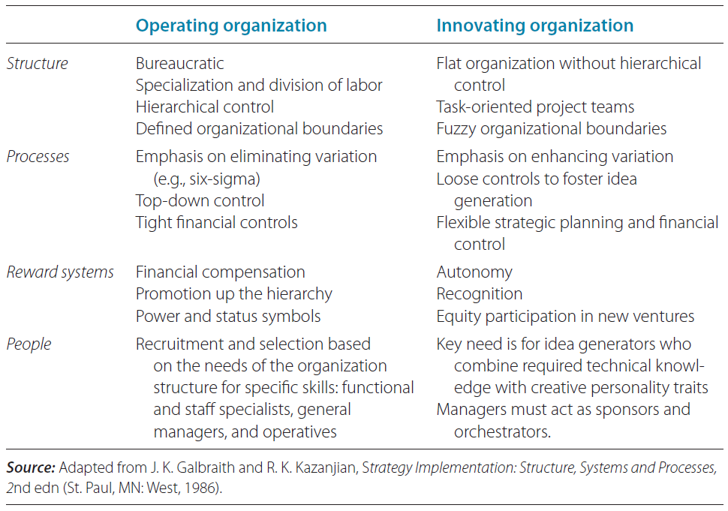
The Characteristics of “Operations” & “Innovating” Organizations
© 2013 Robert M. Grant
www.contemporarystrategyanalysis.com

Slide 24
Organizational Initiatives to
Stimulate Innovation
Cross-functional new product development teams—highly effective in integrating with specialized functional knowledge
Product champions - Provide the direction and motivation needed to link invention with commercialization, drive integration, and counteract organizational inertia
Buying innovation — If start-ups are best at initiating innovation and established companies are rich in complementary resources — Innovation most effective where the latter acquire the former
Open innovation — The sharing of ideas and technical know-how among firms
Corporate incubators — Specialized business development units within established firms
© 2013 Robert M. Grant
www.contemporarystrategyanalysis.com

