Slide 1
The Heckscher-ohlin model – Part II
Econ 490
International Economics
UIUC, Fall 2019
Mauro Rodrigues

Slide 2
Rybczynski effect Changes in factor endowments
What happens when the stock of capital or labor of a country increases?
Migration or capital flows
Keeping fixed output prices $P_{1}$and $P_{2}$
This is unlikely, unless a country is infinitely small
Output changes, which affects world prices
Result is nonetheless useful
Compare the industrial structure of countries with different factor endowments
…when faced with the same prices (because they are trading with each other)

Slide 3
Rybczynski effect Changes in factor endowments
Suppose a country facing output prices $P_{1}$and $P_{2}$
Produces both goods (conditions for this soon)
Factor prices (w and r) depend only on $P_{1}$and $P_{2}$ and on the technologies $F_{1}$and $F_{2}$ (see Lerner diagram)
They define the position of unit-value isoquants
Changes in $\overline{K}$ and $\overline{L}$, keeping prices and technologies fixed, will not affect w and r
As long as both goods continue to be produced
Therefore, capital-labor ratios remain constant

Slide 4
Figure 1
The Lerner Diagram
$$k_{2}$$
$$K$$
$$1/r$$
Sector 2
(capital intensive)
$$F_{2}\left(K_{2},L_{2}\right)=1/P_{2}$$
$$k_{1}$$
Sector 1
(labor intensive)
$$F_{1}\left(K_{1},L_{1}\right)=1/P_{1}$$
$$L$$
$$1/w$$
$$wL+rK=1$$

Slide 5
Rybczynski effect Changes in factor endowments
Then $a_{L1},a_{K1},a_{L2},a_{K2}$ will not be affected:
Amounts of capital and labor used to produce each unit of a given good ($i=1,2$)
$$L_{i}=a_{Li}Q_{i}$$
$$K_{i}=a_{Ki}Q_{i}$$
Use equilibrium condition in labor and capital markets:
$$L_{1}+L_{2}=\overline{L}$$
$$K_{1}+K_{2}=\overline{K}$$
Or:
$${a_{L1}Q}_{1}+a_{L2}Q_{2}=\overline{L}$$
$${a_{K1}Q}_{1}+a_{K2}Q_{2}=\overline{K}$$

Slide 6
Rybczynski effect Changes in factor endowments
Two equations, two unknowns: find $Q_{1}$and $Q_{2}$as functions of $\overline{K}$ and $\overline{L}$
Rewriting:
$$\left[\begin{matrix}a_{L1} \\ a_{K1}\end{matrix}\right]Q_{1}+\left[\begin{matrix}a_{L2} \\ a_{K2}\end{matrix}\right]Q_{2}=\left[\begin{matrix}\overline{L} \\ \overline{K}\end{matrix}\right]$$

Slide 7
Figure 2
Isoquants for both sectors
$$K$$
Sector 2
(capital intensive)
$$k_{2}$$
Sector 1
(labor intensive)
($a_{L2},a_{K2})$
$$k_{1}$$
$$F_{2}\left(K_{2},L_{2}\right)=1$$
Slope = w/r
($a_{L1},a_{K1})$
$$F_{1}\left(K_{1},L_{1}\right)=1$$
$$L$$

Slide 8
Figure 3
Finding production of both goods
$$\left[\begin{matrix}a_{L1} \\ a_{K1}\end{matrix}\right]Q_{1}+\left[\begin{matrix}a_{L2} \\ a_{K2}\end{matrix}\right]Q_{2}=\left[\begin{matrix}\overline{L} \\ \overline{K}\end{matrix}\right]$$
$$K$$
Sector 2
(capital intensive)
$$k_{2}$$
($\overline{L},\overline{K})$
Sector 1
(labor intensive)
($a_{L2},a_{K2})$
$$k_{1}$$
$$Q_{2}×(a_{L2}, a_{K2})$$
$$Q_{1}×(a_{L1}, a_{K1})$$
($a_{L1},a_{K1})$
$$L$$

Slide 9
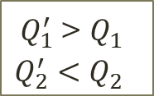
Figure 4
Increase in the labor endowment
$$\left[\begin{matrix}a_{L1} \\ a_{K1}\end{matrix}\right]Q_{1}+\left[\begin{matrix}a_{L2} \\ a_{K2}\end{matrix}\right]Q_{2}=\left[\begin{matrix}\overline{L} \\ \overline{K}\end{matrix}\right]$$
$$K$$
Sector 2
(capital intensive)
$$k_{2}$$
($\overline{L},\overline{K})$
Sector 1
(labor intensive)
($\overline{L}′,\overline{K})$
($a_{L2},a_{K2})$
$$k_{1}$$
$$Q_{1}^{′} ×(a_{L1}, a_{K1})$$
$Q_{1}^{′}$> $Q_{1}^{}$
$Q_{2}^{′}<$ $Q_{2}^{}$
$$Q_{2}×(a_{L2}, a_{K2})$$
$$Q_{1}×(a_{L1}, a_{K1})$$
$$Q_{2}^{′}×(a_{L2}, a_{K2})$$
($a_{L1},a_{K1})$
$$L$$

Slide 10
Rybczynski effect Increase in labor endowment
Sector 1 (labor intensive) expands
Gets all extra labor and some capital and labor from sector 2
Sector 2 (capital intensive) shrinks
Capital-labor ratios and factor prices remain constant
Possible because sector 1 becomes bigger

Slide 11
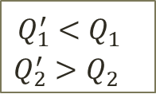
Figure 5
Increase in capital endowment
$$\left[\begin{matrix}a_{L1} \\ a_{K1}\end{matrix}\right]Q_{1}+\left[\begin{matrix}a_{L2} \\ a_{K2}\end{matrix}\right]Q_{2}=\left[\begin{matrix}\overline{L} \\ \overline{K}\end{matrix}\right]$$
$$K$$
Sector 2
(capital intensive)
$$k_{2}$$
($\overline{L},\overline{K}′)$
($\overline{L},\overline{K})$
Sector 1
(labor intensive)
($a_{L2},a_{K2})$
$$Q_{2}^{′}×(a_{L2}, a_{K2})$$
$$k_{1}$$
$Q_{1}^{′}<$ $Q_{1}^{}$
$$Q_{2}^{′}>Q_{2}^{}$$
$$Q_{2}×(a_{L2}, a_{K2})$$
$$Q_{1}^{′} ×(a_{L1}, a_{K1})$$
$$Q_{1}×(a_{L1}, a_{K1})$$
($a_{L1},a_{K1})$
$$L$$

Slide 12
Rybczynski effect Increase in capital endowment
Sector 2 (capital intensive) expands
Gets all extra capital and some capital and labor from sector 2
Sector 1 (capital intensive) shrinks
Capital-labor ratios and factor prices remain constant
Possible because sector 2 becomes bigger

Slide 13
The Rybczynski theorem Summarizing
KEY RESULT
An increase in endowment of a factor results in an increase in the output of the sector that uses this factor intensively and a reduction in the output of the other sector

Slide 14
The Rybczynski theorem Preview of key result
If we look at two countries – Home and Foreign
Facing the same prices (for instance, because they are trading)
But they are different in terms of factor endowments:
$$\frac{\overline{K} }{\overline{L}}>\frac{{\overline{K}}^{∗}}{{\overline{L}}^{∗}}$$
Then Home will produce relatively more of good 2, and Foreign will produce relatively more of good 1:
$$\frac{Q_{1} }{Q_{2}}<\frac{Q_{1}^{∗} }{Q_{2}^{∗}}$$
If preferences are homogeneous:
Home (capital abundant country) will export good 2 (capital intensive good)
Foreign (labor abundant country) will export good 1 (labor intensive good)

Slide 15
Rybczynski effect Cone of diversification
Increasing the supply of capital leads to expansion of sector 2 and contraction of sector 1
Capital and labor flow from sector 1 to sector 2
If the increase is sufficiently large, sector 1 shuts down (see next slide)
Start at point A and increase $\overline{K}$
Point B and beyond: all capital and labor are in sector 2
The opposite happens when we reduce $\overline{K}$
Point C and beyond: sector 2 shuts down; all capital and labor are in sector 1
Similarly for $\overline{L}$:
If labor endowment is too high (point D and beyond), country produces only good 1
If labor endowment is too low (point E and beyond), country produces only good 2

Slide 16
Figure 6
Further changes in factor endowments
$$\left[\begin{matrix}a_{L1} \\ a_{K1}\end{matrix}\right]Q_{1}+\left[\begin{matrix}a_{L2} \\ a_{K2}\end{matrix}\right]Q_{2}=\left[\begin{matrix}\overline{L} \\ \overline{K}\end{matrix}\right]$$
$$K$$
Sector 2
(capital intensive)
$$k_{2}$$
B
Sector 1
(labor intensive)
($a_{L2},a_{K2})$
$$k_{1}$$
E
A
($\overline{L},\overline{K})$
D
($a_{L1},a_{K1})$
C
$$L$$

Slide 17
Rybczynski effect Cone of diversification
Therefore, if factor endowments are not too high or too low, country will produce both goods
Endowment points fall in the region known as Diversification Cone, in the figure
We will focus on situations like these
If $\overline{K}/\overline{L}$ is too low, country produces only good 1 (labor intensive)
If $\overline{K}/\overline{L}$ is too high, country produces only good 2 (labor intensive)

Slide 18
Figure 7
The diversification cone
$$\left[\begin{matrix}a_{L1} \\ a_{K1}\end{matrix}\right]Q_{1}+\left[\begin{matrix}a_{L2} \\ a_{K2}\end{matrix}\right]Q_{2}=\left[\begin{matrix}\overline{L} \\ \overline{K}\end{matrix}\right]$$
$$K$$
Sector 2
(capital intensive)
Country produces only good 2
$$k_{2}$$
Country produces both goods
Sector 1
(labor intensive)
($a_{L2},a_{K2})$
$$k_{1}$$
DIVERSIFICATION CONE
($a_{L1},a_{K1})$
Country produces only good 1
$$L$$

Slide 19
Production possibilities frontier Main idea
The Production Possibilities Frontier describes efficient combinations of $Q_{1}$and $Q_{2}$:
For a given quantity $Q_{1}$, what is the best way to distribute factors across sectors?
Choose the distribution of capital and labor across sectors, so as maximize $Q_{2}$, given $Q_{1}$
As we vary $Q_{1}$, we obtain different efficient levels of $Q_{2}$, which are described by the PPF
Given technological differences across sectors, PPF is concave
Sector 1 – Labor intensive
Sector 2 – capital intensive

Slide 20
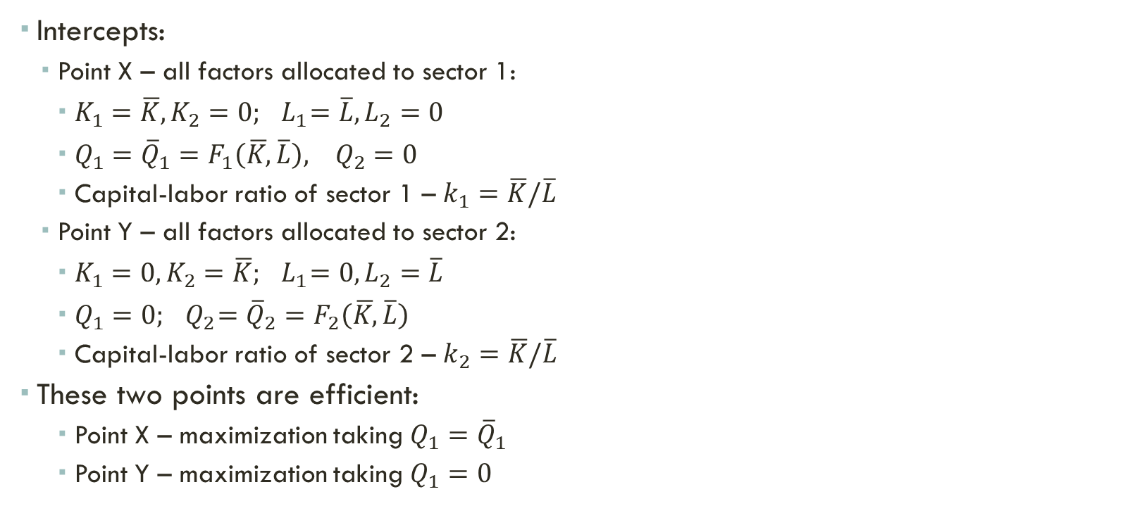
Production possibilities frontier Main idea
Intercepts:
Point X – all factors allocated to sector 1:
$K_{1}=\overline{K},K_{2}=0;{ L}_{1}=\overline{L},L_{2}=0$
${Q_{1}={\overline{Q}}_{1}=F_{1}\left(\overline{K,}\overline{L}\right), Q}_{2}=0$
Capital-labor ratio of sector 1 – $k_{1}=\overline{K}/\overline{L}$
Point Y – all factors allocated to sector 2:
$K_{1}=0,K_{2}=\overline{K};{ L}_{1}=0,L_{2}=\overline{L}$
$Q_{1}=0;{ Q}_{2}={\overline{Q}}_{2}=F_{2}\left(\overline{K,}\overline{L}\right)$
Capital-labor ratio of sector 2 – $k_{2}=\overline{K}/\overline{L}$
These two points are efficient:
Point X – maximization taking $Q_{1}={\overline{Q}}_{1}$
Point Y – maximization taking $Q_{1}=0$

Slide 21
Production possibilities frontier Main idea
Starting at point X, let’s implement the following redistribution of factors across sectors:
Take ½ of capital and labor of sector 1 and give to sector 2
Because of constant returns to scale, output of sector 1 falls by ½
Point Z:
$K_{1}^{Z}=K_{2}^{Z}=.5\overline{K};{ L}_{1}^{Z}=L_{2}^{Z}=.5\overline{L}$
$Q_{1}^{Z}=\frac{1}{2}{\overline{Q}}_{1}$
$k_{1}^{Z}=k_{2}^{Z}=\frac{.5\overline{K}}{.5\overline{L} }$

Slide 22
Production possibilities frontier Main idea
Therefore, at point Z, both sectors have the same capital-labor ratio
This is not efficient, since technologies are different
A different redistribution (w/ relatively more labor to sector 1 and more capital to sector 1) could potentially increase output of both sectors
In other words, point Z is not efficient = FPP lies above it
The same argument can be applied for other points along the red line:
Other (inefficient) redistributions with same capital-labor across sectors

Slide 23
Figure 8
Production Possibilities Frontier
$$Q_{2}$$
Y
$${\overline{Q}}_{2}=F_{2}\left(\overline{K,}\overline{L}\right)$$
$${\overline{Q}}_{2}/2$$
Z
X
$$Q_{1}$$
$${\overline{Q}}_{1}/2$$
$${\overline{Q}}_{1}=F_{1}\left(\overline{K,}\overline{L}\right)$$

Slide 24
Production possibilities frontier Slope
Slope of PPF:
Move factors (efficiently) from sector 2 to sector 1
How much output of good 2 one has to give up in order to increase output of sector 1 by one unit?
$$−\frac{ⅆQ_{2}}{ⅆQ_{1}}=\frac{MPK_{2}}{MPK_{1}}=\frac{MPL_{2}}{MPL_{1}}$$
Loss from moving capital has to be equal to the loss from moving labor
Otherwise we could find a different distribution of capital and labor

Slide 25
Production possibilities frontier Firms
PPF shows possible efficient allocations of capital and labor across sectors
Where will production take place?
Depends on firms’ decisions, that are affected by prices
Firms in both sectors choose amounts of capital and labor to maximize profits, taking prices of goods ($P_{1}$and $P_{2}$) and factors ($w$ and $r$) as given
Problem of a firm in sector $i=1,2$:
$$\max_{L_{i},K_{i}}\left\{{π_{i}=P}_{i}F_{i}\left(K_{i},L_{i}\right)−wL_{i}−rK_{i}\right\}$$

Slide 26
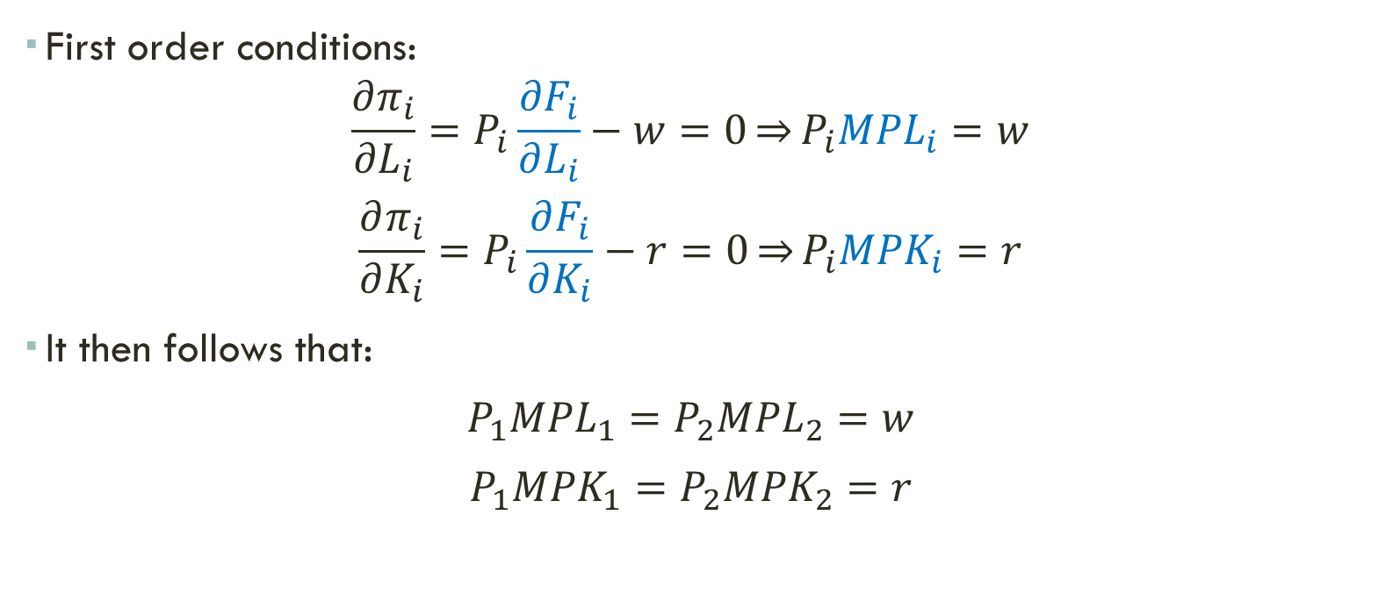
Production possibilities frontier Firms
First order conditions:
$$\frac{∂π_{i}}{∂L_{i}}=P_{i}\frac{∂F_{i}}{∂L_{i}}−w=0\underset{⇒}{}P_{i}{MPL}_{i}=w$$
$$\frac{∂π_{i}}{∂K_{i}}=P_{i}\frac{∂F_{i}}{∂K_{i}}−r=0\underset{⇒}{}P_{i}{MPK}_{i}=r$$
It then follows that:
$$P_{1}{MPL}_{1}=P_{2}{MPL}_{2}=w$$
$$P_{1}{MPK}_{1}=P_{2}{MPK}_{2}=r$$

Slide 27
Production possibilities frontier Firms
Therefore:
$$\frac{P_{1}}{P_{2}}=\frac{{MPL}_{2}}{{MPL}_{1}}=\frac{{MPK}_{2}}{{MPK}_{1}}=slope of PPF$$
Production will take place in the point where the slope of the FPP is equal to the relative price of good 1

Slide 28
Figure 9
Determining the production point
$$Q_{2}$$
A
$$Q_{2}^{A}$$
slope = $P_{1}/P_{2}$
$$Q_{1}$$
$$Q_{1}^{A}$$

Slide 29
Figure 10
Changing the relative price of good 1
$$Q_{2}$$
slope = ${{(P}_{1}/P_{2}\text{)}}^{′}$
$${{(P}_{1}/P_{2}\text{)}}^{′}>P_{1}/P_{2}$$
Increase in the relative price of good 1
Sector 1 expands
Sector 2 shrinks
A
$$Q_{2}^{A}$$
slope = $P_{1}/P_{2}$
$$Q_{2}^{B}$$
B
$$Q_{1}$$
$$Q_{1}^{A}$$
$$Q_{1}^{B}$$

Slide 30
Production possibilities frontier Changes in factor endowments
Consider now an increase in the supply of labor $\overline{L}$ – everything else constant, including the relative price
This leads to an outward shift in the PPF
But this shift is biased towards sector 1 (labor intensive)
Rybczynski Theorem: for a given relative price, increase in the supply of labor leads to an expansion of sector 1 and contraction of sector 2
Analogously, if we increase the supply of labor $\overline{K}$ – everything else constant
Outward shift in the FPP, biased towards sector 2 (capital intensive)
Sector 2 expands, sector 1 shrinks

Slide 31
Figure 11
Increasing the supply of labor
$$Q_{2}$$
A
$$Q_{2}^{A}$$
B
$$Q_{2}^{B}$$
slope = $P_{1}/P_{2}$
$$Q_{1}$$
$$Q_{1}^{A}$$
$$Q_{1}^{B}$$

Slide 32
Figure 12
Increasing the supply of capital
$$Q_{2}$$
B
$$Q_{2}^{B}$$
A
$$Q_{2}^{A}$$
slope = $P_{1}/P_{2}$
$$Q_{1}$$
$$Q_{1}^{B}$$
$$Q_{1}^{A}$$

