Slide 1
EAC 5858 Session 2: HRD
Professor Alexandre Ardichvili, Ph.D.

Slide 2
Course Overview
Module 1: Introduction (Prof. Cornachione)
Module 2: HRD
Module 3: OD
Module 4: Leadership
Module 5: International HRD
Module 6: OL and KM
Module 7: Org. culture and business ethics
Module 8: Conclusion (Prof. Cornachione)

Slide 3
Teaching and Learning Approaches
Active participation
Constructivist paradigm
Use of active learning methods:
Case analysis and discussion
Socratic dialogue
Videos – view and discuss
Student-lead discussions

Slide 4
Introductions
Briefly introduce yourself:
Your name
Your current program of study and stage in the program
Most relevant to this course experience
Anything else about yourself you would like to share

Slide 5
University of Minnesota
At a Glance...
Established: 1851
One of “Big Ten” largest public universities
Students: 40,572 undergraduate students; 25,527 graduate, professional, and other students
Faculty: 4,088 full-time faculty
Alumni: 400,000 alumni
Research: $600 million/year in sponsored research awards
8 Nobel Prize laureates
HRD Program: top 5 program in the US according to the US News and World Report; more than 200 graduate and 300 UG students

Slide 7
Twin Cities: Minneapolis and St. Paul
Population: 3 million people (metro area)

Slide 9
Home to 19 Fortune 500 companies, among them:

Slide 10
Twin Cities Businesses, Cont.
Numerous privately held companies, including world’s second largest (Cargill), and the Carlson Companies (#44 on the Forbes list).
Recently merged Fortune 500 firms; still maintain major presence in TC: Northwest Airlines (Delta); Wells Fargo (Norwest Bank); Honeywell (Allied Signal); St. Paul Companies (Travelers Insurance)

Slide 11
Definitions of HRD
“A set of systematic and planned activities designed by an organization to provide its members with the necessary skills to meet current and future job demands” (DeSimone & Harris, 1998).
Development of human expertise and potential to improve organizational performance (Swanson, 2009)
Includes: training & development; organization development (OD); career development (McLagan, 1989)

Slide 12
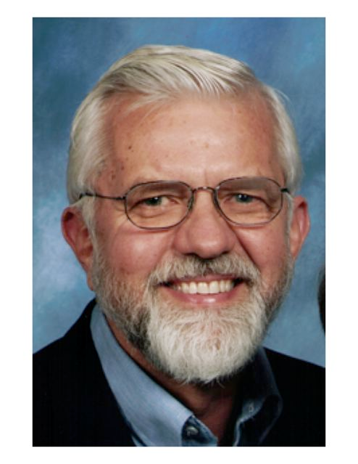
Pat McLagan
Dick Swanson

Slide 13
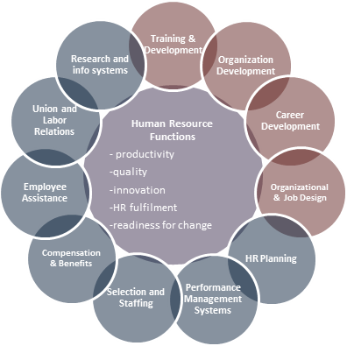
The Relationship Between HRD and other HR-Related Functions

Slide 14
Historical Antecedents of HRD
Classical School ( late 1800s to 1920s)
Scientific mgmt (F. Taylor), industrial efficiency
Human Relations School (1920s - 1950s)
Emergence of social sciences, management sciences, t-groups, survey research
Human Resources School (1950s - now)
Strategic orientation, socio-technical systems design

Slide 15
Five Stems of HRD and OD Practice
Laboratory Training
Action Research/Survey Feedback
Participative Management
Current Practice
Quality of Work Life
Strategic Change
1950 1960 1970 1980 1990 2000

Slide 16
Developments since the 1980s
Quality movement, TQM (Deming, Juran)
Learning organization (P. Senge, MIT)
Reengineering (M. Hammer, MIT)
Globalization
Technological change
Changing organizational forms
Knowledge economy, knowledge management
Leadership and Leadership Development
Virtual work, virtual organizations
Ethics and Corporate Social Responsibility
Employee Engagement

Slide 17
Strategic Role of HRD
Q: Based on today’s readings, how would you describe strategic role of HRD?

Slide 18
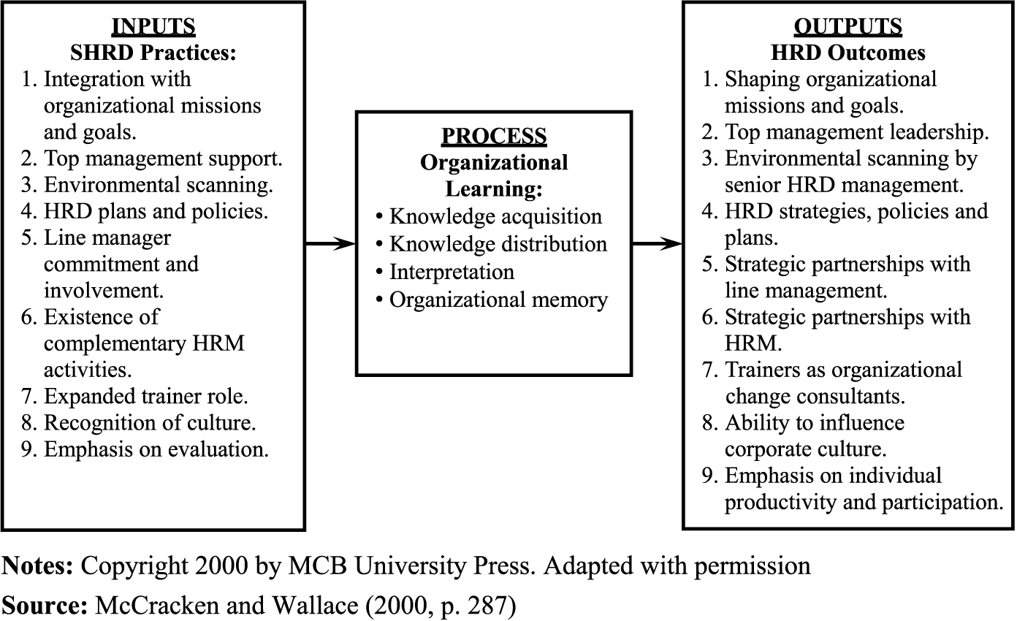

Slide 19
Value Disciplines (Treacy and Wiersema, 1993)
Operational Excellence
Customer Focus
Product Leadership
Need to be excellent at least in one (and at industry standards level in other two). Could be excellent at two, but it is much harder; three – almost impossible

Slide 20
Operational Excellence
Goal: to lead the industry in price and convenience
Corresponding Changes in Internal/Business Processes: pursue continuous improvement of production processes, minimize overhead costs, optimize business processes across functional boundaries, reduce transaction costs
Examples: Dell, Wal-Mart; Federal Express

Slide 21
Dell: Revenues: $61 billion; 103,000 employees

Slide 22
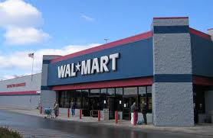
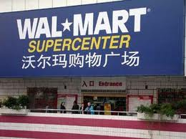
Wall-mart: Revenues: $422 billion; 2.1 million employees; 7,000 locations

Slide 23
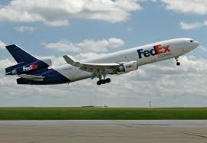
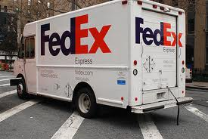
Fedex: Revenues: $32 bil.; Employees: 141,000

Slide 24
Customer Focus
Goal: Long-term Customer Loyalty
Corresponding Changes in Internal/Business Processes: Extreme attention to detail in customer interactions, intimate knowledge of customer needs and preferences, detailed customer segmentation, tailored advertising, development of sophisticated customer information databases
Examples: Home Depot; Nordstrom

Slide 25
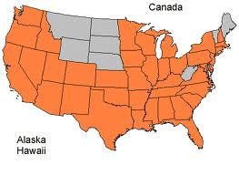
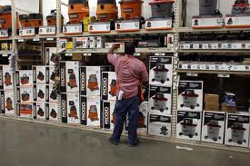
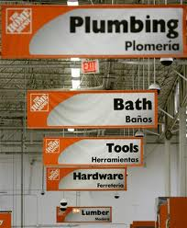
Home depot: $68 billion; 320,000 employees

Slide 26
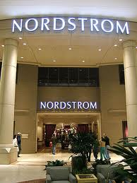
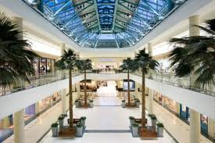
Nordstrom: $8.5 billion; 52,000 employees
Employee handbook: (a 75 word card):
Welcome to Nordstrom
We're glad to have you with our Company. Our number one goal is to provide outstanding customer service. Set both your personal and professional goals high. We have great confidence in your ability to achieve them.
Nordstrom Rules: Rule #1: Use best judgment in all situations. There will be no additional rules.
Please feel free to ask your department manager, store manager, or division general manager any question at any time.

Slide 27
Product Leadership
Goal: To be the leader in producing state-of-the art products or services
Corresponding Changes in Internal/Business Processes: promote innovation and creativity; reduce the commercialization cycle; make own products obsolete; concurrent engineering
Examples: J&J; Apple

Slide 28
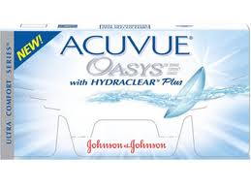
Johnson and Johnson: $62 billion; 118,000 employees

Slide 29
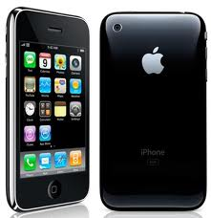
Apple: $65 billion; 50,000 employees

Slide 30
Value Innovation: Blue Sky Strategy (Kim and Mauborgne)
Do not compete for existing markets/customers – make competition obsolete
Offer radically different experience and value package
Focus on what unites customers, not what is different
Focus on what is the most important for the majority of customers
Do not be constrained by existing assets/capabilities and industry boundaries

Slide 31
Four Questions
Which of the factors that our industry takes for granted should be eliminated?
Which should be reduced below standards?
Which should be raised above standards?
Which should be created?

Slide 32
Two Strategic Logics
Industry assumptions: Are given? Or can be shaped?
Strategic Focus: Build competitive advantage? Or make competition irrelevant?
Customers: Segmentation and retention? Or new, broader, customer base?
Assets and Capabilities: Leverage existing ones, or find out what you need to start anew?
Products/Services: Industry’s boundaries determine the choices?

Slide 33
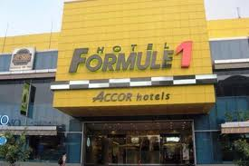
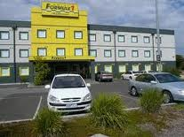
Formule 1 (Accor Hotels)
Factors to Keep/Eliminate/Enhance:
Excellent Beds/Mattresses
24 hour attendant?
Restaurant in the hotel?
Clean rooms
TV in rooms?
Large, comfortable common area?
Writing desk and tables in rooms?
Easy check in/check out

Slide 34
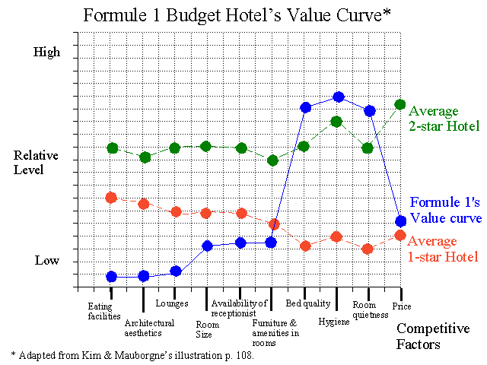
Formule 1 Value Curve

Slide 35
Key Decisions
How are key people:
Selected?
Trained?
Compensated?
Measured?

Slide 36
Evolution of the HR function and of HR/HRD professional’s KSAs
Control (technical skills)
Service (technical plus credibility and people skills)
Decision-making (strong analytic skills, knowledge of HC analysis theory and methods)

