Slide 1
The GREAT LEAP FORWARD

Slide 2
The great leap (1928 – 1950)
Periode of high labor productivity
Great innovation
Great depression
WW II

Slide 3
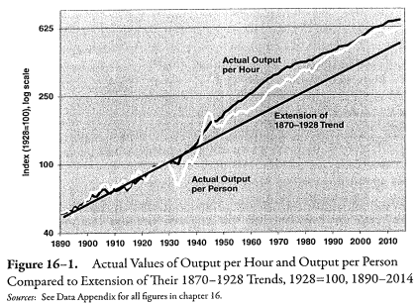
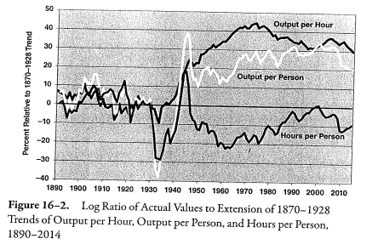

Slide 4
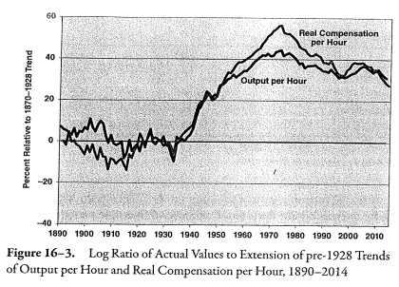
Rise of the real wage
In basic economy theory the marginal product of labors is equal to the real wage
New deal legislation and unionized
The shift to eight-hour day
Rise of wage by hour

Slide 5
Study of the source of productivity growth
Growth accouting was created by R.SOLOW in 1950
Their is 4 mojors points:
Labor quality
Increase of quantity of capital
Increase of quality of capital
Total factor productivity

Slide 6
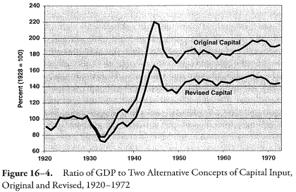
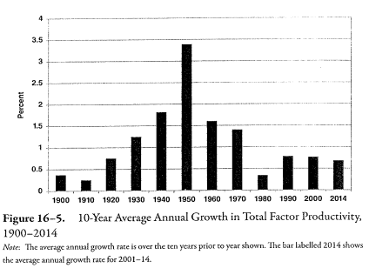
Ratio GDP/input & TFP

Slide 7
Roots in rise of produtivity
Depression
Less work hour
Rise of minimum wage
WW II
Capacity use
High demand
Learning
Patriotisme
Gouvernment investment

Slide 8
Demography & Politics
Urbanization -> Contibutes in TFP rise
1920 -> 50,8%
1960 -> 69,7%
Immigration & High tariffs regime
2,1% population growth in 1870-1913 (4,3 unemployment rate)
Anti-immigration laws (0,25%/years population growth 1925-1929)
Protectionism
Introduction of innovation without outsourcing

Slide 9
Do innovation explain the great leap
General Purpose Technology
« Primal invention »
The big GPT was electricity and internal combustion engine
Subinvention
All that can be creating thanks to GTP
For Alfred Kleinknecht between 1850 and 1970, 36 of the 39 most important invention was create during 20’s and 40’s periode

Slide 10
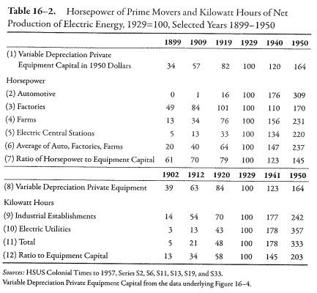
Impact of innovation

Slide 11
THANK YOU

