Slide 1
ALSTON, Lee J.; MELO, Marcus André; MUELLER, Bernardo; PEREIRA, Carlos. Brazil in transition: Beliefs, leadership, and institutional change. Princeton University Press, 2016.
Monitoria - Aula 9
Murilo Motta

Slide 2
Plano da aula
Pergunta proposta
Hipótese
Argumentos
Evidências
Conceitos

Slide 3
Pergunta proposta
“Why isn’t the whole world developed? Why do some countries break from their past and enter the rank of sustainable economic, legal, and political development?” (p. xv)
Is Brazil “on the road to a sustainable developmental path whose hallmarks are social inclusion with steady economic and political development?” (p. 3)

Slide 4
Pergunta proposta
“Our analytical framework is inductive from the case of Brazil, but it can yield insights for development in other countries.” (p. xv)
“The advantage of analyzing a single country in great detail, as opposed to a sample of countries with more generality, is that we can be very explicit about the specific institutions and beliefs and how they change. Moreover, Brazil is an important world economic and political player.” (p. 14)

Slide 5
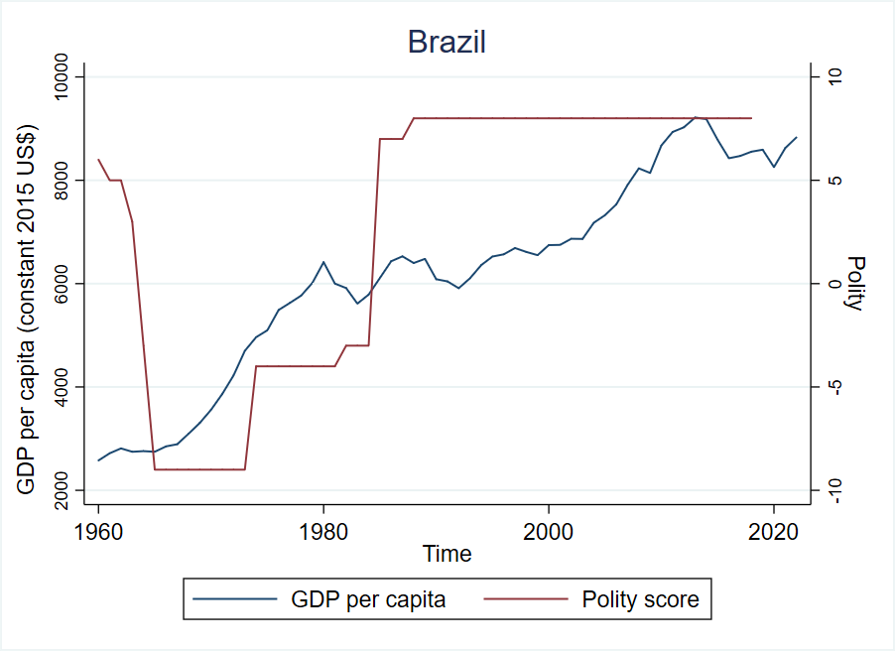

Slide 6
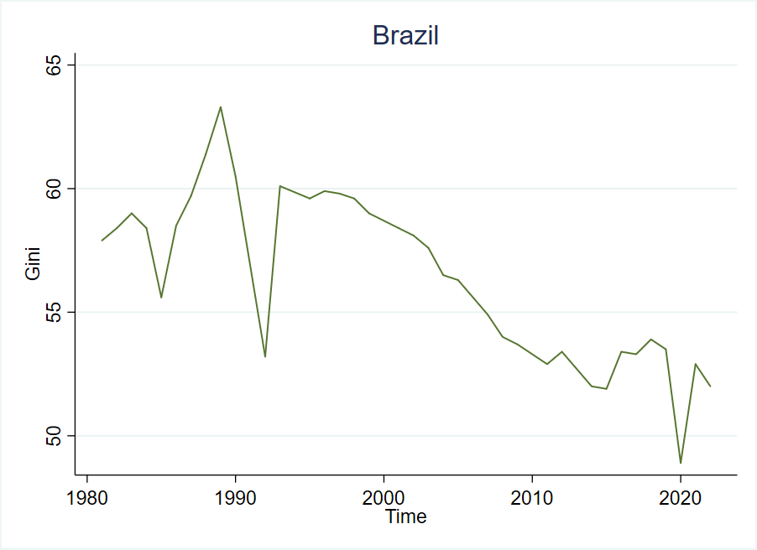

Slide 7
Hipótese
“Although higher levels of income and wealth are necessary for a critical transition, this concept requires important changes in several other dimensions as well. [...] A critical transition, in contrast, requires not only economic improvements but also accompanying changes in social relations (e.g., greater equality) and political institutions (e.g., alterations of power and checks and balances).” (p. 5)

Slide 8
Hipótese
“This time, the miracle is for real because of a change in beliefs in Brazilian society and consequent changes in economic and political institutions. Today, the dominant belief held among those in power as well as the majority of the population is in “fiscally sound social inclusion.”” (p. 3)

Slide 9
Argumentos
“Many times, an increase in GDP per capita can take place in circumstances that are not sustainable or that compromise future growth, creating a middle-income trap.” (p. 5)

Slide 10
Argumentos
“Many times, an increase in GDP per capita can take place in circumstances that are not sustainable or that compromise future growth, creating a middle-income trap.” (p. 5)
The middle-income trap refers to a situation whereby a middle-income country fails to transition to a high-income economy due to rising costs and declining competitiveness. They suffer from low investment, slow growth in the manufacturing sector of the economy, limited industrial diversification, poor labor market conditions and, increasingly, aging populations.

Slide 11
Argumentos
“From 1975 to 1994, the country underwent two decades of unrelenting economic decline during which a crippling process of hyperinflation wreaked havoc with individuals’, organizations’, and governments’ attempts to structure their lives and to plan for the future.” (p. 7)
“Since 1994, things have changed for the better. Inflation has been kept under control, and several economic indicators have clearly improved, some of them remarkably so. [...] Over this period, Brazil has consolidated a vibrant, competitive, and liberal democracy [...]” (p. 7)

Slide 12
Argumentos
“We show that the country [Brazil] has become economically orthodox, politically open, and socially inclusive, with all these three areas marked by a general respect for the rules.” (p. 6)
“The areas where improvement has been the clearest and most impressive are poverty and inequality reduction. From 1990 to 2009, approximately 60 percent of Brazilians moved to a higher economic group, and extreme poverty was practically eliminated.” (p. 11)

Slide 13
Argumentos
“A large literature consolidated in the past two decades argues that institutions, rather than geography, culture, policies, or luck, are the fundamental cause of long-term growth [...] If we are correct that Brazil is on the path to a more prosperous level of economic and political development, then we should be able to provide an argument where changing institutions must play a central role. It is necessary that we show that a dramatic transformation has taken place in the country’s institutions between the previous history of boom and busts to the current period that we identify as a transition to a new order.” (p. 12)

Slide 14
Argumentos
SHARMA, Ruchir. Breakout Nations: In Pursuit of the Next Economic Miracles. W. W. Norton & Company, 2012
“Sharma (2012), for example, puts much weight on the overvalued exchange rate in Brazil and on the poor state of infrastructure as part of his argument for why Brazil will not be a “breakout nation.”
“Brazil is the anti-China, a nation that invested in the premature construction of a welfare state rather than the roads and wireless networks of a modern industrial economy.”

Slide 15
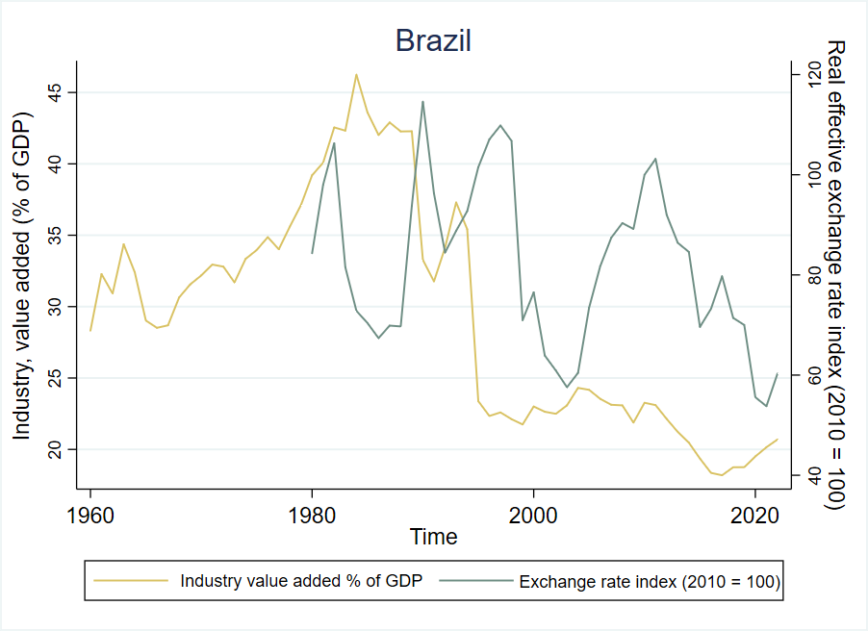

Slide 16
Argumentos
“We focus on the beliefs—the mental constructs mapping institutions onto outcomes—that motivated the choice of institutions. There are two sets of beliefs that have been the driving force of the process of change in Brazil since 1985. The first is a belief in social inclusion that arose as a reaction to the oppressive experience under military dictatorship and the inequalities and injustice inherited from the country’s history. The second is an aversion to inflation born from the traumatic experience under hyperinflationary years of 1985 to 1994. Together, these two separate strands form a belief in fiscally sound social inclusion that constrains and influences the choice of institutions by the dominant coalition, thereby crucially affecting the selection of policies and the incentives influencing outcomes.” (p. 14)

Slide 17
Argumentos
“Typically, those in power structure the formal rules of the game in a manner to produce outcomes that are in their economic and political interests. For those in power, there are rents from a stable status quo where not much changes. Citizens, as well, become accustomed to the status quo, and there are few gains and, at times, high costs to rocking the boat.”

Slide 18
Argumentos
“Typically, those in power structure the formal rules of the game in a manner to produce outcomes that are in their economic and political interests. For those in power, there are rents from a stable status quo where not much changes. Citizens, as well, become accustomed to the status quo, and there are few gains and, at times, high costs to rocking the boat.”
“Rents" refer to the excess profits that individuals or groups can earn due to their special access to or control over a particular resource, market, or policy environment. These rents arise from non-competitive advantages and are not the result of productive economic activity.

Slide 19
Argumentos
“Beliefs are generally quite stable because most economic and political outcomes are at the margin. But, at times, economic and political outcomes diverge considerably from what those in the dominant network expected. When this happens, we call it a window of opportunity for institutional change because the powerful actors may have changed, bringing with them different beliefs, or the beliefs of those in power change. During windows of opportunity, the beliefs of those in power as well as among the citizens become malleable.” (p. 15)
“During these times, we see leadership playing a role to circumvent the free-rider problem.” (p. 15)

Slide 20
Argumentos
“Windows of opportunity are seemingly quite frequent, but the combination of windows of opportunity with the right leaders with beliefs that foster institutions that increase economic and political development is rare.” (p. 16)

Slide 21
Evidências
“In the last three decades, new beliefs have taken hold that wed social inclusion to fiscal and monetary orthodoxy. The beliefs affected formal and informal institutions that in turn have led to many positive outcomes. [...] The access to economic and political markets has made Brazil a fundamentally more inclusive society than it has ever been. The unprecedented recent fall in inequality and poverty and the growth of the middle class are evidence for our claims. The changes are also extending to more inclusion in education, less tolerance for corruption, and greater respect for the rule of law.” (p. 17)

Slide 22
Evidências
“The belief in “developmentalism” motivated the institutions put in place by the military regime. Developmentalism rested on top-down technocratic planning and was a coalition between the military and the business community, both domestic and foreign. Import substitution policies along with state-led industrialization brought economic growth in the late 1960s and into the mid-1970s. [...] Citizens [...] began to blame the government for not reducing economic and social inequality. The dominant belief that economic growth should precede social inclusion started losing political support.” (p. 20)

Slide 23
Evidências
“We explore the role of the Constitution of 1988 in the critical transition process. [...] the constitution embraced the set of beliefs in Brazilian democracy, which evolved out of the fight against military rule. We view the constitution as both a crystallization of beliefs and a focal point for policy. [...]
The “constitutional moment” created a consensus by Brazilian “elites” on the importance of social inclusion with fiscal sustainability, on the one hand, and powerful presidents operating in a constrained institutional environment, on the other.” (p. 20-21)

Slide 24
Evidências
“Second, the Constitution of 1988 redesigned in fundamental ways the country’s social contract. [...] stipulated new foundations for public policies to incorporate inclusion and redistribution.
Third, the constitution vested the presidency with great powers while also strengthening the judicial and the legislative branches.” (p. 21)

Slide 25
Evidências
“We identify the period during and closely after the Real Plan in 1994 as a window of opportunity in which a crucial role was played by leadership, which initiated institutional changes and sustained institutional deepening, moving Brazil toward a critical transition.” (p. 19)
“[...] at the end of the second term of President Cardoso, Brazilian society had adopted a belief in strong inflation aversion, maintaining the belief in inclusion. That is, social inclusion would still be given priority as long as it was fiscally sound. Once society internalized the new beliefs, leadership was no longer critical, and the institutional dynamics and deepening entered an autopilot mode.” (p. 21-22)

Slide 26
Evidências
“The functioning of these economic and political institutions largely explains policy continuity [from 2003 onwards] in key areas such as macroeconomic management. But they ultimately reflected the new beliefs emerging out of the transition process and the Cardoso era.” (p. 22)

Slide 27
Conceitos
Beliefs: “[...] beliefs are mental models about how the world works and are not reducible to preferences or values.” (p. 14)
Critical transition: economic improvements + changes in social relations + changes in political institutions
Middle-income trap: situation whereby a middle-income country fails to transition to a high-income economy due to rising costs and declining competitiveness

Slide 28
Conceitos
Rent: excess profits that individuals or groups can earn due to their special access to or control over a particular resource, market, or policy environment. These rents arise from non-competitive advantages and are not the result of productive economic activity.
Window of opportunity: “During windows of opportunity, the beliefs of those in power as well as among the citizens become malleable.” (p. 15)

Slide 29
Comentários e questões?

