Slide 1
Chapter 2:
Mechanics of Materials, 8th Edition SI Gere & Goodno
Axially Loaded Members

Slide 2
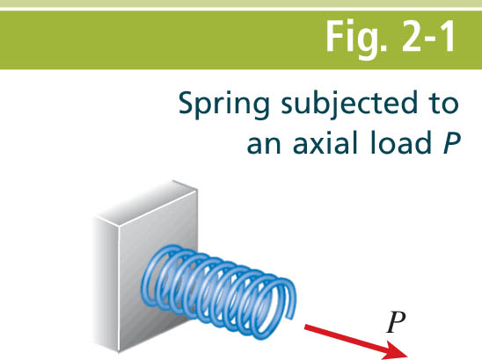
Mechanics of Materials, 8th Edition SI Gere & Goodno

Slide 3
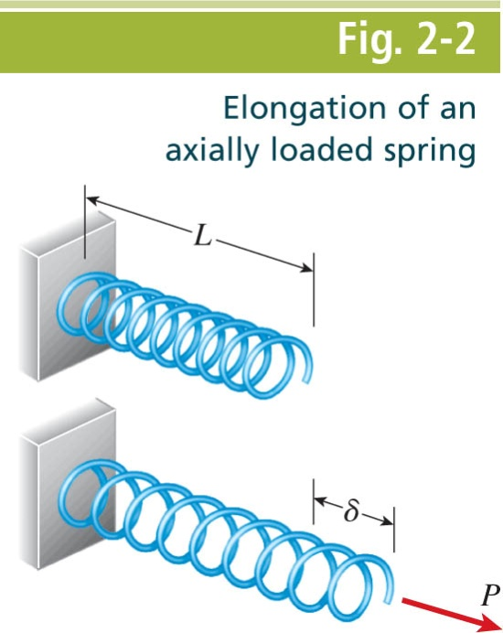
Mechanics of Materials, 8th Edition SI Gere & Goodno

Slide 4
Mechanics of Materials, 8th Edition SI Gere & Goodno

Slide 5
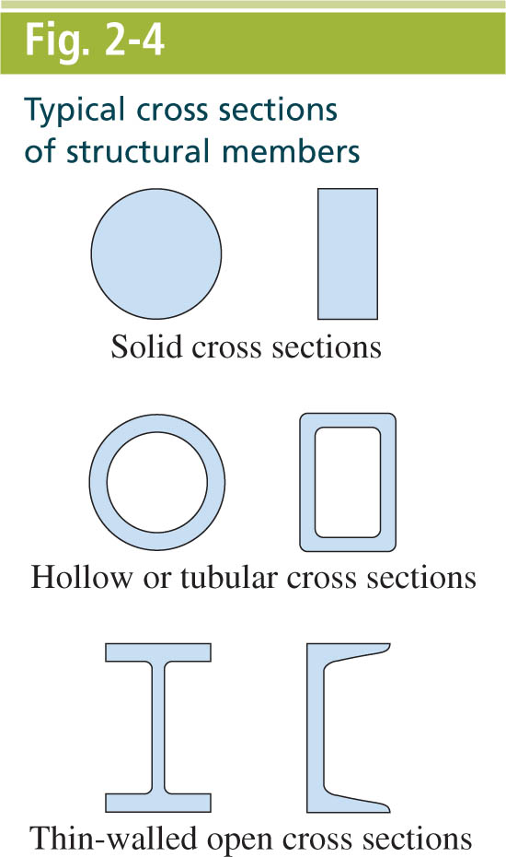
Mechanics of Materials, 8th Edition SI Gere & Goodno

Slide 6
Mechanics of Materials, 8th Edition SI Gere & Goodno

Slide 7
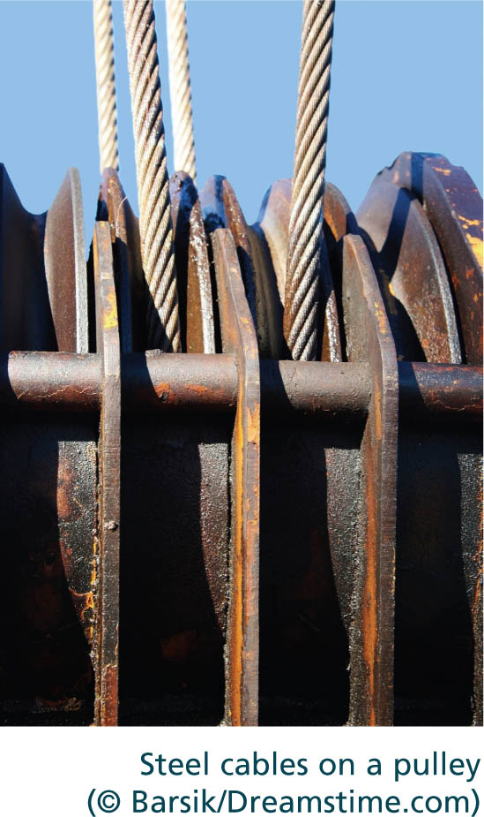
Mechanics of Materials, 8th Edition SI Gere & Goodno

Slide 8
Mechanics of Materials, 8th Edition SI Gere & Goodno

Slide 9
Mechanics of Materials, 8th Edition SI Gere & Goodno

Slide 10
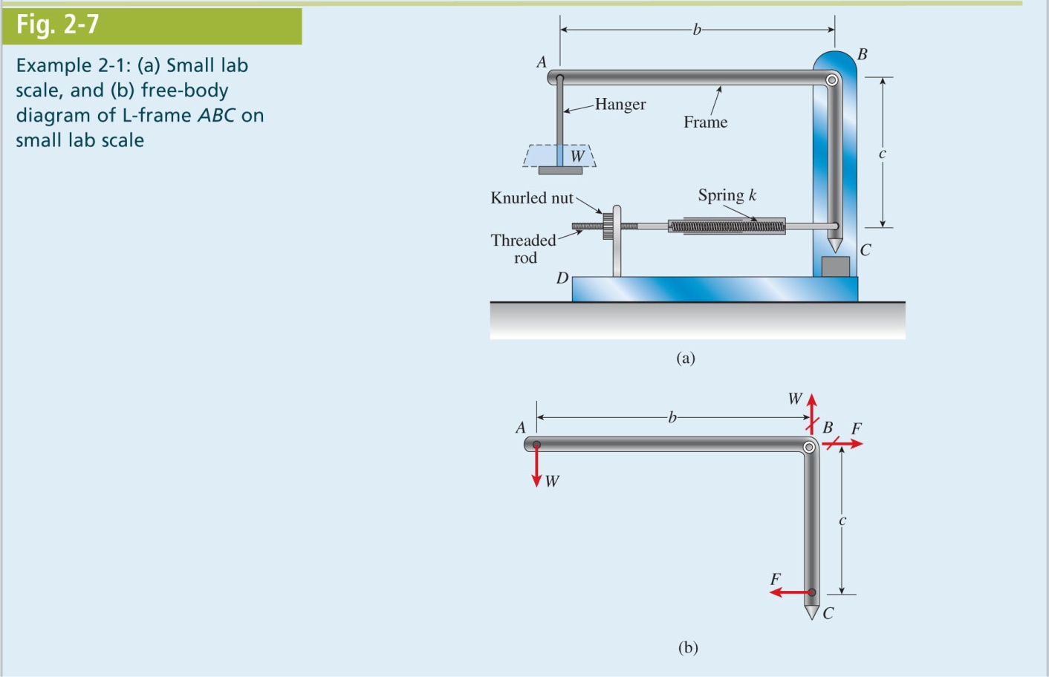
Mechanics of Materials, 8th Edition SI Gere & Goodno

Slide 11
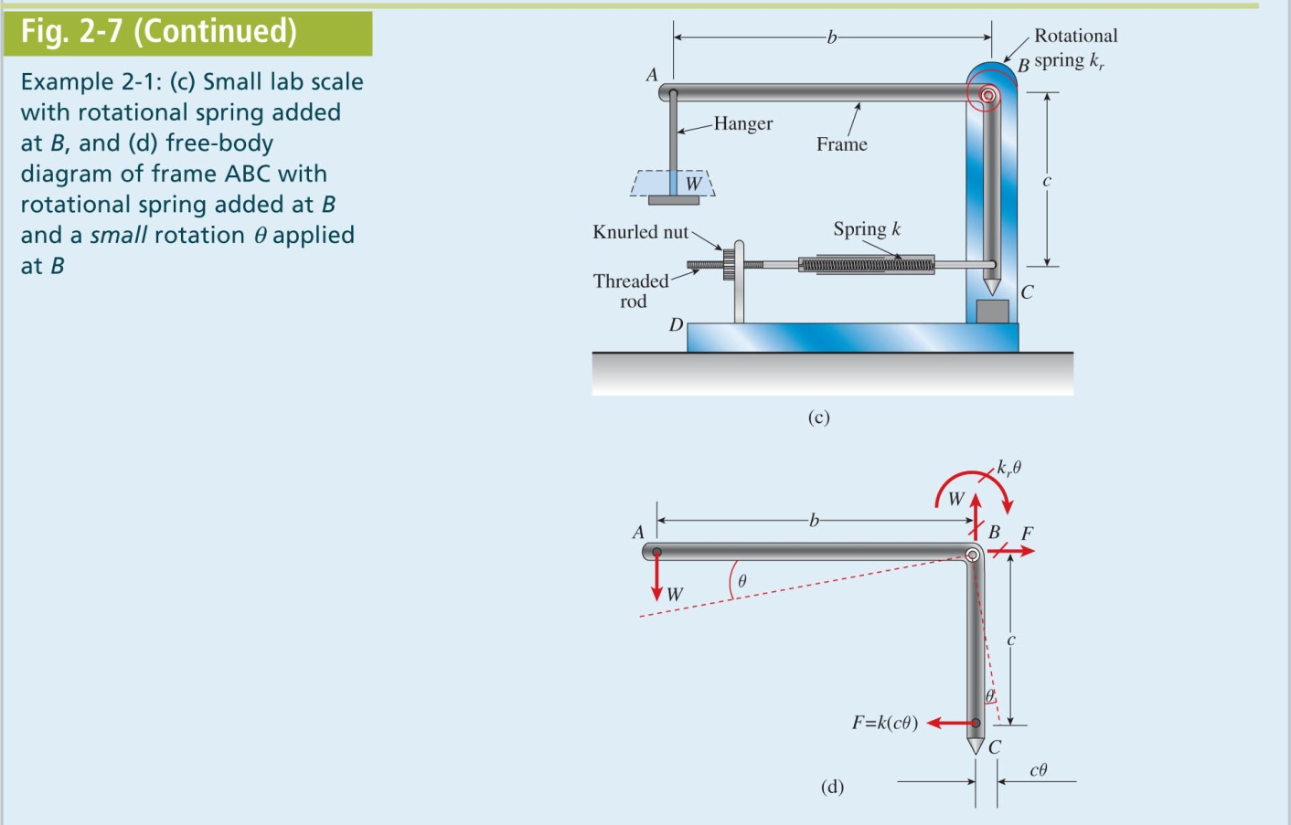
Mechanics of Materials, 8th Edition SI Gere & Goodno

Slide 12
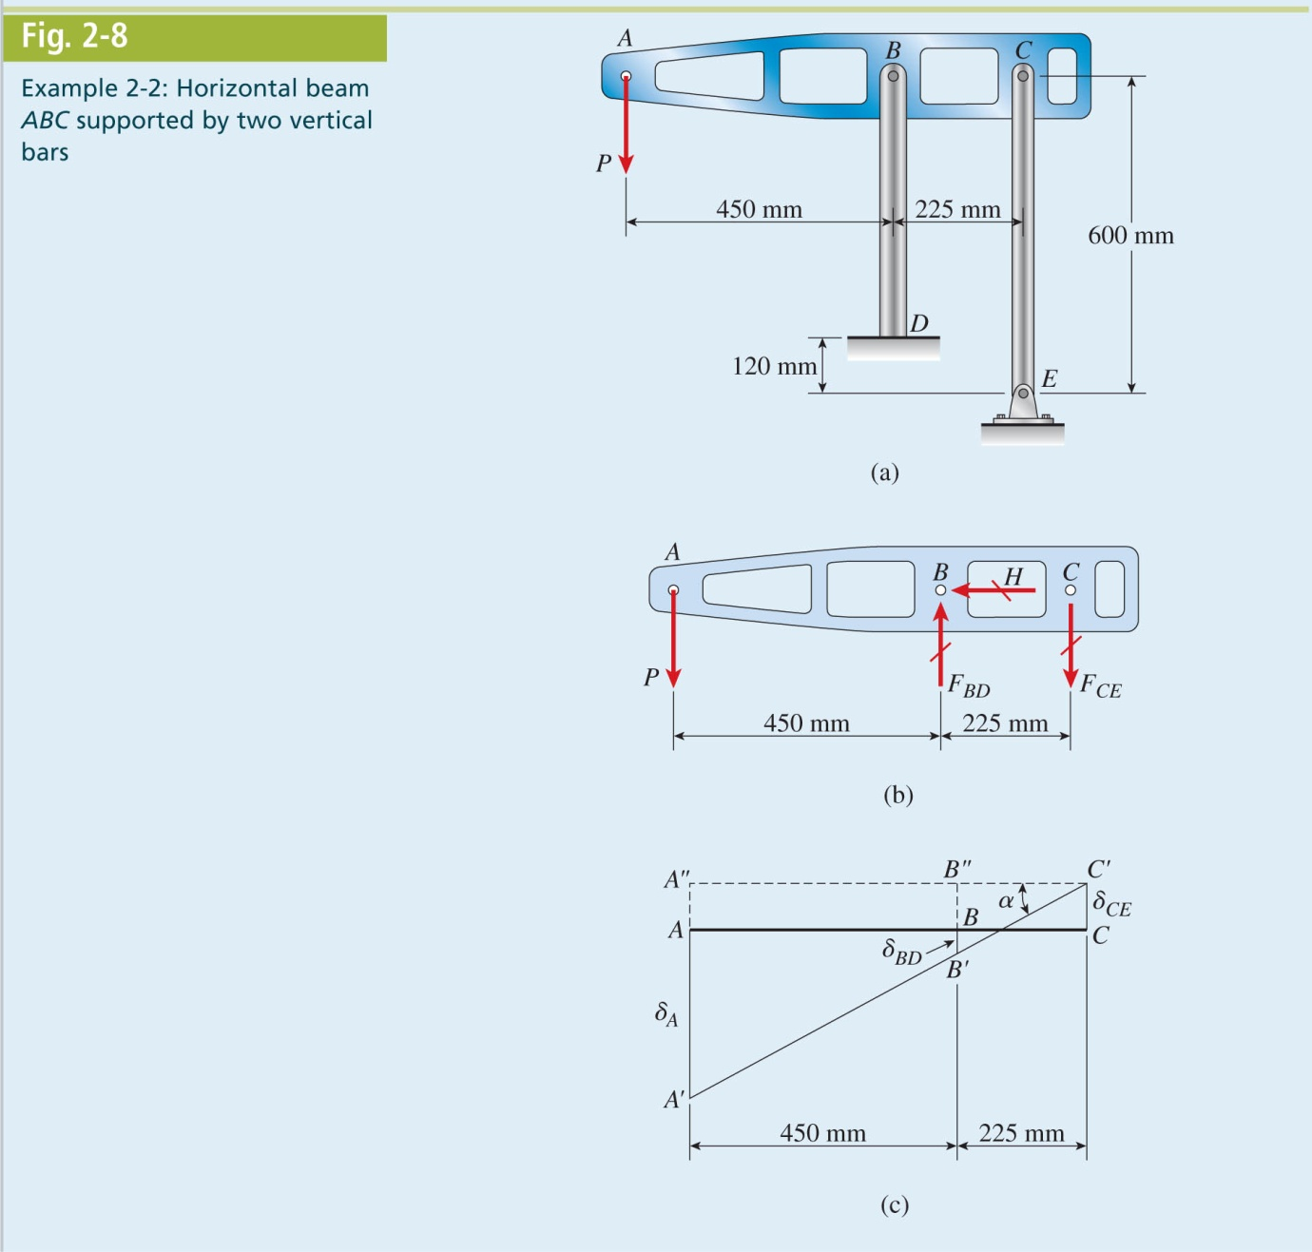
Mechanics of Materials, 8th Edition SI Gere & Goodno

Slide 13
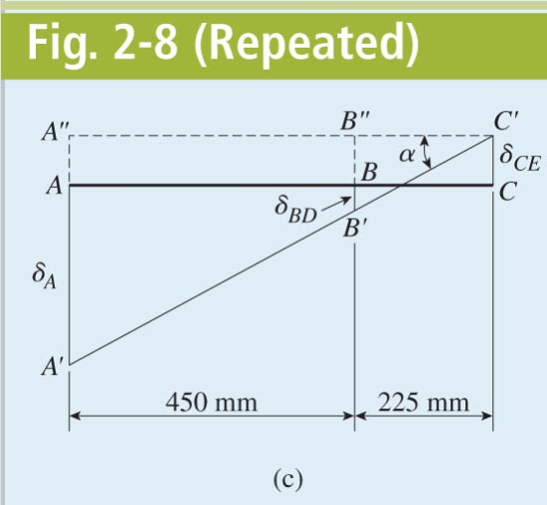
Mechanics of Materials, 8th Edition SI Gere & Goodno

Slide 14
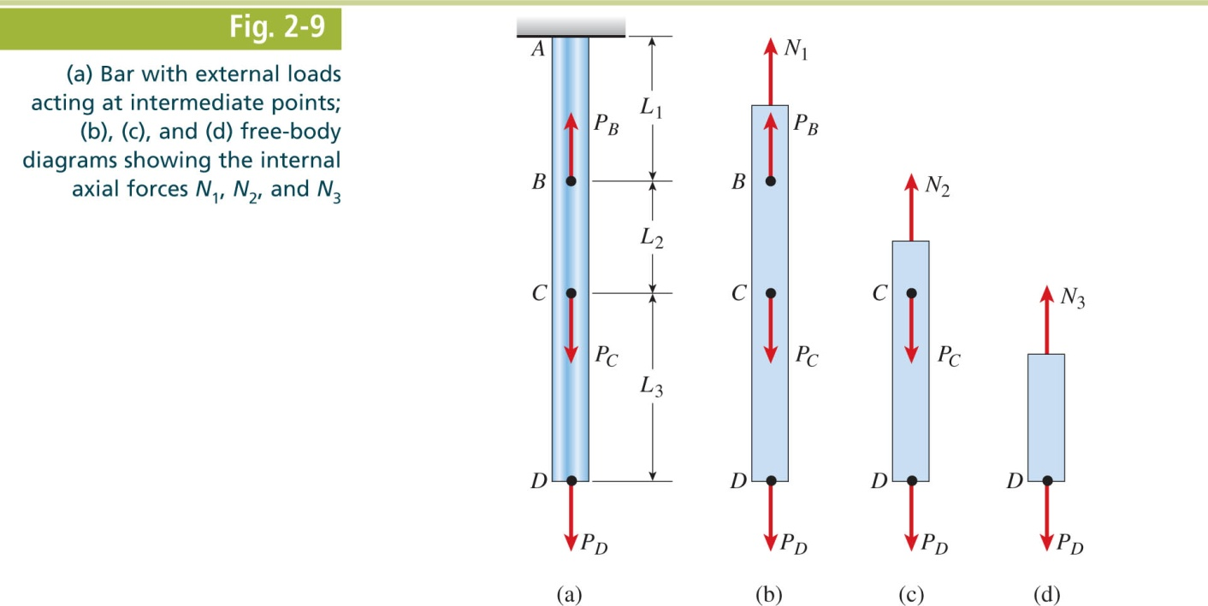
Mechanics of Materials, 8th Edition SI Gere & Goodno

Slide 15
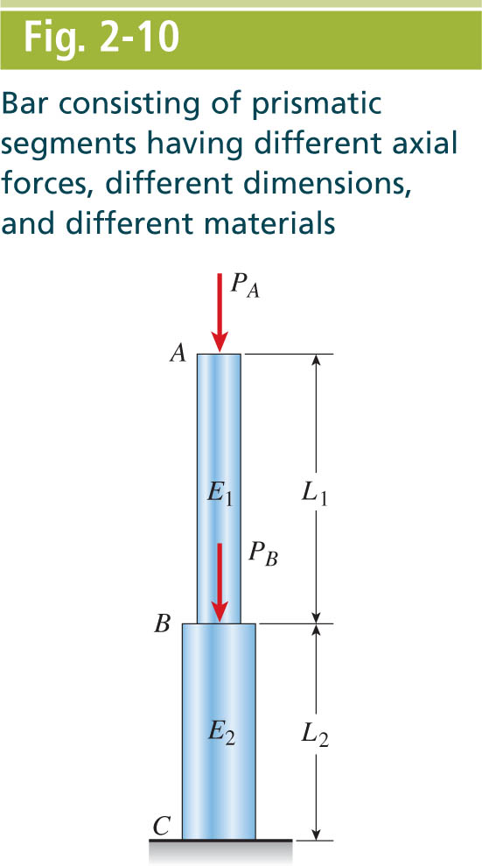
Mechanics of Materials, 8th Edition SI Gere & Goodno

Slide 16
Mechanics of Materials, 8th Edition SI Gere & Goodno

Slide 17
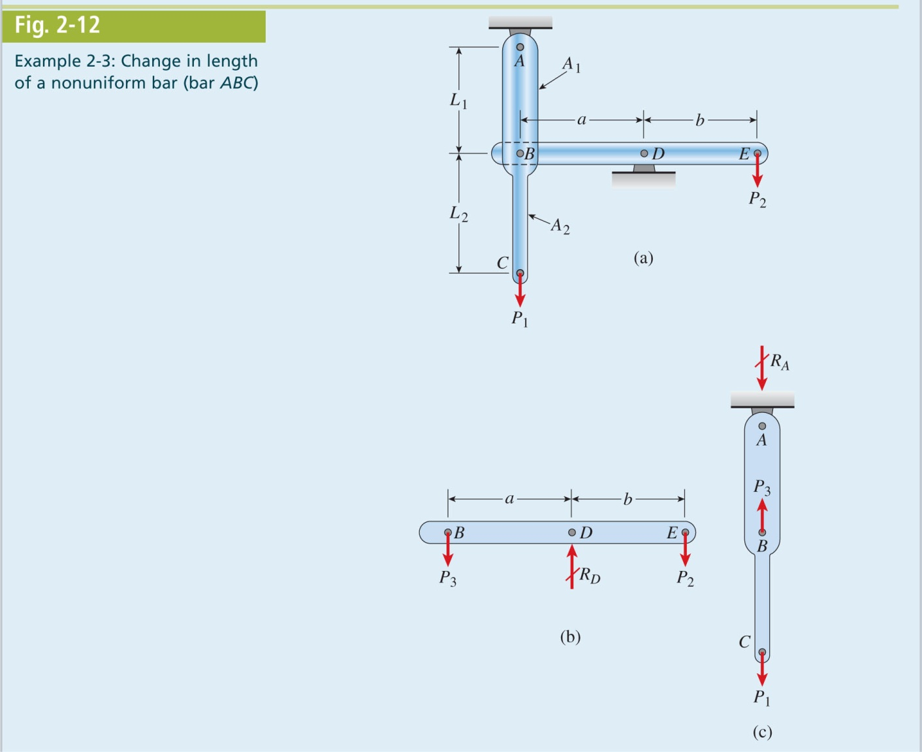
Mechanics of Materials, 8th Edition SI Gere & Goodno

Slide 18
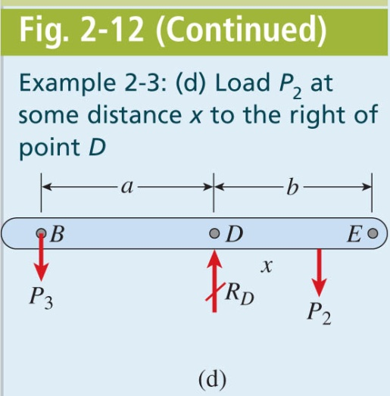
Mechanics of Materials, 8th Edition SI Gere & Goodno

Slide 19
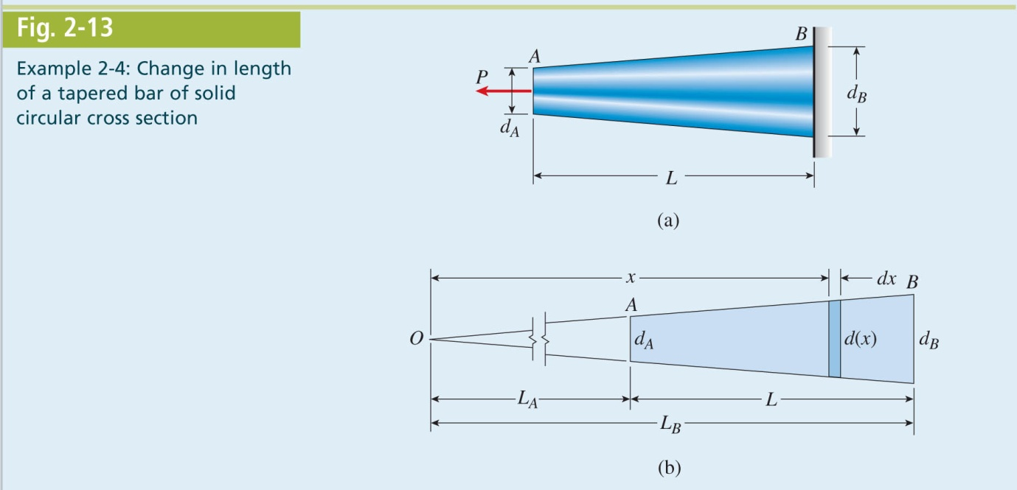
Mechanics of Materials, 8th Edition SI Gere & Goodno

Slide 20
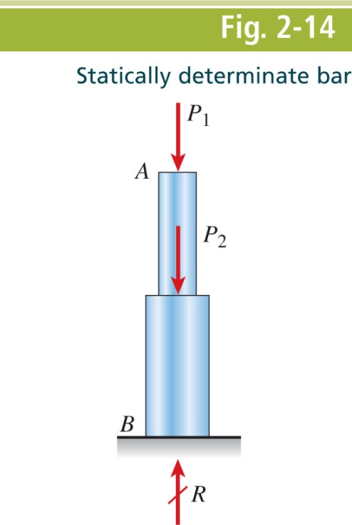
Mechanics of Materials, 8th Edition SI Gere & Goodno

Slide 21
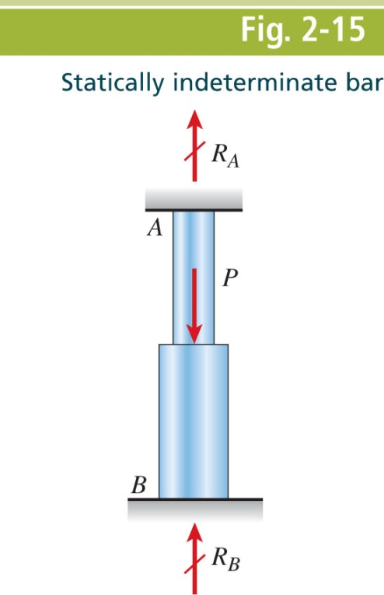
Mechanics of Materials, 8th Edition SI Gere & Goodno

Slide 22
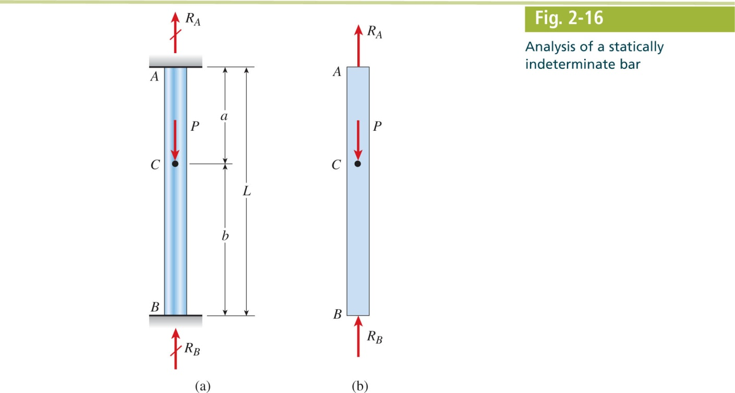
Mechanics of Materials, 8th Edition SI Gere & Goodno

Slide 23
Mechanics of Materials, 8th Edition SI Gere & Goodno

Slide 24
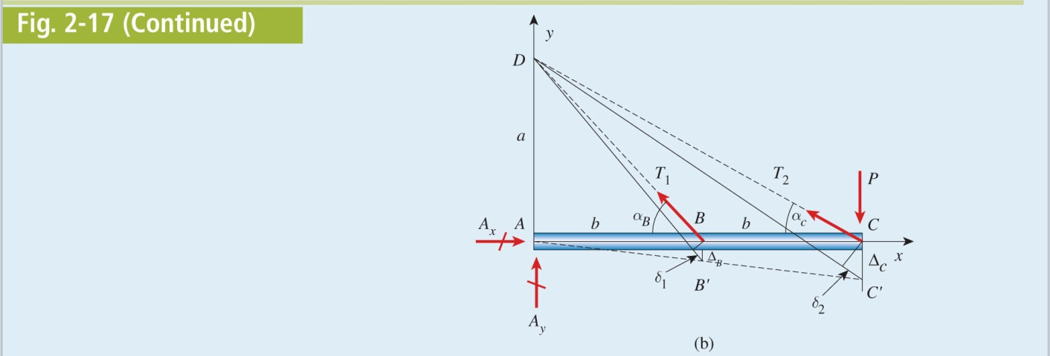
Mechanics of Materials, 8th Edition SI Gere & Goodno

Slide 25
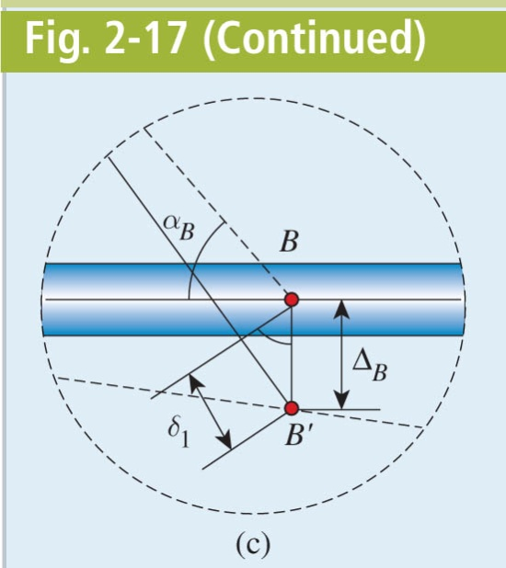
Mechanics of Materials, 8th Edition SI Gere & Goodno

Slide 26
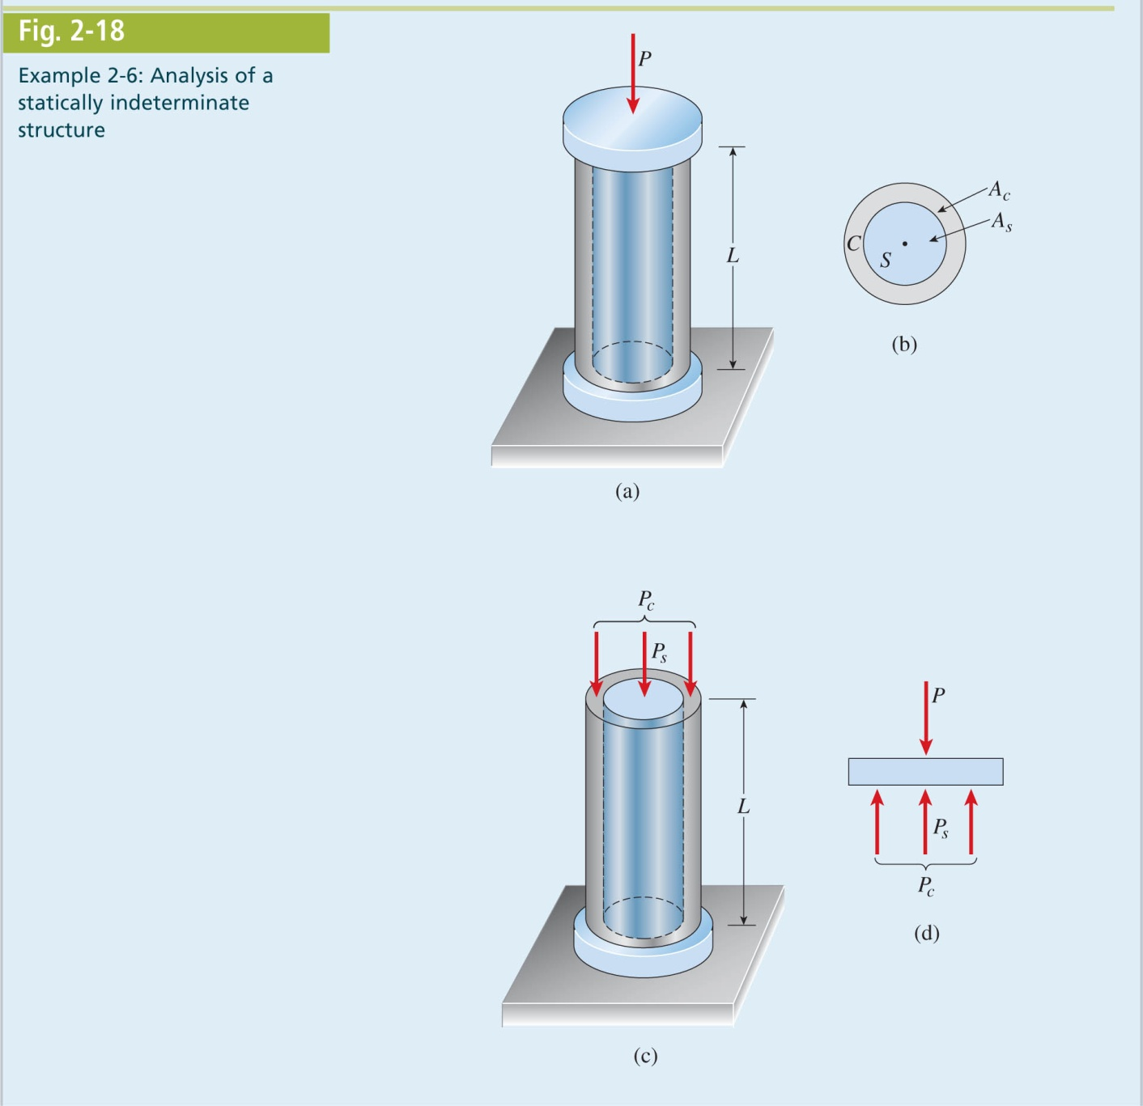
Mechanics of Materials, 8th Edition SI Gere & Goodno

Slide 27
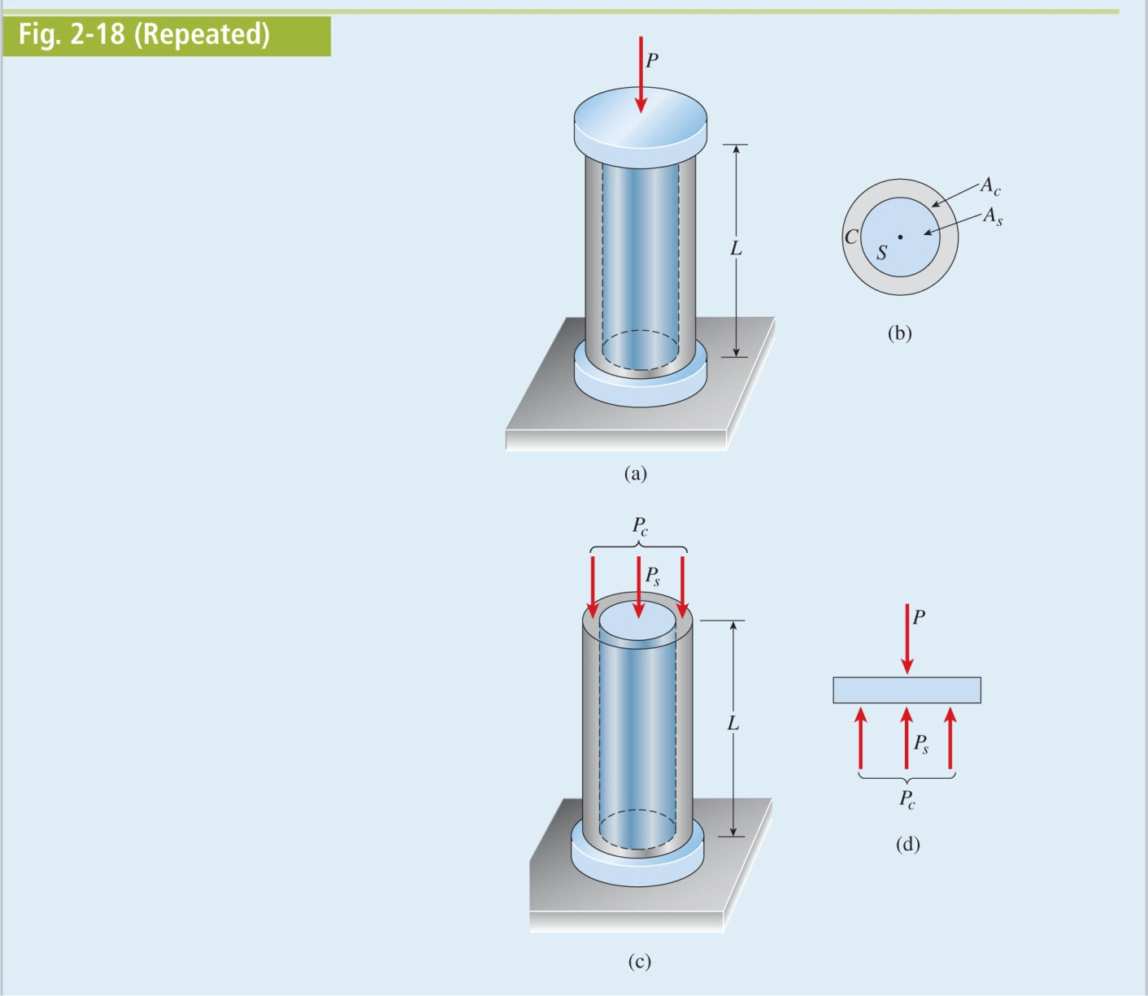
Mechanics of Materials, 8th Edition SI Gere & Goodno

Slide 28
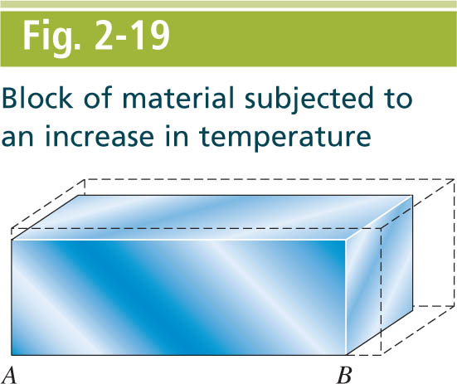
Mechanics of Materials, 8th Edition SI Gere & Goodno

Slide 29
Mechanics of Materials, 8th Edition SI Gere & Goodno

Slide 30
Mechanics of Materials, 8th Edition SI Gere & Goodno

Slide 31
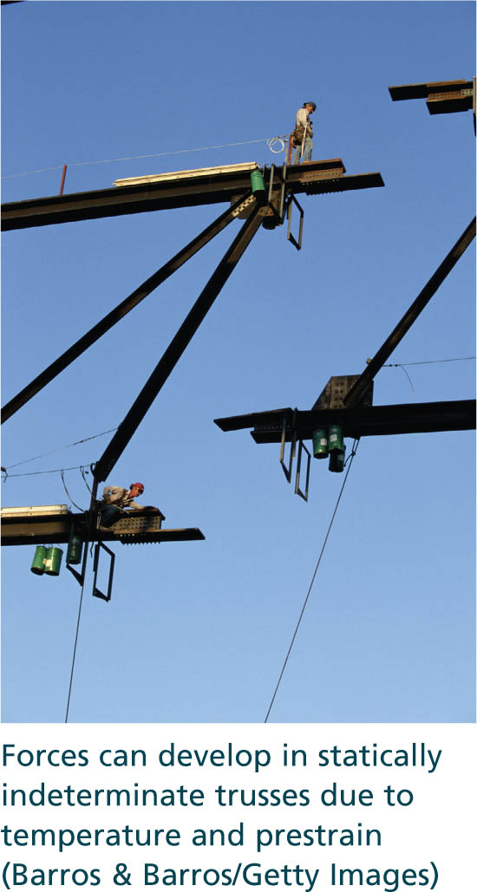
Mechanics of Materials, 8th Edition SI Gere & Goodno

Slide 32
Mechanics of Materials, 8th Edition SI Gere & Goodno

Slide 33
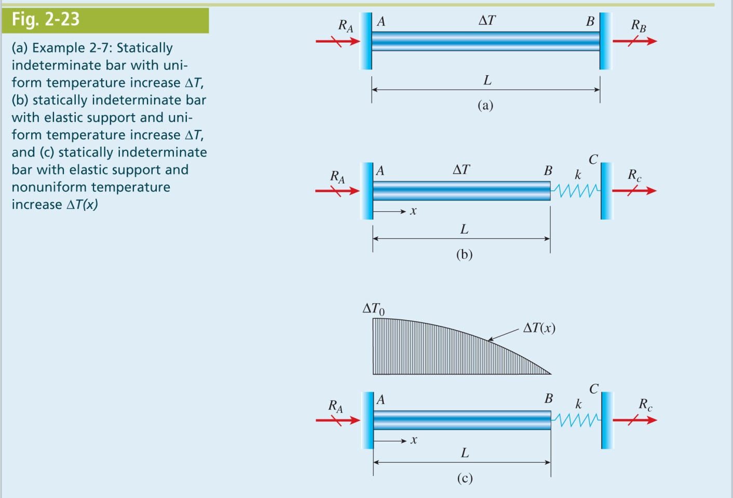
Mechanics of Materials, 8th Edition SI Gere & Goodno

Slide 34
Mechanics of Materials, 8th Edition SI Gere & Goodno

Slide 35
Mechanics of Materials, 8th Edition SI Gere & Goodno

Slide 36
Mechanics of Materials, 8th Edition SI Gere & Goodno

Slide 37
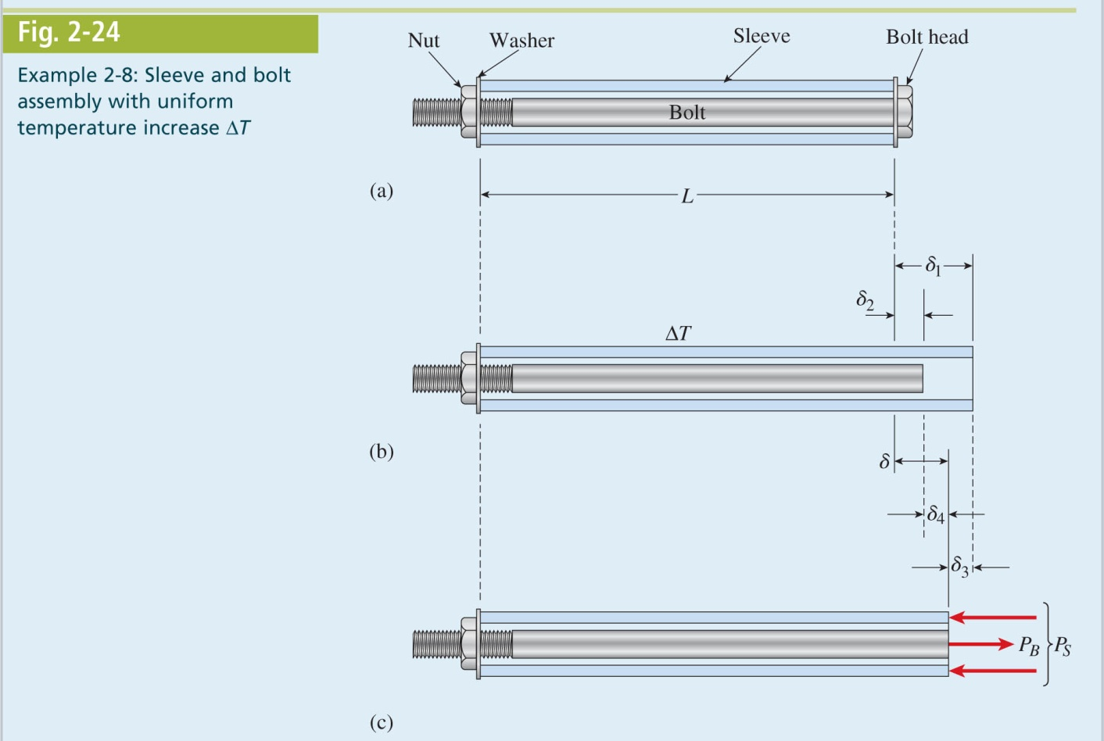
Mechanics of Materials, 8th Edition SI Gere & Goodno

Slide 38
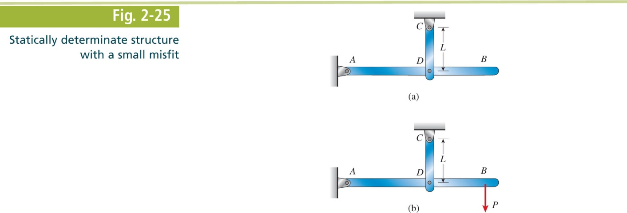
Mechanics of Materials, 8th Edition SI Gere & Goodno

Slide 39
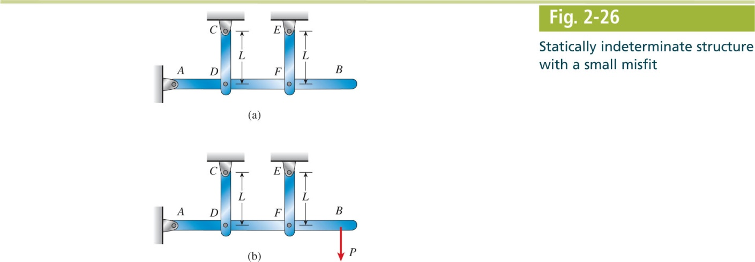
Mechanics of Materials, 8th Edition SI Gere & Goodno

Slide 40
Mechanics of Materials, 8th Edition SI Gere & Goodno

Slide 41
Mechanics of Materials, 8th Edition SI Gere & Goodno

Slide 42
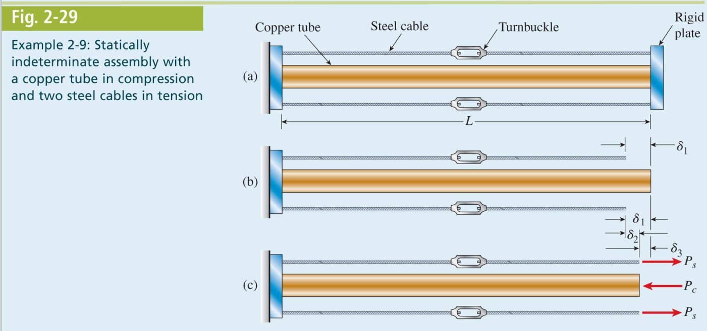
Mechanics of Materials, 8th Edition SI Gere & Goodno

Slide 43
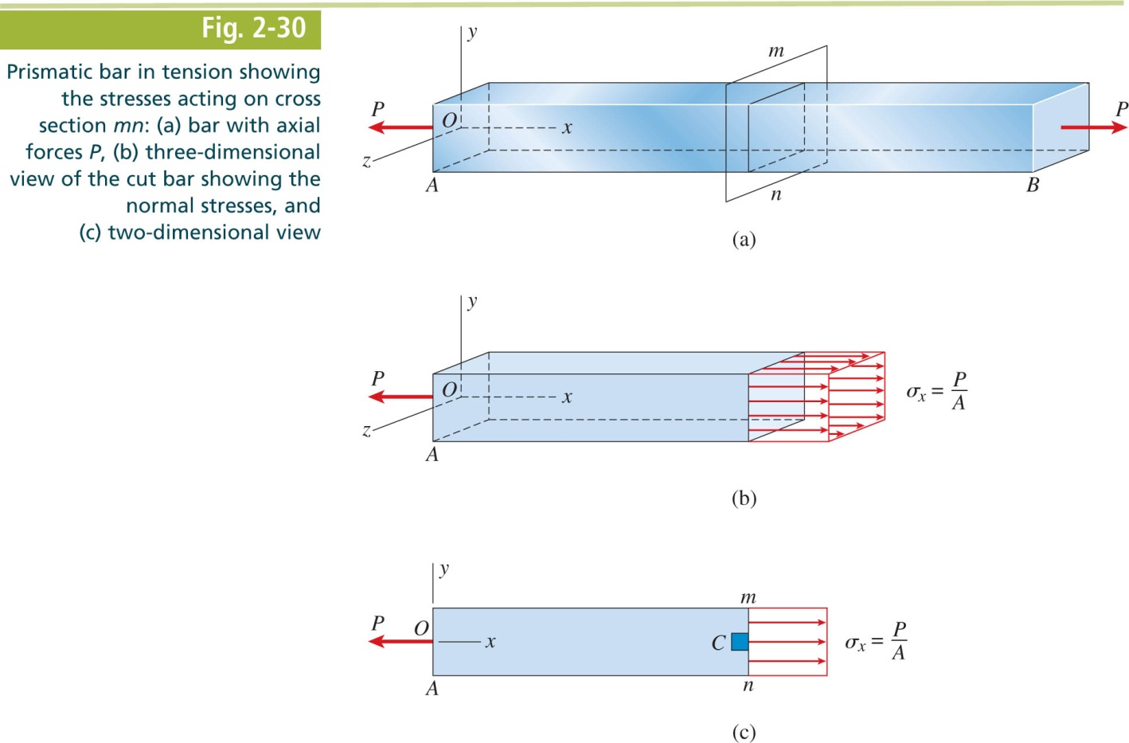
Mechanics of Materials, 8th Edition SI Gere & Goodno

Slide 44
Mechanics of Materials, 8th Edition SI Gere & Goodno

Slide 45
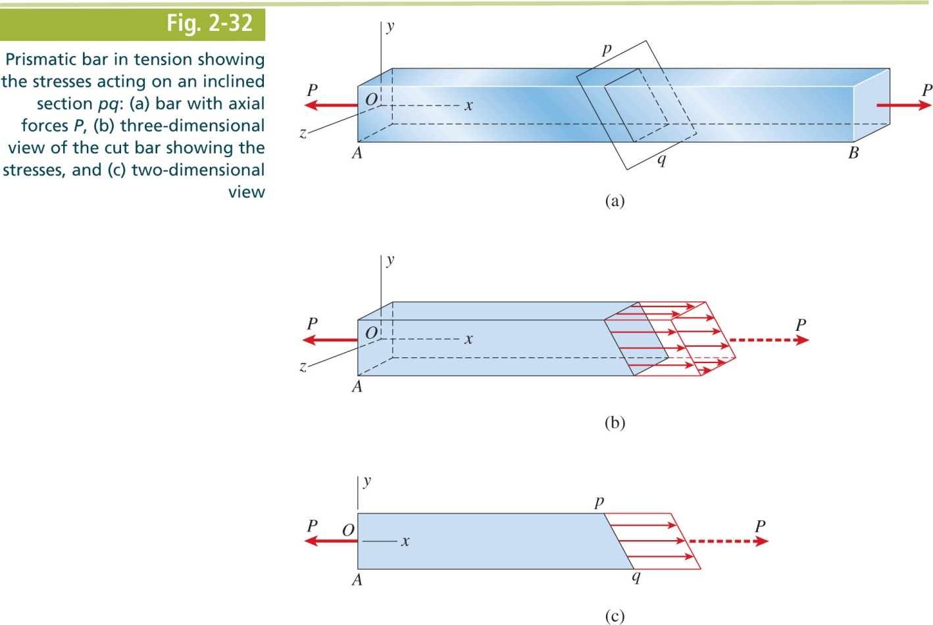
Mechanics of Materials, 8th Edition SI Gere & Goodno

Slide 46
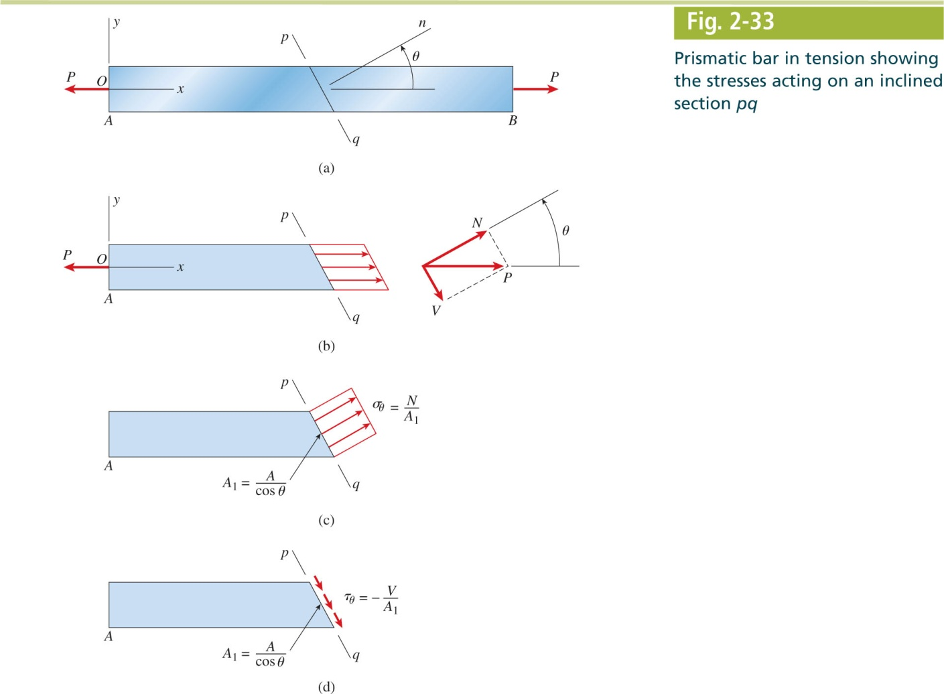
Mechanics of Materials, 8th Edition SI Gere & Goodno

Slide 47
Mechanics of Materials, 8th Edition SI Gere & Goodno

Slide 48
Mechanics of Materials, 8th Edition SI Gere & Goodno

Slide 49
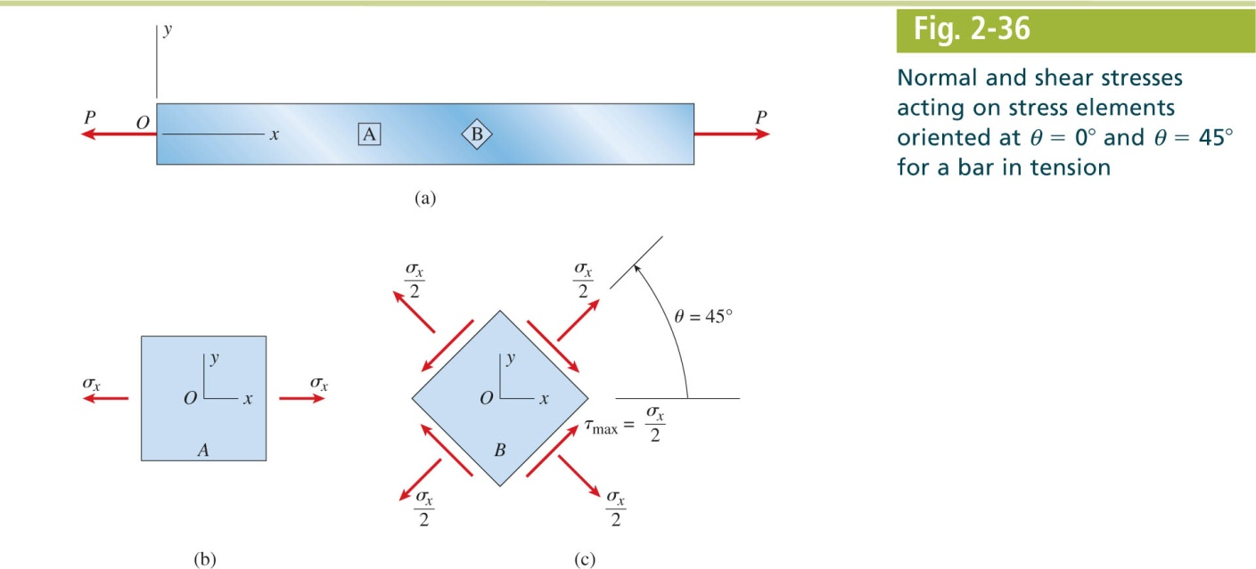
Mechanics of Materials, 8th Edition SI Gere & Goodno

Slide 50
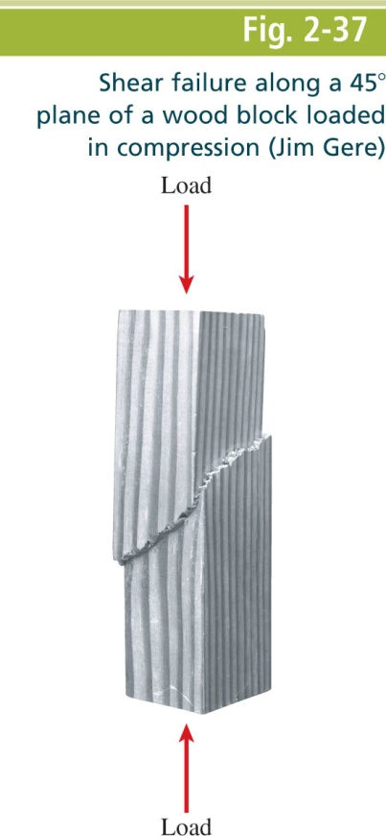
Mechanics of Materials, 8th Edition SI Gere & Goodno

Slide 51
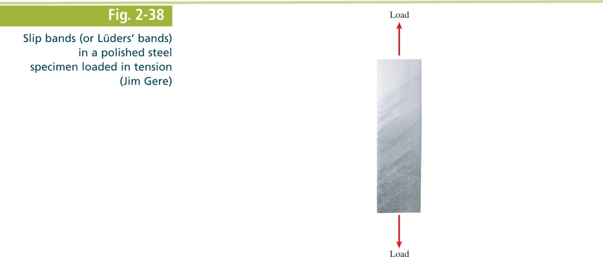
Mechanics of Materials, 8th Edition SI Gere & Goodno

Slide 52
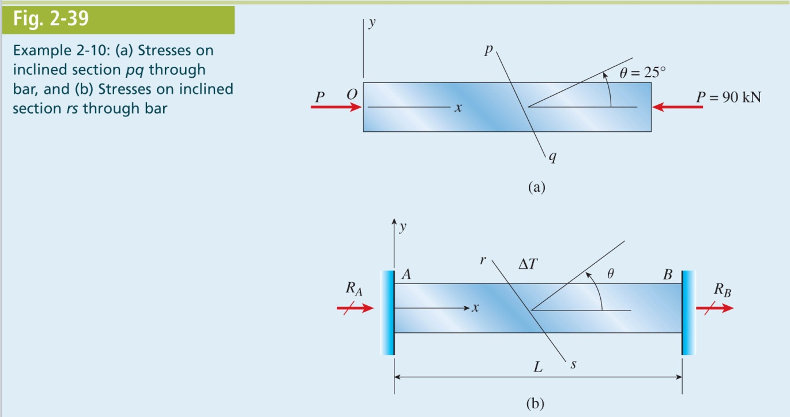
Mechanics of Materials, 8th Edition SI Gere & Goodno

Slide 53
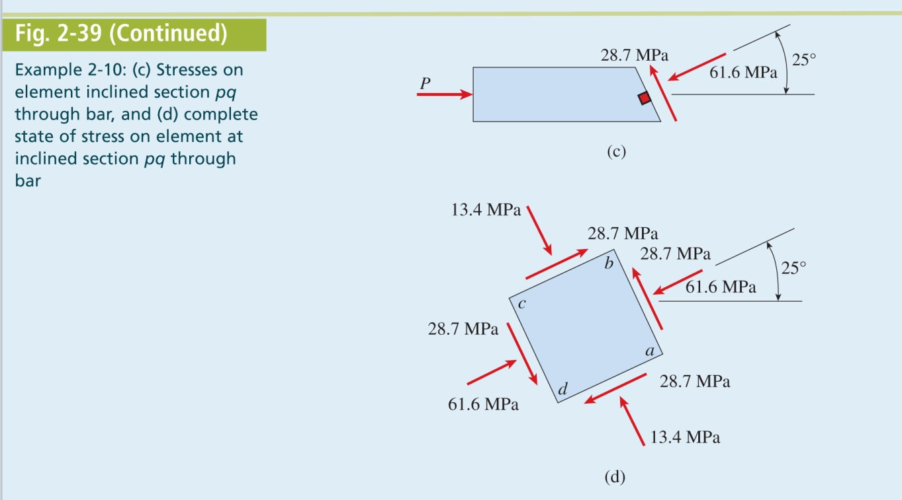
Mechanics of Materials, 8th Edition SI Gere & Goodno

Slide 54
Mechanics of Materials, 8th Edition SI Gere & Goodno

Slide 55
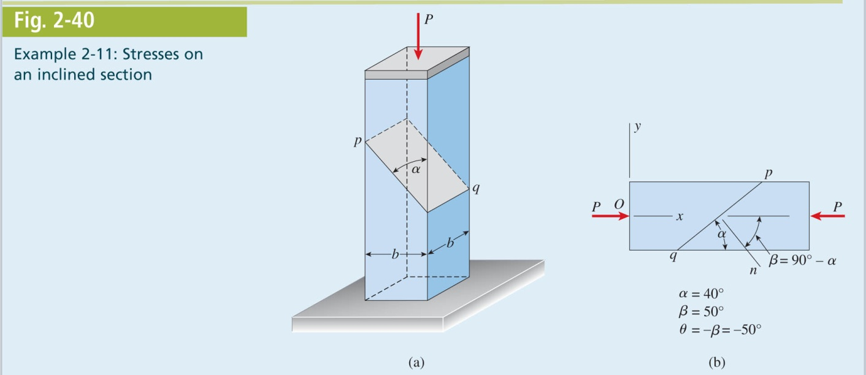
Mechanics of Materials, 8th Edition SI Gere & Goodno

Slide 56
Mechanics of Materials, 8th Edition SI Gere & Goodno

Slide 57
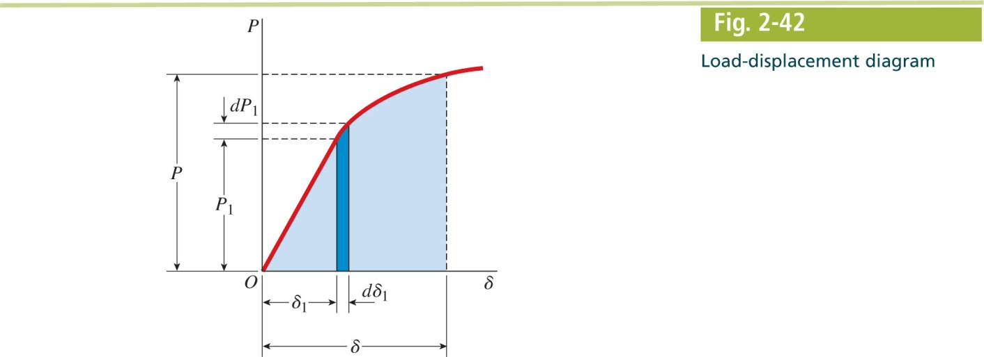
Mechanics of Materials, 8th Edition SI Gere & Goodno

Slide 58
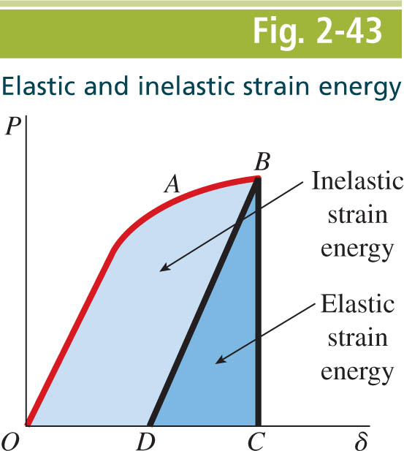
Mechanics of Materials, 8th Edition SI Gere & Goodno

Slide 59
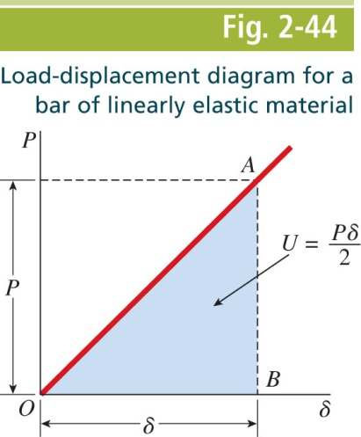
Mechanics of Materials, 8th Edition SI Gere & Goodno

Slide 60
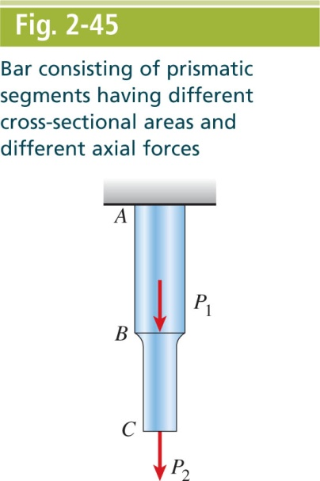
Mechanics of Materials, 8th Edition SI Gere & Goodno

Slide 61
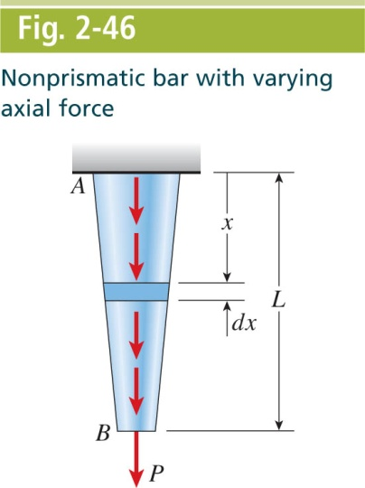
Mechanics of Materials, 8th Edition SI Gere & Goodno

Slide 62
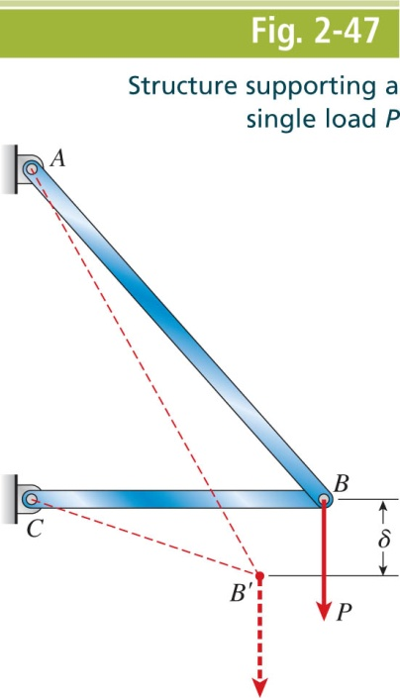
Mechanics of Materials, 8th Edition SI Gere & Goodno

Slide 63
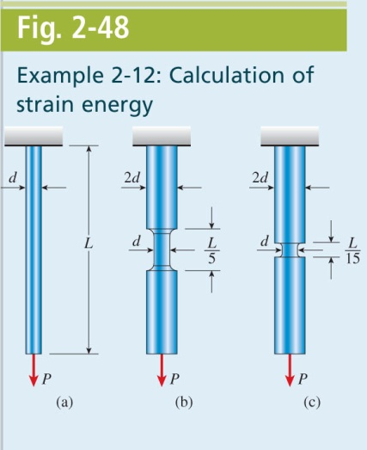
Mechanics of Materials, 8th Edition SI Gere & Goodno

Slide 64
Mechanics of Materials, 8th Edition SI Gere & Goodno

Slide 65
Mechanics of Materials, 8th Edition SI Gere & Goodno

Slide 66
Mechanics of Materials, 8th Edition SI Gere & Goodno

Slide 67
Mechanics of Materials, 8th Edition SI Gere & Goodno

Slide 68
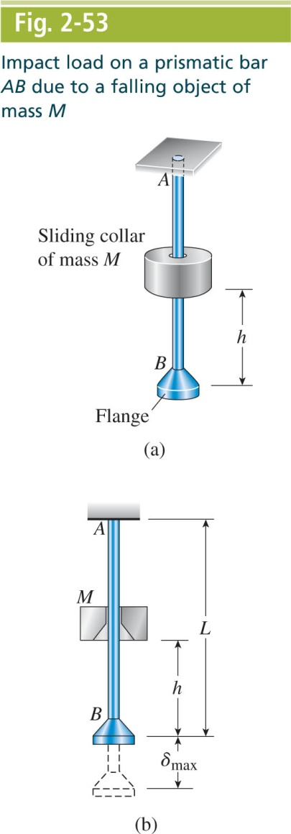
Mechanics of Materials, 8th Edition SI Gere & Goodno

Slide 69
Mechanics of Materials, 8th Edition SI Gere & Goodno

Slide 70
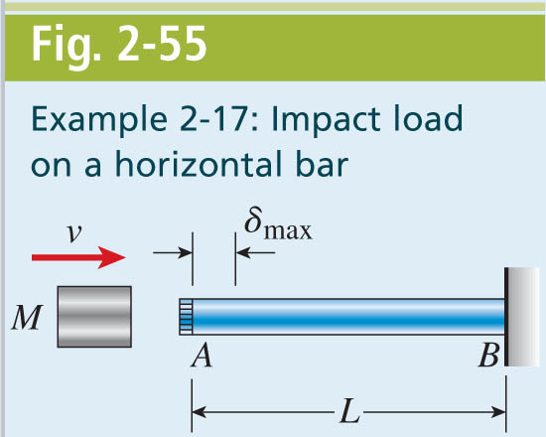
Mechanics of Materials, 8th Edition SI Gere & Goodno

Slide 71
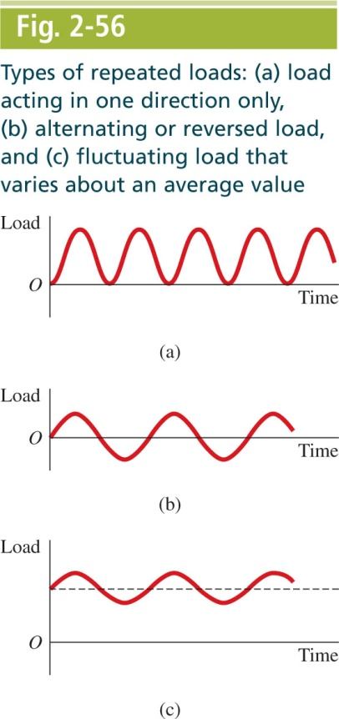
Mechanics of Materials, 8th Edition SI Gere & Goodno

Slide 72
Mechanics of Materials, 8th Edition SI Gere & Goodno

Slide 73
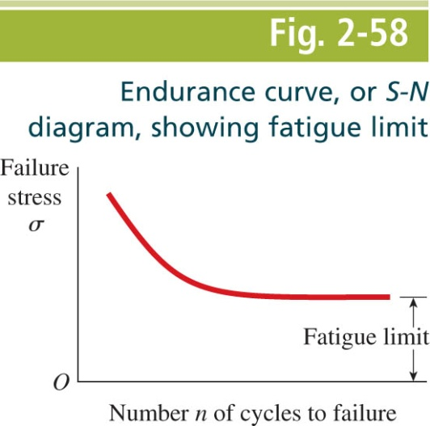
Mechanics of Materials, 8th Edition SI Gere & Goodno

Slide 74
Mechanics of Materials, 8th Edition SI Gere & Goodno

Slide 75
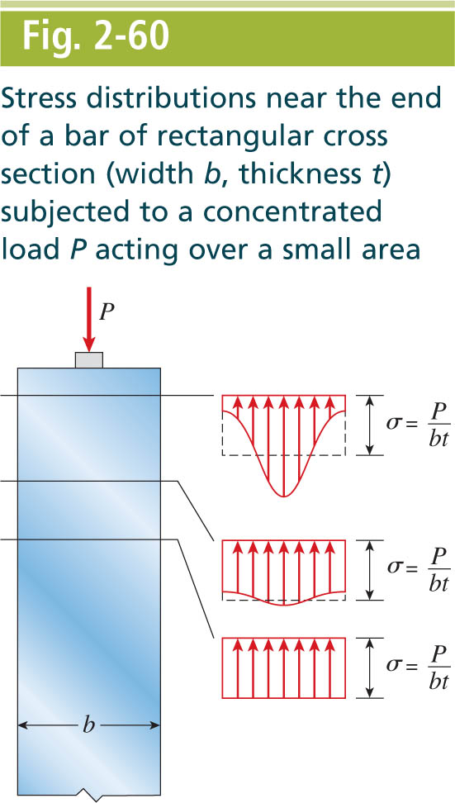
Mechanics of Materials, 8th Edition SI Gere & Goodno

Slide 76
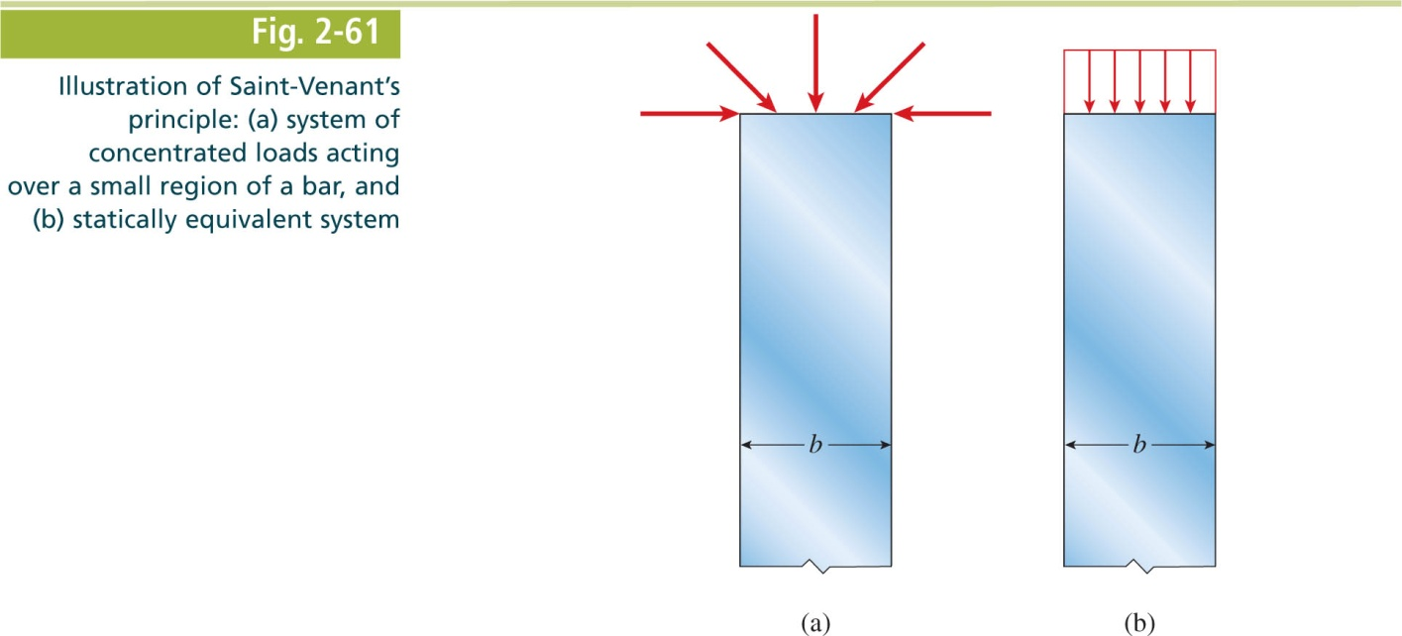
Mechanics of Materials, 8th Edition SI Gere & Goodno

Slide 77
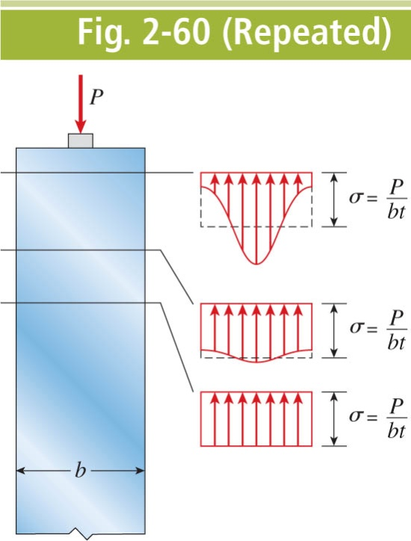
Mechanics of Materials, 8th Edition SI Gere & Goodno

Slide 78
Mechanics of Materials, 8th Edition SI Gere & Goodno

Slide 79
Mechanics of Materials, 8th Edition SI Gere & Goodno

Slide 80
Mechanics of Materials, 8th Edition SI Gere & Goodno

Slide 81
Mechanics of Materials, 8th Edition SI Gere & Goodno

Slide 82
Mechanics of Materials, 8th Edition SI Gere & Goodno

Slide 83
Mechanics of Materials, 8th Edition SI Gere & Goodno

Slide 84
Mechanics of Materials, 8th Edition SI Gere & Goodno

Slide 85
Mechanics of Materials, 8th Edition SI Gere & Goodno

Slide 86
Mechanics of Materials, 8th Edition SI Gere & Goodno

Slide 87
Mechanics of Materials, 8th Edition SI Gere & Goodno

Slide 88
Mechanics of Materials, 8th Edition SI Gere & Goodno

Slide 89
Mechanics of Materials, 8th Edition SI Gere & Goodno

Slide 90
Mechanics of Materials, 8th Edition SI Gere & Goodno

Slide 91
Mechanics of Materials, 8th Edition SI Gere & Goodno

Slide 92
Mechanics of Materials, 8th Edition SI Gere & Goodno

Slide 93
Mechanics of Materials, 8th Edition SI Gere & Goodno

Slide 94
Mechanics of Materials, 8th Edition SI Gere & Goodno

Slide 95
Mechanics of Materials, 8th Edition SI Gere & Goodno

