Slide 1
Relacoes Internacionais e Desenvolvimento (PRI-5058)
Development and Brazilian Foreign Policy
A.W. Pereira
13/5/19

Slide 2
Questions
1 What role does development play in Brazilian foreign policy?
2 How has Brazil helped to construct the post-WWII international development regime?
3 To what extent has the current government in Brazil broken from previous approaches to international development?

Slide 3
Outline
Development as a priority
Pre and post-WW II protagonism
Constitutional principles
Inaugural addresses
FHC: integration with a globalizing world
Lula: an active and assertive policy in a multipolar world
Bolsonaro: alignment with the US in favour of sovereignty and God and against “globalism”

Slide 4
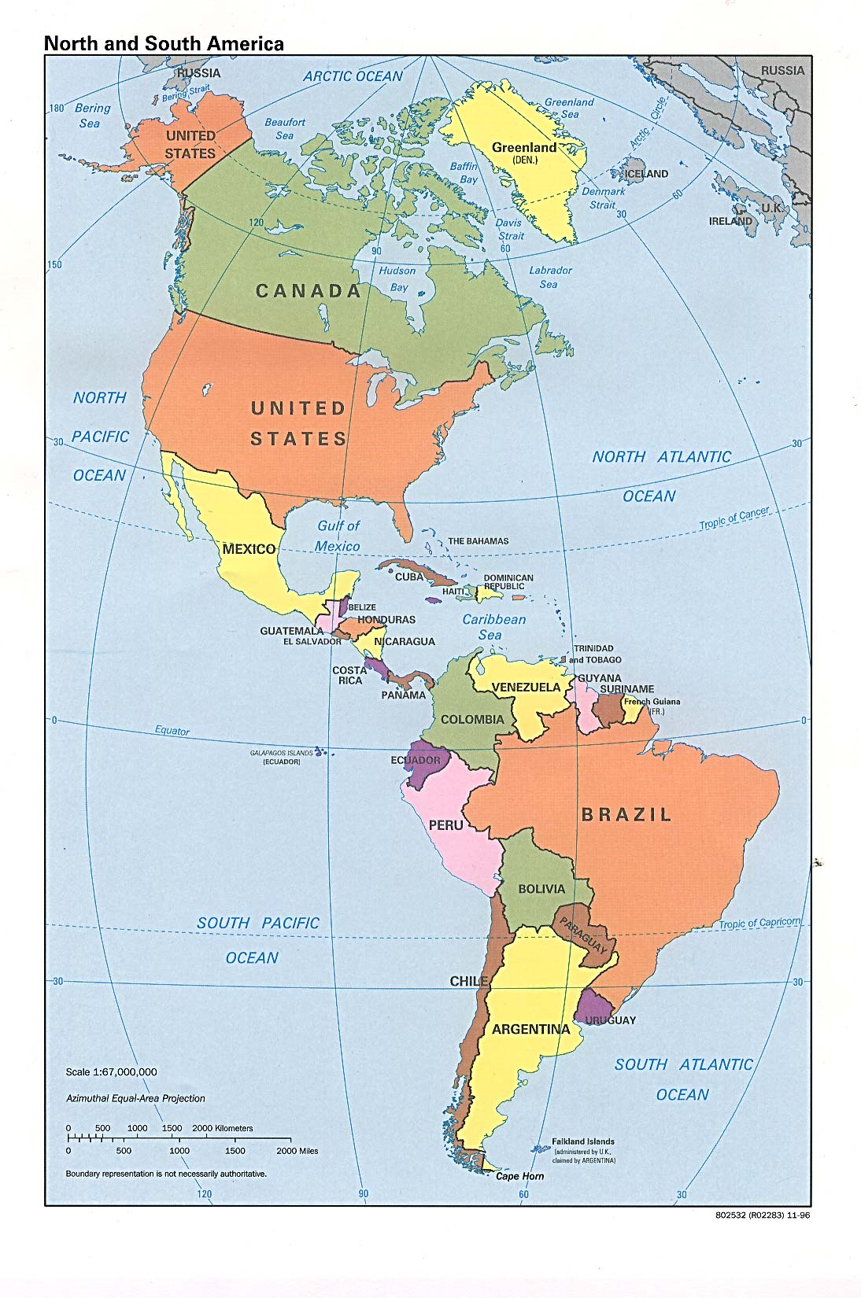
Notes:
Map of Brazil in the Western Hemisphere.

Slide 5
Pre-WW II Protagonism
Rui Barbosa at Hague Conference 1907
Pan-American conferences (8 held between 1889-90 and 1938)
Brazilian Participation in League of Nations 1919-1926 (left because did not get permanent seat in Council)

Slide 6
Post-WW II examples
UN 1945
OAS Charter 1948
Bandung 1955
UNCTAD 1964
Stockholm Conference on Human Environment 1972
Rio (ECO-92)
Rio + 20
Paris Agreement 2015

Slide 7
Constitutional principles
Art. 4º The Federative Republic of Brazil conducts its foreign policy guided by the following principles:
I – national independence;
II – the prevalence of human rights;
III – the self-determination of peoples;
IV – non-intervention;
V – equality between states;
VI – the defence of peace;
VII – the peaceful solution of conflicts;
VIII – a rejection of terrorism and racism;
IX – cooperation between peoples for the progress of humanity;
X – concession of political asylum.
The Federative Republic of Brazil seeks the economic, political, social and cultural integration of the people of Latin America, with a view to the formation of a Latin American community of nations.

Slide 8
Rubens Ricupero
“Few countries owe as much to diplomacy as does Brazil.”
Rubens Ricupero, A diplomacia na construcao do Brasil (Rio: Versal Editores 2017: 27).

Slide 9
Recent administrations. FHC (1995-2003)

Slide 10
FHC Inaugural Speech, 1/1995
“The state began to be transformed, to become more efficient, to avoid waste and provide better quality services to the population. It has ceased to be the state that does everything, but it continues to be a fundamental instrument to guarantee services to the poorest, generate conditions for an increase in production and assure the basic rights of all.”

Slide 11
FHC inaugural speech (2)
“Brazil is respected abroad again. Foreign investment has multiplied, generating new horizons for Brazilians. Again on the external level, Brazil is reaping the benefits of democracy, economic stability and a renewed confidence in the the potential of our market. The country has become more relevant to the world. At the same time, the world has become more relevant to the well-being of Brazilians.”

Slide 12
FHC Inaugural Speech (3)
“The national interest, today, is not achieved through isolation. We affirm our sovereignty by participating and by integrating, not by distancing [ourselves]. This is what we are doing in MERCOSUL – an irreversible priority of our foreign policy. It is what we are achieving with the creation of an integrated space of peace, democracy and prosperity shared with South America. And it is reflected in our vision of hemispheric integration and more solid relations with the EU, Russia, China and Japan, without taking away from our historic links with Africa.”

Slide 13
FHC Inaugural Speech (4)
“Brazil is consolidating an active and sovereign insertion in the international system.”

Slide 14
Luiz Felipe Lampreia Foreign Minister, 1995-2001

Slide 15
Celso Lafer Foreign Minister, 2001-2003

Slide 16
Rubens Barbosa Brazilian Ambassador to GB (1995-99) and USA (1999-04)

Slide 17
Paulo Roberto Almeida, Deputy Chief of Mission, Brazilian Embassy in the USA, 1999-04

Slide 18
Financial contagion
1995 Tequila crisis in Mexico
1997 East Asian economic crash
1998 Russian debt default
1998 FHC re-elected
1999 The Brazilian real is devalued
2000 George W. Bush elected in the USA
2001 9/11
2001-2 Argentine debt default
2002 “Lula” is elected President of Brazil

Slide 19
Changes to sovereignty
1994 Rwandan genocide
1995 Srebrenica massacre
2000 R2P begins to be articulated
2001 9/11 and the “Bush Doctrine”
2005 World Summit adopts R2P
2009 UN Report on Implementing the Responsibility to Protect
2000s Brazil articulates the principle of “responsibility while protecting”

Slide 20
Lula 2003-2010

Slide 21
Lula’s Inaugural Speech 1/2003
“Before the exhaustion of a model that, instead of generating growth, produced stagnation, unemployment, and hunger; before the failure of a culture of individualism, of egotism, of indifference to the other, the disintegration of families and communities.”

Slide 22
Lula’s Inaugural Speech (2)
“Before the threats to national sovereignty, the devastating precariousness of public security, the disrespect of the elderly and the disillusionment of the young; before the economic, social and moral impasse of the country, Brazilian society chose to change and began, itself, to adopt the necessary change.”

Slide 23
Lula’s Inaugural Speech (3)
“Our foreign policy will reflect also the hopes for change that are being expressed on our streets. In my government, Brazil’s diplomatic action will be oriented towards a humanistic perspective and will, above all, be an instrument for national development. Through external commerce, the capture of advanced technology, the search for productive investments, Brazil’s external relations must contribute to an improvement in the life conditions of the Brazilian woman and man, raising levels of income and generating dignified jobs.”

Slide 24
Lula’s Inaugural Speech (4)
“The democratization of international relations without hegemonies of any kind is as important to the future of humanity as the consolidation and development of democracy within each state. The resolutions of the Security Council must be faithfully complied with.”

Slide 25
Lula’s Inaugural Speech (5)
“We are beginning today a new chapter in the history of Brazil, not as a submissive nation, abandoning its sovereignty, not as an unjust nation, watching passively the suffering of its poor, but as a proud (altiva) nation, noble, courageously affirming itself in the world as a nation of all, without distinction of class, ethnicity, sex, and belief.”

Slide 26
The global context 2002-2010
2002 International Criminal Court (ICC) founded. East Timor regains independence from Indonesia.
2003: WTO meeting in Cancun.
2003 US invasion and occupation of Iraq.
2004 Haitian coup and beginning of MINUSTAH.
2008 global financial crisis.
2008 Obama wins US presidential election.
2009 Constitutional crisis in Honduras.
2009 Copenhagen climate change summit.
2010 Tehran Declaration.

Slide 27
Presidential advisor Marco Aurelio Garcia (2003-2016)

Slide 28
Foreign Minister Celso Amorim 2003-2010

Slide 29
Samuel Pinheiro Guimaraes, Sec General of Itamaraty 2003-2009

Slide 30
Antonio Patriota, Amb to US 2007-2009; Sec General of Itamaraty 2009-2010; For Minister 2011-2013

Slide 31
Ricupero’s View
For Rubens Ricupero, Brazil is a country that is satisfied with its territorial status, at peace with its neighbors, confident in international law, accustomed to and skilled in the achievement of negotiated solutions, and keen to be recognized as a constructive, moderating force in world affairs, working to make the international system more democratic and egalitarian, but also more peaceful and balanced (Ricupero 2017: 31)

Slide 32
Lafer’s View
Brazilian diplomats search for the Aristotlean mean (between rich and powerful states, on one hand, and poorer and weaker ones on the other), articulate consensus, and use international law and multilateral institutions to seek solutions to conflicts. Brazil’s key characteristics are its isolation from the centres of global power and its condition as a developing country. In consonance with these conditions, the thread of continuity in Brazilian foreign policy is the concern for autonomy in order to pursue national economic development (Lafer 2009: 101-119; Vigevani and Cepaluni 2009: 1-9).

Slide 33
Ricupero’s pride in Itamaraty
Ricupero reminisces that his enchantment with the Foreign Ministry reached its pinnacle when, during his examination to enter the diplomatic corps in the Itamaraty Palace in 1958, “servants in gloves and white uniforms with golden buttons served us coffee in elegant cups with gold trim and the coat of arms of the republic”. According to the former Ambassador, who had grown up in a working-class neighborhood in São Paulo, he never lost this “love at first sight” of the Foreign Ministry (Ricupero 2017: 24).

Slide 34
Lula’s Foreign Policy
Lula’s foreign policy was “active” and “assertive” (Amorim 2015, 2017). “The core belief [of Brazilian foreign policymakers] is that the United States and its European allies should treat non-Western states with greater respect and some degree of `equality.’ In the Brazilian view, U.S. behavior is often imperialistic, unilateral, and dismissive of third countries and of the United Nations – in sum, illiberal” (Spektor 2016: 34).
“…the fundamental critique Brazil brings to its engagement with multilateral structures is that the norms driving the system and the rules used to enforce them are designed to privilege the North and limit the policy autonomy needed throughout the South to advance national developmental priorities” (Burges 2017: 242).

Slide 35
The Tehran Declaration
On 17 May, 2010, Iran, Turkey and Brazil signed the Tehran Declaration, an agreement which placed limits on Iran’s nuclear power program. Hailed as a breakthrough by Brazilian Foreign Minister Celso Amorim, the deal was condemned by the United States and then ultimately rejected in the United Nations Security Council, when China and Russia joined the UK, France and the U.S. in tightening economic sanctions against Iran (Reid 2014: 240).

Slide 36
Amorim’s View
“The arrogance of the P5, including China and Russia, which negotiated exemptions in accordance with their own exclusive interests, has prevailed over the conciliatory efforts of two outsiders [Brazil and Turkey]. The global political system is still incapable of absorbing the changes [that have taken place] in the geometry of power. But inevitably that will happen, even if [the wait] lasts twenty or thirty years. And [when it happens] it will help bring peace to the world”
(Celso Amorim Acting Globally: Memoirs of Brazil’s Assertive Foreign Policy. Lanham, MD: Hamilton Books 2017: 66).

Slide 37
A preliminary conclusion
Brazil’s global influence depends – to a much greater extent than regional military powers such as China, India, and Russia – on the perceived attractiveness of its economic and political model. When that model appears to be successful, Brazil’s visibility and influence has risen significantly. But when Brazil appears to be politically polarized and in economic crisis, or simply to be struggling with uncertainty, its claims to greater global prestige and decision-making power look less plausible, and are less likely to be accepted by other actors.

Slide 38
Bolsonaro’s Inaugural Speech 2019
“Vamos retirar o vies ideologico de nossas relacoes internacionais.”
In speech to Congress:
“A politica externa retomara seu papel na defesa da soberania, na construcaao da grandeza e no foment ao desenvolvimento do Brasil.”

Slide 39
Ernesto Araujo’s inaugural address
“Para libertar o Itamaraty através da verdade, precisamos recuperar o papel do Itamaraty como guardião da continuidade da memória brasileira.”
“Precisamos desesquecer e lembrar de quem somos, de quem estamos voltando a ser.”
“Não estamos aqui para trabalhar pela ordem global. Aqui é o Brasil.”
“Não tenham medo de ser Brasil.”

Slide 40
Araujo (2)
“Vamos ler menos The New York Times, e mais José de Alencar e Gonçalves Dias.
Vamos escutar menos a CNN e mais Raul Seixas.”
“Por muito tempo o Brasil dizia o que achava que devia dizer. Era um país que falava para agradar os administradores da ordem global. Queríamos ser um bom aluno na escola do globalismo, e achávamos que isso era tudo. Éramos um país inferior, aplicando a classificação de Fernando Pessoa.
Mas o Brasil volta a dizer o que sente, e a sentir o que é.”

Slide 41
Araujo (3)
“…admiramos os Estados Unidos da América, aqueles que hasteiam sua bandeira e cultuam seus heróis. Admiramos os países latino-americanos que se libertaram dos regimes do Foro de São Paulo. Admiramos nossos irmãos do outro lado do Atlântico que estão construindo uma África pujante e livre. Admiramos os que lutam contra a tirania na Venezuela e em outros lugares. Por isso admiramos a nova Itália, por isso admiramos a Hungria e a Polônia, admiramos aqueles que se afirmam e não aqueles que se negam. O problema do mundo não é a xenofobia, mas a oikofobia – de oikos, oikía, o lar. Oikofobia é odiar o próprio lar, o próprio povo, repudiar o próprio passado.”

Slide 42
Araujo (4)
“Há uma teofobia horrenda, gritante, na nossa cultura. Não só no Brasil, em todo o mundo. Um ódio contra Deus, proveniente sabe-se lá de onde, canalizado por todos os códigos de pensamento e de não-pensamento que perfazem a agenda global.
Para destruir a humanidade é preciso acabar com as nações e afastar o homem de Deus, e é isso que estão tentando, e é contra isso que nos insurgimos.”

Slide 43
Araujo (5)
“No sistema multilateral político, especialmente na ONU, vamos reorientar a atuação do Brasil em favor daquilo que é importante para os brasileiros – não do que é importante para as ONGs. Defenderemos a soberania. Defenderemos a liberdade – a liberdade de expressão, a liberdade de crença, a liberdade na internet, a liberdade política. Defenderemos os direitos básicos da humanidade, o principal dos quais talvez seja, se me permitem usar o título de uma novela dos anos 60, o direito de nascer.”

Slide 44
Foreign policy decisions of the new government
?
Influential figures: Filipe Martins, foreign policy advisor to the president; Senator Eduardo Bolsonaro, son of the president; Ernesto Araujo, Foreign Minister.

Slide 45
Some actions
Withdrawal from Marrakech Pact on Global Migration
Cancellation of the hosting of COP-25 in 2019
Hardening of Brazil’s position against Maduro regime in Venezuela
Creation of a diplomatic “office” (but not an Embassy) in Jerusalem
Davos speech: in defense of family principles and “true human rights”
Trip to the USA
OECD
Alcantara
Vistos (EUA, Japao, Canada, Australia)
Major Non-NATO Ally

Slide 46
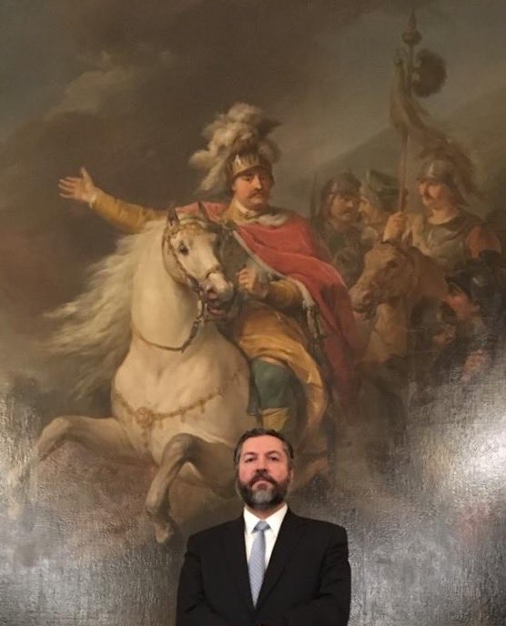
Araujo on Twitter, standing before a depiction of the Battle of Vienna in 1683
Ernesto Araújo‏Verified account @ernestofaraujo
Ontem, no castelo de Varsóvia, com o retrato do rei polonês Jan Sobieski, vencedor da batalha dos portões de Viena em 1683.
12:19 PM - 11 May 2019

Slide 47
For next week
How are concerns in the rich countries about security and development related?
How have crises in the last few decades shaped the global understanding of development?

Slide 48
For next week
What is the liberal good governance agenda in international development?
Why is it contested, and why is it sometimes not implemented in practice?
Is “good enough governance” a preferable alternative to the good governance agenda?
Marketa: globalization and democracy

