Slide 1
Universadade de São Paulo Faculdade De Direito São Paulo Faculty Workshop The Socratic Method and Beyond: ‎Reflections on Teaching about the Law 28 March 2017
Charles J. Russo, J.D., Ed.D. Panzer Chair in Education
Adjunct Professor of law University of Dayton
crusso1@udayton.edu

Slide 2
I. Introduction

Slide 3
Overview
I. Introduction
II. Study of Law
A) A Brief Excursus: School Law
III. Conclusion

Slide 5
II. Study of Law
King George III of England is reputed to have
said that a lawyer is not someone who knows
the law, but is one who knows where to find the law.

Slide 6
II. Study of Law
Thus, the role of a law professor is
to help students find the law . . .

Slide 7
II. Study of Law
But
A challenge:
How can Professors help students find the law even as it changes so much and so rapidly?

Slide 8
II. Study of Law
My Goal is to have students think with me…
not to think like me or necessarily agree with me
Cf. Wedge Theory

Slide 9
II. Study of Law
As the modern study of law emerged in England, lawyers and academicians analyzed judicial decisions in order to uncover the widely held view of the natural law which they “discovered” as a result of litigation.

Slide 10
II. Study of Law
At the same time, professional communities in London, the Inns of Court, which Winston Churchill described as “half colleges, half law schools . . . produced annual law reports or Year Books” that judges began to treat as authoritative.

Slide 11
II. Study of Law
In this way, common law, also referred to as judge made law, the basis for precedent, stood in contrast to the enacted laws or statutes in England
1 Winston S. Churchill, History of the English Speaking Peoples 176–177 (1956).

Slide 12
II. Study of Law
“One cannot step into the same river twice” Heraclitis

Slide 13
II. Study of Law
The Solution:
We must teach students to “think like lawyers”
This is especially true In common law jurisdictions

Slide 14
II. Study of Law
The Paper Chase
“The study of law is something new and unfamiliar to most of you, unlike any other schooling you have ever known before. You teach yourselves the law, but I train your minds. You come in here with a skull full of mush and, if you survive, you leave thinking like a lawyer.”
Professor Kingsfield

Slide 15
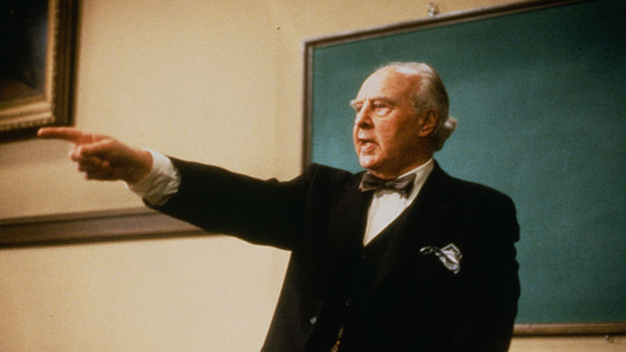
II. Study of Law
https://www.youtube.com/watch?v=zruWCuNmWV8

Slide 16
II. Study of Law
Using the Socratic method . . .
Use of pointed question and answers
to elicit the “right” response,

Slide 17
II. Study of Law
Take a reactive discipline (i.e., courts do not offer
advisory opinions) and use the knowledge, wisdom of
the past (precedent) to take pro-active steps to address
today’s issues of practice.

Slide 18
II. Study of Law
The study of Law does NOT focus solely on abstract
Legal principles, otherwise it is like counting “how
many angels can dance on the head of a pin.”

Slide 19
II. Study of Law
Instead, the Law deals with concrete principles
impacting daily lives of all where it is applied.

Slide 20
A) A Brief Excursus
School Law = Vehicle for change in society (Brown)
School Law = multi-disciplinary legal research vi
historical, legal inquiry,
an amalgam of may areas such as constitutional law,
contracts, administrative law

Slide 21
III. Conclusion
Knowledge is power . . .
Francis Bacon

Slide 22
Muito Obrigado

