Slide 1
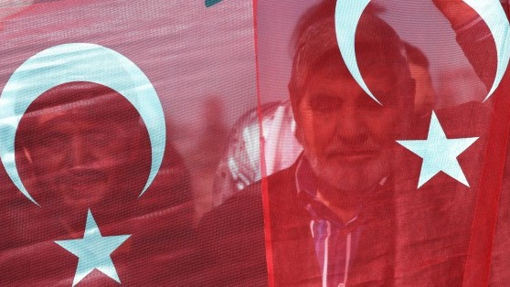
The history and politics of modern turkey
Dr. Feyzi Karabekir Akkoyunlu
karabekir.akkoyunlu@uni-graz.at
IRI – USP 2018

Slide 2
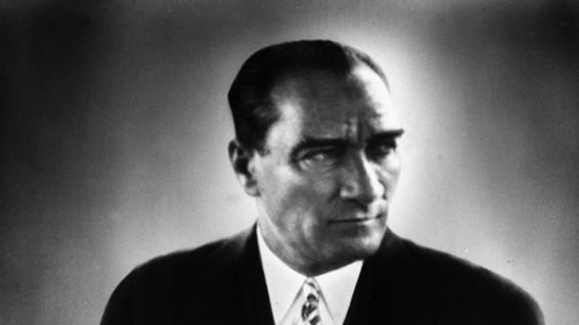
Atatürk and the legacies of kemalism
The Story: From Nation-Saving to Nation-Building
A popular movement made up of a coalition of diverse actors & interest groups, united under a single leadership and immediate goals…
…falls apart once those goals are reached. Clashing interests and visions resurface and a power struggle ensues…
from which an authoritarian one-party state led by a charismatic leader emerges, and sets out to re-engineer state and society from above.
A familiar story?

Slide 3
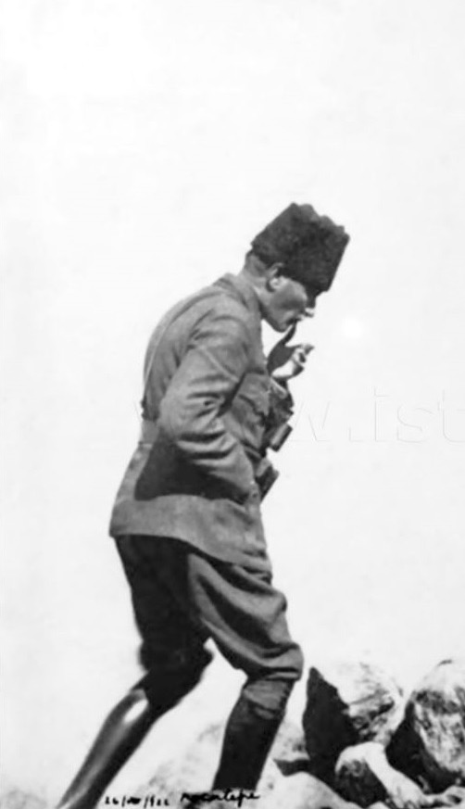
The Anatolian resistance movement 1919 - 1922
Also known as the Turkish War of Independence, the Turkish nationalist movement, the Kemalist movement, the Greco-Turkish war or the Asia Minor Catastrophe (in Greece).
Against the occupation and partition of the Ottoman Empire.
Former Ottoman officers unite local (Muslim) resistance movements in the countryside.
Mustafa Kemal emerges as charismatic leader.
A “national will” rejecting the terms of the occupation in Congresses of Erzurum and Sivas (1919) and the National Assembly in Ankara (April 1920)

Slide 4
The Anatolian resistance movement 1919 - 1922
A diverse coalition:
Ottoman loyalists
Young Turk officers
Socialists
Kurdish notables
Muslim fraternities (tariqats)

Slide 5
The Anatolian resistance movement 1919 - 1922
Fought to defend traditional values & symbols
Fatherland (vatan) based on the ‘National Pact’ (Misak-i Milli) adopted by the last Ottoman parliament in February 1920.

Slide 6
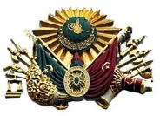
The Anatolian resistance movement 1919 - 1922
Fought to defend traditional values & symbols
The state (devlet) as identified with sultan and dynasty.
No explicit aim to abolish the sultanate/caliphate, establish republic.

Slide 7
The Anatolian resistance movement 1919 - 1922
Fought to defend traditional values & symbols
Nation as understood in religious terms, i.e. the ethnically diverse Muslim millet
Muted expressions of Turkish nationalism, esp. vis-à-vis the Kurds.
“The people who constitute this great Assembly of ours are not only Turks, not only Circassians, not only Kurds, not only the Laz, but the community of Muslims that comprises them all. […] Thus, the nation that we endeavour to preserve and defend naturally does not consist of a single component. It consists of diverse components of Islam. They are compatriots who have mutual respect for each other, and […] will always respect each other’s ethnic, social and geographic rights.” – Mustafa Kemal, Address to GNA, 1 May 1920.

Slide 8
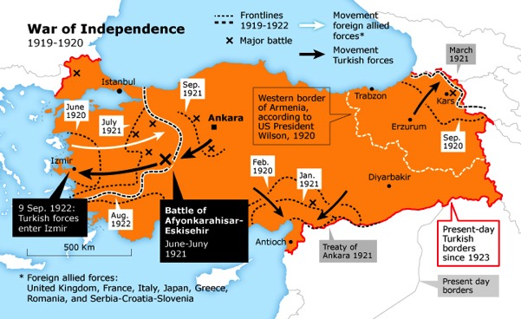
The Anatolian resistance movement 1919 - 1922
Between 1920 – 22, nationalist forces achieve impressive gains on the battlefield
Treaty of Lausanne (July 1923) replaces Sèvres and recognises the Ankara govt.

Slide 9
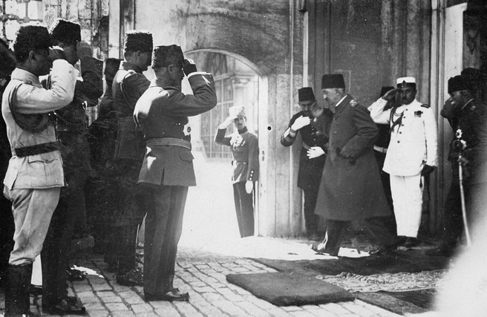
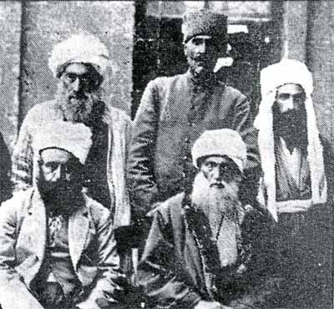
AFTER VICtory
Power struggle and consolidation (1922 – 27)
MK uses charismatic authority to push with radical socio-political reforms
Ottoman monarchy abolished in Nov 1922
Republic declared in October 1923
Caliphate abolished in March 1924
Uses ‘Independence Tribunals’ and military to suppress rebellions and opposition
Declaration of State of Emergency in 1926
Achieves uncontested authority by 1927
Legacy of suppression → layers of entrenched opposition to the regime
Sultan Mehmed VI departing from the backdoor of the Dolmabahçe Palace.
Ottoman loyalists and monarchists
Socialists, Kurdish nationalists, pious Muslims
Other leaders of the resistance movement
Mustafa Kemal & loyalists
Sheikh Said leads a Sunni Kurdish rebellion against Ankara in 1925

Slide 10
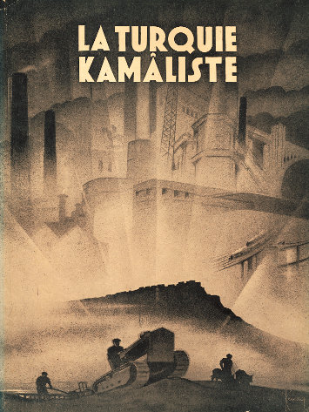
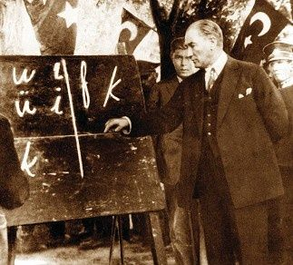
Kemalist turkey

Slide 11
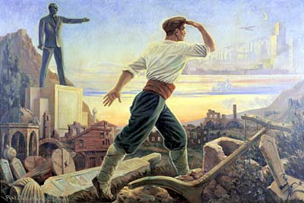
kemalism
WHAT IS IT?
A civilising mission
Belief in complete cultural transformation of society from above and creation of a new modern, western, secular national identity
Dichotomous world view
Civilisation vs. Barbarism
Modernity vs. Tradition
Progress vs. Backwardness
West vs. East
Science vs. Religion
Inspired by European (French) Enlightenment

Slide 12
kemalism
THE CONTEXT
Local context:
Anatolia after the War of Independence
Complete social, demographic and economic catastrophe
This extensive destruction made radical reforms both possible and seemingly necessary.
Global context:
The world in 1920s – 1930s
Interwar era, Geopolitical Uncertainty
The Great Depression of 1929
Rise of totalitarian movements

Slide 13
Turkification
secularisation
Westernisation
Modernisation
THE FOUR PILLARS OF THE KEMALIST PROJECT

Slide 14
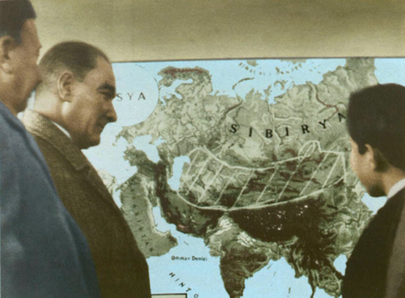
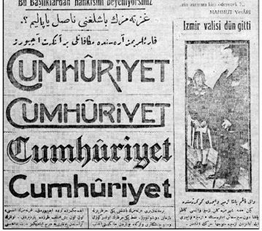
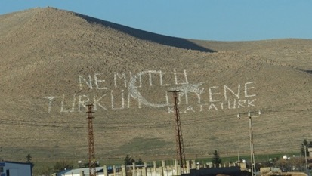
Turkification
secularisation
Westernisation
Modernisation
The Modern Turk: Construction of a new national identity out of the ethnically diverse Muslims of Anatolia
The Historiographical project
History of Turks rewritten, reimagined
Turkish Historical Society (1931)
The Linguistic project
The adoption of the Latin alphabet (1928)
Attempts to “purify” the language
Turkish Language Foundation (1932)
“Vatandaş Türkçe konuş!” (Citizen Speak Turkish!)
The Geographic Project
Nationalisation of people and space
Greek-Turkish population Exchange (1922)
Thrace Pogroms (1934)
Resettlement Law (1934)
Turkification of town and village names
Why need a new history?
Why need a new language?
“Ne mutlu Türküm diyene!” (Happy is he who calls himself a Turk!)

Slide 15
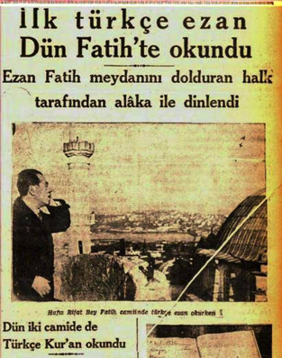
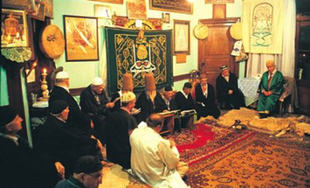
Turkification
Secularisation
Westernisation
Modernisation
Secularisation of state, education and law
The abolition of the sultanate and the caliphate
Abolition of the office of Şeyhülislam & creation of Diyanet (Directorate for Religious Affairs) attached to PM’s office
Abolition of medreses & adoption of a secular, unitary, national education system
Abolition of sharia & adoption of Swiss civil code and Italian penal code
Completes the process begun under Ottoman reformers
Secularisation of society
Suppression of the Islamic networks and fraternities (dervish orders, tarikats) in 1925
Religious practices and symbols pushed out of public life
Secularism or Laïcité?
The first ezan (call to prayer) in Turkish

Slide 16
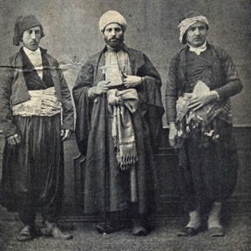
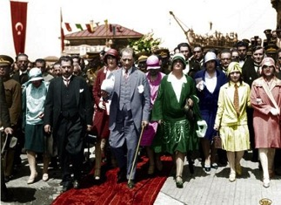
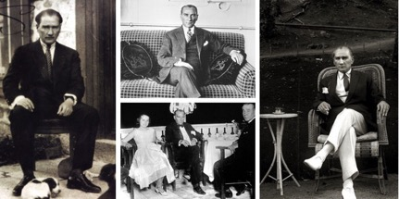
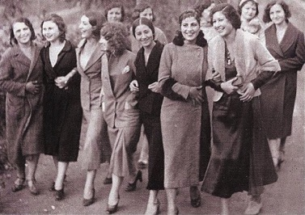
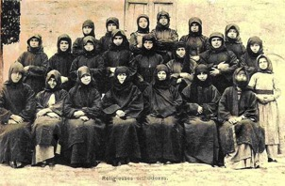
Turkification
secularisation
westernisation
Modernisation
Westernisation of symbols and traditions
Adoption of western dress code
Ban of “traditional” headgear (fez and turban)
Adoption of the western (Gregorian) calendar & weekend
Adoption of the Latin alphabet
Emancipation of women
Policies to encourage women to partake in socio-economic life (education, employment, politics)
Women’s suffrage (1934)
France 1944, Italy 1946, Greece 1952, Switzerland 1971

Slide 17
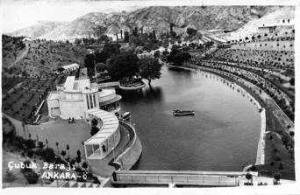
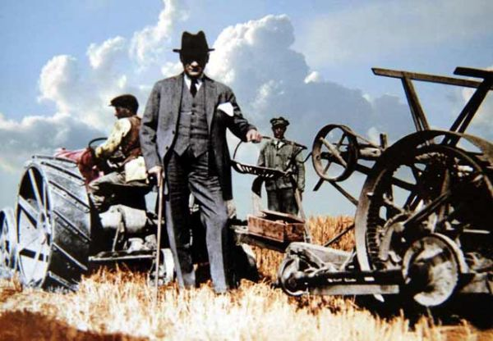
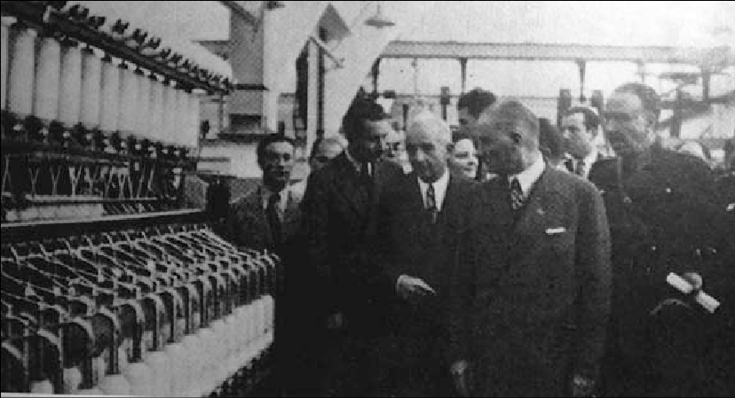
Turkification
secularisation
Westernisation
modernisation
Centralisation
Ongoing attempt to strengthen the authority of the central government
Physical Modernisation
Major Infrastructure Projects
Machinisation in Agriculture
State-driven Industrialisation
Hampered by lack of coherent economic blueprint + Financial hardship
Liberal capitalist economy during 1920s (creation of a Turkish bourgeoisie)
State-led developmentalism in 1930s

Slide 18
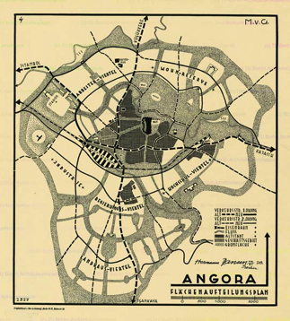
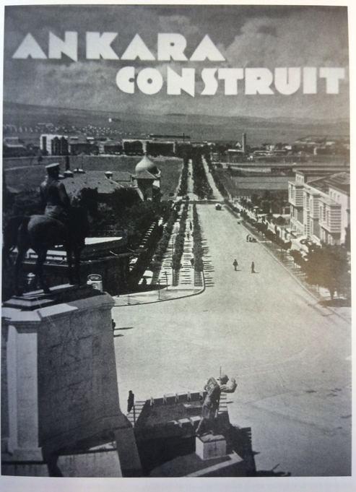
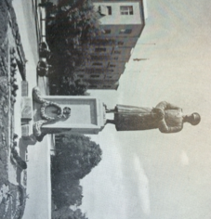
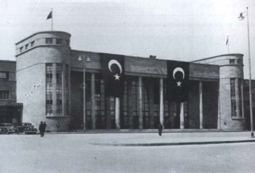
Turkification
secularisation
Westernisation
modernisation
ANKARA
Modernist Showcase of the Republic
Social Experiment for the Kemalist Project
A break from the past (symbolic & political)
From old, weak pre-modern, cosmopolitan empire to new, strong modern, homogenous nation-state
Erasure of Ankara’s own pre-republican history
Planned by Austrian & Swiss radical modernist architects and state planners
Drain on the economy
Leads to neglect of the countryside
The Jansen Plan of 1927
Compare with Brasília!

Slide 19
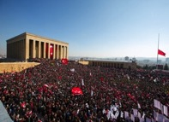
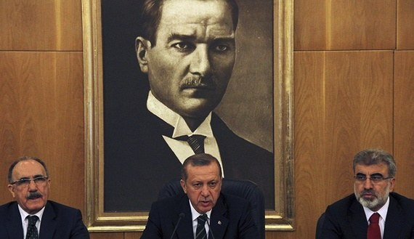
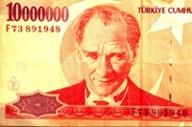
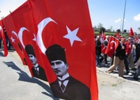
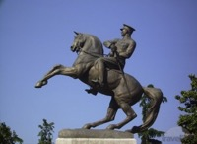
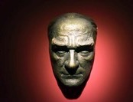
Immortal atatürk
Revered (and feared) while alive, Atatürk is “immortalised” by the state in his death.
His charismatic authority is institutionalised (between the military and the Republican People’s Party).
Rival factions regime portray a different Atatürk to claim ownership of his legacy.

Slide 20
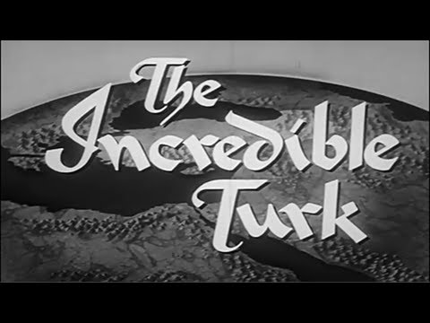
“the incredible turk”
1958 US production about transformation of Turkey under Atatürk
Cold War propaganda piece
https://www.youtube.com/watch?v=PW5Ub0mhYpo

Slide 21
discussion
Was the Kemalist project a ‘revolution’?
Change and Continuity from the Ottoman Empire
State elites and the masses
Civilisational goal (to bring down the int’l system or become a respected part of it?)
Was it ‘successful’ in achieving its intended results?
Transformation of the State and Society
Cities, towns, villages
What are/were some of its lasting legacies?
Democracy and authoritarianism
Nationalism and minorities (Muslim and non-Muslim)

Slide 22
OUTCOMES & legacies
Where the reforms successful?
YES
A new generation of secular, westernised ‘Turks’
Reforms popular among urban middle class professionals
Expressions of sympathy in the West
NO
Reforms rejected in provincial towns, ignored in villages
Sporadic Kurdish uprisings against Turkification
Religious orders survive underground
Rise of political Islam since the 1960s

Slide 23
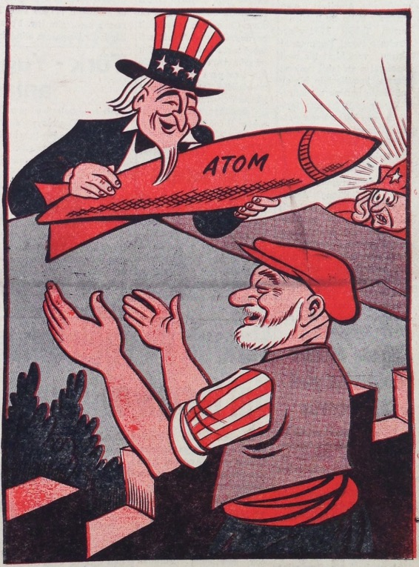
Turkey in the cold war
Next lecture:
Thu, 30 August
Turkey in the Cold War

