Slide 1
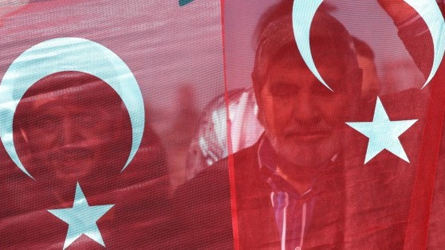
The history and politics of modern turkey
Dr. Feyzi Karabekir Akkoyunlu
karabekir.akkoyunlu@uni-graz.at
IRI – USP 2018

Slide 2
Turkey in the Cold War
1. Turkey’s entry into the Cold War
2. 1950 elections and its legacy
3. The three eras of the CW (politics, economy, society and IR)
1950 – 1960: Democrat Party era
1960 – 1980: Hegemonic Struggles
1980 – 1990s: Washington Consensus

Slide 3
Chronology
1950: Democrat Party wins first competitive multiparty elections
1952: Korean War + Turkey joins NATO
1955: Istanbul pogroms of 6-7 September
1960: Military coup
1971: Military coup
1974: Turkish invasion of Cyprus
1977-80: Economic crash, political violence & instability
1980: Military coup
1983 – 1991: Centre-right ANAP government
1984: Beginning of armed insurrection by PKK

Slide 4
Chronology
1962: Cuban missile crisis
1960s: Civil rights movement in the US. Vietnam War
1964: Military coup in Brazil
1966 – 76: Mao’s Cultural Revolution
1968: Prague Spring
1973: Yom Kippur War. First OPEC Crisis. Coup in Chile.
1979: Islamic Revolution in Iran. Soviet occupation of Afghtanistan
1980 – 88: Iran – Iraq War.
1989: Fall of the Berlin Wall.

Slide 5
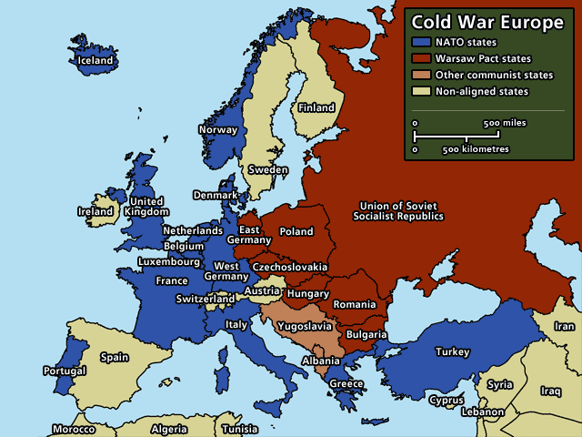
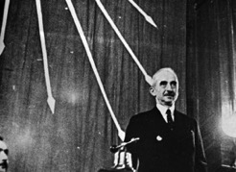
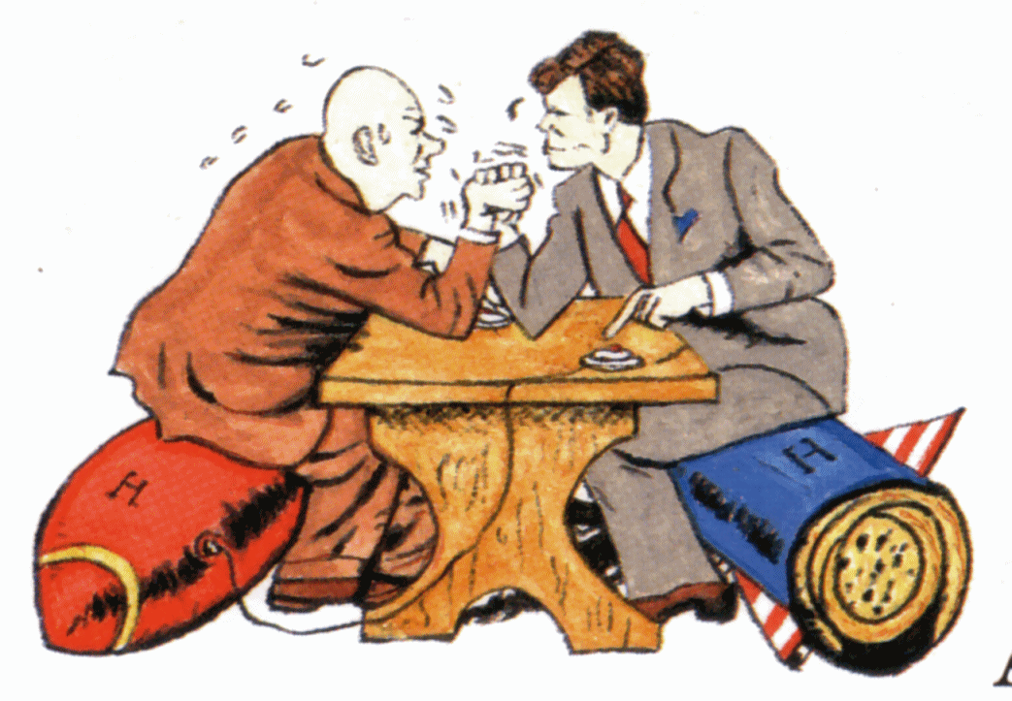
Turkey’s Entry into the cold war
Post-WWII geopolitical alignment
Beginning of Cold War: Turkey located on the new fault line
Fear of Soviet expansionism + Economic crisis push TR to the West

Slide 6
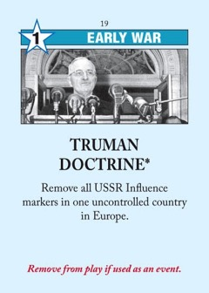
Turkey’s Entry into the cold war
US offers economic aid + security guarantees
Demands political + economic reforms and geopolitical commitment
Division within the CHP
Westernisation vs. Sovereignty
President Inönü chooses the former

Slide 7
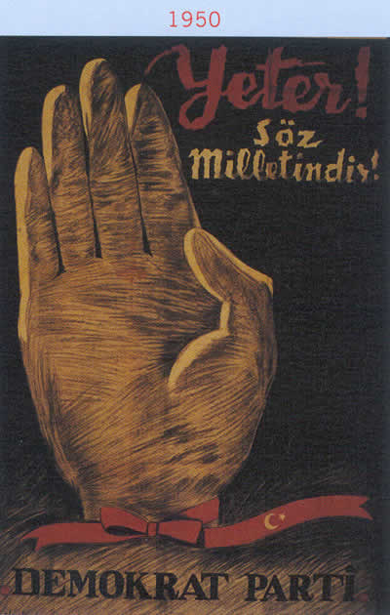
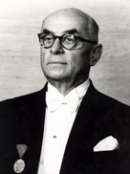
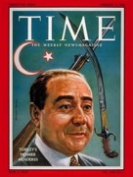
1950 election
DP victory in 1950 general elections
Beginning of multiparty politics
Government of landlords & bourgeoisie
Ends CHP & military-bureaucratic hegemony
Starts dominance of centre-right parties
İnönü hands over power peacefully
Creates democratic path dependence
Celal Bayar (President)
Adnan Menderes (PM)

Slide 8
 | Politics | Economics | Society | Geopolitics
1950s | Democrat Party Majoritarian democracy Anti-communism | Capitalist Development “Little America” Export-oriented economy Agriculture | Beginning of Urbanisation Turkification cont’d (Istanbul pogroms) | Korean War NATO McCarthyism
1960-1980 | Hegemonic Struggles Tutelary Democracy Left/Right clashes “Deep state” | Import-Substitution-Industrialisation Economic growth (60s) and bust (mid-70s) | Rapid Urbanisation Organised labour movements Cultural openness Migration to Europe | Bipolar world Middle East wars and OPEC crises Cyprus issue Post-colonial revolutions & coups
1980s | 1980 Coup Repression Forced liberalisation Turkish-Islamic synthesis Kurdish conflict | Radical free-market reforms | Neo-liberal age From citizen to consumer Activism discouraged | Washington Consensus Iran revolution Occupation of Afghanistan Pereistroika

Slide 9
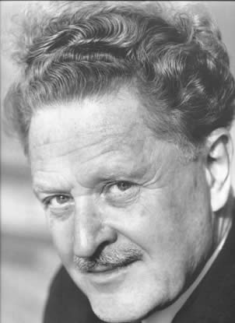
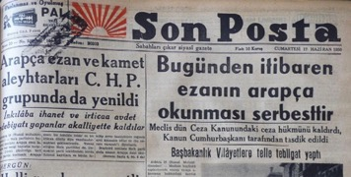
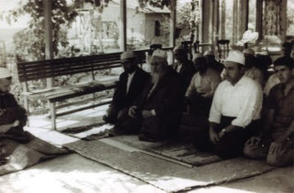
 | Politics | Economics | Society | Geopolitics
1950s
1960-1980
1980s
Relaxations on state control of religion and society
Call the prayer back in Arabic
Establishes Islamic studies departments, reopens mosques
Islamic fraternities resurface
Accusations of anti-secularism
(Were they really anti-Kemalist?)
Anti-communism
Purges in the military, bureaucracy, press
Era of McCarthyism
Majoritarian democracy
Winner takes all system (1924 Constitution)
”Milli irade” (National Will)
Menderes’s claim to charismatic authority
Creeping authoritarianism
“From this day on the call to prayer can be in Arabic.”
Communist poet Nazim Hikmet was expatriated in 1951.
Menderes survives plane crash in London. Adds to charismatic image.

Slide 10
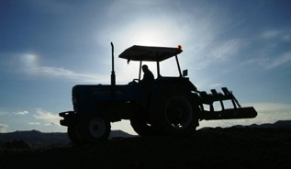
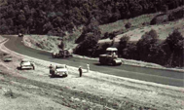
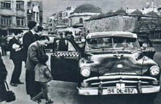
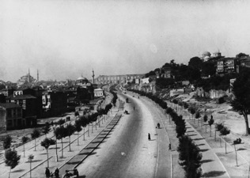
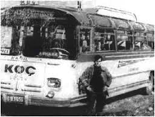
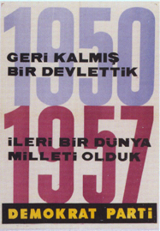
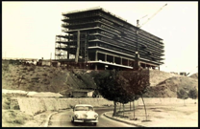
 | Politics | Economics | Society | Geopolitics
1950s
1960-1980
1980s
Capitalist developmentalism “Turkey as little America”
Encourage private enterprises
Mechanisation in agriculture
From a wheat-importing country to world’s 4th exporter in four years
Aideded by high global demand during Korean War
New roads and highways
Financed by US loans and exports
Economic growth brings political success
“It’s the economy stupid!”
Growth slows mid-50s, crisis and currency devaluation after 1958
Wage earners (teachers, bureaucrats, military officers) see their socio-economic status decline.
40,000 Ford tractors imported from the US
Roads and highways: 1,600 km in 1950, 7,000 km in 1960.

Slide 11
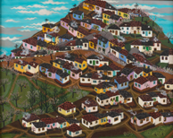
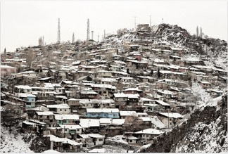
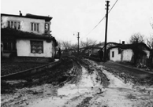
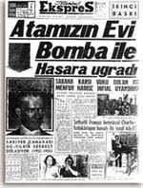
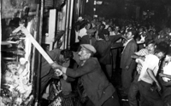
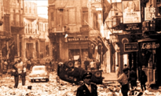
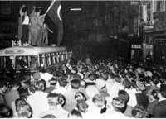
 | Politics | Economics | Society | Geopolitics
1950s
1960-1980
1980s
Rural to urban migration
Outcome of mechanisation in agriculture
The beginning of the “gecekondus” (informal housing)
Turkification project continued
Istanbul pogroms of 6-7 September ’55

Slide 12
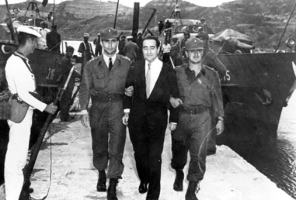
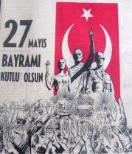
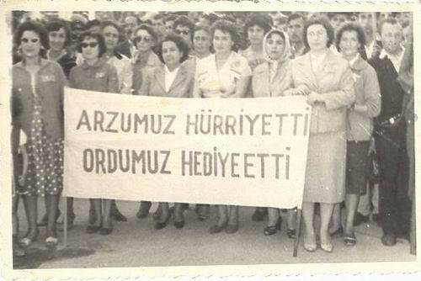
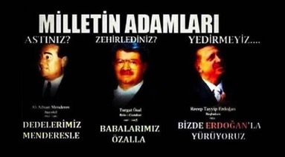
 | Politics | Economics | Society | Geopolitics
1950s
1960-1980
1980s
The coup d’etat of 27 May 1960
Carried out by left-leaning junior officers
Menderes sentenced and hanged
1961 Constitution
Limits the powers of the executive
National Security Council
Senate
Presidency
Constitutional Court
Expands civil liberties and labour rights
Coup sets stage for future interventions
1971, 1980, 1997, (2007), (2016)
Left-right blood feud
TUTELARY DEMOCRACY
Indirect influence of the military and senior bureaucracy + periodic coups
Justified in the of democracy + Kemalism
Constitutional changes after every coup
Backed by NATO & US
”Deep State”
“We demanded liberty
Our military gave it to us.”

Slide 13
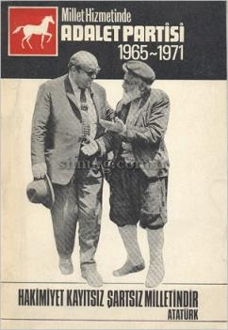
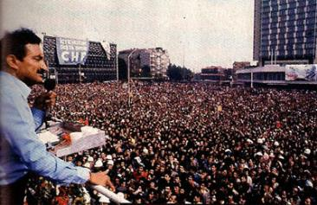
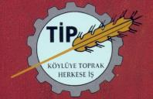
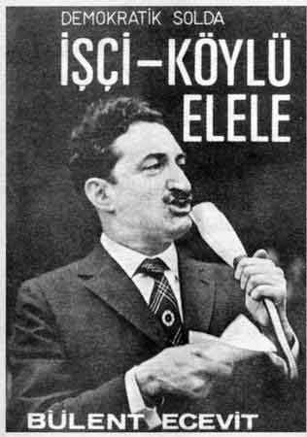
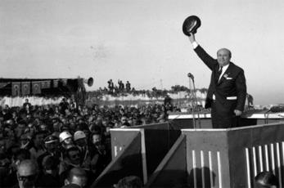
 | Politics | Economics | Society | Geopolitics
1950s
1960-1980
1980s
Parliamentary politics:
Justice Party (Süleyman Demirel)
Centre-right (Continuation of DP)
CHP (Bülent Ecevit)
Democratic left (gov’t in 74 & 77)
Nationalist Action Party (Alparslan Türkes)
Turkish Nationalism
National Salvation Party (Necmettin Erbakan)
Islamism
Workers’ Party
Socialism

Slide 14
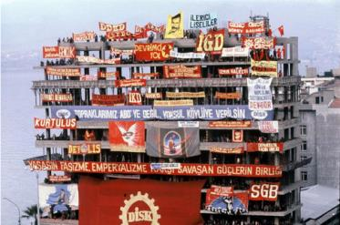
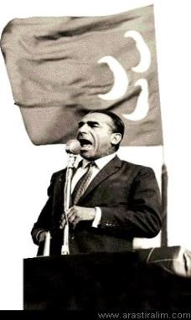
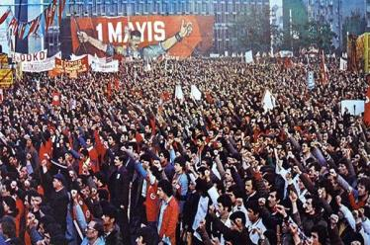
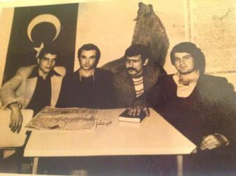
 | Politics | Economics | Society | Geopolitics
1950s
1960-1980
1980s
Popular left
Urbanisation, industrialisation, unionisation
Student movements
Inspired by Cuban, Chinese revolutions, Vietnam war, 1968 cultural movement
Increasingly fractured and militant
Nationalist far-right
Anti-communist, anti-Kurdish
Turkism
Vigilante groups and assassins (Greywolves)
Recruited by security services

Slide 15
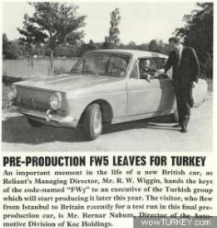
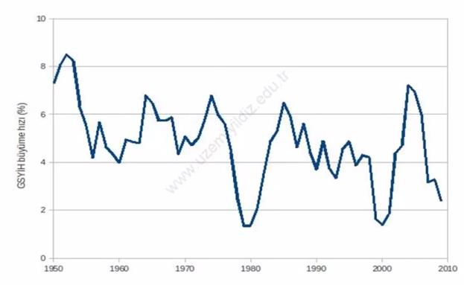
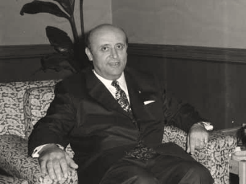
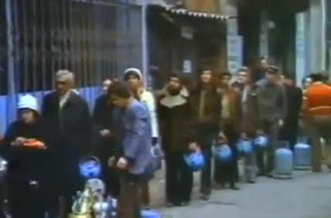
 | Politics | Economics | Society | Geopolitics
1950s
1960-1980
1980s
New economic model: Import-Substitution-Industrialisation (ISI)
Protectionism, State planning
From agricultural to industrial development
Aimed to reduce foreign dependency
Popular in Latin America (Brazil, Argentina)
Erratic growth in the 60s, downturn & crises in the 70s
Regional instability and oil crises
Rising inflation & austerity measures
Social upheaval, strikes
«We are desperate for even 70 cents...»
-PM Süleyman Demirel, 1977

Slide 16
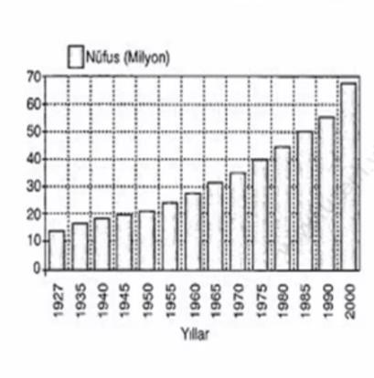
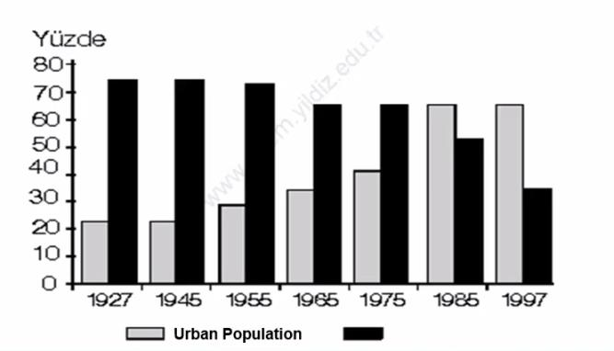
 | Politics | Economics | Society | Geopolitics
1950s
1960-1980
1980s
Rapid urbanisation
Relative increase in wages and job security
Increasing consumption
Rural Population

Slide 17
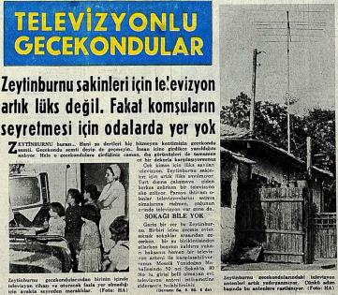
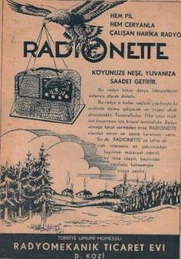
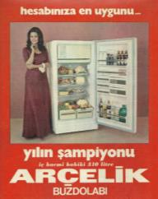
 | Politics | Economics | Society | Geopolitics
1950s
1960-1980
1980s
Rapid urbanisation
Relative increase in wages and job security
Increasing consumption
‘The radio that works with battery and electricity… Brings happiness to your village’
“Gecekondus (shantytowns) with TV”

Slide 18
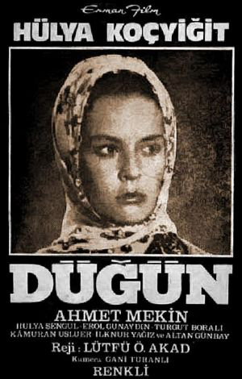
 | Politics | Economics | Society | Geopolitics
1950s
1960-1980
1980s
Düğün [Lütfi Akad, 1974]: The story of an immigrant family from Southeast Anatolia

Slide 19
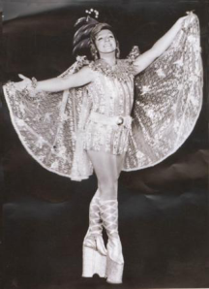
 | Politics | Economics | Society | Geopolitics
1950s
1960-1980
1980s
Period of social liminality, cultural experimentation
Identities more fluid, therefore more tolerant
Zeki Müren [Turkish David Bowie]
Zeki Müren
The sun of art

Slide 20
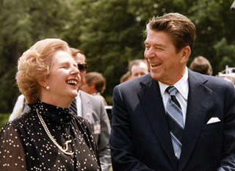
 | Politics | Economics | Society | Geopolitics
1950s
1960-1980
1980s
12 September1980: The mother of all coups
Reasons for the coup:
Domestic:
Economic crisis & austerity measures
Political instability & violence
Macroeconomic:
Era of radical neoliberal transformation
Raegan-Thatcher & The Chicago School
Coup in Chile 1975
IMF Shock Therapy reforms
Geopolitical:
Feb ‘79: Iranian Revolution
Dec’ 79: Soviet invasion of Afghanistan

Slide 21
 | Politics | Economics | Society | Geopolitics
1950s
1960-1980
1980s
12 September1980: The mother of all coups
1961 Constitution annulled.
Parliament dismissed. Senate abolished
Political parties banned. Leaders detained.
Martial law and junta rule for three years.
Mass arrests, trials, torture, executions
Left is crushed
Diyarbakir Prison the birthplace of Kurdish rebellion in 1984
1982 Constitution
Civil liberties & labour rights curtailed.
Media & university freedoms curtailed.
“National security regime”
Permanent SofE in Kurdish regions

Slide 22
 | Politics | Economics | Society | Geopolitics
1950s
1960-1980
1980s
After the coup
Özal years (1983 – 1993)
Turgut Özal, chief architect of economic reforms.
Conservative. Engineer. Stint at WB.
Admirer of Raeganite capitalism.
Forms Motherland Party (ANAP)
ANAP emulates legacy of DP
Wins two general elections (’83 & ‘87)
Becomes president in 1989
Pushes back the military

Slide 23
 | Politics | Economics | Society | Geopolitics
1950s
1960-1980
1980s
Transition from ISI to market economy
Focus shifts from domestic consumption to exports
Currency devaluation
Suppression of wages
Withdrawal of state subsidies
Large scale privatisations
Immediate trade liberalisation
Ushers in economic growth and increased consumer choice
But also corruption, clientelism and inflation
Economic freedoms not coupled with political freedoms
Growing presence of religious groups
McDonalds opens in 1986
Turkey’s first Mall “Galleria” opens in 1988
First private TV channel Star 1

Slide 24
 | Politics | Economics | Society | Geopolitics
1950s
1960-1980
1980s
A depoliticised generation
Political activism discouraged, suppressed
Consumption and personal/material wealth glorified
Turkish-Islamic synthesis
Ideological antidote to the Left
More loyal to the state
Generals recite Quran in public
Mandatory religion courses in schools
New clerical schools and mosques (1500 built every year in 80s)
The junta directly and indirectly supports the rise of political Islam in its various forms
A policy the military (and the US) comes to regret…
In Turkey, coup against Islamists in 1997…
In US Bin Laden & 9/11
A patriarchal heteronormativity enforced
Islamic Green Belt Policy
Supporting Islamists against communists
Mujahedeen in Afghanistan
Hamas in Palestine

Slide 25
 | Politics | Economics | Society | Geopolitics
1950s
1960-1980
1980s
Two different countries
Western Turkey goes into neoliberal development
In Southeastern Turkey (Kurdish provinces) a different regime takes root
The ‘State of Exception” Regime (1987-2002)
Terrorises Kurdish intellectuals and activists
Radicalises Kurdish nationalists
Thousands of people killed by paramilitary and military forces
Thousands of villages destroyed
PRESS, 2011

Slide 26
TURKEY AND THE EU
Next lecture:
Thu, 6 September
Turkey and the EU

