Slide 1
INTERNATIONAL LAW Subjects of Public International Law
International Organizations
Profª Luciana Romano Morilas

Slide 2
1 International Organizations
Definition:
Entities created under the aegis of international law, by agreement of wills of the various subjects of international law, for the purpose of pursuing within the international community, autonomous and continuously, special non-profit purpose of public interest, through its competent organs of their own.

Slide 3
1 International Organizations
Definition, according to the International Law Commission:
An 'organization established by a treaty or other instrument governed by international law and possessing its own international legal personality'.
Members: states and other entities

Slide 4
Objective: promote voluntary cooperation and coordination between or among its members.
Types:
intergovernmental organizations (IGO): composed of nation-states and it promotes voluntary co-operation and coordination among its member. the members do not surrender any power (or sovereignty) to it. Ex.: UN.
supranational organizations: member states do surrender power in specific areas to the higher organization. Decisions taken by a supranational organization must be obeyed by the member states. Often there are courts to determine when violations have occurred.

Slide 5
1.1 Characteristics
I. Its origin is based on multilateral international agreement.
II. The institution has a personality of its own, which is distinct from that of its individual members.
III. It has permanent organs which carry out common aims.
Founding fathers are relatively free to establish whatever they wish.

Slide 6
1.1 Characteristics
International goal.
The organization has autonomy of will, compared to the will of all members.
At least three states with voting rights.
Formal structure.
At least 3 States contributing substantially to the budget.
Independence to choose employees.
Employees should not have the same nationality.

Slide 7
1.1 Characteristics
Decisions tend to be recommendations 🡪 not biding.
Biding decisions: UN Security Council on international peace and security, health regulations of the World Health Organization (providing they meet certain specific conditions).
Activities: convocation of international conferences, compilation of research and reports, and preparation of drafts of international conventions, treaties, and agreements.

Slide 8
1.2 Essential Agencies
GENERAL ASSEMBLY: Adoption, review, amendment, and alteration of the constituent act, admission of new members, establishment of a dues scale, and adoption of a budget.
EXECUTIVE COUNCIL / SECRETARIAT: Board of Directors of continuous operation, comprising by neutral servers on the policy of the Member States, particularly in their own States.
SUBSYSTEMS OF AUXILIARY BODIES: research institutes, for example.

Slide 9
1.3 Structure
Permanent Council
Headquarters: territorial basis
Representatives:
Privileges of diplomatic missions
Inviolability of the facilities
Finance: Non-equal contribution of the member states, according to ability to pay.

Slide 10
1.3 Structure
Admission of new members:
Limits as constitutive Treaty:
Geographical
Geopolitical
UN: peaceful state which accepts the conditions of the Letter +acceptance of the organization
The adhesion is a fundamental condition without reservation.
Acceptance: completes the process.
Sanctions: suspension of rights and exclusion of the frame.

Slide 11
2 UN Historical
1945: UN Letter
Punishment of holocaust’s direct responsible 🡪 Court of Nüremberg
The Jurisdictional phase of International Law begins – creation of international tribunals
Illegitimacy of Courts ad hoc x unlimited powers of UN’s Security Council
International Criminal Court: permanent jurisdiction Even so, the SC can create ad hoc Tribunals.

Slide 12
2.1 Documents
1945: UN Letter
1948: Universal Declaration of Human Rights
1966: International Pact of Civil and Political Rights
1966: International Pact of Economic, Social and Cultural Rights

Slide 13
2.2 Organisms
General Assembly
Security Council
International Court of Justice
Secretariat
Economic and Social Council
Trusteeship Council (1945-1994)

Slide 14
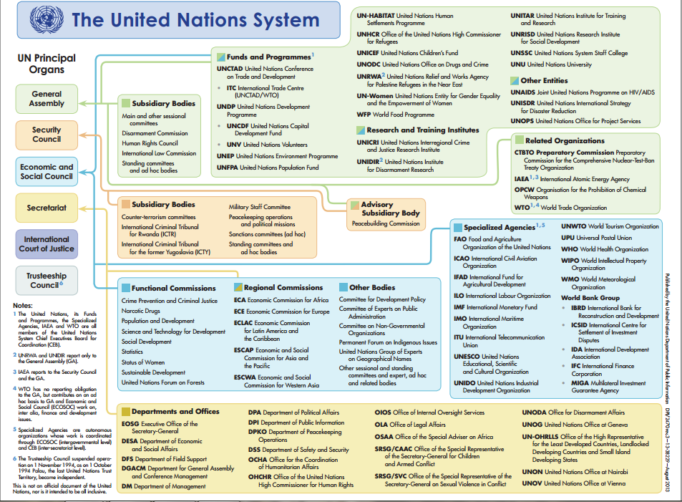

Slide 15
2.2.1 General Assembly
UN top organism
It discusses technical issues
Composed by 193 States (since 2011, South Sudan).

Slide 16
2.2.1 General Assembly
54 countries or territories are not in the UN
Independent Nation States not in the UN:
Vatican City
Palestine: non-member observer state since Nov 29, 2012.

Slide 17
2.2.2 Security Council
15 States:
5 permanent members:
USA,
France,
United Kingdom,
Russia and
China.

Slide 18
2.2.2 Security Council
10 non-permanent: 2 per continent.
Bolivia (2018)
Côte d’Ivoire (2019)
Equatorial Guinea (2019)
Ethiopia (2018)
Kazakhstan (2018)
Kuwait (2019)
Netherlands (2018)
Peru (2019)
Poland (2019)
Sweden (2018)

Slide 19
2.2.2 Security Council
The Council can take any measure to achieve peace (create courts, even ad hoc, authorize bombing)
The decisions shall be taken by absolute majority, HOWEVER the permanent members have the veto power. If the decision is 14x1, but this one comes from a permanent, this opinion prevails.
A State which is a Member of the United Nations but not of the Security Council may participate, without a vote, in its discussions when the Council considers that country's interests are affected.

Slide 20
2.2.3 International Court of Justice
15 judges (5 are from the permanent members)
It judges States – ICC judges individuals.
Principal judicial organ of the United Nations.
Its seat is at the Peace Palace in the Hague (Netherlands).
Role: to settle, in accordance with international law, legal disputes submitted to it by States and to give advisory opinions on legal questions referred to it by authorized United Nations organs and specialized agencies.

Slide 21
2.2.5 Secretariat
Makes the registration and publicity of Treaties.
The Secretary-General is the official administrative head of UN.
Recommended by SC and approved by General Assembly.
Criteria
Five year term ( possibility of 1 re-conduction)
Geographic Rotation System
Not original from the permanent members.
2007-2017: Ban Ki-moon (South Korean)
Previous: Kofi Annan

Slide 22
UN Secretaries-General
Name | Homecountry | Beggining of Tenure | End of Tenure | Note
Trygve Lie | Norway | 2.02.1946 | 10.11.1952 | Resignated
Dag Hammarskjöld | Sweden | 10.04.1953 | 18.09.1961 | Died during his tenure
U Thant | Mianmar | 30.11.1961 | 1.01.1972 | First Secretary –General from Asia
Kurt Waldheim | Austria | 1.01.1972 | 1.01.1982
Javier Pérez de Cuéllar | Peru | 1.01.1982 | 1.01.1992 | First Secretary –General from South America
Bouthros Bouthros-Ghali | Egypt | 1.01.1992 | 1.01.1997 | First Secretary –General from Africa
Kofi Annan | Gana | 1.01.1997 | 1.01.2007
Ban Ki-moon | South Korea | 1.01.2007 | 01.01.2017
António Guterres | Portugal | 1.01.2017 | Until now

Slide 24
2.2.6 Economic and Social Council
The principal body for coordination, policy review, policy dialogue and recommendations on economic, social and environmental issues, as well as implementation of internationally agreed development goals.
54 Members, elected by the General Assembly for overlapping three-year terms.
It is the United Nations’ central platform for reflection, debate, and innovative thinking on sustainable development.

Slide 25
2.3 Documents
Universal Declaration
International Covenant on Civil and Political Rights
International Covenant on Economic, Social and Cultural Rights

Slide 26
2.3.1 Universal Declaration
Paris: 10.12.1948
Fundament: principle of dignity of the human person: Everyone must be judged for their acts and not for his personal attributes. It is a minimum ethical to be followed by States.
Structure:
Articles. 1st-21: First generation rights
Articles. 22-30: Second generations rights

Slide 27
2.3.2 International Covenant on Civil and Political Rights
Regulates the 1st Part of the Universal Declaration.
Right to life
Prohibition of torture
Prohibition of slavery
Right of freedom
Article 11: No one shall be imprisoned merely on the ground of inability to fulfil a contractual obligation.
http://www.ohchr.org/en/professionalinterest/pages/ccpr.aspx

Slide 28
2.3.3 International Covenant on Economic, Social and Cultural Rights
Regulates the 2nd part of the Universal Declaration.
Right to work
Right to health
Right to education
Right to cultural life
http://www.ohchr.org/EN/ProfessionalInterest/Pages/CESCR.aspx

