Slide 1
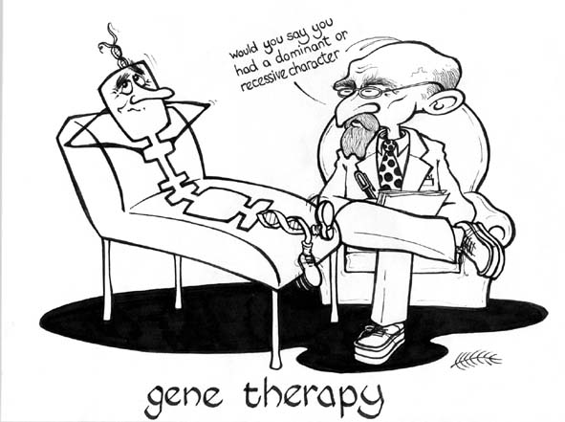
Introduction to Genetics and DNA & RNA

Slide 2
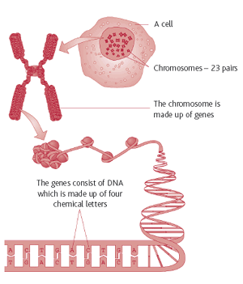
What is Genetics?
Genetics - The study of heredity
Genes - set of characteristics inherited from your parents
Found on chromosomes and contain DNA
Recent discoveries on how characteristics are passed from generation to generation
Genetics Intro I (3:27)
Genetics Intro II (4:25)

Slide 10
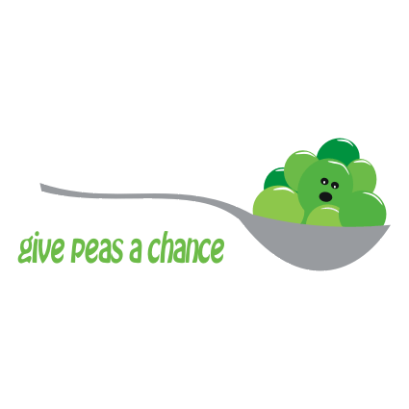
Gregor Mendel and His Peas
After becoming a priest, Mendel went to the University of Vienna to study math and science.
Worked in monastery and taught high school
Was in charge of garden
Here he experimented with peas

Slide 11
True-breeding plants were the basis of Mendel’s experiments
Mendel had true-breeding pea plants
True-breeding: self-pollinating plants that produce offspring identical to themselves
Ex. Tall plant seeds only produce tall plants
Mendel cross-pollinated the pea plants by joining male and female reproductive cells from two different plants.
This allowed him to study results of plants with different characteristics

Slide 12
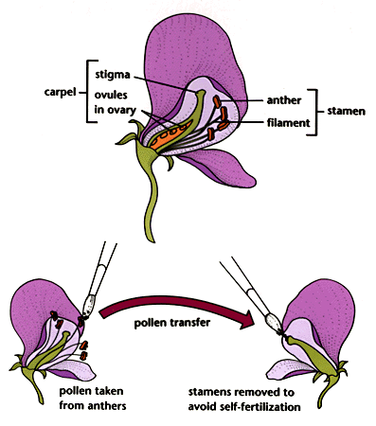
Cross-pollination

Slide 13
Genes and Dominance
Mendel studied 7 different pea plant traits.
Trait: specific characteristic (ex: color)
Mendel’s traits were contrasting
Original pair of plants is called “parent”, or simply P
Offspring are called F₁ for “first filial”
The offspring of crosses between parents with different traits are called hybrids.
Where do our genes come from? (4:20)

Slide 14
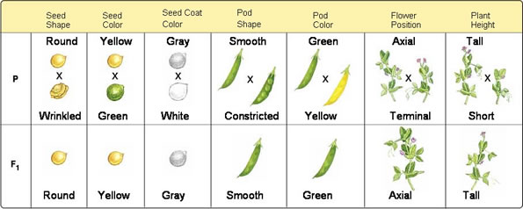
What were F₁ hybrid plants like?
All of the offspring had the trait of only one of the parents.

Slide 15
Mendel’s Conclusions
1. Inheritance is determined by chemical factors that determine traits and are passed from one generation to the next. These chemical factors are called genes.
Each of the traits was controlled by one gene that occurred in contrasting forms.
These different forms are called alleles.
2. Principle of Dominance: Some alleles are dominant while others are recessive
Dominant allele always expressed unless there are two recessive alleles
Example: In peas, tall is dominant while short is recessive; yellow dominant, green recessive

Slide 16
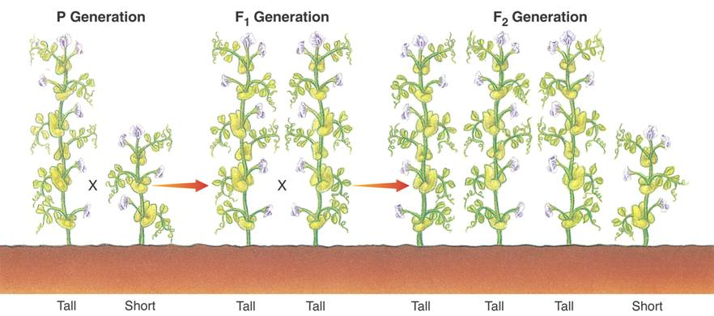
Do recessive alleles disappear?
Mendel allowed all 7 kinds of F₁ plants to produce an F₂ generation by self-pollination. (In other words, he crossed the F₁ generation with itself.)

Slide 17
The F₂ Cross
Recessive traits had reappeared!
Approximately one-fourth of F₂ plants showed trait from the recessive allele
This happens because there is a segregation, or separation, of alleles during the formation of the sex cells (gametes).

Slide 18
Two alleles will segregate from each other so that each gamete carries only a single copy of each gene. So, each F₁ plant produces two types of gametes - those with a dominant allele and those with a recessive.
T is dominant and stands for tallness
t is recessive and stands for shortness
TT and Tt combinations will be tall
tt combinations will be short
The dominant trait is represented with a capital letter, and the recessive trait is represented with a lowercase letter.

Slide 19
Genetics and Probability
Probability is the likelihood that an event will occur
Scientists use probability to predict the outcomes of genetic crosses.
If a coin is flipped once, the chance that it will be heads is 1/2.
If it is flipped three times in a row, the probability of flipping all heads is?
1/2 x 1/2 x 1/2 = _____

Slide 20
Review
Mendel used _______ to determine that inheritance is based from our genes.
Different forms of a gene are called _________.
Mendel experimented with _____ different traits.
The likelihood that an event will occur is called _____________.
A dominant allele is represented with a ________ letter. A ________ allele is represented with a __________ letter.
______ copies of an allele are needed to display the recessive trait, but only _____ copy is needed to display the dominant trait.

Slide 21
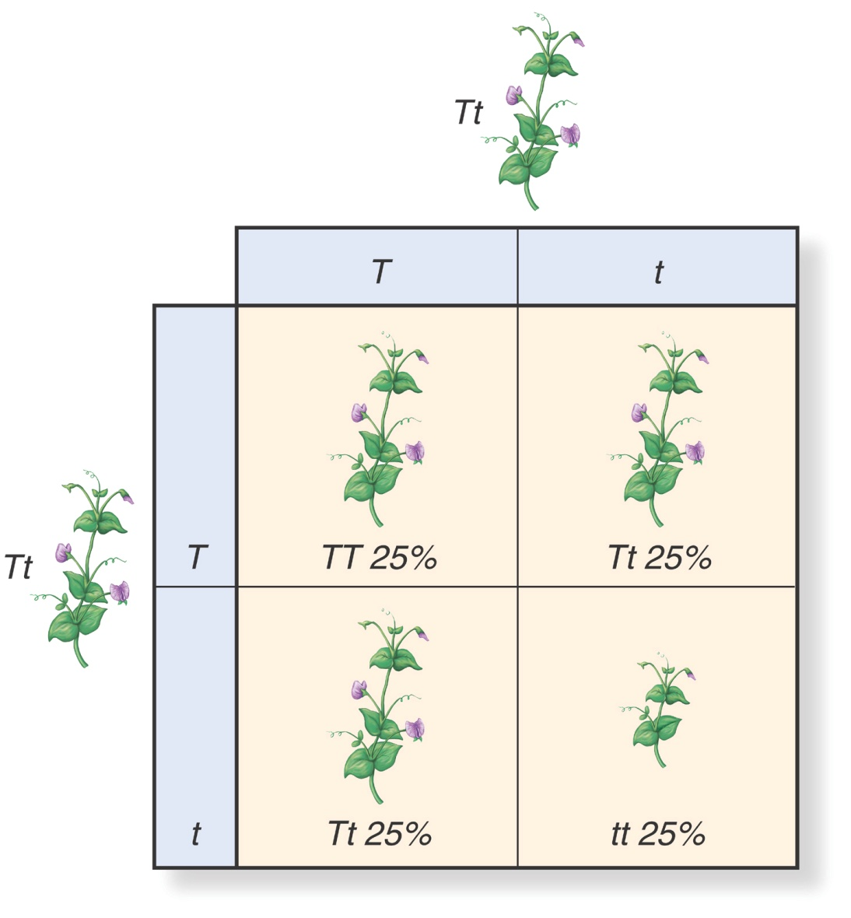
Punnett Squares
Punnett squares are used to represent the possible gene combinations that result from a genetic cross.
Parent alleles shown on top and side
Possible outcomes in boxes

Slide 22
Some FUN Terms!
Homozygous - two identical alleles (TT or tt)
Heterozygous - two different alleles (Tt)
Phenotype - physical characteristic
ex: Tall, short
All tall plants have the same physical characteristics
Genotype - genetic makeup
ex: TT, Tt or tt
All tall plants do not have the same genotype. (They’re either TT or Tt.)

Slide 23
Test Cross
Test cross: Mendel used this to test organisms with an unknown genotype.
He crossed a plant with a dominant phenotype but unknown genotype (TT or Tt?) with a recessive plant. If recessive phenotype appeared, he knew the dominant plant was heterozygous.

Slide 24
Practice Punnett Square
B
b
B
b
Genotypic ratio?
Phenotypic ratio?

Slide 25
Probability and Segregation
For a monohybrid cross:
1/4 of F₂ plants are homozygous dominant (TT)
2/4 are heterozygous (Tt)
1/4 are homozygous recessive (tt)
Ratio of tall to short plants is 3:1
This is the ratio Mendel found and is still used today.

Slide 26
Probabilities Predict Averages
Probability can be used to predict the outcome of a large number of events, but it cannot predict the exact outcome of a single event.
For just one person, there is a greater outcome that they will have a dominant trait, but this is not always true.
In order to get results that reflect the Mendelian ratio, a greater number of individuals (hundreds or thousands) should be considered.

Slide 27
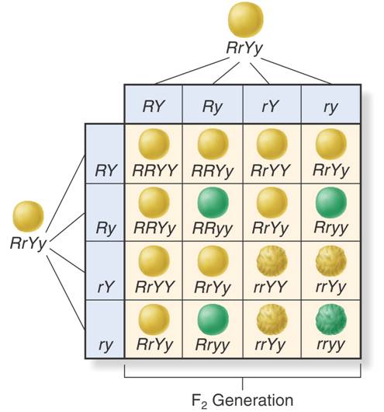
Does the segregation of one pair of alleles affect the segregation of another pair of alleles?
A dihybrid cross is a cross between two different genes.
Mendel crossed RrYy x RrYy
and found that alleles
for seed shape
and color segregated
independently.
This is called
independent assortment.
There is a 9:3:3:1 phenotypic ratio.
There is a 1:2:2:1:4:1:2:2:1 genotypic ratio.

Slide 28
Independent Assortment
The law states that genes for different traits can segregate independently during the formation of gametes.
Independent assortment helps to account for genetic variety.

Slide 29
Summary of Mendel’s Principles
Genes determine the inheritance of biological characteristics.
In cases where two or more alleles of the gene exist, some alleles are dominant and some are recessive.
Each adult has two copies of the gene, one from each parent.
These genes segregate when gametes are formed.
The alleles for different genes usually segregate independently from one another.

Slide 30
Beyond Dominant and Recessive Alleles
There are some exceptions to Mendel’s important principles.
Some alleles are neither dominant nor recessive, and some are controlled by multiple alleles or many genes.

Slide 31
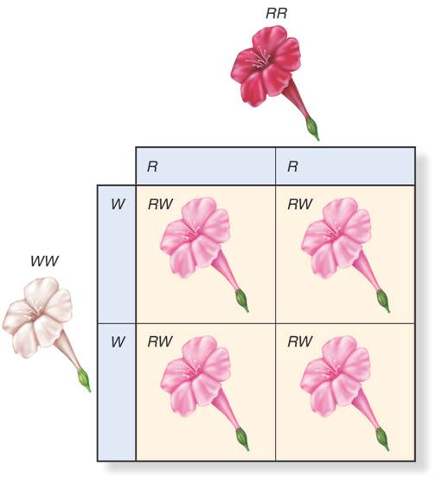
Incomplete Dominance
A case in which one allele is not completely dominant over another is called incomplete dominance.
This means the heterozygous phenotype is a blend of the homozygous phenotypes.
Ex: Homozygous red flowers (RR) crossed with homozygous white flowers (WW) make heterozygous pink flowers (RW).
Three different genotypes (RR, WW, and RW)
No lower-case alleles used

Slide 32
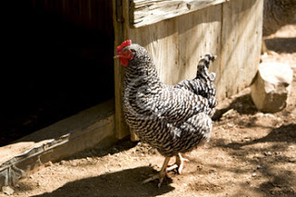
Codominance
When both alleles contribute to the phenotype, we call that codominance.
Colors are not blended; they appear separately.
Examples:
In some varieties of chickens the black feather allele is codominant with the white feather allele. The chickens have feathers that are speckled black and white with no blending.
Human blood types: I^{A} and I^{B} are codominant alleles; there’s no blending of the two blood types.
Notes:
Also a gene for a protein that controls cholesterol levels in blood. People with the heterozygous form of the gene produce two different forms of protein, each with a different effect on cholesterol levels.

Slide 33
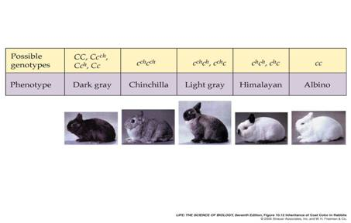
Multiple Alleles
Genes that have more than two alleles are said to have multiple alleles.
This means that more than two possible alleles exist in a population.
However, only two alleles are inherited.
Example: Rabbit fur color is controlled by four alleles (C, c^{ch}, c^{h}, c).

Slide 34
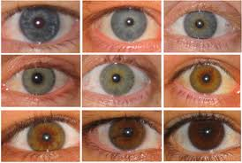
Polygenic Traits
Polygenic traits are traits controlled by two or more genes.
Means “having many genes”
Example: Skin and eye color in humans is controlled by a number of different genes that control these traits.
Different combinations of the alleles yield the enormous range of variation in our skin color.

Slide 35
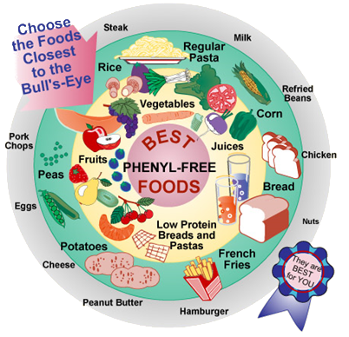
Genetics and the Environment
Characteristics are not solely determined by genes, but they are also determined by the interaction between genes and the environment.
Example: PKU is a genetic disorder that can lead to mental retardation. Wealthier countries have the ability to test for high levels of PKU during pregnancy and mothers can be put on a special diet to lower PKU levels. However, poorer countries are unable to perform this test, leading to mental retardation.

Slide 36
If genes are located on the same chromosome, are they inherited together?
Yes! Thomas Hunt Morgan first realized this when he studied the fruit fly Drosophila melanogaster and realized that many of the genes appeared to be linked.
This led to two discoveries:
1. Each chromosome is a group of linked genes.
2. It is the chromosomes that assort independently, not the individual genes.

Slide 37
If two genes are found on the same chromosome, does this mean they are linked forever?
No! Crossing-over during prophase I of meiosis separates genes that had been on the same chromosome.
Crossover events exchange and separate linked genes to produce new combinations.
This is where genetic diversity comes from!

Slide 38
Gene Map
Alfred Sturtevant, a student in Morgan’s lab, wanted to find the rate at which crossing-over separated linked genes.
He hypothesized that the farther apart the two genes were, the more likely they were to be separated by crossing-over during meiosis.
This rate could then produce a map of distances between genes.
Sturtevant gathered many notebooks and presented a gene map (a map of locations of each gene) on a fruit fly chromosome.
Since then, this method has been use to construct genetic maps, including maps of the human genome.

Slide 39
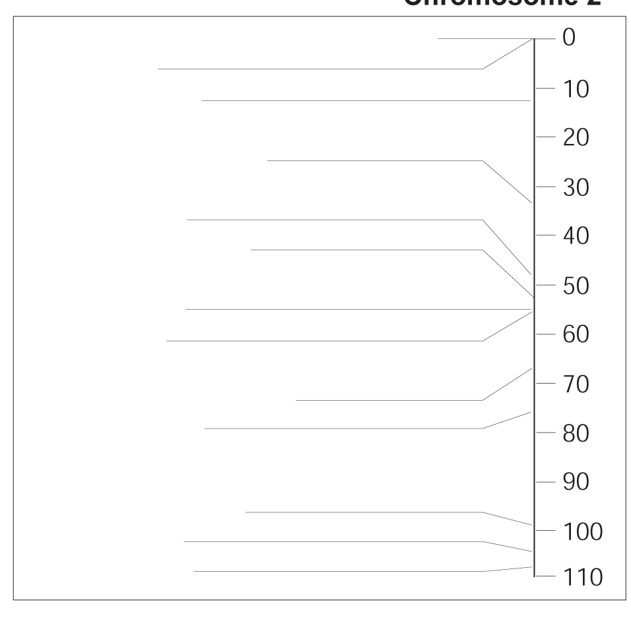
Drosophila Gene Map
If genes are close together, recombination frequency between them should be low.
If genes are far apart, recombination will be high.
1.3
Star eye
31.0
Dachs (short legs)
51.0
Reduced bristles
55.0
Light eye
75.5
Curved wing
104.5
Brown eye

Slide 40
END OF GENETICS
LET’S BEGIN DNA & RNA

Slide 41
Experimento de Avery, McCarty, MacLeod
A “transformação genética” é pelo DNA (1944)

Slide 42
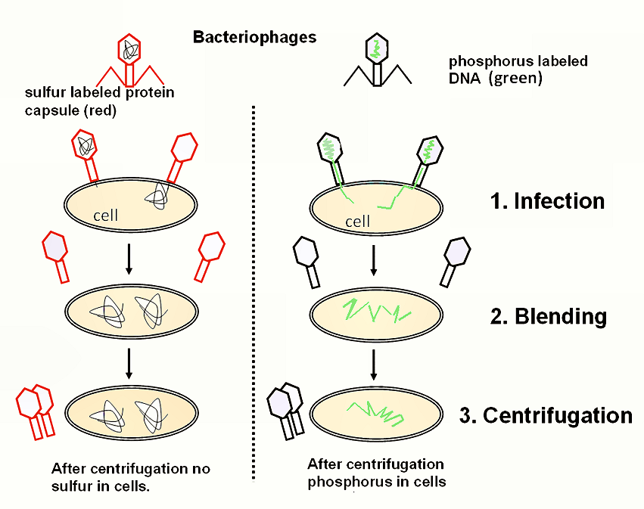
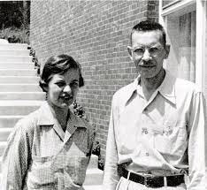
Experimento de Hershey-Chase (1952)
Chase Hershey

Slide 43
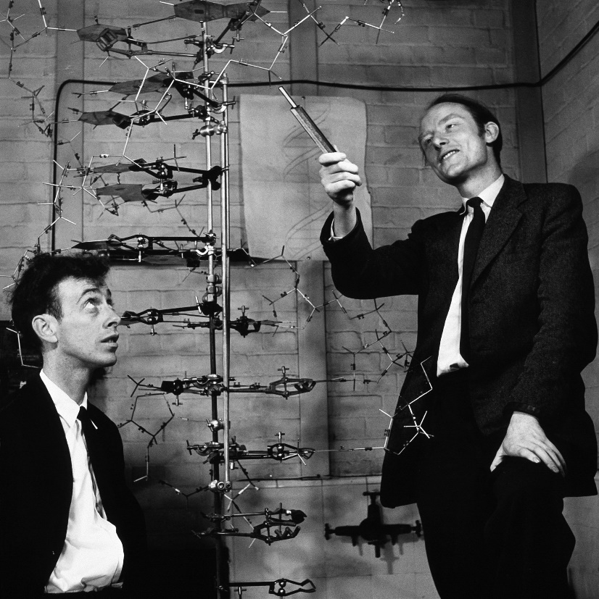
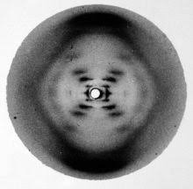
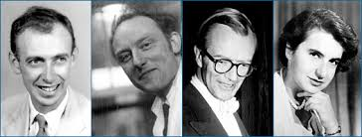
DNA é uma dupla hélice 25/4/1953
Difração de Rx
Watson Crick Wilkins Franklin

Slide 44
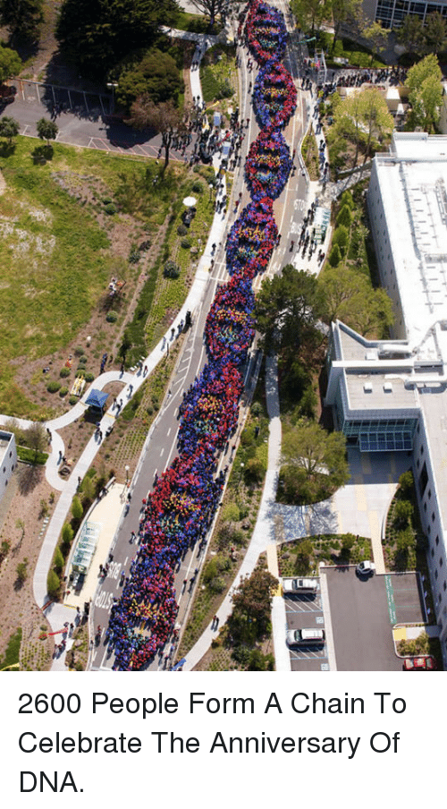
25 de abril : Dia Mundial do DNA

Slide 47
DNA and RNA
In 1953, James Watson and Francis Crick developed the double-helix model of DNA.
DNA is a long molecule made up of subunits called nucleotides. (If you remember, nucleotides are the monomers of nucleic acids.)
DNA nucleotides are made of three basic components: a 5-carbon sugar called deoxyribose, a phosphate group and a nitrogenous base.
The deoxyribose and phosphates make up the “backbone” of DNA while the nitrogenous bases make up the “rungs” of the DNA ladder.

Slide 48
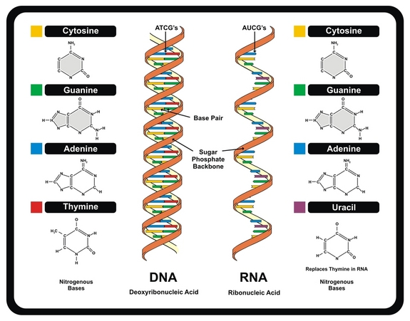
Structure of DNA and RNA

Slide 49
DNA and RNA
There are four nitrogenous bases: adenine, thymine, guanine, and cytosine.
Adenine and thymine always pair up; guanine and cytosine always pair up.
Exons: DNA nucleotide sequences that code for proteins
Introns: nucleotide sequences that do NOT code for proteins; removed from RNA before it leaves the nucleus
Codons: sequences of three bases that form the “words” to make amino acids; mRNA carries them
UCGCACGGU is read as UCG-CAC-GGU
DNA vs RNA (4:43)

Slide 50
DNA and RNA
DNA is copied through a process called replication. During replication, the DNA molecule separates into two strands, then produces two new strands.
The principal enzyme involved in replication is DNA polymerase. It “proofreads” each new DNA strand to make sure that each new copy is identical to the original.

Slide 51
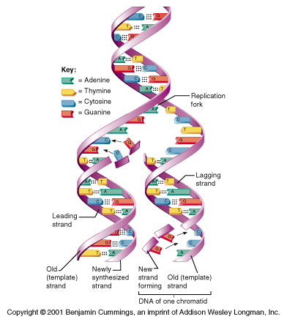
DNA Replication

Slide 52
DNA and RNA
RNA is similar to DNA, but it has three main differences:
the sugar in RNA is ribose
RNA is single-stranded
RNA contains uracil in place of thymine
RNA has one main job – protein synthesis!

Slide 53
DNA and RNA
There are three main types of RNA, all of which are involved in protein synthesis:
messenger RNA (mRNA)
ribosomal RNA (rRNA)
transfer RNA (tRNA)

Slide 54
DNA and RNA
In the nucleus, new RNA molecules are produced from nucleotide sequences of DNA in a process called transcription.
RNA polymerase is the principal enzyme involved in this process.
The strand of RNA contains the info needed to assemble proteins; it’s like an instruction manual.

Slide 55
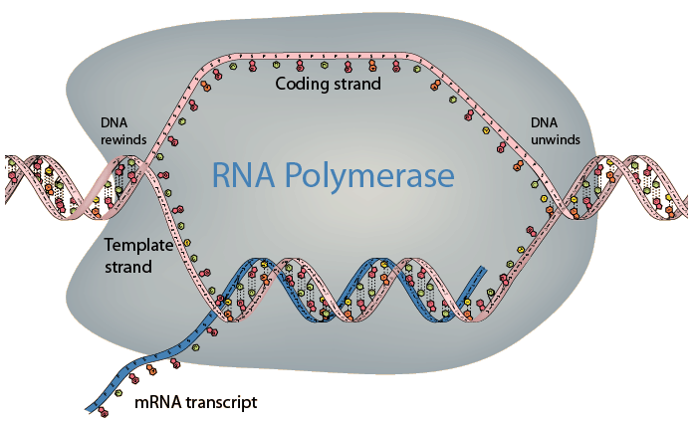
Transcription

Slide 56
DNA and RNA
The readers of the instruction manuals are the ribosomes.
The ribosomes read the instructions (mRNA molecules) and then make the necessary proteins through a process called translation.

Slide 57
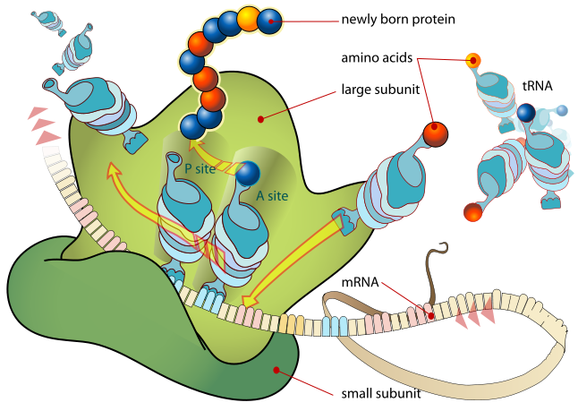
Translation

Slide 58
Mutations
Mutations are changes in the genetic material
They can be beneficial, deleterious, or have no effect (neutral)
There are two main types of mutations:
Gene mutations
Chromosomal mutations

Slide 59
Gene Mutations
Point mutations: involve changes in one or a few nucleotides; there are three main types:
Substitutions: one base is substituted with another
Insertions: an additional base is inserted into the nucleotide sequence
Deletions: a base is removed from the nucleotide sequence

Slide 60
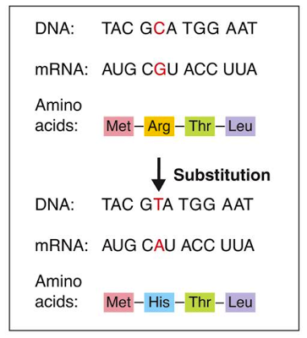
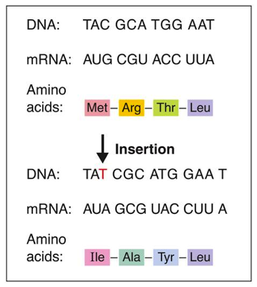
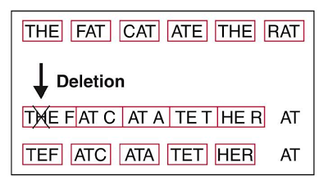
Gene Mutations
Insertions and deletions are called frameshift mutations because they shift the letters of the genetic message. Change the code → different amino acids → useless proteins → major problems!

Slide 61
Chromosomal Mutations
Chromosomal mutations involve changes in the structure or number (e.g. trisomy) of chromosomes.
There are four main types:
Deletion: loss of all or part of a chromosome
Duplication: extra copies produced
Inversion: reverse the direction of parts of chromosomes
Translocation: part of one chromosome breaks off and attaches to another

Slide 62
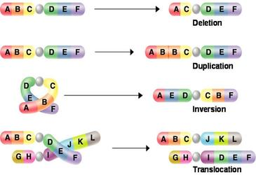
Chromosomal Mutations
Mutations 101 (7:20)

Slide 63
DNA and RNA Summary
In summary, DNA and RNA contain information for making not much else except proteins.
DNA is the “master plan” while RNA is the “blueprint.”
The “job sites” are the ribosomes.
The finished products are PROTEINS!!!
Protein Synthesis I (3:32)
Protein Synthesis II (4:27)

Slide 64
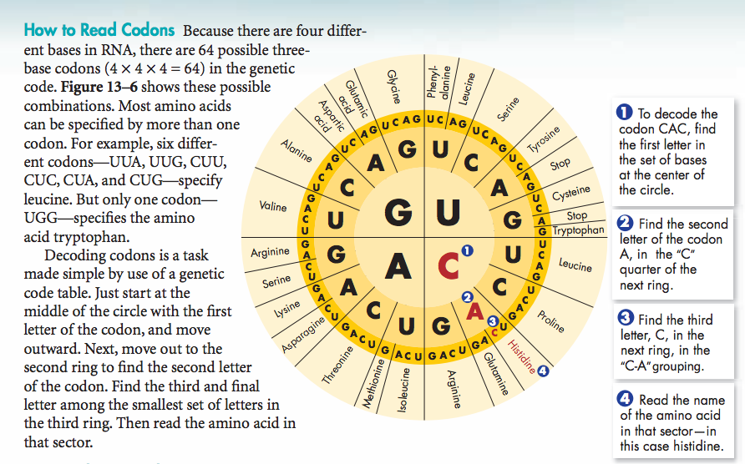
The Codon Wheel
AUG GAC GGG CGC UAA

Slide 65
Using the Codon Wheel
So, how can we use the wheel?
Use this 3-step process:
You’re given the DNA sequence TACCTGCCCGCGATT
Step 1: Separate the sequence into triplets
TAC CTG CCC GCG ATT
Step 2: Make the mRNA sequence
AUG GAC GGG CGC UAA
Step 3: Use the codon wheel to translate the mRNA sequence into amino acids

Slide 66
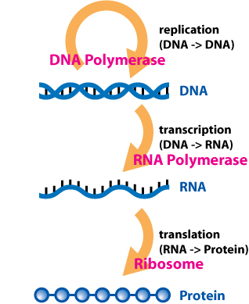
From DNA to Protein

