Slide 1
Irony and Satire

Slide 2
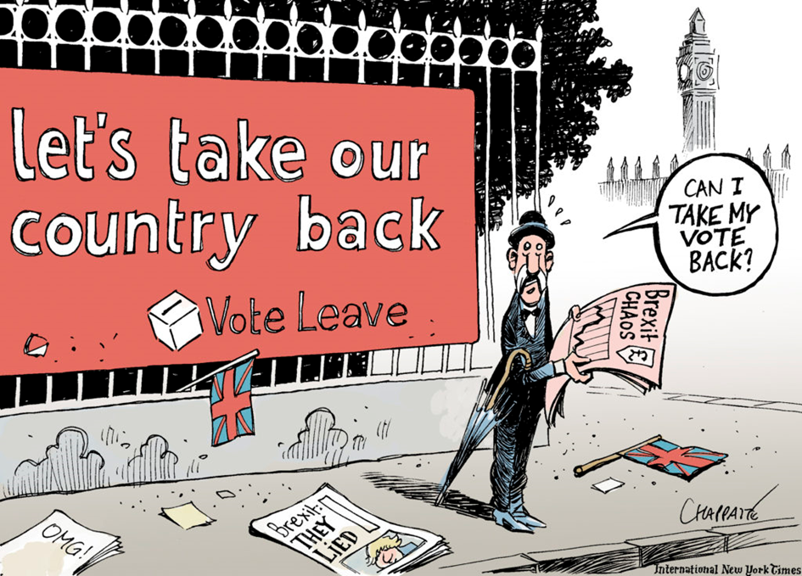
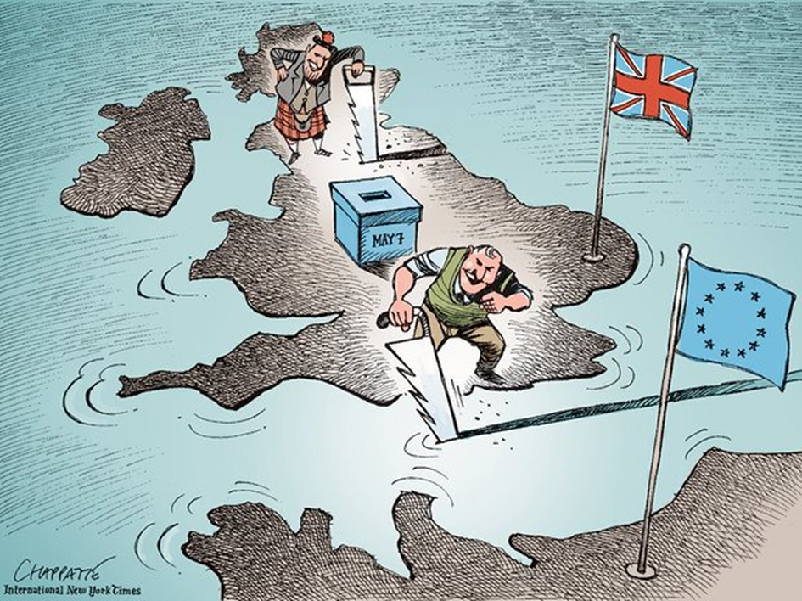
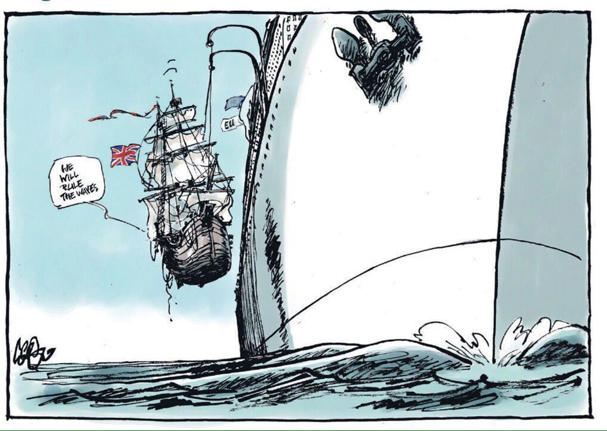

Slide 3
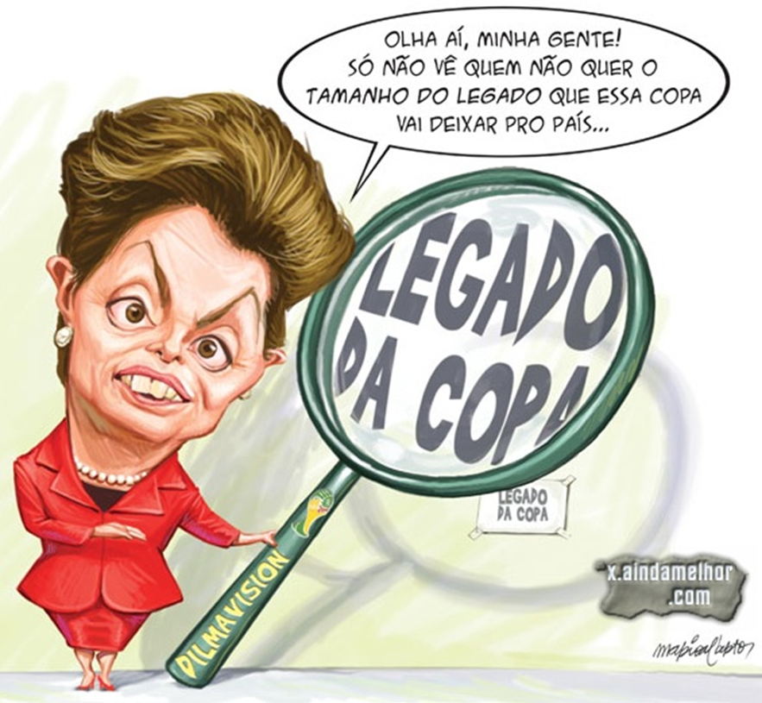
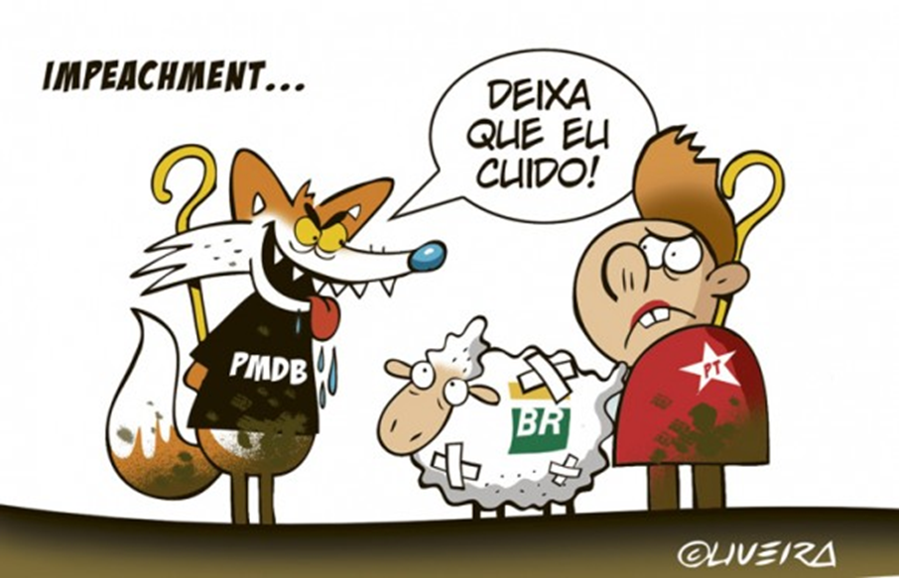

Slide 4
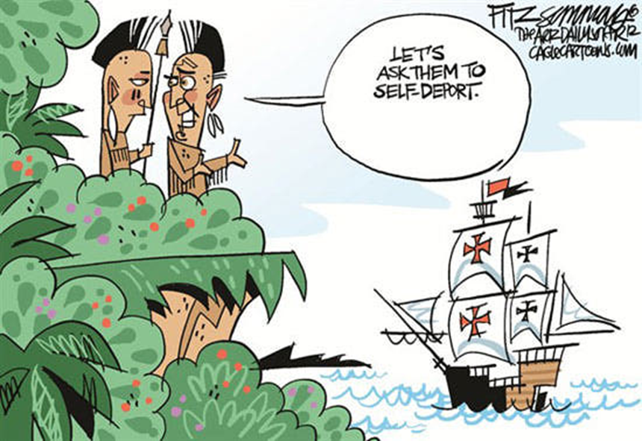
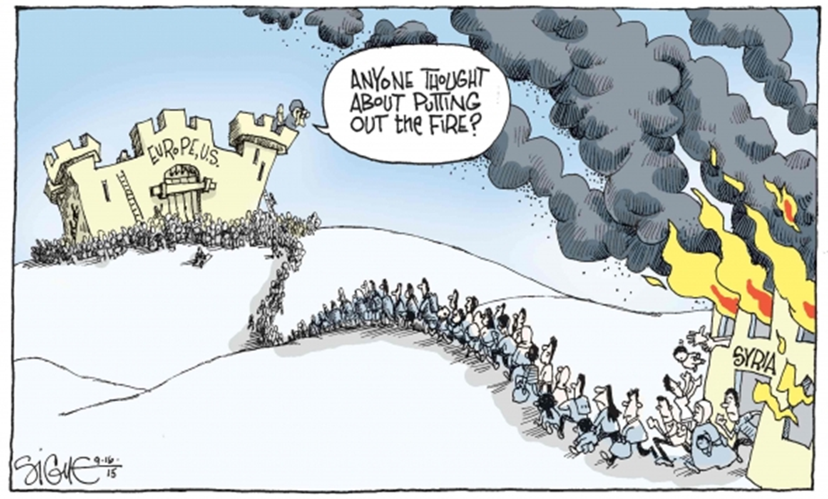
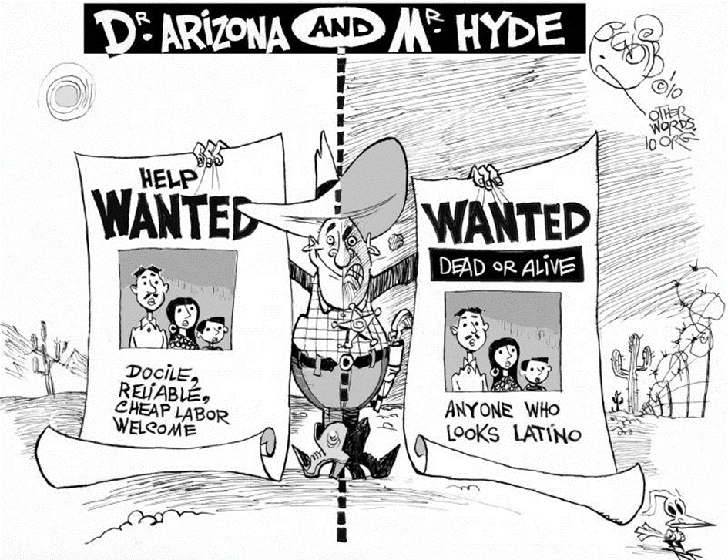

Slide 5
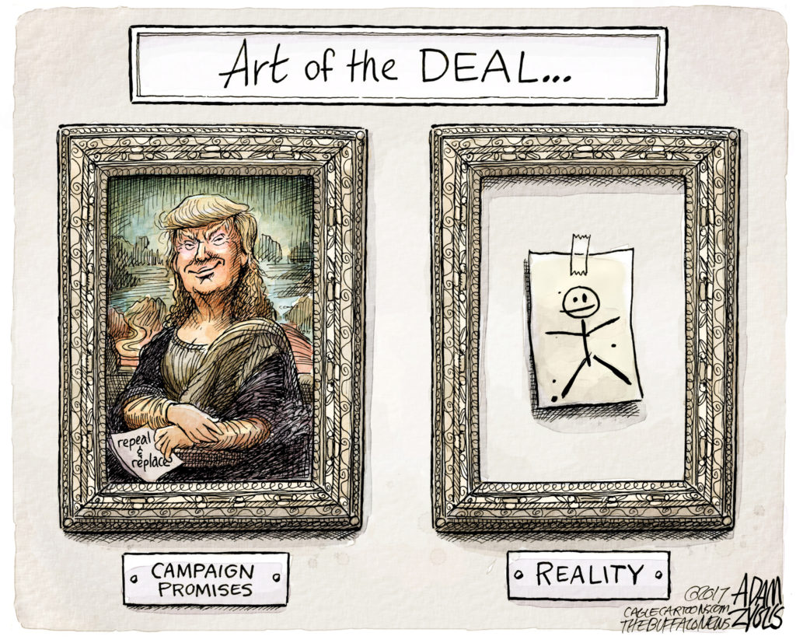
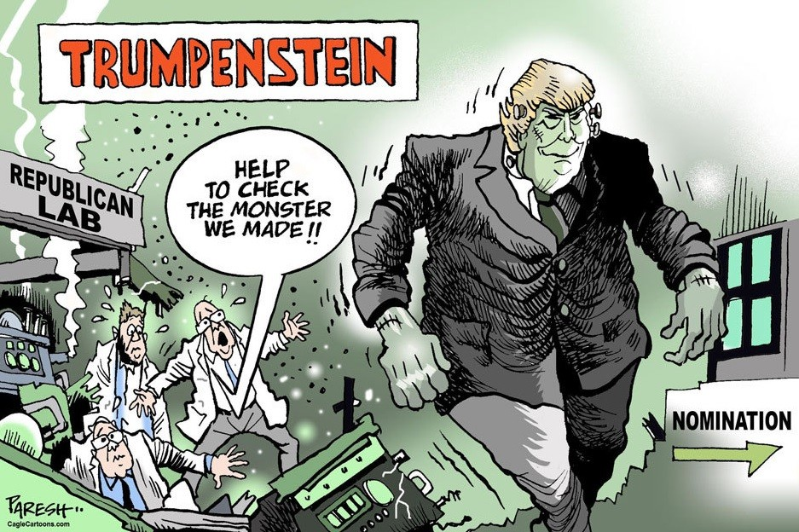

Slide 6
Irony …
Ethymological origin:
eironeia (linguistic and literary device used by the Greeks )
According to The New Oxford English Dictionary:
“The expression of one’s meaning by using language that normally signifies the opposite, typically for humorous or emphatic effect.
A state of affairs or an event that seems deliberately contrary to what one expects and is often wryly amusing as a result.
(also dramatic or tragic irony) A literary technique, originally used in Greek tragedy, by which the full significance of a character’s words or actions is clear to the audience or reader although unknown to the character.”

Slide 7
Os Gemeos

Slide 8
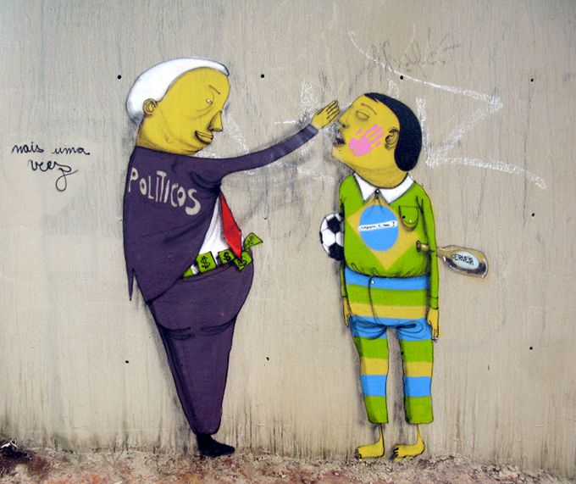

Slide 9
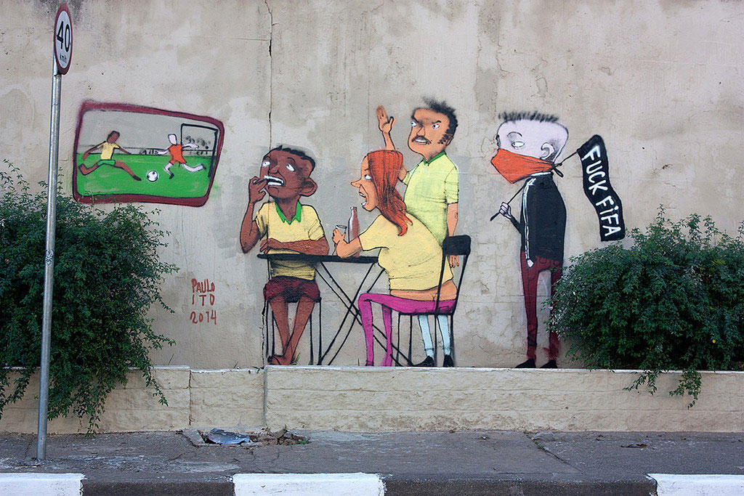

Slide 10
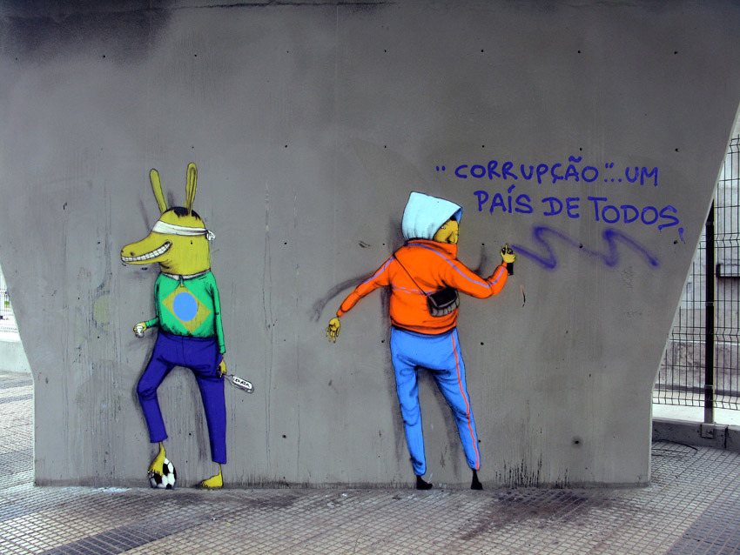

Slide 11
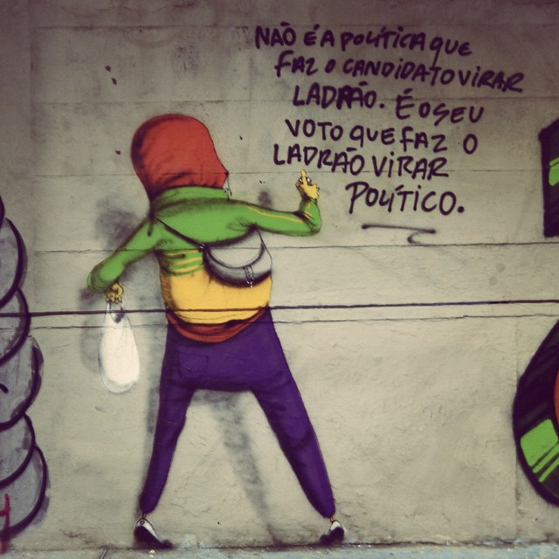

Slide 12
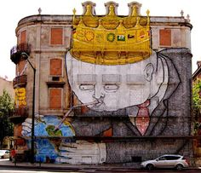

Slide 13
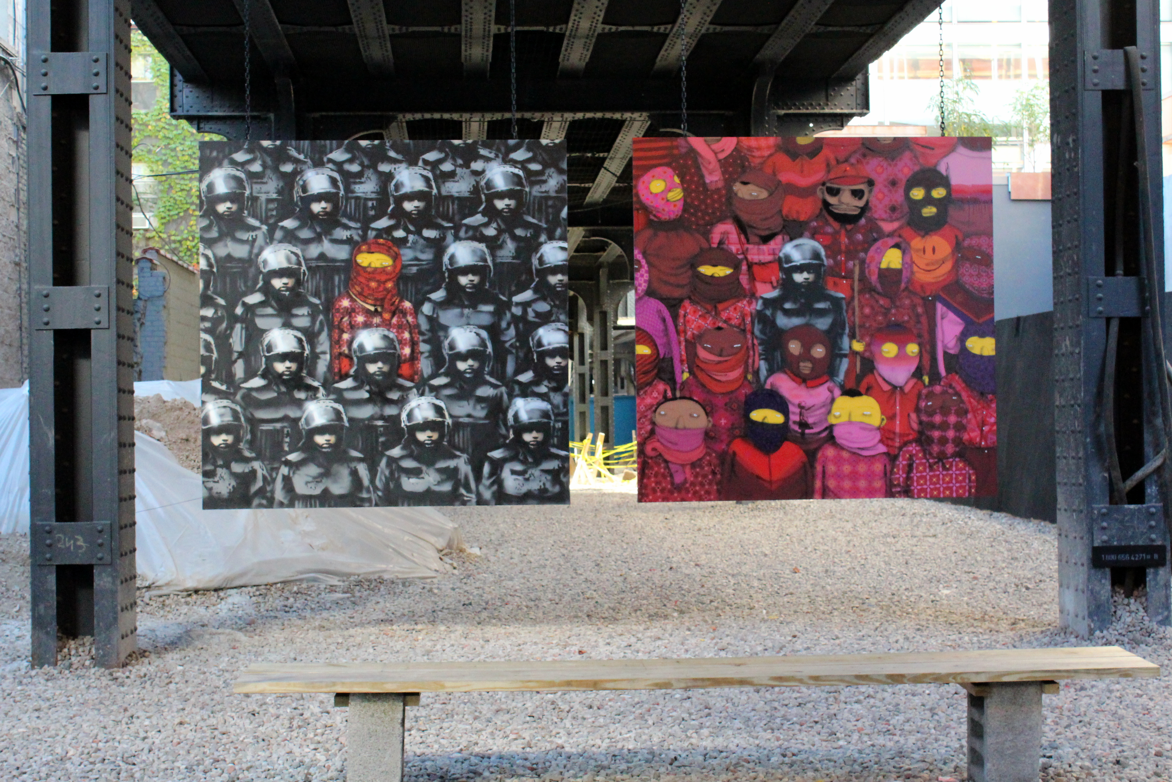
https://www.flickr.com/photos/wallyg/10415447554/in/photostream/

Slide 14
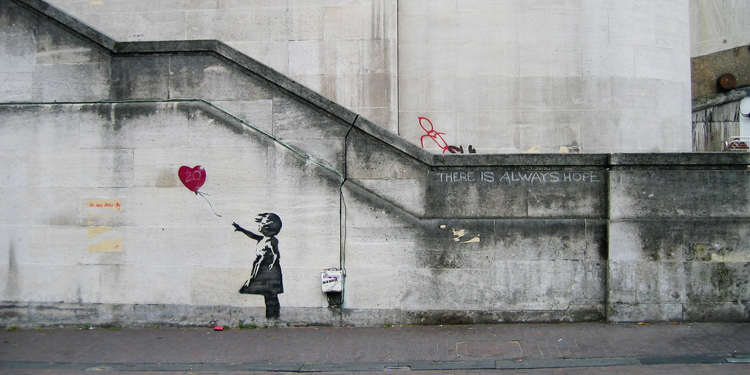
Banksy – Graffiti that explain the world
BANKSY HD
The Hotel
What does Banksy tell us about the world we live in?
https://www.flickr.com/photos/dropstuff/2840632113

Slide 15
Satire …
Ethymological origin: satira (latin)
→ Petronius, “Satyricon“
According to The New Oxford English Dictionary:
“The use of humor, irony, exaggeration, or ridicule to expose and criticize people’s stupidity or vices, particularly in the context of contemporary politics and other topical issues.”

Slide 16
What has the ECHR (European Convention on Human Rights) ever done for us?

Slide 17
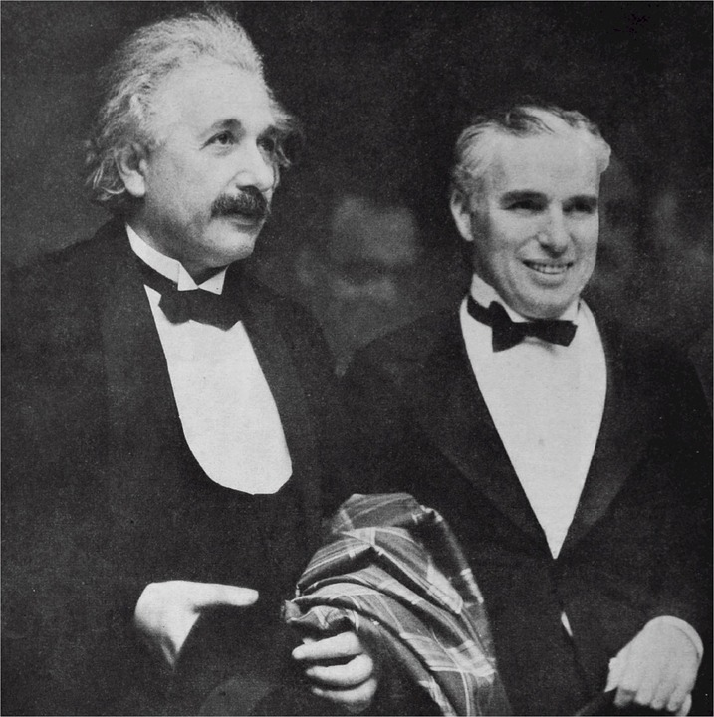
Charlie Chaplin
https://en.wikipedia.org/wiki/Charlie_Chaplin
The Great Dictator, 1940
Film starts in 1918 (collapse of the Tomainian army)
A Jewish barber saves the life of Schultz, a wounded Tomainian pilot
Twenty years later, the barber returns to his Jewish ghetto which is ruled by Schultz /
Tomainia is ruled by the dictator Adenoid Hynkel / Hynkel looks like an identical twin of the Jewish barber
When the ghetto is purged by the Tomainians, Schultz protests and is jailed /Schultz escapes and hides in
the ghetto in the house of the barber and his girlfriend Hannah / when stormtroopers search the ghetto they arrest
Schultz and the barber, while Hannah and her family can flee to Osterlich
Hynkel invades Osterlich
Schultz and the barber escape the camp, where they had been arrested, in official army uniforms
At a huge parade addressed by Hynkel, the Jewish barber is mistaken for Hynkel (and Hynkel mistaken
for the barber and arrested)
https://pixabay.com/de/albert-einstein-charlie-chaplin-510162/

Slide 18
Charlie Chaplin …
Globe Scene
Dictator Speech
Final Speech
(compare with speech “Their finest hour”)

Slide 19
The relationship between Tragedy and Irony / Satire
Focus on hybris / ambitions / corruption of principles
Focus on values / principles /questions of morality
Social and political critique
Appealing to our emotions / human nature
Points to the social complexity of our world
Ridiculing Hybris / ambitions / power (the abuse of power)
(compare: Tragedy focuses much more on the whole cycle of Hybris-Nemesis, while irony/satire expose the ridiculous nature of hybris)
→ Use of laughter / positive emotions / cheerfulness (compare: tragedy relies on pessimism / gravity / seriousness)

Slide 20
Charlie Chaplin, The King of New York (1957)
Produced in the UK where Chaplin had found exile
Social and political critique of US politics and society(McCarthy era)
The film was not shown in the US before 1972

