Slide 1
Retroviruses are a virus family of considerable medical and veterinary importance.
•
Until recently, very little was known about deep retroviral origins.
•
New research supports a marine origin of retroviruses, ∼460–550 million years ago.
•
The evolutionary events leading to the origin of retroviruses remain obscure.
•
Improved understanding of Metaviridae diversity and evolution are required for this.
Retroviruses and Evolution
Jorge Casseb, Professor

Slide 3
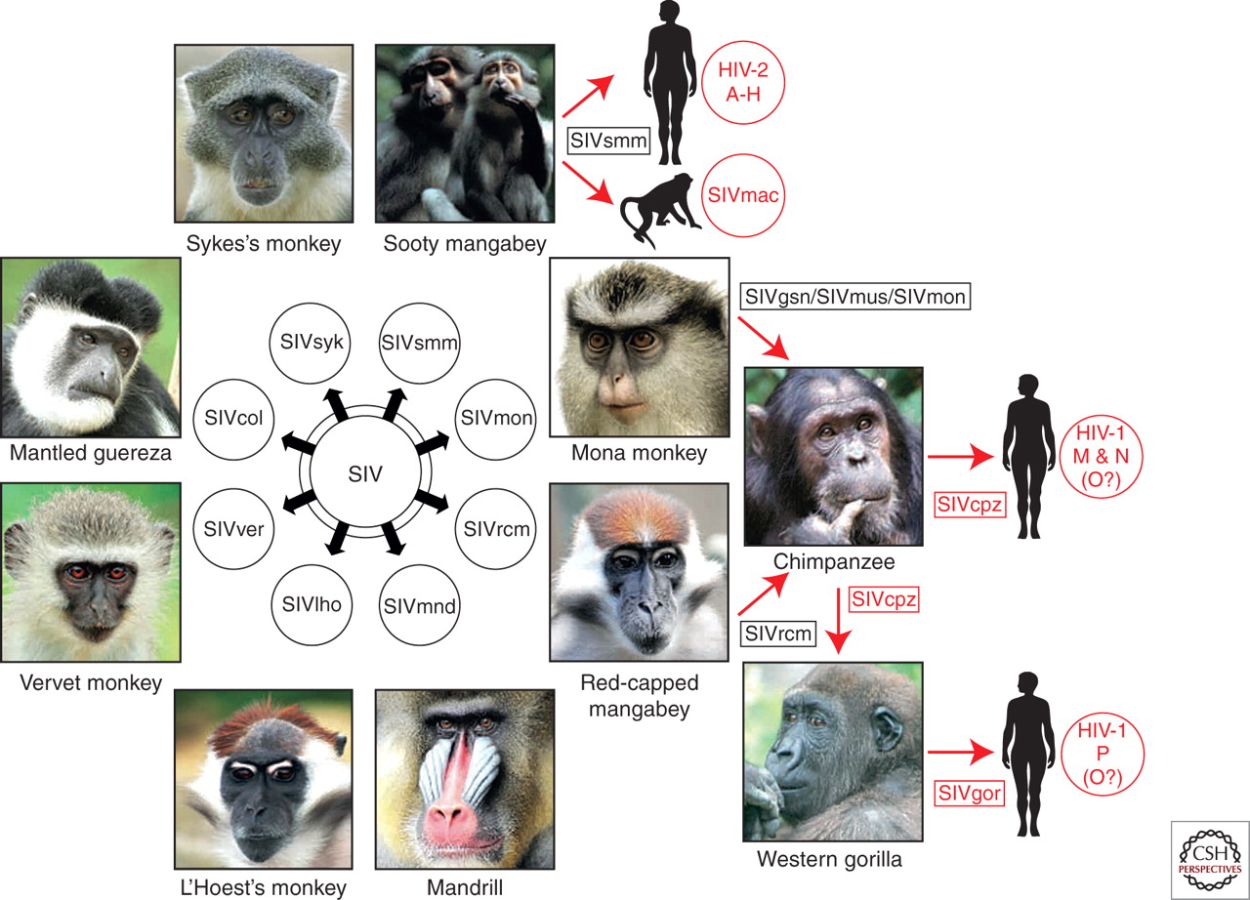
Origins of human AIDS viruses.
Paul M. Sharp, and Beatrice H. Hahn Cold Spring Harb Perspect Med 2011;1:a006841
©2011 by Cold Spring Harbor Laboratory Press
Notes:
Origins of human AIDS viruses. Old World monkeys are naturally infected with more than 40 different lentiviruses, termed simian immunodeficiency viruses (SIVs) with a suffix to denote their primate species of origin (e.g., SIVsmm from sooty mangabeys). Several of these SIVs have crossed the species barrier to great apes and humans, generating new pathogens (see text for details). Known examples of cross-species transmissions, as well as the resulting viruses, are highlighted in red.

Slide 4
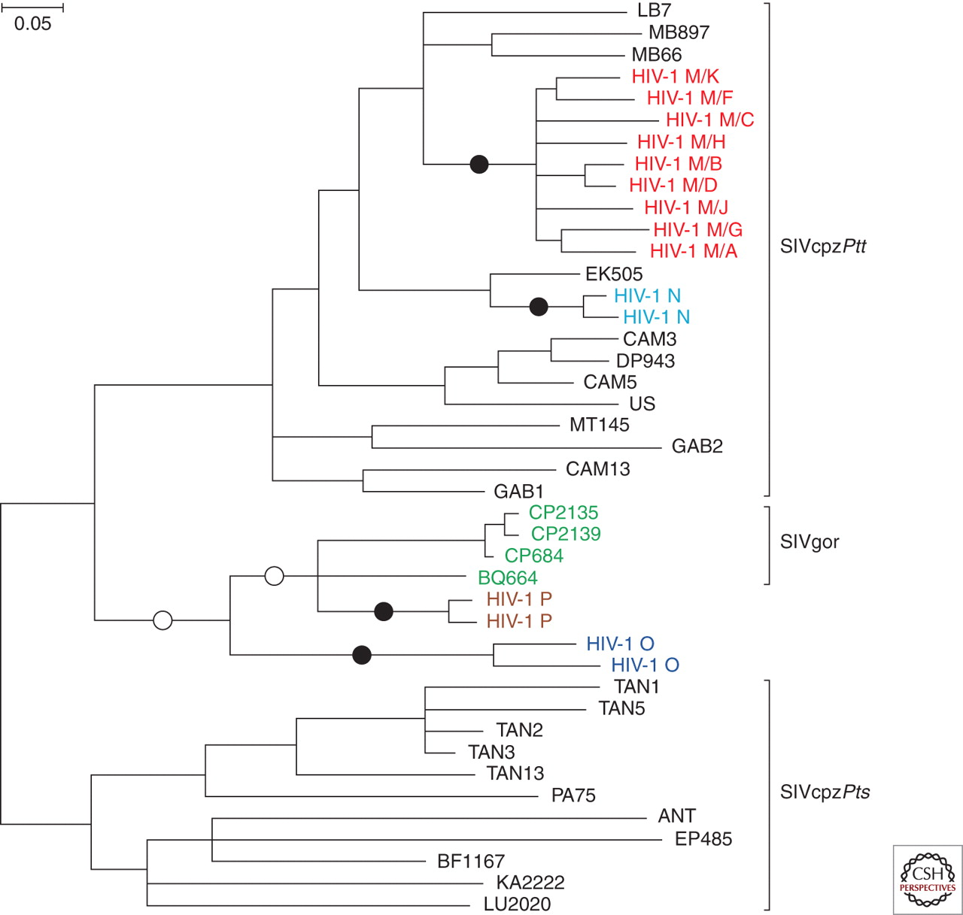
HIV-1 origins.
Paul M. Sharp, and Beatrice H. Hahn Cold Spring Harb Perspect Med 2011;1:a006841
©2011 by Cold Spring Harbor Laboratory Press
Notes:
HIV-1 origins. The phylogenetic relationships of representative SIVcpz, HIV-1, and SIVgor strains are shown for a region of the viral pol gene (HIV-1/HXB2 coordinates 3887–4778). SIVcpz and SIVgor sequences are shown in black and green, respectively. The four groups of HIV-1, each of which represents an independent cross-species transmission, are shown in different colors. Black circles indicate the four branches where cross-species transmission-to-humans has occurred. White circles indicate two possible alternative branches on which chimpanzee-to-gorilla transmission occurred. Brackets at the right denote SIVcpz from P. t. troglodytes (SIVcpzPtt) and P. t. schweinfurthii (SIVcpzPts), respectively. The phylogenetic tree was estimated using maximum likelihood methods (Guindon and Gascuel 2003). The scale bar represents 0.05 nucleotide substitutions per site.

Slide 5
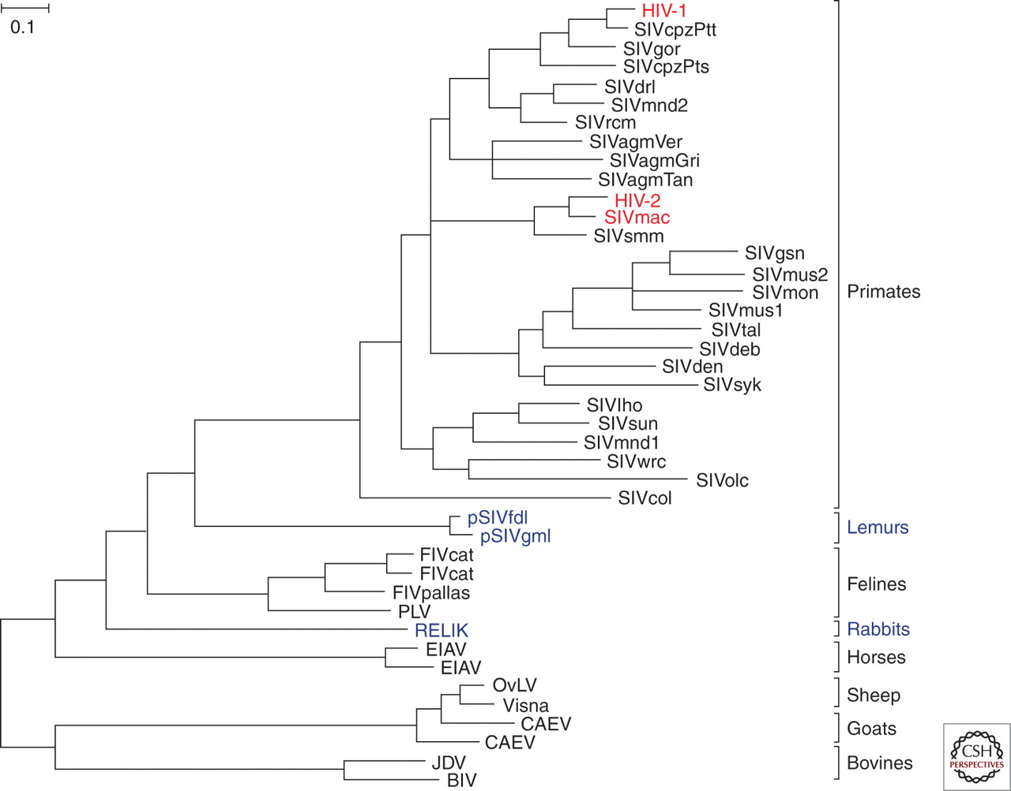
Phylogeny of lentiviruses.
Paul M. Sharp, and Beatrice H. Hahn Cold Spring Harb Perspect Med 2011;1:a006841
©2011 by Cold Spring Harbor Laboratory Press
Notes:
Phylogeny of lentiviruses. The evolutionary relationships among Pol sequences (∼ 770 amino acids) derived from various mammalian lentiviruses; host species are indicated at the right. Exogenous viruses are depicted in black, with HIV-1, HIV-2, and SIVmac highlighted in red; endogenous viruses are shown in purple. The phylogenetic tree was estimated using maximum likelihood methods (Guindon and Gascuel 2003). The scale bar represents 0.10 amino acid replacements per site.

Slide 7
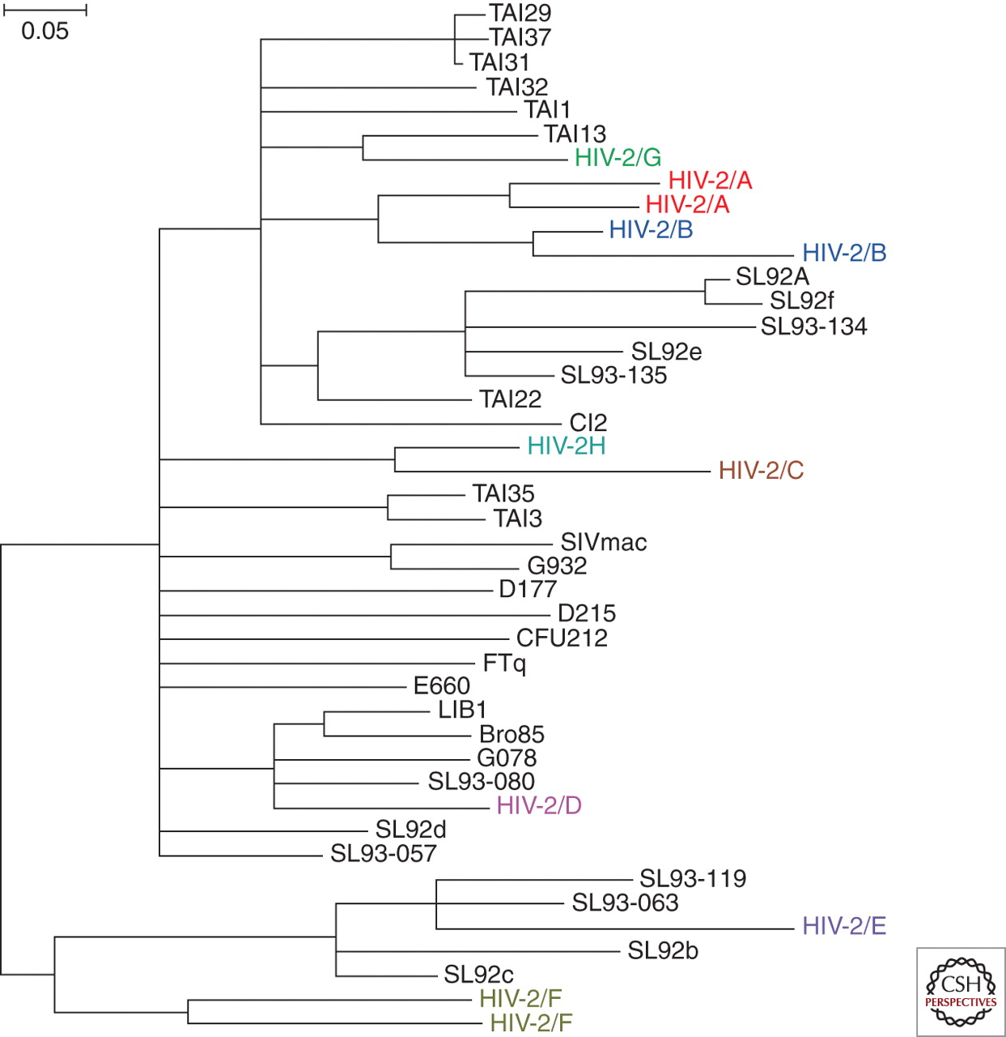
HIV-2 origins.
Paul M. Sharp, and Beatrice H. Hahn Cold Spring Harb Perspect Med 2011;1:a006841
©2011 by Cold Spring Harbor Laboratory Press
Notes:
HIV-2 origins. The phylogenetic relationships of representative SIVsmm and HIV-2 strains are shown for a region of the viral gag gene (SIVmac239 coordinates 1191–1921). SIVsmm and SIVmac are shown in black; the eight groups of HIV-2, each of which represents an independent cross-species transmission, are shown in different colors. The phylogenetic tree was estimated using maximum likelihood methods (Guindon and Gascuel 2003). The scale bar represents 0.05 nucleotide substitutions per site.

