Slide 1
Ferramentas de análise de expressão e interação miRNA/lncRNAs e mRNAS

Slide 2
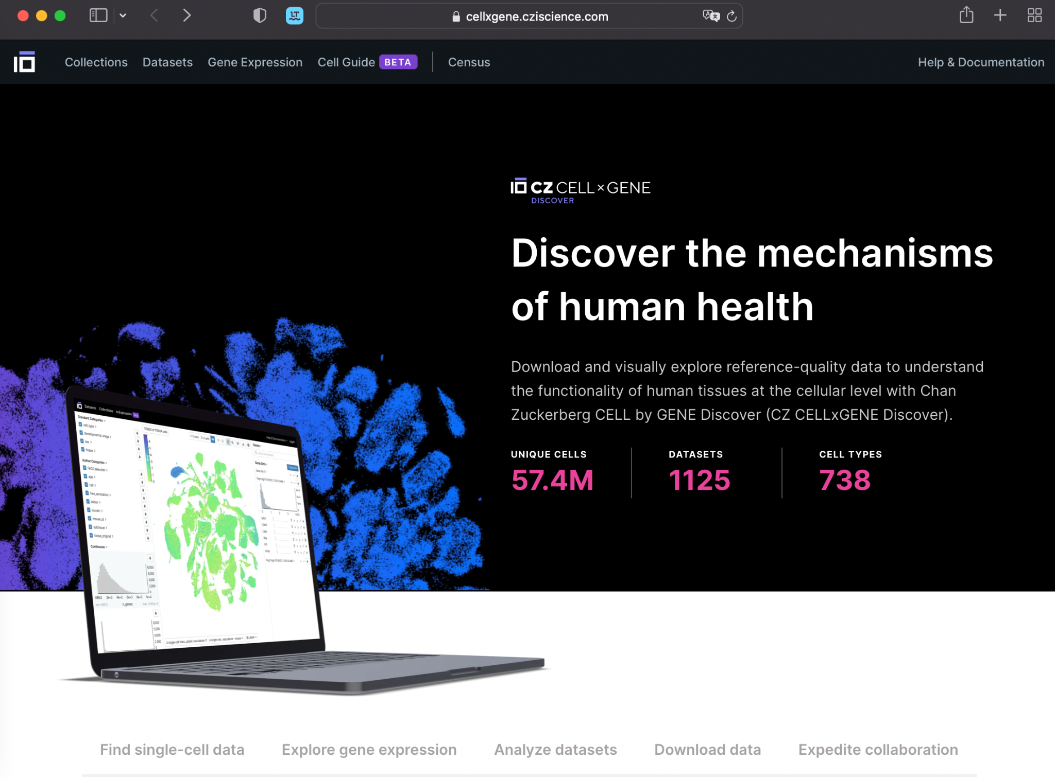
https://cellxgene.cziscience.com/?utm_source=twitter_czi&utm_medium=social

Slide 3
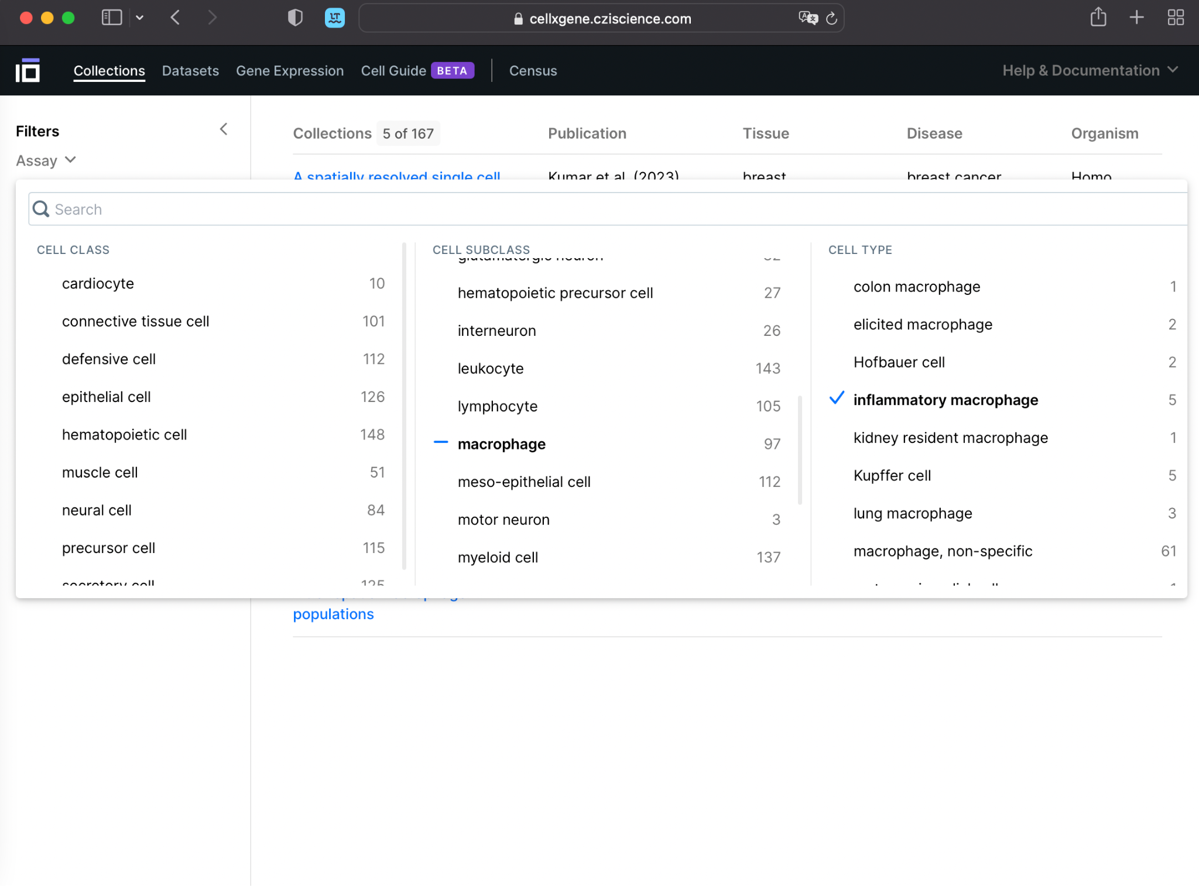

Slide 4
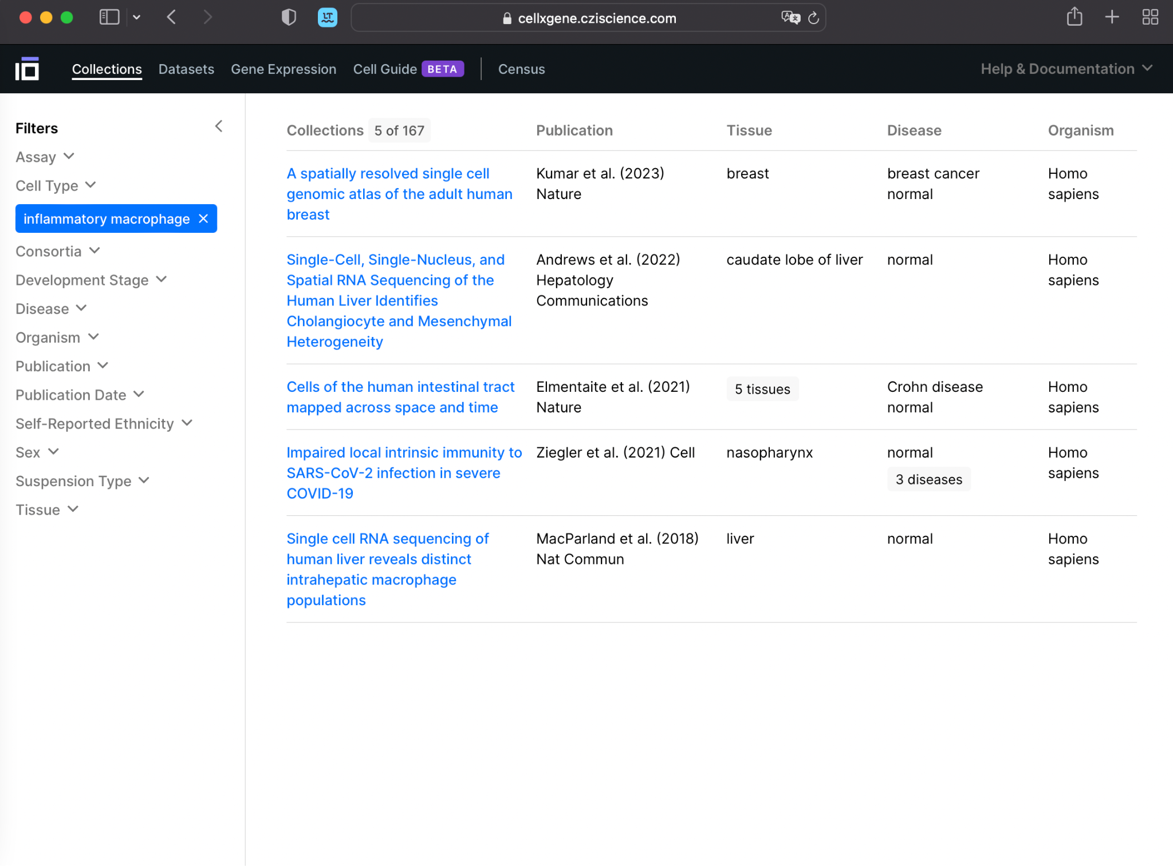

Slide 5
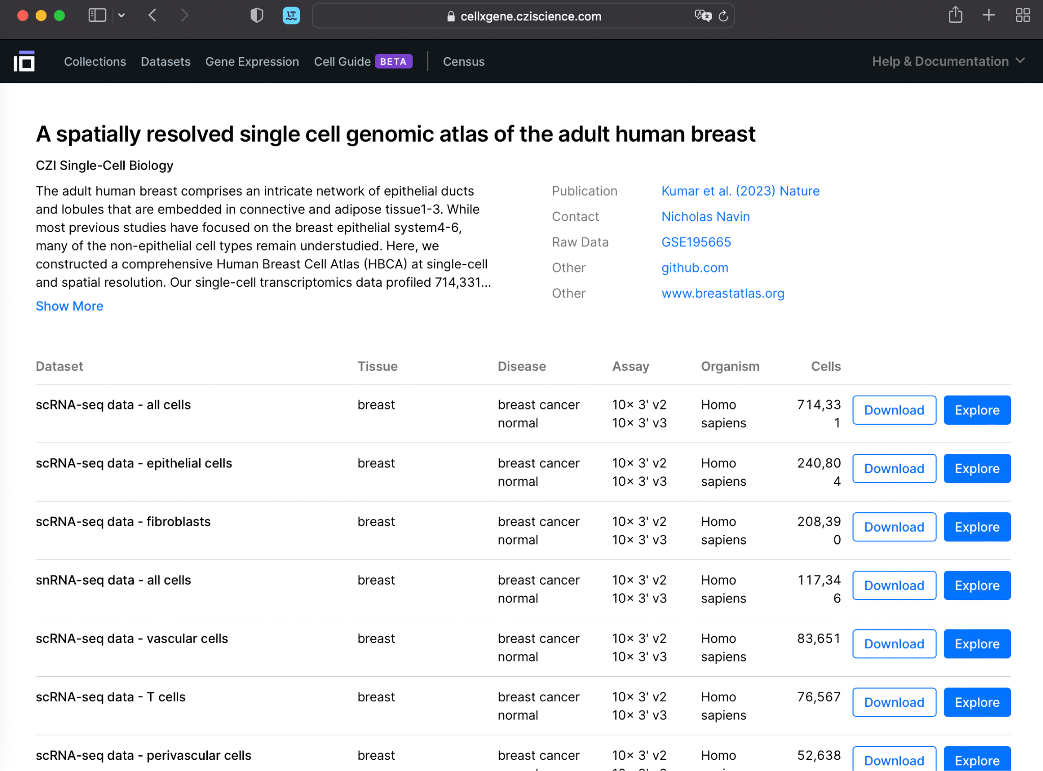

Slide 6
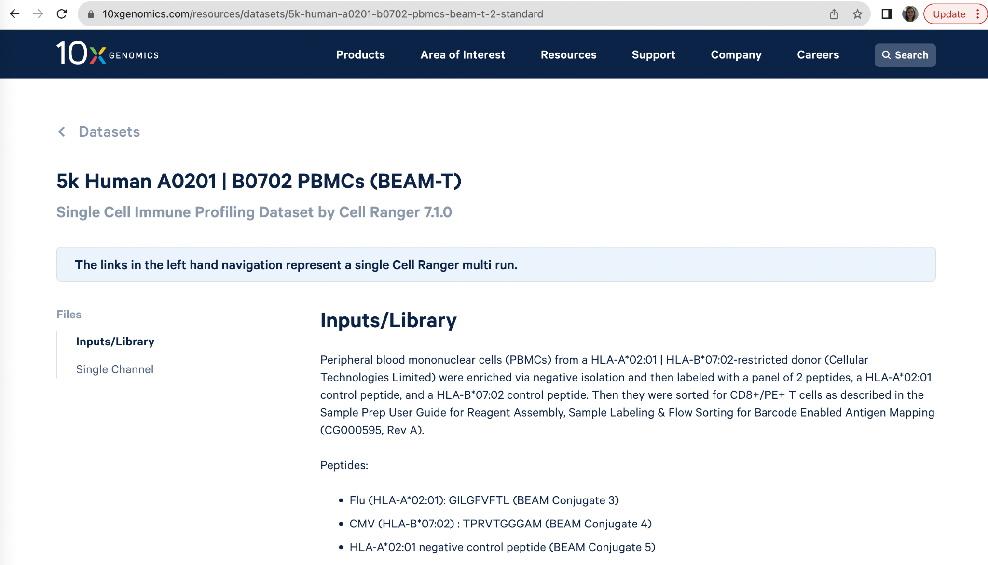
10X Genomics Datasets
https://www.10xgenomics.com/resources/datasets?menu%5Bproducts.name%5D=Single%20Cell%20Gene%20Expression&query=&page=1&configure%5BhitsPerPage%5D=50&configure%5BmaxValuesPerFacet%5D=1000

Slide 7
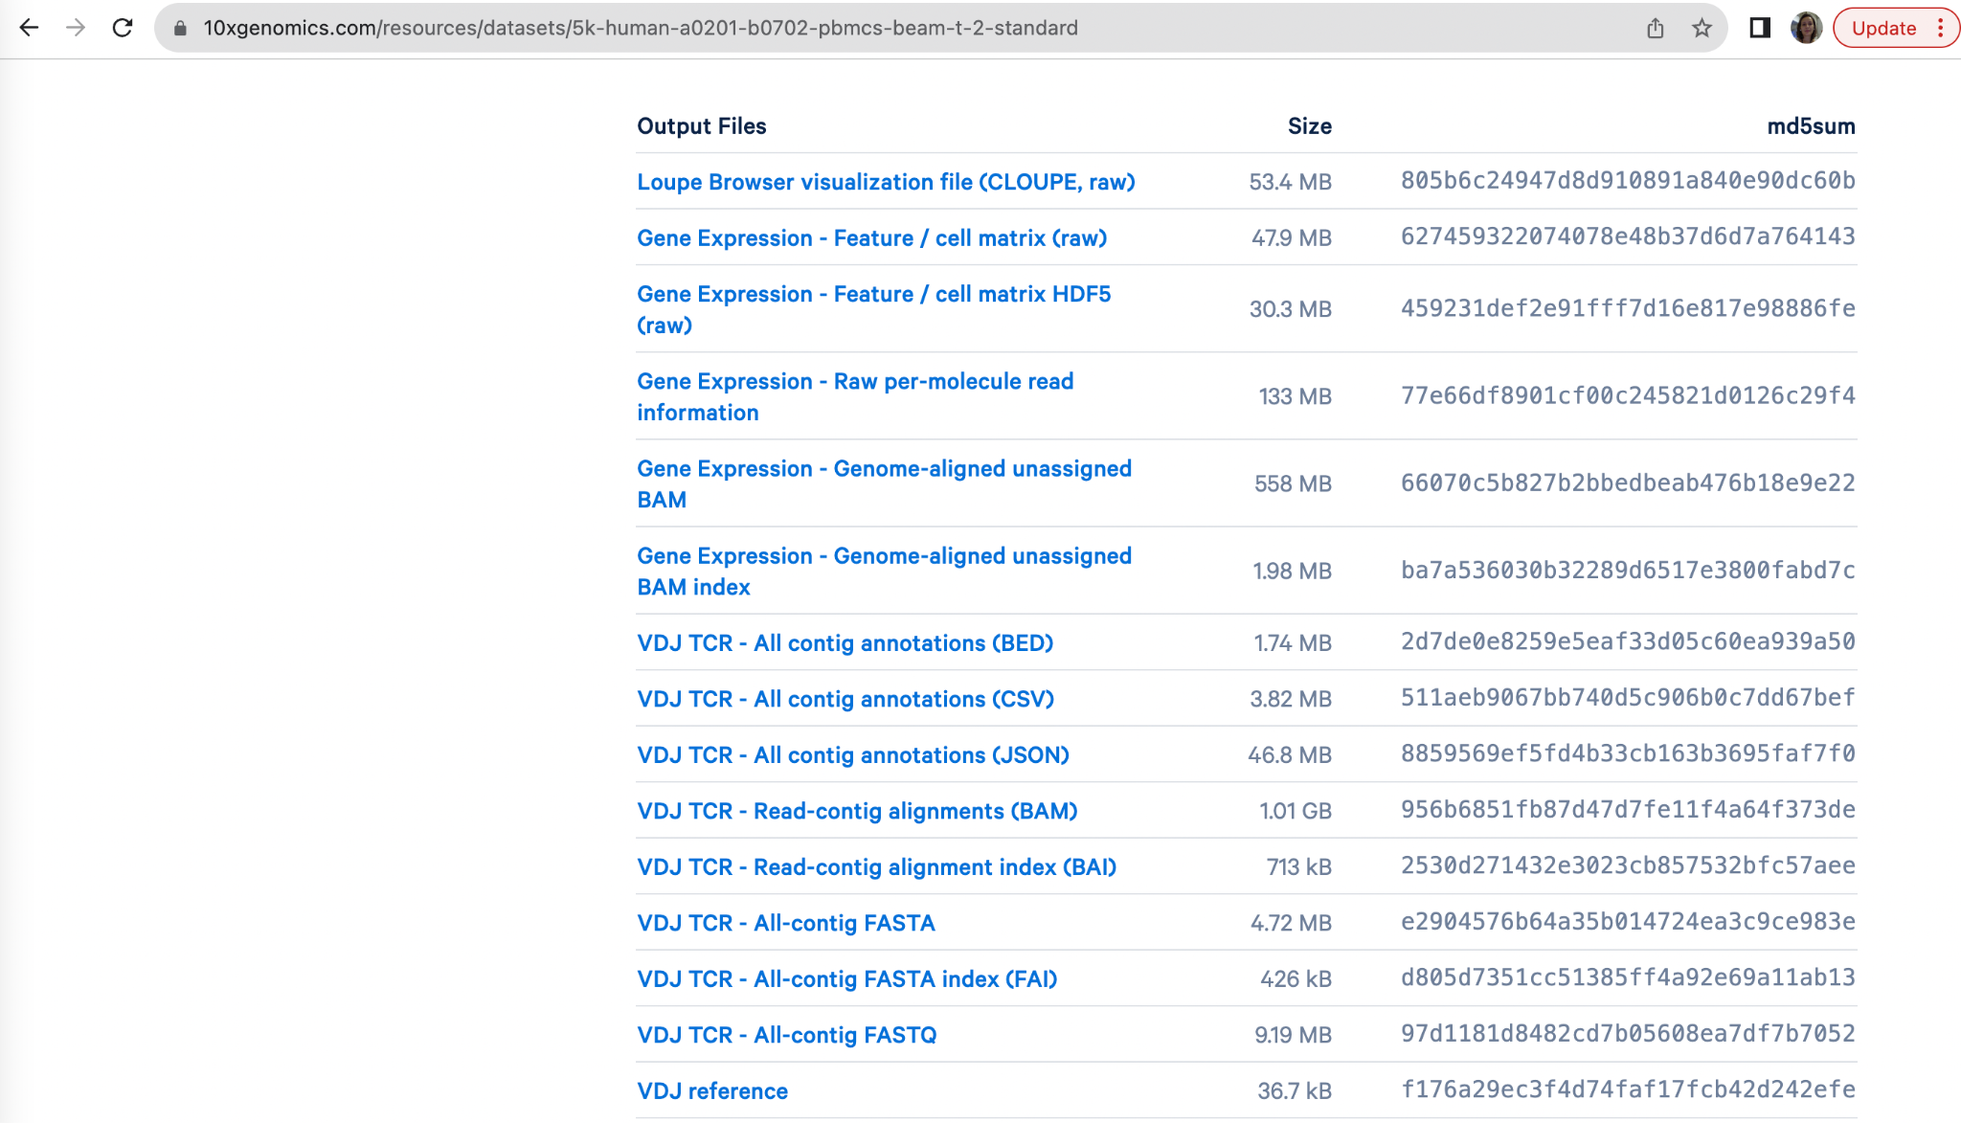
10X Genomics Datasets
https://www.10xgenomics.com/resources/datasets?menu%5Bproducts.name%5D=Single%20Cell%20Gene%20Expression&query=&page=1&configure%5BhitsPerPage%5D=50&configure%5BmaxValuesPerFacet%5D=1000

Slide 8
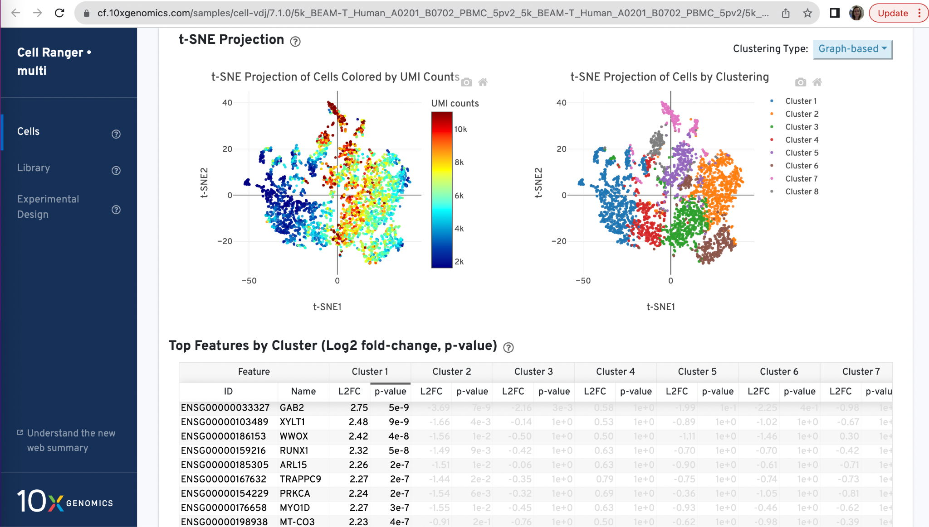
10X Genomics Datasets
https://cf.10xgenomics.com/samples/cell-vdj/7.1.0/5k_BEAM-T_Human_A0201_B0702_PBMC_5pv2_5k_BEAM-T_Human_A0201_B0702_PBMC_5pv2/5k_BEAM-T_Human_A0201_B0702_PBMC_5pv2_5k_BEAM-T_Human_A0201_B0702_PBMC_5pv2_web_summary.html

Slide 9
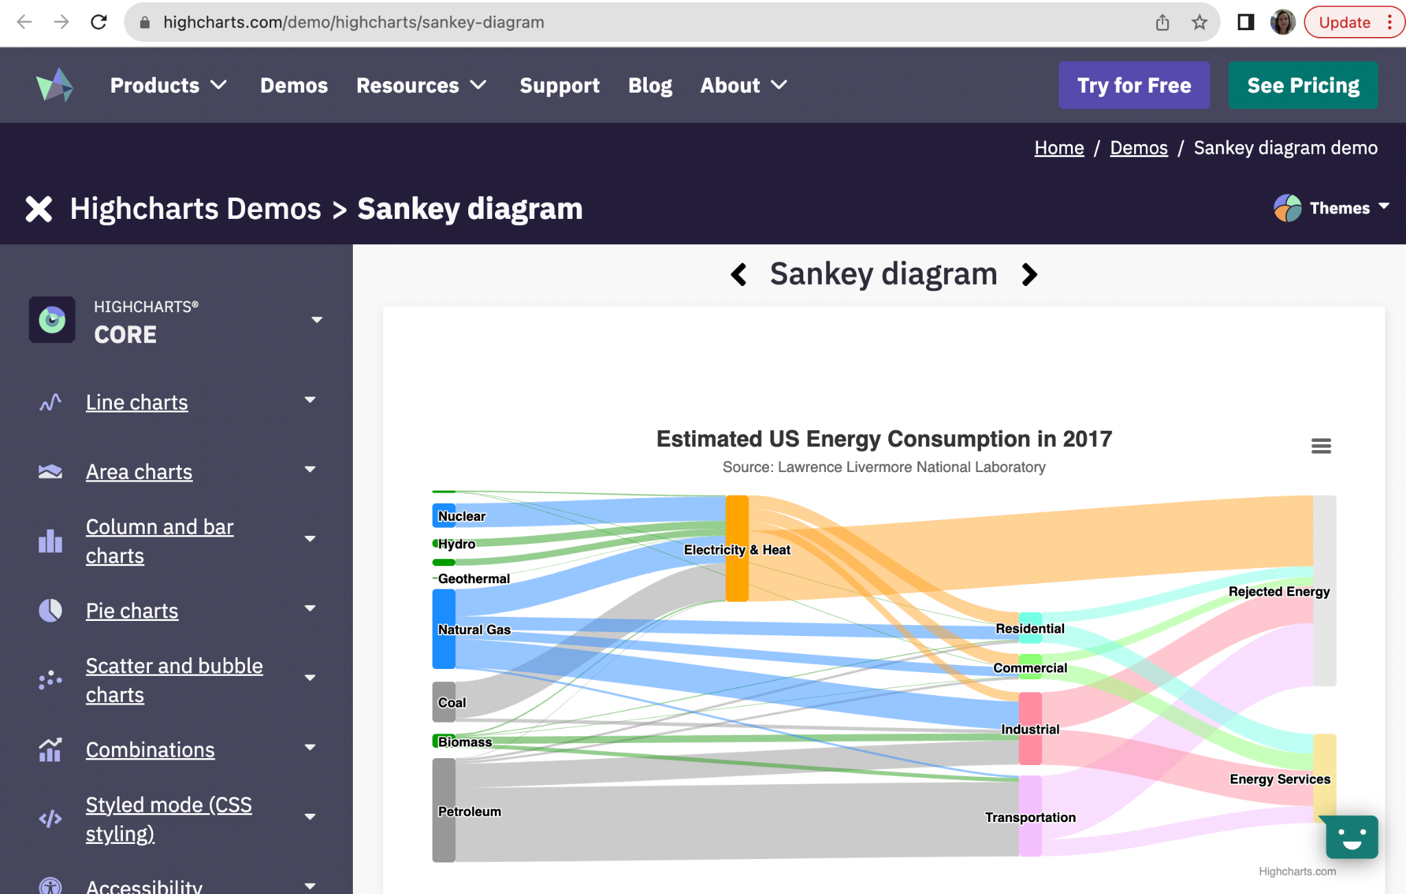
HighCharts.com
https://www.highcharts.com/demo/highcharts/sankey-diagram
The Sankey diagram is an intuitive visualization approach for depicting flows from one set of values to another. We plotted the Sankey diagram using Highcharts (https://www.highcharts.com/demo/sankey-diagram) to explore the relationships between bead-enriched T cell subsets and scCPops.

Slide 10
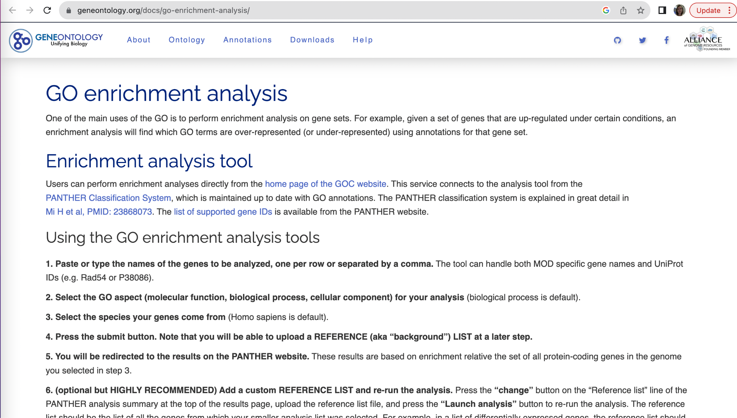
GO - GeneOnthology
https://geneontology.org/docs/go-enrichment-analysis/

Slide 11
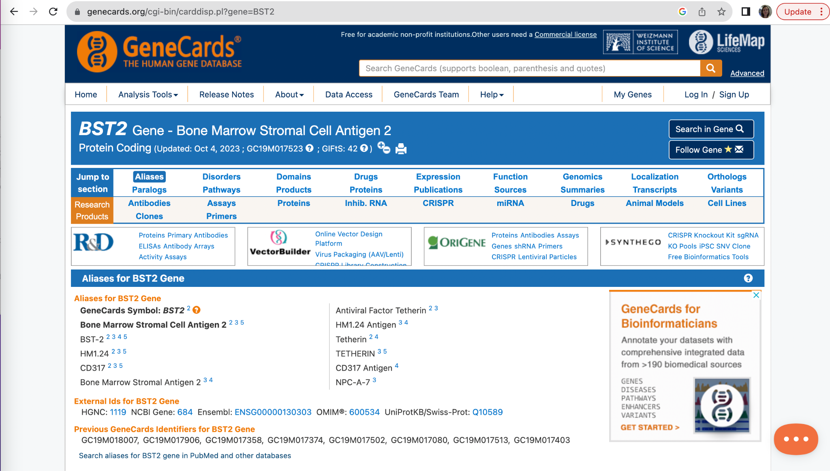
GeneCards
https://www.genecards.org/cgi-bin/carddisp.pl?gene=BST2

