Slide 1
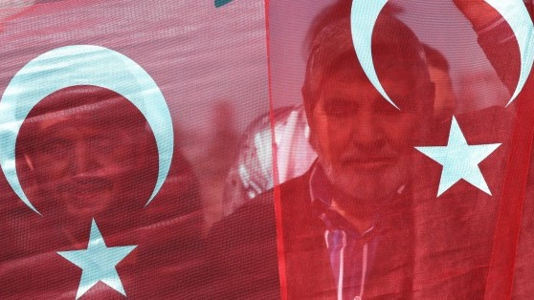
The history and politics of modern turkey
Dr. Feyzi Karabekir Akkoyunlu
karabekir.akkoyunlu@uni-graz.at
IRI – USP 2018

Slide 2
Why study turkey?
GEOPOLITICAL RELEVANCE
At the intersection of multiple geopolitical neighbourhoods
Influencing (and influenced by) regional dynamics
A story of economic boom (and bust?)
Millions of people from Turkey living abroad (mostly in Europe and the US)

Slide 3
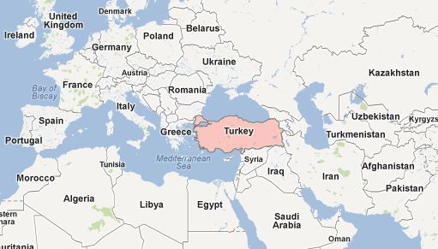
Why study turkey?

Slide 4
Why study turkey?
HISTORICAL RELEVANCE
Many of the regional issues can traced back to the collapse of the Ottoman Empire, Turkey’s predecessor:
Kurdish conflict
Armenian efforts for genocide recognition
Nationalism and identity politics in the Balkans
Unsettled borders and identities in the Middle East
Cyprus

Slide 5
Why study turkey?
CONCEPTUAL RELEVANCE
The major themes of our times can be studied through the example of Turkey:
Secularism and religion
Nationalism and minorities
“Clash of Civilisations”
Civil-military relations
The crisis of liberal democracy, rising populism & new authoritarianisms
Globalisation and its discontents

Slide 6
Course outline
SIX LECTURES
Intro / From Empire to Nation-State (16 August)
Atatürk and the Legacies of Kemalism (23 August)
Turkey in the Cold War (30 August)
Turkey and the European Union (6 September)
The AKP and the Rise and Fall of the ‘Turkish Model’ (13 September)
Changes and Continuities from Atatürk to Erdoğan (20 September)

Slide 7
Course outline
ASSESSMENT
Class Participation (20%)
Attendance to lectures and participation in class discussions.
You are expected to do the assigned readings ahead of each lecture.
Presentation (30%)
15 minute presentation. Topic of your choice OR chosen from among discussion Qs in syllabus.
Come talk to me in advance, I’ll help you prepare.
Final Essay (50%)
3,000 words. Due midnight Thursday, 11 October.
Questions to be announced.

Slide 8
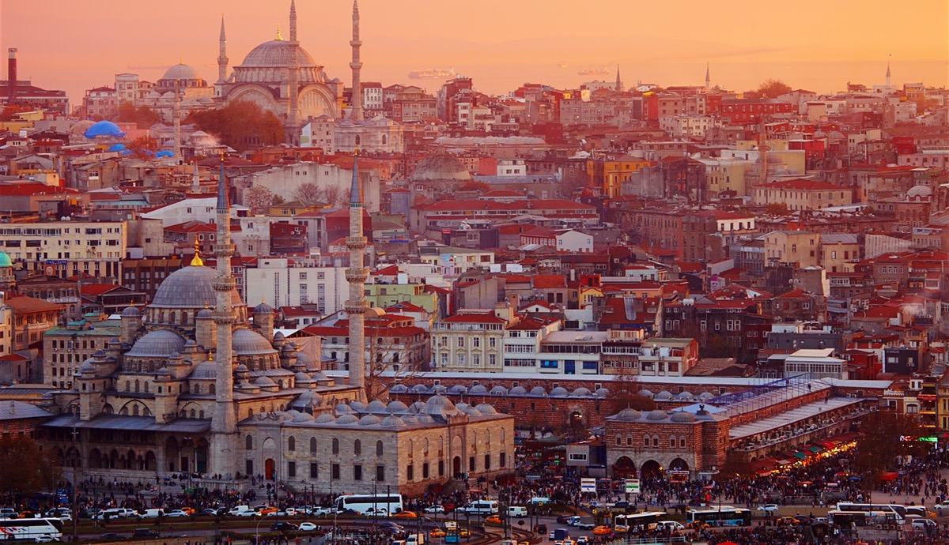
Your turn!

Slide 9
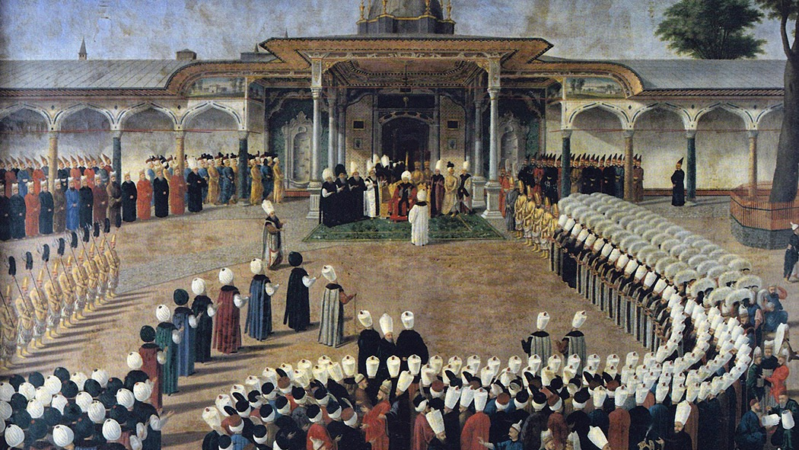
From Empire to nation-state

Slide 10
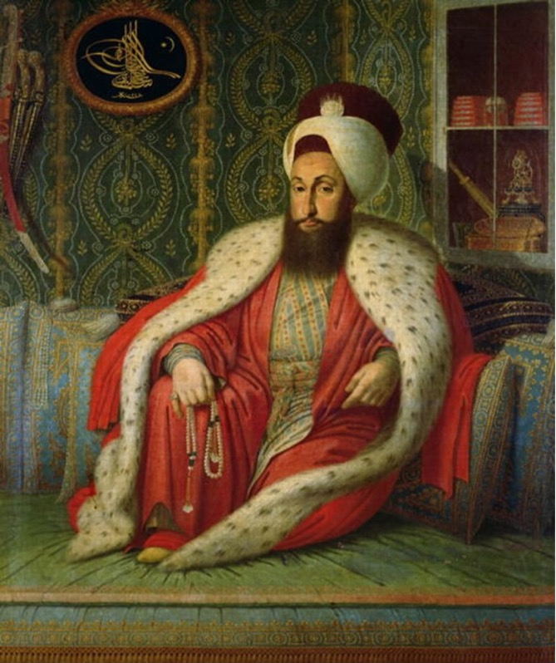
The Ottoman Empire
WHY START HERE?
The predecessor of Turkey
Changes and continuities in the 19th & early 20th century set the stage for the Turkish Republic.
Origins of today’s regional issues found in its long and shorter & traumatic collapse

Slide 11
The Ottoman Empire
WHAT WAS IT?
An empire of only Turks and Muslims? No.
A multi-cultural, multi-religious, multi-ethnic, multi-lingual empire.
600 year rule in the Balkans, 400 years in the Middle East & North Africa.
A single dynasty: the House of Osman
Combined Turkic, Persian, Byzantine (Greek) and Islamic state traditions.

Slide 12
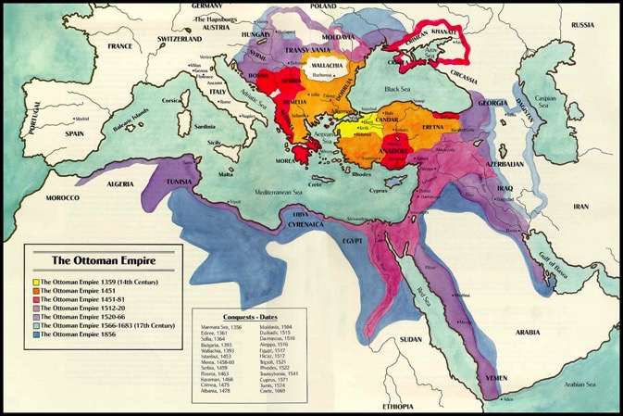
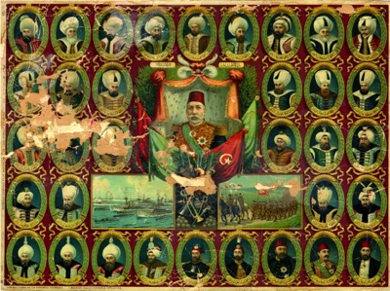
The Ottoman Empire

Slide 13
The Ottoman Empire
HOW DID IT FUNCTION & SURVIVE?
Effective central military & bureaucracy
The devshirme (child levy) system
Decentralised government
Significant regional, professional and confessional autonomy
The millet system: each religion a self-governing community under the Sultan
Division of labour among millets:
Muslims: officers, bureaucrats or peasants
Non-Muslims: artisans, merchants, traders (the emerging bourgeoisie) and peasants
Provision of security and stability in return for loyalty and taxes

Slide 14
The Ottoman Empire
WHY DID IT DECLINE?
Consistent inflation from the mid-16th century onwards
Unsuccessful defensive wars (against Imperial Russia)
Twin Revolutions of Europe in 18th century: Industrial & French
Agrarian economy forced into global trade with industrialising powers
Central government loses control: increased corruption, erosion of security and stability
Rise of powerful, semi-autonomous provincial notables
Nationalist (non-Muslim) revolts against increased tax burden & arbitrary rule

Slide 15
The Ottoman Empire
‘THE SICK MAN OF EUROPE’

Slide 16
The Ottoman Empire
RESPONSES TO DECLINE?
Throughout 19th century, attempts to reform the state and “save” the empire from above
Catching up with the West
Happening all over the non-western world
Russia, Japan, Egypt, Latin America
Formula
Centralisation (to restore the authority and legitimacy of the central government)
Institutional Modernisation (in military, bureaucracy, legal system, education)
Pursuit of a new Identity (who are we?)

Slide 17
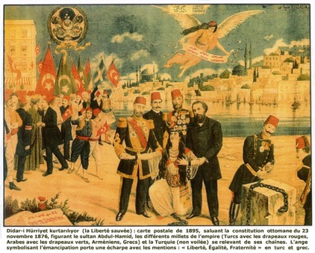
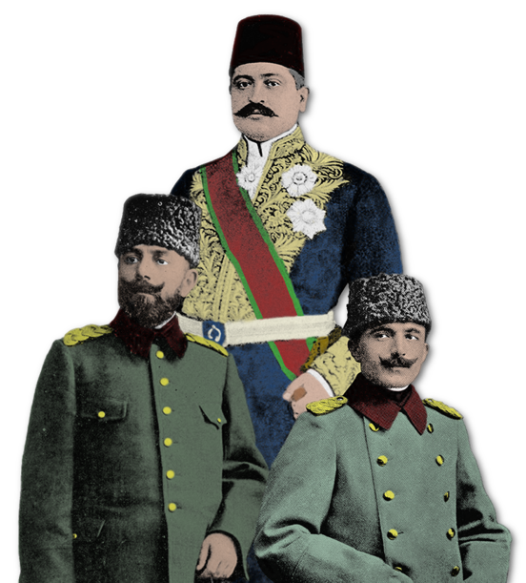
OTTOMANISM
ISLAMISM
TURKISM
Tanzimat 1839 – 1876
Constitutional Revolution 1908
Sultan Abdulhamid II
1876 - 1909
Young Turks
(Committee of Union and Progress)
1913 - 1918
Constitutional Revolution
The Imperial Edict of Reorganisation (Islahat) 1856
The Young Turk triumvirate: Jamal, Talat and Enver Pashas

Slide 18
The Ottoman Empire
THE OUTCOME OF REFORMS
Hampered by lack of economic resources, financial basis and competent personnel
Top-down nature created resistance and fueled new opposition
A system of dualisms: new laws and institutions clashed with old ones
Overall successful? If the aim was to save the empire… then no!
BUT: Also laid the foundations of the modern Turkish state

Slide 19
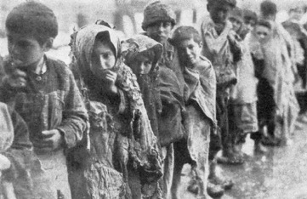
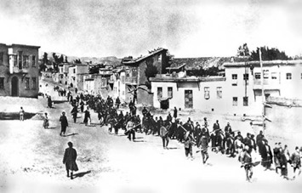
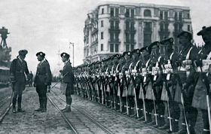
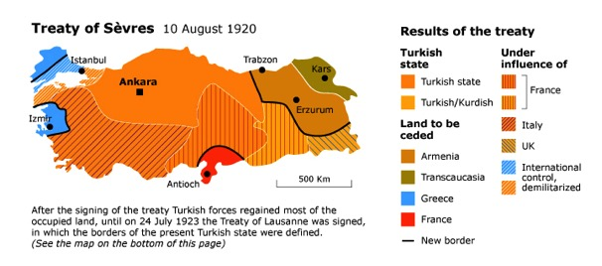
The Ottoman Empire
THE COLLAPSE
“A decade of warfare, famine & ethnic cleansing”
Balkan Wars (1912 – 1913)
Loss of entire European territories, inc. Salonika
Massive influx of Muslim refugees
First World War (1914 – 1918)
Allied with Germany, Austria-Hungary and Bulgaria
Armenian Genocide (1915 - 1916)
Defeat and occupation (Treaty of Sèvres,1920)
’Turkish War of Liberation’ (1919 – 1922)
Led by Mustafa Kemal Atatürk
Declaration of Republic in 1923

Slide 20
The Ottoman Empire
THE OUTCOME
Near complete devastation of economic infrastructure, industry
Population decline and radical demographic change
Non-Muslim population of Anatolia reduced to 2% (from about 35-40% a century earlier)
An overwhelmingly Muslim (but ethnically diverse) population
Loss of expertise, knowledge, capital
Very tough conditions to establish a new ’nation-state’
But there are also opportunities… “strong state, weak society”

Slide 21
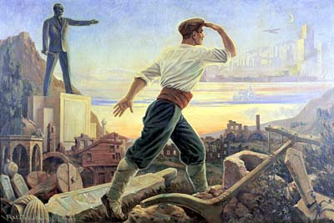
The Republic of turkey
Next lecture:
Thu, 23 August
Atatürk and the Legacies of Kemalism

