Slide 1
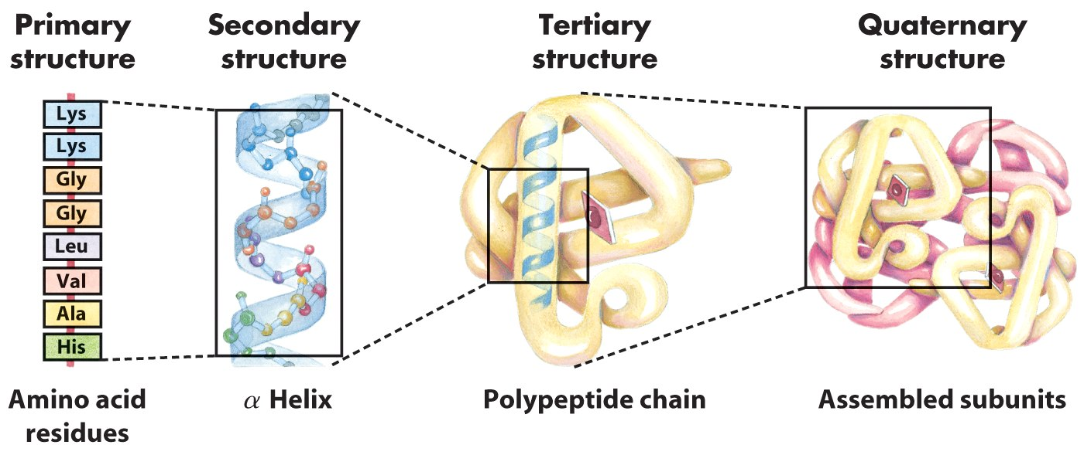
Atomic and molecular spectroscopy (electromagnetic)
Study of the interaction between EM radiation with matter
Analysis of the EM radiation that is absorbed, emitted or scattered by biological (macro)molecules
Composition: C, N, O, S and H
Chemical analysis: composition fingerprint
Structural analysis: distances, bond length, bond angle, strength, energy level, etc
4. Possible interations
2. Probing tool
1. Size scale
3. Chemistry
Types of molecular energy can probe: translational, rotational, vibrational and electronic

Slide 2
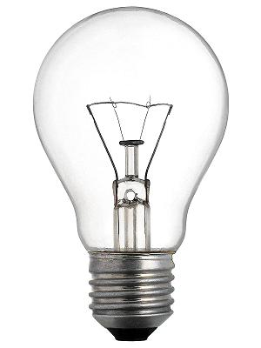
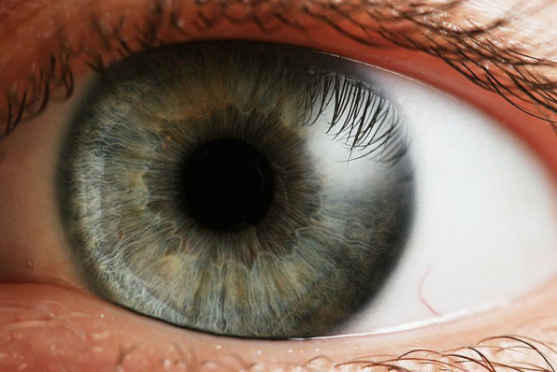
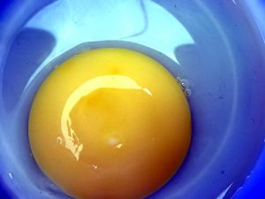
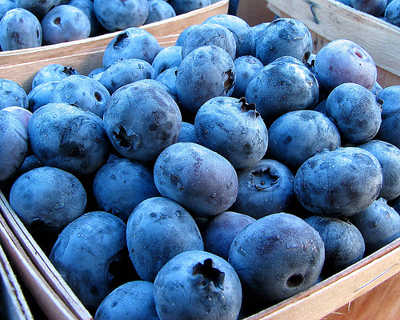
An everyday spectroscopic experiment we take for granted: vision
For an object to be seen, we need to (1) light it up and (2) look at it
?
Object
Detector
Data processing
Light source
“Lights on”
“Lights out”

Slide 3
Spectral absoroption
Atoms or molecules which are exposed to light absorb light energy and may re-emit light in different directions with different intensity, and that depends on the molecular components of an object.
Chlorophyl / Licopene
Lutein
Antocyanin
The selective absorption of certain colors, determines the color of most objects with some modification by elastic scattering.
Color selection is mainly dictated by the chemical and structural composition of an object

Slide 4
Matter and the four observed fundamental forces in physics
Single or Multibody system
Gravity
Matter: An entity that occupies space and possesses a non-zero rest mass
Interactions between Molecules define
Interactions between Atoms define
Interactions between Protons, neutrons, electrons define
Interactions between Quarks, gluons, mesons, etc. define
Electromagnetism
Weak forces
Strong forces

Slide 5
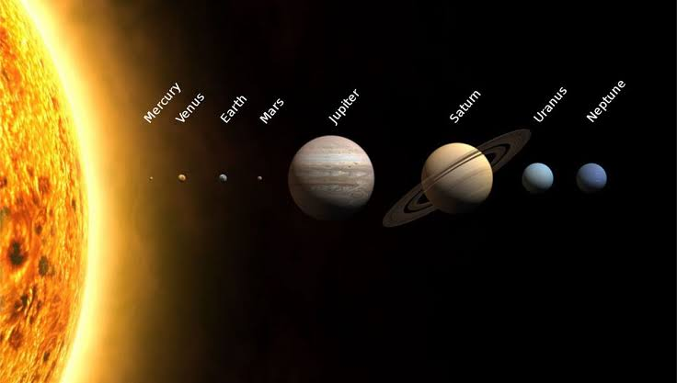
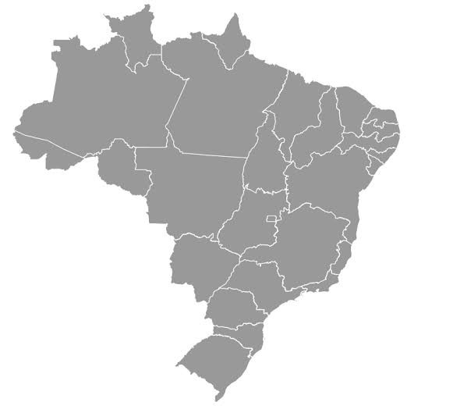
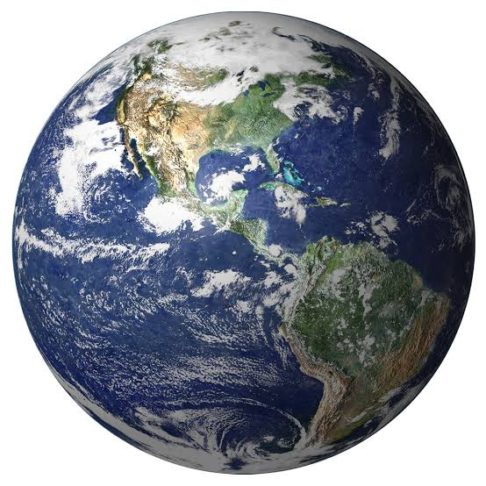
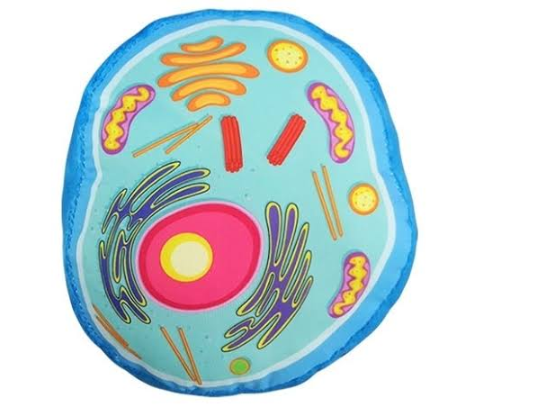
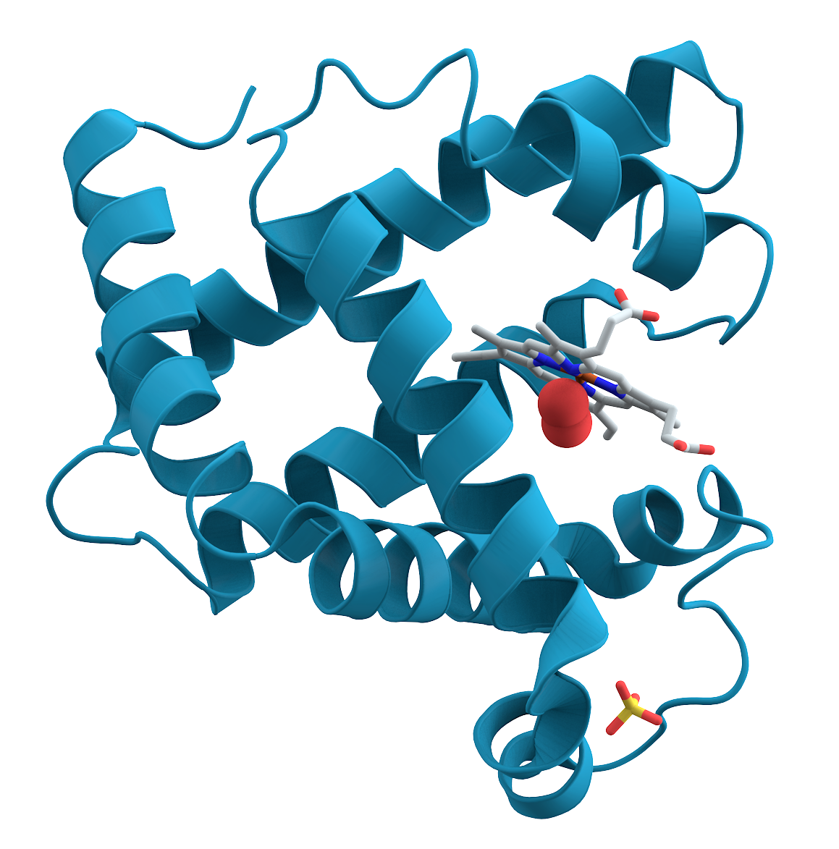
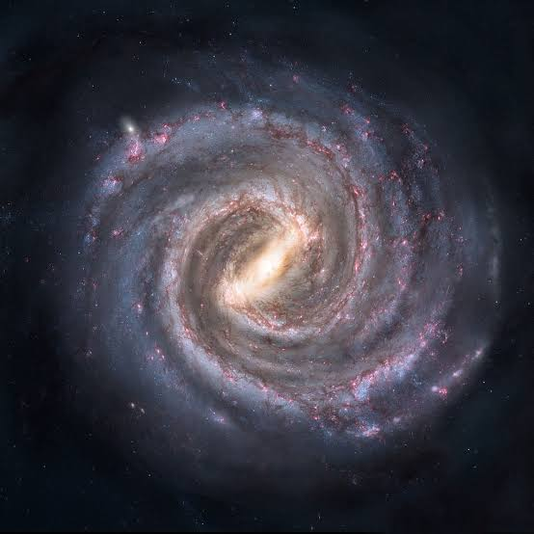
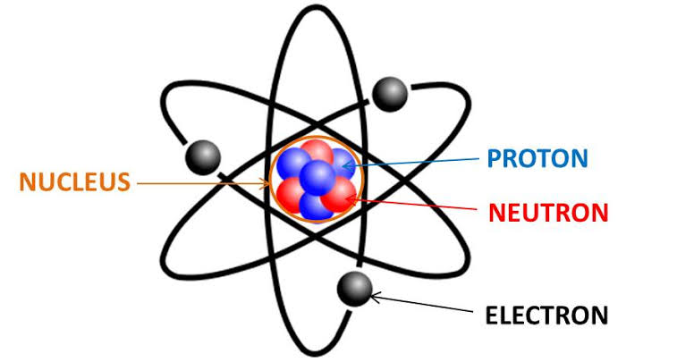
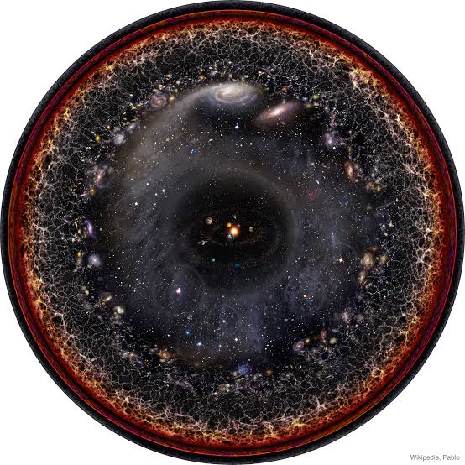
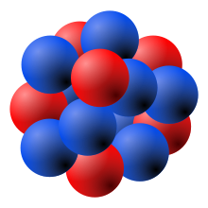
The Universe, in orders of magnitude
Human
Cell
Planet
Country
Protein
10⁻⁵ m
Solar system
10¹³ m
10⁴ m
10⁰ m
10⁷ m
Milky way
10⁻⁸ m
Atom
10²¹ m
10⁻¹⁰ m
Visible universe
Small
Big
10²⁶ m
Nucleus
10⁻¹⁵ m
How much DNA do we have in our body, in length?

Slide 6
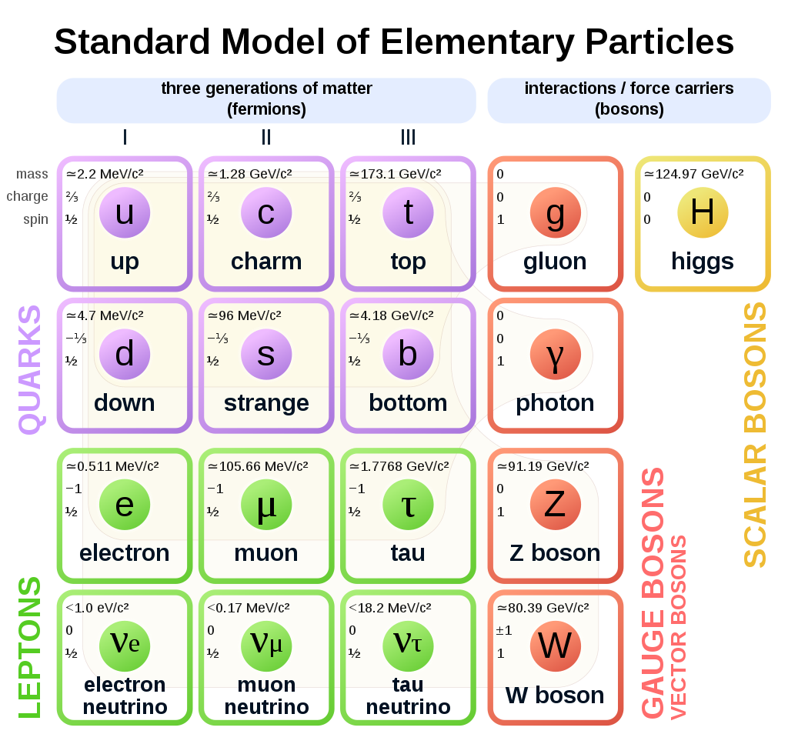
Electromagnetic radiation
EM radiation is basically oscilating disturbances (periodic in space and time) in $\vec{E}$ and $\vec{B}$
EM spectrum
$E= hf=h\frac{v}{λ}$, [J, eV, cal]
where $v=\frac{1}{\sqrt{με}}$ and $h$ = 6.626$×$10⁻³⁴ J·s (Planck´s constant)
A photon is the quantum of and the force carrier of EM radiation
In vacum, $v=\frac{1}{\sqrt{μ_{o}ε_{o}}}=c$ $=$ 3$×$10⁸ m.s⁻¹
Notes:
Permissividade épsilon e permeabilidade mi

Slide 7
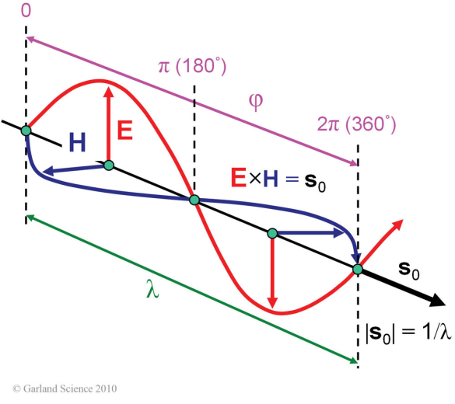
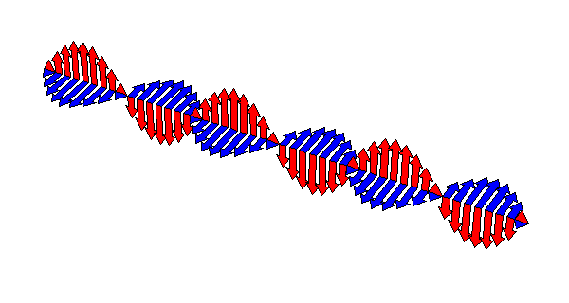
EM spectrum
EM wave
The electric field vector $\vec{E}$ is perpendicular to the magnetic field vector $\vec{H}$ and both oscillate perpendicularly to the propagation vector s_{o}, with a wavelength $λ$, and phase $φ$.
The interaction between $\vec{E}$ and matter (atoms) is way more substantial. Dielectric polarizability is ~10⁶ greater than diamagnetic susceptibility (Electrodynamics).

Slide 8
Lorentz Force law and Maxwell's equations: Classical electromagnetism
Describe how charged particles generate or are affected by EM fields
Region in which each point is affected by a force (according to Newton’s 2nd law: $\vec{F}=m\vec{a}$)
Lorentz Force
$\vec{F}=q\left(\vec{E}+\vec{v}×\vec{B}\right):$combination of electric and magnetic force on a point charge due to EM field
Maxwell's equations
$∇∙\vec{E}=\frac{ρ}{ε_{o}}:$(Gauss´) relationship between a static electric field and the electric charges that cause it
$∇∙\vec{B}=0:$(Gauss´ for magnetism) magnetic field has divergence equal to zero
$∇×\vec{E}=−\frac{∂\vec{B}}{∂t}:$(Faraday´s) time varying magnetic field creates an electric field
$∇×\vec{B}=μ_{o}\vec{J}+μ_{o}ε_{o}\frac{∂\vec{E}}{∂t}:$(Ampère-Maxwell´s) magnetic fields can be generated by electric current and…

Slide 9
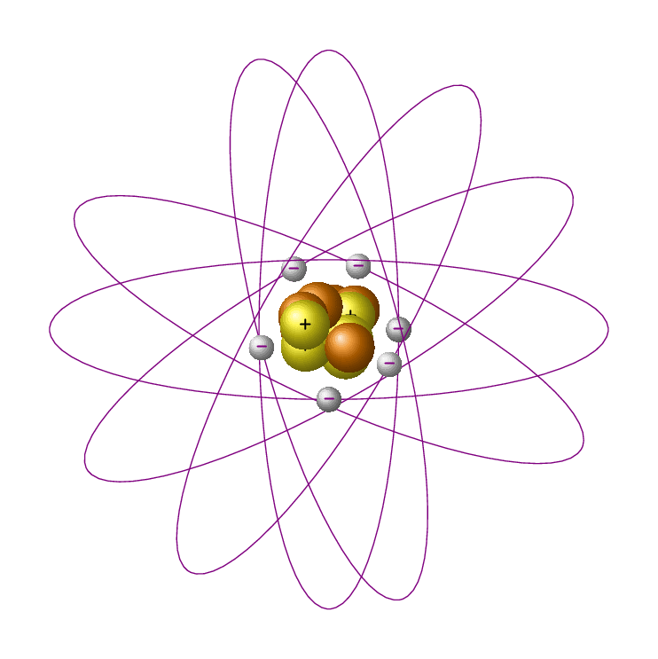
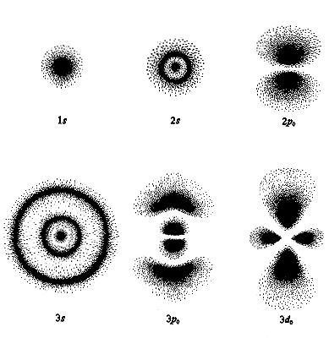
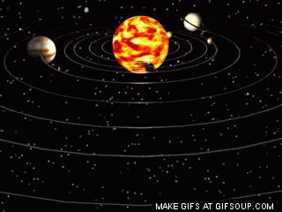
Models of the atom
Classical model of the atom
Quantum mechanical model of the atom
Solar system
Orbit: mathematically defined pathway
Orbital: where an electron is likely to be found in an atom 90% of the time, with fixed amount of energy (boundary surface):
Energy + shape = orbital
We know nothing about how the electron moves around the nucleus

Slide 10
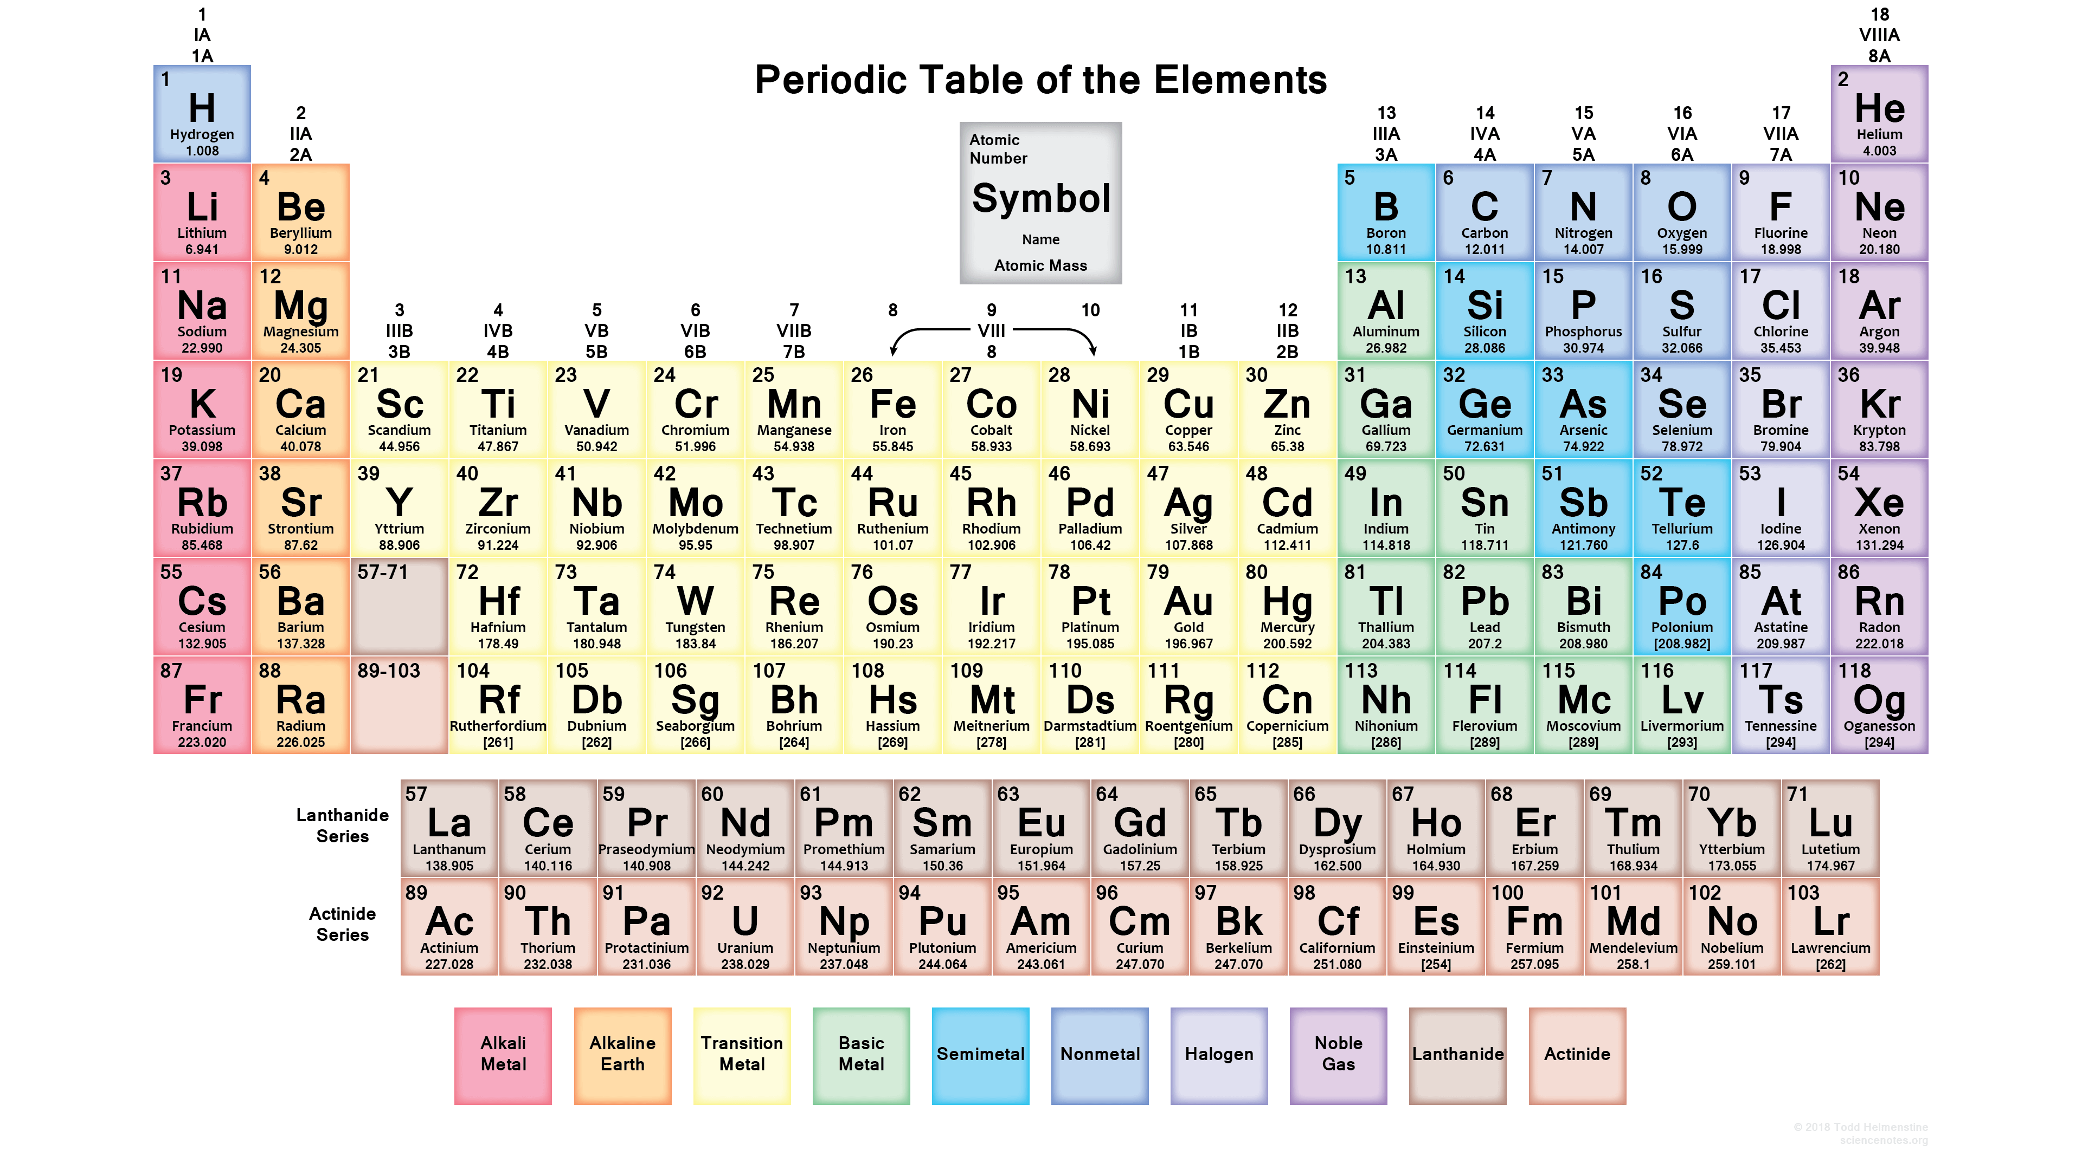
Electron configuration: finding a home (orbital) for each electron
1s²
2s² 2p⁶
3s² 3p⁶ 3d¹⁰
4s² 4p⁶ 4d¹⁰ 4f¹⁴
5s² 5p⁶ 5d¹⁰ 5f¹⁴
6s² 6p⁶ 6d¹⁰ 6f¹⁴
7s² 7p⁶ 7d¹⁰ 7f¹⁴
${1s}_{2}^{2} {2s}_{4}^{2}{ 2p}_{10}^{6} {3s}_{12}^{2}$ ${3p}_{18}^{6} {4s}_{20}^{2}$ ${3d}_{30}^{10} {4p}_{36}^{6}$ ${5s}_{38}^{2} {4d}_{48}^{10}$ ${5p}_{54}^{6} {6s}_{56}^{2}$ ${4f}_{70}^{14} {5d}_{80}^{10}$ ${6p}_{86}^{6} {7s}_{88}^{2}$ ${5f}_{102}^{14} {6d}_{112}^{10}$

Slide 11
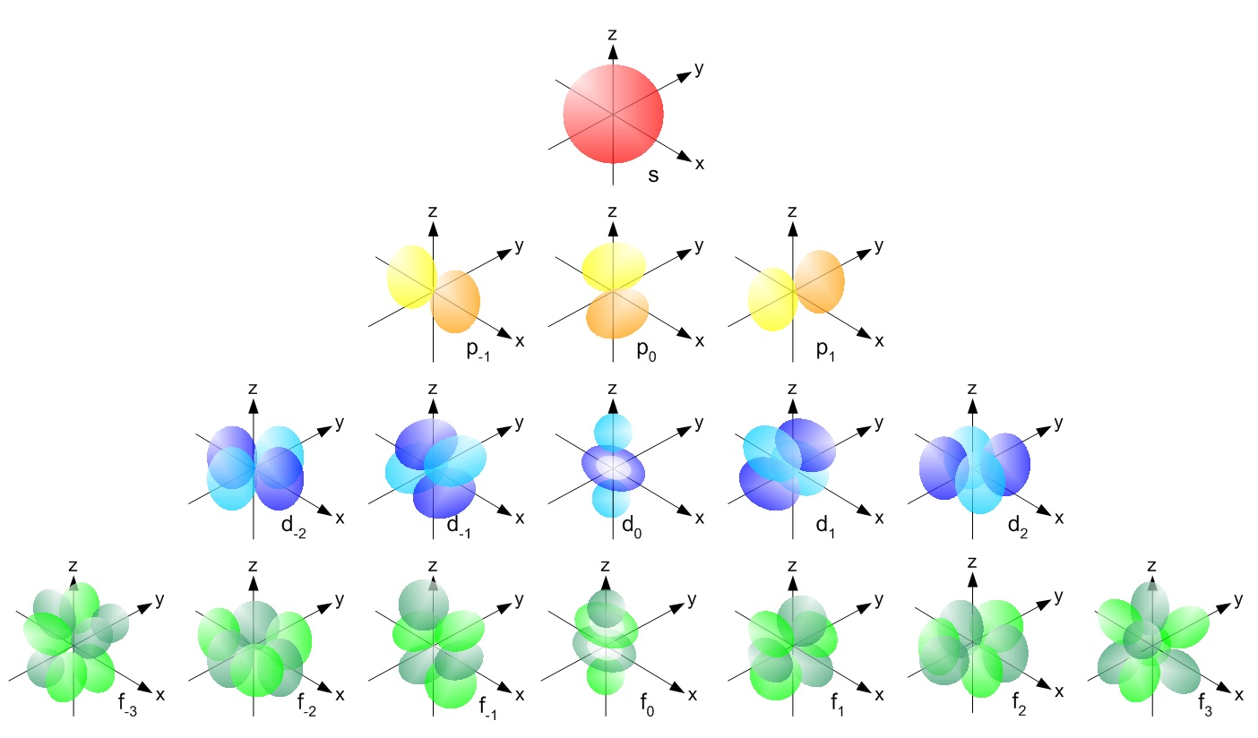
Electron configuration: finding a home for each electron
Principal quantum number (n): energy level (shell) occupied by electron; n = 1, 2, 3, 4, 5, 6, 7...
Angular momentum quantum number ($ℓ$): shape of the orbital(s) within the shell; (ℓ = 0, 1, 2,..., n − 1) of n
Magnetic quantum number (m_{ℓ}): orientation of an orbital around the nucleus; (from −ℓ to ℓ, in intergers);
Spin quantum number (s): projection of intrinsic angular momentum of electron (±½)
1s²
2s² 2p⁶
3s² 3p⁶ 3d¹⁰
4s² 4p⁶ 4d¹⁰ 4f¹⁴
5s² 5p⁶ 5d¹⁰ 5f¹⁴
6s² 6p⁶ 6d¹⁰ 6f¹⁴
7s² 7p⁶ 7d¹⁰ 7f¹⁴
ℓ = 0 (spherical), ℓ = 1 (principal), ℓ = 2 (diffuse), ℓ = 3 (fundamental)...
ℓ = 0
First p orbital(ℓ = 1) appear in the second shell (n = 2), the first d orbital (ℓ = 2) appear in the third shell (n = 3), and so on
ℓ = 1
ℓ = 2
ℓ = 3

Slide 12
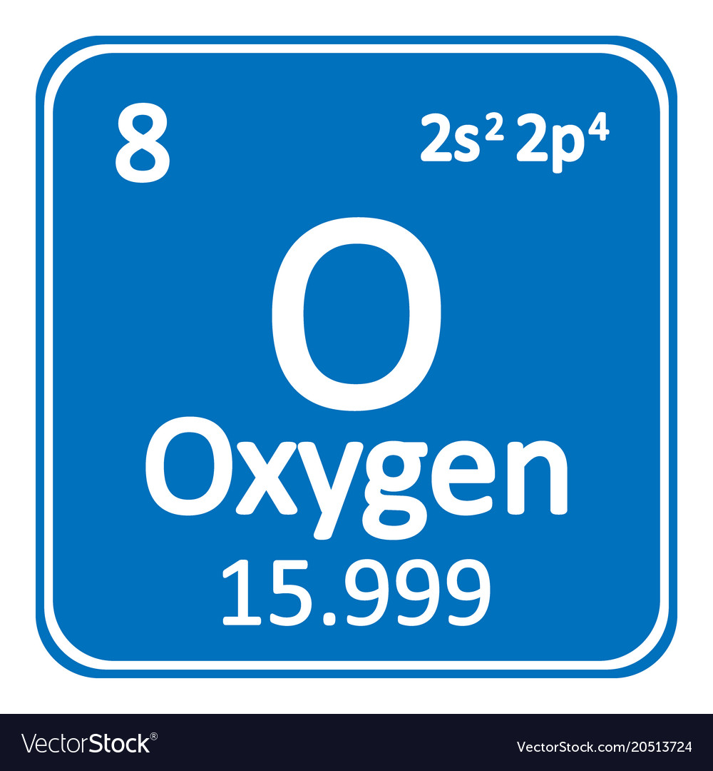
Electron configuration: finding a home for each electron (4 QN combined)
6p
5d
4f
6s
5p
4d
5s
4p
3d
4s
3p
3s
2p
2s
1s
f (-3) f (-2) f (-1) f (0) f (1) f (2) f (3)
d_{xy} (-2) d_{xz} (-1) d_{yz} (0) d_{x2-y2} (1) d_{z2} (2)
How to add electrons to orbitals
3 rules: Aufbau + Pauli + Hund
p_{x} (-1) p_{y} (0) p_{y} (1)
Two electrons in s
Six electrons in p
Ten electrons in d
Fourteen electrons in f
s (0)
Each line represents an orbital (abstractly)

Slide 13
Periodic table of elements and quantum numbers
3d
2p
4d
3p
1s
1s
2s
5d
4f
4p
3s
6d
5f
5p
4s
6p
5s
7p
6s
7s
${1s}_{2}^{2} {2s}_{4}^{2}{ 2p}_{10}^{6} {3s}_{12}^{2}$ ${3p}_{18}^{6} {4s}_{20}^{2}$ ${3d}_{30}^{10} {4p}_{36}^{6}$ ${5s}_{38}^{2} {4d}_{48}^{10}$ ${5p}_{54}^{6} {6s}_{56}^{2}$ ${4f}_{70}^{14} {5d}_{80}^{10}$ ${6p}_{86}^{6} {7s}_{88}^{2}$ ${5f}_{102}^{14} {6d}_{112}^{10}{ 7p}_{118}^{6}$

Slide 14
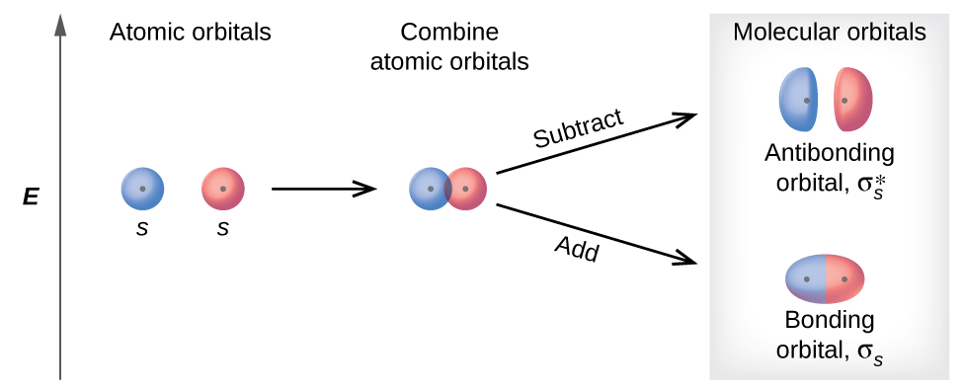
We are working with molecules, not isolated atoms = molecular orbitals
Bonding occur when two atoms are brought close enough to permit overlap of valence orbitals: single orbital encompassing both nuclei
Energy is released during overlap and covalente bond is formed.
Atoms overlap in-phase: wave functions reinforce one another: Bonding orbital
(b) Atoms overlap out-of-phase: wave functions have opposite signs: Anti-bonding orbital

Slide 15
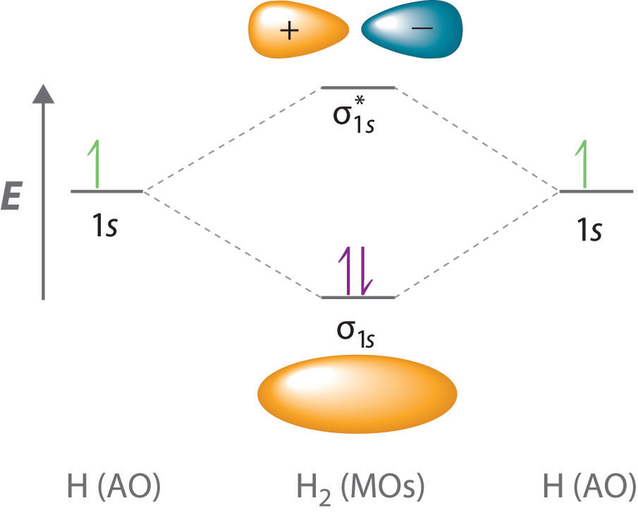
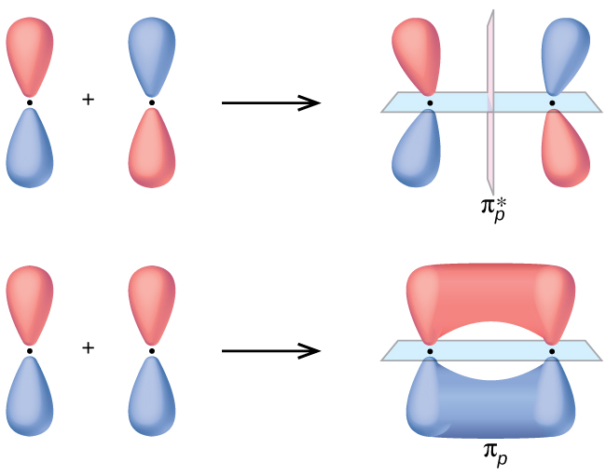
Molecular orbital. Ex: H₂
Anti-bonding: node develops between two atoms
Bonding: ED is high between two atoms
Side-by-side overlap of two p orbitals
π* antibonding molecular orbital
End-to-end overlap of two s or p orbitals
σ_{px} bonding molecular orbital
σ_{px} antibonding molecular orbital
pi (π) bonding molecular orbital

Slide 16
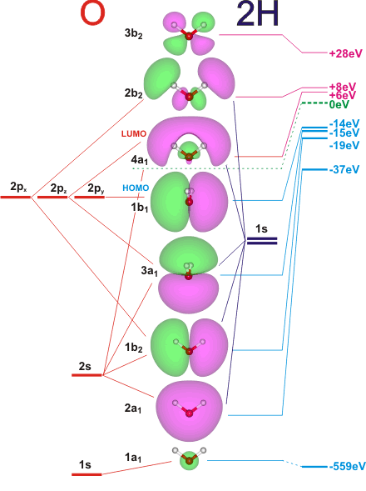
Organic molecules
Atomic and non-bonding orbitals
Molecular bonding orbitals

Slide 17
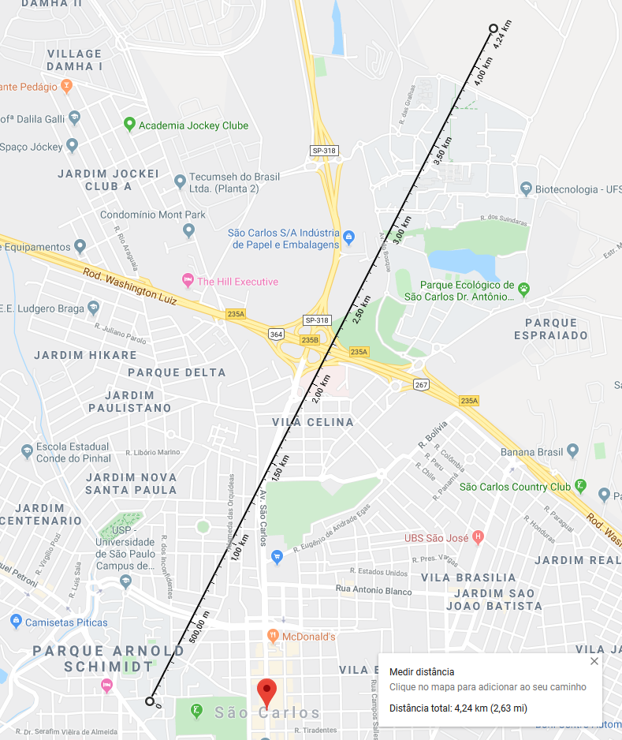
Size of an atom and possible interaction events
Beyond UFScar
(electron)
e⁻
1s orbital
Hydrogen atom
$$R_{n}$$
p⁺
$$r_{Bhor}$$
$$\frac{r_{Bhor}}{R_{n}}=\frac{\text{5.29177210903}×{10}^{−11}}{1.2×{10}^{−15}}\sim 42400$$
An atom is mostly empty space!
$R_{n}=r_{o}\sqrt[3]{A}$, where $A$ = mass number and $r_{o}$= 1.2 (± 0.2)͓$×$10⁻¹⁵ m
$r_{Bhor}$ (Bohr radius): most probable distance between the nucleus and the electron in a H atom in its ground state.
IFSC (proton)

Slide 18
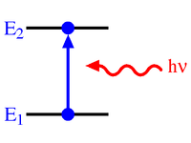
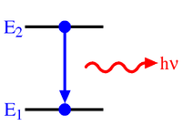
When an EM photon hits an atom, nothing happens at 99% of the times.
Atoms and molecules are mostly empty space!
The remaining 1% consists of:
Absorption
Emission
Scattering
Energy state transition;
Ionization;
Photoelectric effect;
Heat;
Depends on the existance or not, and lifetime, of an excited state as well as enegy conservation
Elastic
Inelastic
Thomson;
Rayleigh;
Mie;
Geometric.
Compton;
Raman.

Slide 19
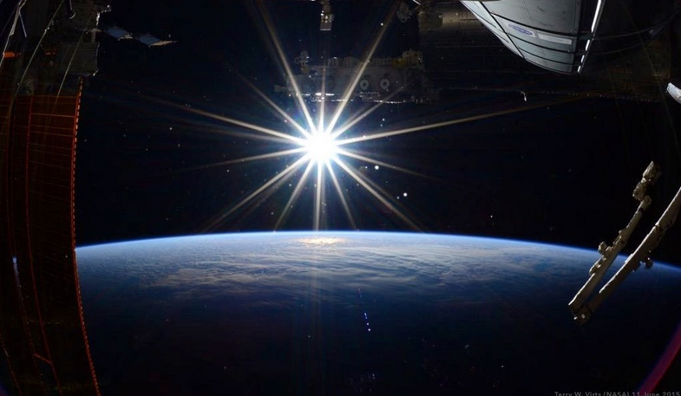
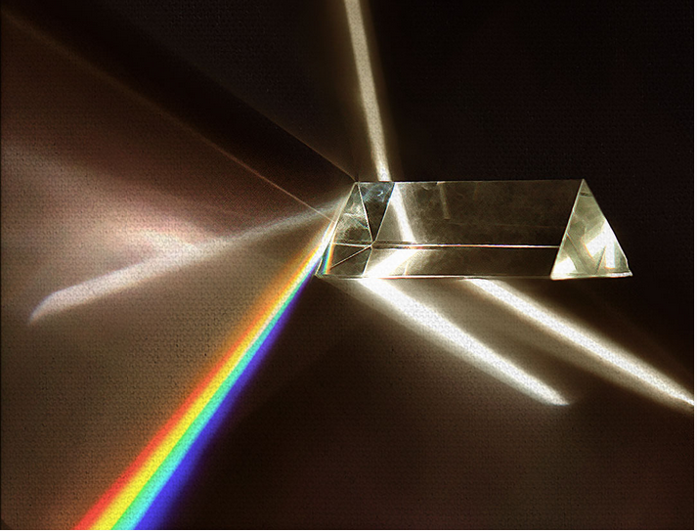
Models of light scattering by matter: just look at the sky!
Three domains, based on a dimensionless size parameter $α=\frac{πD_{p}}{λ}$
Detector
Sun, as seen from space
Newton´s prism

Slide 20
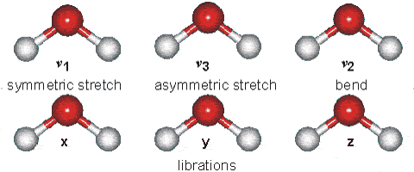
Energy levels in proteins are limitless
$$E_{\text{total}}=E_{\text{eletronic}}+E_{\text{nuclear}}+E_{\text{rota}\text{t}\text{ional}}+E_{\text{vibra}\text{t}\text{ional}}+E_{\text{transla}\text{t}\text{ional}}$$
For a 3-atom molecule

Slide 21
For the purposes of biological experiments
EM spectrum vs molecular energy levels (interaction varies)
Electronic
transitions
Vibronic
transitions
Magnetic coupling
Electrons Nucleus
Vibrational
Rotat.
$$E_{\text{total}}=E_{\text{eletronic}}+E_{\text{nuclear}}+E_{\text{rota}\text{t}\text{ional}}+E_{\text{vibra}\text{t}\text{ional}}+E_{\text{transla}\text{t}\text{ional}}$$

Slide 22
Faixas do EM úteis para experimentos biológicos
Transição energética nuclear
Espalhamento e difração de raios-X
Espalhamento e difração de raios-X
Espectro eletrônico / vibracional
Espectro vibracional
Espectro rotacional
Acoplamento magnético eletrônico
Acoplamento magnético nuclear

